Slide 1


TAKETHE
WARRIOR RESILIENCE CHALLENGE
ROCK
TAKETHEROCK.COM
AUGUST 2024

Slide 2
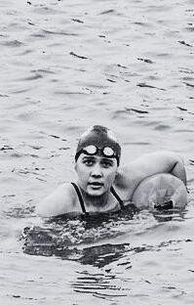
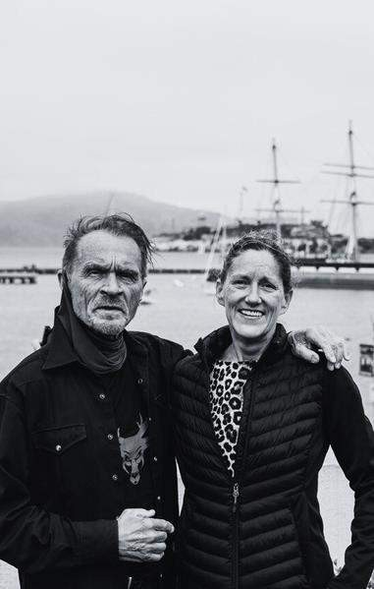
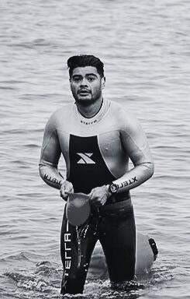
01
PROJECT OVERVIEW
AGENDA
02
03
04
05
06
07
MISSION
ORIGINS
TIMELINE
MEMBERS
TRAINING & LOGISTICS
Q & A

Slide 3


GOALS AND OBJECTIVES
PROJECT OVERVIEW
PURPOSE
•
•
•
•
•

Slide 4

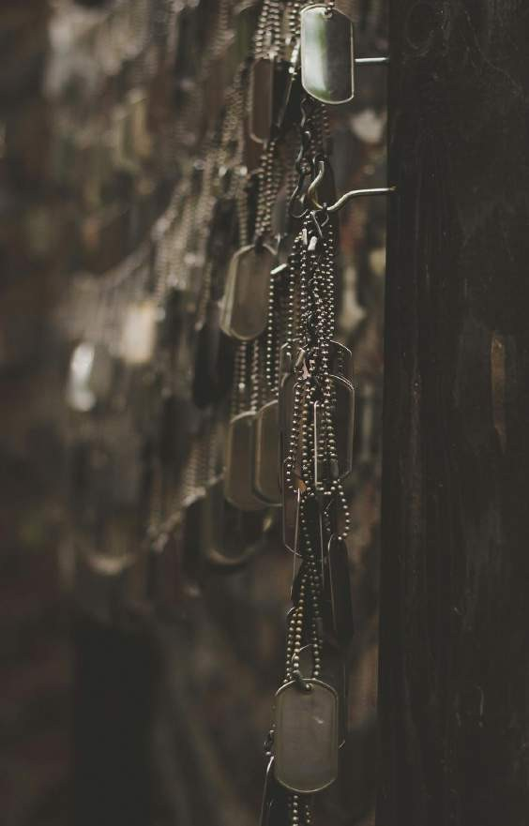
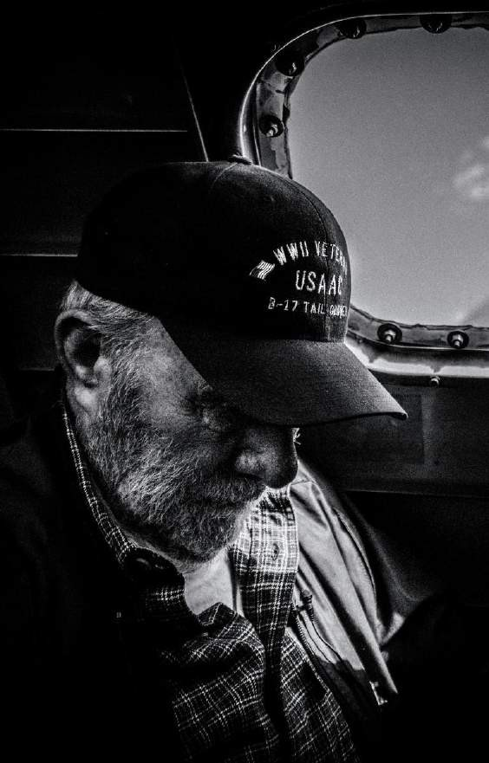


MISSION
THE BRAND

Slide 5
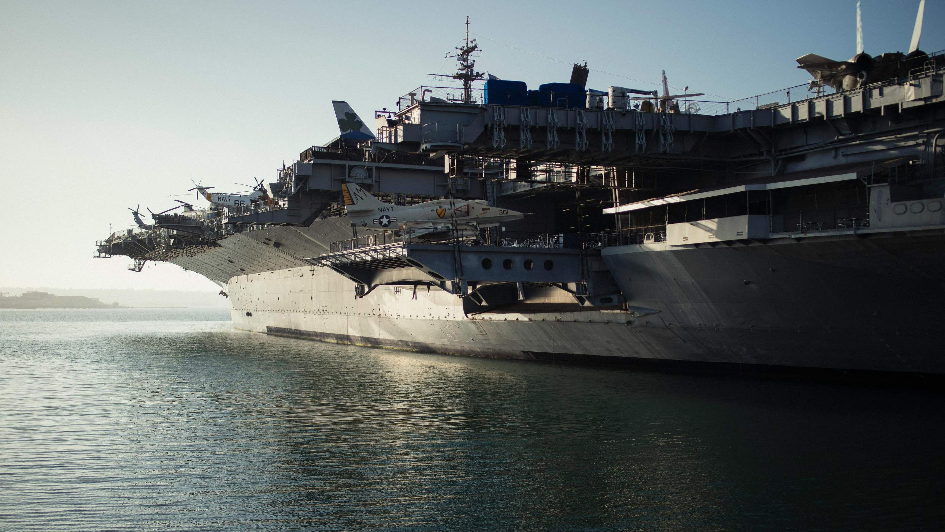



ORIGINS

Slide 6



TIMELINE

Slide 7
BOARD
WARRIOR RESILIENCE CHALLENGE
PRESENTATION
MEMBERS
President | Shannon Kleinschmit | U.S. Army Veteran
Vice President | Terri Parker | USCG Retired - Veteran
Treasurer | Jaclyn Mariano | USAF Gold Star Daughter
Secretary | Kira Halpern | U.S. Army (Parent)
Public Affairs LNO | Cathrine Sumner | U.S. Army Daughter
Head Coach | Kory Boeckler | U.S. Navy / Army Veteran
SF Aquatic Park LNO | Kevin Raith | USMC Veteran
TAKETHEROCK.COM
AUGUST 2024

Slide 8
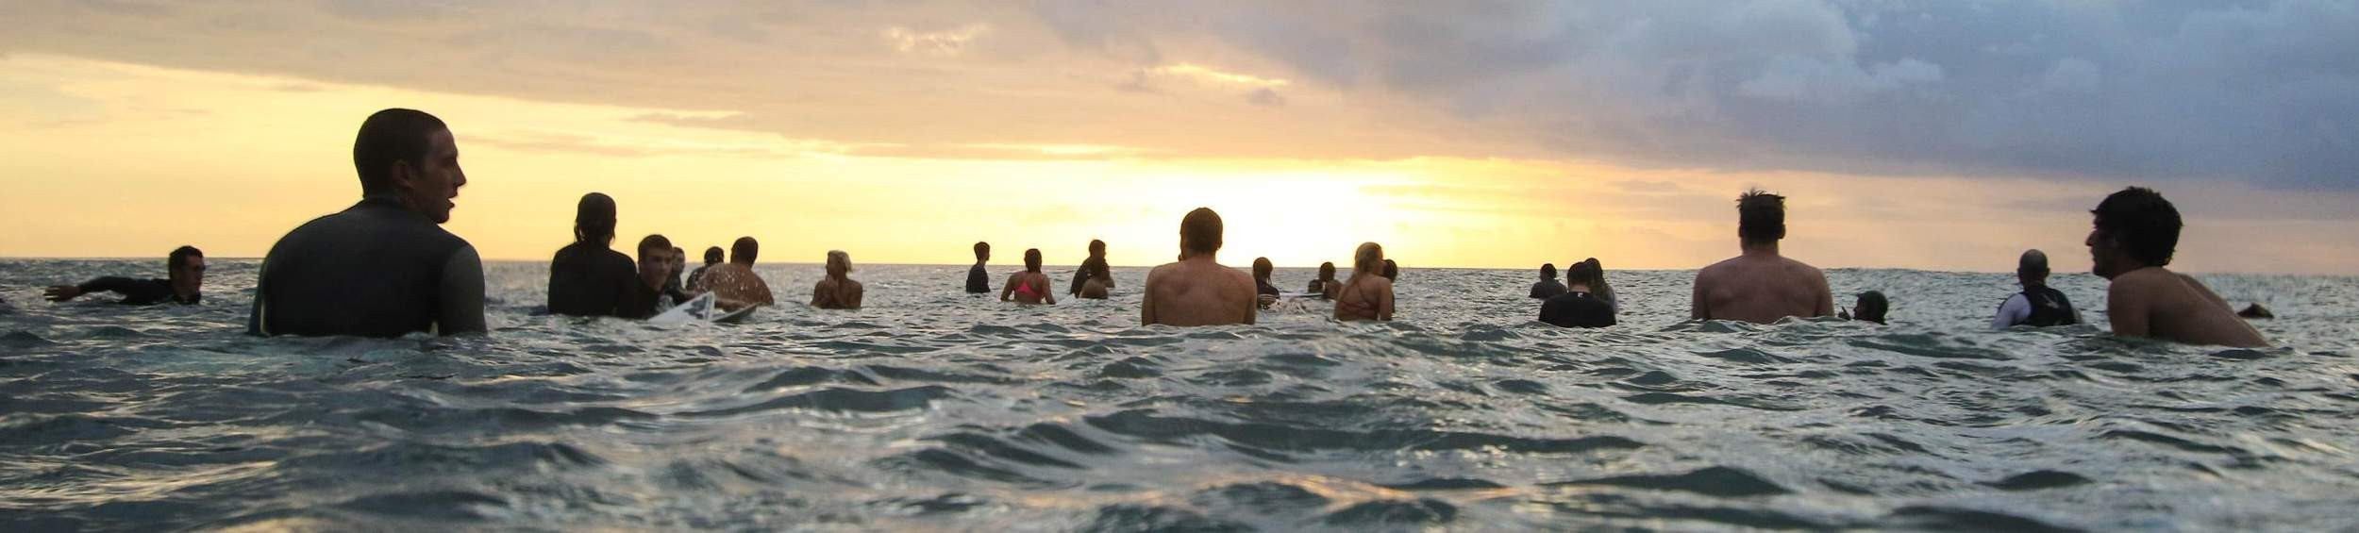











Slide 9
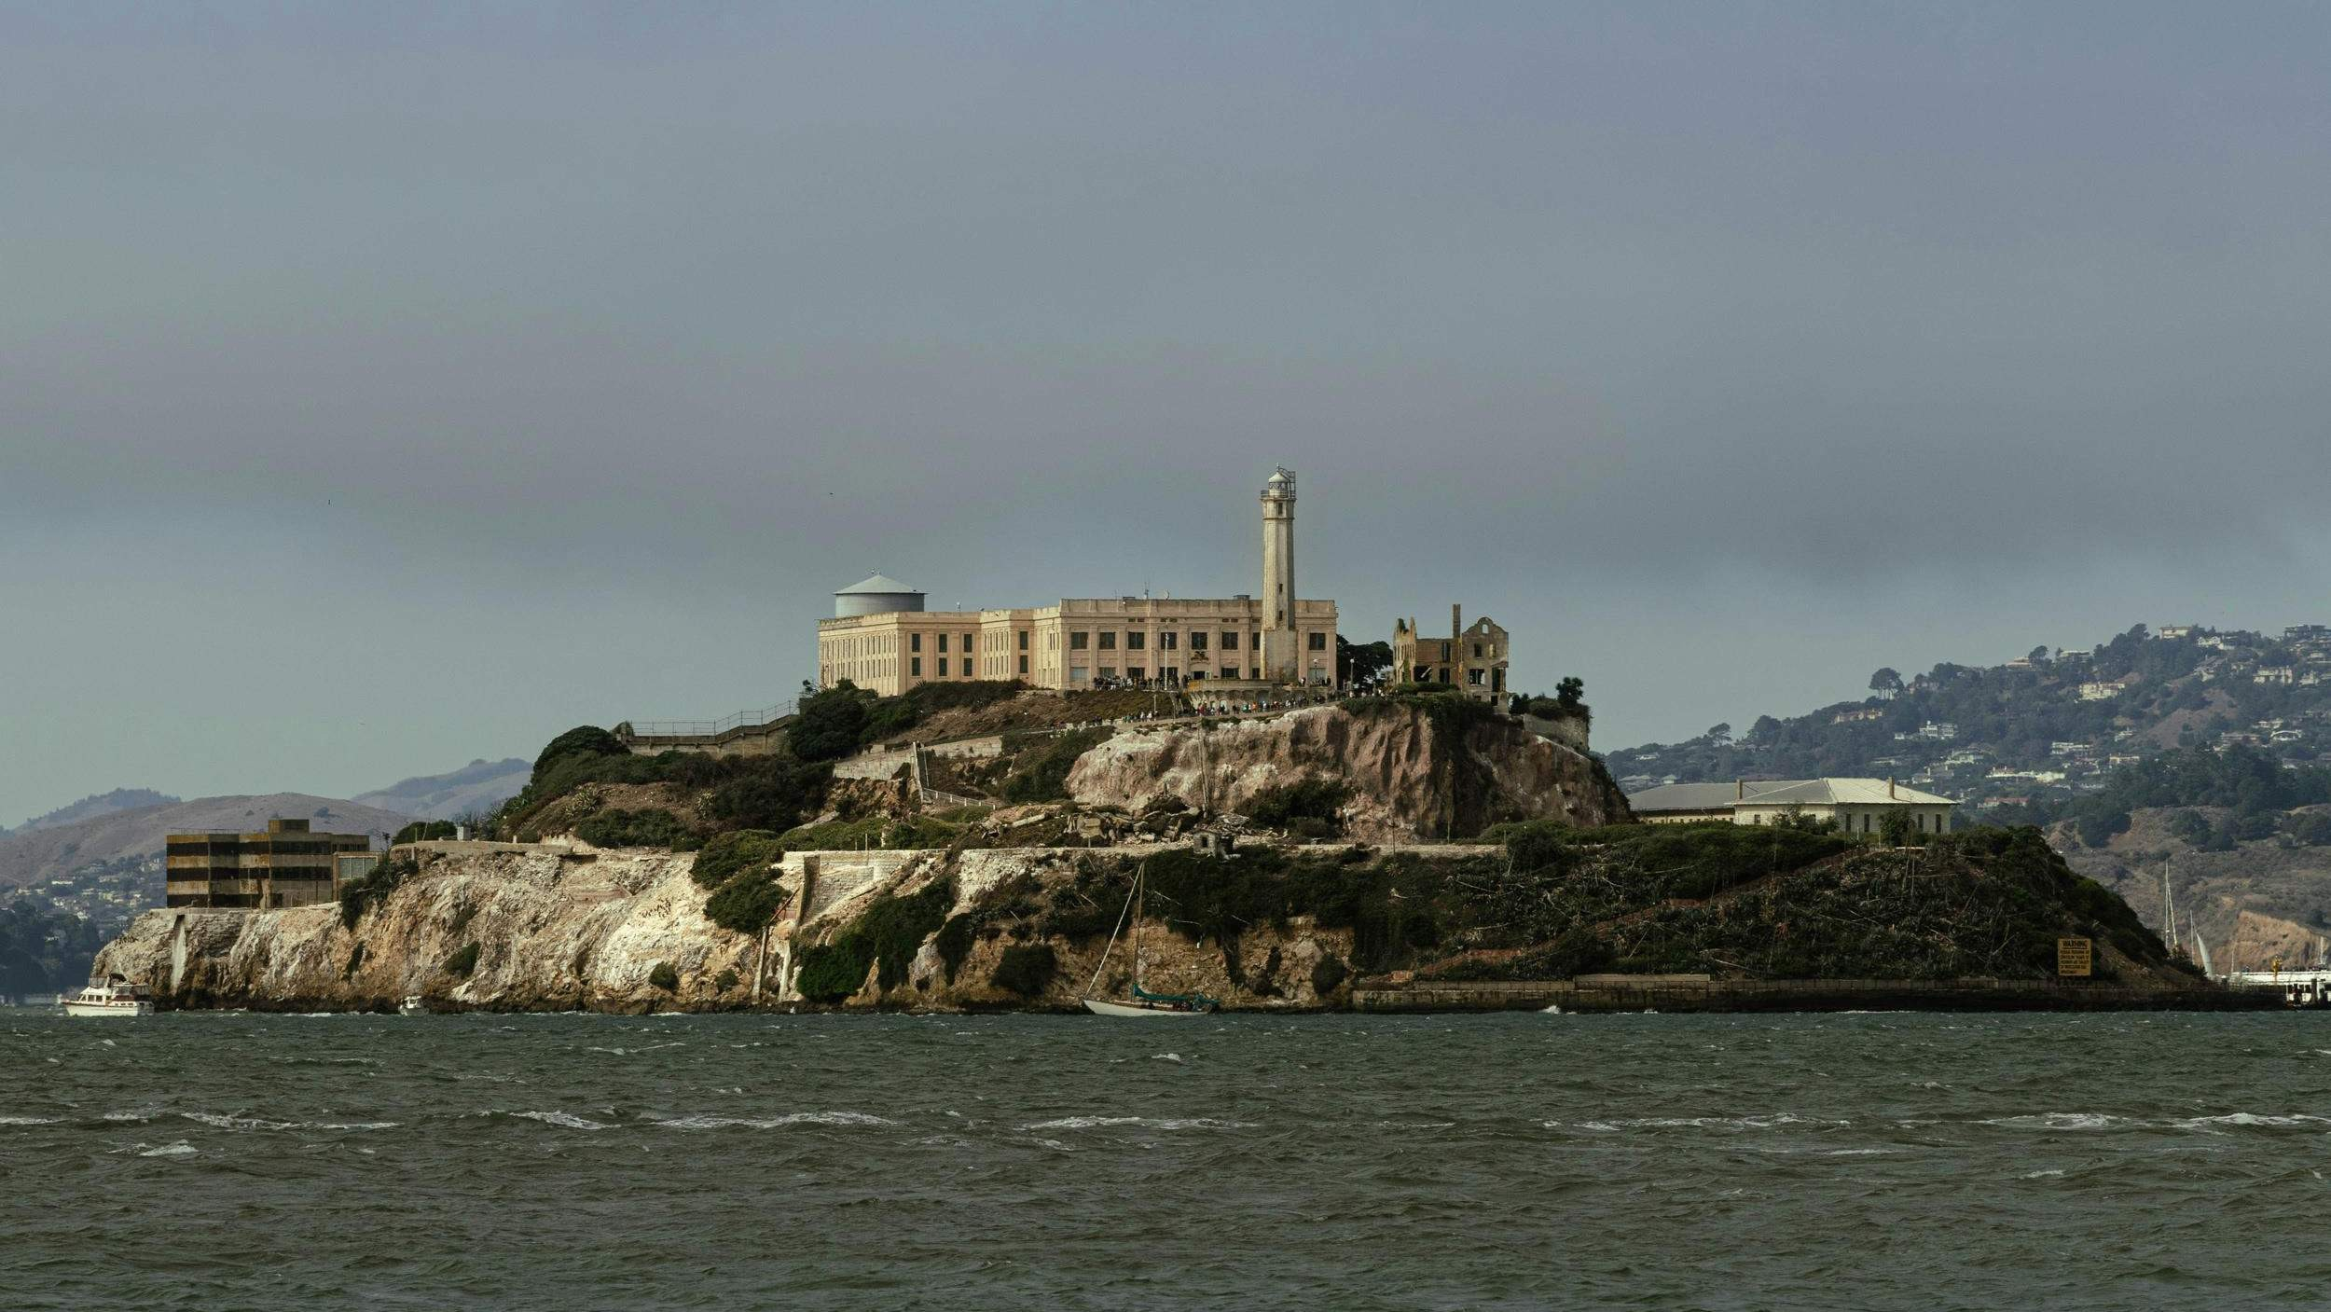

QUESTIONS?
WEBSITE
EMAIL
CONTACT

