Slide 1




TNDC Healthy Retail SF
&
TL Food Policy council
John McCormick (He/Him)
TNDC Healthy Retail San Francisco
Program Manager

Slide 2

Funding/ Allocation Amounts:
For FY 22/23 TNDC received a total of $445,042 of which
$194,388 was allocated to HRSF.
  $166k is for personnel costs
  $28k is for direct operating expenses.
$250k allocated to TNDC Kain Na Project
Notes:
Important to note the focus groups were ALWAYS led by community food justice leaders, and that participants received a $50 gift card for participating. Part of this was leadership development training.

Slide 3
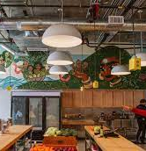
Kain Na (lets eat)
Community food empowerment market in Mission Bay
150 + households served each week

Slide 4
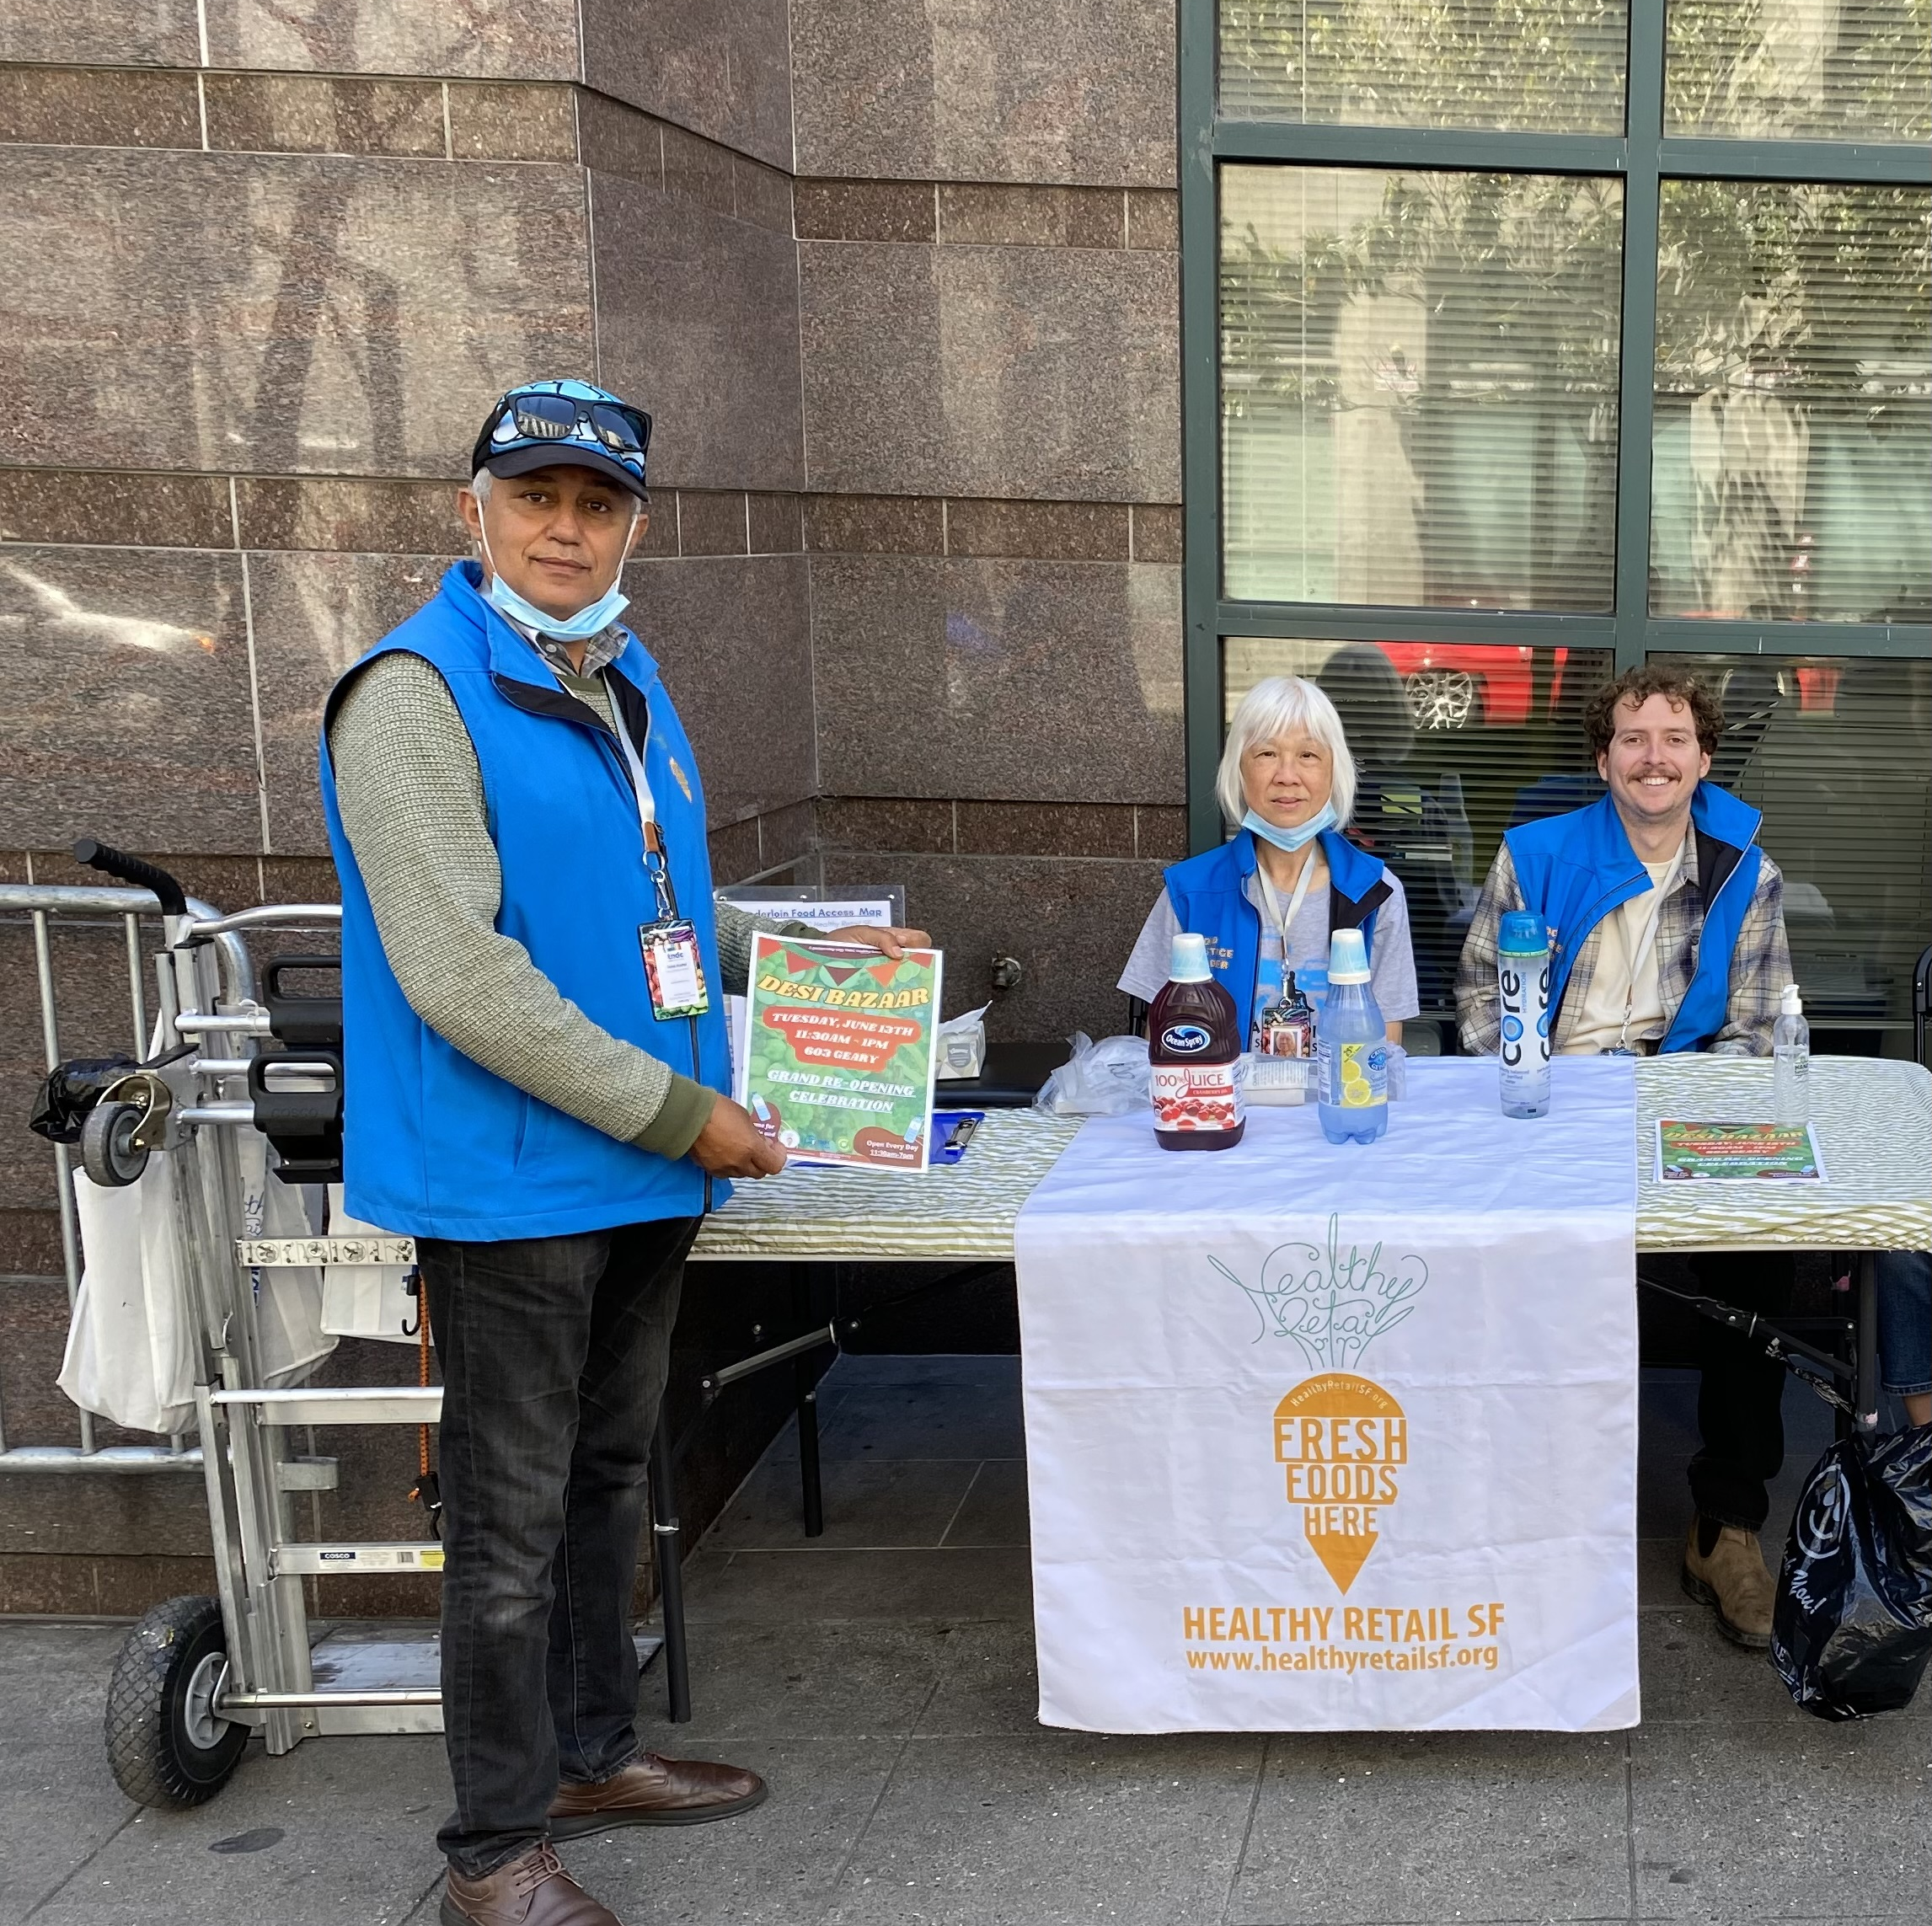
Employing Staff from Impacted Communities:
Food Justice Leaders!
Jalal Alabsi
Tammy Huynh
Austin Dalmasso
Notes:
Also good to re mention the gift cards here

Slide 5
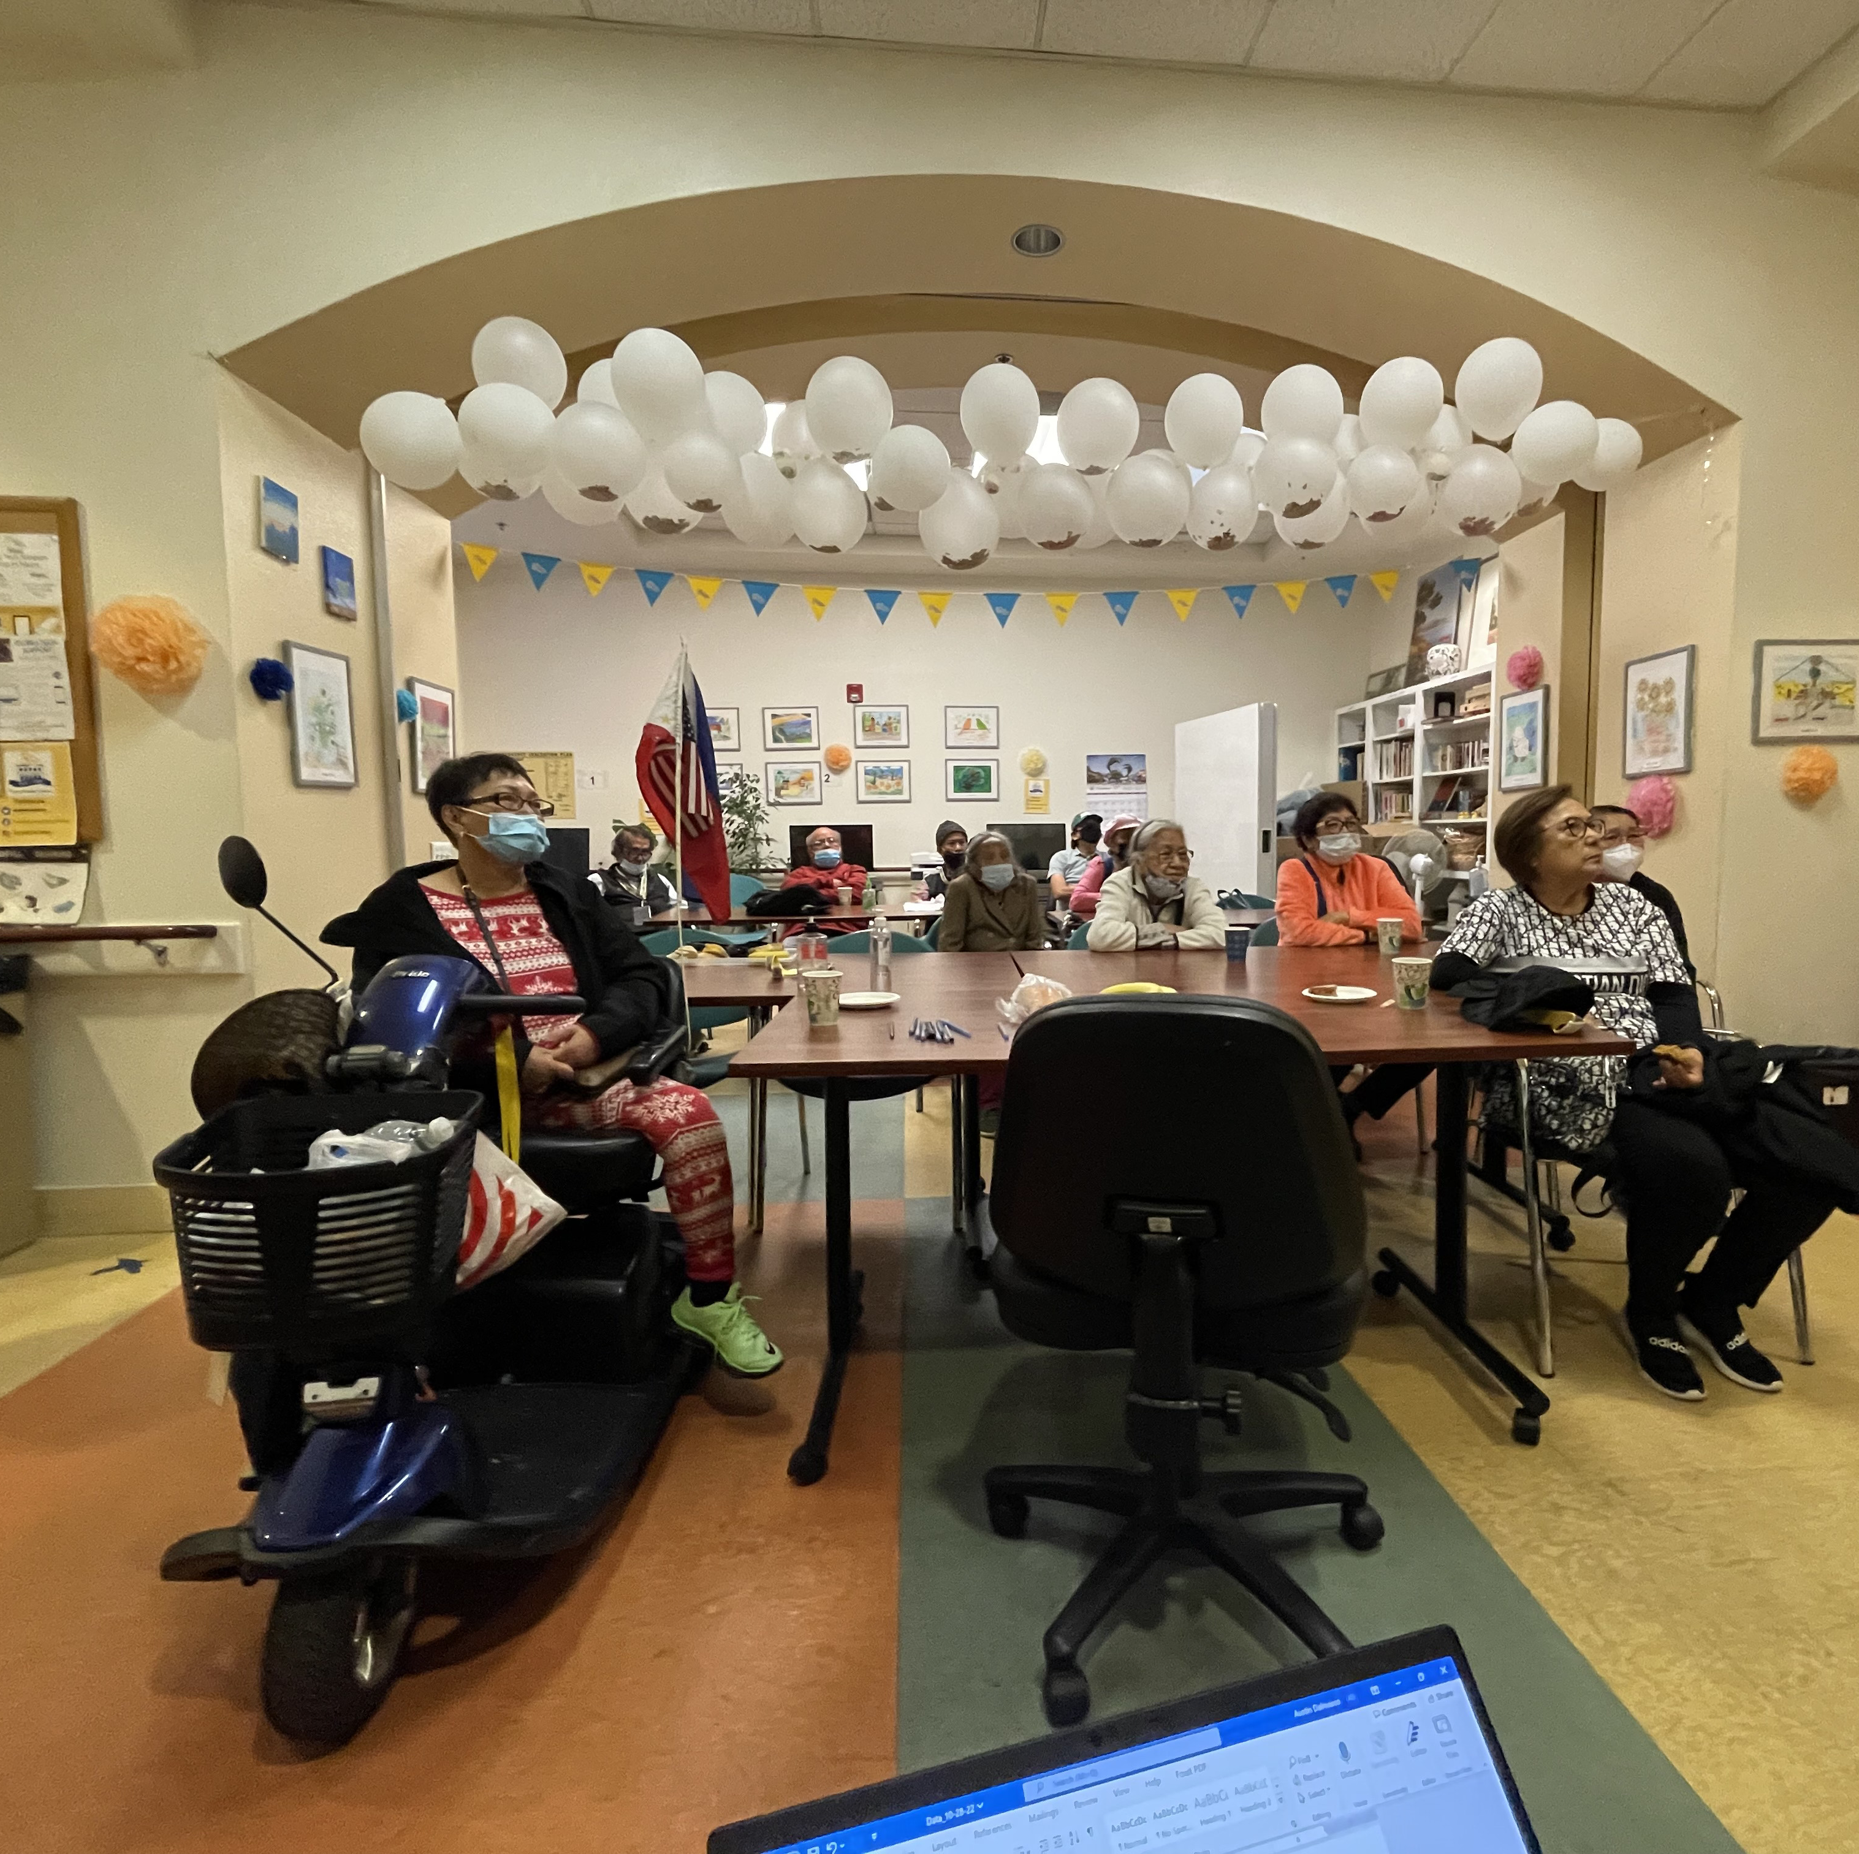
Impact: Focus Groups March- December 2022
139 unique participants
21 focus groups held in:
  Mandarin & Cantonese
  Arabic
  Spanish
  English
    Including with African American and Filipino communities in the TL
Notes:
Important to note the focus groups were ALWAYS led by community food justice leaders, and that participants received a $50 gift card for participating. Part of this was leadership development training.

Slide 6
Impact: Focus Group Preliminary Results
Lack of access to adequate kitchen spaces.
Desire for increased food related funds/benefits such as CalFresh.
Tenderloin residents are commuting to other neighborhoods to buy groceries.
Food pantry options are not culturally relevant.
Notes:
Information that can turn into policies, classes, and more. Also mention water quality issues as something we want to follow up on more.

Slide 7

~Food Policy Council Inaugural Meeting
~Policy Agenda Creation
What's Next?

Slide 8
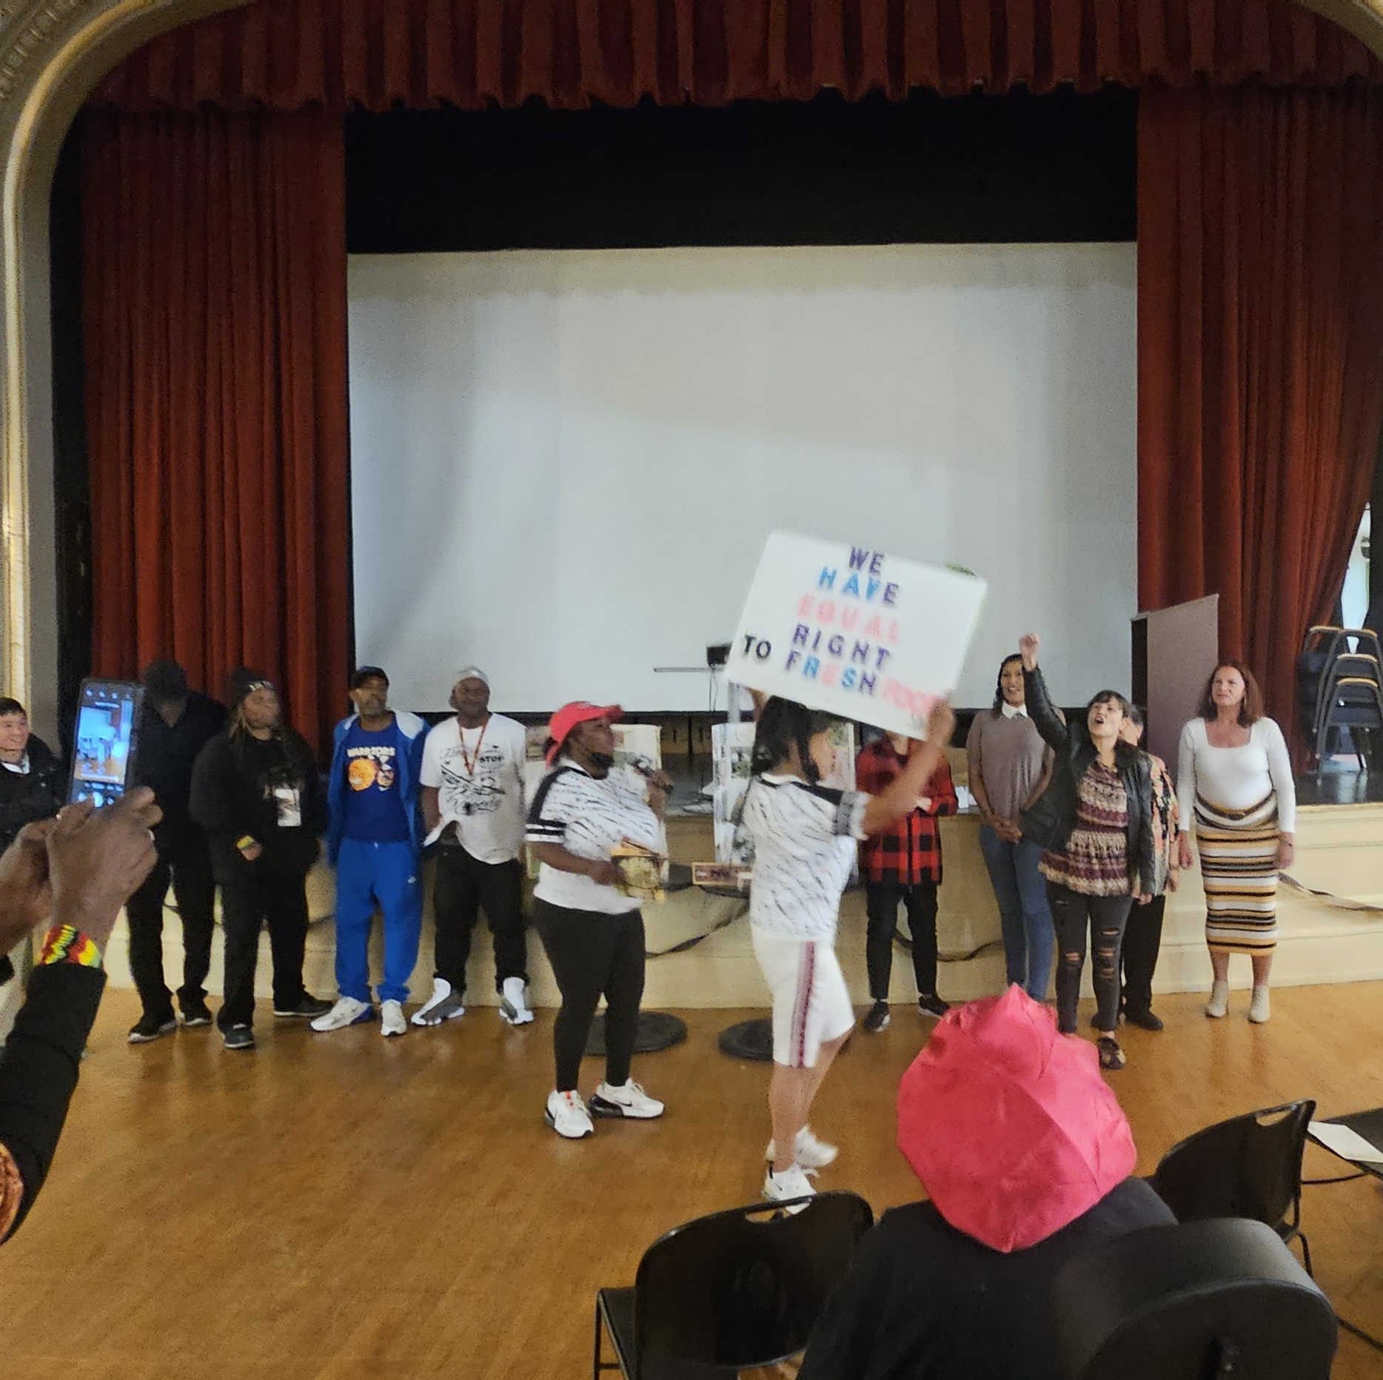
Impact: Food Justice Academy & "Neighborhood Food Congress"
10 week course with stipend
Class of 2022
  9 graduates
  Creates idea for "Neighborhood Food Congress"
Class of 2023
  12 graduates
  Graduation: 6/13/23

Slide 9
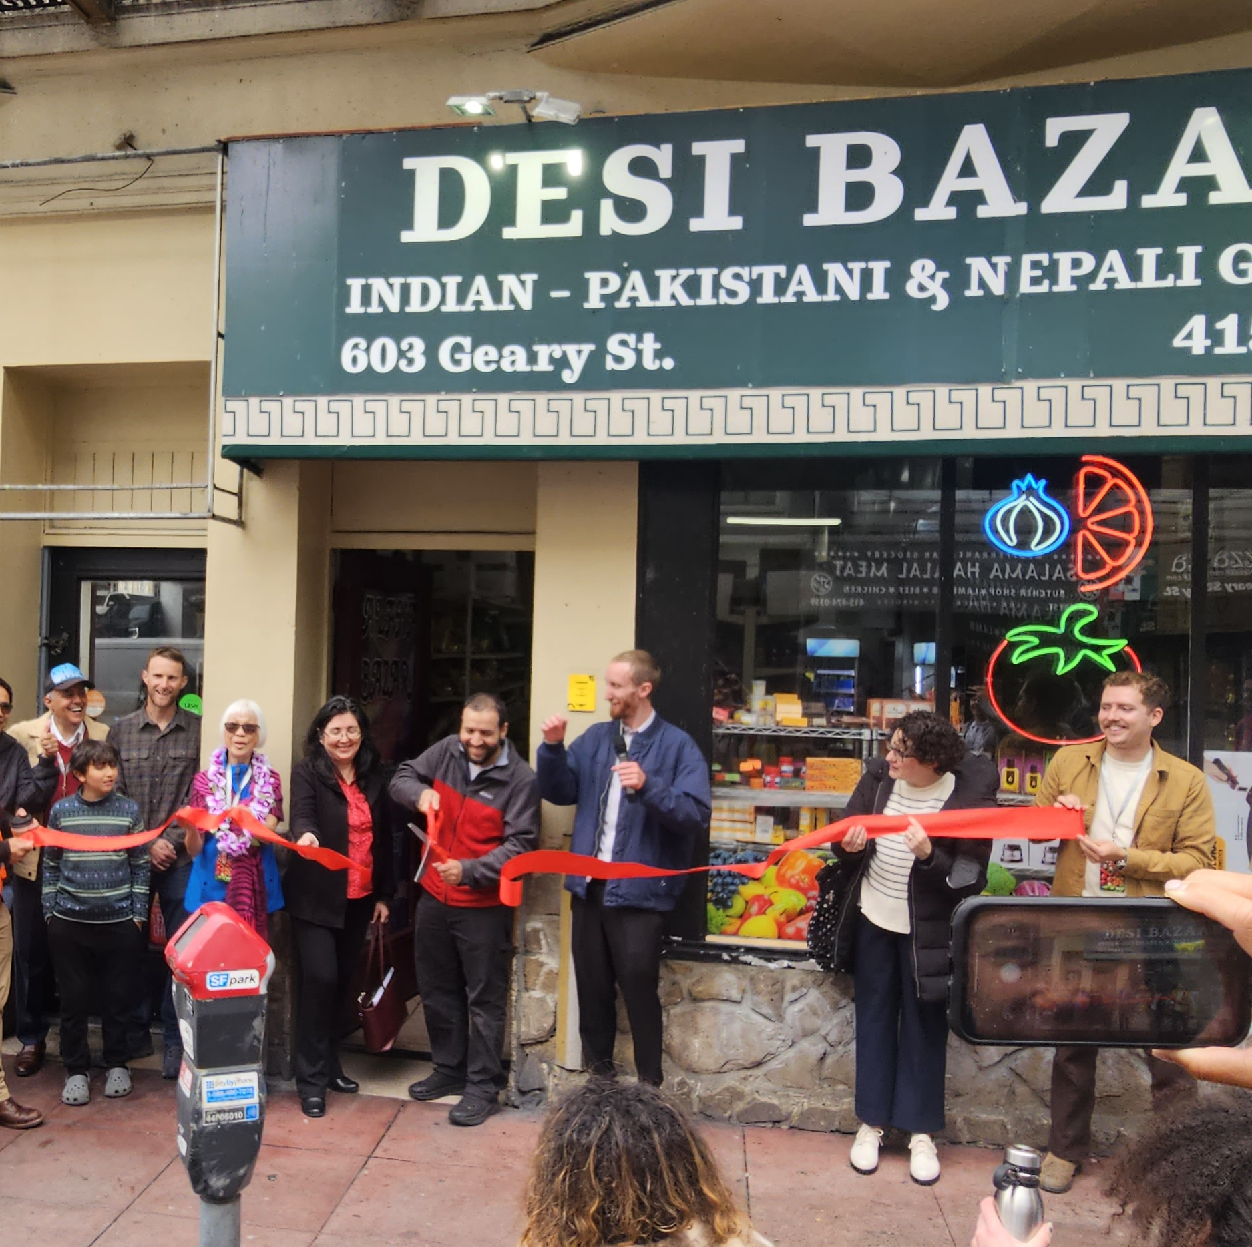
Impact: Healthy corner store conversions/ relationship building with corner stores.
Desi Bazaar grand re opening 6/13/23
Store visits during pandemic

Slide 10
Success, Challenges, and Barriers:
How do we move from data into the policy council and policy agenda?
Bringing on a new Healthy retailers. Specifically issues with POS systems.

Slide 11
Evaluation Process:
Tracking data through online

Slide 12
Unspent Funds: 11K
Investments in pay equity, data systems to help keep track of program outcomes and client satisfaction.
Notes:
Pay equity and investment in systems

Slide 13
Thank you!
John McCormick
TNDC Healthy Retail SF
Jmccormick@tndc.org

