Slide 1
SFSO Staffing
Summary

Slide 2
2017 Staffing
Authorized: 1,158
Actual: 992.5
Change: -165.5
86%
Sworn
Professional
Cadet
Authorized: 936
Actual: 799
Authorized: 123
Actual: 98
Authorized: 99
Actual: 95.5
85%
79%
96%

Slide 3
2018 Staffing
Authorized: 1,161
Actual: 1,005
Change: -156
87%
Sworn
Professional
Cadet
Authorized: 940
Actual: 824
Authorized: 123
Actual: 93
Authorized: 98
Actual: 88
88%
76%
90%

Slide 4
2019 Staffing
Authorized: 1,174
Actual: 995
Change: -179
84%
Sworn
Professional
Cadet
Authorized: 946
Actual: 820
Authorized: 129
Actual: 93
Authorized: 98
Actual: 82
87%
72%
84%

Slide 5
2020 Staffing
Authorized: 1,175
Actual: 987
Change: -188
84%
Sworn
Professional
Cadet
Authorized: 946
Actual: 805
Authorized: 131
Actual: 101
Authorized: 98
Actual: 81
85%
77%
83%

Slide 6
2021 Staffing
Authorized: 1,191
Actual: 927
Change: -264
78%
Sworn
Professional
Cadet
Authorized: 933
Actual: 744
Authorized: 142
Actual: 96
Authorized: 116
Actual: 87
80%
67%
75%

Slide 7
2022 Staffing
Authorized: 1,191
Actual: 855
Change: -336
71%
Sworn
Professional
Cadet
Authorized: 933
Actual: 675
Authorized: 142
Actual: 97
Authorized: 116
Actual: 83
72%
68%
72%

Slide 9
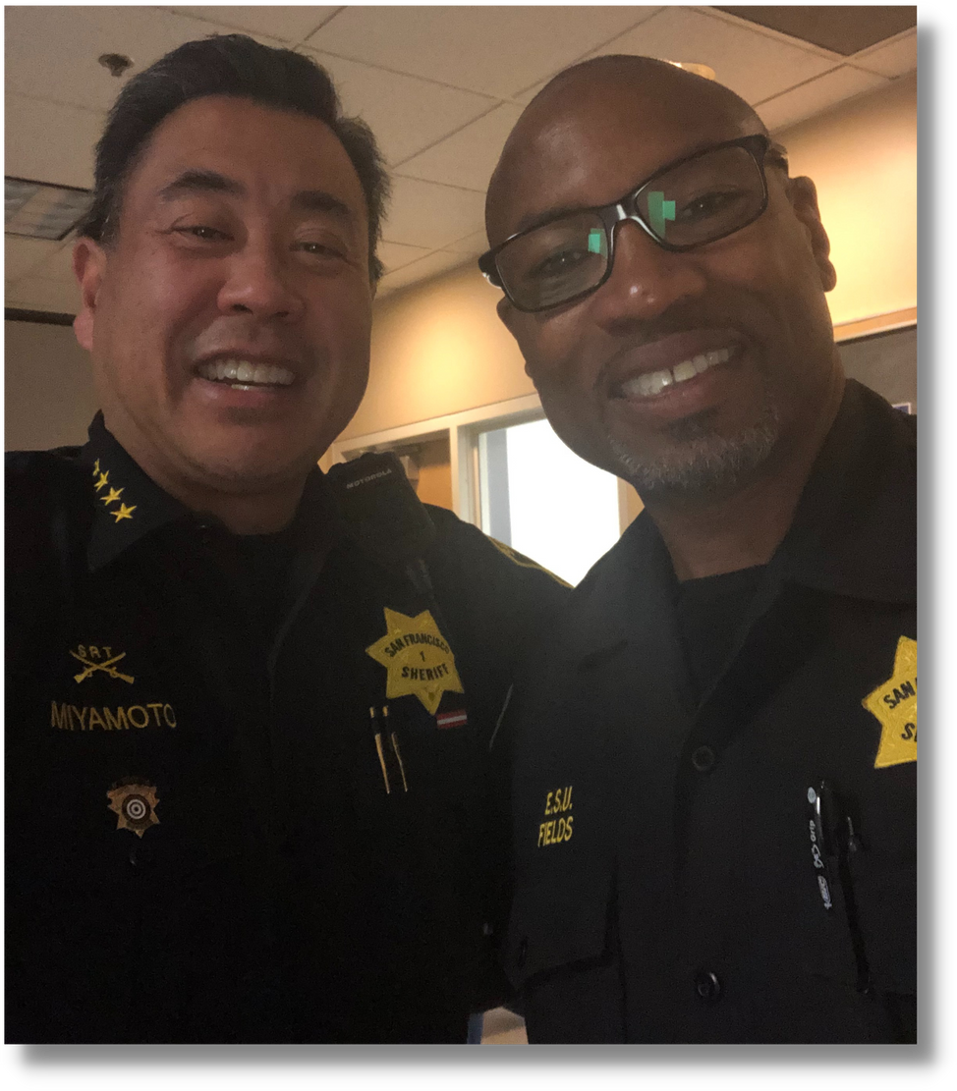
Staffing
Challenges
Training
COVID-19
Mandatory OT
Recruitment
Digital/Billboard Advertising
PAYS Partnership
Job Fairs

Slide 10
Thank You!
Notes:
• Scheduling the Catholic Chaplain to conduct confessions through screened window visits at CJ 3.
• Scheduling 40 video visits per week between faith providers and persons in custody.
• Organizing Thanksgiving meals for all persons in custody through the support of the Catholic Archdiocese.
• Distributing hygiene products to incarcerated women sponsored by Epic Church and Women Aglow, a faith-based organization.
• Distributing Holiday cards to everyone in custody. These cards were later collected and mailed.
• Distributing Mother’s Day and Father’s Day cards to everyone in custody. These cards were later collected and mailed.
• Organizing Grace Cathedral’s Stories from Mom or Dad Program to provide 99 children with an age-appropriate gift book “from” their incarcerated family member during the holidays.
• Collaborating with Grace Cathedral’s Stories from Mom or Dad Program to provide 104 children with two age-appropriate gift books “from” their incarcerated family member in the Spring. The San Francisco Public Library supported this event by purchasing the children’s book Milo Imagines the World which is about a child visiting an incarcerated parent.

Slide 11
CRIMINAL INVESTIGATIONS UNIT
IN CUSTODY CASES
JULY AND AUGUST 2022

