Slide 1
Responses to rising violence
Patrick Sharkey
William S Tod Professor of Sociology and Public Affairs, Princeton School of Public and International Affairs

Slide 2
FBI Uniform Crime Reports

Slide 3
Trends in US violence
Falling violence, with fluctuations, throughout most of the nation’s history through the 1950s
Rising violence in the 1960s, followed by sustained high levels through the early 1990s
Falling violence from the early 1990s through the mid 2010s
Rising violence from 2014 onward, accelerating in 2020

Slide 4
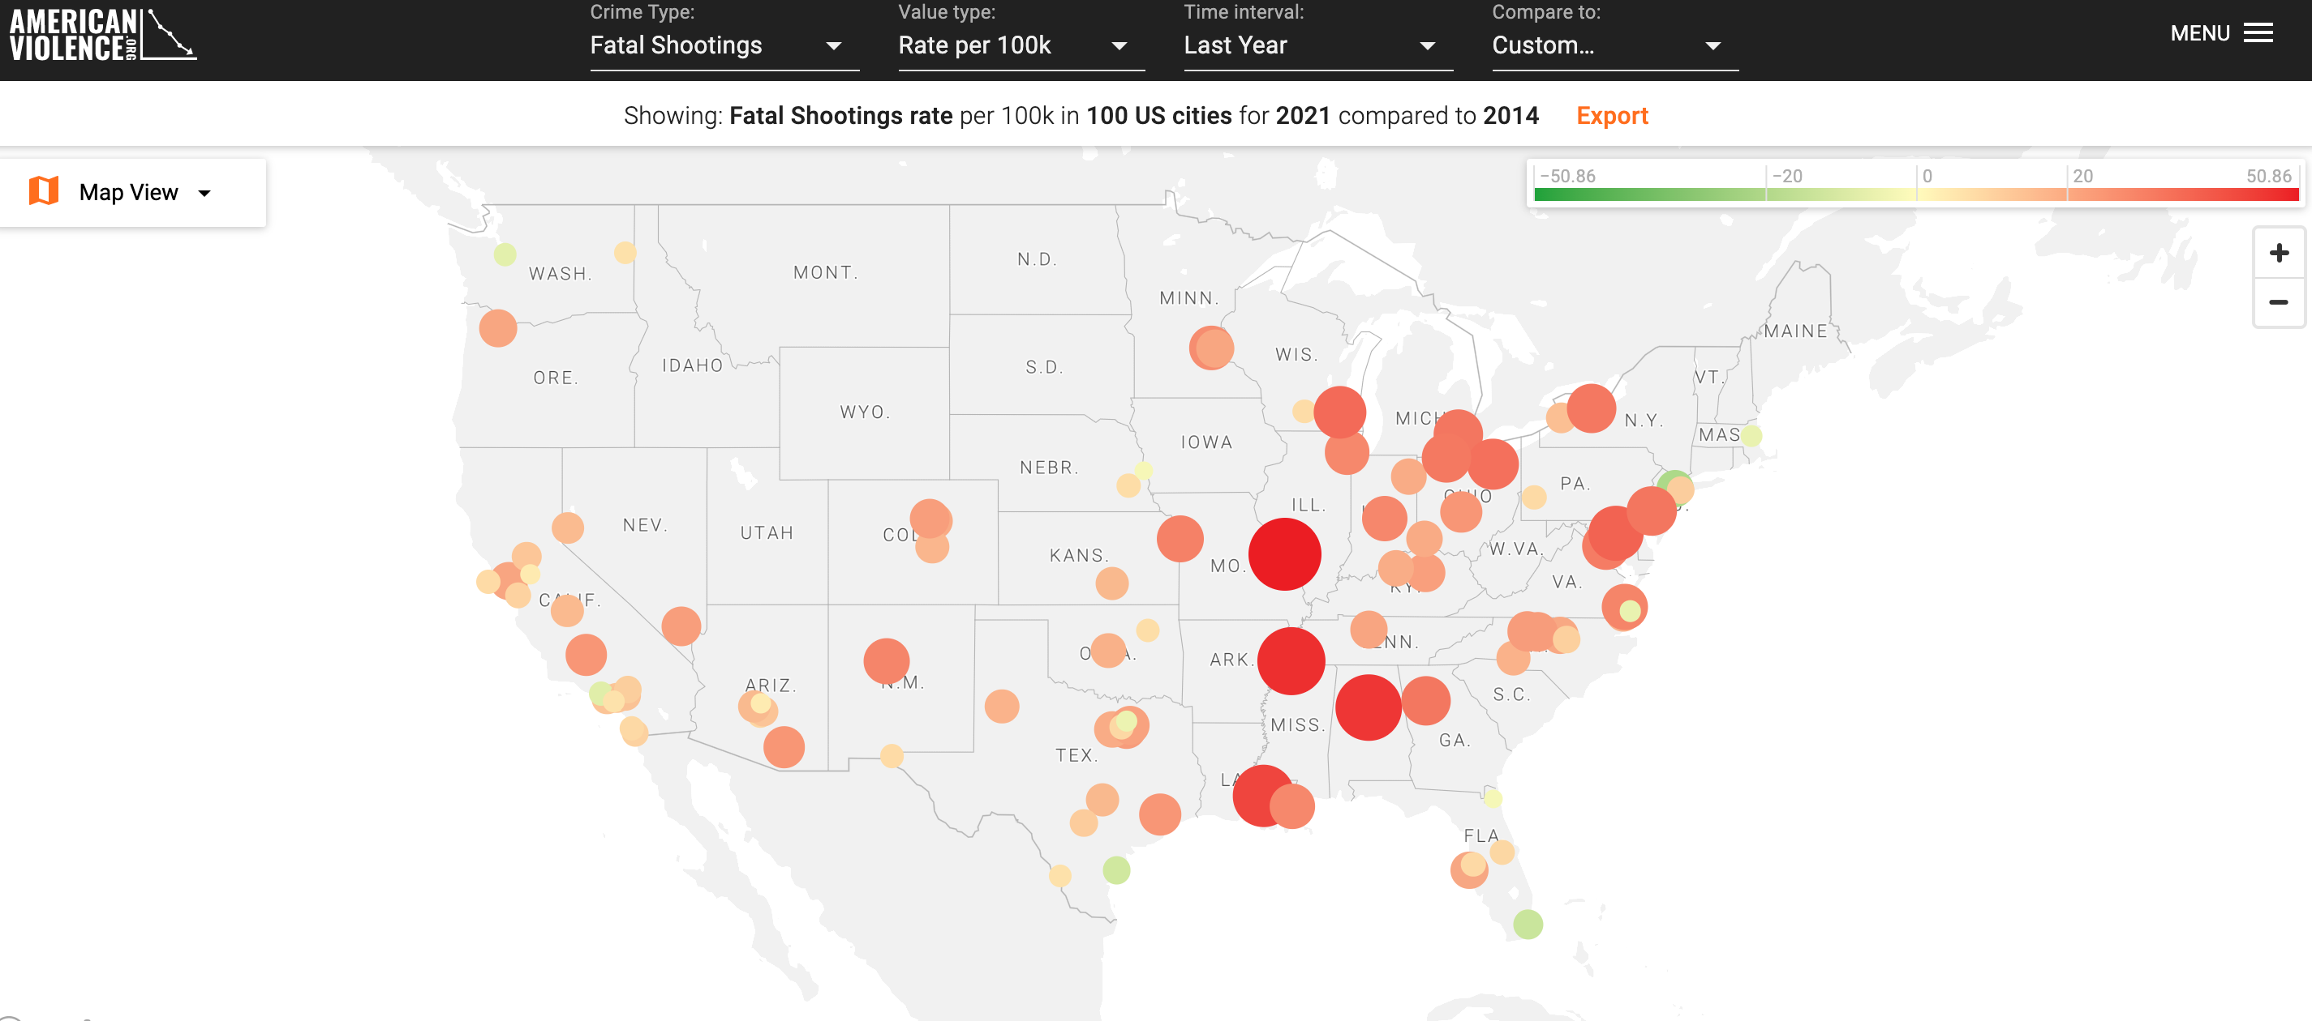
www.AmericanViolence.org

Slide 5
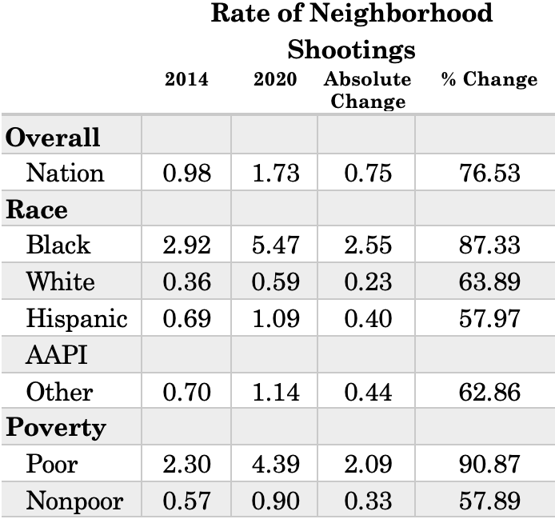

Sharkey and Marsteller, “Neighborhood Inequality and Violence in Chicago, 1965-2020.”

Slide 6
Four points
Violence has risen sharply from 2014 to the present; the greatest impact has been felt in the most disadvantaged communities
Our nation’s response to extreme urban inequality, combined with rising prevalence of guns, creates the conditions for high levels of violence
Relying on police and the prison can reduce violence, but it comes w great costs and weakens, rather than strengthens, communities
A different model, which invests in community organizations and includes police, has substantial evidence behind it

Slide 7
Four points
Violence has risen sharply from 2014 to the present; the greatest impact has been felt in the most disadvantaged communities
Our nation’s response to extreme urban inequality, combined with rising prevalence of guns, creates the conditions for high levels of violence
Relying on police and the prison can reduce violence, but it comes w great costs and weakens, rather than strengthens, communities
A different model, which invests in community organizations and includes police, has substantial evidence behind it

Slide 8
Sharkey, Uneasy Peace

Slide 9
Concentrated disadvantage
Disinvestment
Urban inequality
Violent crime
Institutional decline
Collective efficacy
Sharkey and Sampson (2015). “Violence, Cognition, and Neighborhood Inequality in America.” Social Neuroscience: Brain, Mind, and Society.

Slide 10
Four points
Violence has risen sharply from 2014 to the present; the greatest impact has been felt in the most disadvantaged communities
Our nation’s response to extreme urban inequality, combined with rising prevalence of guns, creates the conditions for high levels of violence
Relying on police and the prison can reduce violence, but it comes w great costs and weakens, rather than strengthens, communities
A different model, which invests in community organizations and includes police, has substantial evidence behind it

Slide 11
Four points
Violence has risen sharply from 2014 to the present; the greatest impact has been felt in the most disadvantaged communities
Our nation’s response to extreme urban inequality, combined with rising prevalence of guns, creates the conditions for high levels of violence
Relying on police and the prison can reduce violence, but it comes w great costs and weakens, rather than strengthens, communities
A different model, which invests in community organizations and includes police, has substantial evidence behind it

Slide 12
Average Exposure to Violent Crime of Poor and Non-Poor City Residents
GROWTH OF POLICE PER CAPITA
Chalfin and McCrary (2013). “Are U.S. Cities Underpoliced? Theory and Evidence.”

Slide 13
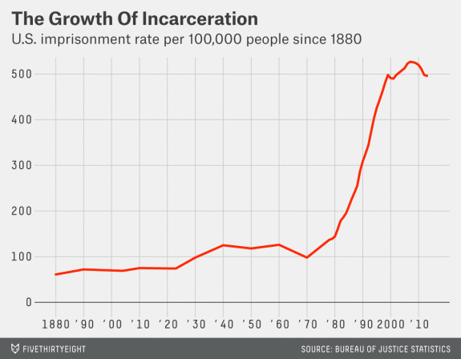
MASS INCARCERATION
Oliver Roeder, “The Imprisoner’s Dilemma.” FiveThirtyEight.com

Slide 14
Four points
Violence has risen sharply from 2014 to the present; the greatest impact has been felt in the most disadvantaged communities
Our nation’s response to extreme urban inequality, combined with rising prevalence of guns, creates the conditions for high levels of violence
Relying on police and the prison can reduce violence, but it comes w great costs and weakens, rather than strengthens, communities
A different model, which invests in community organizations and includes police, has substantial evidence behind it

Slide 15
Four points
Violence has risen sharply from 2014 to the present; the greatest impact has been felt in the most disadvantaged communities
Our nation’s response to extreme urban inequality, combined with rising prevalence of guns, creates the conditions for high levels of violence
Relying on police and the prison can reduce violence, but it comes w great costs and weakens, rather than strengthens, communities
A different model, which invests in community organizations and includes police, has substantial evidence behind it

Slide 16
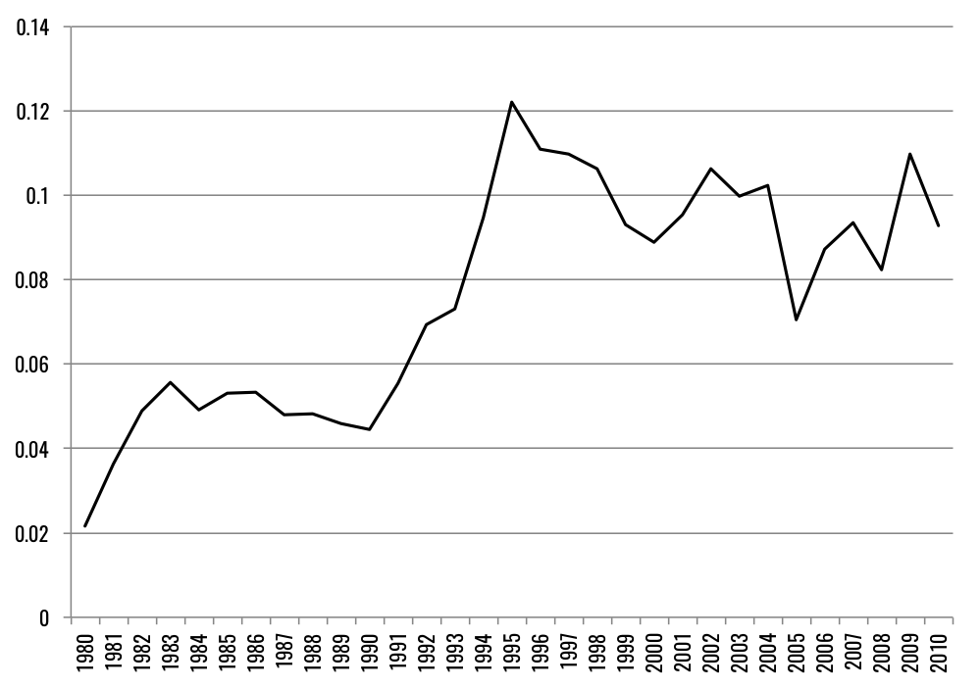
GROWTH OF ANTI-VIOLENCE NONPROFITS
Yearly growth in anti-violence nonprofits per 100,000
Sharkey, Torrats-Espinosa and Takyar, “Community and the Crime Decline:
The Causal Effect of Local Nonprofits on Violent Crime.” American Sociological Review.

Slide 17
WHAT ROLE DID COMMUNITY ORGANIZATIONS PLAY IN THE CRIME DECLINE?
In a city of 100,000 residents, every 10 additional nonprofits focused on crime/community led to a 9% drop in murder, a 6% drop in violent crime and 4% drop in property crime rates.
Sharkey, Torrats-Espinosa and Takyar, “Community and the Crime Decline:
The Causal Effect of Local Nonprofits on Violent Crime.” American Sociological Review.

Slide 18
EVIDENCE ON THE IMPACT OF LOCAL PROGRAMS
Cognitive behavioral therapy plus after-school sports reduced arrests for violent crimes by 45-50% (Heller et al. 2016)
Summer jobs and youth programming reduced violence by 43% over 16 months (Heller 2014)
Establishment of business improvement districts reduced violence by 11% (Cook and MacDonald 2011)
Redesigning abandoned buildings/plots of land reduced violence by 29% in high-poverty neighborhoods (Branas et al. 2018)

Slide 19
Four points
Violence has risen sharply from 2014 to the present; the greatest impact has been felt in the most disadvantaged communities
Our nation’s response to extreme urban inequality, combined with rising prevalence of guns, creates the conditions for high levels of violence
Relying on police and the prison can reduce violence, but it comes w great costs and weakens, rather than strengthens, communities
A different model, which invests in community organizations and includes police, has substantial evidence behind it

