Slide 1
VA Community Based Interventions for
Suicide Prevention (CBI-SP)
Amanda Lopez, LCSW
Community Engagement and Partnerships Coordinator
San Francisco VA Healthcare System
Amanda.lopez3@va.gov
415-619-2903

Slide 2
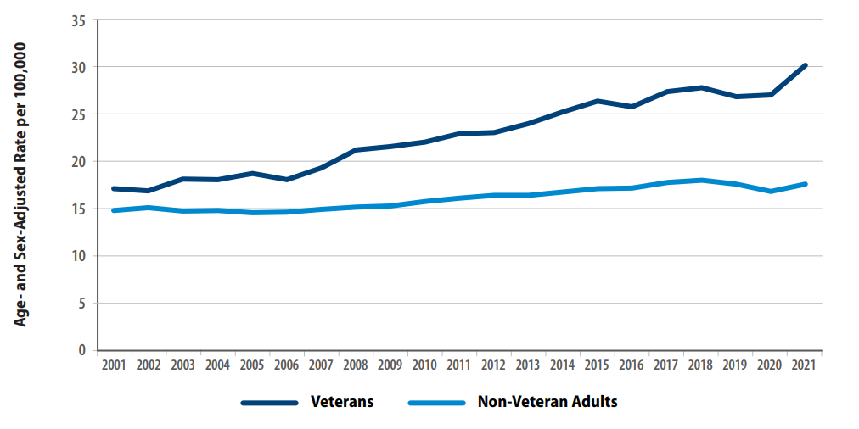
Age- and Sex-Adjusted Suicide Rates, Veterans and
Non-Veteran U.S. Adults, 2001-2021

Slide 3
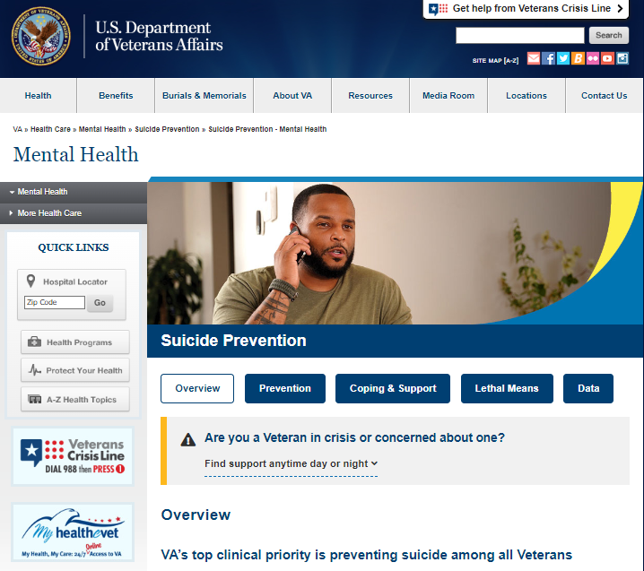

Slide 4
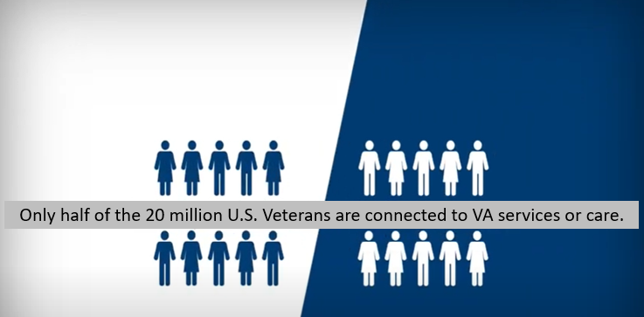

Slide 5
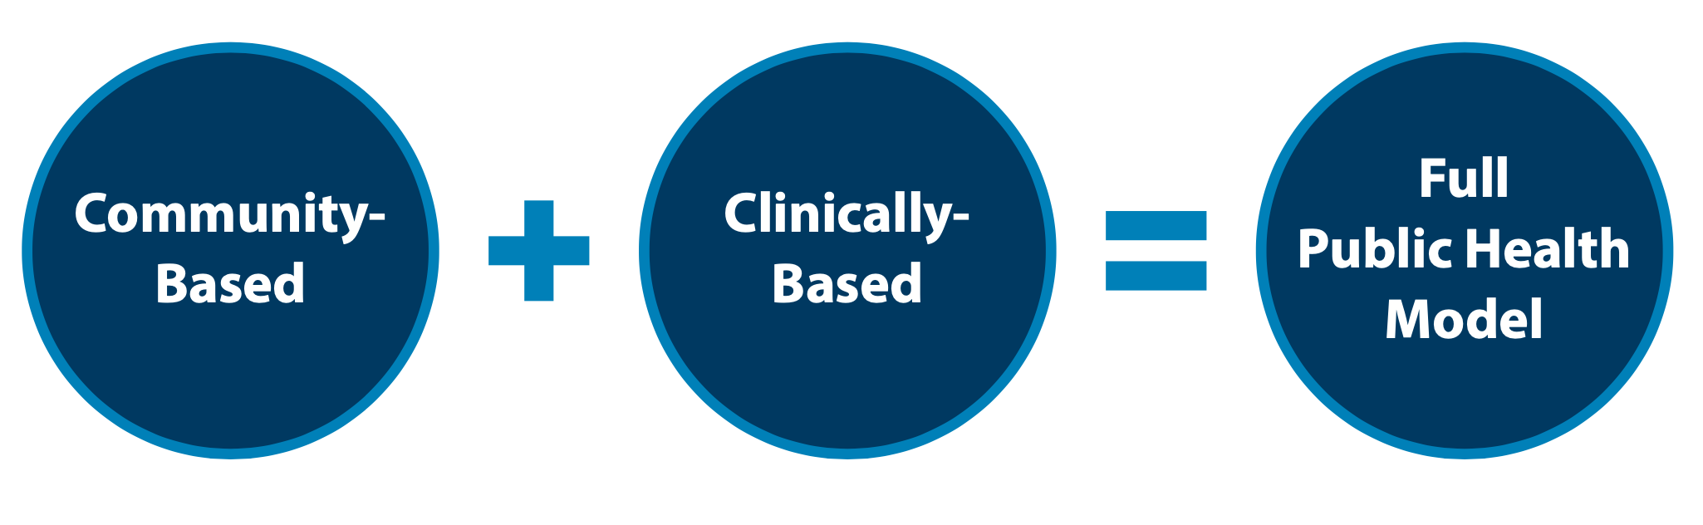
Public Health Strategy
VA's public health strategy combines partnerships with communities to implement tailored, local prevention plans while also focusing on evidence based clinical strategies for intervention. Our approach focuses on both what we can do now, in the short term, and over the long term, to implement VA’s National Strategy for Preventing Veteran Suicide.
Notes:
Instead of focusing exclusively on clinically based methods or other in house mehtods, we are now combining community based and clinically based approaches. And this is what led to what the VA coined…

Slide 6
Suicide Prevention 2.0
Community-Based Interventions for Suicide Prevention (CBI-SP)

Slide 7
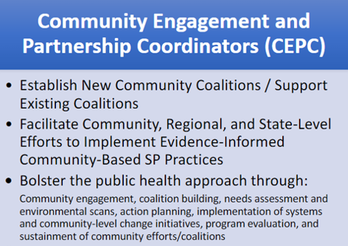

Slide 8



Focused Priority Areas Across CBI-SP Unifying Model
Identify Service Members, Veterans, and their Families and Screen for Suicide Risk
Promote Connectedness and Improve Care Transitions
Increase Lethal Means Safety and Safety Planning

Slide 9
Percentage of U.S. Adult Suicide Deaths and Methods Involved, 2021
Method | Non-Veteran | Veteran | Non-Veteran Women | Veteran Women | Non-Veteran Men | Veteran Men
Firearm | 52.2% | 72.2% | 34.6% | 51.7% | 57.2% | 73.4%
Suffocation | 26.8% | 14.9% | 26.8% | 19.7% | 26.9% | 14.6%
Poisoning | 12.4% | 7.8% | 28.8% | 23.7% | 7.7% | 6.9%
Other | 8.6% | 5.2% | 9.8% | 4.9% | 8.3% | 5.2%
In 2021, firearm was the most common method involved in all U.S. adult suicide deaths.

Slide 10
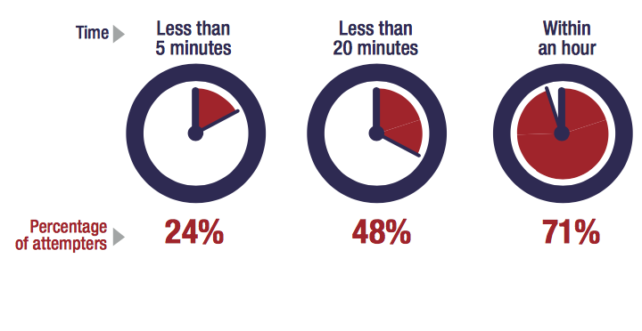
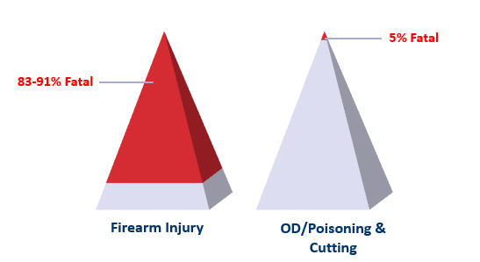
Most Suicidal Crises are Brief
Time from Decision to Action < 1 hour
Source: Simon, T.R., Swann, A.C., Powell, K.E., Potter, L.B., Kresnow, M., and O’Carroll, P.W. Characteristics of Impulsive Suicide Attempts and Attempters. SLTB. 2001; 32(supp):49-59.
Source: CDC WISQARS and US Dept. of Veterans Affairs
https://www.mirecc.va.gov/lethalmeanssafety/facts/

Slide 11
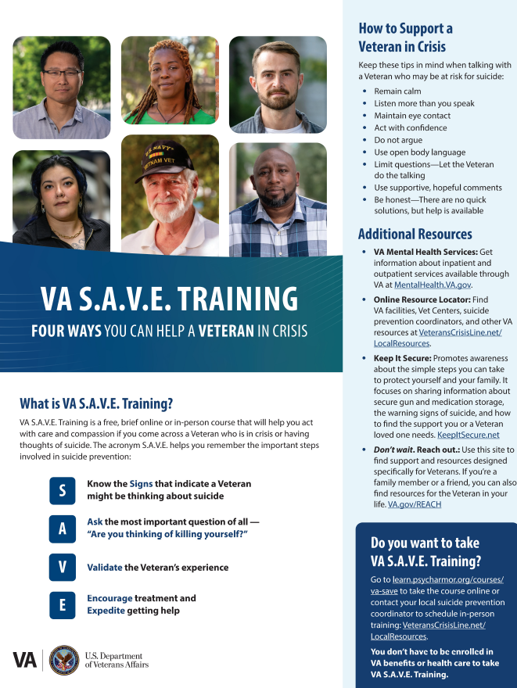

Slide 12
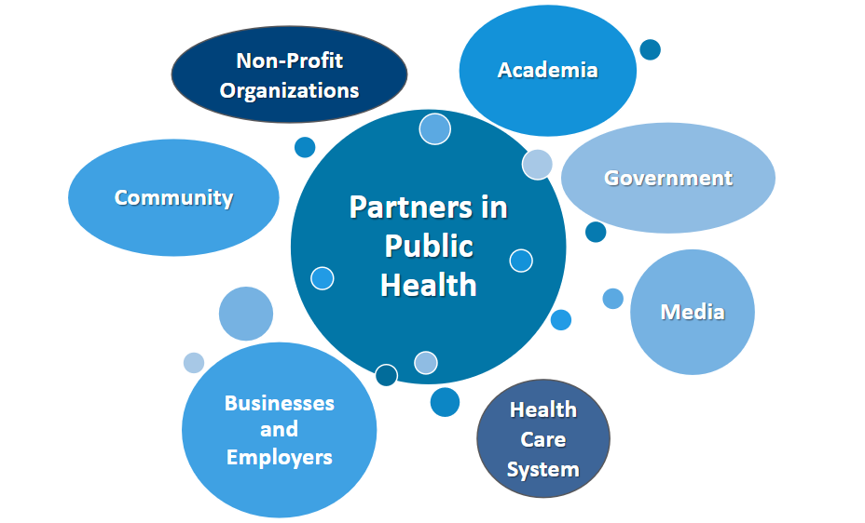
Suicide Prevention is Everyone’s Business

Slide 13
Thank You
Questions?

