Slide 1
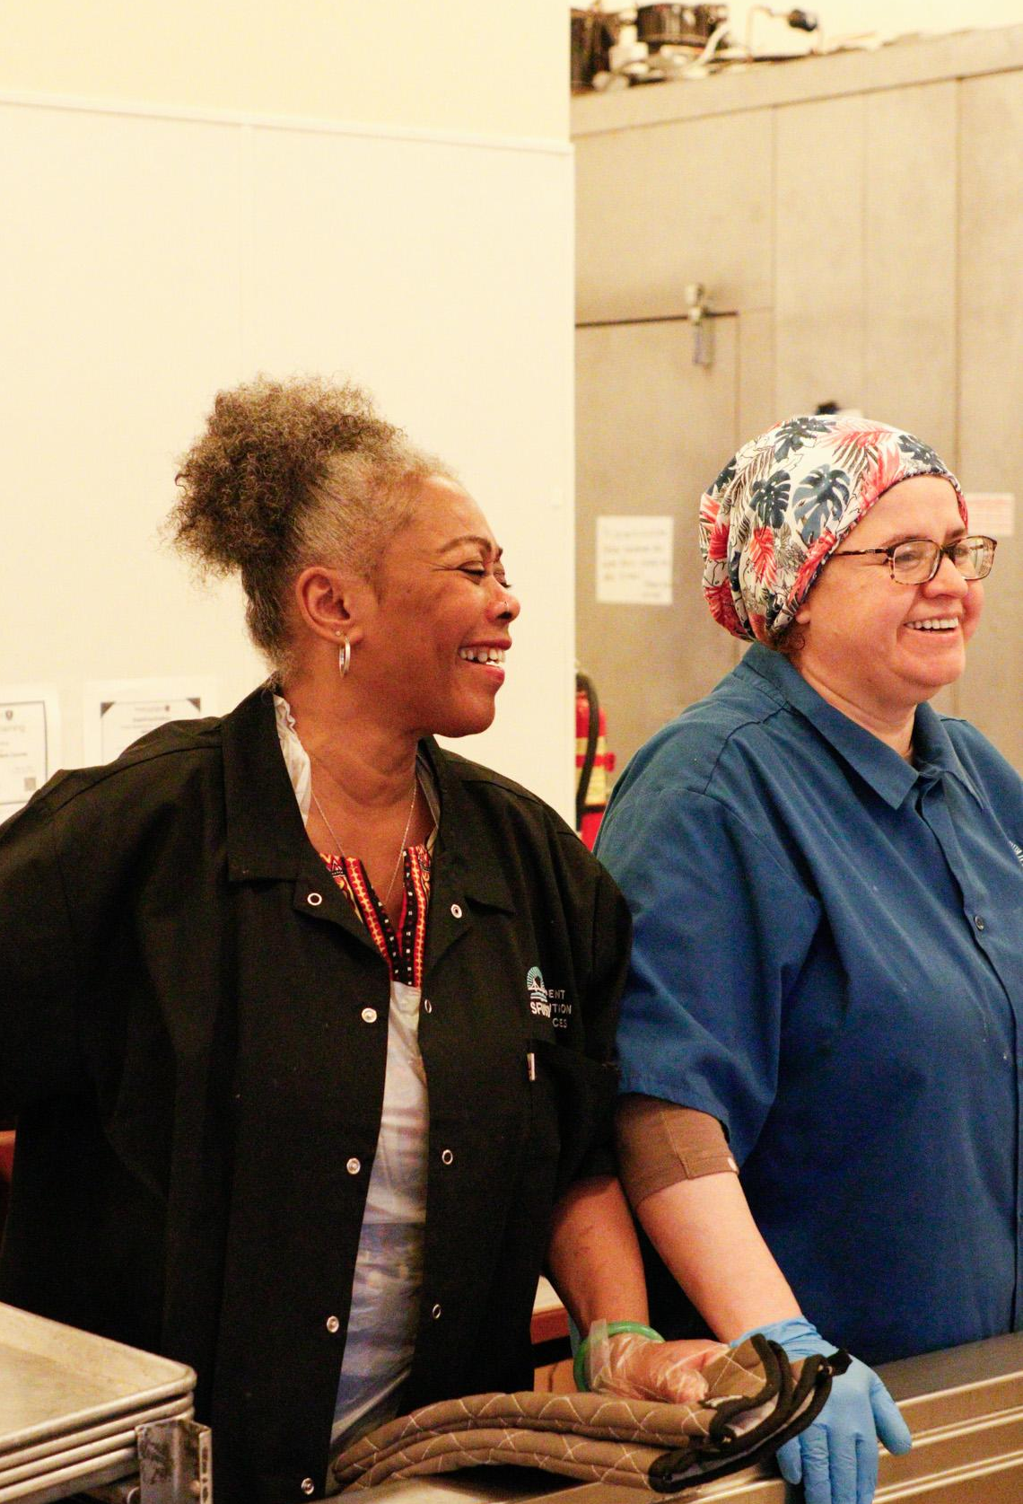
Student Nutrition Services Overview
September 3, 2025
Prepared by Jennifer LeBarre, Executive Director lebarrej@sfusd.edu
For Food Security Task Force

Slide 2
Who We Are & Why We Exist
Mission
Why we exist and what we do.
Everyday we nourish our students with food that enables them to live healthy lives and thrive inside and outside the classroom.
Vision
Where we want to go as a department; our compass.
Student Nutrition Services is a student centered, equitable, and financially stable school food ecosystem with thriving employees that provide dignified meal experiences and engage all students in a positive food culture.
Core Values
Define who we are collectively and how we work together.
Equity: We provide a dignified meal experience for all students.
Student-centered: We put students' needs first.
Wellness: We help our community live healthy lives.
Good Food: We provide food students love that is culturally diverse, sustainable, well sourced, and healthy.
Sustainability: We are responsible with our purchasing and practices.
Accountable: We provide an experience we are proud of.

Slide 3
Who We Are & Why We Exist
Core Beliefs
Essence of how we see other people, the world, ourselves (assumptions).
Equity: Hungry students have a difficult time learning and school meals help close the achievement gap by providing the nourishment needed to learn.
Community: Meal times provide opportunities to foster a fun and supportive environment that emphasizes a sense of community.
Wellness: School meals can relieve hunger, promote health, and encourage students to develop positive eating habits for life.
Partnership: Partnerships inside and outside of the school building are essential to achieving our vision.
Accountability: A thriving workforce, modernized business infrastructure, and innovative mindset will create more financial stability.

Slide 4
What We Plan to Achieve
Goals
Broad aims toward which all efforts are directed.
Nourish our Students with Good Food: Provide access throughout the school day to food that is healthy, culturally diverse, affordable, fair, sustainable and loved by students.
Create Dignified Built Environments. Create dining spaces that delight students and kitchen spaces that make it possible to prepare and serve good food.
Support a Thriving Workforce: Invest in people, technology, and processes to create a thriving workforce and environment that fosters a human-centered design approach to achieving SNS’s vision.
Build a Strong School Food Culture: Engage the whole community in creating a financially stable school food culture that activates students’ voices and shows how much we value and care for our students.
Theory of Action
The actions we believe are our greatest levers to bring our vision to fruition.
If we
Nourish our students with good food, +
Create dignified built environments, +
Support a thriving workforce, +
Build a strong school food culture,
then we will be a student centered, equitable, and financially stable school food ecosystem with thriving employees that provide dignified meal experiences and engage all students in a positive food culture.

Slide 5
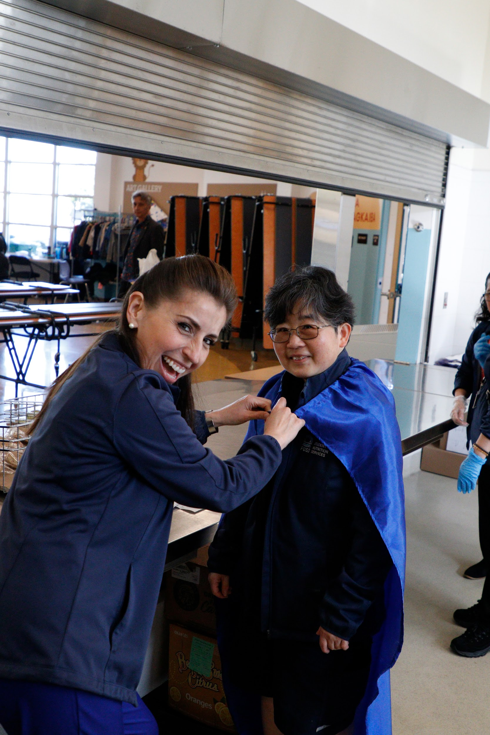
SNS by the Numbers
200 Employees (Site Based & Central Office)
120 Locations
11 Stand Alone Early Education Sites
1 Charter Co-Located with Elementary School
All TK-12 Schools on CEP
All Meals Served for FREE at All Schools
Average Daily Participation (across all programs)
Breakfast- 9565
Lunch- 20,226
Snack- 1227
Supper- 6023

Slide 6
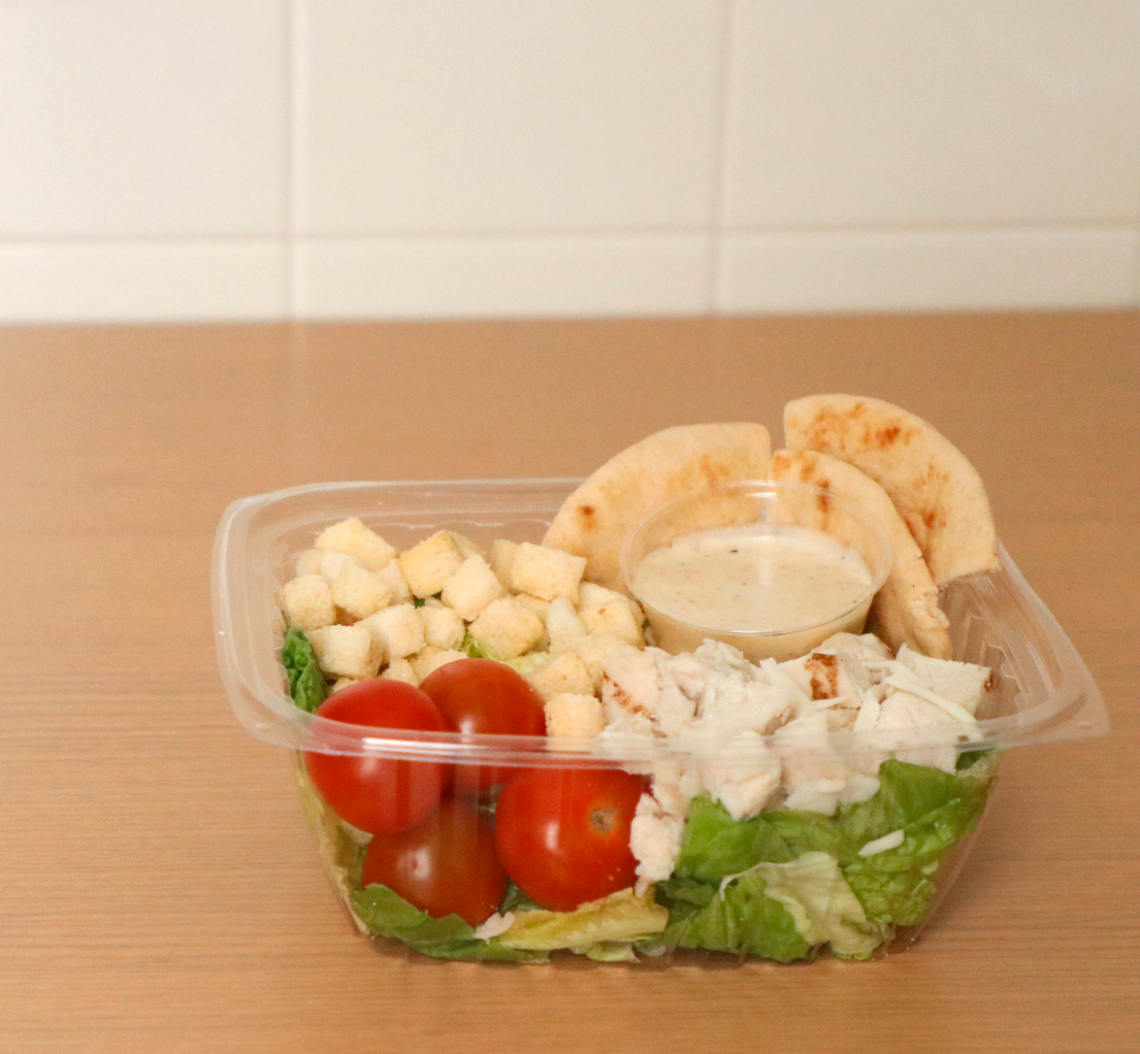
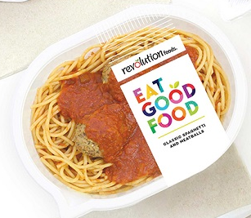

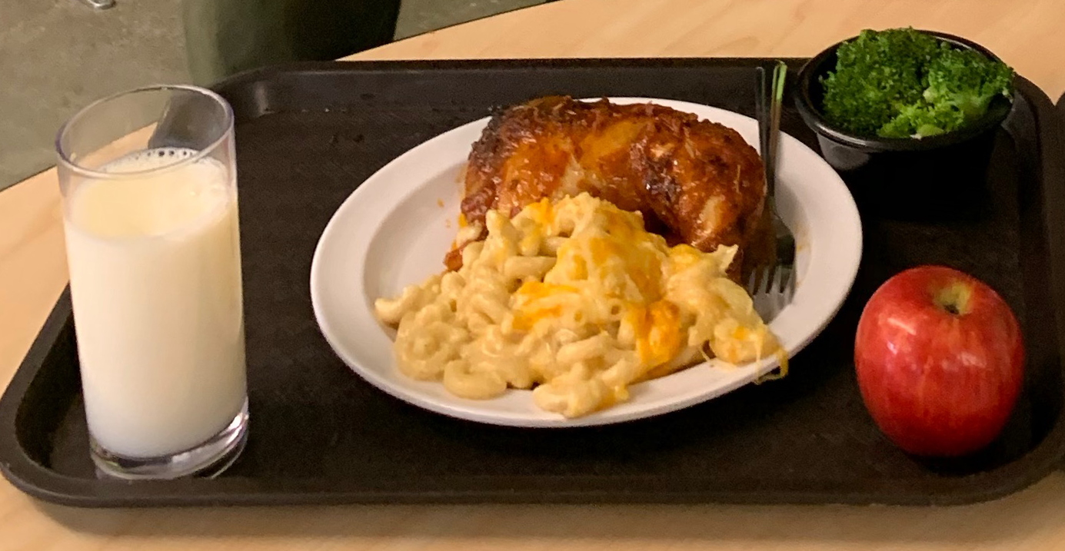
Future
McAteer Culinary Center
Serving Ruth Asawa SOTA & The Academy + EED
10%
Refresh
Serving 20 Middle & High Schools
30%
Vended Meal
(Revolution Foods)
Serving Elementary, Middle & High Schools
60%
SNS Meal Programs

Slide 7
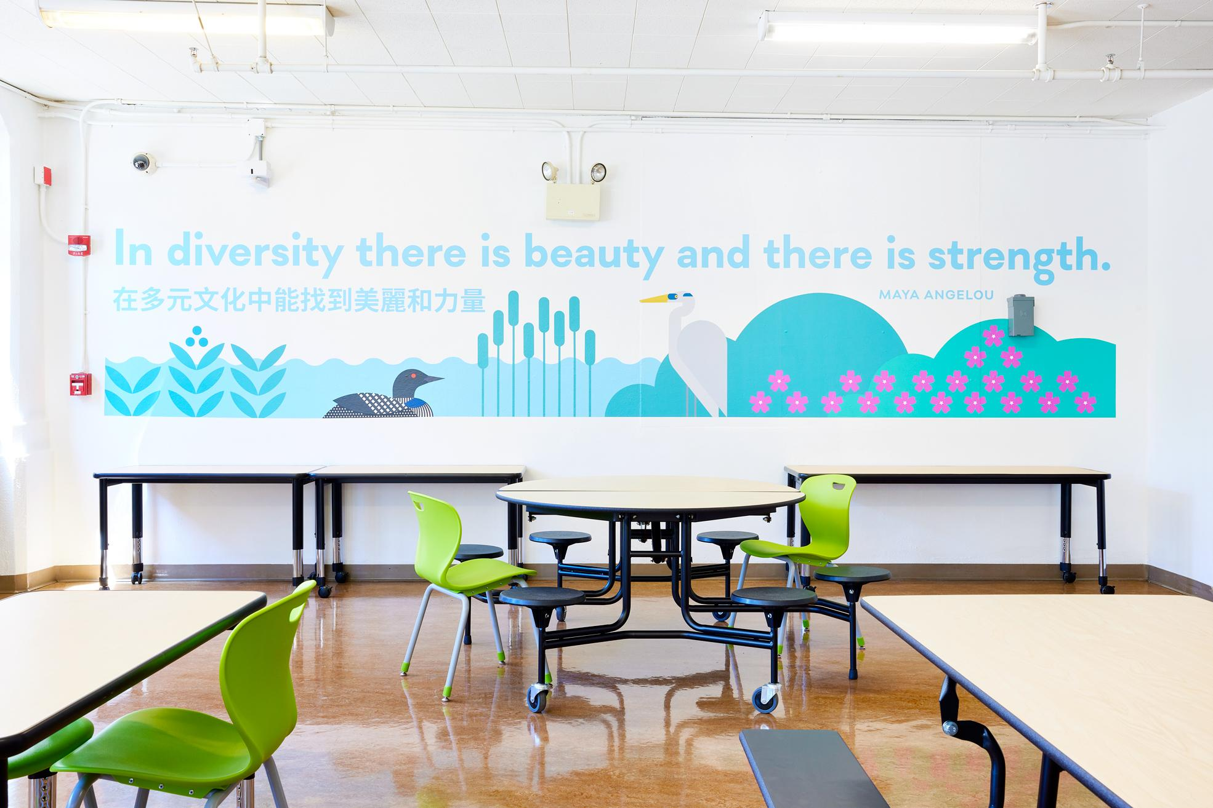
2025-26 Key Priorities
Nourish Our Students With Good Food
Salad Bar Program Implementation
Menu Alignment Across Programs
Continued Implementation of Good Food Purchasing Policy
Expansion of Breakfast After the Bell Programs
Create Dignified Built Environments
Partnering with Bond Team
Kitchen Modernizations
Dining Space Redesigns
New Central Kitchen
Notes:
This is not exhaustive list- some of the highlights.

Slide 8
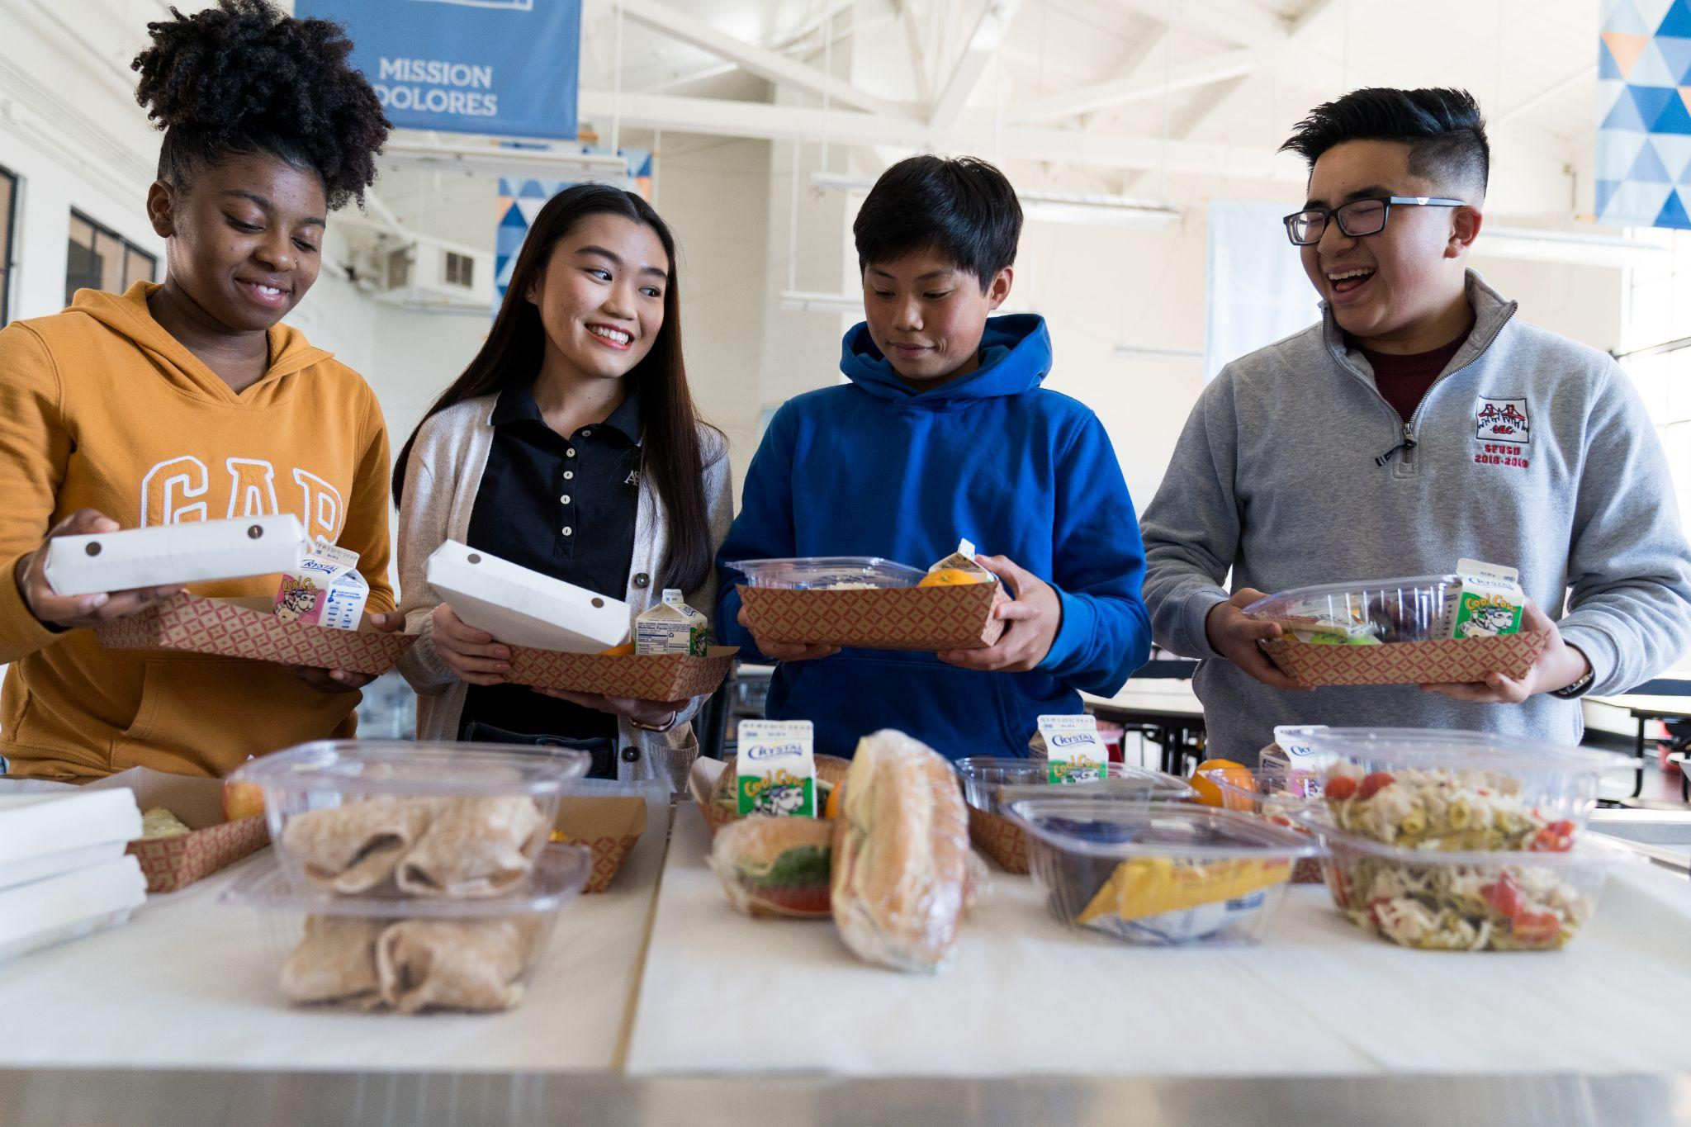
2025-26 Key Priorities
Support a Thriving Workforce
Increased and Improved Professional Development opportunities
Increased and Improved Communication with Dining Staff
Development of Central Kitchen Staffing Plan
Build a Strong Food Culture
Robust Student Engagement
Robust Adult Engagement
Reduction in Single Use Plastics
Notes:
This is not exhaustive list- some of the highlights.

Slide 9
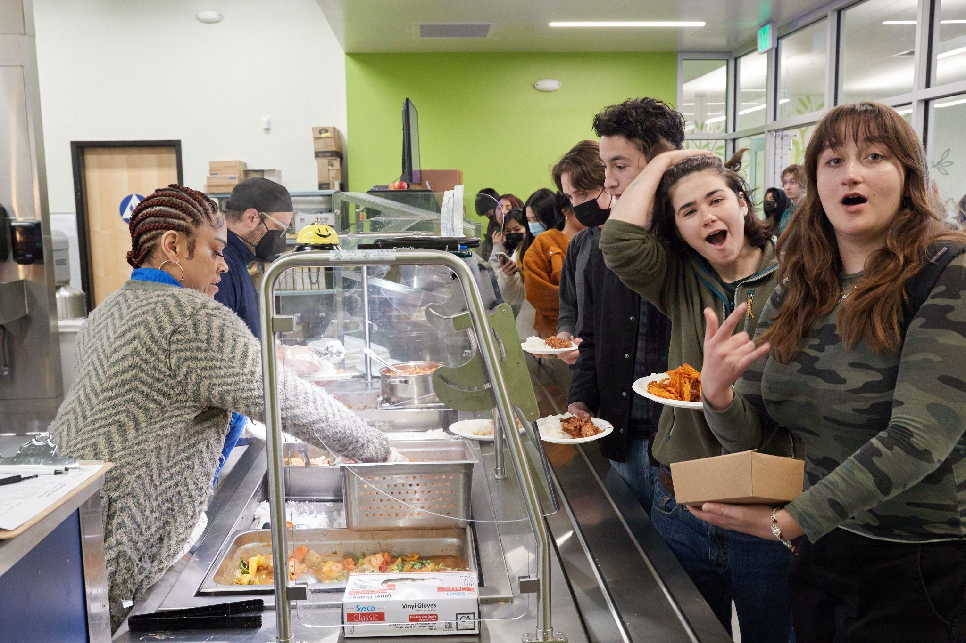
Partners & Funding Sources
Kodama Foundation
Partner & funding since 2012
Focus: Improved Student Dining Experience
No Kid Hungry
Partner & funding since 2015
Focus: Breakfast After the Bell Expansion
FoodCorps
Partner since 2019
Focus: Meal Program and Procurement Improvements
Sugary Drinks Distributor Tax
Funding since 2018 (sunsets 2028)
Focus: Improved meals
KITS
Funding since 2021
Focus: Kitchen infrastructure & training
ELOP
Funding since 2021
Focus: Supper & Summer programs
Notes:
This is not exhaustive list- some of the highlights.

Slide 10
Legislative Impacts
Federal
Impacts of the bill signed on July 4, 2025
We won’t truly know impacts until rules on Food Stamps, Welfare go into effect in 2028
HOWEVER- families are not electing into SunBucks, we saw a dip in Direct Certification for July
The 2026 Appropriations Bill will also have impacts.
Right now it looks positive but….
State
2025-26 Budget
Continued funding for California’s Universal Meal Program
Continued funding for Kitchen Infrastructure & Training

