Slide 1





SAN FRANCISCO SHERIFF’S OFFICE OVERSIGHT BOARD
PROGRAMS PRESENTATION
NOVEMBER 2022
Children of Incarcerated Parents Framework Document: Promising Practices, Challenges, and Recommendations for the Field (urban.org)
Notes:
1

Slide 2

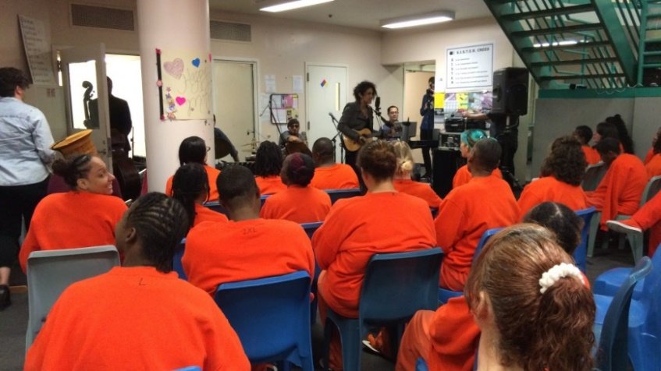
Sisters in Sober Treatment Empowered by Recovery (SISTER) Program
A gender specific substance use treatment and behavior modification program for female identified clients at County Jail #2.
There are 12 clients participating in groups and 4 who meeting weekly with a case manager and complete independent study packets.
Roads to Recovery
An in-custody substance use treatment program for men. Services include groups, individual case management, referrals and linkages to community-based services. There are twelve participants engaged in group work in three different program pods in two jails and an additional twenty-five participants in other housing locations who meet weekly with a case manager and complete independent study packets.

Slide 3


Slide 4
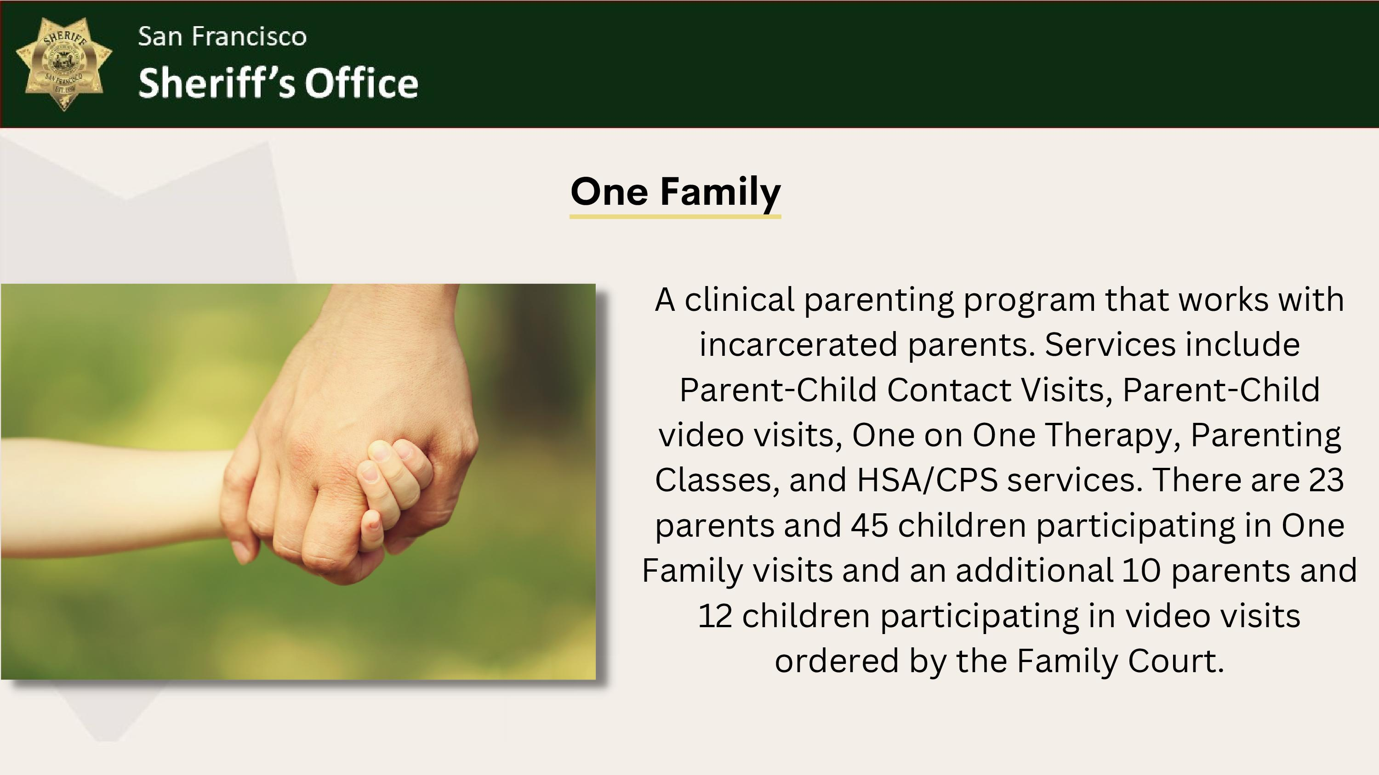

Slide 5
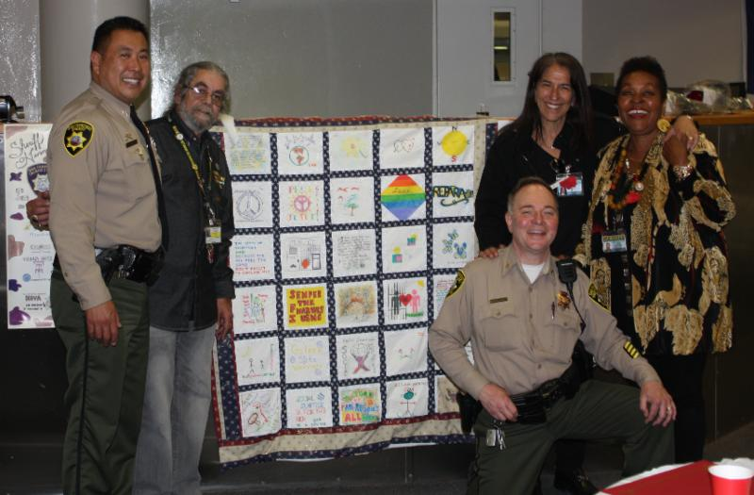
Community of Veterans Engaged in Restoration (COVER)
A program designated for veterans of all the branches of the US Military, regardless of the character of discharge. Staff collaborates with Veterans' Justice Court and the Department of Veteran’s Affairs to provide service appropriate to the special needs of the community. There are 13 veterans participating in individual case management throughout both jails and 3 veterans participating in groups in a program pod at CJ3.

Slide 6



City College
Over the past two years, City College has offered correspondence courses for incarcerated students. Initial post-COVID in person class starts October 17 and will be offered to students in Keys to College pod.
Stanford Lecture Series
Graduate student facilitators teach two cohorts of classes 2-3 times per year. Classes held in program pod class rooms. The summer quarter classes concluded on July 1, 2022 and the fall quarter classes started October 5, 2022.
SF Public Library Jail and Reentry Services Program
Librarians distribute books weekly and facilitate a “Trans Representation in Media” class in CJ 2 upper A pod.
Notes:
Five Keys Charter School: This is the first charter high school ever established in an adult detention facility designed to provide diploma programs.
Number of participants Feb 2020: 125 students participating in classroom instruction 25 hours per week and an additional
Number of participants March 2022: 16 students participating in small group instruction and 125 students participating in Independent Study.
Keys to College: Keys to Change and Keys to College are programs of the Five Keys Charter High School which focuses on an individual's capacity to change the behaviors that led them to incarceration. Daily process groups, cognitive behavioral classes, and case management are tools previously used in these pods.
Number of participants Feb 2020: 96 participants in 2 dedicated housing units participating in 25 hours of groups per week.
Number of participants Feb 2022: 41 participants in 1 dedicated housing unit and an additional ? participants from the High School housing unit participating in ? hours of groups per week and individual work.
City College: San Francisco City College provides student with credit-bearing classes.
Number of participants Feb 2020: ? students participating in classroom instruction.
Number of participants Feb 2022: ? students participating in correspondence courses

Slide 7

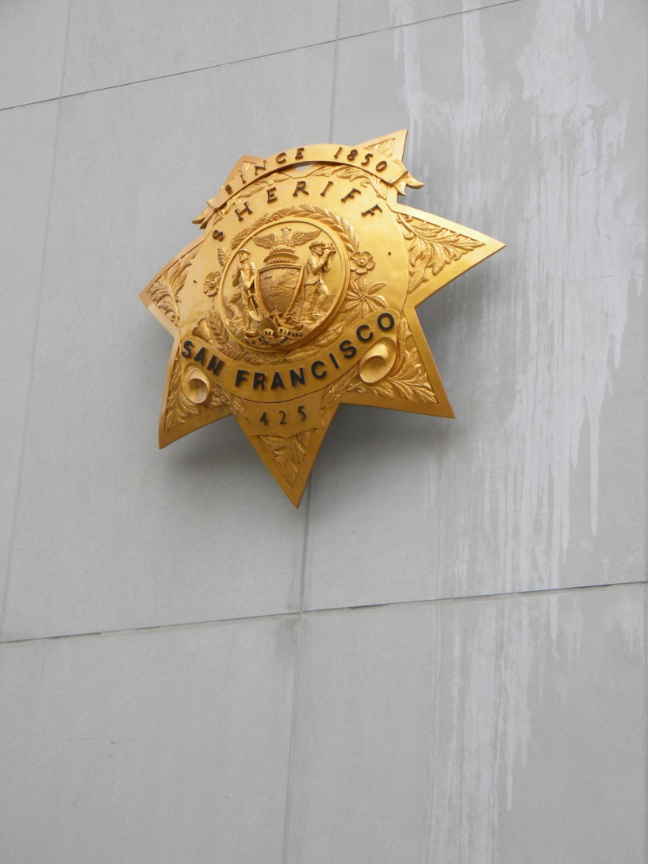
Partnerships
FOUNDED INSIDE A COUNTY JAIL
In an effort to create educational programming in the SF County Jails, Sheriff Michael Hennessey and Sunny Schwartz
founded Five Keys Charter School in 2003.
EDUCATION ★ EMPLOYMENT ★ RECOVERY ★ FAMILY ★ COMMUNITY

Slide 8










Partnerships
OUR COUNTY PARTNERS IN EDUCATION & REENTRY
Five Keys Schools and Programs is located in 12 different counties, including San Francisco, Alameda, Marin, Riverside, San Diego, Solano, Sonoma, San Mateo, Santa Clara, San Joaquin, San Bernardino, and Los Angeles counties
Notes:
And we are expanding. We have locations both in custody and in community in all of these locations.

Slide 9
FIVE KEYS IN CUSTODY PROGRAMS
Specialized Job Center
The goal of the program is to ensure the continued success of job placements for clients reentering the community by better integrating career services within the criminal justice system. Overall goals also include reducing recidivism and promoting public safety. Each participant will work with the case manager to work on a reentry employment plan and will be referred to partnering agencies for added success, when needed.
Keys to Change and Keys to College Pods
Five Keys runs two programing “pods” at County Jail 3. Both pods feature a variety of courses and programs including college classes, college readiness curriculum, Restorative Justice Live Skills and community building meetings.
Snapshot of what we do within the Specialized Job Center
Resume and Cover Letter writing
Interviewing with a background workshop
Different certifications testing (CDL Test Prep, Real Estate, Safe Serve Certification and much more)
Assistance with barrier removal, such as housing, I9 docs and other needs.
Self-Directed Learning – Programs
The goal of the Self Directed Learning (SDL) programs is to give the clients the opportunity to program on a variety of topics independently. They have the option to pick a class and complete it on a 12 week block period and earn a grade and hours towards milestones. A few examples of this program offers; CDL Commercial Drivers License, Building Reliance, Life Skills/ Reentry and the list goes on.

Slide 10
FIVE KEYS IN CUSTODY PROGRAMS
Roadmap to Peace (RTP)
Collaborative between multiple agencies to provide supportive services to Latino/a youth & families
Creation of an interconnected youth service network, effective community-building, and meaningful policy advocacy
“Healing Wheel” - what does the youth need/want support with?
TAY Resiliency Program
Expand on connection made with TAY population beyond RTP
Facilitation of therapeutic programs
Intensive one to one case management
Coordination with community based agencies to build bridges
Community Partners
Bay Area Community Resources (BACR/CHALK)
Central American Resource Center (CARECEN)
Horizons Unlimited
Instituto Familiar del la Raza, Inc. (IFR)
Mission Neighborhood Centers (MNC)
Mission Neighborhood Health Center (MNHC)
Community Partners
Bay Area Community Resources
ReSET Collaborative
Samoan Community Development
Notes:
Here is a breakdown of our TAY programs

Slide 11
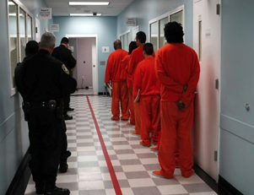
WHAT DOES FIVE KEYS PROVIDE IN THE SFSD JAILS?
Academic Education:
CJ3 - Education Corridor - 10 classes including High School Diploma, ESL, CCSF, Life Skills, Violence Intervention and Financial Literacy course provided
All Jails –Independent Study to obtain High School Diploma
COVID-19 In-Custody Shift of Programming
All contact with students has been made through:
The doors
Video visits
Phone calls
Notes:
Our education corridor has 10 classrooms that are set up for clients to get education services such as ESL, Computer Literacy, Math, English and a variety of other course. We also have a Five Keys library, Law Library, and a classroom that is used for our CCSF courses, or any other programming needs. Unfortunately, with covid restrictions we had to close down the corridor for now and are doing small groups in the pods for certain courses. We continue to work with the SF Sheriff's Department and SF Dept of Public Health to figure out ways to get back in the corridor.
Programming has temporarily changed to smaller groups in the POD and 5 Keys has shifted a majority of programming through independent study style both for high school students and students who are programing with any of the in-custody programs.

Slide 12

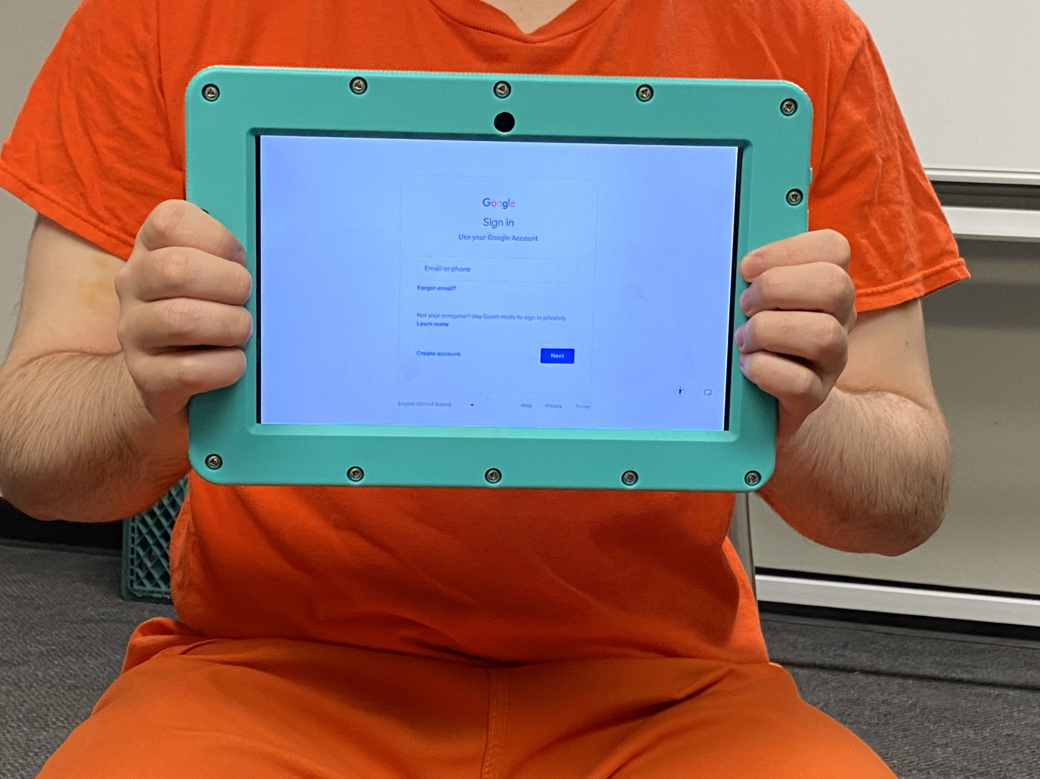
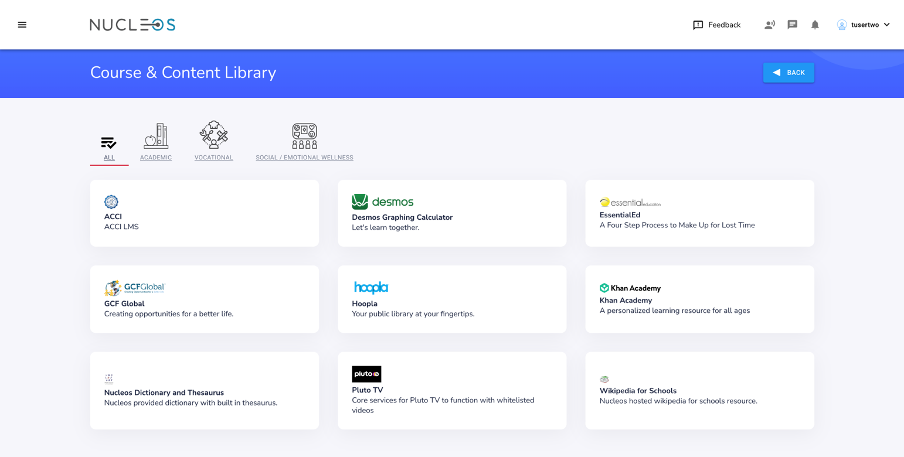
The SFSO Tablet Program Pilot started in October 2022 in two pods at County Jail #3-San Bruno. Tablets are scheduled to be available to every incarcerated person by the end of the calendar year.

Slide 13

Milestones
Milestones Credits - program began on May 13, 2019
Milestone Credits can be earned by participating in jail programs.
60 hours = 1 Milestone Credit
1 Milestone Credit = 7 day reduction in County Jail sentence
2,143 credits issued as of 8/15/22 = 15,001 jail beds days saved

Slide 14
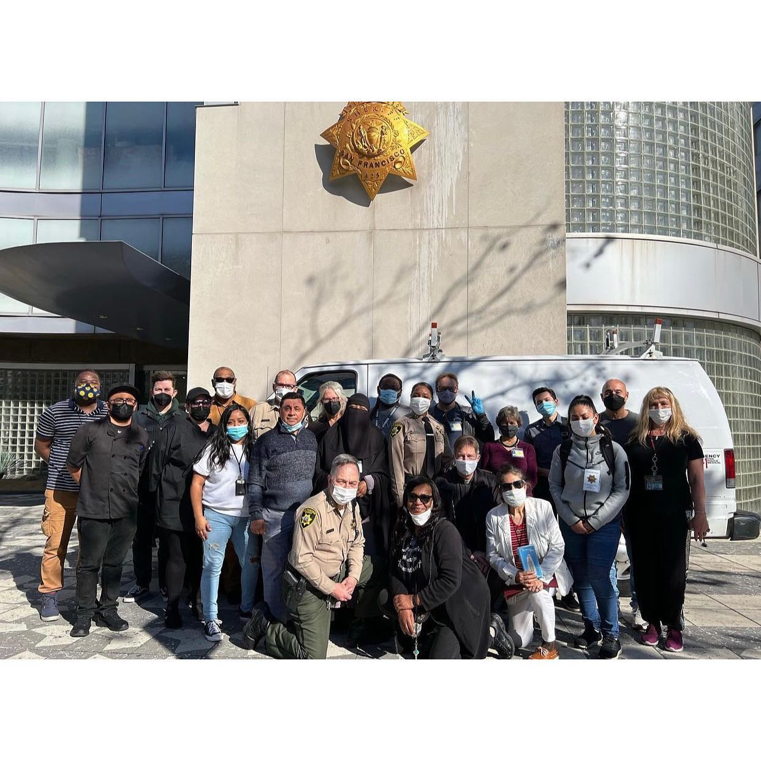
Religious Services
The SFSO Religious Services Coordinator is responsible for the recruitment, orientation, scheduling and supervision of all religious programs and services offered in the jails. This work includes maintaining a database of 238 faith-based providers and overseeing clearances and trainings.
Notes:
Religious Services
The SFSO Religious Services Coordinator is responsible for the recruitment, orientation, scheduling and supervision of all religious programs and services offered in the jails. This work includes maintaining a database of 238 faith-based providers and overseeing clearances and trainings. Over the past two years this work has included:

Slide 15





Scheduling confessions through screened window visits
Provide feminine hygiene products, sponsored by faith-based organizations
Over the past two years this work has included:
40 video visits between faith providers per week
Collaborating with over 238 faith-based providers.
Notes:
• Scheduling the Catholic Chaplain to conduct confessions through screened window visits at CJ 3.
• Scheduling 40 video visits per week between faith providers and persons in custody.
• Organizing Thanksgiving meals for all persons in custody through the support of the Catholic Archdiocese.
• Distributing hygiene products to incarcerated women sponsored by Epic Church and Women Aglow, a faith-based organization.
• Distributing Holiday cards to everyone in custody. These cards were later collected and mailed.
• Distributing Mother’s Day and Father’s Day cards to everyone in custody. These cards were later collected and mailed.
• Organizing Grace Cathedral’s Stories from Mom or Dad Program to provide 99 children with an age-appropriate gift book “from” their incarcerated family member during the holidays.
• Collaborating with Grace Cathedral’s Stories from Mom or Dad Program to provide 104 children with two age-appropriate gift books “from” their incarcerated family member in the Spring. The San Francisco Public Library supported this event by purchasing the children’s book Milo Imagines the World which is about a child visiting an incarcerated parent.

Slide 16




Organizing Thanksgiving meals for persons in custody
Distributing Mother's and Father's Day cards for everyone in custody
Over the past two years this work has included:
Gifting age-appropriate books and holiday gifts to children "from" parents in custody
Distributing Holiday cards for everyone in custody
Notes:
• Scheduling the Catholic Chaplain to conduct confessions through screened window visits at CJ 3.
• Scheduling 40 video visits per week between faith providers and persons in custody.
• Organizing Thanksgiving meals for all persons in custody through the support of the Catholic Archdiocese.
• Distributing hygiene products to incarcerated women sponsored by Epic Church and Women Aglow, a faith-based organization.
• Distributing Holiday cards to everyone in custody. These cards were later collected and mailed.
• Distributing Mother’s Day and Father’s Day cards to everyone in custody. These cards were later collected and mailed.
• Organizing Grace Cathedral’s Stories from Mom or Dad Program to provide 99 children with an age-appropriate gift book “from” their incarcerated family member during the holidays.
• Collaborating with Grace Cathedral’s Stories from Mom or Dad Program to provide 104 children with two age-appropriate gift books “from” their incarcerated family member in the Spring. The San Francisco Public Library supported this event by purchasing the children’s book Milo Imagines the World which is about a child visiting an incarcerated parent.

Slide 17
Stories from Mom and Dad utilizes volunteers from Grace Cathedral who facilitate recorded stories from in custody parents which they send to the children along with the book.
Some in person religious services in the program pods have started in CJ3 and will soon start in CJ2. Religious Services Coordinator has surveyed participants to determine most requested denominations for these initial services.
In-person Religious Services
Notes:
• Scheduling the Catholic Chaplain to conduct confessions through screened window visits at CJ 3.
• Scheduling 40 video visits per week between faith providers and persons in custody.
• Organizing Thanksgiving meals for all persons in custody through the support of the Catholic Archdiocese.
• Distributing hygiene products to incarcerated women sponsored by Epic Church and Women Aglow, a faith-based organization.
• Distributing Holiday cards to everyone in custody. These cards were later collected and mailed.
• Distributing Mother’s Day and Father’s Day cards to everyone in custody. These cards were later collected and mailed.
• Organizing Grace Cathedral’s Stories from Mom or Dad Program to provide 99 children with an age-appropriate gift book “from” their incarcerated family member during the holidays.
• Collaborating with Grace Cathedral’s Stories from Mom or Dad Program to provide 104 children with two age-appropriate gift books “from” their incarcerated family member in the Spring. The San Francisco Public Library supported this event by purchasing the children’s book Milo Imagines the World which is about a child visiting an incarcerated parent.

Slide 18
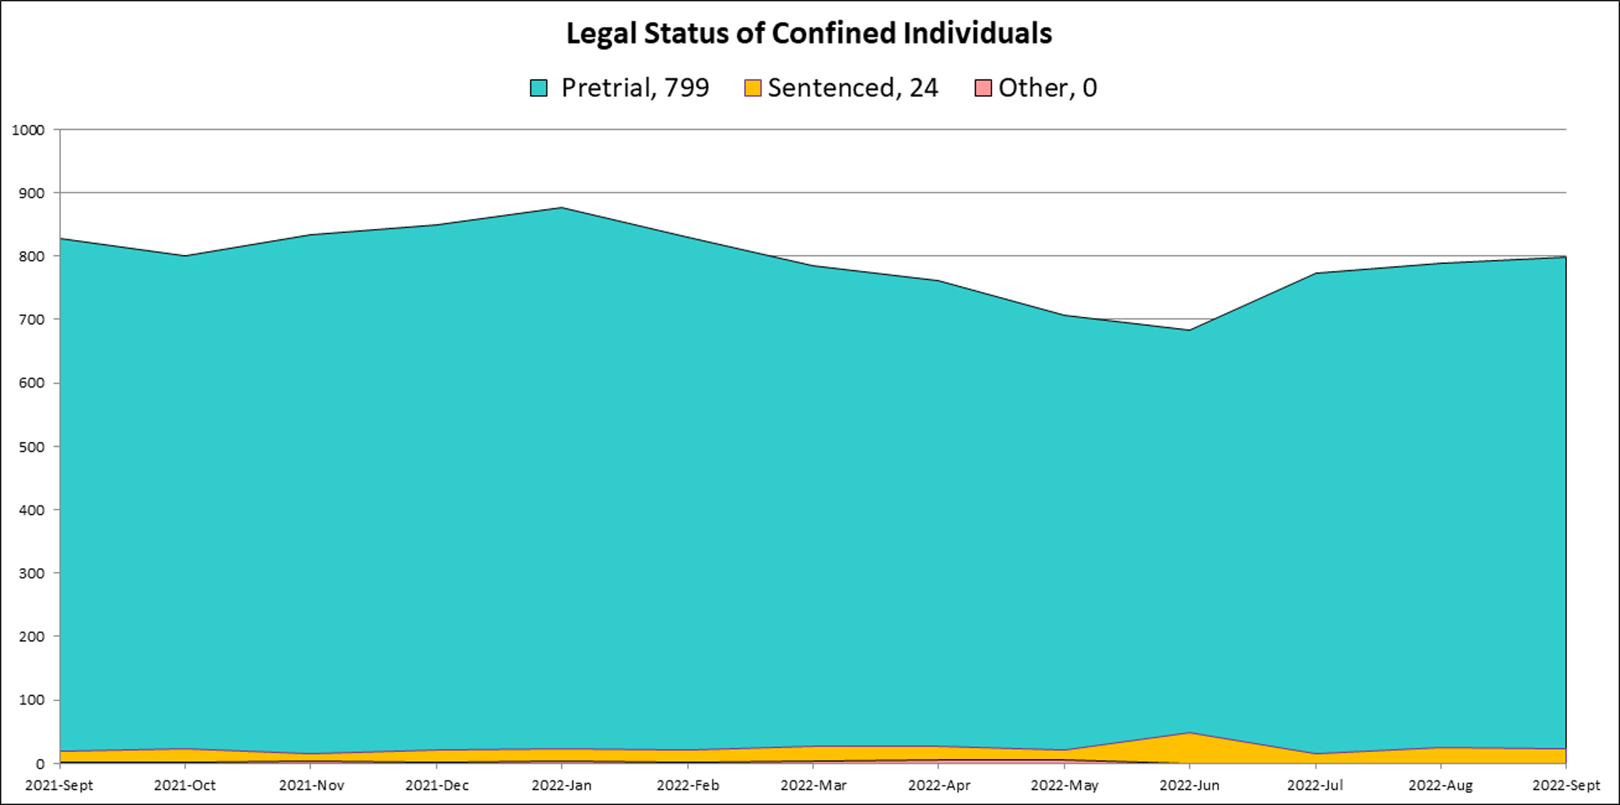

Slide 19


Discharge Planning Office
The Discharge Planning office monitors and creates linkages for:
3) Those persons who are booked into the San Francisco Jail most frequently.
Every year SFSO does an analysis of the prior year’s bookings and identifies the top 2% of people booked. The current cohort is comprised of 140 individuals with between four and ten bookings during fiscal year 21/22. Each day, the Discharge Planning staff receive an automated email with information on individuals on this list who have been booked within the previous 24 hours.
1) Sentenced population 2) Post-plea population
Affordable Care Act Enrollment
SFSO in collaboration with the Human Services Agency (HSA) has implemented a program where a case worker screens the sentenced and post-plea jail population for Medi-Cal eligibility. When appropriate, the case worker assists clients with the Medi-Cal application which is submitted to HSA with the projected release date, so that benefits will be immediately available upon release.

Slide 20

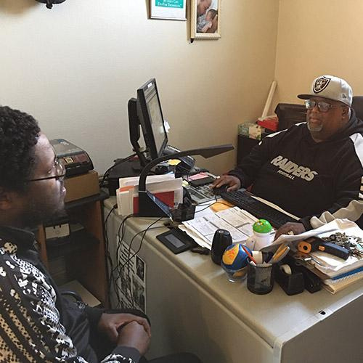
Older Adult Programming
SFSO contracts with Bayview Senior Services to provide a case manager focused on assisting persons in custody who are 55 years or older with re-entry plans. The SFSO Health Worker and Discharge Planning staff review criminal justice status of incarcerated older adults to ensure that sentenced, post-plea and frequently booked older adults are assigned to the case manager and assist with coordinated releases so that the case manager can meet clients at release.
NOVA
The vision of the NoVA Project is that persons released from jail in San Francisco will get the support and tools needed to succeed in the community. The mission is to increase public safety by implementing a seamless system of services for clients when they return to the community. Case Managers meet clients at release and have the ability to immediately link clients with services such as sober living housing and mental health care, while also having access to a flex fund for other barrier removal needs such as paying for transportation and identification.

Slide 21
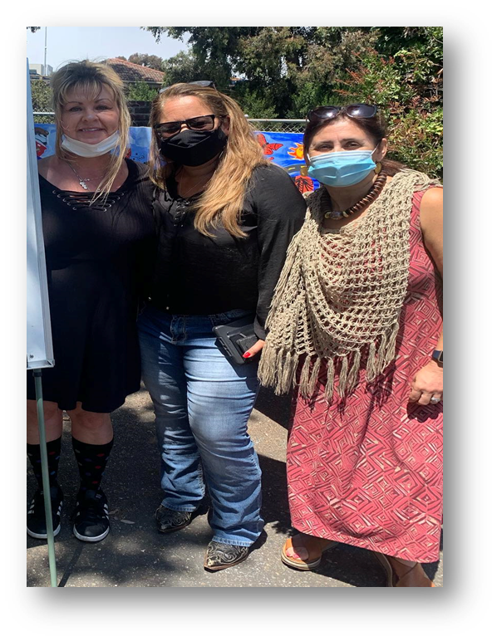
Adult Coordinated Entry System (ACE)
The Adult Coordinated Entry System (ACE), operated by the San Francisco Department of Homelessness and Supportive Housing, is a community-wide intake process to match people experiencing homelessness to available housing and/or focused community resources. The Discharge Planning staff are trained in accessing the One System where ACE assessments are maintained and review the sentenced, post-plea and frequently booked populations to ensure that those who identify as unhoused are assessed by staff.
Survivor Reentry Program
This project works with survivors of domestic violence and human trafficking by providing trauma-informed, culturally responsive and strength-based treatment through groups, individual counseling and case management both in custody and at the Women’s Resource Center.
Transitional Age Youth (TAY) Programming
SFSO works with non-profit service providers funded by the Department of Children Youth and their Families to provide targeted case management services to support young adults upon release from jail. The SFSO Health Worker and Discharge Planning staff review criminal justice status of incarcerated TAY to ensure that sentenced, post-plea and frequently booked TAY are assigned a case manager and assist with coordinated releases so that case managers can pick up clients at release.

Slide 22


Project Juno
This is a 5-year SAMHSA grant administered by Jail Health Services which is focused on connecting patients with Opioid Use Disorder to care in the community, primarily through two patient navigators. Project staff meet with clients identified by Jail Health in B and F pods and offer services. Those who enroll post-release are followed for 6 months to assist with treatment linkage.
Trans and GNC Reentry Program
A case manager provides a weekly group in CJ2 and individual case management this program is funded by the Mayor's Office of Housing and Community Development (MOHCD)
*Assaults on staff include spitting, gassing, unwanted physical touching or acts of violence directed towards staff

Slide 23
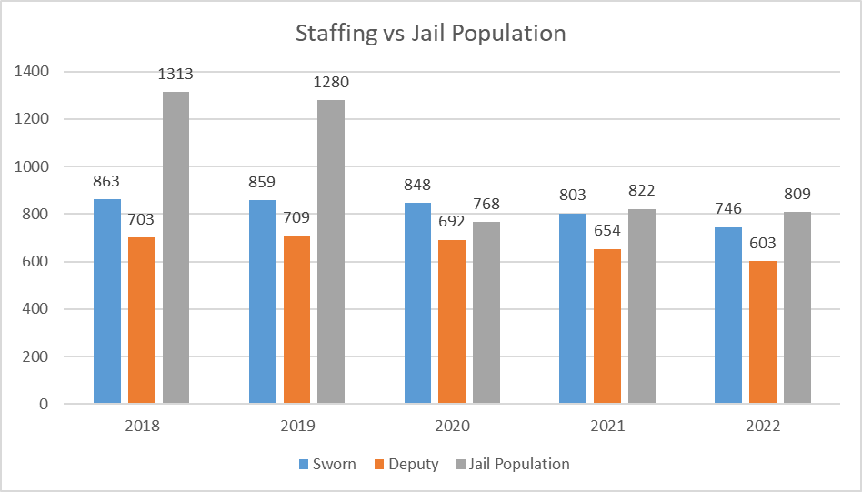
*Monthly breakdowns can be found in information packet provided with this slideshow

Slide 24
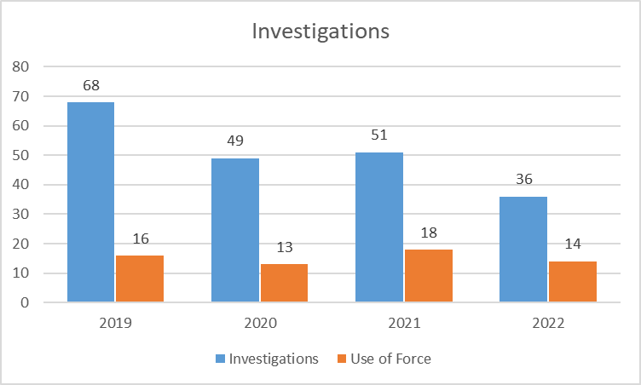
*Detailed breakdowns can be found in information packet provided with this slideshow

Slide 25
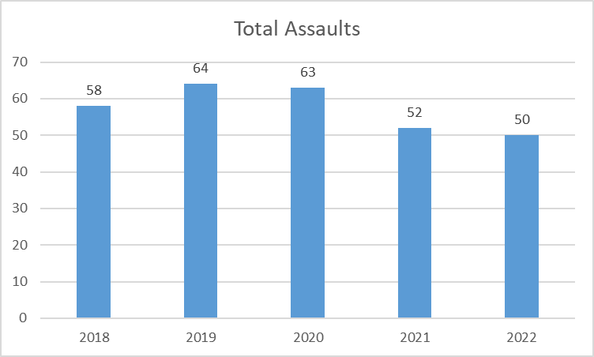
*Assaults on staff include spitting, gassing, unwanted physical touching or acts of violence directed towards staff

Slide 26

Questions?

Slide 27
Thank You!

