Slide 1
Social Media Monitoring
(Hootsuite)
San Francisco Public Library
August 27, 2021

Slide 2
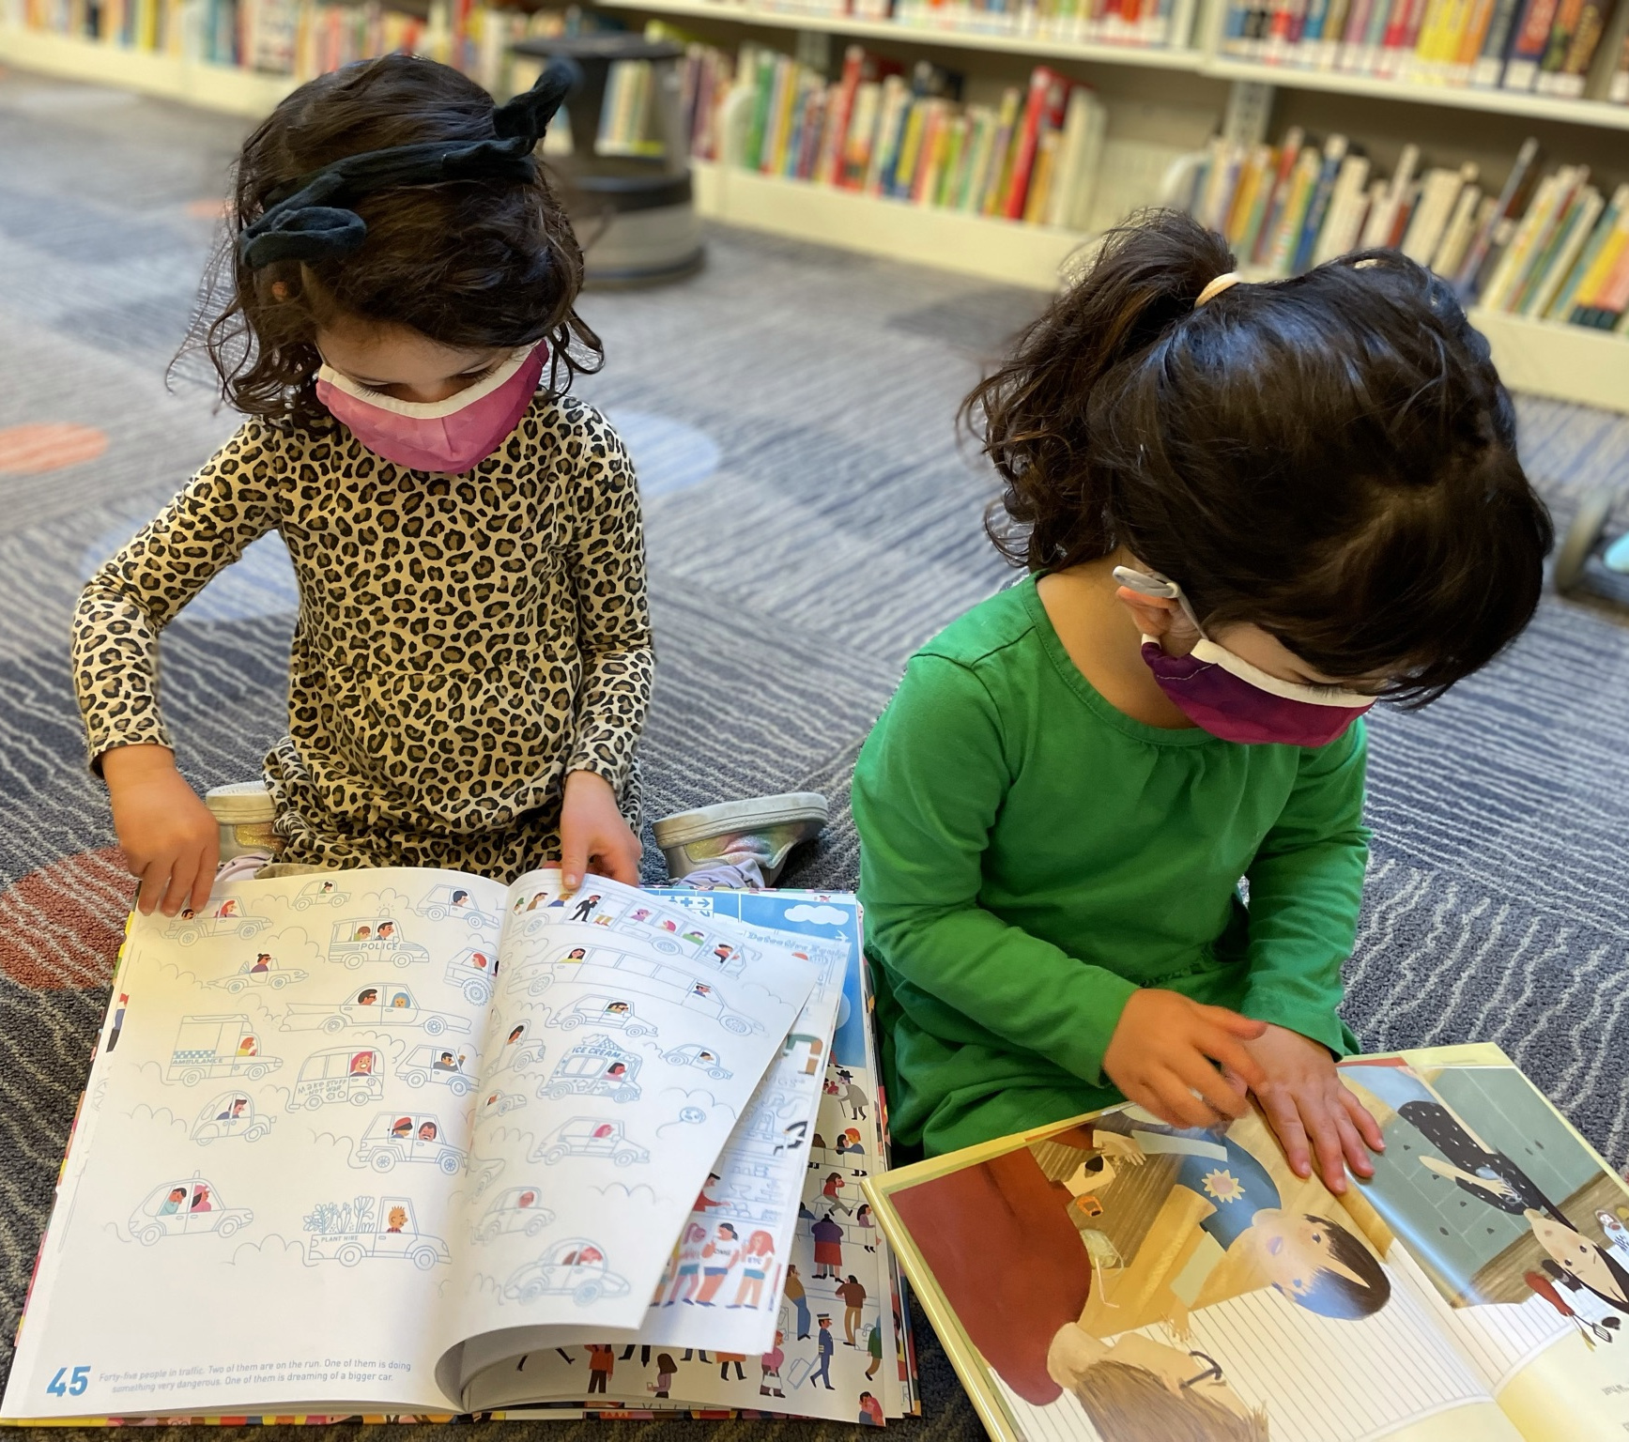
Department Mission
The San Francisco Public Library system is dedicated to free and equal access to information, knowledge, independent learning and the joys of reading for our diverse community.

Slide 3
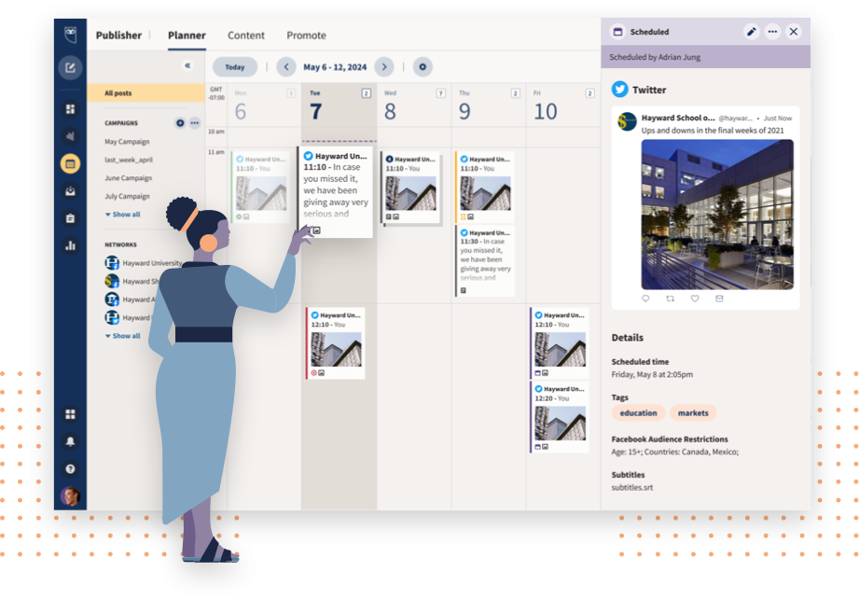
Technology Description
Hootsuite is a social network manager that allows users to create custom views of all connected social networks. Hootsuite can be used to post to multiple social media accounts, manage social media messaging, and coordinate the organization's social media marketing. The platform aggregates social media feeds so that content and trends can be viewed holistically.

Slide 4
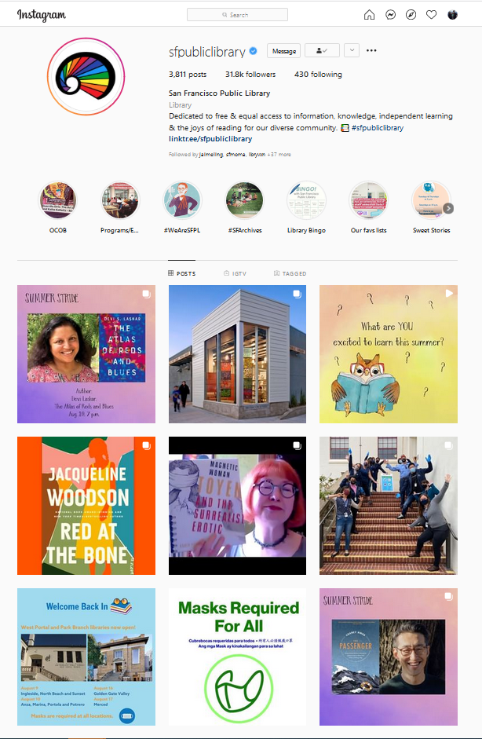
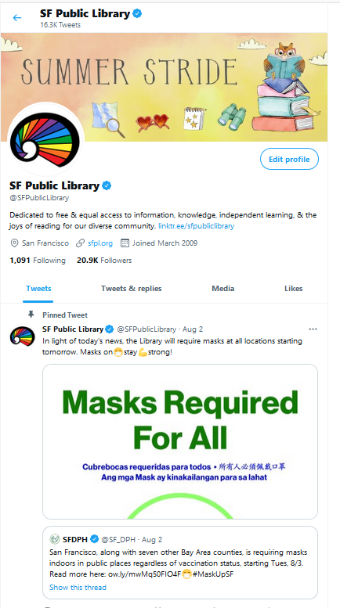
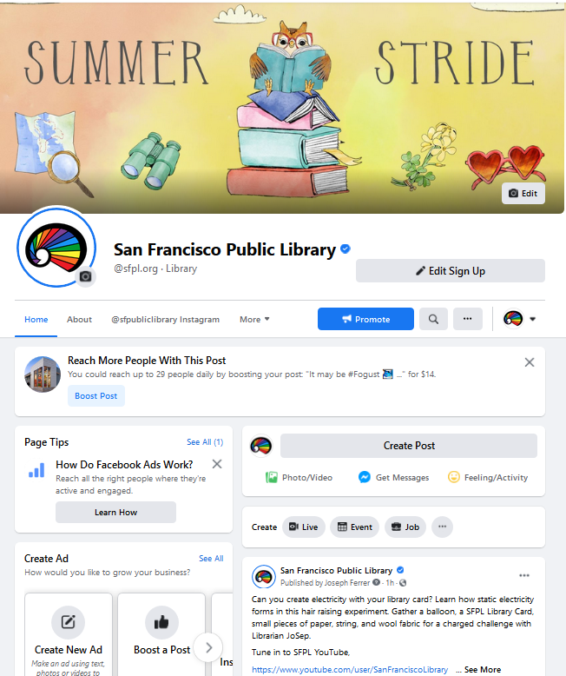
Authorized Use Cases
Schedule multiple social media posts in advance, including on weekends when staff is off.
Create and monitor multiple streams of content across various platforms at once.
Ensure consistent messaging across all social media platforms.
Track performance and analyze trends to improve content and strategy. Create reports.

Slide 5
Current Process Map – Alternative to Hootsuite
Draft content for Instagram, Twitter & Facebook
Reserve time slot in Instagram and Twitter/Facebook calendars
Post content separately on multiple platforms at given time or schedule IG and FB posts using FB Creator Studio
Monitor performance on 3 separate social media platforms
Review & respond to public comments in 3 separate platforms
Currently, we manually enter social media posts for thousands of events in each individual platform (presently, Facebook, Twitter and Instagram) each day at various times, including weekends.

Slide 6
Process Map – Future State
Draft content for FB, Twitter & IG in Hootsuite
Schedule posts simultaneously via Hootsuite scheduler
Review/respond to public comments via Hootsuite dashboard
Hootsuite enables SFPL to plan, coordinate and schedule its social media postings, which inform the public about the abundance of free programs (+18,000 events per annum) and resources the library offers.

Slide 7
Privacy
The Department will not utilize geographic tags added by users to postings or commenter demographics to track or intercept residents, nor will the Department access such posts with the intention to maliciously surveil, track or monitor its residents.
SFPL has a strong privacy policy that protects confidential information related to individuals’ identity and use of library resources, materials and facilities.
Hootsuite does not provide access to private direct messaging—messages between accounts owned by members of the public—or payment information.

Slide 8
Additional Details
Vendor info: Hootsuite provides social media dashboards that allow updates to social networks through web, desktop, and mobile platforms and track campaign results and industry trends.
Public Information: Information gathered and shared through Hootsuite is public information that has been published by individual social media users.
Retention: The Library will follow its Records Retention Policy, which recommends 2 years for “General/Administrative Correspondence” and 5 years for “General/Administrative Statistical Information”, such as data reports.

Slide 9
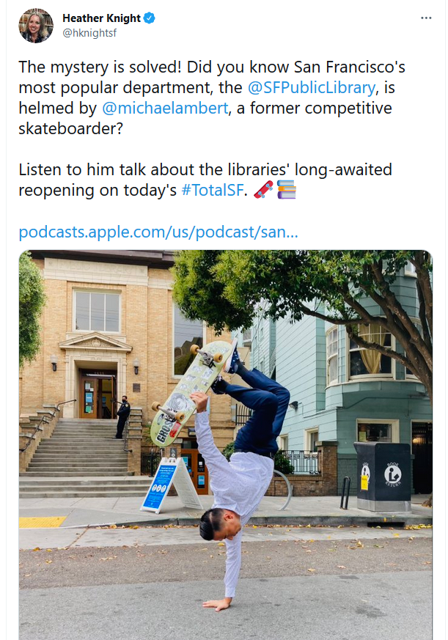
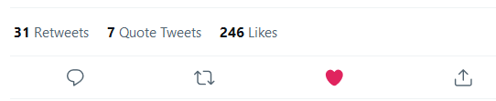
Questions

