Slide 1

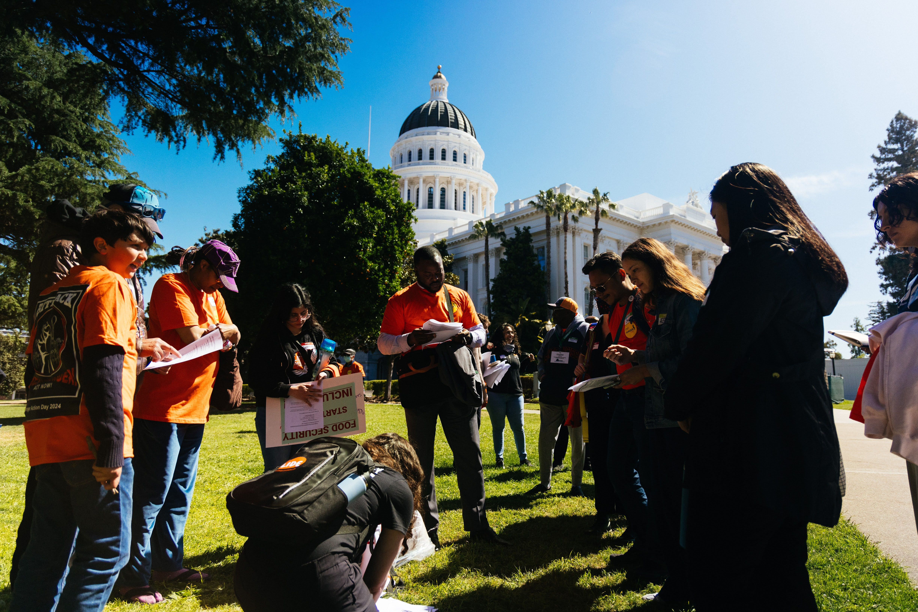

Policy and Advocacy
Notes:
Noriko – welcome everyone. I will give everyone a few minutes to join. With recent shifts in the political landscape, let us know how you feel in the chat.

Slide 2


Policy & Advocacy Team
Marchon Tatmon
Assoc. Dir. Policy & Advocacy
Alex Raffanti
Public Policy Manager
Notes:
My name is Alex,
Alex – intro self.
Next slide please

Slide 3

AGENDA
Federal Updates
State Updates
Local Updates
Questions/Dicussion
Notes:
Noriko

Slide 4
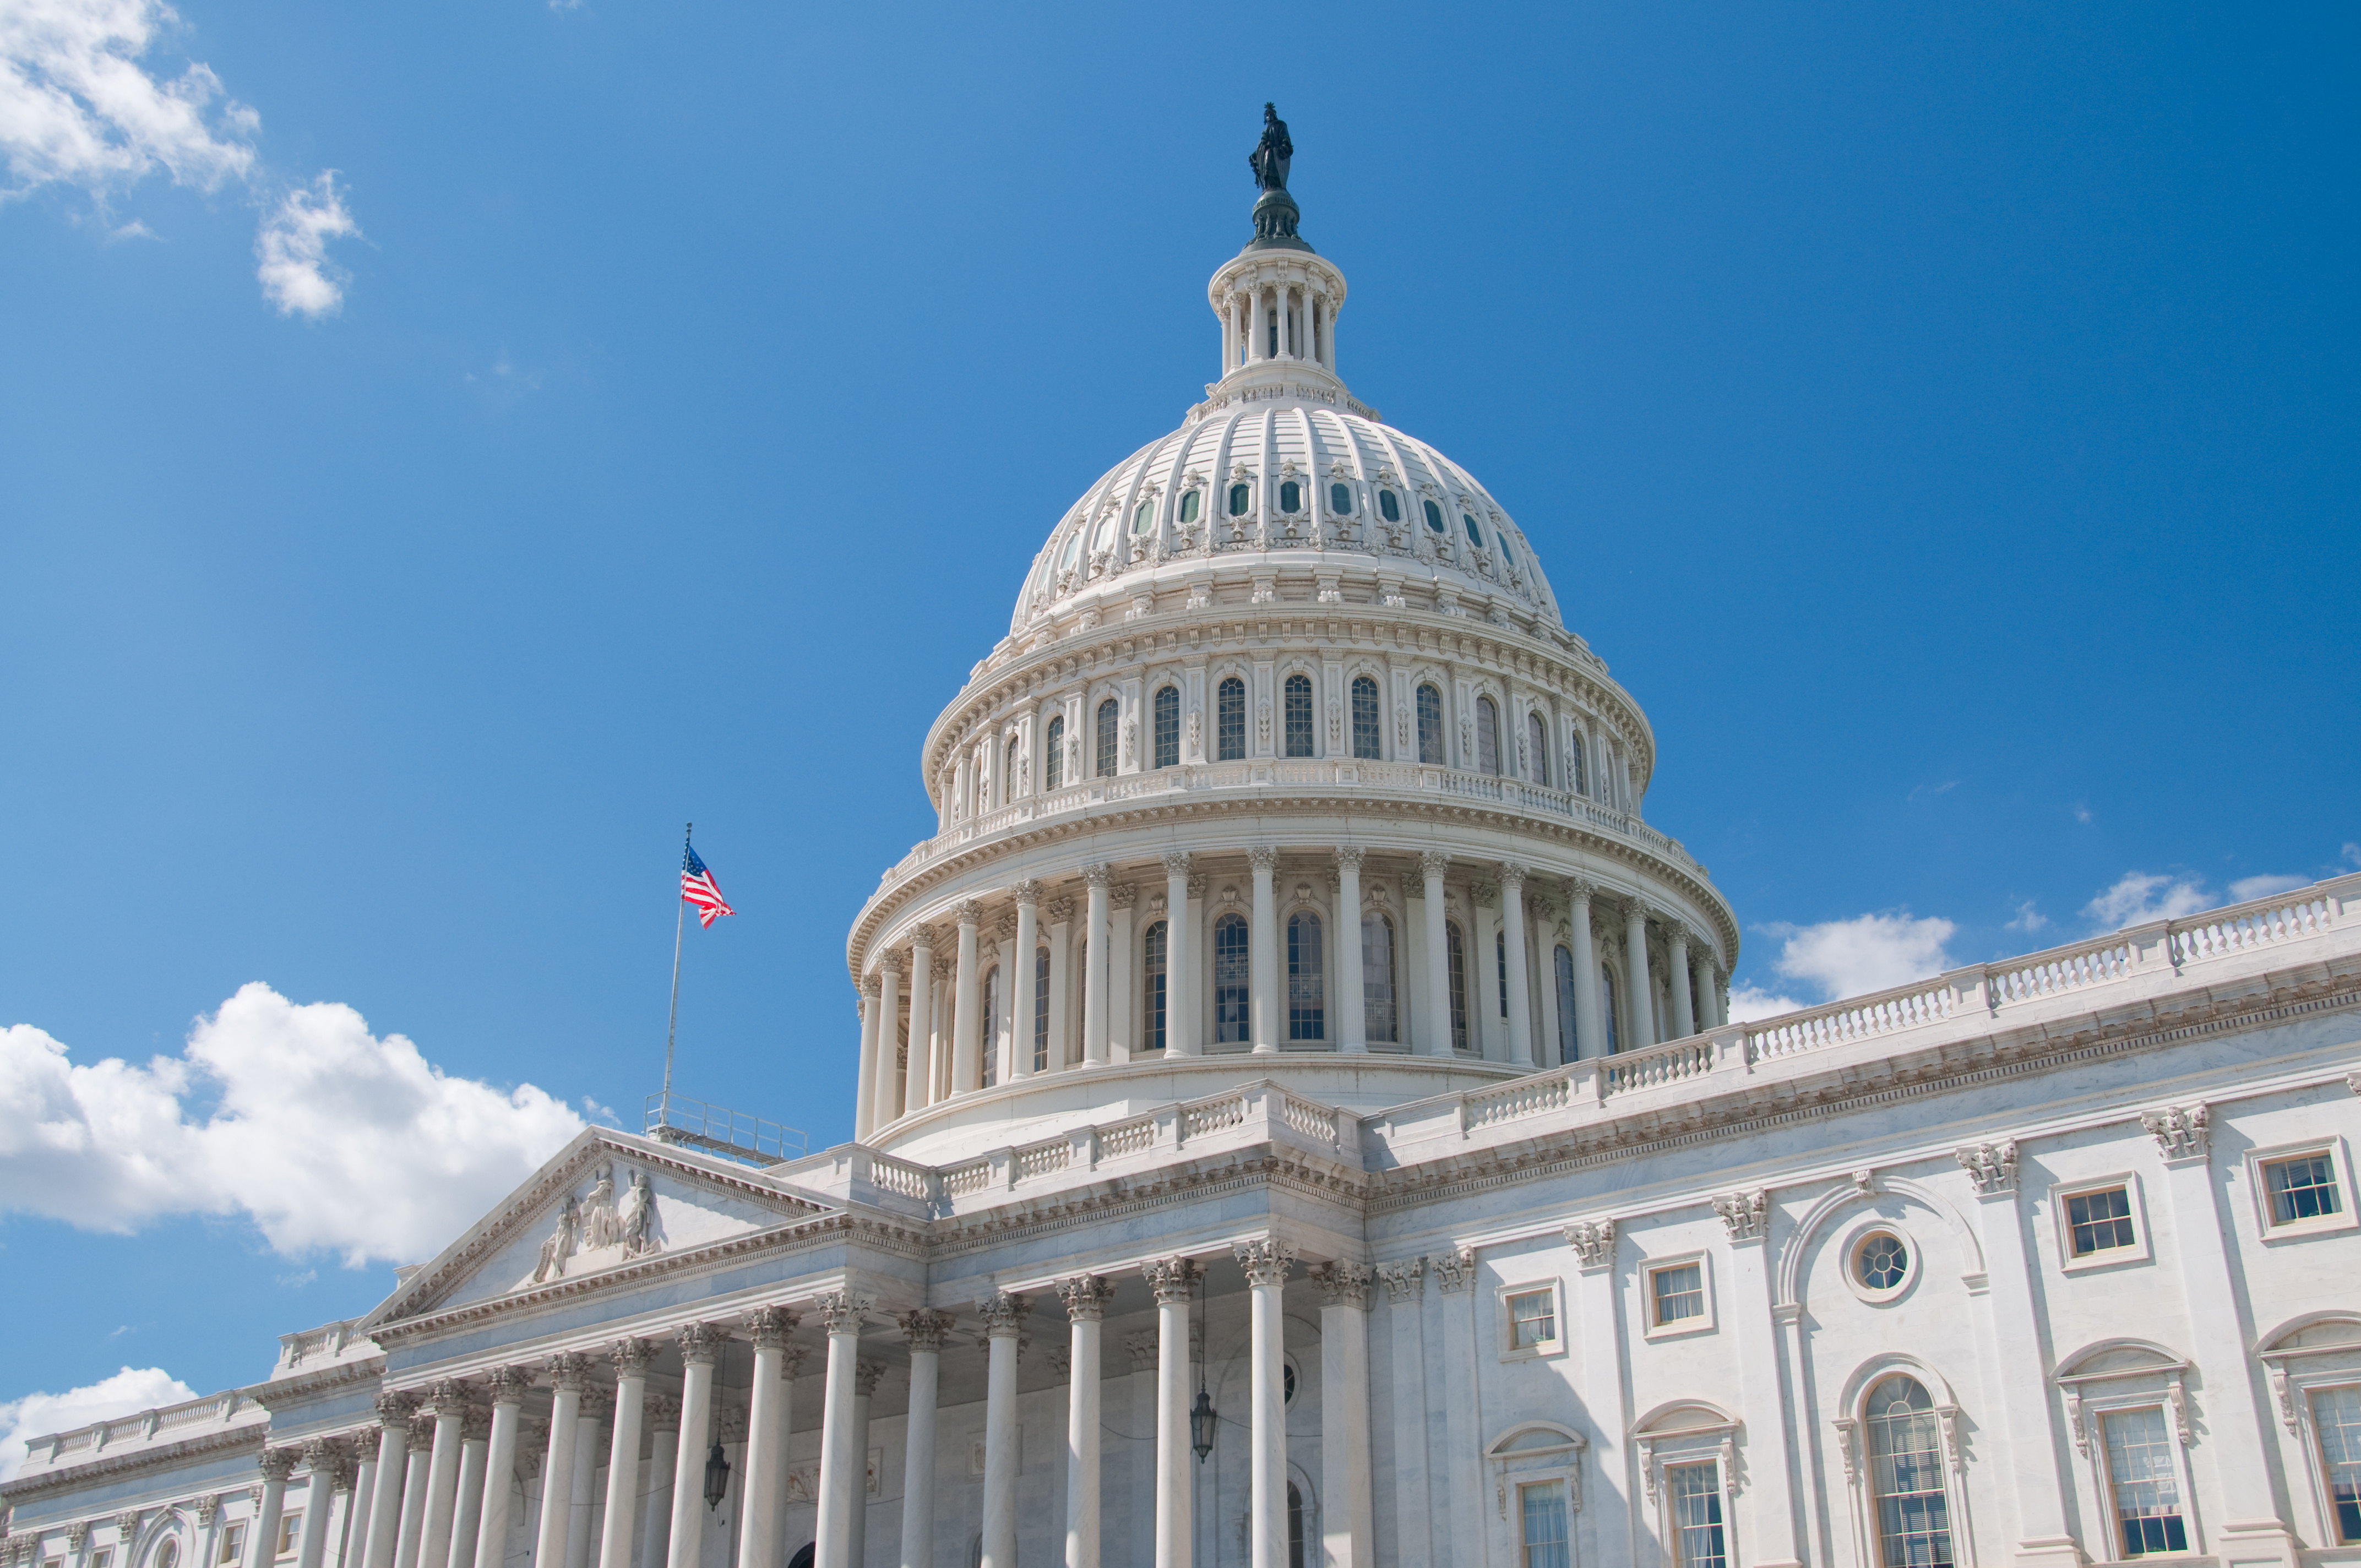
Federal Updates
Notes:
Diving into our legislative updates. Let’ start with the federal level. I would like to start by saying given all the threats we are seeing, cuts to federal programs mean fewer benefits and worsening of food insecurity. Benefits to Medicaid and the Supplemental Nutrition Assistance Program (SNAP), which is known as CalFresh in California, are under threat. These cuts to CalFresh will increase food insecurity rates at a time when the Food Bank has been forced to reduce its services, during a time when a substantial number of people are on waitlists in need of support, while the demand just hasn’t died down. There is also economic uncertainty compounding the challenges. People are experiencing strain, and budgets are stretched thin – the Food Bank’s primary concern is for people in our community who are experiencing these impacts.
In San Francisco and Marin where we serve its estimated 25,000 households (12K SF and 13K Marin)- 14,000 families with children and 11,000 households of older adults - are at risk to lose benefits due to cuts and new guidelines. Our federal government is abandoning its duty to support its citizens in need. People on the margins of poverty can no longer depend on the Federal government because they are catering to the rich.
Do not make a mistake: the federal government is a threat to some of our neighbors’ livelihoods with all these adverse actions, cuts, raids, etc.
We are monitoring everything that comes from DC,

Slide 5

Budget Reconciliation Process
Harmful and Historic cuts to SNAP
The Farm Bill
Notes:
A few things we’ve been watching on the federal level:
Congress and the White House supported the passage of a federal budget reconciliation bill (HR1) that includes a staggering $186 billion in cuts to the Supplemental Nutrition Assistance Program (SNAP) known as CalFresh in CA. An effort to gut the program and more than $900 billion from Medicaid over the next 10 years. The President signed the Budget Reconciliation Bill (HR1) into law on July 4.
Cuts to SNAP and new guidelines are estimated to result in the loss of 6 billion meals annually, nationwide. For comparison, the entire Feeding America Food Bank network, together with front-line partners, shares enough food for about 6 billion meals annually. The new guidelines include:
New work requirements
Time limit of the food assistance program
Enhance paperwork and age requirements impacting adults 55 to 64, and parents with school-aged children 14 and under.
All pending new guidelines from the USDA, these initiatives will go into effect immediately after.
These SNAP cuts will create a gaping hole of need that can’t be filled by the charitable food system. Millions of families with children and seniors across the country will be impacted by these cuts. Hunger is a policy choice, and Congress and the White House chose a budget that provides tax breaks to the wealthiest in our nation over the well-being of the poorest.
In California, it is estimated that 3.1 million participants will lose some or all of their SNAP benefits.
Additionally, California will now be forced to pay up to 15% of SNAP benefits starting in 2026, along with the 75% SNAP administrative burden, costing the state up to $2.5 billion a year just to maintain current eligibility and benefits, effective October 1, 2027.
For the Farm Bill – We’re watching all developments. Last year in September, Congress voted for a one-year continuing resolution on this already severely delayed piece of legislation, but omitted several critical pieces, like the prohibition on replacing stolen snaps. However, CA will replace benefits for one month. From partners, we are hearing about what’s being called a skinny farm bill that could potentially be on the horizon. More on that as information is released.

Slide 6
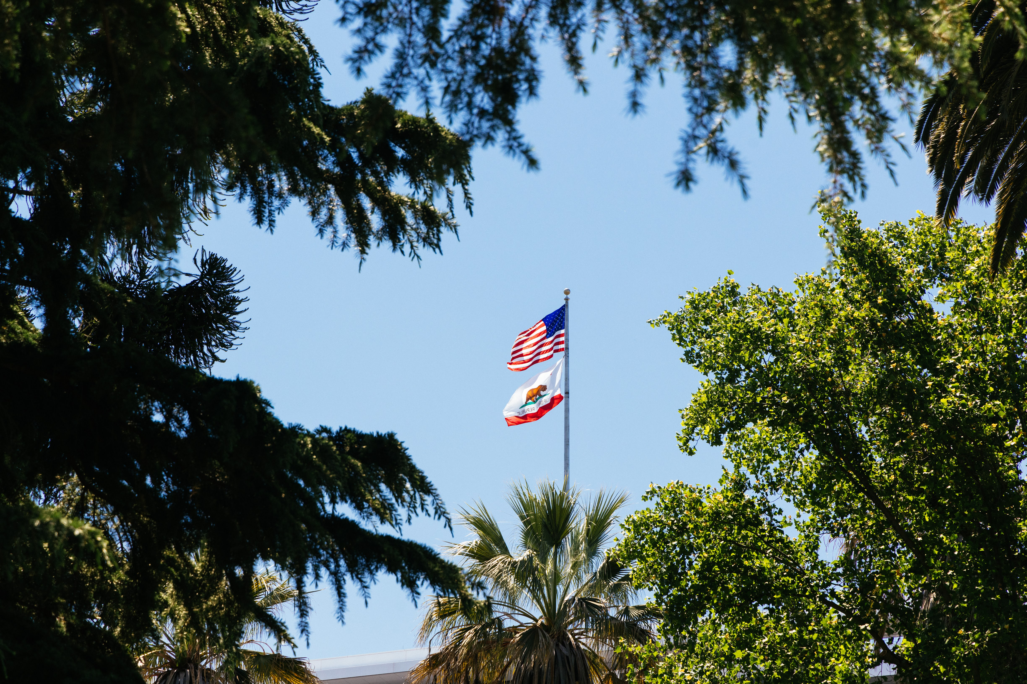
California State Legislative Priorities
Notes:
California is leading in anti-hunger policies compared to other states and us as advocates want to continue to move CA. forward not backyards.
Governor Newsom signed California’s Budget Act of 2025 in late June. The Food Bank is deeply grateful to the state legislature and the governor for prioritizing food security in California. Here are some of the early victories
School Meals for All
Maintains School Meals for All with an additional $90.7M, and invests $160M for the Universal School Meals Support Grant, for kitchen infrastructure upgrades and staffing.
SUN Bucks (Summer EBT)
Provides $43.8M for implementation, and requires Local Education Agencies (LEAs) to determine children’s eligibility for SUN Bucks if they attend a school that participates in the National School Lunch Program or School Breakfast Program.
Here are some of the bills we are backing this year on the State level:

Slide 7
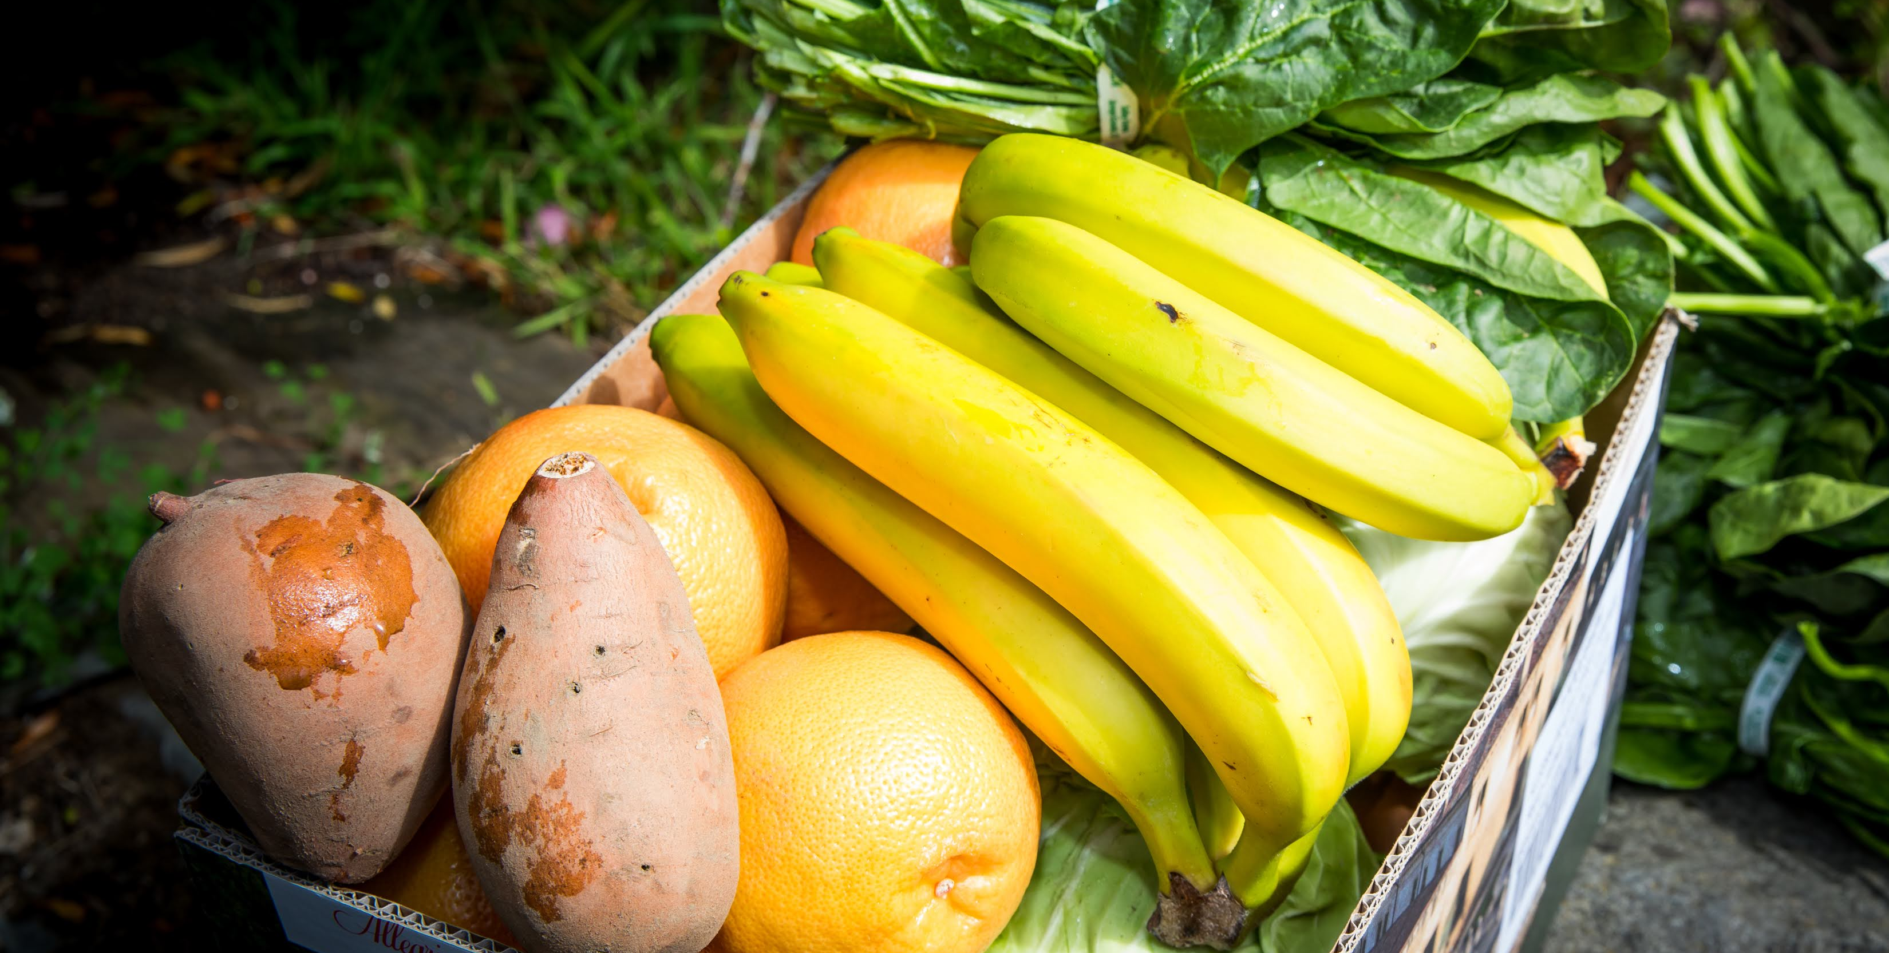
Support Food Banks Across California
    Budget Ask
CalFood Funding - Appropriate $60M in 2025-26 and sustain the CalFood program at $60M annually
Notes:
Marchon
CalFood
$60M one-time, to support the purchase of California-grown and produced food by California food banks.

Slide 8
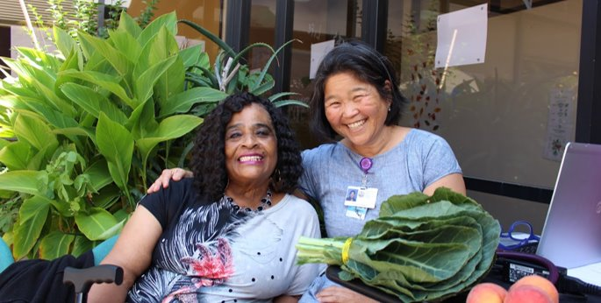
Food4All
    AB 1049
Food4All- Protect our investment in Food4All
.
Notes:
Marchon
Food4All
Maintains the implementation timeline to expand the California Food Assistance Program (CFAP) for older adults 55+ regardless of immigration status, by October 2027.

Slide 9

School Meals for All
    Pupil Nutrition
Maintains School Meals for All investments.
Notes:
Alex
School Meals for All
Maintains School Meals for All with an additional $90.7M, and invests $160M for the Universal School Meals Support Grant, for kitchen infrastructure upgrades and staffing.

Slide 10
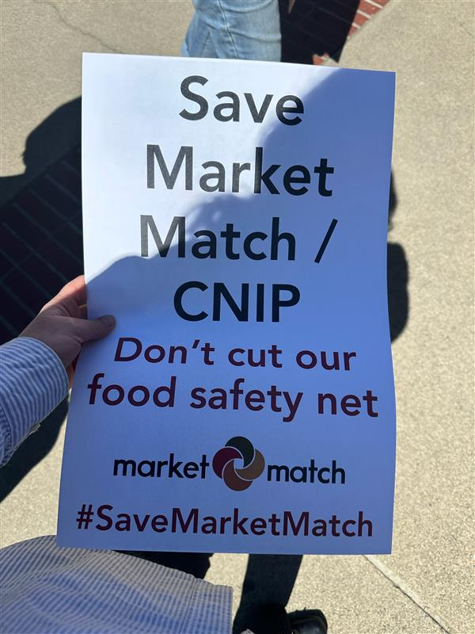
Farmer’s Market Nutrition Incentive
    Market Match/ CNIP
Farmer’s Market Nutrition Incentives: Include CNIP (California Nutrition Incentives Program, which funds Market Match) as a permanent part of California’s annual budget.
Notes:
Alex
Preserves $33.2 million for the California Nutrition Incentive Program (Market Match)

Slide 11
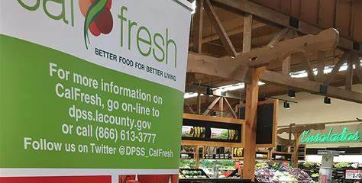
Improve CalFresh Enrollment
    AB 119 (Trailer Bill Language)
CalFresh: Data - The legislator seeks to improve the progress made with AB 1967 and the passage of AB 518.
Notes:
Alex
One bill we’re watching closely but haven’t crossed the finish line is the one we co-sponsor, AB 119. The legislator aims to build upon the progress made with AB 1967 and the passage of AB 518 by cleaning up some of the language, both of which we co-sponsored last session. This bill will require CDSS to develop new methods for estimating CalFresh and California Food Assistance Program (CFAP) participation rates and identifying Californians eligible for program benefits by 2026, and submit a legislative report with budgetary and policy recommendations to combat food insecurity and improve state and federal food and nutrition programs enrollment

Slide 12
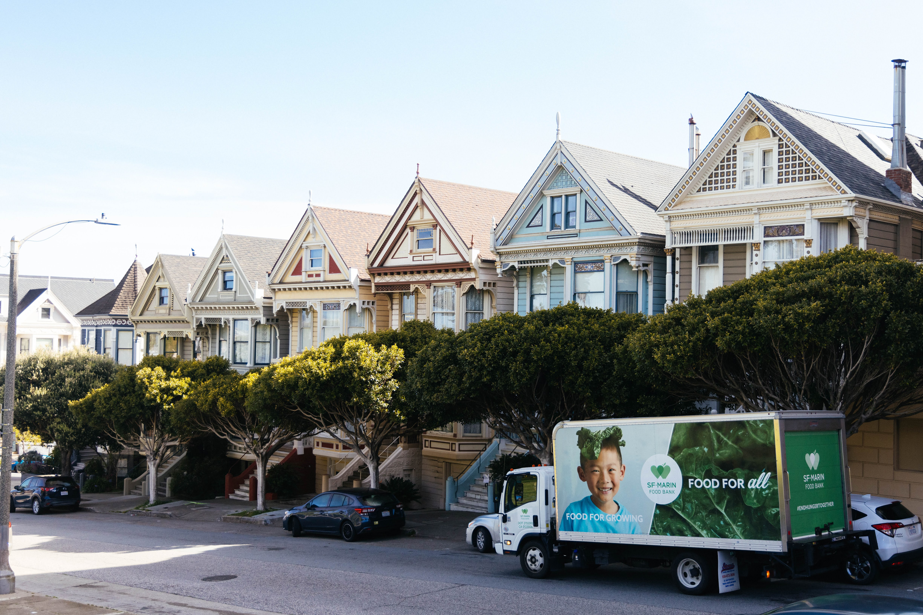
Local Budget Updates
Notes:
You might be asking, Why are we advocating locally? It's not about the fact that the food bank is receiving funding cuts, but the impact of those cuts means fewer services for participants and a destabilized safety net.
The Board of Supervisors for the City and County of San Francisco passed a $16 billion budget that included significant cuts to address a nearly $800 million budget deficit, and the mayor signed it into law last Friday. The budget required most SF city and county departments to reduce their budgets by 15% and included deep cuts to funding that nonprofit agencies rely on.
Unfortunately, like many other agencies, the Food Bank did see a substantial cut. The City canceled $439,000 in annual funding that supports the Food Bank’s CalFresh Outreach efforts. The City will instead conduct CalFresh Outreach efforts internally. Food Bank leadership will assess how this will impact our CalFresh Outreach efforts, which will begin in mid-August.

Slide 13
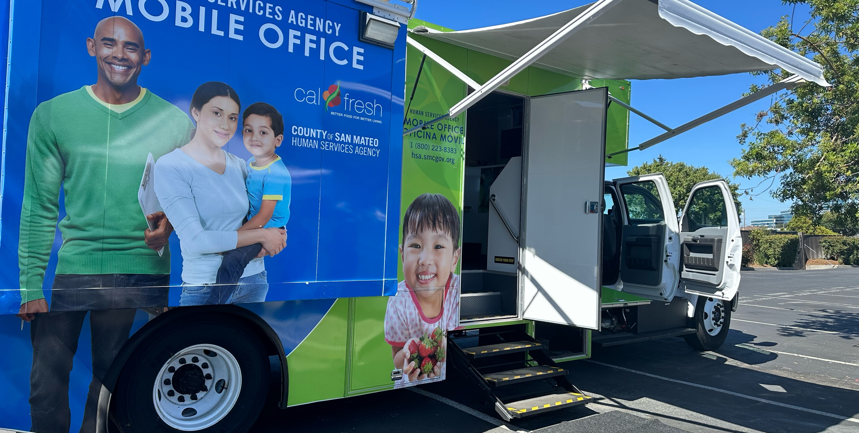
CalFresh Access
    CalFresh Mobile Van
Continuation the City and County support in its mobile CalFresh outreach van program through December 2025
Notes:
City continuing calfresh mobile van project through dec 2025
This program would ensure that critical food benefits are accessible and available to every eligible San Franciscan. This is our partners in San Mateo County who are starting to switch to this community-based approach, meeting people where they are.

Slide 14
