Slide 1
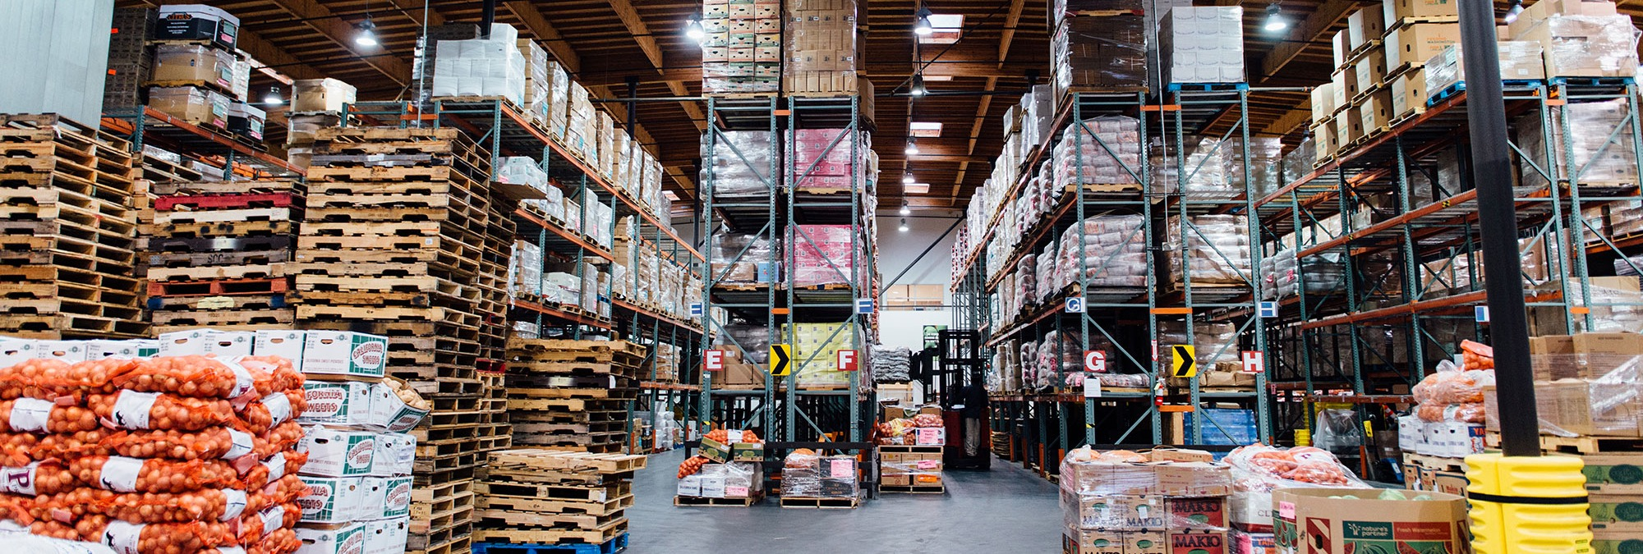
Closure of the Pop-Up Pantry (PUP) Program
Sean Brooks
Chief Program Officer
San Francisco-Marin Food Bank
sbrooks@sfmfoodbank.org

Slide 2
Pop-Up Pantry (PUP) Program History
Many Food Bank partner pantries closed early in the Covid pandemic.
The Food Bank partnered with SF County disaster workers and community volunteers to start mass grocery distributions in outdoor public settings, distributing produce and surplus federal food to all in need.
The program was funded by a mix of County, federal, and private support.
At the peak, there were 22 locations serving 22,000 participants per week, with some sites serving 1300+ in 4-hrs.

Slide 3
Pop-Up Pantry Overview
Participants were all enrolled in the Food Bank database.
Timeslots were assigned to shorten lines.
Households were deduplicated across the Food Bank network.
Converted from pre-bagged to farmers market-style distribution with choice.
Standard menu featuring seasonal produce, a protein and a grain.

Slide 4
Pop-Up Pantry Stats
Began closing the program after losing significant financial support.
Last distributions will be this Friday, June 6, 2025.
 | FY23 | FY24 | FY25
Active Households (Yr-end) | 17,500 | 10,500 | 7,250
Units of Service (Total) | 864,332 | 609,123 | 415,680
Pounds of Food (Total) | 19,904,254 | 15,425,229 | 11,865,928

Slide 5
Pop-Up Pantry Closure
Initially notified participants of the June 2025 closure late 2023, closed enrollment.
Started actively transferring and waitlisting participants at Food Bank partner pantries and community markets in late 2024.
Transferred over 2,600 participants to available capacity since November 2024. There is limited space still available in some areas.
To-date over 80% of the remaining approximately 7,000 participants have been added to partner pantry waitlists. Wait times for many will be long.

Slide 6
Final Stats
Neighborhood | Location | District | Active Participants | On Waitlist
North Beach | 750 Greenwich St. | D3 | 1038 | 818
Sunset | 2050 41st Ave. | D4 | 1117 | 1003
Western Addition | Glad Tidings | D5 | 103 | 35
Western Addition | St. Dominic's | D5 | 237 | 189
Tenderloin | Golden Gate Greenway | D5 | 121 | 53
SOMA | 7750 Lapu Lapu St. | D6 | 356 | 173
Ingleside | City College | D7 | 808 | 718
Sunset/Lake Merced | Stonestown (Wed) | D7 | 660 | 544
Sunset/Lake Merced | Stonestown (Fri) | D7 | 668 | 588
Portola | 100 Somerset St. | D9 | 652 | 533
Bayview | Cornerstone Missionary Baptist | D10 | 447 | 342
Visitation Valley | Cow Palace | D10 | 825 | 684
 |  |  | 7249 | 5830

Slide 7
Reflections
You’re never ready for a disaster.
Grocery distribution is very scalable.
It takes & makes a village to respond to a disaster.
The Food Bank is a community resource – coordination and collaboration is strength.
Continue to take advantage of opportunities (tariffs create surplus food).
Demand never returns to baseline.
Donated produce is cheap, healthy and (mostly) cross-cultural.
Food Bank is exploring cultural menu customization, but expensive & complicated to coordinate in diverse community.

Slide 8
Next Steps
Food Bank is investing in Community Markets & equitable-access.
Continue conversations about better public and nonprofit collaboration and coordination.
Advocate for public support for nonprofit food distribution capacity growth to shorten waitlists.
Advocate for public investment to improve/bolster CalFresh access given likely dramatic cuts to SNAP/CalFresh.

Slide 9
QUESTIONS?
Notes:
3. Which Population will be impacted the most

Slide 10
APPENDIX
Current Demographics
Notes:
3. Which Population will be impacted the most

Slide 11
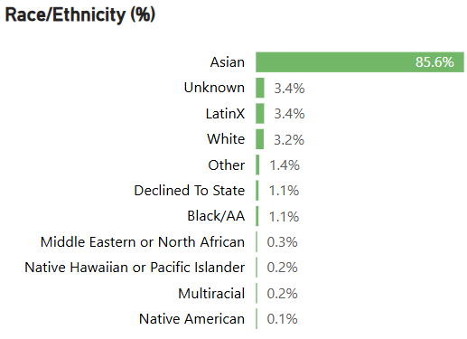

Slide 12
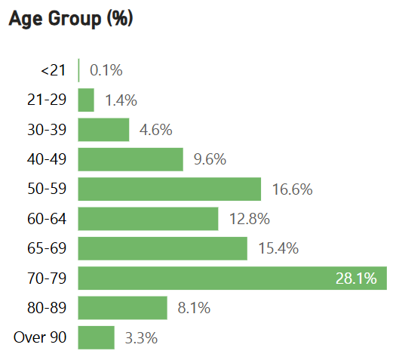

Slide 13
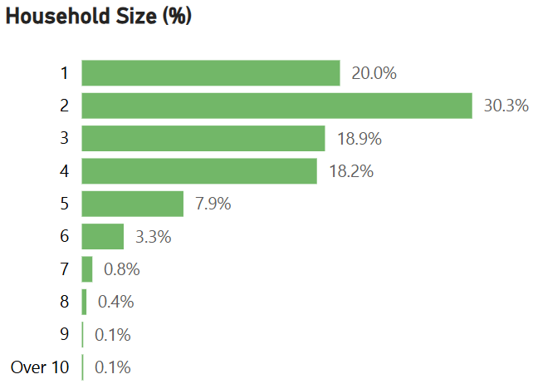

Slide 14
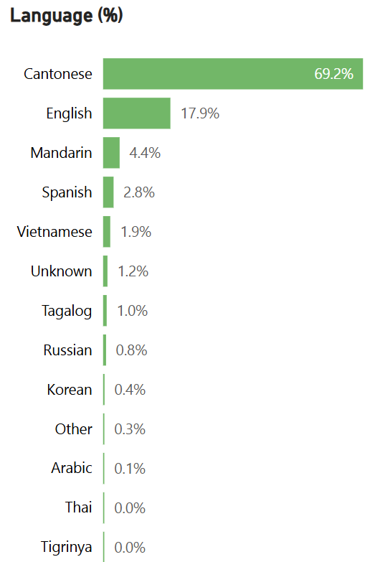

Slide 15
