Slide 1
Addressing Food Insecurity
A summary of SFHSA's role and current context
Dec 3rd, 2025
Notes:
Cindy, Mike, Tiffany to introduce themselves

Slide 2
SFHSA's Role

Slide 3
SFHSA's Role
SFHSA is the City's home for food support
  Tasked by Federal and State government to administer primary safety net resources, including CalFresh and Older Americans Act senior meals
  Manages nearly 75% of City's food funding*
  Provides major amount of food resources: 97% of groceries and 32% of meals*
Over 40 years of partnership with community on food programs
  Currently contract with 40 community-based organizations to provide 12 programs to strategically and equitably address unmet food needs
Much of our funding is backed by state and federal revenue streams
*Source: 2023 Biennial Food Report
Notes:
Cindy takes 3 – 6 (CalFresh)

Slide 4
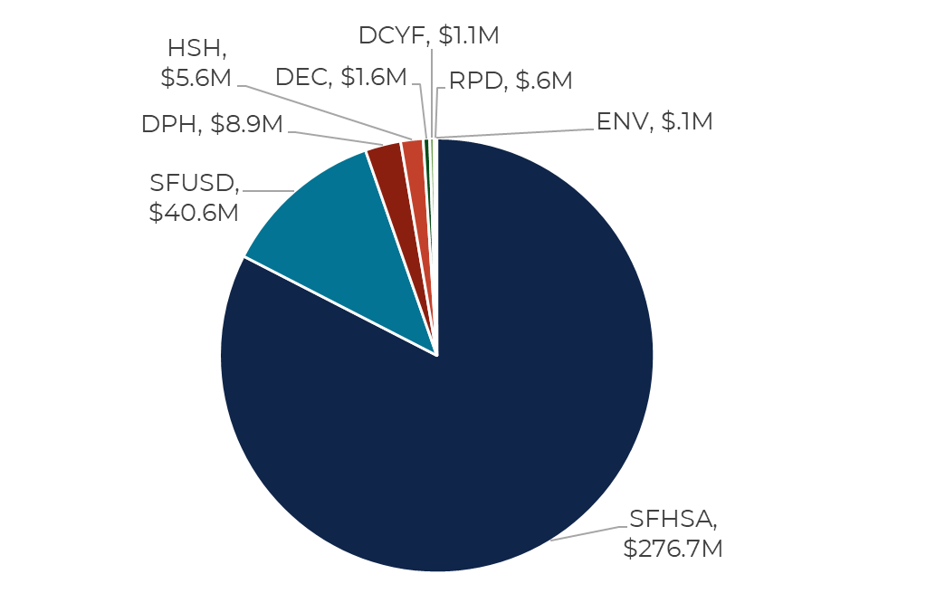
Food Investments by Department
Note: SFHSA data represents FY 24/25 food resource investments (including $225M in annual CalFresh EBT benefits). Other City department data reflects FY 22/23 budget (source: 2023 Biennial Food Report).
Notes:
Cindy

Slide 5
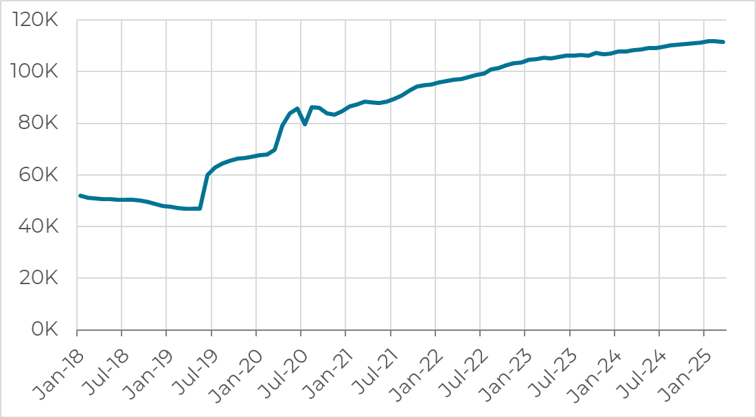
CalFresh
110,000 individuals in 82,000 households
  Reaches about 82% of San Franciscans who are eligible
4,800 applications each month
$225 million disbursed in benefits annually (approximately $19 million monthly)
$240 average monthly benefit per household
CalFresh Monthly Caseload
Notes:
Cindy covers this, plus slides about GiveCards

Slide 6
CalFresh Emergency Grocery Cards
All 82,000+ HH sent letter on 11/3
Since then, we have past 70% in activation of cards
Strong utilization of the funds
Reminder for community to activate by 12/31/2025 and use funds by 3/31/2026
Huge thank you to our CBO partners who helped to amplify messaging and provide technical assistance!!!

Slide 7
SFHSA Community-Based Food Security Strategies
GOALS
STRATEGIES
Reach: Meet diverse, high need communities via partnerships with community-based organizations that have garnered hard-earned trust*
Efficiency: Contract with organizations that have demonstrated ability to leverage bulk buying power while providing culturally relevant and high-quality food—achieving cost efficiencies and reducing food waste
Dignity: Provide high quality and tailored resources that offer choice and reflect population needs and preferences
Groceries: Provide fresh produce, grains, and protein that allow people to independently prepare meals in preferred style
Meals: Prepared meals for those facing functional, logistical, and financial barriers in making or accessing healthy meals
Purchasing power: Flexible food funds that help low-income individuals and families select and purchase food to prepare
Hybrid: Strategies that blend groceries, meals, and other resources to best meet unique population needs
​
*See appendix for client demographics by program​
Notes:
Mike to cover this one

Slide 8
Strategy: Groceries
Provide fresh produce, grains, and protein that allow people to independently prepare meals in preferred style
 | Program | Units | People | Budget | Strategy | Contractors
CFAT | Grocery Access | 164K | 4,600 | $7.8M | Culturally responsive food provided by neighborhood organizations tailored to local community preferences; scaled to family size | 17 (APA, APRI, Bayanihan, Booker T, Chinatown Y, Chinese Newcomers, Curry, Farming Hope, Mission Action, Mission Y, RNC, Self-Help, )
 | D10 Market (Pilot) | 39K | 1,500 | $1.25M | Grocery store model offering free food, paired with connection to services; scaled to family size | 1 (Bayview Senior Services)
D A S | Food Pantries | 376K | 3,600 | $2.8M | Supplemental groceries for pick up at various pantry sites; provides food for 7 meals | 1 (SFMFB)
 | Home-Delivered Groceries | 136K | 4,000 | $1.6M | Grocery delivery for those with limited mobility; food bags provided by SFMFB and provides food for 7 meals | 5 (CCDC, Community Living Campaign, Golden Gate Senior Services, SFMFB)
ESSS | Immigrant Food Pantry Assistance & Food Pantry Assistance | 46K | n/a | $630K | Supplemental groceries for pick up at various pantry sites, including a subset intended to serve immigrant communities; $25 food value | 1 (SFMFB)
Notes:
Tiffany covers 7-9

Slide 9
Strategy: Meals
Prepared meals for those facing functional, logistical, and financial barriers in making or accessing healthy meals
 | Program | Units | People | Budget | Strategy | Contractors
CFAT | Meal Support | 670K | 1,000 | $6.2M | Supplemental meals for families with young children and adults in need of a hot meal without another option (TL & other high-need areas) | 6 (Booker T, Chinatown Y, Glide, Farming Hope, SFHDC, SF New Deal)
D A S | Home-Delivered Meals | 2.3M | 5,900 | $16.5M | Prepared meals in a variety of cuisines delivered for those unable to shop or prepare their own meals due to functional impairment; utilizes a centralized waitlist managed by DAS | 8 (Centro Latino, JFCS, Kimochi, MOW, On Lok, Project Open Hand, RACS, Self-Help)
 | Communal Dining | 1.3M | 24,700 | $12.8M | Hot meals in a variety of cuisines provided at community centers, offering socialization in addition to nutrition | 10 (Bayview Senior Services, Centro Latino, ECS, Glide, Kimochi, On Lok, Project Open Hand, RACS, Self-Help)
Notes:
Tiffany 7-9

Slide 10
Strategy: Purchasing Power
Flexible food funds that help low-income individuals and families select and purchase food to prepare​
 | Program | Units | People | Budget | Strategy | Contractors
CFAT | Grocery Vouchers | 180K | 2,250 | $2.3M | Vouchers to purchase groceries at grocery stores and farmers market across the City; centering choice and healthy food access for low-income households | 1 (UCSF/EatSF)
Strategy: Hybrid
Strategies that blend groceries, meals, and other resources to best meet unique population needs
 | Program | Units | People | Budget | Strategy | Contractors
CFAT | Food Production | n/a | 825 | $317K | Urban farms that provide freshly grown produce to low-income households in the community, while training BIPOC youth as apprentices | 2 (Alemany Farm, Florence Fang)
D A S | Culturally Responsive Nutrition | 30K | 740 | $310K | Meals and supplemental grocery items that empower participants to maintain cultural integrity and choice | 2 (Bayview Senior Services, Centro Latino)
 | Nutrition as Health | 50K | 500 | $590K | Medically-tailored meals, groceries, and supportive services to support disease management for certain conditions | 1 (Project Open Hand)
Notes:
Note: CFAT food production grants support urban farms that grow produce. Impact is measured in pound of produce distributed, with a goal of 35,000 pounds for FY 24-25.

Slide 11
CFAT Updates for FY25-29
CFAT released RFP opportunities and as a result, the grantees are different
More investment via more providers in D11 to meet the need
Budget constraints
  Increased cost of food and labor but relatively stagnant level of funding available
  Decreased budget from height of COVID, but need persists
    Less frequent services without disenrolling participants
Notes:
Cindy takes this one

Slide 12
DAS Updates for FY 2025-26
DAS released multiple RFPs for existing nutrition support programs
Nutrition Support Programs | Number of Contractors
Congregate Nutrition Services (Communal Dining) | 9
Culturally Responsive Supplemental Grocery Program | 2
Culturally Responsive Nutrition Support and Outreach | 1
Food Assistance Program | 1
Home Delivered Grocery Program (HDG) | 4
Home Delivered Nutrition Services (HDM) | 8
To-Go Nutrition Services | 6

Slide 13
DAS Budget Constraints and Cost Challenges
DAS did not receive the $3M Dignity Fund increase for FY 2025–26, a portion of which would have supported nutrition services
Flat baseline funding
Rising food and labor costs have increased contractor pricing
DAS is experiencing decreased purchasing power due to rising service costs
Notes:
Tiffany to cover 11-13

Slide 14
Current Impacts on DAS Nutrition Programs
Fewer congregate and to-go meals available daily at communal dining sites
Reduced number of daily meals for Home-Delivered Meals (HDM) clients
Increased number of consumers waiting for HDM services
Limited or no weekend meal service
Closure of some dining sites
Elimination of nutrition counseling services
Notes:
5 site closures (onlok=4, Southwest=1); 2 reopened and 1 pending reopening; as of 11/25, 629 on waitlist, mixed of older adults (75%) and adults with disabilities (~25%)

Slide 15
Planned and Ongoing
Efforts to Address Service Impacts
Utilizing annual Dignity Fund savings to bridge funding gaps and sustain core nutrition services, such as home-delivered meals and grocery programs
Working in partnership with DAS nutrition partners to track service levels and waitlists
Exploring strategies with partners to maximize service reach without compromising quality
Notes:
Some savings used during negotiations to sustain service levels; Additional savings recently identified and OTO from state had been (i.e., reopening of congregate meal sites) and will be allocated to address known funding/service gaps

Slide 16
Full Grantee List: Citywide Food Access Team
Contractor | Program
Alemany Farm | Food Production
APA Family Support Services | Grocery Access
A. Philip Randolph Institute (APRI) | Grocery Access
Bayview Senior Services (BVSS) | D10 Market
Booker T. Washington | Grocery Access, Meal Support
Chinatown YMCA | Grocery Access, Meal Support
Chinese Newcomers | Grocery Access
Curry Senior Center | Grocery Access
Farming Hope | Grocery Access, Meal Support
Florence Fang | Food Production
Glide | Meal Support
Contractor | Program
Mission Action | Grocery Access
Richmond Neighborhood Center (RNC) | Grocery Access
Self-Help for the Elderly | Grocery Access
SF Housing Development Corporation (SFHDC) | Meal Support
SF New Deal | Meal Support
UCSF/EatSF | Grocery Vouchers

Slide 17
DAS OCP Nutrition Contractors FY 25/26
Contractor | Program
Bayview Senior Services | Congregate Nutrition Services/Communal Dining Culturally Responsive Supplemental Grocery Program Culturally Responsive Nutrition Support & Outreach To-go Nutrition Services
Chinatown Community Development Center | Home Delivered Grocery Program
Centro Latino de San Francisco | Congregate Nutrition Services/Communal Dining Culturally Responsive Supplemental Grocery Program Home Delivered Nutrition Services To-go Nutrition Services
Community Living Campaign | Home Delivered Grocery Program
Episcopal Community Services | Congregate Nutrition Services/Communal Dining To-go Nutrition Services
Glide Foundation | Congregate Nutrition Services/Communal Dining
Golden Gate Senior Services | Home Delivered Grocery Program
Jewish Family and Children's Services | Home Delivered Nutrition Services
Kimochi Inc. | Congregate Nutrition Services/Communal Dining Home Delivered Nutrition Services
Notes:
No new grantees; one less HDG partner d/t Urban Services not reapplying-their clients assumed by CLC; Southwest also did not reapply

Slide 18
DAS OCP Nutrition Contractors FY 25/26
Contractor | Program
Meals on Wheel San Francisco | Home Delivered Nutrition Services
On Lok Day Services | Congregate Nutrition Services/Communal Dining Home Delivered Nutrition Services To-go Nutrition Services
Project Open Hand | Congregate Nutrition Services/Communal Dining Home Delivered Nutrition Services To-go Nutrition Services Nutrition and Supportive Services for Healthy Outcomes*
Russian American Community Services | Congregate Nutrition Services/Communal Dining Home Delivered Nutrition Services To-go Nutrition Services
Self-Help for the Elderly | Congregate Nutrition Services/Communal Dining Home Delivered Nutrition Services
SF Marin Food Bank | Food Assistance Program (Food Pantries) Home Delivered Grocery Program
*Grant ends 6/30/2026; RFP issued 11/24/2025

Slide 19
Full Grantee List: Economic Support and Self-Sufficiency
Contractor | Program
SF Marin Food Bank (SFMFB) | Immigrant Food Pantry Assistance & Pantry Food Assistance
Notes:
Mike to mention remaining slides are reference point, happy to take questions from here.

Slide 20
Thank You!

