Slide 1
Impact of HR1 and State Medi-Cal Change
San Francisco Immigrant Rights Commission
September 14, 2026

Slide 2
Outline
DPH Serving All
Healthy San Francisco Overview
Enrollment Trends
HR1 Federal and State Medi-Cal Changes
Responding to Changes

Slide 3
SFDPH – Serving the Immigrant Community
The mission of the San Francisco Department of Public Health is to protect and promote the health of all San Franciscans
Regardless of a patient’s immigration status, gender, race, ethnicity, sexual orientation, or the complexity of their needs
  DPH does not collect information on a patient’s immigration status
DPH’s hospitals, clinics, and programs are here for all in our communities

Slide 4
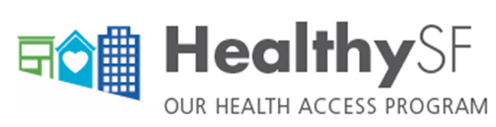
Program Overview
Health access program since July 2007
Not health insurance (services limited to San Francisco)
Immigration status, employment status and pre-existing conditions are not factors in determining eligibility
Income-based fee structure (participation and point of service fees)
One-stop, web-based eligibility and enrollment system used by trained certified application assistors in the community
12-month eligibility with annual redetermination

Slide 5
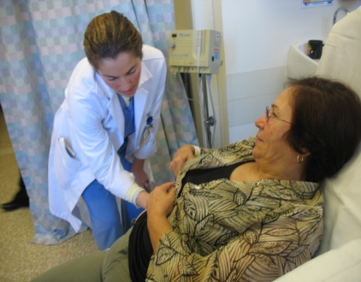
HSF Eligibility, Services and Network
ELIGIBILITY
San Francisco resident
Aged 18+ (under 18 if legally emancipated)
Uninsured
Income ≤ 500% FPL
Ineligible for full-scope publicly-funded health insurance (Medi-Cal or Medicare)
SERVICES
Preventive and primary care
Specialty care
Hospital care
Urgent and emergency care
Ancillary & Diagnostic (lab & x-ray)
Pharmacy
Behavioral health
Therapy (PT, OT, ST)
Durable medical equipment
PROVIDER NETWORK
(SF only)
30 primary care medical homes
(public & private)
All SF acute care hospitals (provide ED services)
Community Behavioral Health Services Network

Slide 6
HSF Enrollment Trends (2007 – 2025)
Downward HSF enrollment due to:
  Affordable Care Act (2014)
  Medi-Cal expansion to undocumented adults (2020, 2022, 2024)

Slide 7
HSF Enrollment Trends (CY 2026 to Date)
Downward enrollment trend has been reversed
39% increase in enrollment from Jan. – Aug. 2026

Slide 8
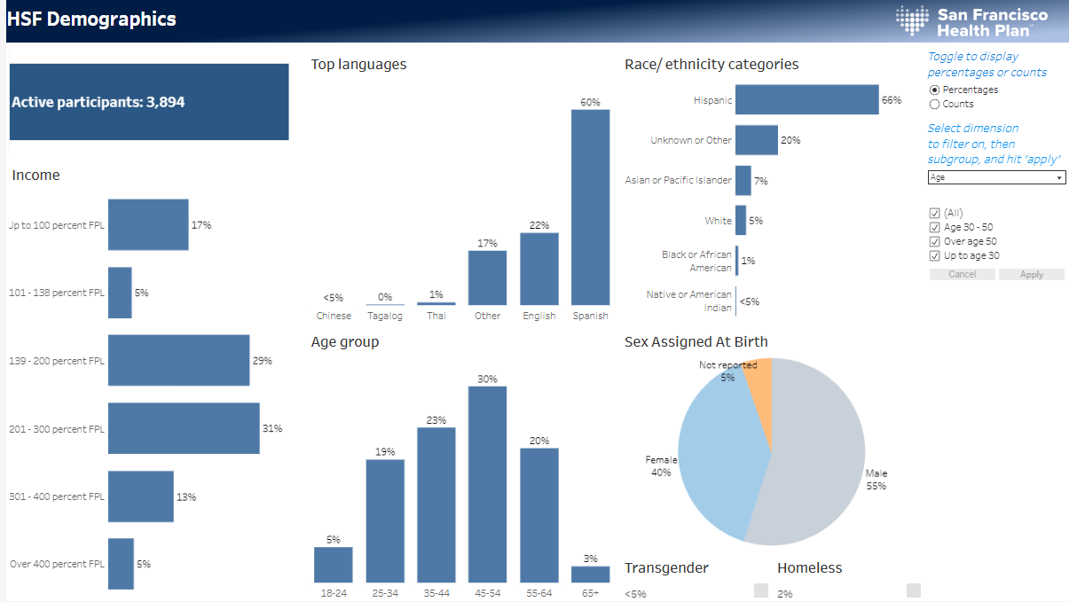
Healthy SF Demographics (8.31.2026)

Slide 9

HR1 Federal and State Changes
Mandatory work requirements to maintain Medi-Cal eligibility (Jan 1; FED)
6-month eligibility redeterminations for Medi-Cal (Jan 1; FED)
Transition UIS Medi-Cal beneficiaries from managed care to Fee-for-Service (Jan 1; FED)
Elimination of dental services for UIS Medi-Cal members (July 1; STATE)
UIS Medi-Cal members charged $30 monthly premiums (July 1; STATE)
Eliminate PPS payment system for UIS Medi-Cal (July 1; STATE)
2026
2028
Medi-Cal enrollment freeze for undocumented/UIS population (Jan 1; STATE)
2027
Medicaid mandatory cost-sharing up to $35 for some services for some expansion adults (Oct 1; FED)

Slide 10
Changes Impact Access to Care
Changes affect more than just eligibility and enrollment
State Medi-Cal changes also impact the health care delivery system for the UIS population
Barriers can occur whether a person has documented or undocumented status
  Barriers to access services can be more significant for immigrant residents

Slide 11
Responding to HR1 and State Medi-Cal Changes
Overarching Goals:
  Maximize Medi-Cal retention for those eligible for full-scope coverage
  Ensure continued Healthy San Francisco enrollment for UIS population ineligible for or losing full-scope Medi-Cal
HSF estimated enrollment increase by 5,000-7,000 in CY 2026
Board of Supervisors approved DPH contracts increasing funding to non-DPH Healthy San Francisco providers over next several years
Collaborating with county departments, community-based organizations and stakeholders on outreach, communication, etc.
DPH programs will also assist SIS population impacted by HR1

Slide 12

QUESTIONS AND ANSWERS

