Slide 1

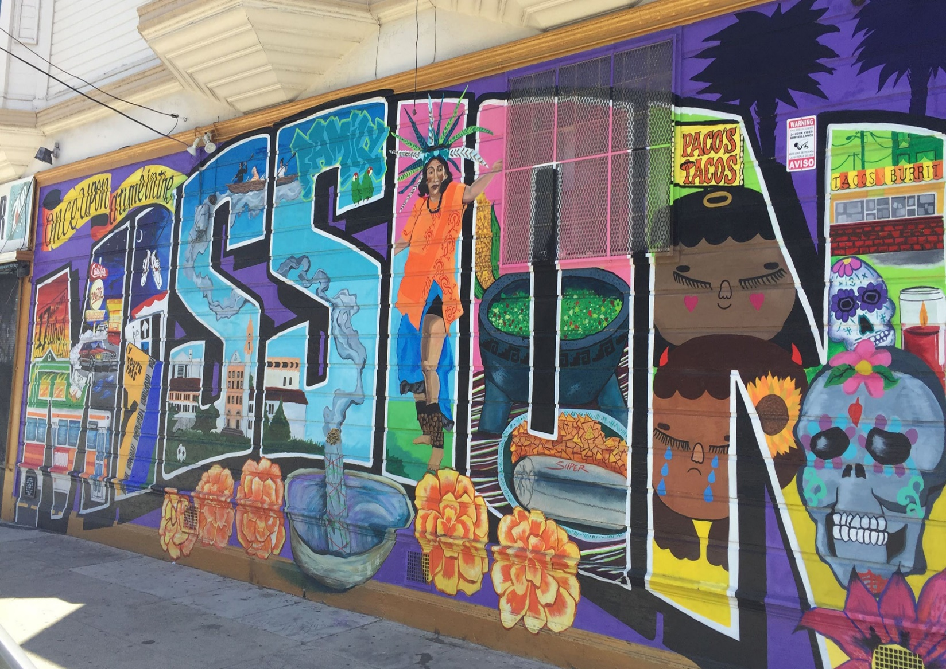

SAN FRANCISCO DEPARTMENT OF PUBLIC HEALTH
HIV Health Services Clinical Quality Improvement Program John Aynsley Beth Neary June 13, 2022
Notes:
Good morning. My name is Hanna Hjord and I am the HIV/HCV/STI Behavioral Health Coordinator with the San Francisco Department of Public Health. I oversee our Ending the Epidemics work and the CDC EHE funding. I work closely with my HIV Health Services colleagues who oversee the HRSA EHE funding and San Francisco City Clinic, one of the recipients of the PS20-2010 Comp C funding.

Slide 2


HIV & Persons Experiencing Homelessness
7,020
Clients received DPH Health Care for the Homeless services in 2020
878
Or 12.5% were people living with HIV/AIDS
12,085
People living with HIV/AIDS in San Francisco in 2020
293
Or 2.4% were persons experiencing homelessness
Note: narrower definition of experiencing homelessness

Slide 3
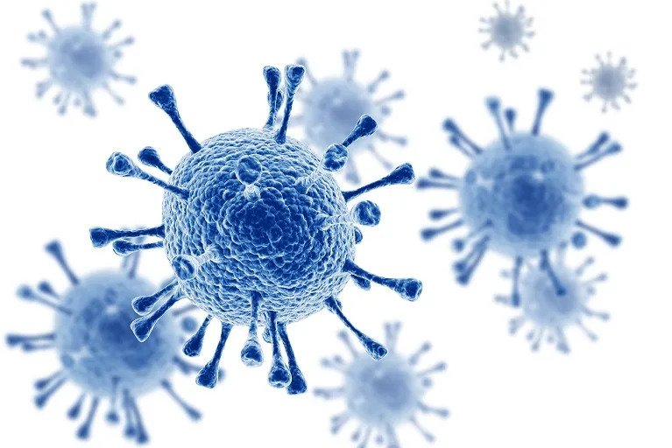
HIV Viral Load
An HIV viral load is the amount of HIV measured in a volume of blood. The goal of HIV treatment is to lower viral load to be undetectable. That is, the goal is to reduce the amount of HIV in the blood enough so that it is below 200 copies per milliliter of blood and ideally can’t be detected in a laboratory test. When the virus gets below 200, medicines are very effective at controlling the virus from reproducing and damaging a person’s immune system.
Having an undetectable viral load also means that the risk of passing HIV to someone else is effectively zero. Undetectable = Untransmittable

Slide 4


HIV Viral Load
Snapshot of new HIV Diagnoses in SF
San Francisco Department of Public Health HIV Epidemiology Annual Report 2020

Slide 5
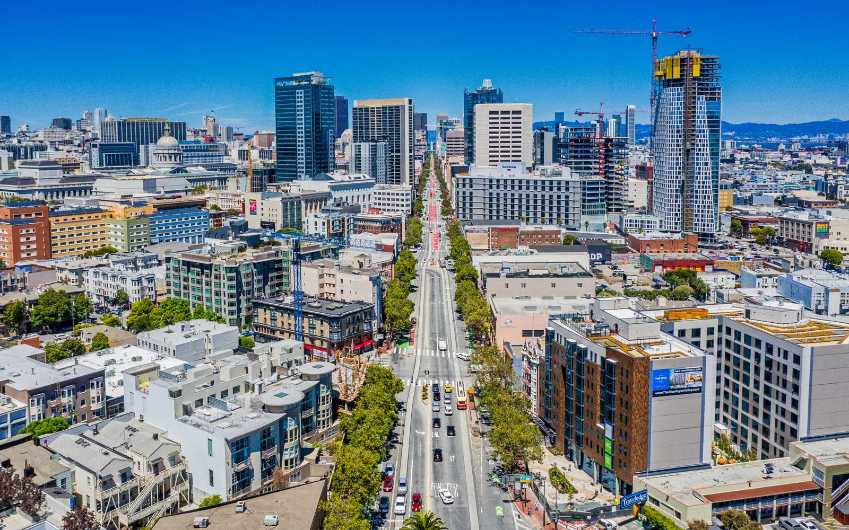
HIV & Persons Experiencing Homelessness
18% of all new HIV diagnoses from 2019 were people experiencing homelessness
51% of those HIV+ and experiencing homelessness identify as people of color
22% of those HIV+ and experiencing homelessness identify as cis or trans women
8% of all HIV+ individuals identified as not being housed in 2019
San Francisco Department of Public Health HIV Epidemiology Annual Report 2020

Slide 6

SF HIV Health Services (HHS) & Persons Experiencing Homelessness
87% of the 2,982 HHS clients who report stable housing were virally suppressed in April 2022
73% of the 751 HHS clients who report unstable housing were virally suppressed in April 2022
100 additional HHS unstably housed clients need to be virally suppressed to achieve equity
AIDS Regional Information & Evaluation System (ARIES) April 2022

Slide 7
Quality Improvement (QI)
HIV Health Services (HHS) has an established Clinical Quality Improvement (CQI) Program to address viral load and other health inequities. The focus of 2022 and 2023 is to address viral load suppression rates among persons experiencing homelessness and those who report unstable housing. Ten large programs are participating in this initiative. Across these programs, 3,468 people living with HIV are receiving medical or medical case management services. Of these people, 756 are also facing housing instability.

Slide 8
Quality Improvement Goals
REDUCE HIV-RELATED DISPARITIES IN HEALTH OUTCOMES AMONG PEOPLE EXPERIENCING HOMELESSNESS AND HOUSING INSTABILITY
PRIMARY GOAL: Close gap in Viral Load (VL) suppression rate to 0.0% when comparing VL rates for people experiencing homelessness and/or housing instability to overall VL suppression rate in each program
REACH GOAL: Aim a little above current average VL suppression rate to reach 86.0% by December 31, 2023 given upward trend in overall VL suppression rates in San Francisco

Slide 9
Request for Input from HCH Co-Applicant Board
What can we adjust to make accessing medical services easier for people experiencing homelessness and living with HIV?
How can we make it easier to take daily medications?
How can we reach additional people experiencing homelessness and living with HIV who may not yet have connected with medical services?

