Slide 1
SF Fellows Informational Session for FY2026-2027

Slide 2
Agenda
Purpose
Expectations
Program Introduction
Application Timeline
Fellows Testimonials
Q&A
Final Resources

Slide 3
Agenda
Purpose
Expectations
Program Introduction
Application Timeline
Frequently Asked Questions
Fellows Testimonials
Q&A
Final Resources
Networking

Slide 4
Purpose
To provide an overview of the San Francisco Fellows hiring process and timeline.
To review some of the frequently asked questions about the program (posted on our website).
To learn about the San Francisco Fellows program experience.

Slide 5
Expectations
This or an older version of these slides is on our website. We will not be sharing these slides via email.
We look forward to answering your clarifying questions. We will not be able to answer questions about the program that are not available online.
We will be reading questions from the chat and answering them by the end of the presentation.
You won’t be able to come off mute during the meeting.

Slide 6
Program Introduction

Slide 7
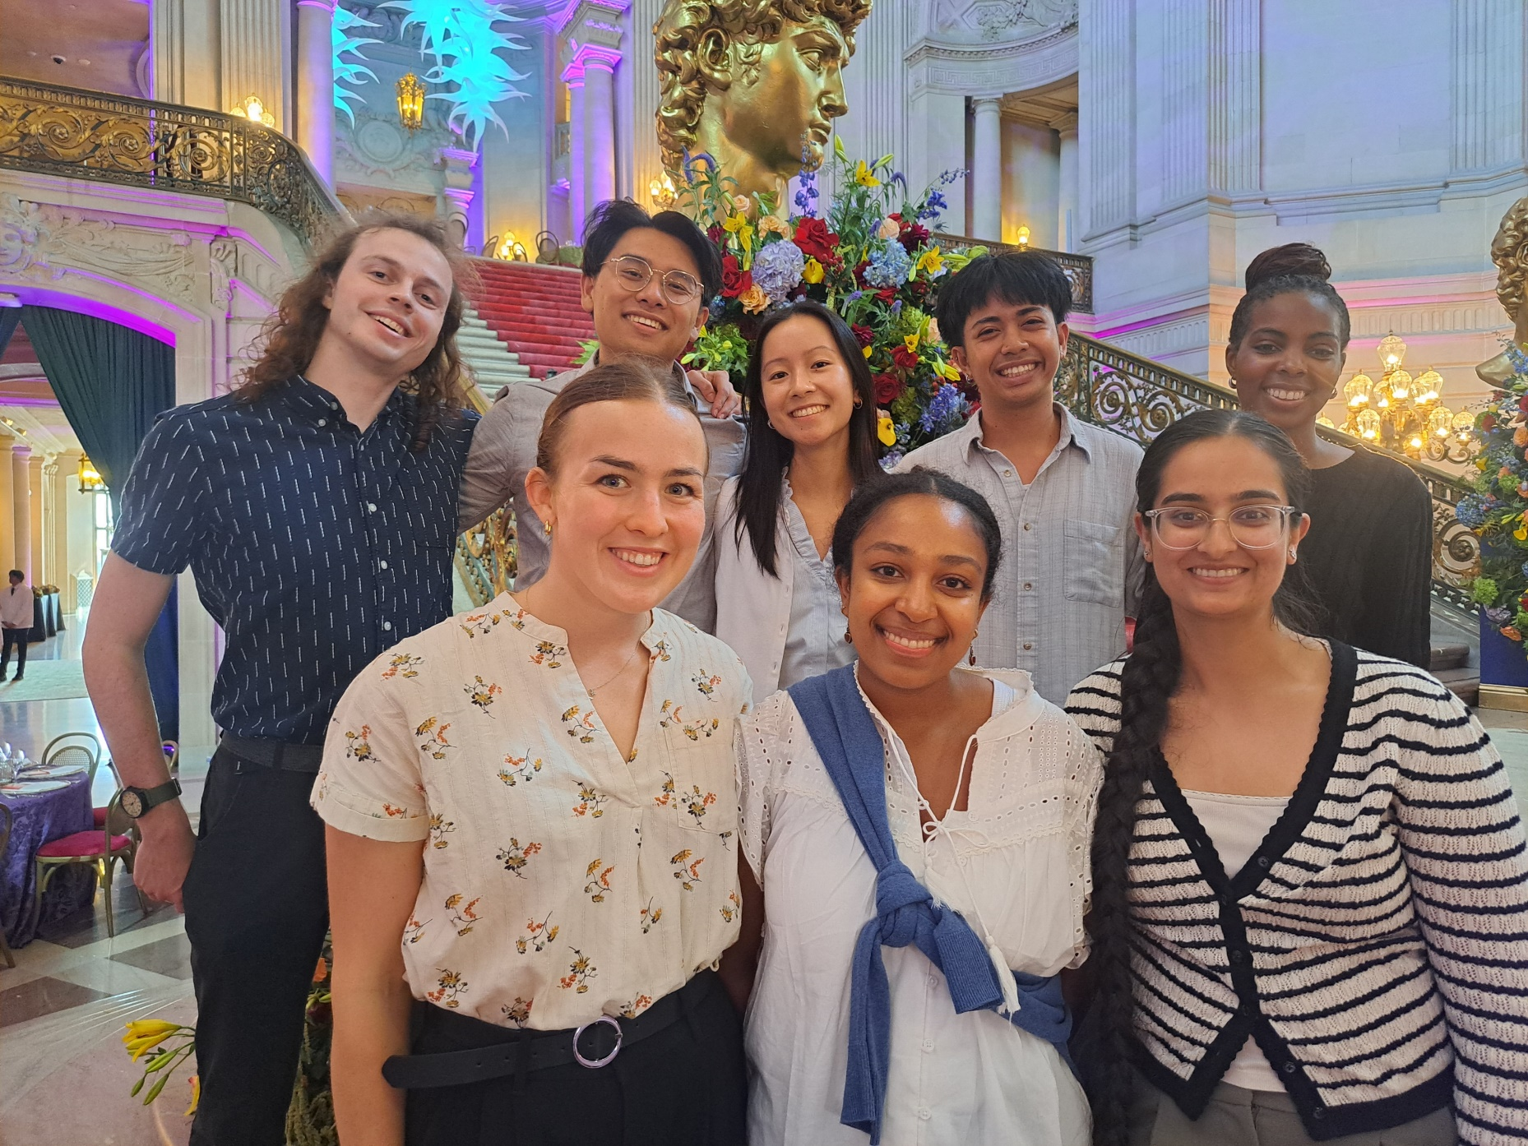
What is the San Francisco Fellows Program?

Slide 8
What is the San Francisco Fellows Program?
One-year fellowship: Aug 2026 – Aug 2027
Fellows start with 2-3 weeks of Orientation at Department of Human Resources
Fellows are 1801 Administrative Analyst Trainees
Goal: Immerse Fellows in a meaningful one-year learning experience that develops their knowledge, skills, and abilities as administrative analyst trainees, and enables them to gain one year of professional experience to advance in the Administrative Analyst series

Slide 9
Application Timeline

Slide 10
Year-Long Schedule
DHR-Led FLDs:
September-January
Job Search Support Begins:
January
Peer-Led FLDs:
May-July
Placement Work
Orientation:
August-September
City-Wide Projects:
February-May
Presentations of Learning and Closing:
July-August

Slide 11
Governance of
San Francisco
FELLOWSHIP AREAS OF LEARNING
Fellowship Structure
Professional Development

Slide 12
Application Timeline (approximate)
Late January 2026: Application opens
February 2026: Application closes
March 2026: Selected applicants will complete an online exam
March-April 2026: Selected applicants will be invited to complete essay questions.
April-May 2026: Selected applicants will participate in a phone interview with a member of the selection committee
May-June 2026: Selected applicants will be invited to participate in a half-day virtual group interview process
June-July 2026: Finalists will receive conditional offer letters
Mid to late August 2026: Fellowship begins

Slide 13
Frequently Asked Questions

Slide 14
The Ideal Candidate
Who is an ideal candidate for the San Francisco Fellows program?
To qualify for the Fellowship, candidates must have earned their undergraduate degree within the last five years (between May 1, 2021, and June 30, 2026). Ideal candidates will have less than five years of full-time professional work experience, as this program is designed as a learning opportunity for individuals with limited work experience. Ideal candidates have a strong desire to learn and perform analysis work and be flexible and open to placement in any City department.

Slide 15
Internship? Fellowship?
Is the San Francisco Fellows Program an internship?
No, the Fellows program is a full-time professional work experience opportunity. You will serve the City & County of San Francisco as a full-time employee working on various public administration projects that directly impacts a City department’s goals and mission.

Slide 16
Program Timeline
How long is the program and when does it start and end?
The Fellows Program lasts approximately 11.5 months. The Program begins in mid-August and kicks off with 2-3 weeks of group orientation and training with the entire cohort. The Program finishes in early August the following year, with a graduation ceremony to recognize your achievements for the year.

Slide 17
Public Policy? Administration?
Is this a public policy fellowship?
No, the program provides professional experience in public administration rather than public policy. Fellows work within real program implementation versus policy research and development.

Slide 18
Departments, Pt I
Which department will I work in?
Final participating departments will not be known until program orientation starts in August. Fellows are selected in part for their interest to work in any department. During orientation, Fellows go through a placement process to determine which department they will work in.

Slide 19
Past Host Departments
Department of Children, Youth, and Their Families
Department of Emergency Management
Department of Homelessness and Supportive Housing
Department of Human Resources
Department of Public Health
Department of Public Works
Juvenile Probation
Municipal Transportation Agency (SFMTA)
Office of Assessor Recorder
Office of Civic Engagement and Immigrant Affairs
Office of the Controller
Office of Economic and Workforce Development
Port of San Francisco
San Francisco Public Utilities Commission
Recreation & Parks Department
San Francisco Arts Commission
San Francisco International Airport (SFO)
San Francisco Public Library

Slide 20
Departments
Do I get a choice of what department I will work in?
Department placements are determined during Fellows’ orientation in August. Fellows interview with participating departments & supervisors during orientation to discuss each department's needs and the Fellows' interests. Through a matching process, Fellows are then assigned to their placement department for the year.

Slide 21
Selection Process, Pt 1
What is the selection process for the Fellows Program?
The application period will open in late January 2026. Exact details of the required application will be provided once the application period opens. Applicants will complete an online application which requires submission of the following:
Resume
Undergraduate degree transcripts (unofficial/non-sealed transcripts are acceptable) that show your degree earned or will be earned between May 1, 2021 and June 30, 2026
Responses to written prompts

Slide 22
Selection Process, Pt 2
What is the selection process for the Fellows Program?
In addition, as part of the selection process you may be required to do any/all of the following:
Online analytical skills assessment
Phone/Video interview(s)
Submission of references
Final Interviews comprising of group activities and panel interviews

Slide 23
Selection Process, Pt 3
What is the selection process for the Fellows Program?
We will send acceptance notices between mid-May to June to selected finalists and begin the pre-employment vetting process. If not initially selected for the program, some candidates will be asked if they want to be placed on a waitlist for the program.
Selected candidates will be given a conditional offer of employment and go through a background clearance and reference check required of all City employees. Finalists will receive a formal offer of employment with the San Francisco Fellows program upon completion of the background clearance process.

Slide 24
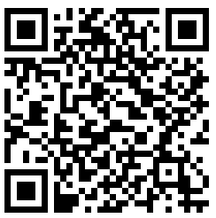
Accommodations
What if I need an accommodation?
If you need a reasonable accommodation during the application process, reach out to the HR analyst on the job posting. Please view the City's reasonable accommodation policy: https://www.sf.gov/reports/may-2023/reasonable-accommodation-policy

Slide 25
Time Off
Can I take time off during the Fellowship?
Fellows are expected to attend all of the initial in-person orientation. After that, Fellows are expected to work full time, and like all City employees must request approval for time off from their supervisors. Fellows receive up to 12 paid observed holidays and 5 paid floating holidays. Paid sick days are available after 90 days. Additional unpaid days off are made available at the discretion of department placement supervisors.
If you continue employment with the City after the end of the Program with no break in service, you will become eligible for paid vacation days after 12 months of full-time employment (per SF City Charter).

Slide 26
Hybrid Work
Is this position in-person or remote?
Generally, all City and County of San Francisco employees are expected to work in-person at least 4 days a week. The Fellows Orientation at the beginning of the program is in-person every day, hosted at various locations around the City. Once Fellows are placed at their assigned departments, reporting to the office varies by departments (days of the week, location, etc.). The weekly Fellows Learning and Development sessions are also in-person.

Slide 27
Relocation
If I am relocating from another State or City, can the program assist with my relocation expenses?
No, the City is unable to provide relocation assistance. Fellows are responsible for finding their own local housing during the fellowship year.

Slide 28
Work Visa Sponsorship
Will the San Francisco Fellows Program sponsor a work visa for me?
The City and County of San Francisco does not sponsor visas. If you have an F1 student visa, the City will not sponsor the “optional practical training” requirement through work as a Fellow in the San Francisco Fellows program, so an F1 visa therefore does not demonstrate eligibility to work as an employee of the City and County of San Francisco. All Fellows must be able to demonstrate that they are legally able to work in the United States without visa sponsorship by the employer.

Slide 29
Master’s Degree
What if I have a Master's Degree?
Many past Fellows have had Master’s Degrees, but it is not a requirement of the program. The minimum requirement of the program is that an undergraduate degree was earned within the past 5 years, between May 1, 2021 to June 30, 2026.

Slide 30
Non-US Degree
What if my undergraduate degree is not from an American institution?
Your undergraduate degree must have been earned from an accredited school. If it is not an American institution or from an accredited school, your degree may still be acceptable.

Slide 31
Work Experience Required?
I never had a full-time job before - am I qualified?
Prior work experience is not required. Cohorts have a diversity of experiences in and out of the classroom. For many past Fellows, this program was their first full-time work experience. The program is designed for recent college graduates with less than five years of professional experience.

Slide 32
Applying from Outside San Francisco
May I apply if I am not from and/or do not live in San Francisco/Bay Area?
Yes, you are welcome to apply even if you are not from here or do not live here now.

Slide 33
After the Fellowship
What happens after the Fellowship is over?
Fellows are not guaranteed employment with the City after completion of the program.
The SF Fellows program recruits talented recent college graduates to join our City workforce for one year of employment. We actively support Fellows who are interested in staying with the City and County of San Francisco beyond the fellowship year to apply for jobs beyond the one year. We provide guidance and career counseling on the City’s job application process throughout the program year.

Slide 34
Testimonials

Slide 35
Questions

Slide 36
Final Resources

Slide 37
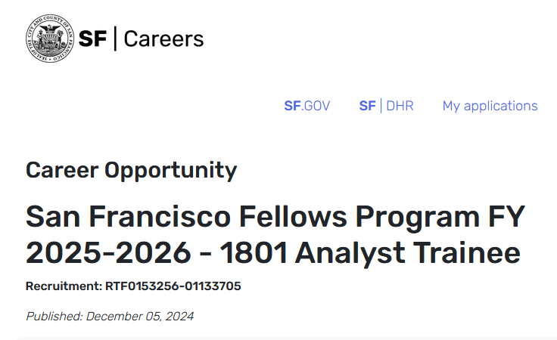
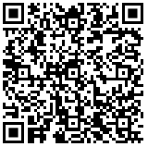
Interest Form Link
https://forms.office.com/Pages/ResponsePage.aspx?id=z8LVIj7OPUSaf9_MAjH3P-o0SZARJOFGmA1EEo8vPKlUMFFIS0FETEhFWU01QTZSSDBBNVAwMzFMWSQlQCN0PWcu

Slide 38
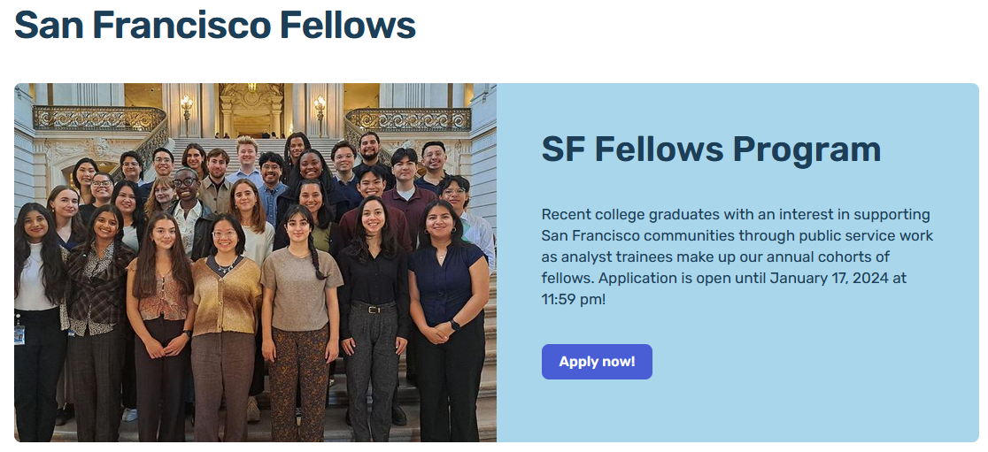
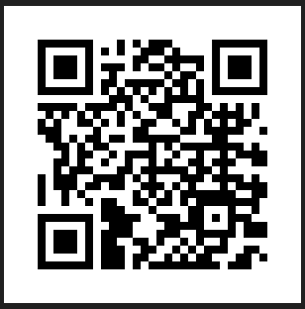
Contact Information
Contact: dhr-sanfranciscofellows@sfgov.org
Website: https://www.sf.gov/san-francisco-fellows

Slide 39
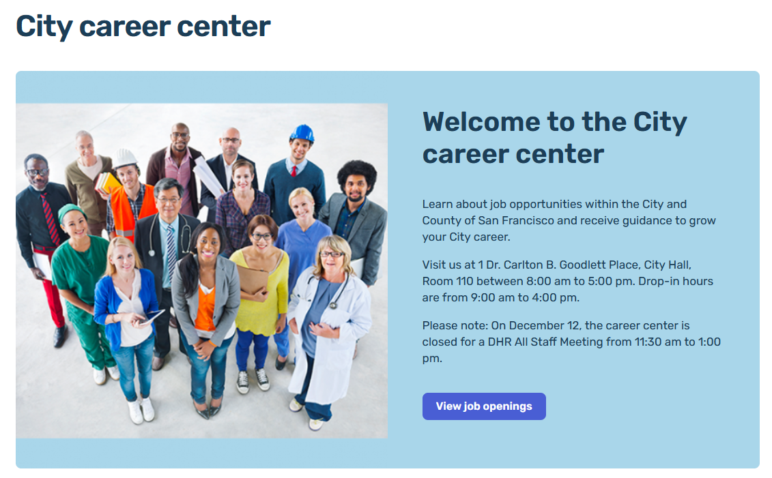
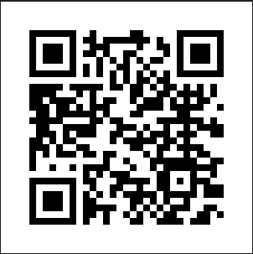
City Career Center
Careers.sf.gov/city-career-center

Slide 40
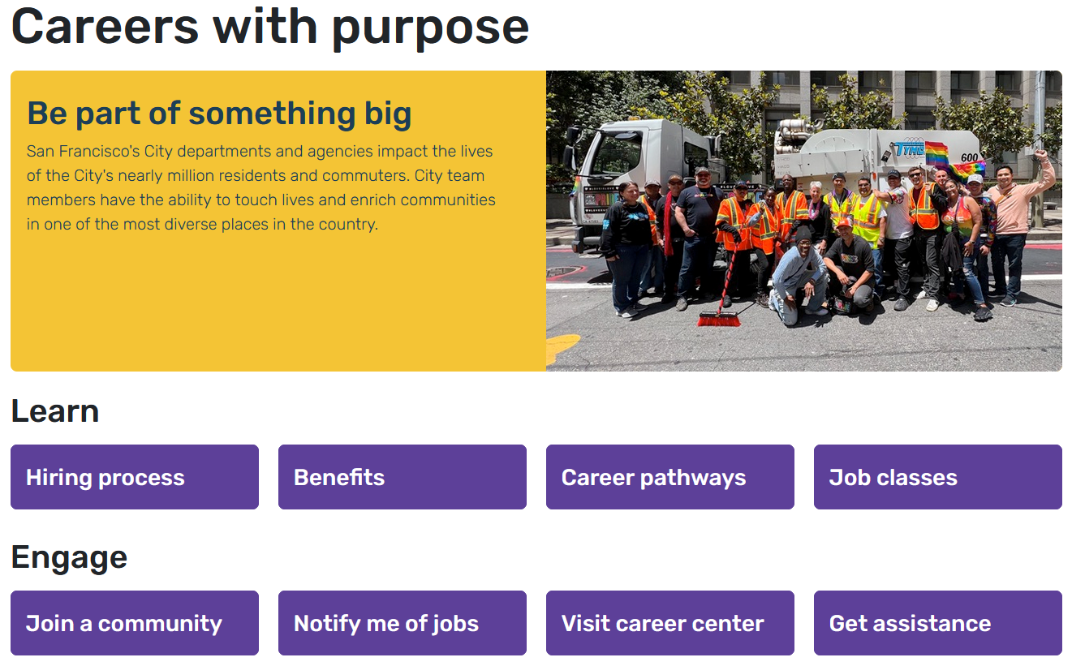
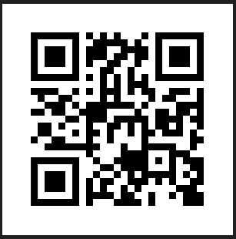
SF Gov Careers Website
careers.sf.gov

