Slide 1

Sugary Drinks Distributor Tax Advisory Committee
FY 26-27 and FY 27-28
Budget Recommendations
April 1, 2026

Slide 2
Sugary Drinks Distributor Tax (SDDT)
In 2016, SF voters passed the Sugary Drinks Distributor Tax (SDDT aka soda tax).
Levies 1 penny per ounce on the Distributor making the initial distribution of a bottled sugar-sweetened beverage, syrup, or powder in the City.
General tax - tax revenue is deposited in the General Fund.
The ordinance established the Sugary Drinks Distributor Tax Advisory Committee (SDDTAC) to make recommendations on how the tax revenue should be allocated
Notes:
In 2016, the SDDT was adopted by voters in November 2016 and the tax levies 1 penny per ounce on the distributor of sugar sweetened beverages (SSB) in SF.
The SDDT is considered a General Tax - which means it goes into the general fund of the city; Since 2018 22% of the revenue goes towards set asides that support various allocations towards MTA, library, SFUSD, Children Services, etc.
The intent and will of the voters, is that the soda tax revenue is to be reinvested into communities most targeted by the beverage industry.

Slide 3





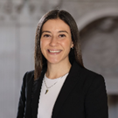

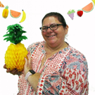
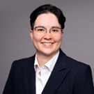

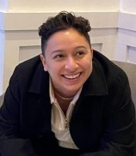

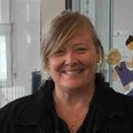


Sugary Drinks Distributor Tax Advisory Committee (SDDTAC)
Seat 3
Open
$95.5M collected since 2018
Community-informed, data-driven, evidenced-based, transparent process to make recommendations for over $85M
FY26-27 and FY27-28 SDDT revenue for recommendations $11,372,000
Notes:
Along with the passage of SDDT, voters approved the creation of a 16-member advisory committee to make recommendations on how the soda tax revenue should be spent and to monitor the impact of the tax on public health, sugary drink consumption, and sales.
The SDDTAC is designed to intentionally reflect San Francisco’s diverse communities with community and city agency seats, balancing grassroots and institutional voices.
Members’ lived experiences provide crucial insight, enabling the committee to make informed, targeted decisions that support those most affected by sugary drinks.
The SDDTAC has made recommendations on $85.6M, directed to communities most impacted by nutrition-sensitive chronic diseases and targeted by the sugary drinks industry.
Support the committee by accepting the Commission Streamlining Taskforce’s recommendation to sustain the committee beyond 2028.

Slide 4
SDDTAC Recs Timeline FY26-27
Co-chairs met with Director Tsai to walk through the two sets of recommendations. Director Tsai supports the Bridge Plan finding it reasonable
Co-chairs met with Director Tsai to review recommendations and Mayor’s allocations
SDDTAC voted to approve two-year North Star Recommendations
October 2025
December 2025
February 2026
September 2025
November 2025
January 2026
Commission Streamlining Task Force voted to reverse recommendation to eliminate SDDTAC
SDDTAC voted to approve one-year Bridge Plan Recommendations
SDDTAC and Co-chairs met with policymakers and stakeholders
BoS staff (All but D2)
Jack English and Santiago Silva (Mayor’s Office)
Kunal Modi, Eufern Pan, Peggy Moriarty
Notes:
Here is a list of the SDDT priority populations, of who are most targeted by the beverage industry and which hold the greatest health disparities (e.g. cardiovascular disease, heart disease, diabetes, oral health, etc) which can be linked to the consumption of sugar sweetened beverages
Black or African American adults have nearly twice the mortality rate as White or Asian adults for most nutrition sensitive diseases.

Slide 5
SDDT Priority Populations
Black/African American
Native Hawaiian or Other Pacific Islander (NHOPI)
Latine
American Indian/Alaska Native
Asian
Low Income Populations
Notes:
Here is a list of the SDDT priority populations, of who are most targeted by the beverage industry and which hold the greatest health disparities (e.g. cardiovascular disease, heart disease, diabetes, oral health, etc) which can be linked to the consumption of sugar sweetened beverages
Black or African American adults have nearly twice the mortality rate as White or Asian adults for most nutrition sensitive diseases.

Slide 6
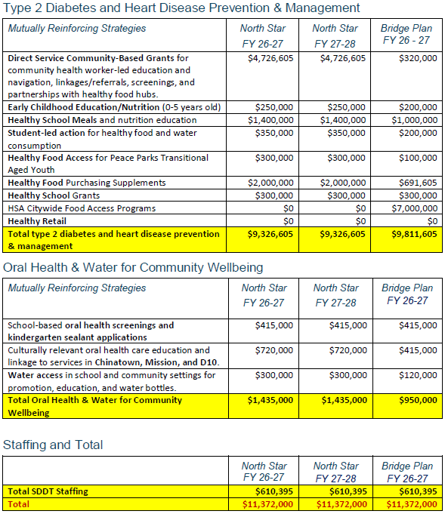
Submitted Recommendations by March 1, 2026
Disparity-focused domains and strategies
Type 2 Diabetes
Heart Disease Prevention & Management
Oral Health
Voted in two sets of recommendations
North Star
Bridge Plan

Slide 7
SDDTAC Budget Recommendations FY 26-27
Type 2 Diabetes & Heart Disease Prevention and Management | Bridge Plan FY 26-27 | % | Dept Rx
Direct Service Community-Based Grants | $320,000 | 2.81% | DPH/CHEP
Early Childhood Education/Nutrition (0-5 years old) | $200,000 | 1.76% | DPH
Healthy School Meals and Nutrition Education | $1,000,000 | 8.79% | DCYF
Student-led Action for Healthy Food and Water Consumption | $200,000 | 1.76% | DCYF
Healthy Food Access for Peace Parks Transitional Aged Youth | $100,000 | 0.88% | RPD
Healthy Food Purchasing Supplements | $691,605 | 6.08% | DPH/CHEP
Healthy School Grants | $300,000 | 2.64% | DPH
Total Type 2 Diabetes & Heart Disease Prevention and Management | $2,811,605 | 24.72%

Slide 8
SDDTAC Budget Recommendations FY 26-27
Equitable Food Access and Distribution | Bridge Plan FY 26-27 | % | Dept Rx
HSA citywide food access programs | $7,000,000 | 61.55% | HSA
Total Equitable Food Access and Distribution | $7,000,000 | 61.55%
Oral Health & Water for Community Wellbeing | Bridge Plan FY 26-27 | % | Dept Rx
School-based oral health screenings and sealant applications | $415,000 | 3.65% | DPH
Oral health care coordination and services | $415,000 | 3.65% | DPH
Water access in school and community settings | $120,000 | 1.06% | DPH
Total Oral Health & Water for Community Wellbeing | $950,000 | 8.35%
SDDT Staffing | Bridge Plan FY 26-27 | % | Dept Rx
SDDT staffing | $610,395 | 5.37% | DPH
Total SDDT Staffing | $610,395 | 5.37%

Slide 9
SDDTAC Budget Recommendations FY 26-27
SDDT Staffing | Bridge Plan FY 26-27 | % | Dept Rx
SDDT staffing | $610,395 | 5.37% | DPH
Total SDDT Staffing | $610,395 | 5.37%

Slide 10
Discussion
What are your initial thoughts or reflections on what you’ve heard today?
Where do you see the strongest alignment and collaboration between the SDDTAC and FSTF?
What are 1–2 concrete ways we can better coordinate to advance shared goals?
From your perspective, what are communities telling you they need most right now and where do you see overlap with SDDT-recommendations?

Slide 11
Next Steps
Support these recommendations as a whole
Support the CST recommendations at April hearing to continue SDDTAC and remove the sunset
Continue dialogue with SDDTAC around your district’s priorities for healthy eating/active living and sugary drink policies
Notes:
There is momentum following Santa Cruz’s 2 penny per ounce tax
Interest in SF to increase and created a dedicated tax, looking for champions for this work.

Slide 12
Thank you!
SDDT Advisory Committee Co-Chairs
Abby Cabrera, MPH
SDDTAC Seat 4, Research/Medical Institution
abby.cabrera@ucsf.edu
Laura Urban
SDDTAC Seat 16, Children 0-5 years old
lurban@childrenscouncil.org

Slide 13
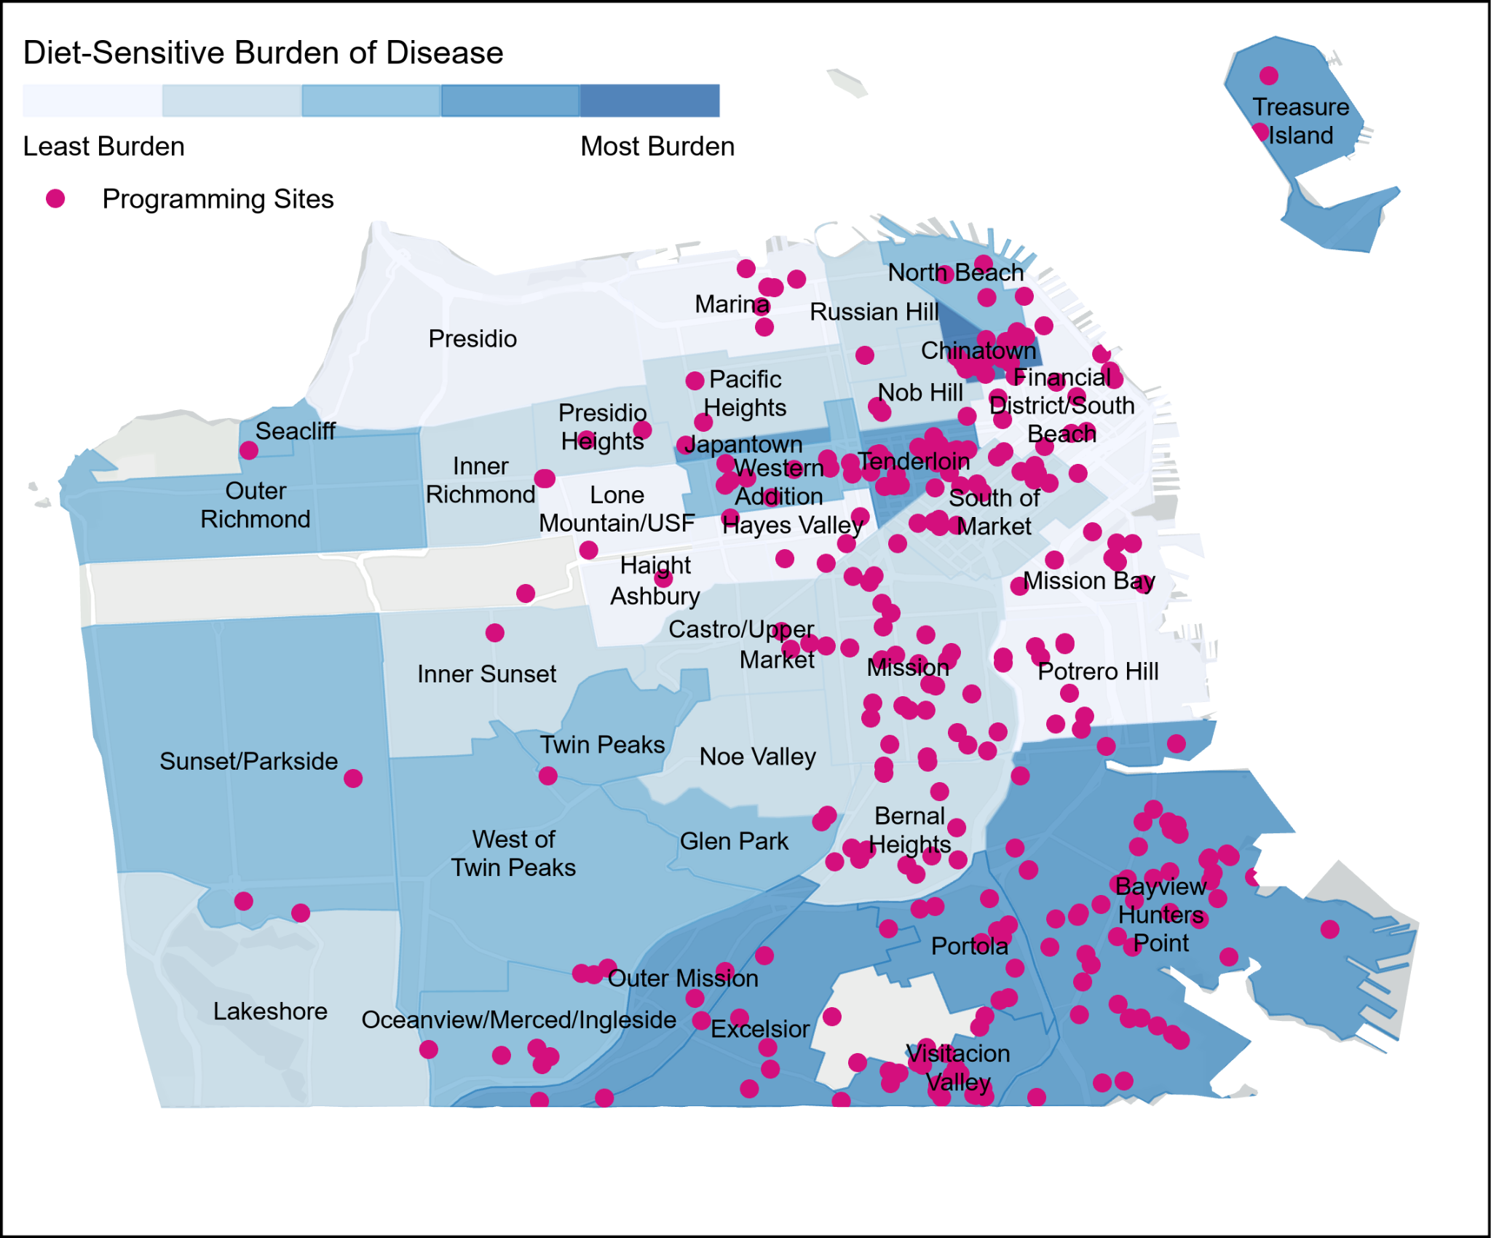
Impact of SDDT
Programming in neighborhoods with the greatest chronic disease burden
Culturally responsive programs and services
Approximately 32,000 participants have participated in SDDT funded programs in FY 24-25
SDDT investments are successfully engaging BIPOC community members
Notes:
The impact of SDDT funding supports programming and benefits every neighborhood in SF.
Map illustrates where SDDT funded programming are.
SDDT focuses on concentrated services, programs and interventions in the neighborhoods most impact by nutrition sensitive chronic diseases and targeted by the sugar sweetened beverage industry: Chinatown, Tenderloin, Western Addition, South of Market, Bayview Hunter’s Point, Visitacion Valley, Mission and Excelsior.
The dots represent: location of SDDT funded entities and where programming occurred, sites where SDDT funded benefits were distributed and used to purchase produce or where there were facility improvements (e.g. hydration stations, kitchen upgrades).
The SDDT culturally responsive services are those that are shaped and informed by the languages, cultural practices, traditional knowledge, perspectives and expressions reflective of the communities being served.
In fiscal year 23-24 approximately 90,000 participants (7-16% are BIPOC residents) have participated in SDDT funded programs and continued to increase over time from FY 2019-2020
Among participants with race/ethnicity data, the majority of SDDT participants identified as Latino, followed by Asian and Black/African American individuals.

Slide 14
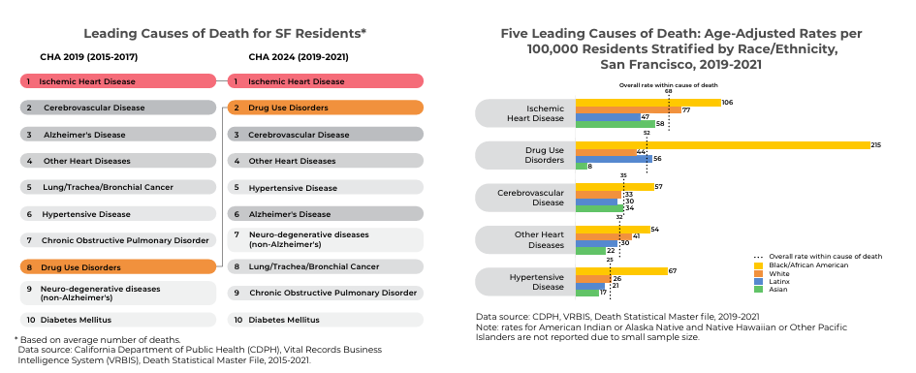
Top 10 Leading Causes of Death in San Francisco by Race/Ethnicity: Nutrition-Sensitive Chronic Conditions

Slide 15
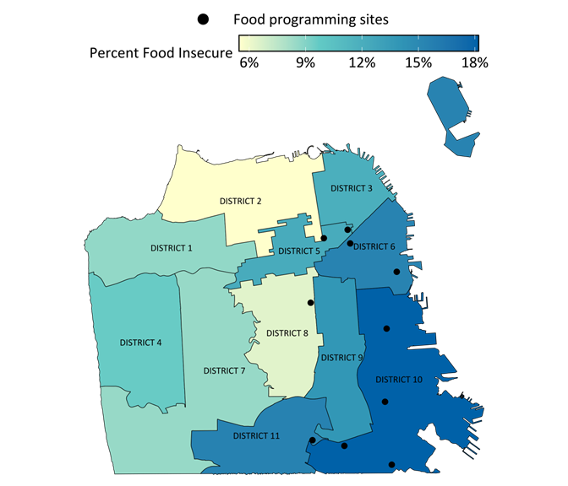
Adults in SF that are Food Insecure by District, 2022
In the past 12 months, adults were food insecure
Almost 1 in 5 adults in district 10 (18%)
Almost 1 in 7 adults in districts 11 (15%) and 6 (15%)
Organizations funded by the SDDT to provide food assistance are generally located in districts with higher rates of adult food insecurity
Notes:
Map of SF that shows the percentage of adults who reported food insecurity by supervisorial districts. Darker shading indicates that a higher percentage of adults in that district reported food insecurity.

