Slide 1


SFPD Q1 & Q2 2026 “Sparks” Report
Policy Updates: January 1 - June 30, 2026
CITY & COUNTY OF SAN FRANCISCO
Police Department
September 2, 2026
Notes:
Introductions

Slide 2
Safety with Respect
Policy Status Updates: Q1 & Q2 2026
Quarter | DGOs & Manuals | Department Notices
Q1 | 31 DGOs 1 Manual | 43 DNs: Review, Reissue, Archived or Rescinded
Q2 | 25 DGOs 0 Manuals | 38 DNs: Review, Reissue, Archived, or Rescinded

Slide 3
Safety with Respect
DGOs in Meet & Confer
2.05 Complaints Against Non-Sworn Members | PC Vote: 6/17/26
3.01 Department Written Directives | PC Vote: 6/10/26
6.05 Death Cases | PC Vote: 6/17/26
10.11 Body Worn Cameras | PC Vote: 7/8/26
11.12 Temporary Modified Duty | PC Vote: 7/15/26

Slide 4
Safety with Respect
In Queue for Concurrence
1.01 Organizational Structure
3.11 Data Management
3.16 Release of Police Reports and New Manual
6.09 Domestic Violence and DM 26 Manual
6.15 Property Processing and New Manual
11.06 Personnel Transfers
DM 12 Booking and Detention Manual

Slide 5
Safety with Respect
Working Group Updates
DGO 8.10 Working Group
DGO 8.10, Guidelines on First Amendment Activities, is currently in Stage I, which is due to end on September 10th First Meeting: Thursday, September 24, 2026 2pm-4pm, PHQ Community Room 1025

Slide 6
Safety with Respect
Working Group Membership
Stakeholders
DPA ACLU-Northern CA SF Pride Coleman Advocates Community Forward SF
Community Districts Represented
District 1 District 3 District 4 District 8 District 9

Slide 7
Safety with Respect
PDD - Implementation Unit
Dr. Carolyn M. Coles
PhD in Criminology, Law & Society from the University of California, Irvine
Dissertation: California Blue: An Exploration of Evidence-Based Policing in Three Law Enforcement Agencies in California
Previous work with:
Denver Police Department
Los Angeles Police Department
Anaheim Police Department
California POST
Baltimore Police Department
Evidence-based policing asks “what works”
Implementation science asks “how do we adopt, scale and sustain what works”

Slide 8
Safety with Respect
PDD - Implementation Unit
What is Implementation Science (IS) in policing?
Exploration – understanding the issue
Preparation – designing solutions
Implementation – monitoring fidelity of the model
Sustainment – institutionalizing the changes through policy

Slide 9
Practical Application in SFPD – Example of IS in practice
Stated Goals
Effectiveness
Adoption
Implementation
Maintenance

Slide 10
Safety with Respect
Further Action and Follow-Up
Q3 Sparks Report to be submitted to the Commission in October
Meet and Confer conclusions on several DGOs
Request the Commission to update Resolution 27-06 (SPARKS Reso)
PDD is now included in the Disciplinary Review Board (DRB)

Slide 11
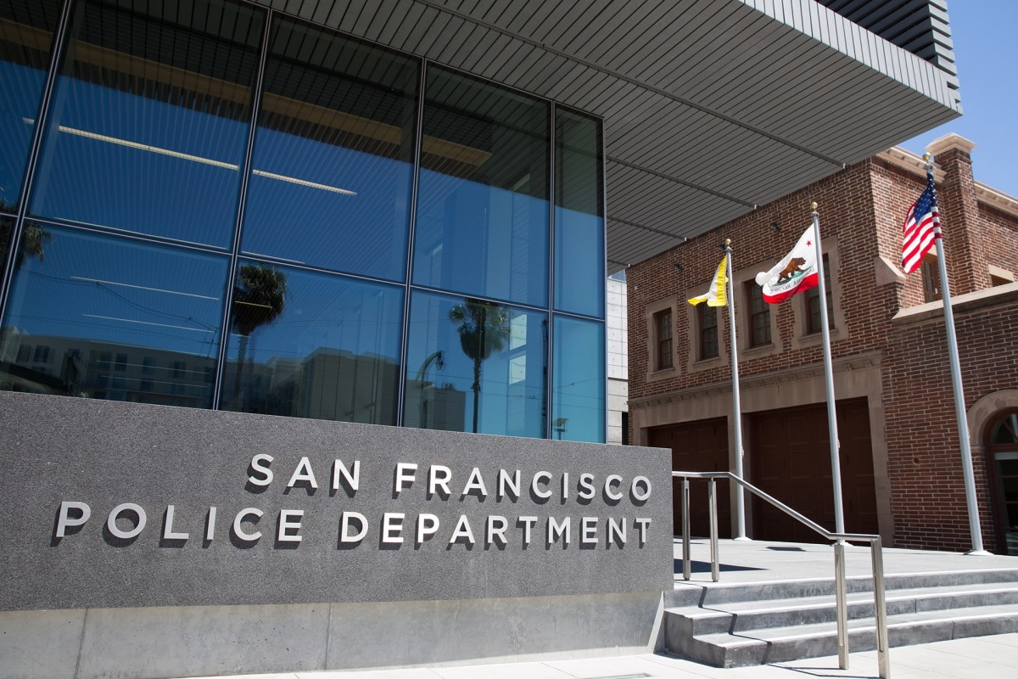
Questions?

