Slide 1

Power Station
Local Business Enterprise Advisory Committee
(LBEAC) Bi-Monthly Meeting
June 05, 2025

Slide 2
Agenda
Power Station Introduction
LBE Status
LBE Community Outreach
LBE Opportunities
Q & A

Slide 3
Introduction

Slide 4
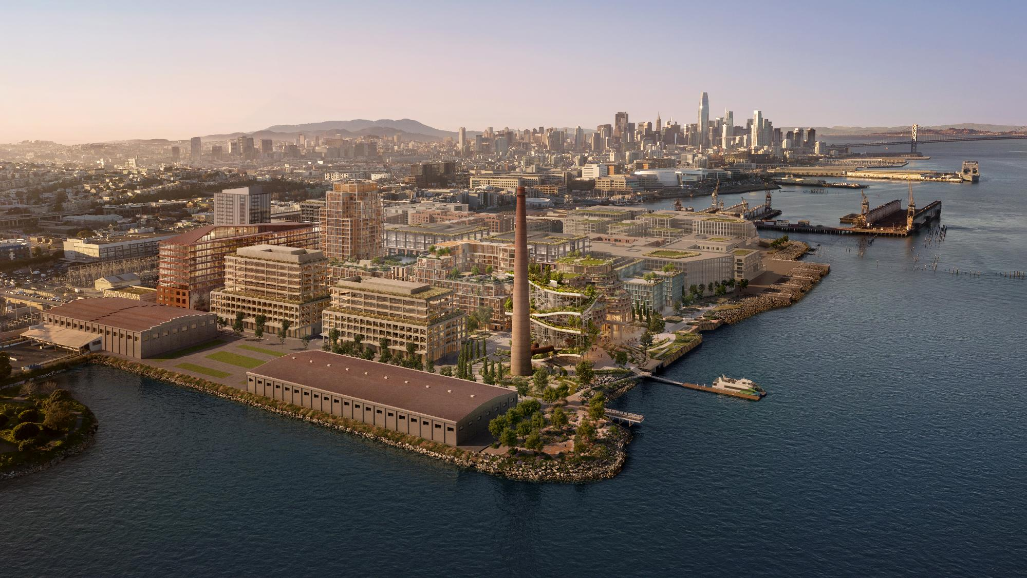
Notes:
Tina provides high level overview of project visions and goals (2 Minutes)

Slide 5
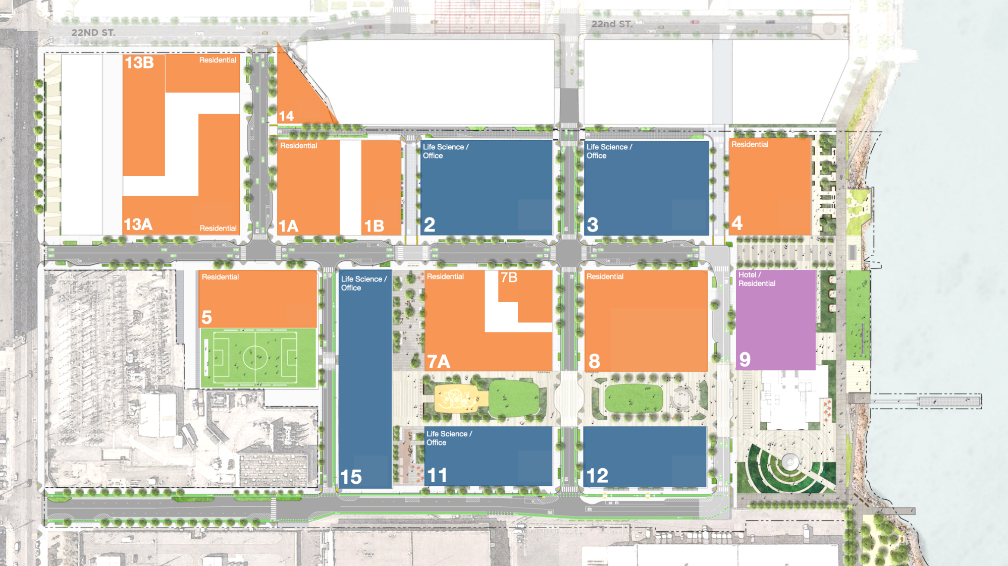


Pier 70
UCSF
Life Sciences Building
Site Plan
22 Apr 2025
Presented to UCSF

Slide 6
Workforce Agreement Hiring and Training
~2,000 jobs created as of Q4 2024
$1 million paid to fund OEWD Workforce Readiness and Job Training Funds
  Across two payments between Dec 2020 and March 2021 in lieu of various Development Phases
Compliance with First Source Hiring
Local Hiring on City- or Port-Owned property
  3,865 work hours in 2024; exceeding the goal by 64%
  454 apprentice hours in 2024; exceeding the goal by 70%

Slide 7
LBE Status

Slide 8
LBE Status as of Q4 2024
LBE Goal 17%
Construction Started in Q4 2020
Total Contracts: $235.5 mil
Total LBE Contracts: $44.9 mil
Total LBE: 19%
LBE CONTRACTS BY SIZE
Category | Contract Value | Percent of Total
Micro | $13.4 mil | 5.7%
Small | $28.4 mil | 12.0%
SBA | $3.1 mil | 1.3%
TOTAL | $44.9 mil | 19%
LBE CONTRACTS BY PRIORITY ZIP CODES
Zip Code | Contract Value | Percent of Total
94124 | $28.5 mil | 12.1%
94134 | $14,220 | 0%
94107 | $3.6 mil | 1.5%
Non-Priority | $12.7 mil | 5.4%
TOTAL | $44.9 mil | 19%

Slide 9
LBEs (past and active projects)
Albion Partners
Alta Group
Andrea Cochran Landscape Architecture, Inc.
A.R. Sanchez Corea & Associates, Inc.
Baird Trucking, Inc.
BAF Specialty, Inc.
Bay Print Solutions
BEI Steel
Bertco, Inc.
Bess Testlab
Buie Porter Munson
Cirius Engineering
Cobra Trucking Inc.
Collier Building Specialties
Divis Consulting
Eco Bay Services, Inc.
E.J. Weber Electric Company
Fontenoy Engineering Inc.
French California
FTF Engineering, Inc.
Ground Control, Inc.
Hoseley Corporation
HVYW8, Inc.
J Flores Construction
Kristen Hall City Design
Leddy Maytum Stacy Architects
Liffey Electric Inc.
Maven Commercial Inc.
Meridian Surveying Engineering Inc.
Mike O’Dell Surveys, Inc.
Molina’s Painting
Monte Wilson
On the Level Concrete
Palazzo Projects
Plural
Priority Architectural Graphics, Inc.
R&S Construction Management
RTI Environmental, LLC
Singular Builders
S J Engineers
Southeast Electrical Contractor
Specialties, Etc. Corp
Spencer Masonry
Team North Construction Services, Inc.
Temper Insulation Co.
Tuan & Robinson
Value Fire Protection
YCAT-C LLC
Zachary Nathan Architect
+ More

Slide 10
LBE Community Outreach

Slide 11
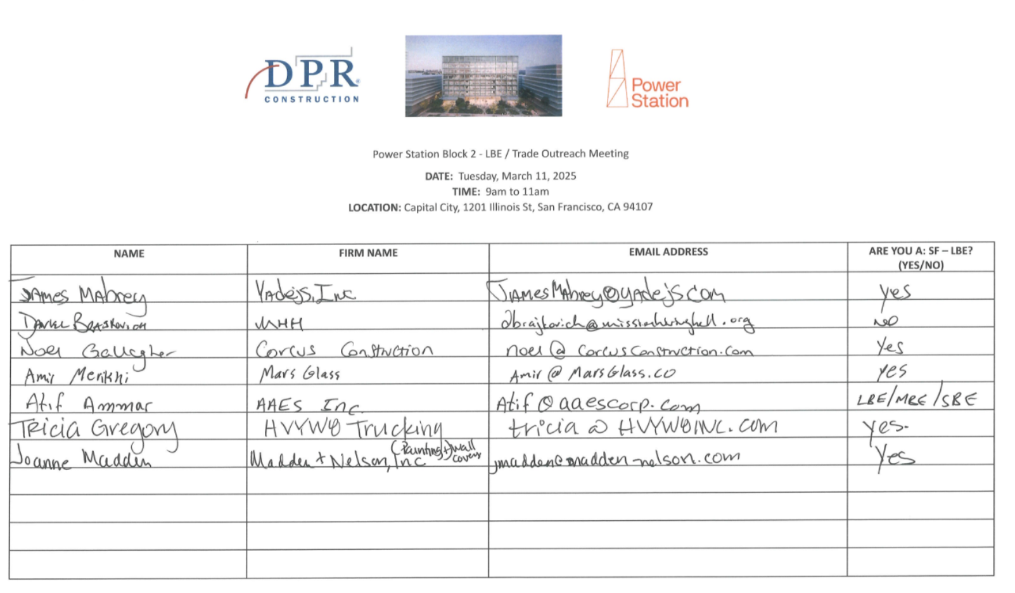
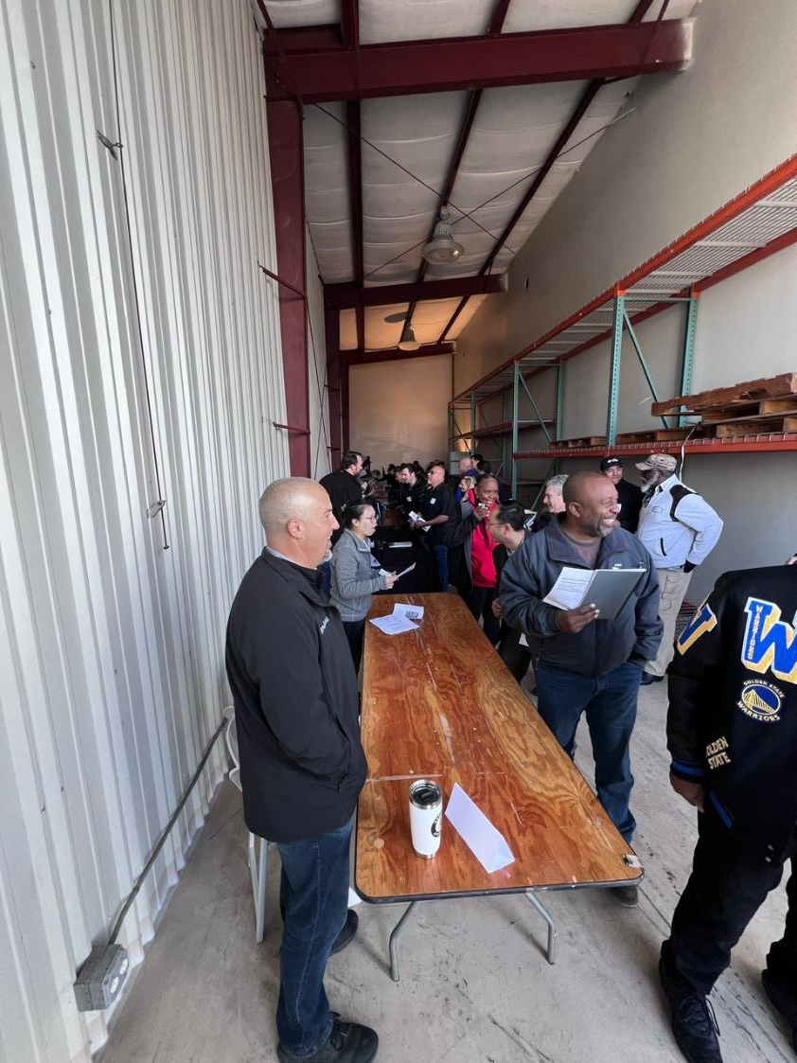
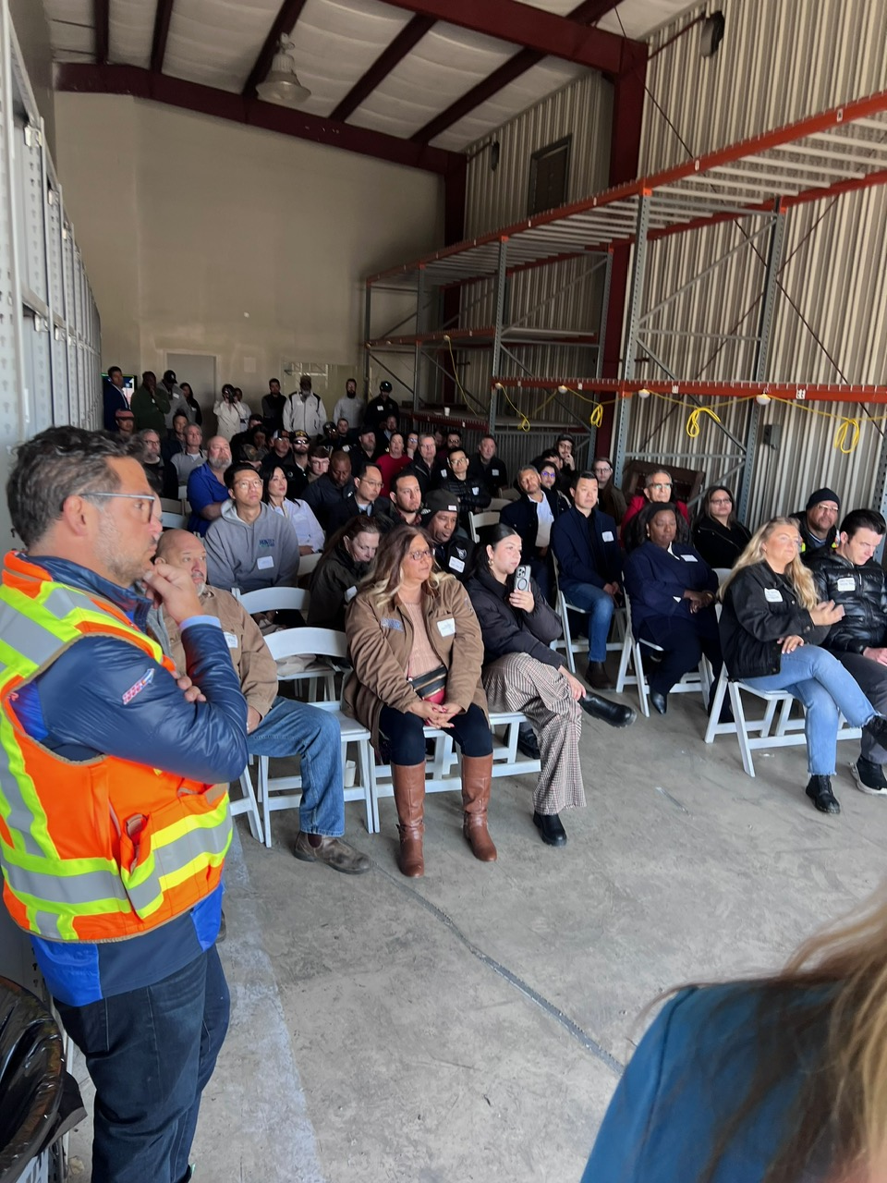
3/11/25 Block 2 LBE / Trade Outreach Meeting
Held onsite at Power Station
80+ attendees
60+ companies

Slide 12




D10 Key Stakeholder Meetings
5/13/25
SF Hyper Local Building Trades Contractors Collective (SFHLBTCC)
5/13/25
African American Construction Collective (AACC)
To be Scheduled
Aboriginal Blackman United (ABU)
To be Scheduled
National Association of Minority Contractors (NAMC)

Slide 13
LBE Opportunities

Slide 14
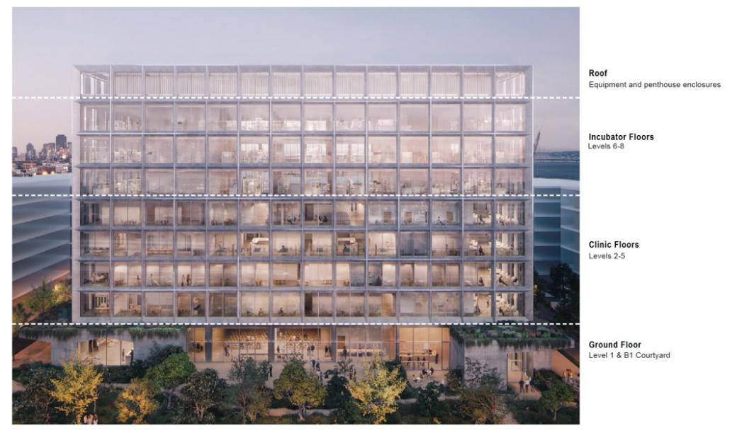

Block 2
302,000 sf building
8 stories above grade, 26,000 sf/floor
2-1/2 floor basement (varies 42’-60’ deep)​
Program areas:​
    UCSF Proton (cancer) therapy 60,000 SF​
    UCSF Conventional clinics 93,000 SF​
    Ground level lobbies, BOH and Symposium space
    Lifesciences tenant (NOT PART OF THIS PROJECT)​
Construction Start - June 2025

Slide 15
B2 Upcoming Bid Packages
Upcoming Trades to be Bidding:
  Drywall
  Concrete
  (including Formwork and Rebar)
  Structural Steel
  (including Metal Decking)
Remaining Structural Trades – 70% CD – Bidding Q3 2025:
  Misc. Steel – Basement
  Radiation Protection
  Proton Vault Hoisting
Remaining Trades – 95% CD – Q4 2025:
  Doors Frames & Hardware
  Sheet Metal Flashing
  Acoustical Ceilings
  Interior Specialties
  Anchor Medical Equipment
  Site Concrete
  Landscaping
  Masonry (CMU)
  Misc. Steel – Tower
  Casework & Millwork
  Fireproofing
  Metal Panels
  Roofing
  Sealants
  Glass & Glazing
  Tile
  Terrazzo
  Flooring (carpet, vinyl)
  Painting & Wall Covering
  Toilet Partitions & Accessories
  Access Floor
  Signage
  Loading Dock Equipment
  Food Service Equipment
  Laboratory Casework
  Window Treatment
  Paving
  Final Cleaning

Slide 16
B2 Upcoming Bid Packages
How can I bid, need more information?
  Concrete (Prime Subcontractors currently bidding):
Swinerton
  Manthan Kanabar, Sr. Estimator Manthan.Kanabar@swinerton.com
  Catherine Joslin Catherine.Joslin@swinerton.com
  Mick Penn Mpenn@swinerton.com
Webcor
  Mark Bettencourt mbettencourt@webcor.com
  Drywall (Prime Subcontractors currently bidding):
Swinerton
  John Jones John.Jones.1@swinerton.com
  Mick Penn Mpenn@swinerton.com
Webcor
  Derek Nagle dnagle@webcor.com
J&J Acoustics
  Abel Leon abel@jjacoustics.com
Performance Contracting Inc. (PCI)
  Brian Ohara brian.ohara@pcg.com

Slide 17
B2 Awarded Design/Precon Bid Packages
LBE Contracting Opportunities and Strategies
Contact Power Station to connect with Prime Subs
Prime Subcontractors directed to reach out to LBEs for partnering
Attend our “Meet the Prime Event”
Shoring & Earthwork
  Malcolm Drilling & Silverado Contractors
Hoist/Crane
  Bigge
Fire Protection
  Superior Automatic Sprinkler Co.
HVAC, Process & Plumbing Systems
  Southland Industries
Electrical
  Cupertino Electric
Low Voltage
  W Bradley Electric
Elevators
  Kone
Curtainwall & Storefront
  Walters & Wolf

Slide 18
B2 Upcoming Bid Packages
How can I bid, need more information?
  Please see advertisements on CMDs website
  www.sf.gov/departments--contract-monitoring-division
  Please attend Prebid meetings
  All documents shared via Building Connected (project NDA)
  All bid notifications sent via Building Connected
  Please Email: Sarah Mae Ledesma sml@associatecapital.com

Slide 19
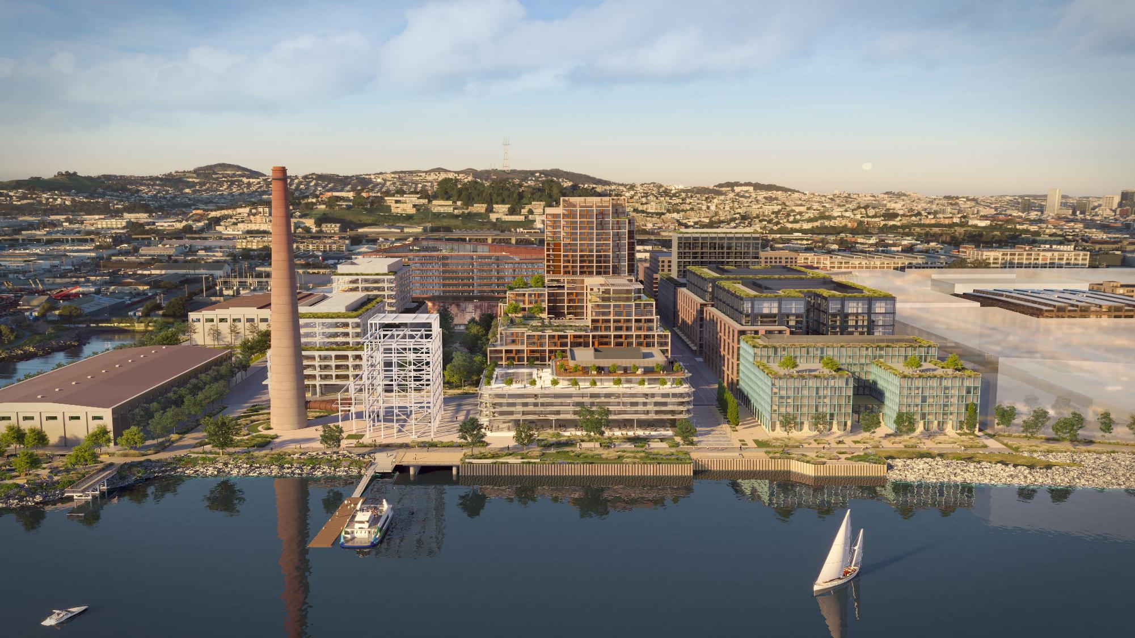


POWER STATION / PRESENTATION NAME
Q & A
1201 Illinois St, SAN FRANCISCO, CA 94107
DOGPATCHPOWERSTATION.COM
Advancing new development opportunities that will shape the future of the city.

