Slide 1
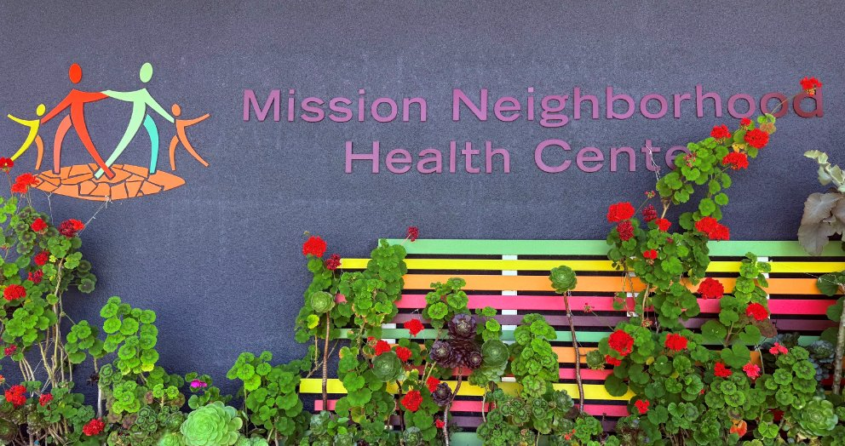
Immigrant Rights Commission Special Hearing
“Access to Healthcare for Immigrant Communities in San Francisco”
Mission Neighborhood Health Center (MNHC)
Presenters:
Chief Executive Officer, Anna Robert
Chief Clinical Operations Officer, Denisse Porter
Chief Strategy Officer, Willie Ramirez

Slide 2

Presentation Outline
MNHC will demonstrate what is at stake, what inaction will cost San Francisco, and why immediate investment in trusted community health centers is essential to protect access to care and prevent greater human and financial cost to San Francisco.
Who is Mission Neighborhood Health Center?
The Emerging Health Care Crisis: Barriers to Care
Patient, Family, and Community Impacts
Maintaining Trusted, Accessible, and Affordable Care in Community Health Centers
Government Leaders Securing the Financial Investment Needed to Maintain Access to Care

Slide 3
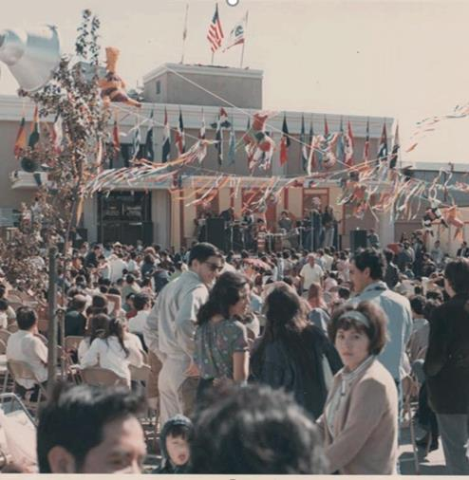
Our story
Founded in 1967 by community activists, Mission Neighborhood Health Center is an independent Federally Qualified Community Health Center that offers low-cost and free healthcare services to the community. MNHC is part of the SF Community Clinic Consortium. We are not part of the DPH/SFHN clinic system.
Our Mission
Mission Neighborhood Health Center honors our Latino roots with a tradition of providing compassionate, patient-centered care. We advocate for health equity and deliver innovative, high-quality services responsive to the neighborhoods and diverse communities we serve.
Opening Day, 1967

Slide 4
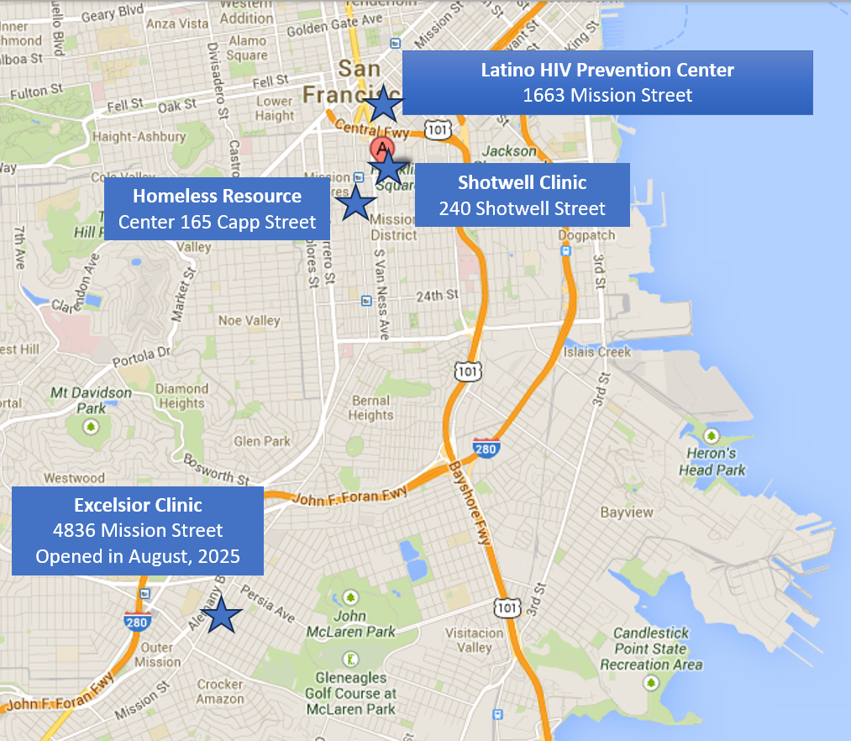
Our Services and Locations
Comprehensive Medical/Primary Care
  Pediatric
  Adult
  Women’s Health
  Prenatal Care
  Podiatry
In house Pharmacy
Dental
Optometry
Acupuncture
HIV Care and Prevention Services

Slide 5
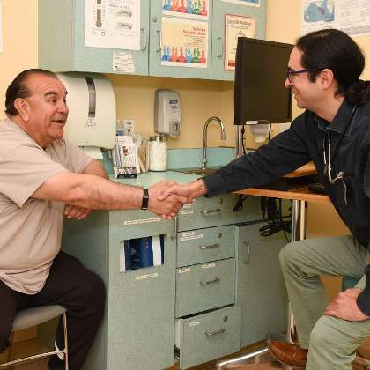
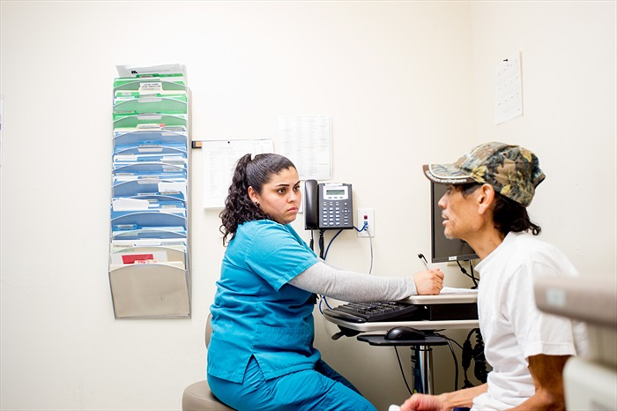
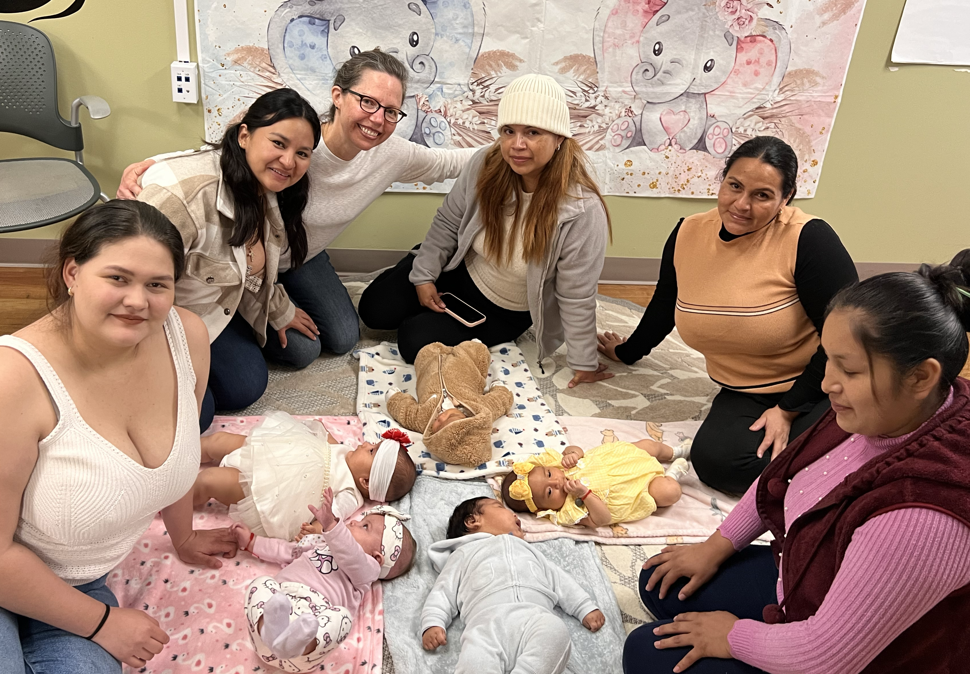
Our Patients
Beyond demographics, our patients live, work, attend schools, and contribute to the City and County of San Francisco well beyond the Mission District. They are the foundation that keeps this city thriving and many were frontline workers throughout the COVID pandemic.
18,000 unduplicated patients
75% prefer to receive care in Spanish
51% are less than 30 years old
76% live <100% FPL
90% consistently rate their provider a 9 or 10 ☺
Most common diagnoses and healthcare needs: hypertension, diabetes,
oral caries and gum disease, depression/anxiety/trauma
Social drivers of health needs consistent with underinsured populations:
Food, transportation, housing, utilities, etc.

Slide 6
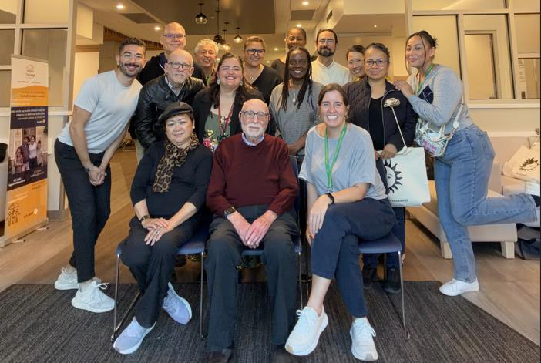
Our Secret Sazόn (Sauce)
Cultural congruence and competency, longevity of invested team members (>15% have worked at MNHC for more than 20 years), community trust, strong promotora presence, robust QI infrastructure and culture of patient centered, high-quality care. Our team responds to community needs.
When many of the Walgreen's closed, our pharmacy expanded – we are on track to fill over 30K prescriptions in 2026 – a 50% increase over 2024.
Our BOD has pushed us to be open weekday evening and Saturday hours to accommodate patients who cannot take time off of work.
A Tuesday meeting at Everett Middle School resulted in 24 students getting sports physicals 4 days later, on a Saturday.
At our first HSA pop-up event last week, 4 of the 7 enrollment workers did not speak Spanish. A rotation of team members were happy to fill in the gap when they typically had administration time throughout the day.

Slide 7
Our Growth and MediCal
Mission Neighborhood Health Center growth and improved health of our community is directly related to Medi-Cal expansion – it allowed the community to increase access to medical, dental and behavioral health. We saw 13,800 pts in 2020 and over 18,000 in 2025.

Slide 8
Our Health Impact – we are healthier!

Slide 9
Medi-Cal Changes: Community & Clinic Impact
The crisis is already here — and greater impacts are ahead
~18,000
~1,300
500+
San Franciscans have fallen off Medi-Cal since December 2025
Additional San Franciscans enrolled in Healthy San Francisco in the same period
MNHC patients each month already need help renewing Medi-Cal
WHAT WE ARE SEEING NOW
MNHC’s MediCal enrollment numbers have decreased by 2k since January 2026. More patients are arriving at MNHC without coverage after losing Medi-Cal or becoming ineligible to enroll. Not all patients want to sign up for Healthy San Francisco.

Slide 10
Healthy SF Does Not Replace Medi-Cal
Patients face narrower benefits and more costs
while clinics receive less support for comprehensive care
FOR PATIENTS
FOR COMMUNITY CLINICS
• Quarterly dues for anyone above 101% FPL, plus point-of-service fees at the clinic.
• Adults only and medical services in San Francisco only.
• Does not cover dental, behavioral health or acupuncture.
• Fear and public charge confusion may also increase the number of uninsured children, who are not eligible for Healthy SF.
• Healthy SF reimbursement does not come close to covering the comprehensive cost of care our community needs and we provide
• 2027 six-month renewals, work requirements and monthly fees for some immigrants will increase the risk of coverage loss -> more HSF and uninsured.
Healthy SF is an important safety net program, but it cannot replace the coverage, services or funding that Medi-Cal provides, and community clinics need to care for patients.

Slide 11
San Francisco Health Care Workforce at Risk
Visa restrictions, DACA delays and work-authorization uncertainty can make it harder for community providers to recruit and retain the people who provide that care.
Losing these experienced health care workers reduces staffing capacity, disrupts continuity of care, and further limits access for the communities to language capacity, cultural understanding, trusted relationships and years of connection to the communities we serve.
This is a healthcare infrastructure issue that impacts all of San Francisco’s health centers and entities that provide medical, behavioral health, and dental services – including those run by SFDPH.

Slide 12
Where Care Is Delivered Matters
Illustrative direct staffing cost to provide 18 primary care visits with care team of nurse practitioner, nurse, medical assistant and front desk team members – 80% more expensive in SFDPH clinics.
$5,000–$7,000
+ hours of patient time
for an avoidable ED visit
that could have been treated in an outpatient primary care setting – no one wants this
In order to prevent uninsured patients seeking care in higher-cost settings, we need to understand the true cost and capacity of care across the entire safety net.

Slide 13
A Different Approach Is Needed
We believe there is a solution that can meet the needs of patients and communities, while addressing the financial pressures facing San Francisco’s health care system.
REQUIRES TRUE PARTNERSHIP IN PLANNING, RETHINK THE CURRENT MODEL
No single community health center, health system, or SFDPH can absorb all of the patients who may lose coverage. Not relying on a healthcare coverage and delivery system for the uninsured that has not fundamentally changed in more than 20 years – the system needs to adapt to current realities
WE NEED TO USE THE ENTIRE SAFETY NET
Community health centers, behavioral health clinics, SFDPH and other providers each have different capacity, services, geography and community relationships.
WE ALSO NEED TO PLAN FOR MORE FEDERAL UNCERTAINTY
Pending litigation over PRWORA could further restrict which federally funded providers are permitted to serve some immigrant patients.
We cannot wait for patients to lose coverage and then figure out where they can go.
We need a citywide plan now.

Slide 14
Solution in Partnerships
In response to the urgent need to maintain and expand affordable, trusted, and culturally responsive health, dental, and behavioral health services for immigrant families and other underserved and vulnerable communities, we ask the San Francisco Immigrant Rights Commission to call for the creation of a Healthcare Access Rapid Response Team (HARRT) or Corazon, led by the Mayor’s office, with representatives from the San Francisco Health Commission, Department of Public Health, Human Services Agency, San Francisco Community Clinic Consortium and at least two CBO’s who provide specialty behavioral health services.
HARRT should develop within 60 days a coordinated funding and implementation plan that protects access to care and stabilizes the community health care workforce.
Sustainably fund community-based care. For patients who are uninsured or choose not to enroll in HSF, community health clinics must be sustainably funded to provide affordable, trusted health, dental, and behavioral health services through existing community-based infrastructure and funding mechanisms.
Close the Healthy San Francisco reimbursement gap. While Healthy San Francisco is not health insurance, community health centers are providing essential care to enrolled and uninsured patients. HSF reimbursement must adequately and equitably reflect the actual cost of providing this care and address the financial gap currently being absorbed by community clinics.
Embed Medi-Cal and CalFresh enrollment services at community health centers. The Human Services Agency should provide full-scale, on-site enrollment and renewal assistance at trusted community health centers to prevent eligible patients and families from unnecessarily losing health coverage and food assistance.
Protect the health care workforce. Provide or reimburse legal assistance for health care workers affected by changes in immigration status or work authorization.
Report back to the Immigrant Rights Commission within 30 days. To gauge progress on the HARRT implementation.

Slide 15
Questions
Thank you – Gracias!

