Slide 1

Street Artist Committee
Meeting
July 27, 2026

Slide 2

Item 1: Call to Order, Roll Call, Agenda Changes,
Land Acknowledgement
      Call to order​
      Roll call / Confirmation of quorum​
      Agenda Changes​
      Ramaytush Ohlone Land Acknowledgement

Slide 3
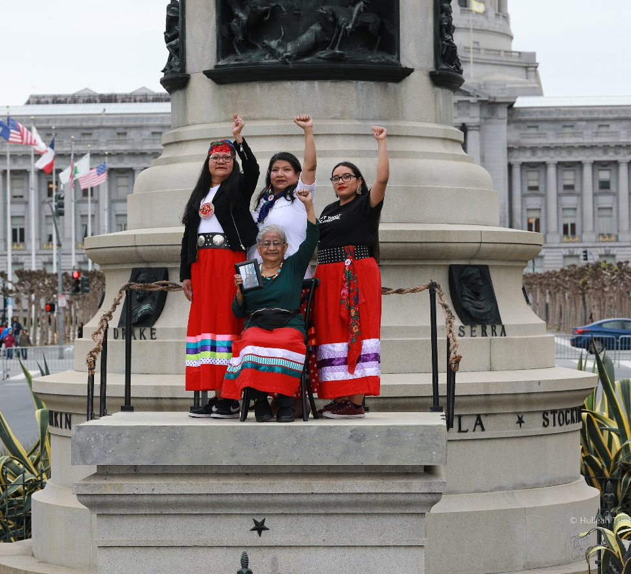
Land Acknowledgement
The San Francisco Arts Commission acknowledges that we are on the unceded ancestral homeland of the Ramaytush Ohlone who are the original inhabitants of the San Francisco Peninsula. As the indigenous stewards of this land and in accordance with their traditions, the Ramaytush Ohlone have never ceded, lost nor forgotten their responsibilities as the caretakers of this place, as well as for all peoples who reside in their traditional territory. As guests, we recognize that we benefit from living and working on their traditional homeland. We wish to pay our respects by acknowledging the ancestors, elders and relatives of the Ramaytush Community and by affirming their sovereign rights as First Peoples. As a department dedicated to promoting a diverse and equitable Arts and Culture environment in San Francisco, we are committed to supporting the traditional and contemporary evolution of the American Indian community.​
Antone Family (Tohono O'odham), 2019, Photo by Hulleah Tsinhnahjinnie
Left to right: Christine [seated], Melanie, Michelle and Arianna

Slide 4
Item 2: General Public Comment
Discussion
(This item is to allow members of the public to comment generally on matters within the Committee’s purview as well as to suggest new agenda items for the committee’s consideration.)

Slide 5
Item 3: Overview of Art Vendor Disciplinary Procedures
Discussion
Staff Presenter: Senior Program Officer, Anne Trickey
Presentation Time: Approximately 5 minutes

Slide 6
Item 3
Art Vendor Disciplinary Procedures and the Role of the Street Artists Committee/Community Investments Committee
Step 1: The Report
Arts Commission staff receive a verbal or written report of a program violation.
Step 2: The Investigation
Arts Commission staff investigate the report and gather evidence in support of or contesting the complaint.
Step 3: Issuance of Notice
If a violation is found, Arts Commission staff issue a Notice of Warning.
Program violations are divided into Minor and Serious categories. Minor violations are “non-violent/non-threatening.” Serious violations are “violations of a violent or threatening nature and violations that significantly threaten the integrity,” of the program. Two subsequent minor violations trigger a disciplinary hearing. A serious violation immediately goes to a disciplinary hearing. Disciplinary hearings are heard at the Street Artists Committee.

Slide 7
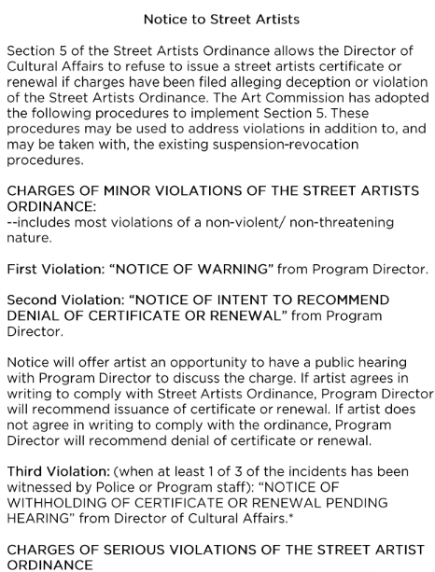
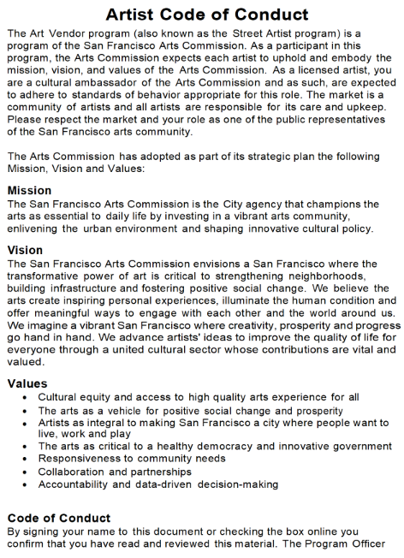
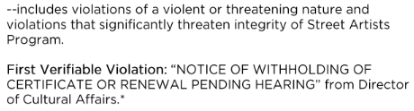
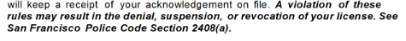

Slide 8
Item 3
Step 4: Public Hearing
Arts Commission staff only bring disciplinary cases with clear evidence of violation to the Committee, as the Street Artists Committee is the body empowered to deny, suspend, or revoke a license. The Street Artists Committee is held on the same date and time as the Community Investments Committee and is made up of the same Commissioners. These meetings are agendized separately. Evidence gathered during the investigation is posted as supporting documentation with the agenda and may be redacted to protect individuals’ personal information and to impede retaliation.
At the Committee meeting, the disciplinary hearing proceeds as follows:
4(a): Open with Public Comment
The public is provided a time limit to speak on the agendized motion.
4(b): Presenting the Case
The Arts Commission staff member that investigated the violation presents the case, referring to the written report included in the meeting’s supplementary documents. The Director of the Program makes the recommended disciplinary action as agendized to the Committee.

Slide 9
Item 3
4(c): Artists Speak
The parties involved are given five (5) minutes to speak on their behalf and a two (2) minute rebuttal. If there is only one party they are given five (5) minutes. Artists in need of language assistance are provided interpreters.
4(d): Deliberation
During deliberation, Committee members may ask any questions of the artists, of staff, or of any other member of the public present. It is best practice that Committee members keep their questions to staff and the artists involved in the case so as not to privilege certain members of the public over others. This process should take no more than ten (10) minutes.
4(e): The Vote
The Committee may decide to take the action as recommended by staff, or they may amend the recommend action. The action as listed on the agenda is what staff believe to be the most appropriate response to the investigated violation.

Slide 10
Item 3
Step 5: Rehearing Process
If new evidence becomes available that was not possible to present at the time of the hearing or if the artist was unable to attend for good cause shown, they may be granted a rehearing if they make the request within (5) five days of the Committee meeting. After (5) five days, the Program Director issues a formal notice of decision not appealable to any level of the Arts Commission.
Step 6: Formal Notice of Decision
The Program Director’s formal notice of decision is sent no later than (15) fifteen days after the disciplinary hearing. Because this program specifies the validity of a license or permit, the Board of Appeals is the final arbitration body of the decision. An artist may file an appeal with the Board of Appeals up to (15) fifteen days from the notice of decision. Arts Commission staff then present their case at the Board of Appeals according to their process.
Sources:
Notice to Artists
Code of Conduct
Article 24 of the Police Code
  Hearing procedures start in section 2408
The Program Manual aka “Blue Book”
  Hearing Procedures start on page 104
The Board of Appeals Process
  Hearing Procedures start on page 3

Slide 11
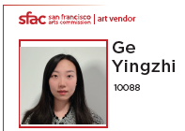
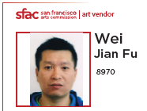
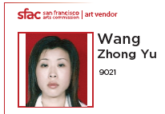
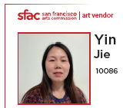
Parties and Actions Confirmed by Witnesses:
Committed violence against Wang
Physically restrained Wang
Submitted Incident Report
Threatened Wei on video
Attempted violence against Wang

Slide 12
Item 3
Discussion
Item 3: Overview of Art Vendor Disciplinary Procedures

Slide 13
Public Comment
Item 3: Overview of Art Vendor Disciplinary Procedures

Slide 14
Item 4: Hearing and possible motion to approve revocation of art vendor license for art vendor ZhongYu Wang (9021):
• Participating in a violent altercation, threats against art vendor Jianfu Wei (8970) and disrupting the business of the market.
Discussion and Possible Action
Staff Presenter: Senior Program Officer, Anne Trickey
Presentation Time: Approximately 5 minutes

Slide 15
Parties and Actions Confirmed by Witnesses
Physically restrained Wang
Submitted Incident Report
Threatened Wei on video

Slide 16
Item 4
TOPIC: Revocation of art vendor license for Art Vendor ZhongYu Wang, License Number 9021:
• Participating in a violent altercation, threats against art vendor Jianfu Wei Number 8907 and disrupting the business of the market.
I. ZhongYu Wang, Number 9021: Approximately 5 minutes, additional 5 minutes for interpretation for total 10 minutes.
II. Statement by Jianfu Wei, Number 8907 : Approximately 5 minutes, additional 5 minutes for interpretation for total 10 minutes.
III. Rebuttal by ZhongYu Wang, Number 9021: Approximately 2 minutes, additional 2 minutes for interpretation for total of 4 minutes
IV. Counter-Rebuttal by Jianfu Wei, Number 8907 : Approximately 2 minutes, additional 2 minutes for interpretation for total of 4 minutes
Notes:
Jonell

Slide 17
Item 4
Discussion
Item 4: Hearing and possible motion to approve revocation of art vendor license for art vendor ZhongYu Wang (9021):
• Participating in a violent altercation, threats against art vendor Jianfu Wei (8970) and disrupting the business of the market.
Possible action to revoke the art vendor license for ZhongYu Wang, License Number 9021.

Slide 18
Public Comment
Item 4: Hearing and possible motion to approve revocation of art vendor license for art vendor ZhongYu Wang (9021):
• Participating in a violent altercation, threats against art vendor Jianfu Wei (8970) and disrupting the business of the market.

Slide 19
Item 4
TOPIC: Revocation of art vendor license for Art Vendor ZhongYu Wang, License Number 9021.
MOTION to approve revocation of art vendor license for ZhongYu Wang, License Number 9021.
Notes:
Jonell

Slide 20
Item 5: Adjournment
Action

