Slide 1

San Francisco Arts Commission Executive Committee Meeting
January 20, 2023

Slide 2

Item 1: Call to Order, Roll Call, Agenda Changes,
Land Acknowledgement
      Call to order​
      Roll call / Confirmation of quorum​
      Agenda Changes​
      Ramaytush Ohlone Land Acknowledgement

Slide 3

Public Comment via WebEx:​
  Hover over your name in the attendee list and click on the hand icon ​
  to raise your hand.​
  You will be placed in the queue once your hand is raised.​
  When are unmuted by the host, you will see a request to unmute window pop up. ​
  Click “unmute” and you will be prompted to speak.​
​
Public Comment via Phone:​
  Dial 415-655-0001. ​
  Enter the Access Code: 2486 505 8549 followed by #.
  Enter the Numeric Meeting Passcode: SFAC120 (7322120 from phones) then #.​
  When prompted, dial ‘*’ then ‘3’ to be added to the speaker line.​
  You will receive a request to unmute yourself. Press "*6" to be unmuted. You will hear, “Your line has been unmuted.” This is your time to speak.​
​
Participants who wish to speak on other public comment periods may stay on the line and listen for the next public comment opportunity. For further inquiries, please contact: art-info@sfgov.org. ​

Slide 4
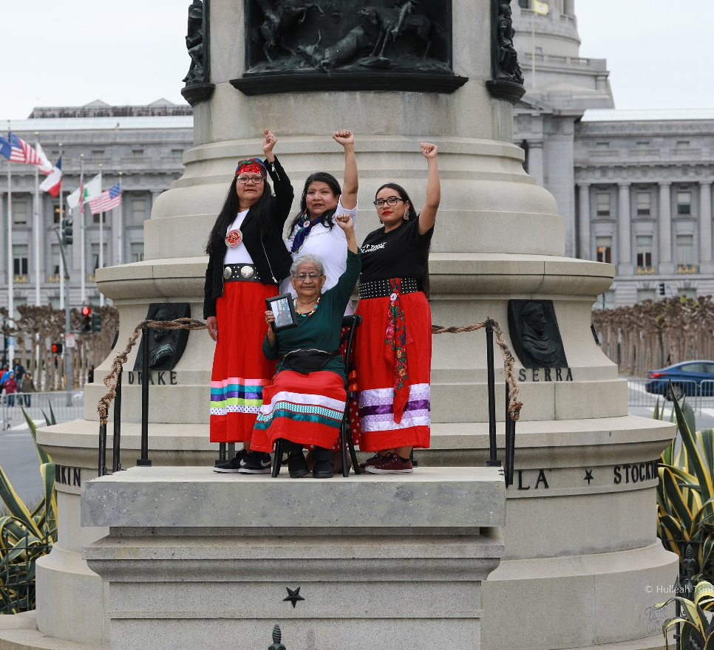
Land Acknowledgement
The San Francisco Arts Commission acknowledges that we are on the unceded ancestral homeland of the Ramaytush Ohlone who are the original inhabitants of the San Francisco Peninsula. As the indigenous stewards of this land and in accordance with their traditions, the Ramaytush Ohlone have never ceded, lost nor forgotten their responsibilities as the caretakers of this place, as well as for all peoples who reside in their traditional territory. As guests, we recognize that we benefit from living and working on their traditional homeland. We wish to pay our respects by acknowledging the ancestors, elders and relatives of the Ramaytush Community and by affirming their sovereign rights as First Peoples. As a department dedicated to promoting a diverse and equitable Arts and Culture environment in San Francisco, we are committed to supporting the traditional and contemporary evolution of the American Indian community.​
Antone Family (Tohono O'odham), 2019, Photo by Hulleah Tsinhnahjinnie
Left to right: Christine [seated], Melanie, Michelle and Arianna

Slide 5
Item 2: General Public Comment
Discussion
( This item is to allow members of the public to comment generally on matters within the Committee’s purview as well as to suggest new agenda items for the committee’s consideration. )

Slide 6
Public Comment via WebEx:​
  Hover over your name in the attendee list and click on the hand icon ​
  to raise your hand.​
  You will be placed in the queue once your hand is raised.​
  When are unmuted by the host, you will see a request to unmute window pop up. ​
  Click “unmute” and you will be prompted to speak.​
​
Public Comment via Phone:​
  Dial 415-655-0001. ​
  Enter the Access Code: 2486 505 8549 followed by #.
  Enter the Numeric Meeting Passcode: SFAC120 (7322120 from phones) then #.​
  When prompted, dial ‘*’ then ‘3’ to be added to the speaker line.​
  You will receive a request to unmute yourself. Press "*6" to be unmuted. You will hear, “Your line has been unmuted.” This is your time to speak.​
​
Participants who wish to speak on other public comment periods may stay on the line and listen for the next public comment opportunity. For further inquiries, please contact: art-info@sfgov.org. ​

Slide 7
Item 3: Director’s Report
Discussion
Staff Presenter: Director of Cultural Affairs, Ralph Remington
Presentation Time: Approximately 10 minutes

Slide 8
Public Comment via WebEx:​
  Hover over your name in the attendee list and click on the hand icon ​
  to raise your hand.​
  You will be placed in the queue once your hand is raised.​
  When are unmuted by the host, you will see a request to unmute window pop up. ​
  Click “unmute” and you will be prompted to speak.​
​
Public Comment via Phone:​
  Dial 415-655-0001. ​
  Enter the Access Code: 2486 505 8549 followed by #.
  Enter the Numeric Meeting Passcode: SFAC120 (7322120 from phones) then #.​
  When prompted, dial ‘*’ then ‘3’ to be added to the speaker line.​
  You will receive a request to unmute yourself. Press "*6" to be unmuted. You will hear, “Your line has been unmuted.” This is your time to speak.​
​
Participants who wish to speak on other public comment periods may stay on the line and listen for the next public comment opportunity. For further inquiries, please contact: art-info@sfgov.org. ​

Slide 9
Item 4: Arts Commission FY 2023-2024 and
2024-2025 Draft Budget
Discussion and Possible Action
Staff Presenter: Deputy Director of Finance and Administration Rally Catapang
Presentation Time: Approximately 10 minutes

Slide 10
Public Comment via WebEx:​
  Hover over your name in the attendee list and click on the hand icon ​
  to raise your hand.​
  You will be placed in the queue once your hand is raised.​
  When are unmuted by the host, you will see a request to unmute window pop up. ​
  Click “unmute” and you will be prompted to speak.​
​
Public Comment via Phone:​
  Dial 415-655-0001. ​
  Enter the Access Code: 2486 505 8549 followed by #.
  Enter the Numeric Meeting Passcode: SFAC120 (7322120 from phones) then #.​
  When prompted, dial ‘*’ then ‘3’ to be added to the speaker line.​
  You will receive a request to unmute yourself. Press "*6" to be unmuted. You will hear, “Your line has been unmuted.” This is your time to speak.​
​
Participants who wish to speak on other public comment periods may stay on the line and listen for the next public comment opportunity. For further inquiries, please contact: art-info@sfgov.org. ​

Slide 11
Item 5: Amendment to SF Symphony Contract
Discussion and Possible Action
Staff Presenter: Deputy Director of Programs, Joanne Lee
Presentation Time: Approximately 10 minutes

Slide 12
Public Comment via WebEx:​
  Hover over your name in the attendee list and click on the hand icon ​
  to raise your hand.​
  You will be placed in the queue once your hand is raised.​
  When are unmuted by the host, you will see a request to unmute window pop up. ​
  Click “unmute” and you will be prompted to speak.​
​
Public Comment via Phone:​
  Dial 415-655-0001. ​
  Enter the Access Code: 2486 505 8549 followed by #.
  Enter the Numeric Meeting Passcode: SFAC120 (7322120 from phones) then #.​
  When prompted, dial ‘*’ then ‘3’ to be added to the speaker line.​
  You will receive a request to unmute yourself. Press "*6" to be unmuted. You will hear, “Your line has been unmuted.” This is your time to speak.​
​
Participants who wish to speak on other public comment periods may stay on the line and listen for the next public comment opportunity. For further inquiries, please contact: art-info@sfgov.org. ​

Slide 13
Item 6: Racial Equity Update
Discussion
Staff Presenter: Senior Racial Equity & Policy Analyst, Sandra Panopio
Presentation Time: Approximately 5 minutes

Slide 14
2023 Priorities
Ensuring an Equity-centered Strategic Planning process
Continuation of internal Racial Equity Action Plan
Creating meaningful Community Engagement process
Exploring phase II of the Monuments & Memorials work

Slide 15
Public Comment via WebEx:​
  Hover over your name in the attendee list and click on the hand icon ​
  to raise your hand.​
  You will be placed in the queue once your hand is raised.​
  When are unmuted by the host, you will see a request to unmute window pop up. ​
  Click “unmute” and you will be prompted to speak.​
​
Public Comment via Phone:​
  Dial 415-655-0001. ​
  Enter the Access Code: 2486 505 8549 followed by #.
  Enter the Numeric Meeting Passcode: SFAC120 (7322120 from phones) then #.​
  When prompted, dial ‘*’ then ‘3’ to be added to the speaker line.​
  You will receive a request to unmute yourself. Press "*6" to be unmuted. You will hear, “Your line has been unmuted.” This is your time to speak.​
​
Participants who wish to speak on other public comment periods may stay on the line and listen for the next public comment opportunity. For further inquiries, please contact: art-info@sfgov.org. ​

Slide 16
Item 7: New Business and Announcements
Discussion
( This item is to allow Commissioners to introduce new agenda items for consideration; to report on recent arts related activities and to make announcements. )

Slide 17
Public Comment via WebEx:​
  Hover over your name in the attendee list and click on the hand icon ​
  to raise your hand.​
  You will be placed in the queue once your hand is raised.​
  When are unmuted by the host, you will see a request to unmute window pop up. ​
  Click “unmute” and you will be prompted to speak.​
​
Public Comment via Phone:​
  Dial 415-655-0001. ​
  Enter the Access Code: 2486 505 8549 followed by #.
  Enter the Numeric Meeting Passcode: SFAC120 (7322120 from phones) then #.​
  When prompted, dial ‘*’ then ‘3’ to be added to the speaker line.​
  You will receive a request to unmute yourself. Press "*6" to be unmuted. You will hear, “Your line has been unmuted.” This is your time to speak.​
​
Participants who wish to speak on other public comment periods may stay on the line and listen for the next public comment opportunity. For further inquiries, please contact: art-info@sfgov.org. ​

Slide 18
Item 8: Adjournment

