Slide 1
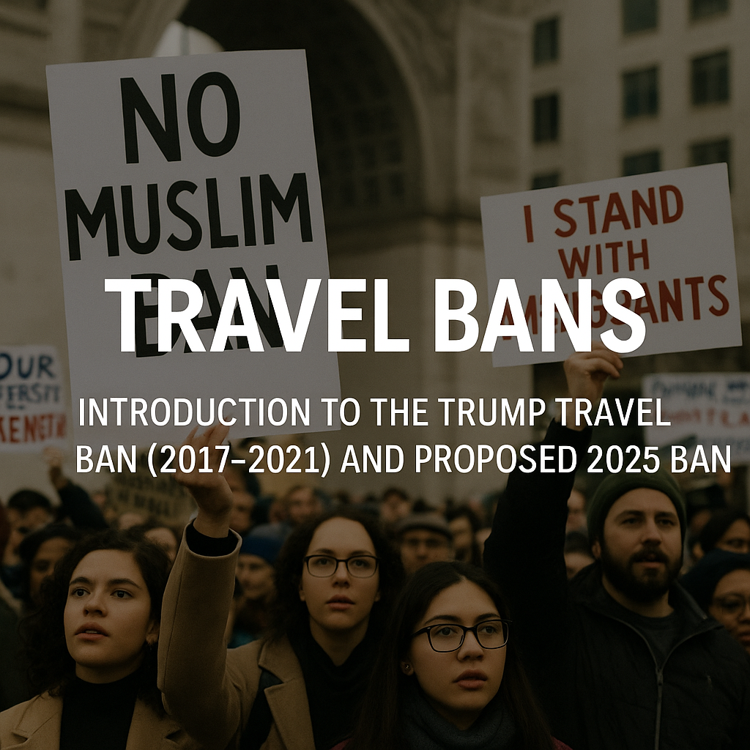
Trump Travel Ban: 2017–2021 and Proposed 2025 Ban
An Analysis of Origins, Impact, Legal Challenges, and Future Prospects

Slide 2
Origins of the Muslim Ban (2017)
Executive Order 13769:
Banned entry from 7 Muslim-majority countries
Justification:
Terrorism concerns and security vetting
Chaotic implementation:
Detentions at airports, legal challenges

Slide 3
Countries Affected and Changes Over Time
Initial countries:
Iran, Iraq, Libya, Somalia, Sudan, Syria, Yemen
Revised list:
Removed Iraq, added Chad, North Korea, Venezuela
2020 expansion:
Added Nigeria, Sudan, Tanzania, Eritrea, Kyrgyzstan, Myanmar
Total affected:
Up to 13 countries at various points

Slide 4
Human Impact of the First Travel Ban
Families separated:
Thousands of visa holders were stranded abroad
Personal stories:
Yemeni-American families and Iranian students were unable to enter
Legal support:
Lawyers stationed at airports to assist detainees
Emotional toll:
Anxiety and fear among affected communities

Slide 5
Legal Challenges and Supreme Court Rulings
Immediate legal injunctions: Federal judges blocked the ban
Supreme Court ruling (2018): Upheld the ban (5-4 decision)
Key arguments: National security vs. religious discrimination
Dissent: Risk of religious bias in policy implementation

Slide 6
Political Context and Motivations
Campaign Promise: 'Muslim Ban' rhetoric from 2016
National security framing: Targeting perceived terror risks
Support: Conservative base emphasizing strong borders
Criticism: Perceived as religious discrimination

Slide 7
Public and International Responses
Mass protests: Airports and public spaces
International condemnation: Allies criticizing the policy
Domestic pushback: Civil rights groups, CAIR, ACLU and AILA, ABA and many other organizations

Slide 8
Travel Ban Revocation (2021)
President Biden's action: Repealed the travel ban on day one of his administration
Impact: Reinstatement of visa processing and refugee admissions
Restored family reunification and humanitarian support

Slide 9
Proposed Travel Ban (2025)
Promoted by Donald Trump: Expanding the original ban
Broader scope: Up to 41-43 countries targeted
Tiered restrictions: Full bans, partial bans, conditional bans

Slide 10
Proposed Travel Ban (2025)
Background: Overview of the Trump administration's travel bans initiated in 2017, aimed at enhancing national security.
Objective: To categorize affected countries based on the severity of restrictions and associated risk levels.

Slide 11
Red Category:
All Travel Banned
Afghanistan
Bhutan
Cuba
Iran
Libya
North Korea
Somalia
Syria
Venezuela
Yemen

Slide 12
Orange Category:
Sharply Restricted
Belarus
Eritrea
Haiti
Laos
Myanmar
Pakistan
Russia
Sierra Leone
South Sudan
Turkmenistan

Slide 13
Yellow Category:
60 Days to Address Concerns
Angola
Antigua and Barbuda
Benin
Burkina Faso
Cambodia
Cameroon
Cape Verde
Chad
Republic of Congo

Slide 14
Yellow Category:
60 Days to Address Concerns
Dem. Republic of Congo
Dominica
Equatorial Guinea
Gambia
Liberia
Malawi
Mali

Slide 15
Yellow Category:
60 Days to Address Concerns
Mauritania
St. Kitts and Nevis
St. Lucia
Sao Tome and Principe
Vanuatu
Zimbabwe

Slide 16
Conclusion and Key Takeaways
The 2017 travel ban led to widespread controversy and human suffering
The 2025 proposed ban seeks to expand restrictions significantly
Balancing security needs with civil rights remains a contentious issue

