Slide 1
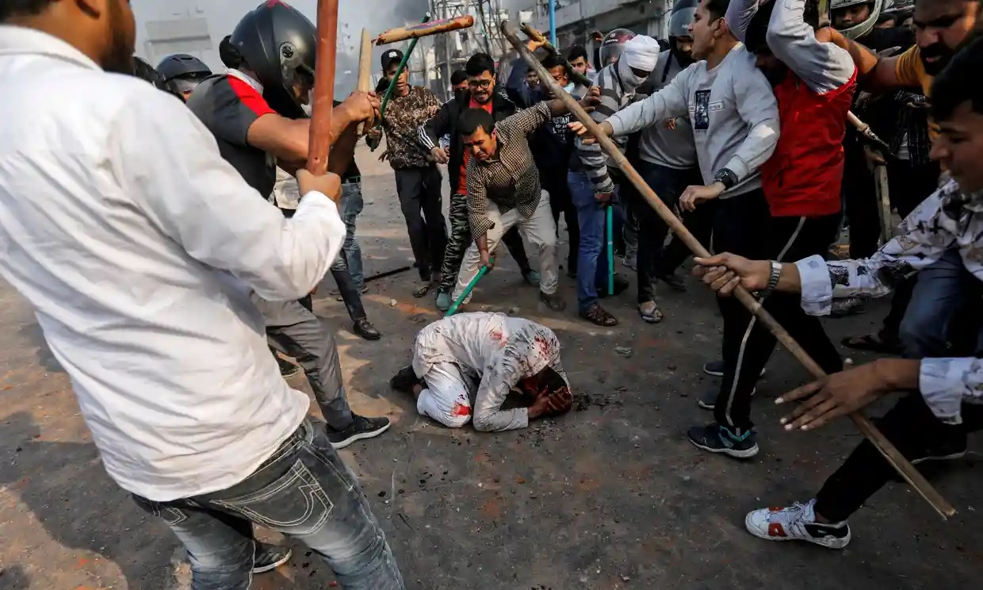
THIS IS HINDUTVA

Slide 2
WHAT IS HINDUTVA?
Hindutva, or Hindu nationalism, is a far right political ideology modeled off Nazism and Italian facism.

Slide 3
VIEWS OF HINDUTVA
India belongs to Hindus and should therefore be a Hindu theocratic ethno-state
Non-Hindus such as Muslims and Christians are aliens, even if they have lived in India for thousands of years
Muslims and Christians should subordinate themselves to Hindus, or else be:
  stripped of their Constitutional rights
  reduced to second-class citizens
  subjected to mass violence

Slide 4
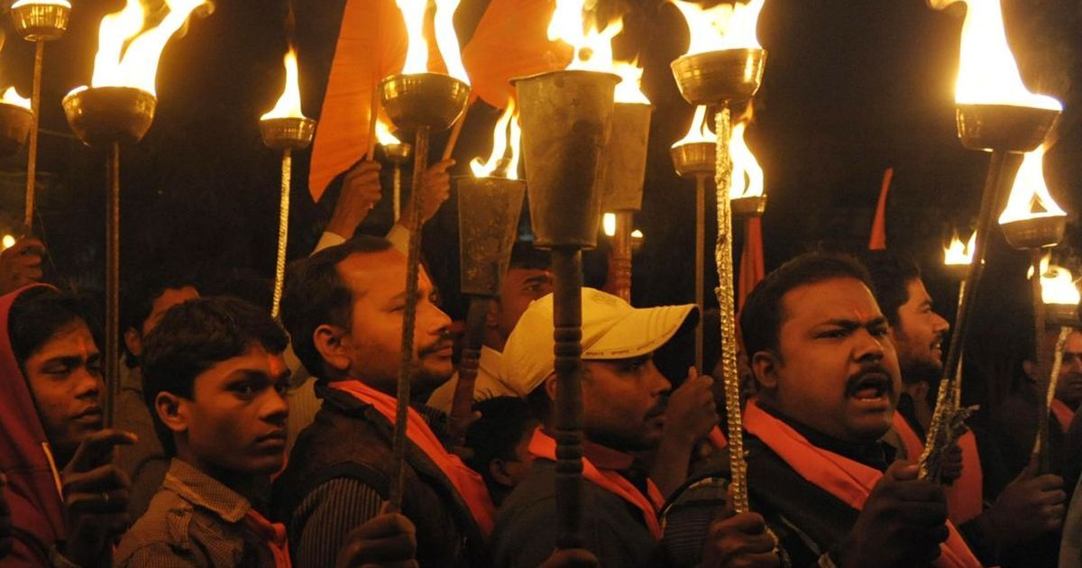
HINDUTVA TIMELINE

Slide 5
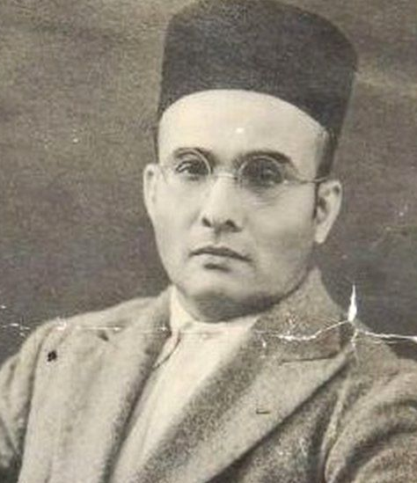
1923
Vinayak Savarkar, a Far Right Hindu Brahmin, articulates the Hindutva ideology and advocates for mass violence against Muslims and Christians.

Slide 6
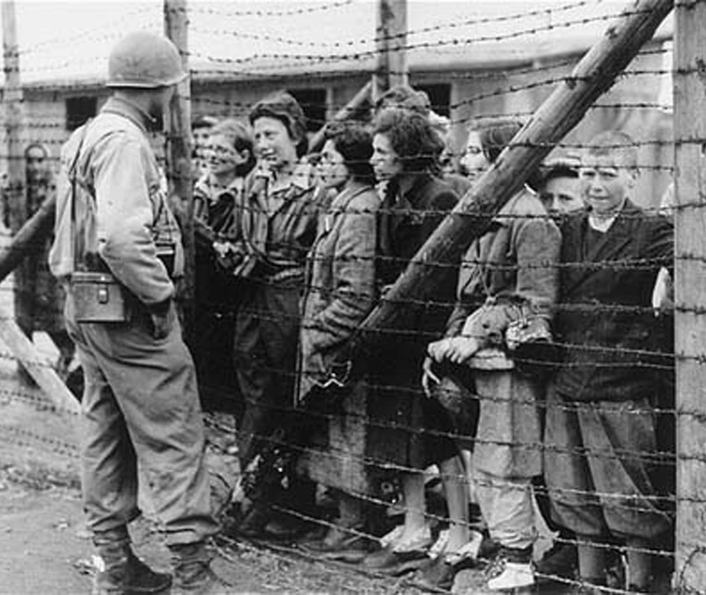
SAVARKAR’S VIEWS
“Germany has every right to resort to Nazism and Italy to fascism, and events have justified that those isms… were imperative and beneficial under the conditions that obtained there.”

Slide 7
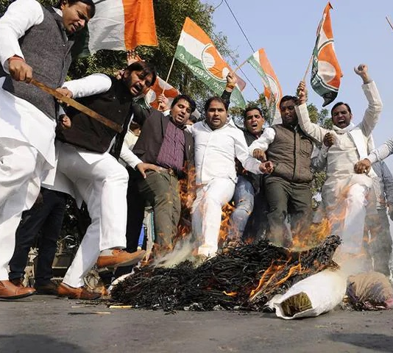
M. S. GOLWALKAR’S VIEWS
“The foreign races in [India]... must entertain no idea but those of the glorification of the Hindu race and culture, i.e., of the Hindu nation and must lose their separate existence to merge in the Hindu race, or may stay in the country, wholly subordinated to the Hindu Nation, claiming nothing, deserving no privileges, far less any preferential treatment, not even citizen’s rights.”

Slide 8
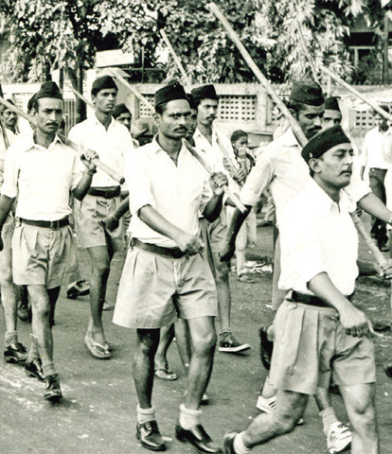
1925
The Rashtriya Swayamsevak Sangh (RSS) is founded to implement Hindutva’s objectives.

Slide 9
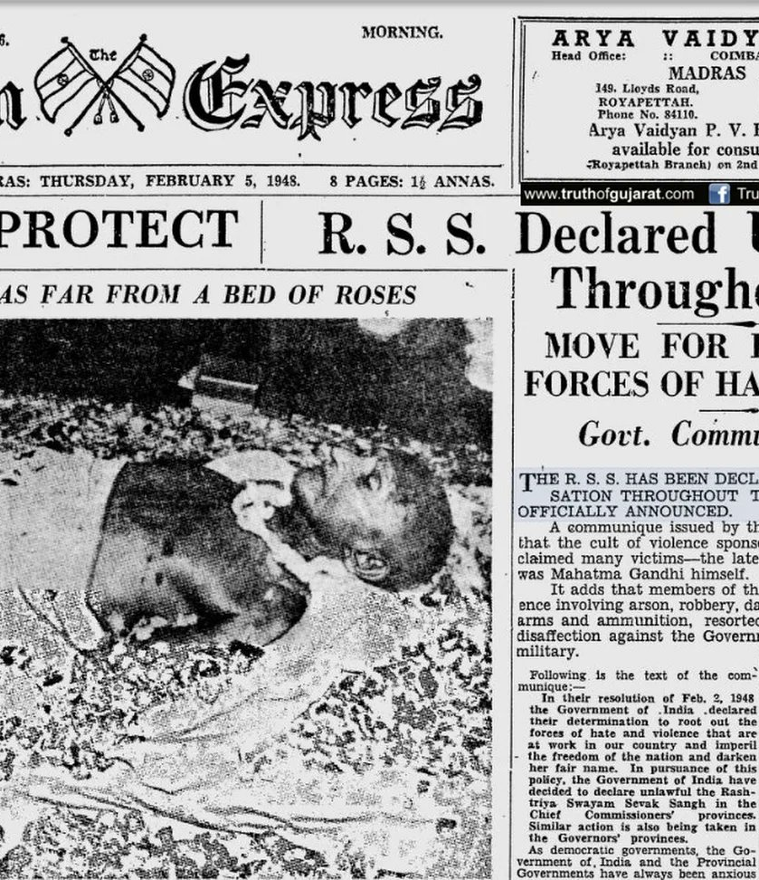
1948
Gandhi is assassinated by former RSS member Nathuram Godse.
RSS is banned as a group by the Indian government.

Slide 10
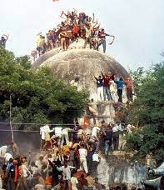
1992
RSS is banned after thousands of its members criminally demolish a 16th-century mosque, triggering nationwide rioting against Muslims.

Slide 11
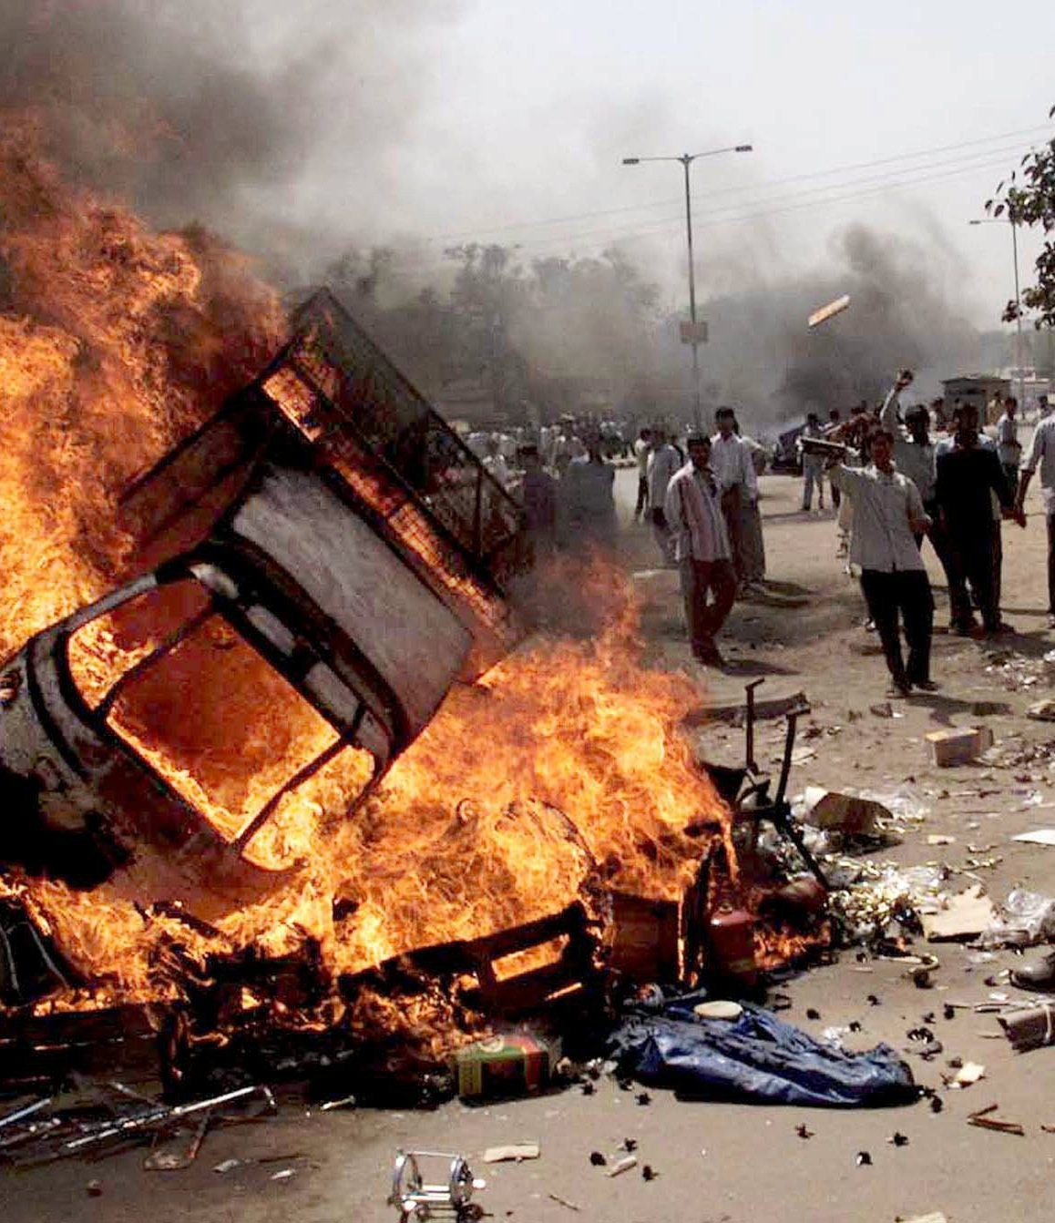
2002
RSS members mass slaughter 2,000 Muslims in Gujarat state. Chief Minister Narendra Modi, a lifelong RSS member, is accused of encouraging the massacres by refusing administrative intervention.

Slide 12
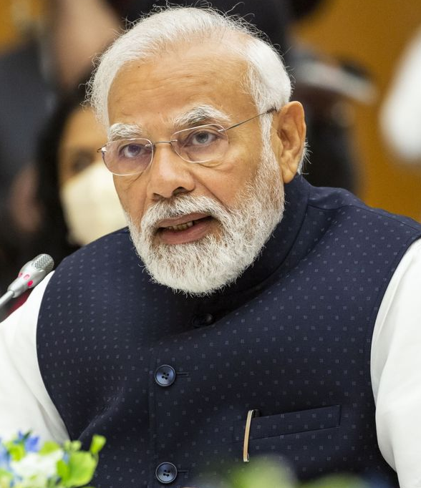
2005
The United States bans Narendra Modi from visiting for his role in the Gujarat genocide

Slide 13
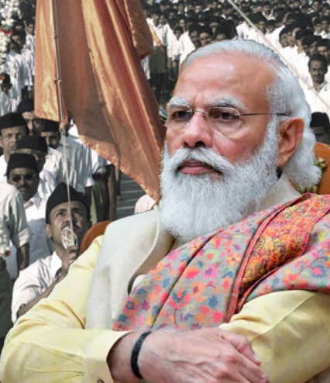
2014
Modi becomes Prime Minister of India, marking the beginning of Hindu supremacist rule over India.

Slide 14
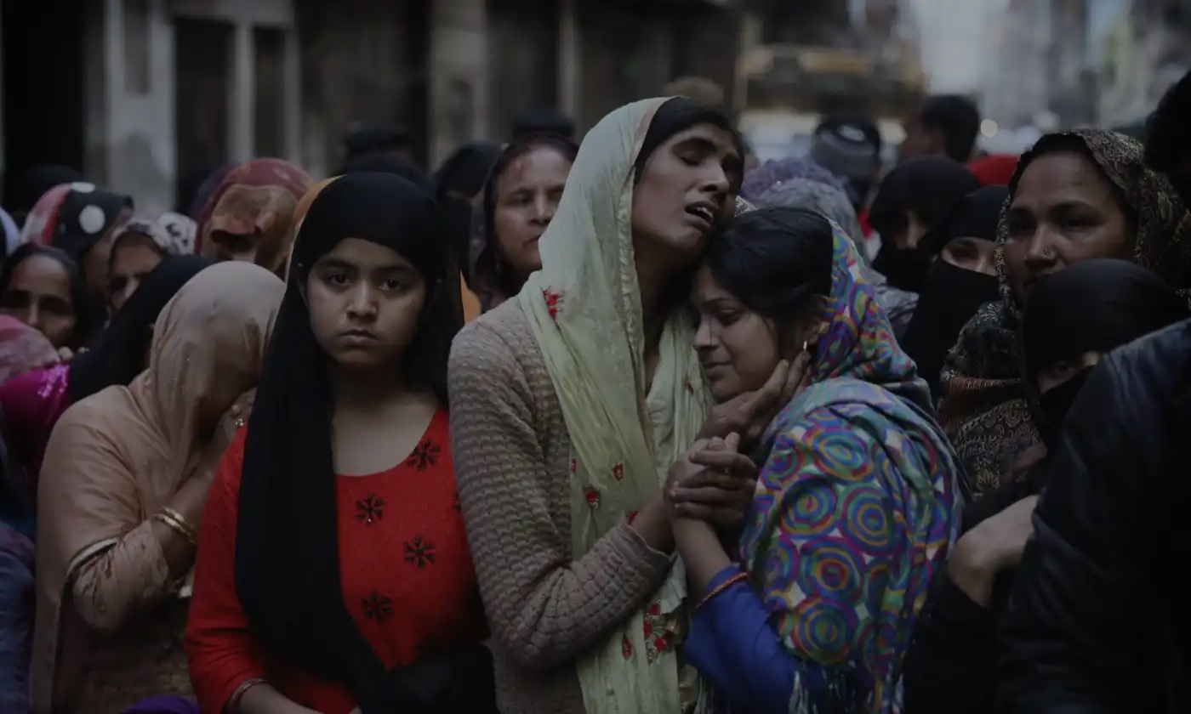
ATTACKS AGAINST MUSLIMS 2014-2023
MOB LYNCHINGS
HATE SPEECH
HATE CRIMES
BOYCOTTS
SEXUAL HARASSMENT
DISCRIMINATORY POLICY

Slide 15
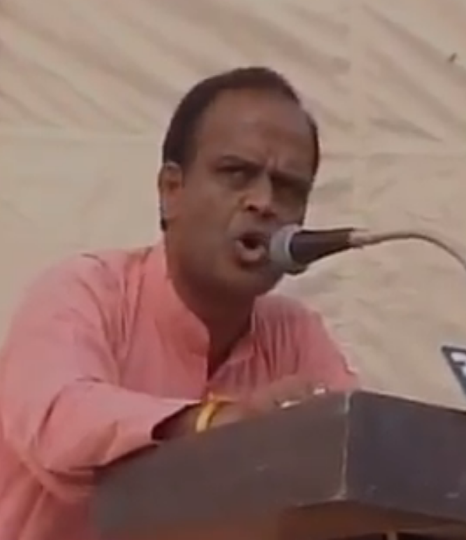
2017
RSS leader Kundan Chandrawat boasts about slaughtering thousands of Muslims in Gujarat and calls for the beheading of Kerala state’s Chief Minister, with no consequences.

Slide 16
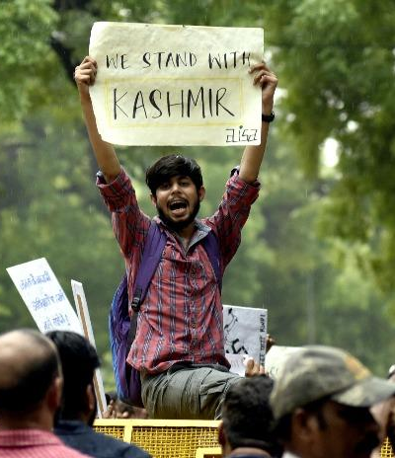
2019
The government strips Muslim-majority Kashmir of its semi-autonomous status, placing it under brutal military control. Hundreds of people are killed by military officials, internet blackouts become commonplace, and human rights defenders are imprisoned under draconian anti-terror laws.

Slide 17
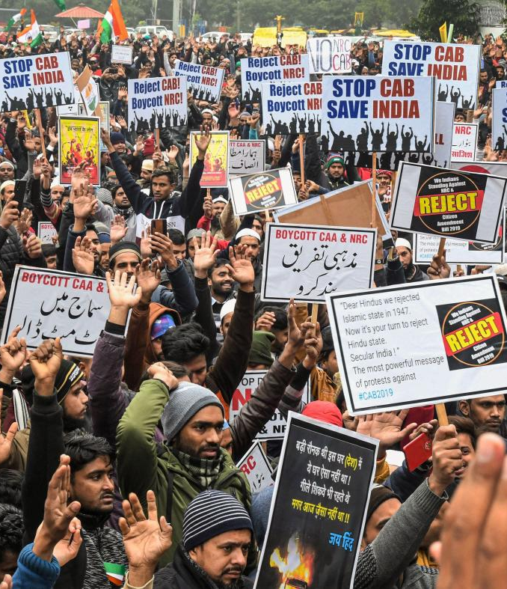
2019
The Modi government introduces the anti-Muslim Citizenship Amendment Act (CAA).

Slide 18
2020
RSS members attack and kill 35 Muslims in India’s capital, Delhi.

Slide 19
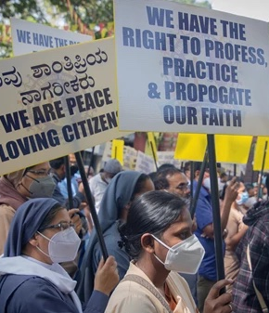
2021
Multiple states pass anti-conversion laws to criminalize conversion to faiths other than Hinduism, citing “love jihad” and “forced conversion” propaganda claims.

Slide 20
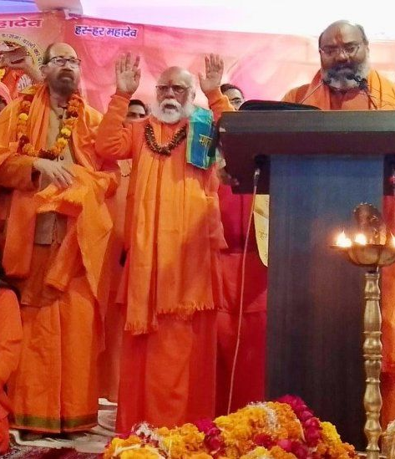
2021
Hindu supremacist leaders call for a genocide of Muslims at a massive gathering in Haridwar city.

Slide 21
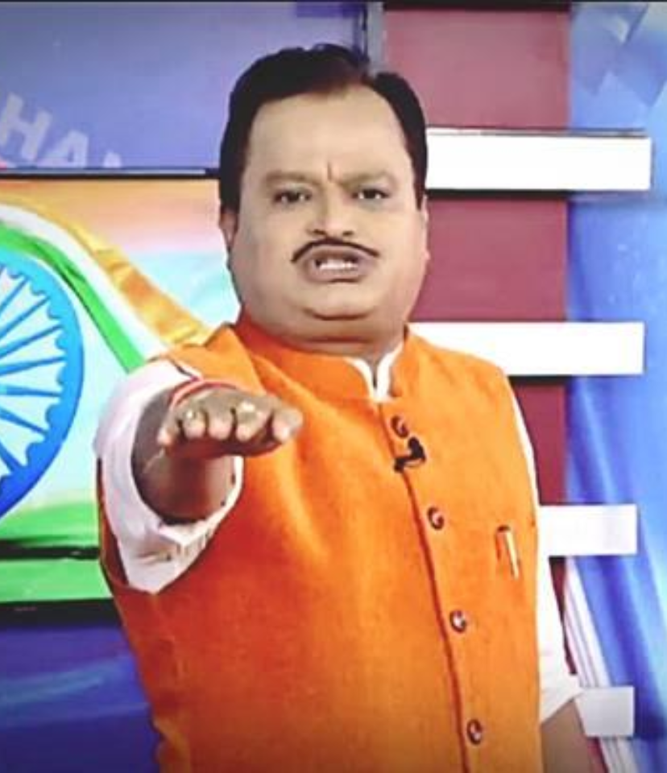
2022
Editors’ Guild of India compares mainstream media’s treatment of Muslims to Radio Rwanda prior to the Rwandan Genocide.

Slide 22
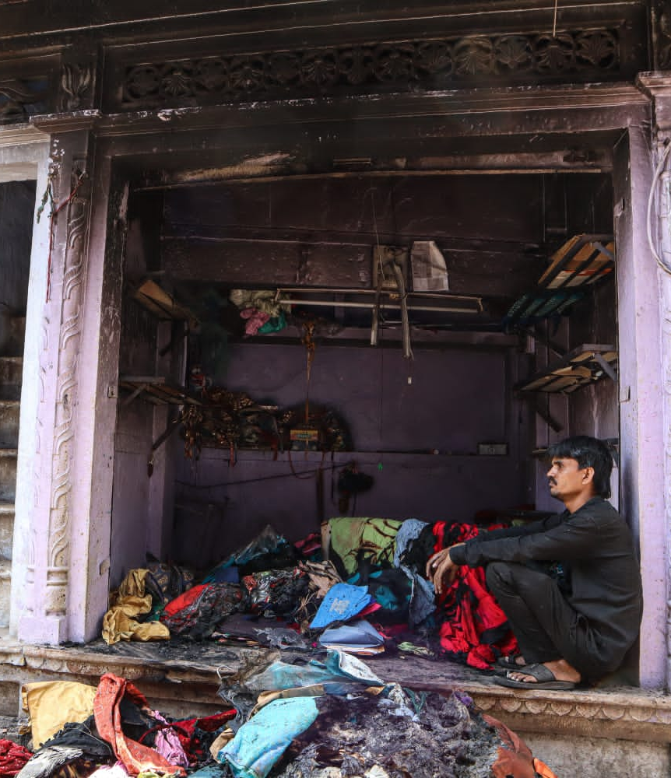
2022
RSS-led mobs riot against Muslims across India on day of Hindu festival, which coincides with Ramadan. Hundreds of homes, mosques, shops, and vehicles are vandalized and arsoned.

Slide 23
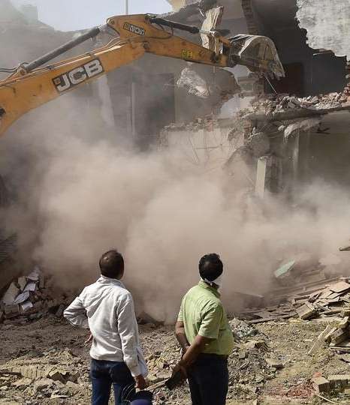
2022
RSS-allied federal and state administrations demolish Muslim-owned homes and businesses, as well as mosques and churches, across India without due procedure or cause.

Slide 24
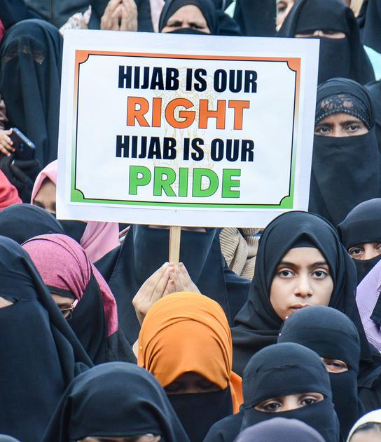
2022
50,000 Muslim girls are forced to drop out of school after the RSS-allied administration in Karnataka state bans the hijab.

Slide 25
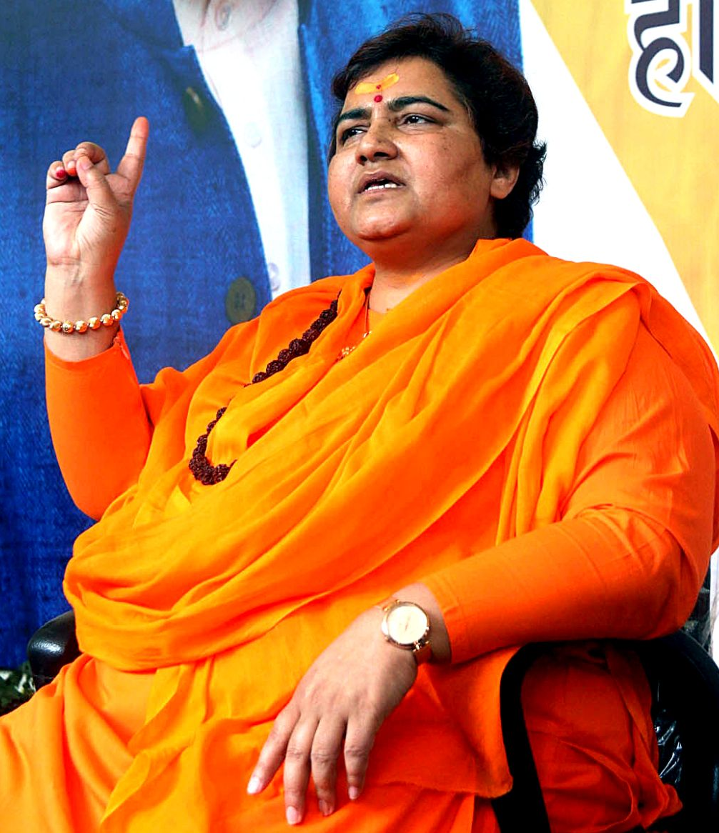
2023
Pragya Singh Thakur, a parliamentarian from the RSS-allied ruling party of India, calls for Muslim beheadings. For years, Thakur has been under trial on accusations of terrorism.

Slide 26
WHAT THE WORLD IS SAYING

Slide 27
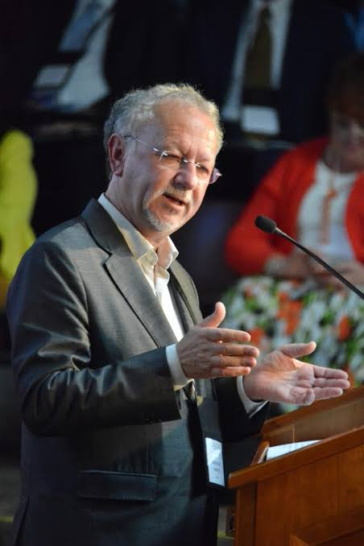
UNITED NATIONS
“Nothing short of an international investigative mechanism – as has been done by the UN Security Council, Human Rights Council for countries such as Syria, Myanmar, Sri Lanka, and Ethiopia – may be necessary [to combat violence against minorities in India].”
~ Fernand de Varennes, Special Rapporteur for Minority Rights

Slide 28
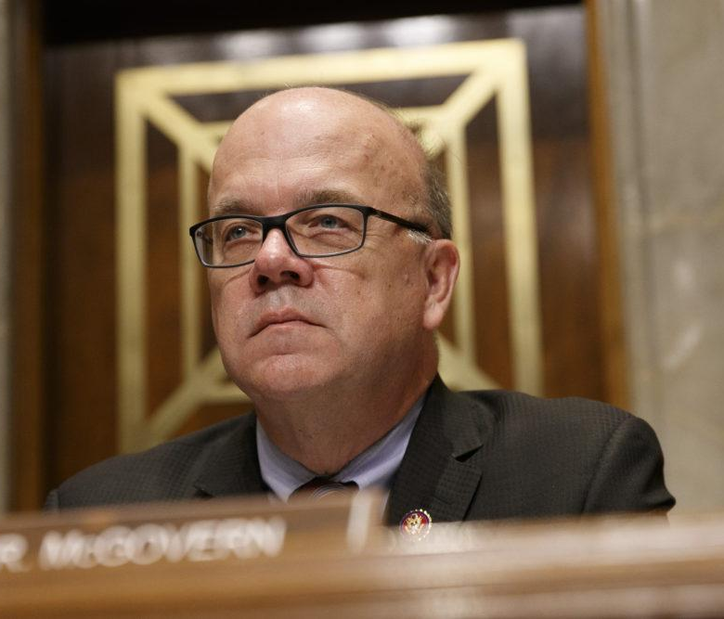
REP. JIM MCGOVERN
“We cannot be silent when measures are taken that discriminate against whole populations or when inflammatory language is used that could incite violence against those populations.”

Slide 29
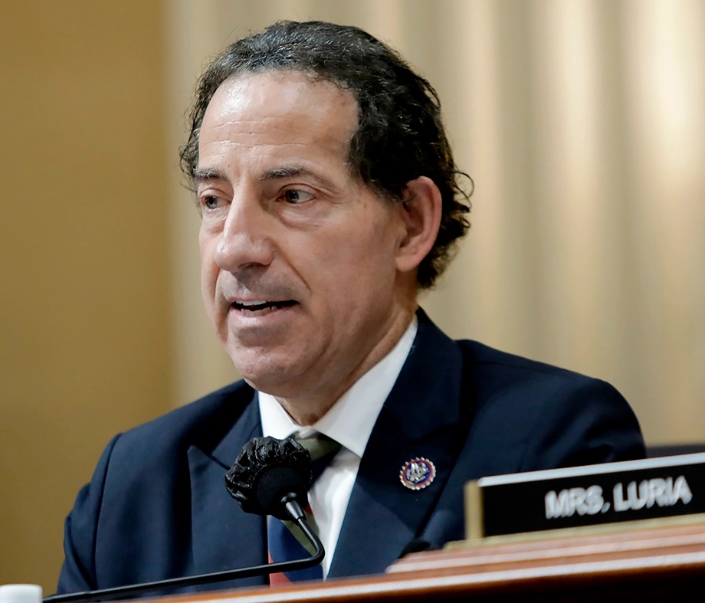
REP. JAMIE RASKIN
“There have been a lot of problems with the issue of religious authoritarianism and discrimination taking place in India…
We don't want to see discrimination against any minority religious group or any majority religious group, for that matter. That is the road to authoritarianism and destruction of civil liberty.”

Slide 30
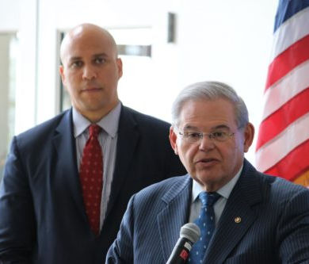
SEN. BOB MENENDEZ & CORY BOOKER
“The bulldozer has come to be a symbol of intimidation against Muslims and other religious minorities in India, and its inclusion in this event was wrong. “

Slide 31
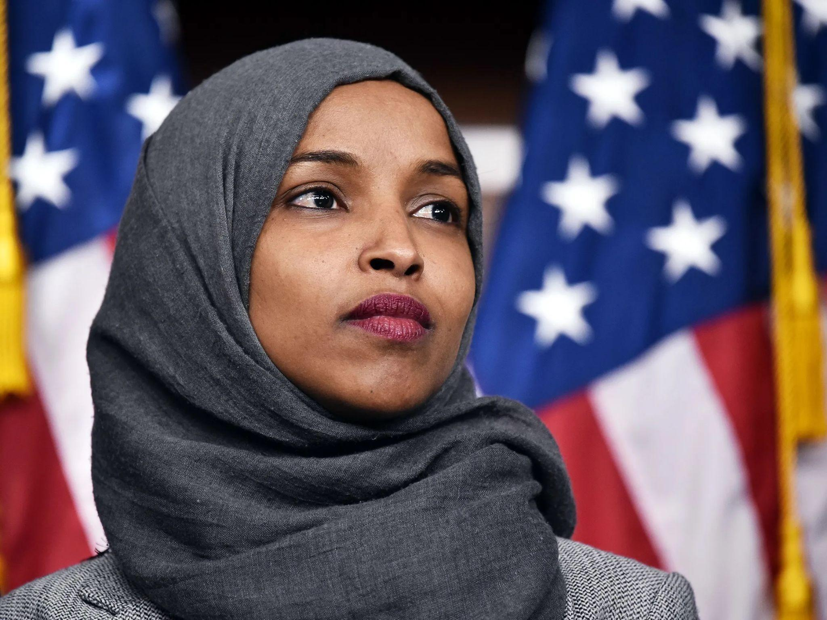
REP. ILHAN OMAR
“How are we promoting a free and open region by supporting Modi? Why has the Biden administration been so reluctant to criticize Modi’s government on human rights? How much does the Modi administration have to criminalize the act of being Muslim in India for us to say something? What will it take for us to outwardly criticize the action that the Modi administration is taking against its Muslim minorities?”

Slide 32
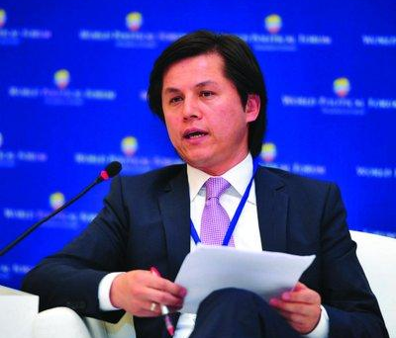
UNITED STATES COMMISSION ON INTERNATIONAL RELIGIOUS FREEDOM
“USCIRF is tremendously disappointed that the Secretary of State did not implement our recommendations and recognize the severity of the religious freedom violations that both USCIRF and the State Department have documented in… India.”
~ Nury Turkel, USCIRF Chair

Slide 33
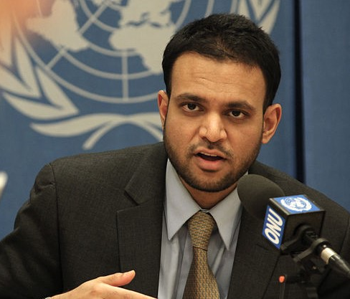
UNITED STATES AMBASSADOR-AT-LARGE FOR INTERNATIONAL RELIGIOUS FREEDOM RASHAD HUSSAIN
“We are concerned with the targeting of a number of communities in India, including Muslims, Christians, Sikhs, [and] the Hindu Dalit community and indigenous communities.”

Slide 34
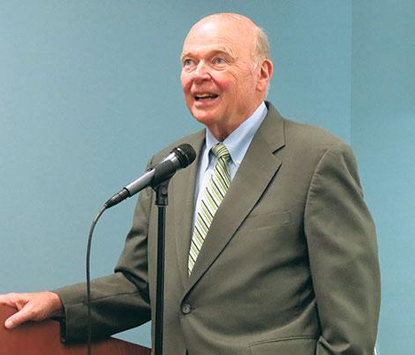
GENOCIDE WATCH FOUNDER DR. GREGORY STANTON
“[The Haridwar event] was exactly aimed at inciting the genocide of Muslims. As the leader of India he has an obligation to denounce this genocidal speech... Yet, Narendra Modi has not spoken against it.”

Slide 35
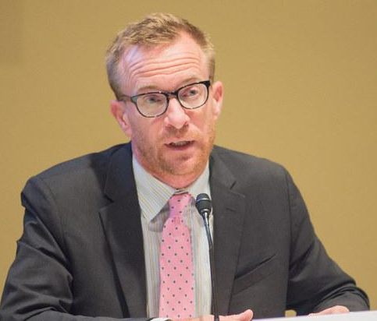
HUMAN RIGHTS WATCH
“The facts are clear: attacks against religious minorities in India, especially Muslims, have increased… BJP leaders and affiliated groups have long stigmatized minority communities as a threat to national security and to the Hindu way of life, in particular making divisive, hate-filled remarks against Muslims around state and national elections, targeting the Hindu vote.”
~ John Sifton, Asia Advocacy Director

Slide 36

REPORTERS WITHOUT BORDERS
“The violence against journalists, the politically partisan media and the concentration of media ownership all demonstrate that press freedom is in crisis in ‘the world’s largest democracy’, ruled since 2014 by Prime Minister Narendra Modi, the leader of the Bharatiya Janata Party (BJP) and the embodiment of the Hindu nationalist right.”

Slide 37
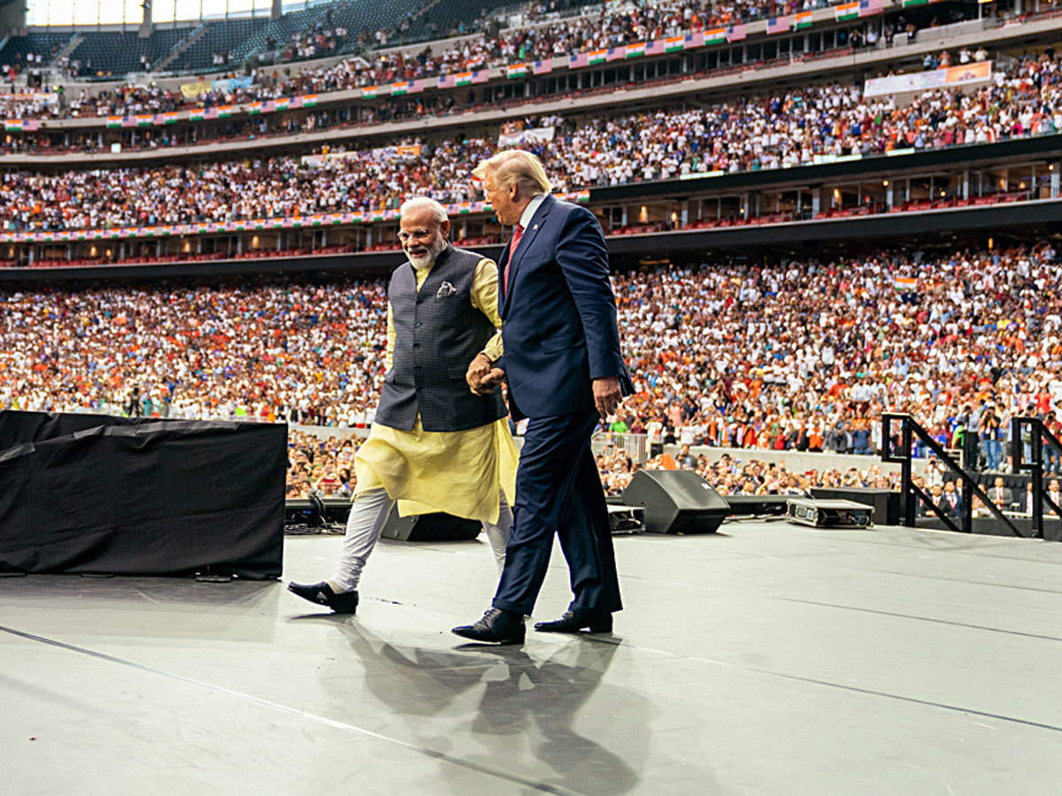
AMERICAN HINDUTVA

Slide 38

2021-2022
Hindu American Foundation sues the state of California to push back against caste protections.
HAF also sues five activists and academics in a SLAPP lawsuit.

Slide 39
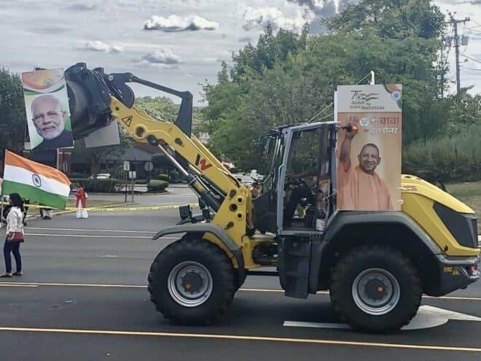
AUGUST 14, 2022
A rightwing Hindu group includes a bulldozer in its Indian Independence Day parade in Edison, NJ.

Slide 40
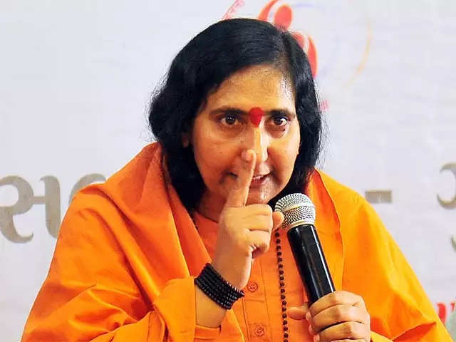
SEPTEMBER
Sadhvi Ritambhara, a leader of one of India’s largest / most violent extremist groups, is invited to events across the US.

Slide 41
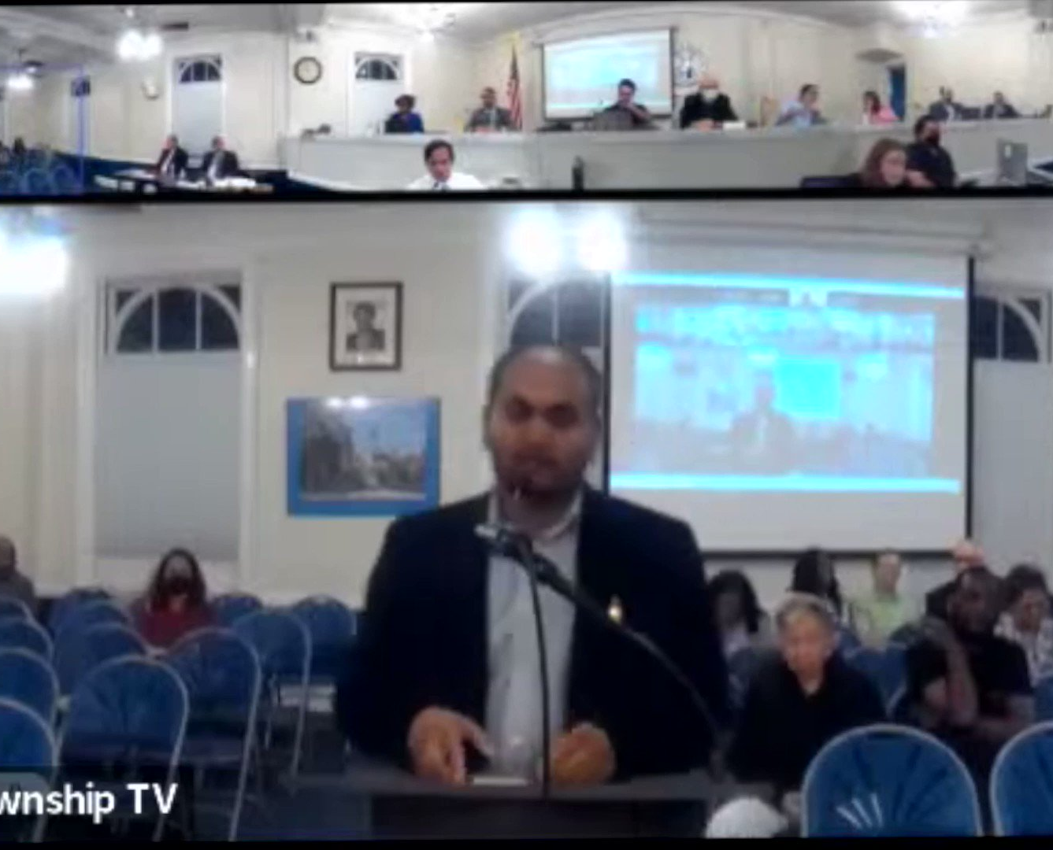
SEPTEMBER
A Hindu extremist attends a Teaneck city council meeting, where he makes a hate speech calling Muslims rapists and terrorists.

Slide 42
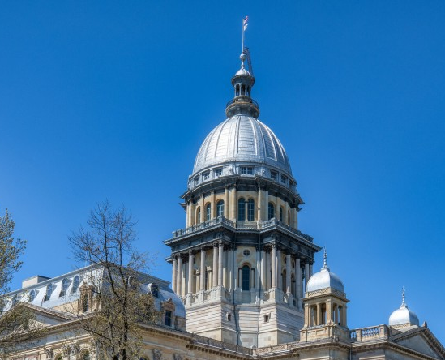
NOVEMBER
Under influence from RSS sympathizers, Illinois General Assembly passes the Illinois Indian American Advisory Council Act (HB4070). The law excludes Muslims from being able to join the council, stating that "Indian" refers to “a person descended from any of the countries of the subcontinent that are not primarily Muslim in character.”

Slide 43
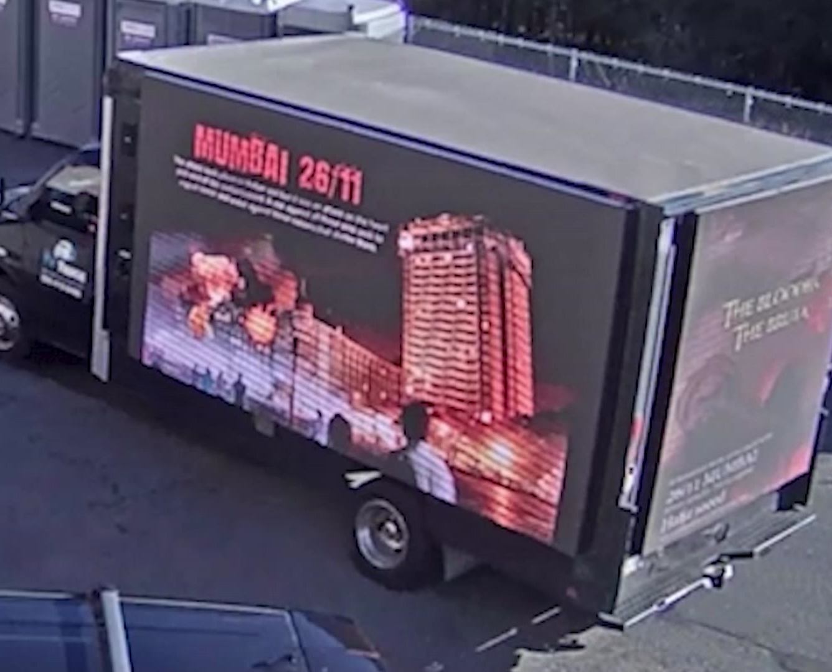
NOVEMBER
A digital billboard truck displaying images of 2008 terrorist attack in Mumbai (India) circles the parking lots of 4 mosques in Piscataway, NJ and surrounding areas. Elected officials condemn the incident as an act of hatred and intimidation.

Slide 44
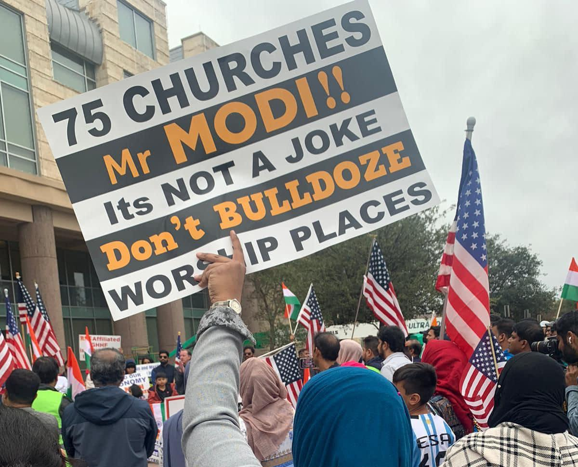
NOVEMBER
Global Hindu Heritage Foundation (GHHF), an RSS-aligned Hindu supremacist group based in Texas, holds a fundraiser to demolish churches in India, triggering protests in the diaspora.

Slide 45
OUR ASKS
That the City of San Francisco do its due diligence in learning about Hindutva
That the City distances itself publicly from RSS-affiliated groups and from Hindutva as an ideology

