Slide 1
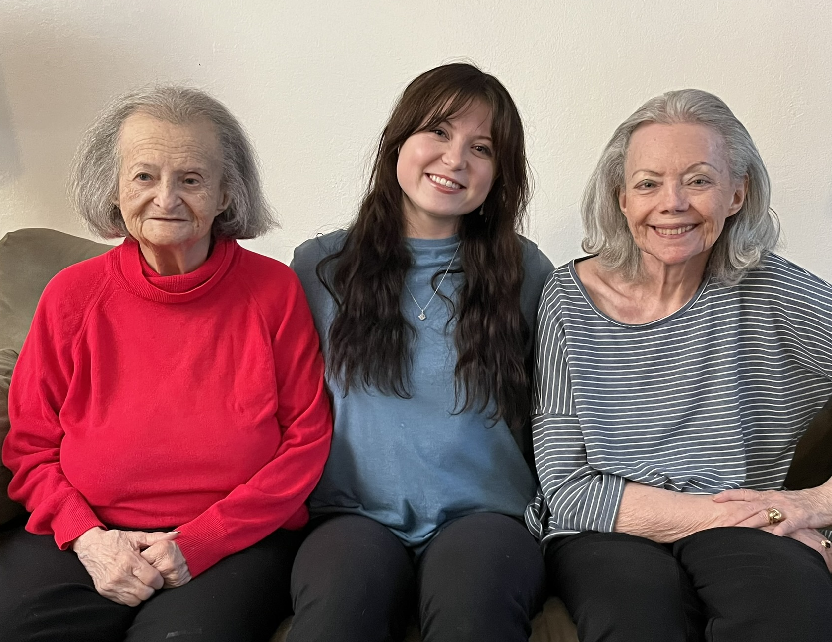
SHARED
LIVING
COMMON
GROUND

Slide 2
Front Porch Provides
19 Market Rate Retirement Communities
35 Affordable Housing Communities
FRONT PORCH
COMMUNITIES
& SERVICES
Support Areas
Social Connection
Creative Engagement
Housing
Programs
Well Connected
Well Connected Español
Creative Spark
Ruth’s Table
Home Match

Slide 3
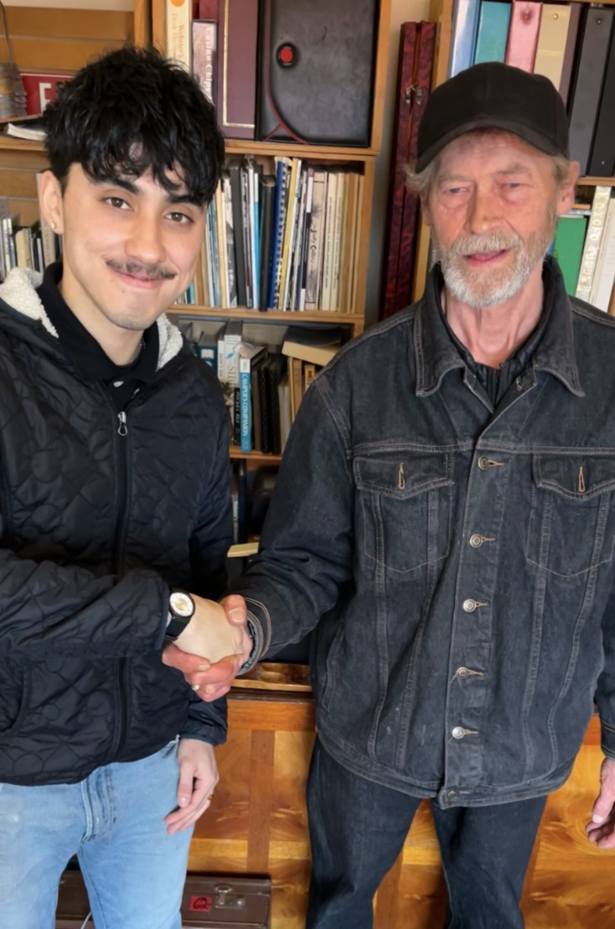
WHAT IS
HOME SHARING?
Home sharing is a living arrangement in which two or more unrelated people share a house, condo, or apartment and oftentimes also share household expenses and responsibilities.
In-law units and ADUs are eligible, too!

Slide 4
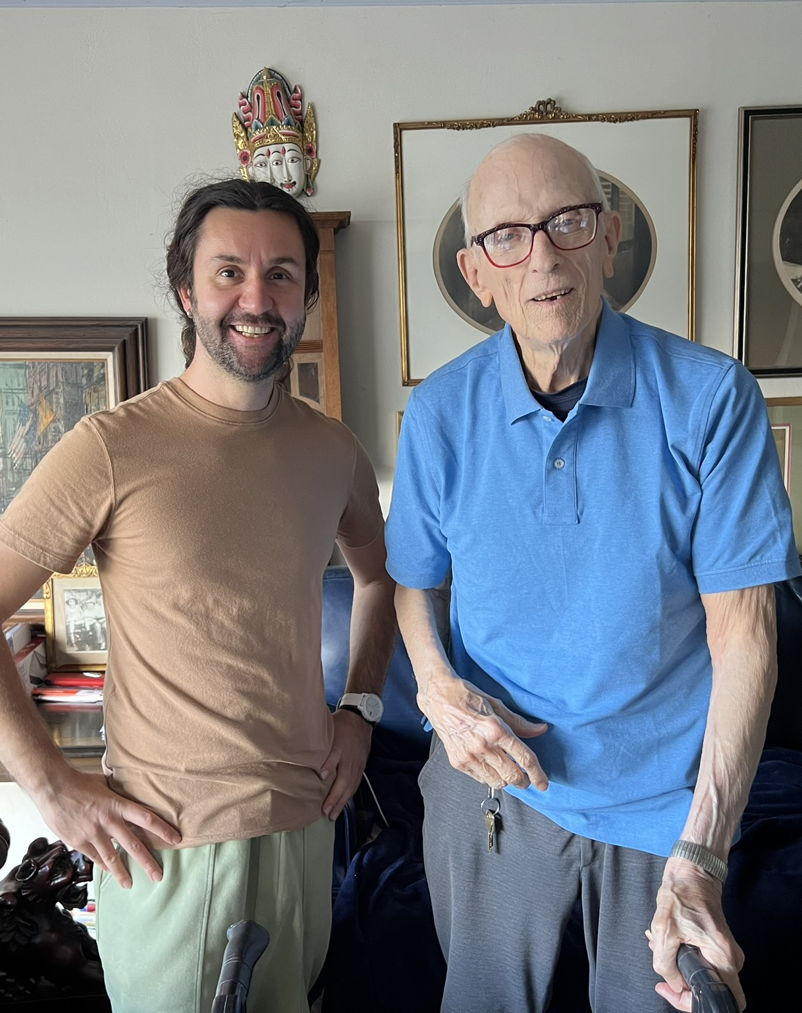
WHY
HOME SHARING?
“Given the significant health consequences of loneliness and isolation, we must prioritize building social connection the same way we have prioritized other critical public health issues.”
– 19th & 21st U.S. Surgeon General, Dr. Vivek Murthy
Significant
Cost Savings
Housing Shortage
Combat
Social
Isolation
Age
In
Place
Live Where
You Work

Slide 5
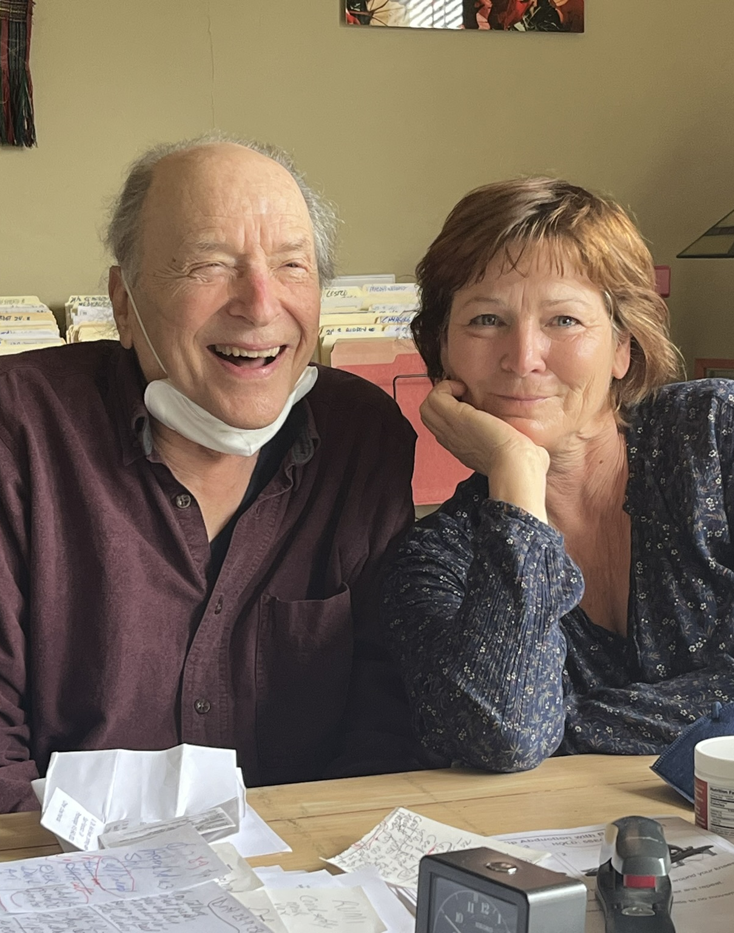
WHAT IS A
TASK EXCHANGE?
Some home providers may request support with household tasks, errands, and/or companionship
(No caregiving related tasks)
Home seekers can benefit from reduced rent in exchange for these services
Task exchange hours cannot exceed 10 hours/week
Small portion of listings request task exchanges

Slide 6
HOME MATCH PROCESS
Home Visit/Intake
Compatible Matching
Introducing Candidates
Match Agreement
Ongoing Support
Home visit or interview. Screening process. List room and manage inquiries.
Review lifestyle preferences & communication style
Introductions by phone, then in-person
Sign Living Together Agreement - shared use of space & terms
Support throughout the match

Slide 7
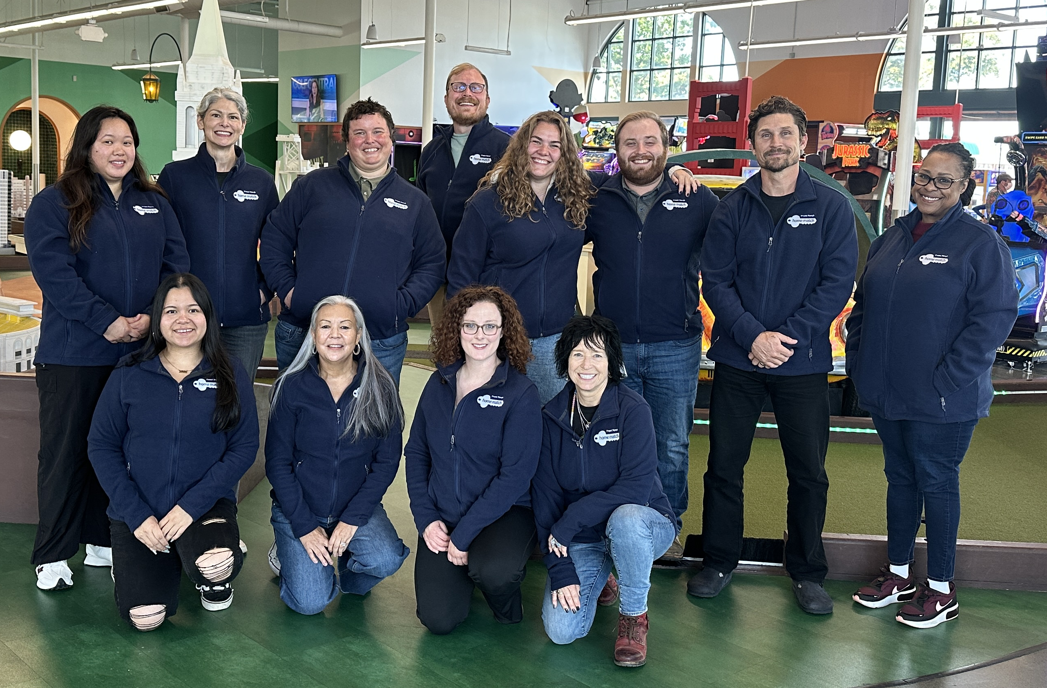


Contra Costa County
HomeMatchContraCosta@frontporch.net
(925) 956-7385
CONTACT US!
Marin County
HomeMatchMarin@frontporch.net
(415) 456-9068
Alameda County
HomeMatchAlameda@frontporch.net
(510) 350-4367
San Francisco County
HomematchSF@frontporch.net
(415) 351-1000

Slide 8

500 Matches
and Counting!

