Slide 1
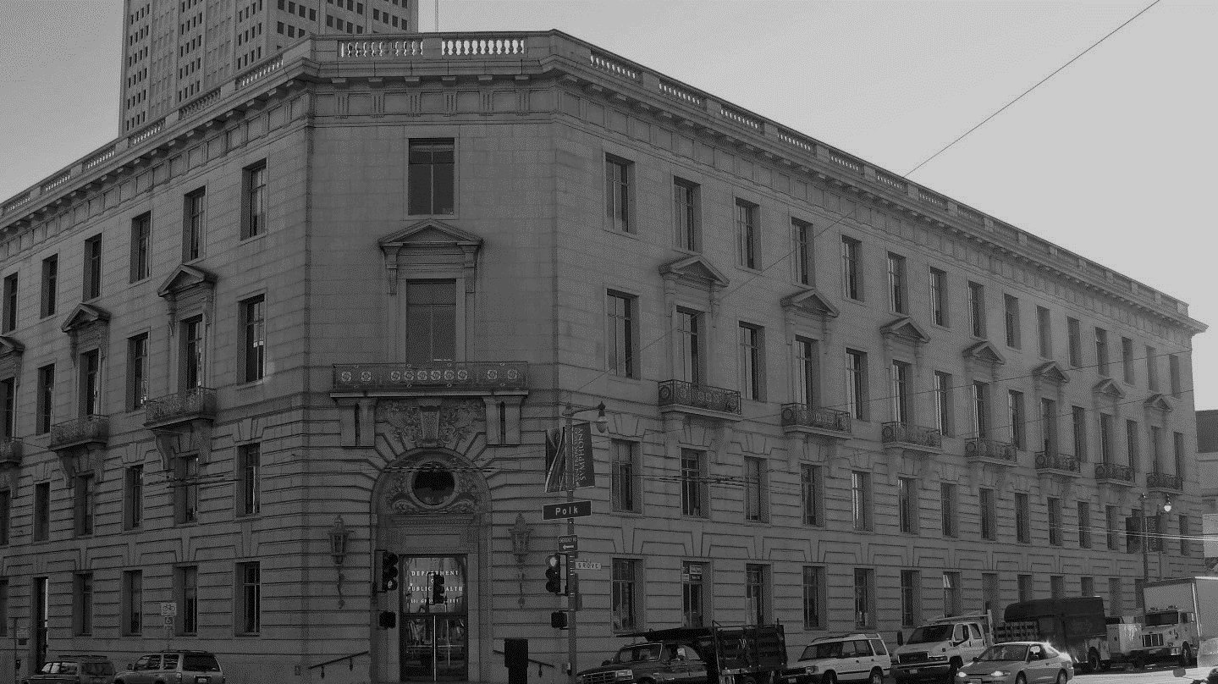
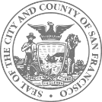
COVID-19 Command Center
Transition Planning Update
Andi Tenner, MD, MPH, FACEP
COVID Task Force Transition Manager
Director, Public Health Emergency Preparedness and Response
July 6, 2021
SAN FRANCISCO DEPARTMENT OF PUBLIC HEALTH

Slide 2
Overview
CCC to DPH Operational Phases
Initial Response
DOC/EOC Structure
January 2020 – June 2020
Unified Command
CCC Structure
July 2020 – March 2021
Transition State
CCC → EOC/Dept Structure
Start April 2021
DPH COVID Task Force
Start July 2021

Slide 3
DPH COVID Task Force Vision
To reduce the threat of COVID-19 in our community, both from severe, life-threatening disease, as well as long-term consequences of post-COVID syndrome in milder cases

Slide 4
DPH COVID Task Force Mission
To monitor and respond to public health threats from COVID and to reduce inequities in disease prevalence, severity, and access to services

Slide 5
We will achieve this mission and vision by:
Focusing DPH Vaccine outreach efforts to our most impacted communities
Focusing low-barrier testing, case-investigation, contact tracing, and prevention and mitigation services to highly-impacted, under-immunized communities
Coordinate with our Community partners using sound community engagement principles to enable person-centered care.
Monitoring COVID variants and indicators of waning immunity to COVID-19
Maintaining readiness (including training and exercises) in the event of a resurgence in cases
Notes:
Highlight focus on bringing services to highly impacted communities. Health systems will take care of the population at large, DPH is taking care of those that need the most support.

Slide 6
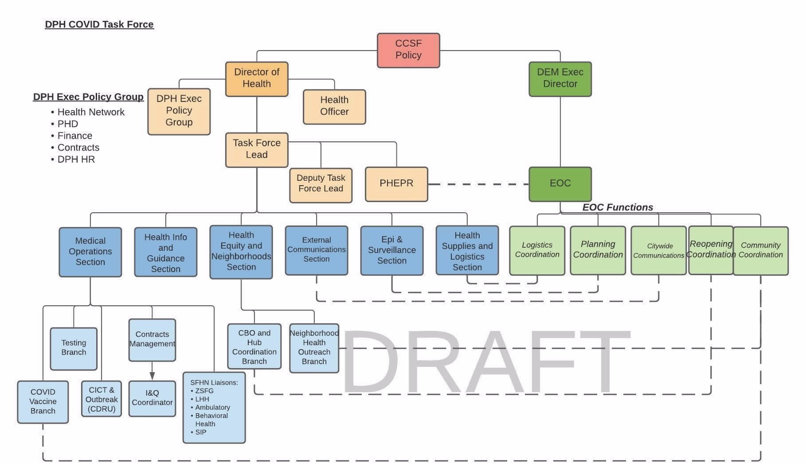
Org Chart
Notes:
Note the task force in the blue, leadership in the orange.

Slide 7
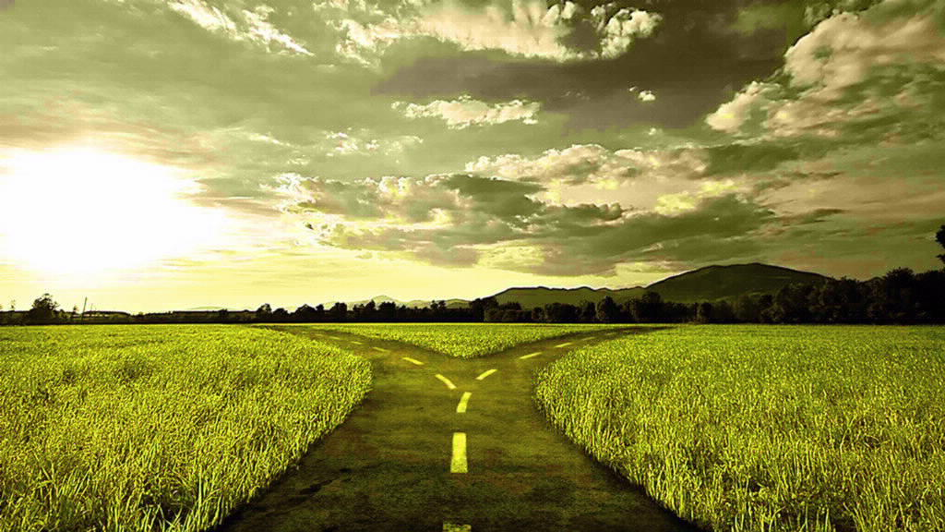
Maintain readiness for two distinct paths
Notes:
One: our current success continues and low levels of COVID transmission become the new normal. As things stabilize, we will work to demobilize the task force and integrate services back into the health system. The other: we have a relatively vaccine resistant variant (or are unable to vaccinate enough people) that causes a surge of some level (whether within communities that are hardest hit by COVID or in the population at large if vaccine resistance develops.)
Trying to predict the future can be difficult. We have created models, similar to a hurricane track projection. In the same way, the further out you are, the wider set of possibilities. But we can use these projections to get a sense of our best and worst case scenarios. Current Path assumptions: Delta is 40% more transmissible than Alpha, no increase in severity over Alpha, no waning immunity, 10% increase in contact rate, 83% of 64 vaccinated
Worst case assumptions: pessimistic, delta variant predominates, Delta is 60% more transmissible than Alpha, hospitalization rate twice Alpha, waning immunity
10% increase in contact rate, vax at 83%
These assume no interventions are taken (no change in social distancing, masking, etc)

Slide 8
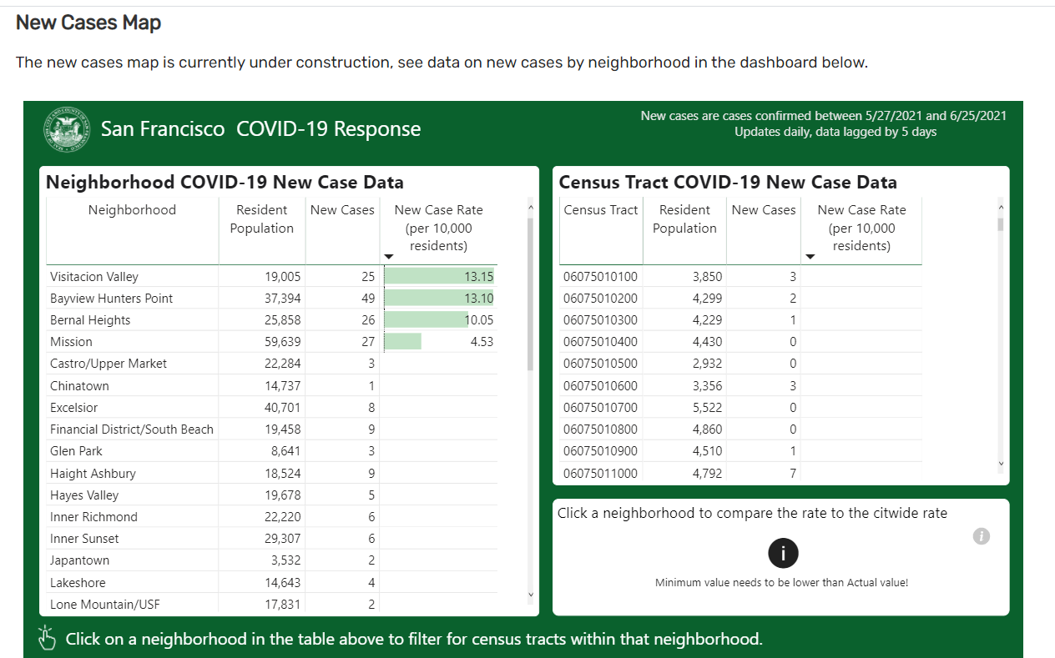
Notes:
Even in the best case scenario, We know that we will continue to see cases in the areas hit hardest by COVID. Given the increased transmissibility of the delta variant, unvaccinated populations are at particular risk. While overall vaccination rates are excellent, there are pockets of communities that have lower vaccination rates. We are working to reach those communities to ensure that everyone in San Francisco has the opportunity to be vaccinated and, for those who are not yet protected, that they have access to necessary services. Tactics: low barrier access, use contracts to expand capabilities, bring teams to the people, empower community to lead local efforts.

Slide 9
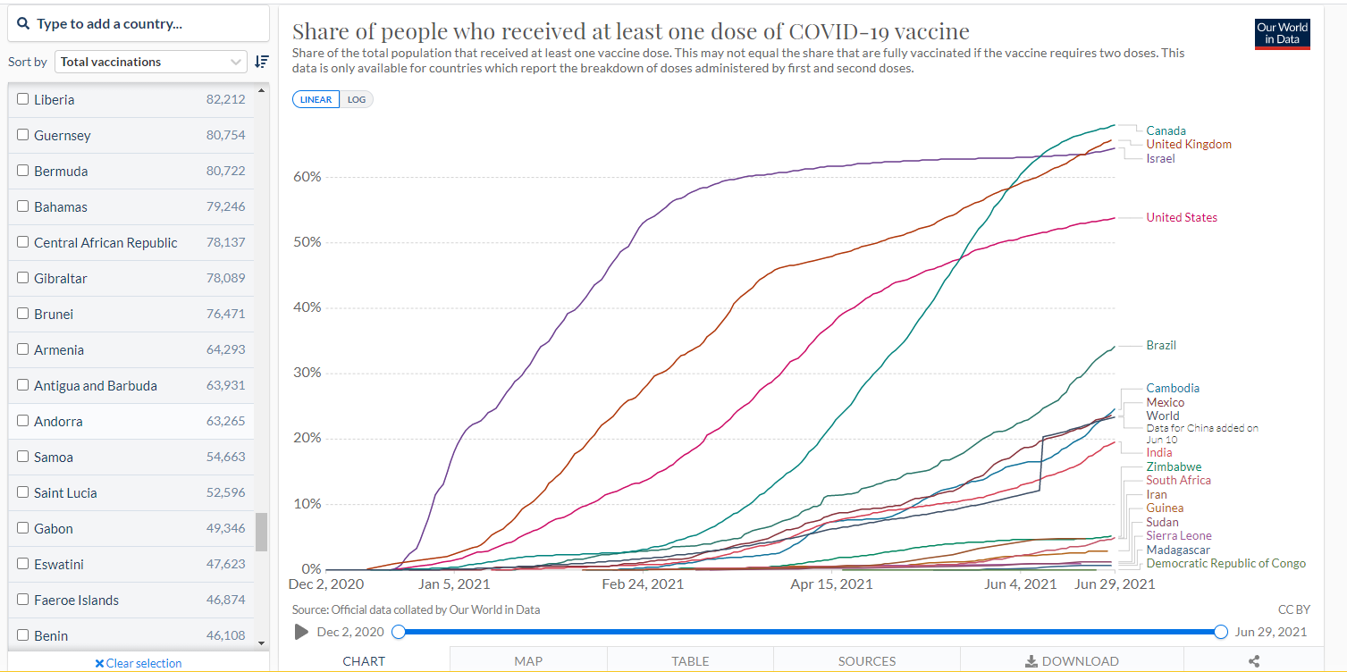
https://ourworldindata.org/covid-vaccinations
Notes:
We also know that, while we are doing quite well here in SF, many places around the world have abysmal rates of vaccination. This could lead to the development of variants that could derail our success. We will be watching this very closely to be as prepared as possible if new threats arise.

Slide 10
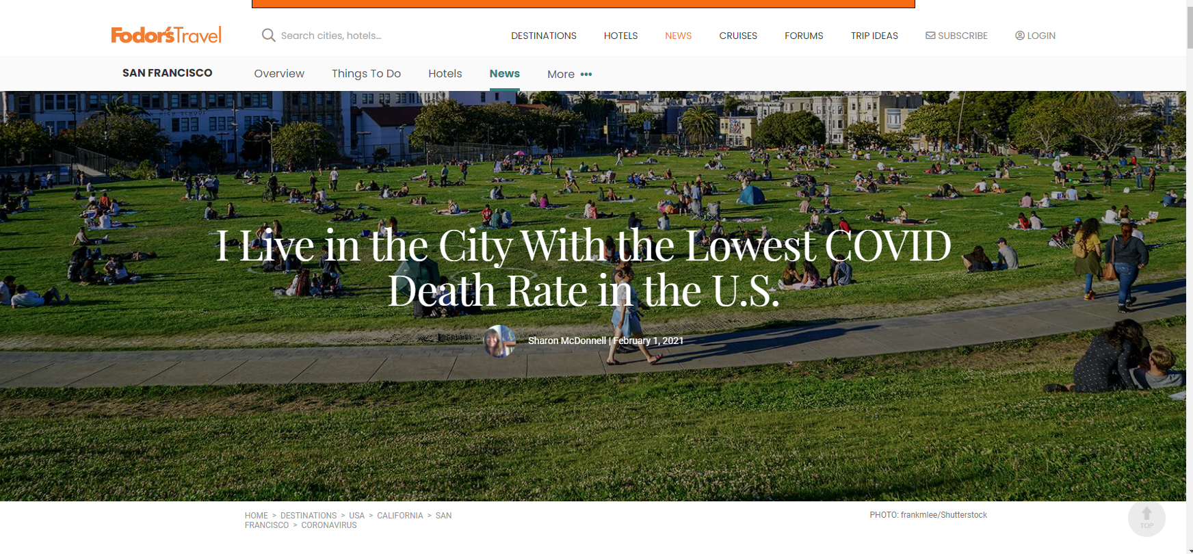
Notes:
While we are hoping for the best, but at the same time making sure we are prepared for the worst, we also want to take a minute to celebrate how far we have come. From the early days when the Bay Area was seeing the first COVID cases, to the uncertainty and fear while we watched what was happening in NYC, to the multiple hazards of protests, air quality emergencies, and heat emergencies during the pandemic, to our winter surge, we are now in a position where we can take a breath. We have run one of the most successful vaccine campaigns in the world. We have the lowest death rate in the US. Even in our worst-case scenarios, we will likely be able to sustain some normalcy and support infrastructure, thanks to our high vaccination rates. Many, many people have contributed to this, from those on the front lines at the health facilities, to disaster service workers, to the strong leaders who made tough choices to keep the community safe—we all worked together to make this possible and should take a moment to enjoy our success. And now, we go back to work.

