Slide 1
The Homelessness Response System & Food Service in Shelter
Food Security Task Force meeting 11/5/2025
Lisa Rachowicz, HSH Director of Outreach and Shelter

Slide 2
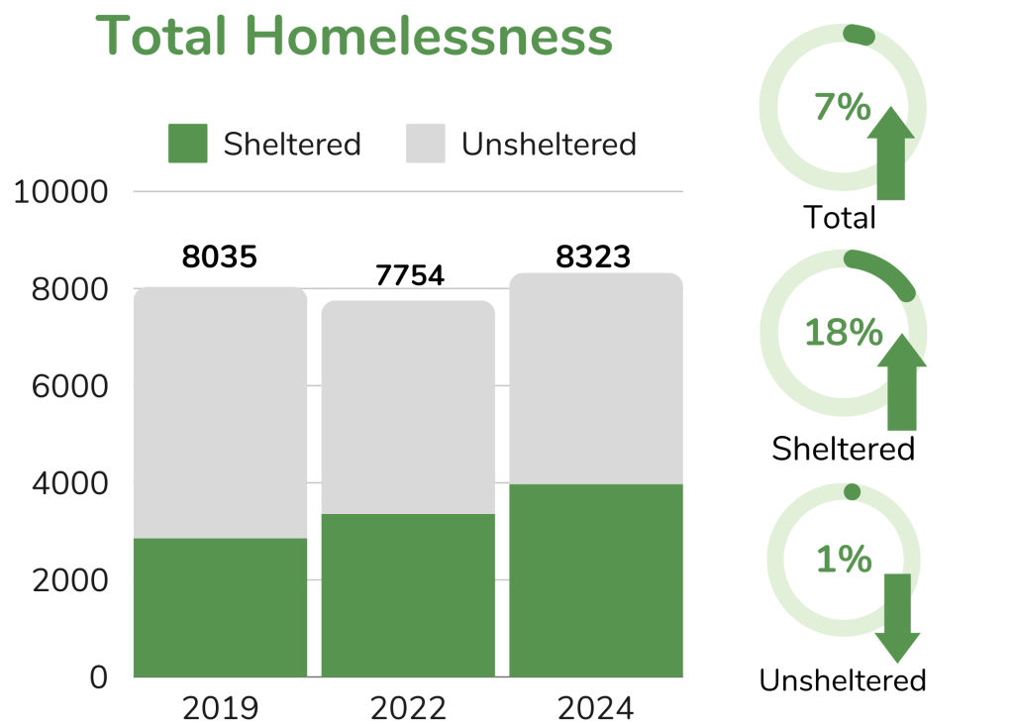
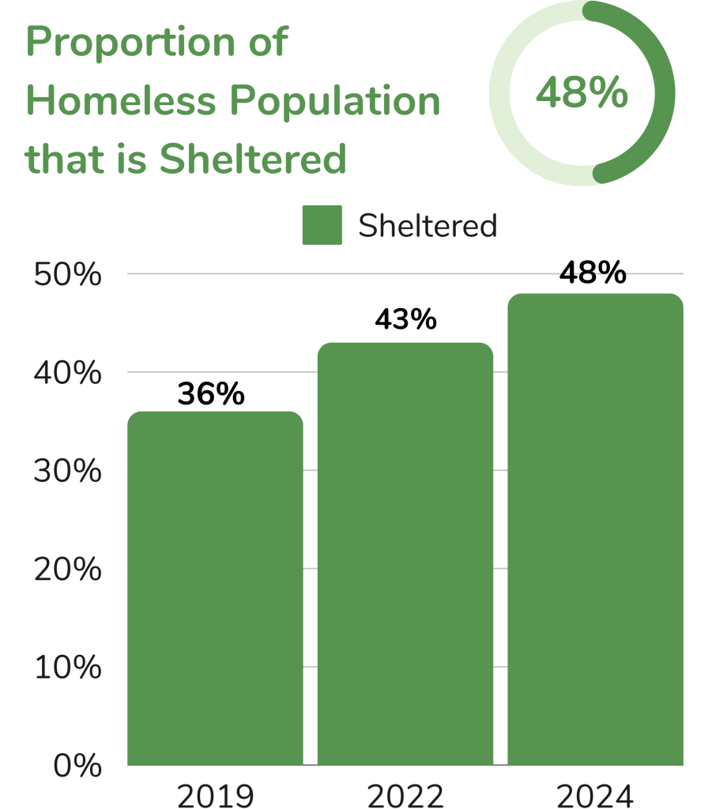
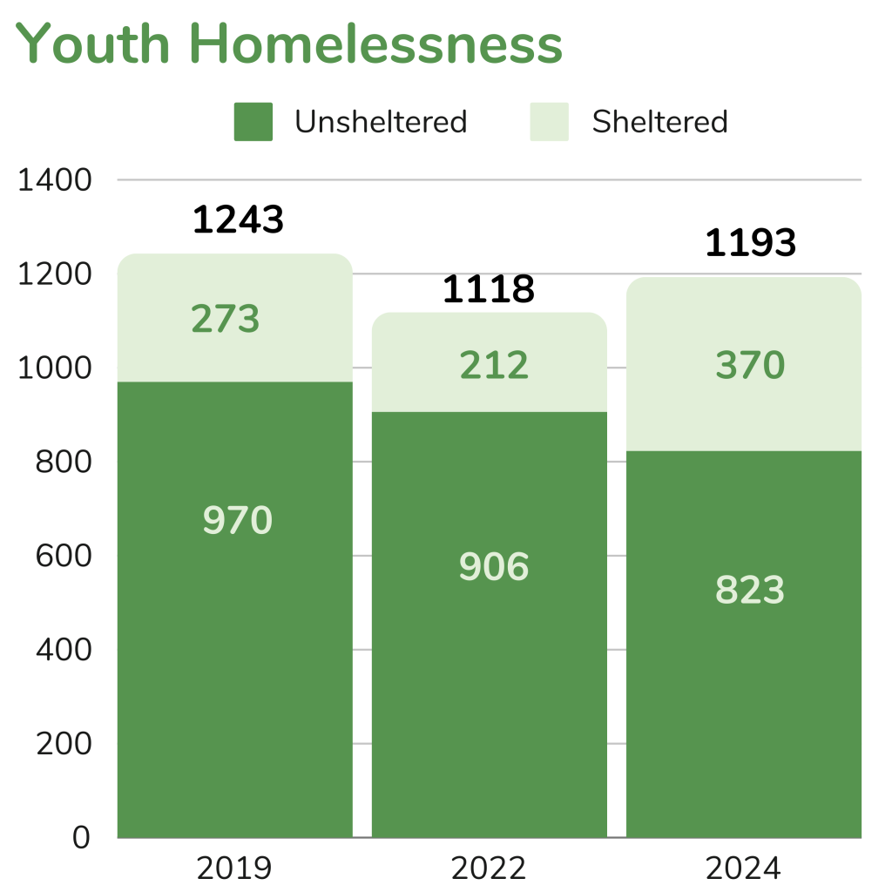
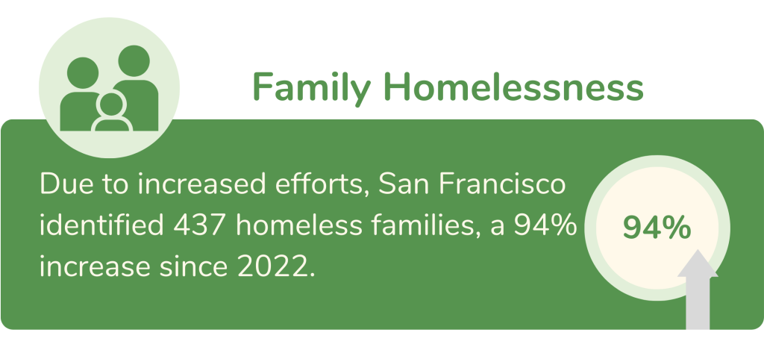
Homelessness in San Francisco

Slide 3
Who We Serve at HSH
Learn more on the HSH website.
Federal definition of homelessness (used in the PIT Count) includes individuals and families:
With a primary nighttime residence not meant for human habitation (incl. cars).
Living in a shelter or transitional housing.
People fleeing domestic violence, dating violence, sexual assault, stalking, and other violent situations that make them afraid to return to their primary residence, when they have no other housing resources.
People at imminent risk of homelessness who will lose their residence within 14 days and have no other housing resources
San Francisco uses a broader definition that includes families who are "doubled up" or living in single room occupancy units.

Slide 4
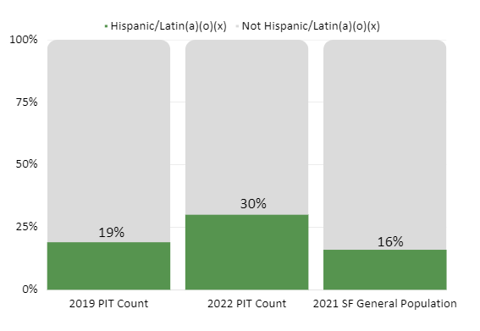
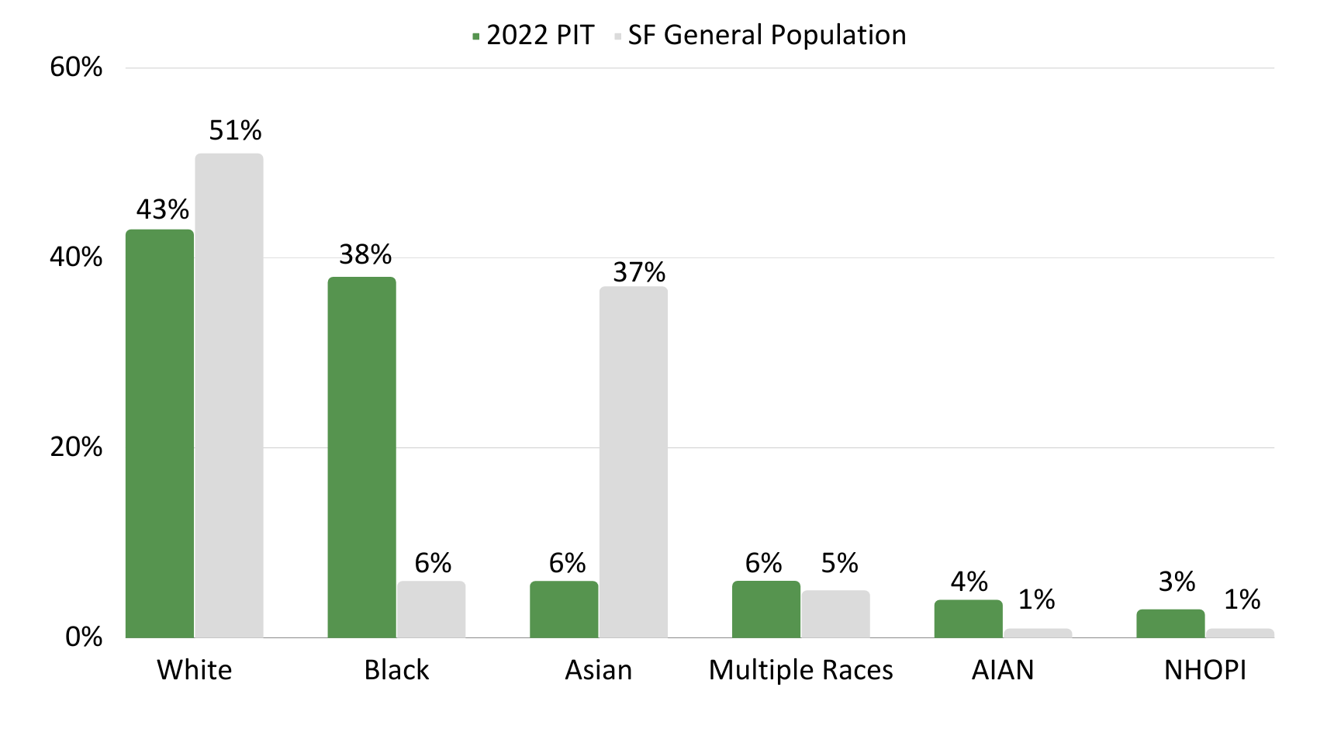
Racial Equity & Homelessness
Structural & racial justice issue - disproportionate impact on people of color.

Slide 5
HSH Overview – Background and Mission
The Department of Homelessness and Supportive Housing (HSH) launched in August 2016.
Consolidates and coordinates City programs to address homelessness.
Mission: make homelessness in San Francisco rare, brief, and one-time.
Serves over 15,000 people daily through the homelessness response system (HRS):
youth ages 18-24 (sometimes called transitional age youth/TAY)
families with minor children
adults

Slide 6
Homelessness Oversight Bodies
Homelessness Oversight Commission: main oversight body for HSH
Launched in spring 2023 with seven members; other oversight bodies report up to Commission.
Approves budgets, sets performance goals, conducts audits, submits annual report.
Local Homeless Coordinating Board
Oversees and advises Commission on federal Continuum of Care programs.
Shelter Grievance Advisory Committee
Oversees the shelter grievance process and makes recommendations for improvements to the shelter system.
Shelter Monitoring Committee
Tracks the conditions of shelters in San Francisco; takes and investigates complaints.
Our City, Our Home Oversight Committee
Makes recommendations on the use of Our City, Our Home (Prop C) funds.

Slide 7
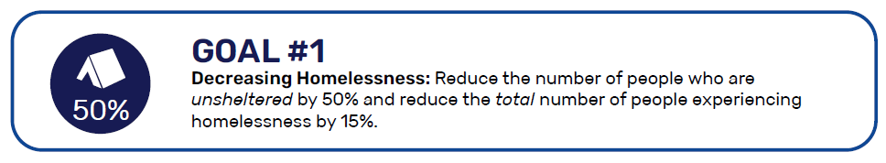

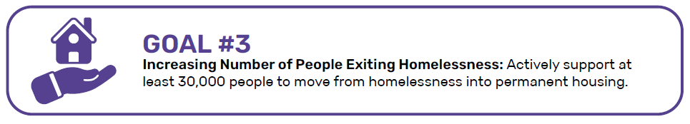
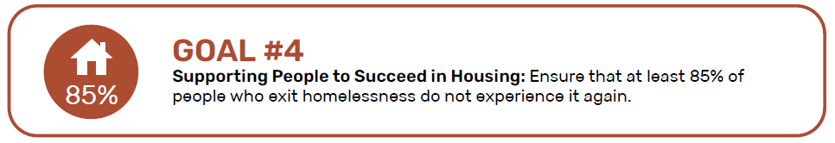
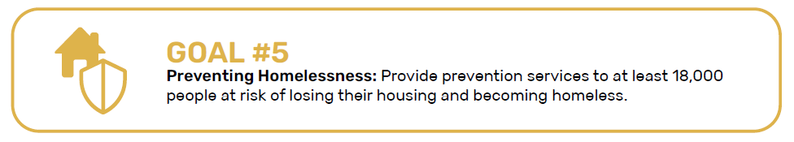
Strategic Plan 5-Year Goals (July 2023 - June 2028)

Slide 8
Homelessness Response System: Core Components and Access

Slide 9
Homelessness Response System Overview
HSH's work is organized into several core components:
homelessness prevention
coordinated entry
outreach
shelter
housing problem solving
housing

Slide 10

Core Component: Outreach
Learn more on the HSH website.
Connects people living outside with the rest of the homelessness response system.
The San Francisco Homeless Outreach Team (SFHOT):
Works to engage and stabilize people experiencing homelessness.
Build trust and relationships.
Offers available resources, supplies, case management, and Access Partner services.
Works in small teams 7 days a week as part of the City’s Neighborhood Street Teams collaboration.
Staffs Street Response Teams such as SCRT.
Client phone line: (628) 652-8000
Last 12 months: 43,454 outreach engagements
2,007 shelter placements
2,627 Coordinated Entry assessments.
SFHOT member at work.

Slide 11

Core Component: Homelessness Prevention
Learn more on the HSH website.
Interventions to prevent people from homelessness.
Flexible financial assistance for needs tied to securing or retaining housing
Engagement with partner systems (schools, workforce development) to identify households at risk of homelessness
Accessing Homelessness Prevention
Access: Apply for SF Emergency Rental Assistance Program (ERAP) online or via partners.
Target Population: Households at highest risk of losing housing and experiencing homelessness (including formal and informal living situations).
Different from (but sometimes overlaps with) Eviction Prevention (led by Mayor’s Office of Housing and Community Development).

Slide 12
Core Component: Coordinated Entry (CE)
Learn more on the HSH website.
Federally mandated consistent, streamlined, standardized process to match people experiencing homelessness with housing and other resources.
Goal of CE is to match people with the right resource to end their crisis.
CE Access Points and Access Partners are the "Front door" of the homelessness response system.
Organizes the homelessness response system using:
A centralized data system (Online Navigation and Entry System – “ONE System”) that creates a "by name" database of clients
A prioritization method for available HSH-funded housing.​

Slide 13
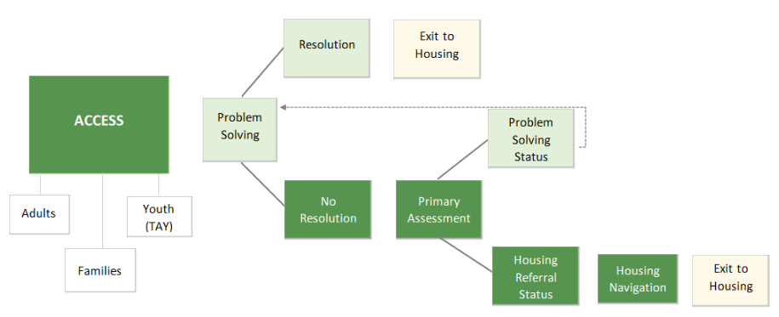
What happens in the CE Process?
Access Points also provide:
Problem Solving interventions, Housing Primary Assessment and Prioritization, and Navigation.
Free MUNI and MTA Fee Waivers for people active with CE.
Connection to shelter for youth and families.
Score based on (1) vulnerability, (2) length of homelessness, & (3) barriers to housing. Learn more about sliding thresholds.

Slide 14
Accessing Coordinated Entry: "Front Door"
Front Door to the Homelessness Response System
All HSH housing
Housing problem solving
Family and youth shelter
Access Points around the City:
Access Point locations: 4 adult, 3 family, 5 youth, 3 DV
Mobile teams available to meet clients around the City.
Access Partners (ex. HOT, DPH residential treatment) conduct assessments as part of their work.
Visit the HSH website for locations, phone numbers, and hours.

Slide 15
Core Component: Housing Problem Solving
Learn more on the HSH website.
Interventions to divert or rapidly exit people from homelessness without needing ongoing services from the homelessness response system.
Housing location assistance
Travel and relocation assistance to a housing connection in another community
Reunification, mediation, and conflict resolution
Financial assistance
Accessing Housing Problem Solving
Access: CE Access Points + family shelter
Target Population: People experiencing homelessness (i.e., have lost or are going to lose housing within 14 days) and are at or below 50% Area Median Income.

Slide 16
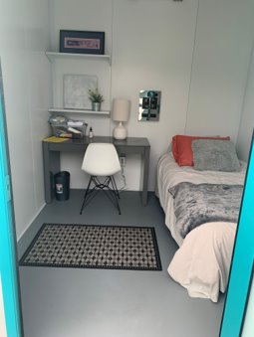
Core Components: Shelter
Learn more on the HSH website.
Shelter provides temporary places for people to stay while accessing other services & seeking housing solutions.
Shelter: umbrella category for many programs.
Congregate shelter: shared spaces.
Includes most navigation centers (pets, partners, more possessions & privacy)
Non-congregate shelter: private units (hotels, cabins)
Semi-congregate shelter: small shared rooms.
Transitional Housing: Place to stay and services for up to 2 years. Current programs for families and youth ages 18-24.
FY2024-25 Data: Served 10,161 people in shelter and 520 people in transitional housing.
Non-congregate cabin at 33 Gough.

Slide 17
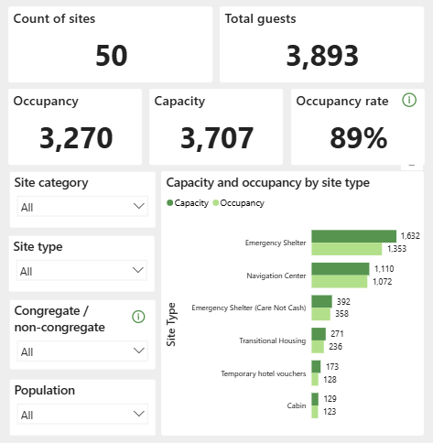
HSH Shelter Inventory
Snapshot as of November 2025.
Public dashboard available on HSH website; refreshes daily Monday – Friday.
Ability to filter to drill down on specific programs and populations served.

Slide 18
Accessing Shelter
Adults
Walk-in Self-Referrals: Dolores Adult Shelter
Families
Access through Coordinated Entry Access Points.
Self-Referral to Downtown High School
Youth (18-24):
Access through Youth Coordinated Entry Access Points
Youth may also access the adult shelter system
Call SFHOT to join the Adult Shelter Waitlist at 628-652-8000.
Any changes will be reflected on HSH website
Inclement/winter shelter available for walk-in during winter season.
Community Partner Referrals: Taimon Booten, Jazzie’s Place
Limited self-referral for 14-day Urgent Accommodation Vouchers for short term shelter needs
Up-to-date information available on the HSH website.
Resources outside HSH:
Domestic violence shelters – see SF.gov consolidated list.
Other shelter resources – see SF Service Guide for consolidated list.

Slide 19
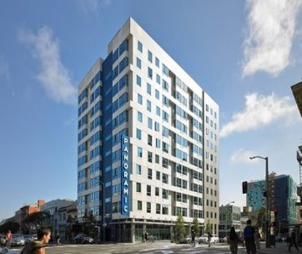
Core Component: Housing
Permanent solutions to homelessness. HSH housing team contracts with nonprofits to fund subsidies, supportive services, property management services, and leasing and operations costs.
Permanent Supportive Housing:
Tenants pay up to 30% of income in rent & receive voluntary support services.
Services include housing case management, physical and behavioral health through DPH, and In-Home Supportive Services for older adults and people with disabilities through DAS.
Site-based programs
>9,300 units in over 150 buildings across the City.
Housing sites include non-profit owned, master leased and City-owned buildings.
Scattered-site programs:
>2,600 PSH units
Tenants use rental subsidies to live in private market units.
Flexible Housing Subsidy Pool: locally funded subsidy.
Supportive services for some federal housing choice voucher programs like Emergency Housing Vouchers (EHVs).
Family and adult permanent supportive housing at The Margot (1321 Mission Street).

Slide 20
Core Component: Housing
Rapid re-housing (RRH): Time-limited rental assistance for up to two to five years with supportive services.
About 2,200 scattered-site private market units.
Housing ladder: ongoing subsidy for former residents of PSH to live in a more independent site-based or scattered-site unit with a lower level of supportive services.
Frees up PSH unit for a client with higher need.
Housing for Veterans:
The 2022 PIT Count indicates ~600 veterans are unhoused on any given night in San Francisco.
HSH resources focused on veterans:
CE Access Point for veterans (Swords to Plowshares)
Lower Housing Referral Status threshold for veterans
PSH units designated for veterans

Slide 21
Accessing Housing
HSH Housing
Other Housing
All HSH housing (permanent supportive housing and rapid re-housing) goes through CE Access Points.
Housing ladder: eligible PSH tenants referred by case managers.
Mayor's Office of Housing and Community Development (MOHCD):
City-sponsored affordable housing (DAHLIA)
Homeownership assistance
SF Housing Authority:
Federal voucher programs.
Other programs that take referrals from supportive agencies (ex. Veterans Affairs Supportive Housing).

Slide 22
Homelessness Response System: Meal Services

Slide 23
Meal Service at HSH Shelters
Meals/food funded by HSH
Family emergency shelter programs – 3 meals per day (some exceptions)
Adult and Youth emergency shelter programs – 2 meals per day
Snacks/additional food budget – daily snacks, food for special events, coffee, etc
No regular meals provided in scattered site hotel voucher programs, although grocery vouchers may be available
Meal provider
Kitchen in facility: CBO cooks meals in-house
No kitchen in facility:
HSH will provide meals through our meal vendor Meals on Wheels – hot or frozen meals depending on facility
In some cases, CBO will subcontract their own selected meal vendor
In a few programs, grocery vouchers/gift cards are provided instead of meal service when kitchens or kitchenettes are available to guests
Food donations

Slide 24
DPH Registered Dietician Partnership
The Department of Public Health (DPH) Shelter Health Team staffs a registered dietician (RD) dedicated to supporting food service in HSH shelter programs
RD services ensure consistent, professional nutrition and food service technical support is provided to meet the San Francisco Shelter Standards of Care (SOC) and nutrition, health and food safety guidelines for shelter residents:
SOC #9: engage a nutritionist, who shall review and advise on all meal plans, including meal plans for children and pregnant women and post menus on a daily basis;
SOC #10: make dietary modifications to accommodate requests from clients based on religious beliefs and practices, health, or disability reasons;
SOC #30: provide annual all-staff mandatory trainings, appropriate for each shelter position, that address…proper food handling and storage

Slide 25
DPH Registered Dietician Role
Provide quarterly on-site visits to each shelter/navigation center to review operations, provide support and professional assistance to shelter staff regarding menus, staffing, equipment, purchasing, receiving/storage, preparation, meal service, sanitation and training needs.
Review all menus to ensure compliance to Adult and Family Shelter Menu Pattern established by SF Shelter Nutrition Project.
Review all menus for vegetarian and religious/diet accommodations per SOC guidelines. Provide technical support as needed.
Provide RD investigation and response to SOC complaints related to #9, 10, and 30.
Plan and/or provide annual Standards of Care “Proper Food Handling and Storage” training.
Complete annual RD food service evaluations as 4th quarter on-site visits for each shelter, navigation center and central kitchen.

Slide 26
HSH Meal Service Provider - Meals on Wheels
Serves 16 adult and youth shelter programs, mostly Navigation Centers
2 meals per person per day - frozen and hot
Began in Navigation Centers with a “Meals on Demand” model
HSH designed Navigation Centers to be low barrier – no curfew, limited rules, pets/partners/possessions, expanded hours to access meals
Frozen meals allowed Navigation Centers to provide access to meals throughout the day/evening
3,334 meals per day
463 hot meals
2,871 frozen meals
1,159,059 total meals per year

Slide 27
Key HSH Requirements for Meals on Wheels
Individually portioned, packaged, and delivered ready to eat meals
Condiments and dinnerware included
Meet DPH Shelter Health Menu Pattern for Adults:
4 oz. Protein/protein equivalent
1 cup fruit/vegetable serving:
½ cup must be vegetable in both breakfast and dinner meals.
½ cup will be 4 oz 100% fruit juice for the breakfast meals.
½ cup will be fresh fruit or canned fruit in juice in dinner meals.
1 ½ cup grain or starchy vegetable serving and
8 oz. 1% milk.
Fruit juice, canned fruit, and milk provided in individual, commercially packaged containers. Fresh fruit provided in bulk.
Two-week cycle menus submitted for review by DPH Registered Dietician. Nutrient analysis provided for the two-week cycle menu: a. Calories, b. Protein, c. Carbohydrates, d. Total Fat, and e. Sodium.
Provide special meals to meet special dietary needs:
Vegetarian
Diabetic/low sodium/low-fat and
Mechanical soft entrees.
Work with DPH Registered Dietician.

Slide 28
Other Food Support at HSH Programs
Housing
Housing tenants in HSH funded housing programs utilize community resources, such as food banks, home delivered meals, and drop-in meal programs. Housing program case managers assist tenants in accessing these resources.
Some housing programs are able to provide community meals/food for tenants through external grant funding, fundraised dollars, or food donations
Outreach
SFHOT may provide water and snacks when engaging with people on outreach
Case managers and outreach workers provide information about community food resources, including drop-in meal programs
Drop-In
Bayview Drop-In program provides daily meals to people experiencing homelessness in the Bayview Hunters Point community.

Slide 29
Key Links
HSH website
Information on the Homelessness Response System
Get help from HSH
Shelter Monitoring Committee
Shelter Standards of Care

Slide 30
Thank you! General HSH Inbox | dhsh@sfgov.org

