Slide 1
CalFresh Work Requirements: Population Estimates
March 2026

Slide 2
Policy

Slide 3
CalFresh: Expanded Work Requirements
Implementation Date: June 1, 2026
California’s waiver of the CalFresh work requirement has ended. Starting June 1, 2026, many CalFresh recipients are required to meet federal work requirements under newly-expanded definitions.
The work requirements apply to Able-Bodied Adults Without Dependents (ABAWDs) or people who:
Are adults 18-64
Can work
Do not care for a child under 14
People subject to these requirements can only get 3 months of benefits in a 3-year period unless they meet certain work requirements or qualify for an exemption.
Starting June 2026, applicants will be subject to HR 1 screening and work rules, while existing clients will be subject at their next renewal.

Slide 4
CalFresh: Expanded Work Requirements (continued)
Implementation Date: June 1, 2026
Exemptions remain for anyone who:
Cares for a child under 14​*
Is pregnant
Physically or mentally unfit to work (based on interview)
Works 30+ hours/week or earns $217.50+ per week
Is in school at least half-time​
Is participating regularly in a substance treatment program
Receives/applies for Unemployment Insurance​ or disability benefits
Cares for an ill or disabled person
Meets CalWORKs work requirements
Is U.S. Native American
*People experiencing homelessness, veterans and individuals age 24 or younger in foster care are no longer categorically exempt. Similarly, adults living in the home are no longer categorically exempt, but instead must be at least partially responsible for the care of the dependent.

Slide 5
CalFresh: Expanded Work Requirements (continued)
Implementation Date: June 1, 2026
If not exempt, someone can meet work requirements by doing one or more of the following:
Working 20 hours per week or 80 hours per month
Volunteering or performing community service 20 hours per week, at least 80 hours per month
Participating in a qualifying employment training program 20 hours per week, at least 80 hours per month
Participating in SFHSA Workfare
The number of workfare hours required per month is determined by dividing the CalFresh benefit amount by the City's minimum wage​ (e.g., $250 monthly benefit / $19 SF minimum wage = 13 hours per month)
Workfare can be a placement in a City Agency or with a nonprofit

Slide 6
CalFresh: Expanded Work Requirements (continued)
Starting June 1, 2026
Implementation Rollout:
New Applicants will be subject to screening and the expanded work requirements starting June 1
Ongoing Households will be subject to screening and the expanded work requirements at their next recertification, starting for households with recertifications due in June.
Example: A person applies and is approved for CalFresh in January 2026 with a 12-month certification period. This person will not be subject to the HR 1 screening and rules until their recertification in December 2026.
If screened and found not exempt, this person will be required to meet work rules starting January 2027 to keep getting CalFresh after the three-month limit.

Slide 7
Client Impact Estimates
Approximately 19,300 clients likely subject to work requirements and unlikely to qualify for exemption
They represent about 18% of San Francisco’s CalFresh caseload

Slide 8
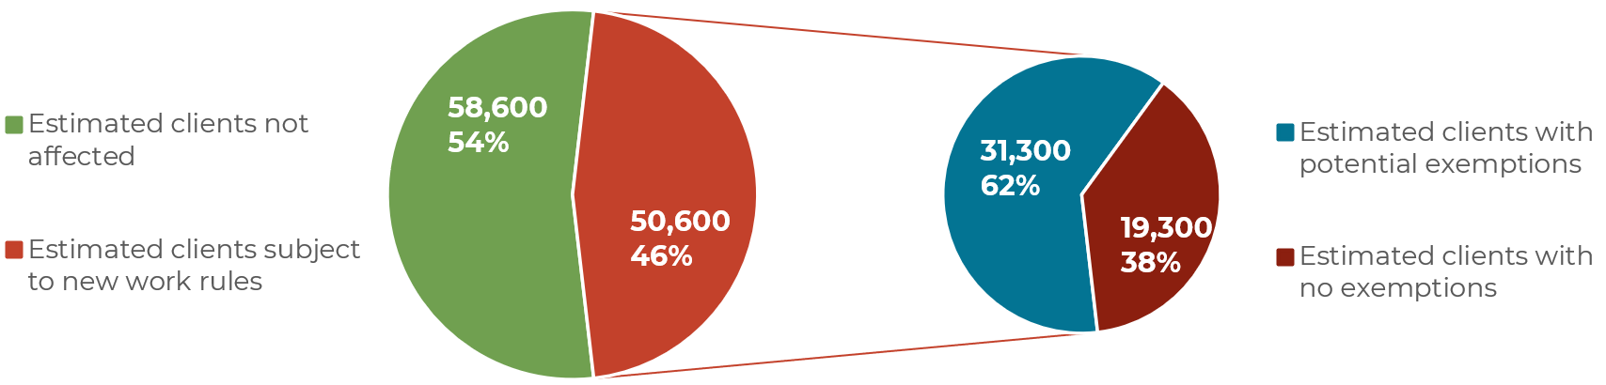
Projected Impact for CalFresh Caseload
(CalFresh ABAWDs)
Source: CalSAWS May 2025

Slide 9
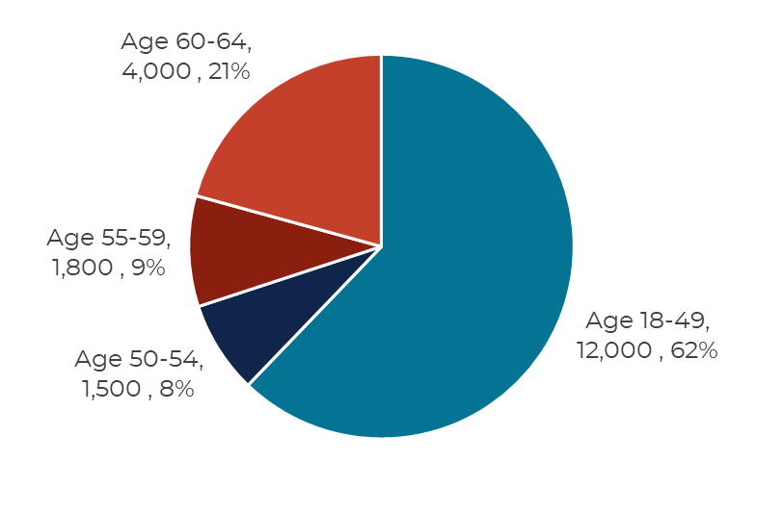
CalFresh ABAWDs by Age
Source: CalSAWS December 2025

Slide 10
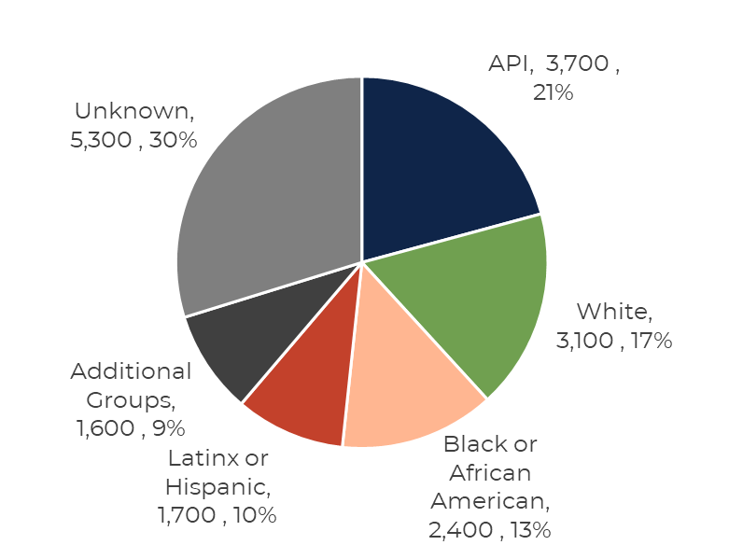
CalFresh ABAWDs by Race/Ethnicity
Source: CalSAWS December 2025

Slide 11
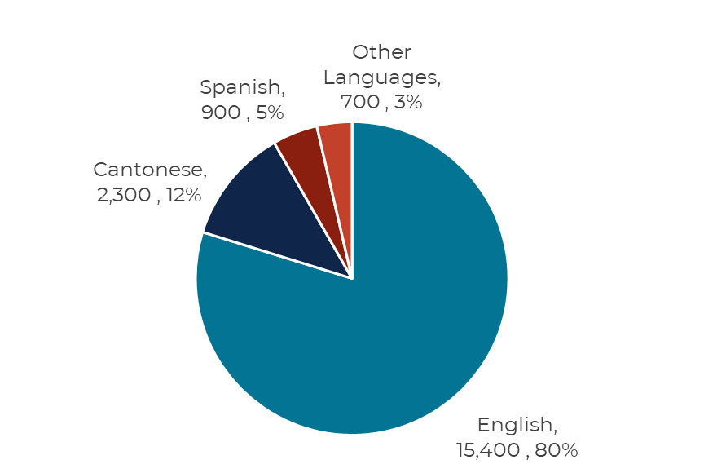
CalFresh ABAWDs by Language
Source: CalSAWS December 2025
Other languages include Vietnamese (300 clients), Russian (100), and Filipino (100) among others

Slide 12
Zip | Neighborhood | #
94102 | Hayes Valley/Civic Center/ Tenderloin | 5,250
94103 | South of Market | 1,450
94112 | Ingleside/Excelsior | 1,400
94124 | Bayview/Hunters Point | 1,400
94109 | Polk/Russian Hill/Nob Hill | 1,300
94110 | Mission District/Bernal Heights | 1,100
94134 | Visitacion Valley | 950
94122 | Sunset | 750
94133 | North Beach | 550
94115 | Western Addition/Japantown | 500
94116 | Sunset/Parkside | 500
94121 | Outer Richmond | 500
Zip | Neighborhood | #
94107 | Potrero Hill/SOMA | 450
94117 | Haight-Ashbury | 400
94118 | Inner Richmond | 400
94132 | Lake Merced/ Lakeside | 400
94108 | Chinatown | 300
94114 | Castro/Noe Valley | 250
94131 | Twin Peaks/Glen Park | 250
94142 | General Delivery | 150
94158 | Mission Bay | 150
94105 | Rincon Hill | 100
94111 | Embarcadero | 100
94123 | Marina/Cow Hollow | 100
94127 | St. Francis Wood/West Portal | 100
94130 | Treasure Island | 100
94104 | Financial District | -
94129 | Presidio | -
CalFresh ABAWDs by Location
Source: CalSAWS December 2025

Slide 13
Community Partnership
Support clients with applying & keeping benefits
Help tech-comfortable clients set up online BenefitsCal accounts so clients can submit documentation electronically
Offer volunteer opportunities to help clients meet requirements
Share accurate information
Regularly check SFHSA’s website for updates:
https://www.sfhsa.org/community-partner-resources
Subscribe to the Quarterly Partners Newsletter about our services' updates and events

