Slide 1
Food Security Task Force August 6, 2025
CalFresh

Slide 2
CalFresh Program
Jeimil Belamide, Policy Manager for CalFresh & Medi-Cal
San Franciso Human Services Agency

Slide 3
CalFresh Program
Background
CalFresh - California’s name for the Federal Supplemental Nutrition Assistance Program (SNAP), formerly know as Food Stamps
Benefit levels and eligibility criteria are set at the Federal Level
US Dept. of Agriculture – Food and Nutrition Service (FNS) provide regulatory guidance and compliance standards to States.
California Department of Social Services (CDSS) provide regulatory guidance and ensure compliance for all 58 counties in CA.
SF Human Services Agency (SFHSA) administers the program for San Francisco

Slide 4
CalFresh Program
SF Caseload as of March 2025
111,766k individuals
82,918 households

Slide 5
Age Groups
As of March 2025
Age | Appox. # of Individuals in Age Group
0-17 years | 18,000
18-24 years | 7,000
25-39 years | 18,000
40-49 years | 11,000
50-59 years | 10,000
60-64 years | 8,000
65+ years | 41,000

Slide 6
Primary Language
As of March 2025
Language | Appox. # of Individuals in Language Group
English | 66,000
Chinese | 29,000
Spanish | 11,000
Russian | 2,000
Vietnamese | 2,000
Other Languages | 1000
Tagalog or Filipino | <1000

Slide 7
CF Persons by Race/Ethnicity
As of March 2025
Race/Ethnicity | Appox. # of Individuals in Race/Ethnicity Group
Asian or Pacific Islander | 34,000
Black or African American | 11,000
Latinx or Hispanic | 14,000
White | 10,000
Additional Groups | 9,000
Unknown | 34,000

Slide 8
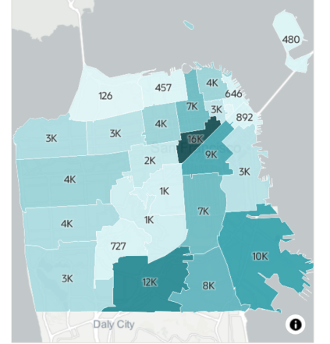
CF Persons by Zip Code
Notes:
(

Slide 9
High level H.R. 1 Impacts on CalFresh

Slide 10
Impacts of HR 1
Work Requirements (ABAWD)
Work Rule
Requires certain individuals to work at least 80hs/month or be limited to three months of CF in a three-year period.
Changes (effective date TBD)
Changes the work requirement age to 18-64 (from 18-54)
Changes dependent children in the home exception to apply to children under the age of 14 (from under 18)
Eliminates exemptions for people experiencing homelessness, veterans and those under 24 years old and aged out of Foster Care at 18
New exemption for individuals who are Indians, Urban Indians, and California Indians

Slide 11
Impacts of HR 1
Work Requirements (ABAWDs) continued…
Right now
CA is currently under waiver that is set to expire on 1/31/2026
CA waits for details on effective dates

Slide 12
Impacts of HR 1
Noncitizen Eligibility For CF
Changes (effective date TBD)
Limits CalFresh eligibility to LPRs, Cuban or Haitian Entrants, or Compacts of Free Association (COFA) citizens (Micronesia, Marshall Islands, Palau)
Right Now
Eligibility for CF includes Refugees, those granted asylum, and others not included in the above description.

Slide 13
Impacts of HR 1
Matching Funds Requirement - Benefits
Changes effective Oct 1, 2027
Requires States to pay a percentage of CalFresh benefits based on their payment error rate. States are required to match between 0 – 15% of benefits issued depending upon size of its payment error rate.
Right now
Feds fund 100% of SNAP benefits

Slide 14
Impacts of HR 1
Matching Funds Requirement – Administrative Costs
Changes effective Oct 1, 2026
Federal portion of administrative costs reduced from 50 to 25%
State portion will increase from 50 to 75%
CA will continue to share the State portion with Counties at a rate of 70% (State) and 30% (Counties)
Right Now
Feds and States share 50/50 in Admin costs
CA and County share 70/30 of State share.

Slide 15
Thank you!

