Slide 1
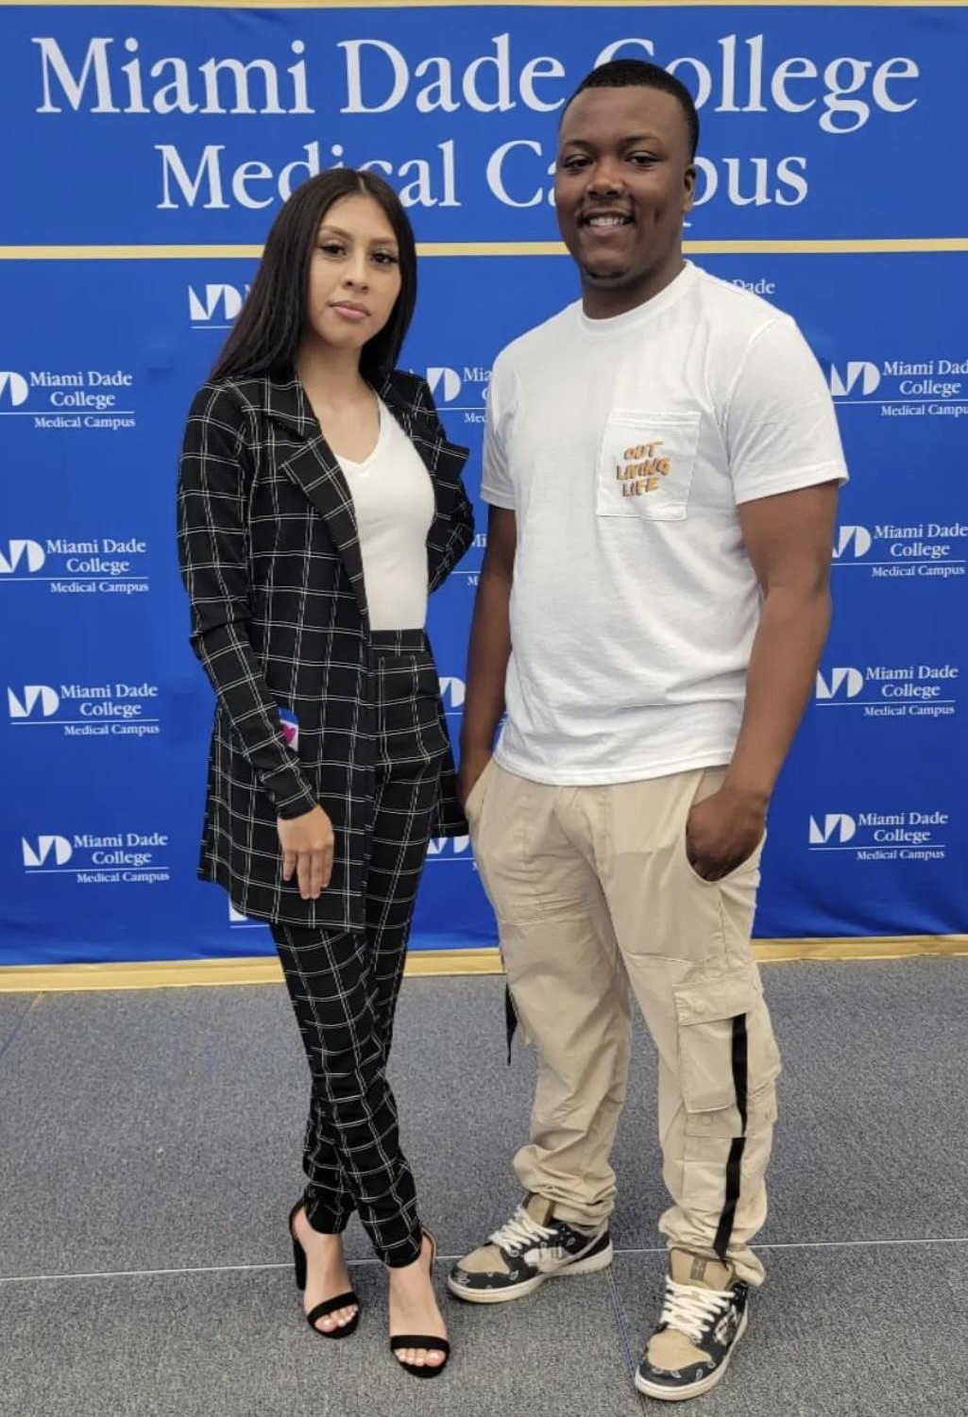
My Brother and Sisters Keeper
Opportunity Youth United San Francisco Community Action Team
The MBSK Youth Council had conducted interviews last month for their Economic Advancement Fellowship and had selected the fellows for this 1st cohort.
  6 part-workshop series focused on generational wealth-building and changing the narrative about economic advancement.
  Training curriculum developed in collaboration with wealth building experts.
  $100 per session plus $200 for completion = $800 for all 6 workshops!
The 17 Youth Fellows they selected will have their first session next Wednesday, September 14th, and will be joined by guest speaker and Dream Keeper Initiative Director, our very own Dr. Saidah Leatutufu-Burch who will talk about financial empowerment from a lens of uplifting people from poverty within a frame of navigating historical economic oppression.
Additionally, from August 22-25, two of our AMAZING Youth Council Members Alexjandra Teyer (Pictured left) and Danny Lockett! (Pictured Right) traveled to Miami, Florida for the Opportunity Youth United’s Annual Convening where they provided updates to youth leaders across the nation on what the MBSK CAT has been working on.
  There were also able to build connections and ideas for collaborative efforts with other communities across the country.
NEXT STEPS
  We plan to reconvene the partners from the MBSK Champions (partner organizations and allies) in October as the school year is back in session.
  With the new school year started, there will be considerations to add councilmembers as some participants have started their first semesters of college.

Slide 2
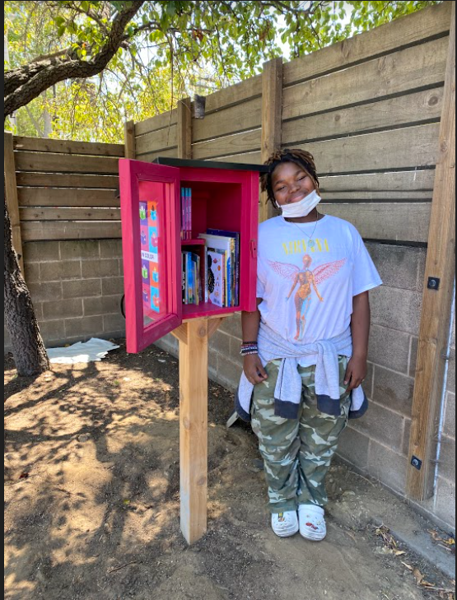
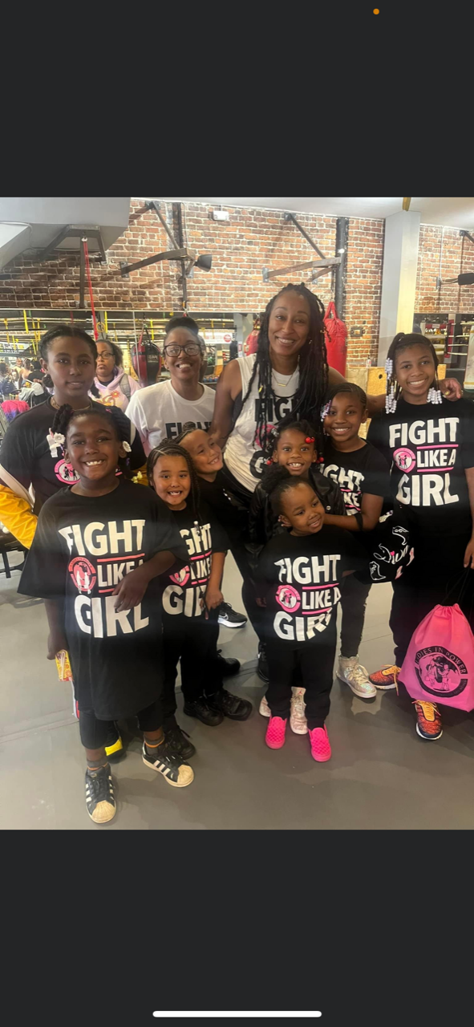
Dream Keeper Initiative Brighter Futures
Goal:
Brighter Futures takes a holistic approach, using an innovative wrap-around service delivery model to work with households and families to lay a foundation of collective success. Working with key partners Brighter Futures will work closely with 30 families to build a model of integrated, multigenerational social support.
Highlights:
DKI Brighter Futures supports community organizations by providing funding, collective impact and celebratory spaces for grantees, and support with naviting city process and resources.
Organizations (Ladies Empower and AAPAC)

Slide 3
Equity Studies Task Force - Overview
Equity Studies to Implement Humanizing Learning Experiences for All Students PK-12 in
SFUSD — Board of Education President Jenny Lam, contributor Commissioner Boggess
Legislative Mandates
DEFINE METRICS for measuring success;
MONITOR AND EVALUATE/ASSESS the work of the SFUSD’s Equity Studies Team;
RESOURCES & REPORT: Serve as a resource and thought partner in the work and make recommendations on implementation; and
BUDGET: The taskforce will make budgetary and organizational recommendations to” implement this resolution;
PERMANENT EQUITY STUDIES TEAM to Meet Biweekly.
CALENDAR: Create a PK-12 culturally and community responsive calendar for sites and a rubric/set of resources.
EVALUATE EXISTING CURRICULUM AND BOOKS: Develop a comprehensive Culturally Responsive Curriculum Scorecard.
ANTI-BIAS TRAINING:
  All site and central office staff in implicit bias, stereotyping and LGBTQ sensitivity.
  Implement school-wide curriculum, to ensure educators address intolerance and prejudice within school sites.

Slide 4
Equity Studies Task Force - HRC Support
HRC Convened 12 meetings between January 29, 2020 and April 25, 2022
Participants included all Parent Advisory Groups, Students Advisory Groups, SFUSD Instructional Leadership, Community Based Organizations. Average attendance 48 participants.
April 29, 2020 & May 27, 2020– Meetings after COVID-19 Lockdown attended by 232 participants.
Distributing Laptops, wifi hot spots, K-1 learning packets. Addressing issues related to supporting students with Individual Education Plans, families with severely impacted special needs students, English Language Learners.
Responding to immediate basic needs of families: Meals, Health Care, Unemployment, PPE
Connecting Essential Service Workers to Childcare & Learning Hubs supporting 200-2021 school year.
Broke for COVID response during the 2020-2021 School Year

Slide 5
Equity Studies Task Force
Summer 2021 Meetings Focused on disseminating information about school reopening and DCYF summer programming.
2021-2022 School Year - Meetings focused on supporting SFUSD and DCYF efforts to support educators, students, and caregivers as the city slowly reopened from the COVID-19 Pandemic.
Shared Task Force Work in 2021-2022 School Year: Providing space for parents, educators to share concerns directly to SFUSD Deputy Superintendent of Curriculum and Instruction. Also a space for SFUSD to share out important updates.
SF RISE Initiative-School Remediation and Retention Plan for SFUSD students
Task Force Projects Nearing Completion or Completed
Calendar
Asset Map
Classroom & Library Book List

Slide 6

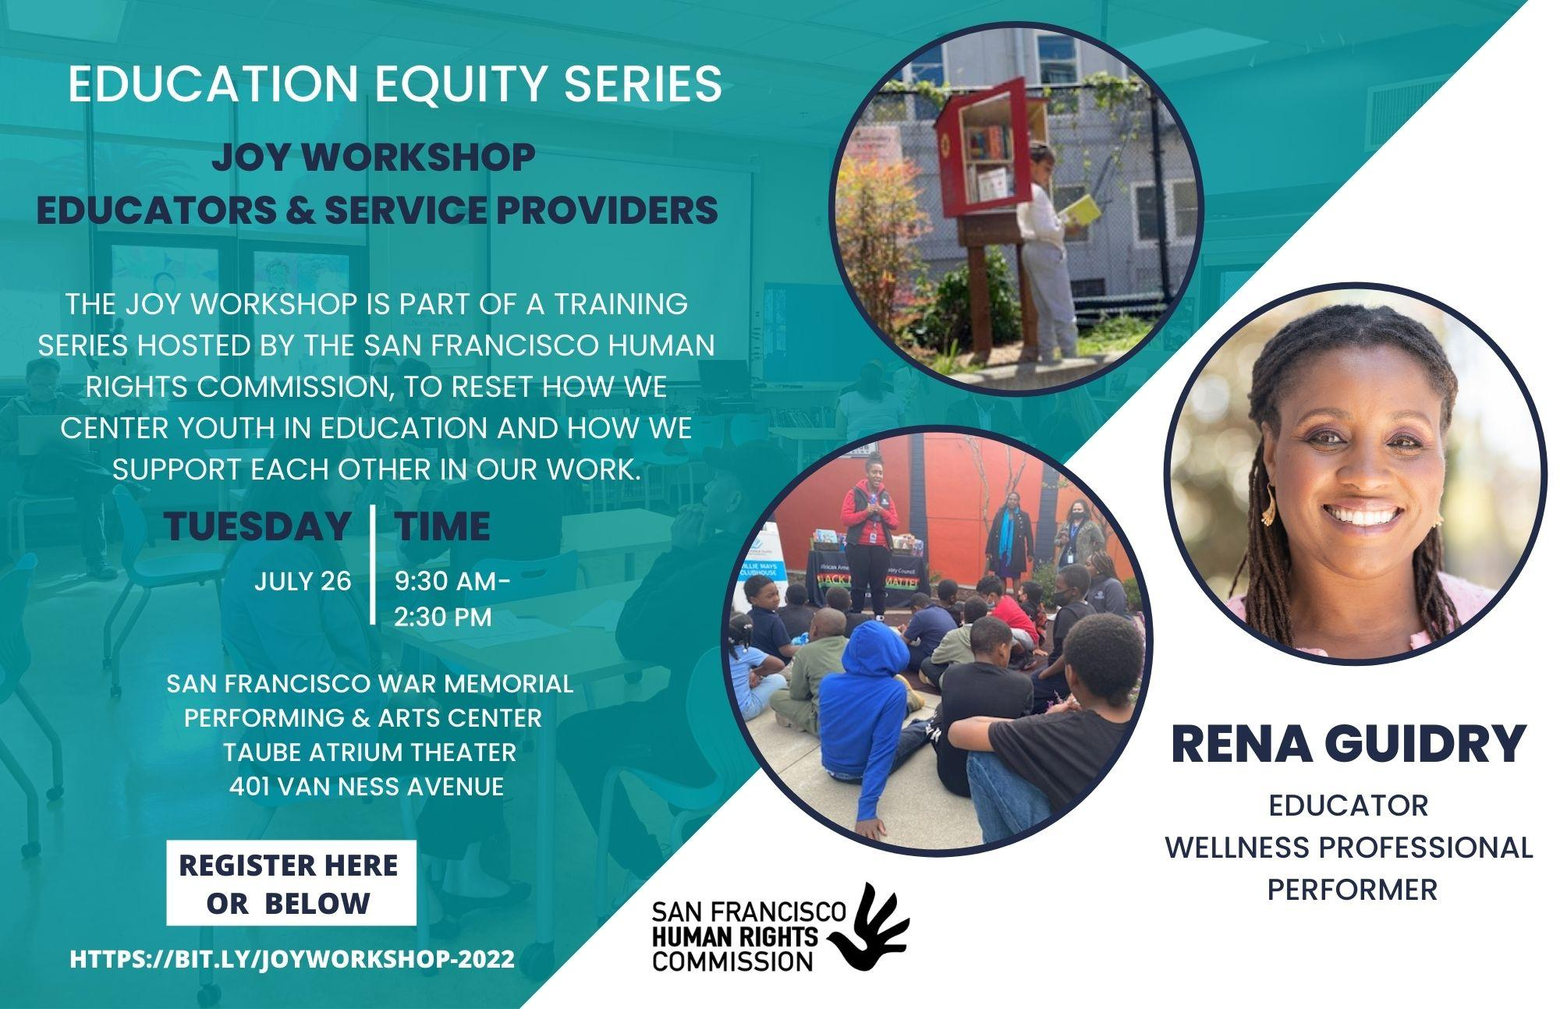
Summer 2022 - Education Equity Series
The Power to Heal - Moving Beyond Potential to Individual Success
Success means something different for each young person. Far too often, we focus on the trauma they experience and don’t recognize or celebrate their successes. Transformational healing-based practices require a shift away from using deficit-based models to those honoring the talents, skills, and wisdom of youth.

Slide 7
Q & A
Thank you for your time and space shared.

