Slide 1

Health Care for the Homeless (HCH) Financial Conflicts of Interest – A Brief Introduction SF HCH CAB March 14, 2022
From the Office of the City Attorney:
Virginia Dario Elizondo, Deputy City Attorney
Henry Lifton, Deputy City Attorney

Slide 2
Financial Conflicts of Interest
Generally, do not make, participate in making, or use your position to influence a governmental decision in which you have a financial interest
Financial Interests include:
Real Property
Income
Investment
Gifts
Personal Finances
If you have a conflict, you must abstain from any participation or efforts to influence the decision
Notes:
Financial interest: real property in SF and worth $2K or more but not month to month rentals; income from any source worth $500 or more; investment in business that does business in SF and worth $2K or more or you are director, officer, employee of that entity; gifts of $500 or more in last 12 months; personal finances is income, assets, and expenses of immediate family
Government decision: voting, appointing someone, committing your board to course of action, or entering into a contract
participate: negotiating, providing advice by way of research, investigation, preparing reports for decision maker; seek to influence means using your position to try to affect outcome of decision
Participate includes: negotiating, providing advice by way of research, investigation, and preparing reports for decision maker
Seek to influence includes: using your position to try to affect outcome

Slide 3
Financial Conflicts of Interest
If you have questions or concerns about a potential conflict of interest, please direct them to DPH staff
When in doubt, ask!
Applicable Laws
SF Campaign and Governmental Code
California Political Reform Act
California Government Code Section 1090

Slide 4
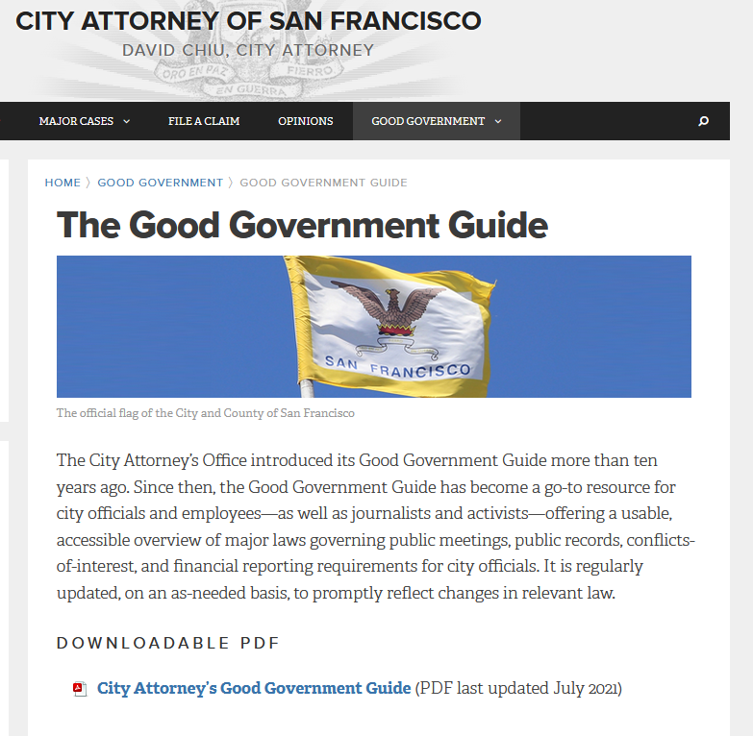
SF Good Government Guide
www.sfcityattorney.org/good-government/good-government-guide/

