Slide 1
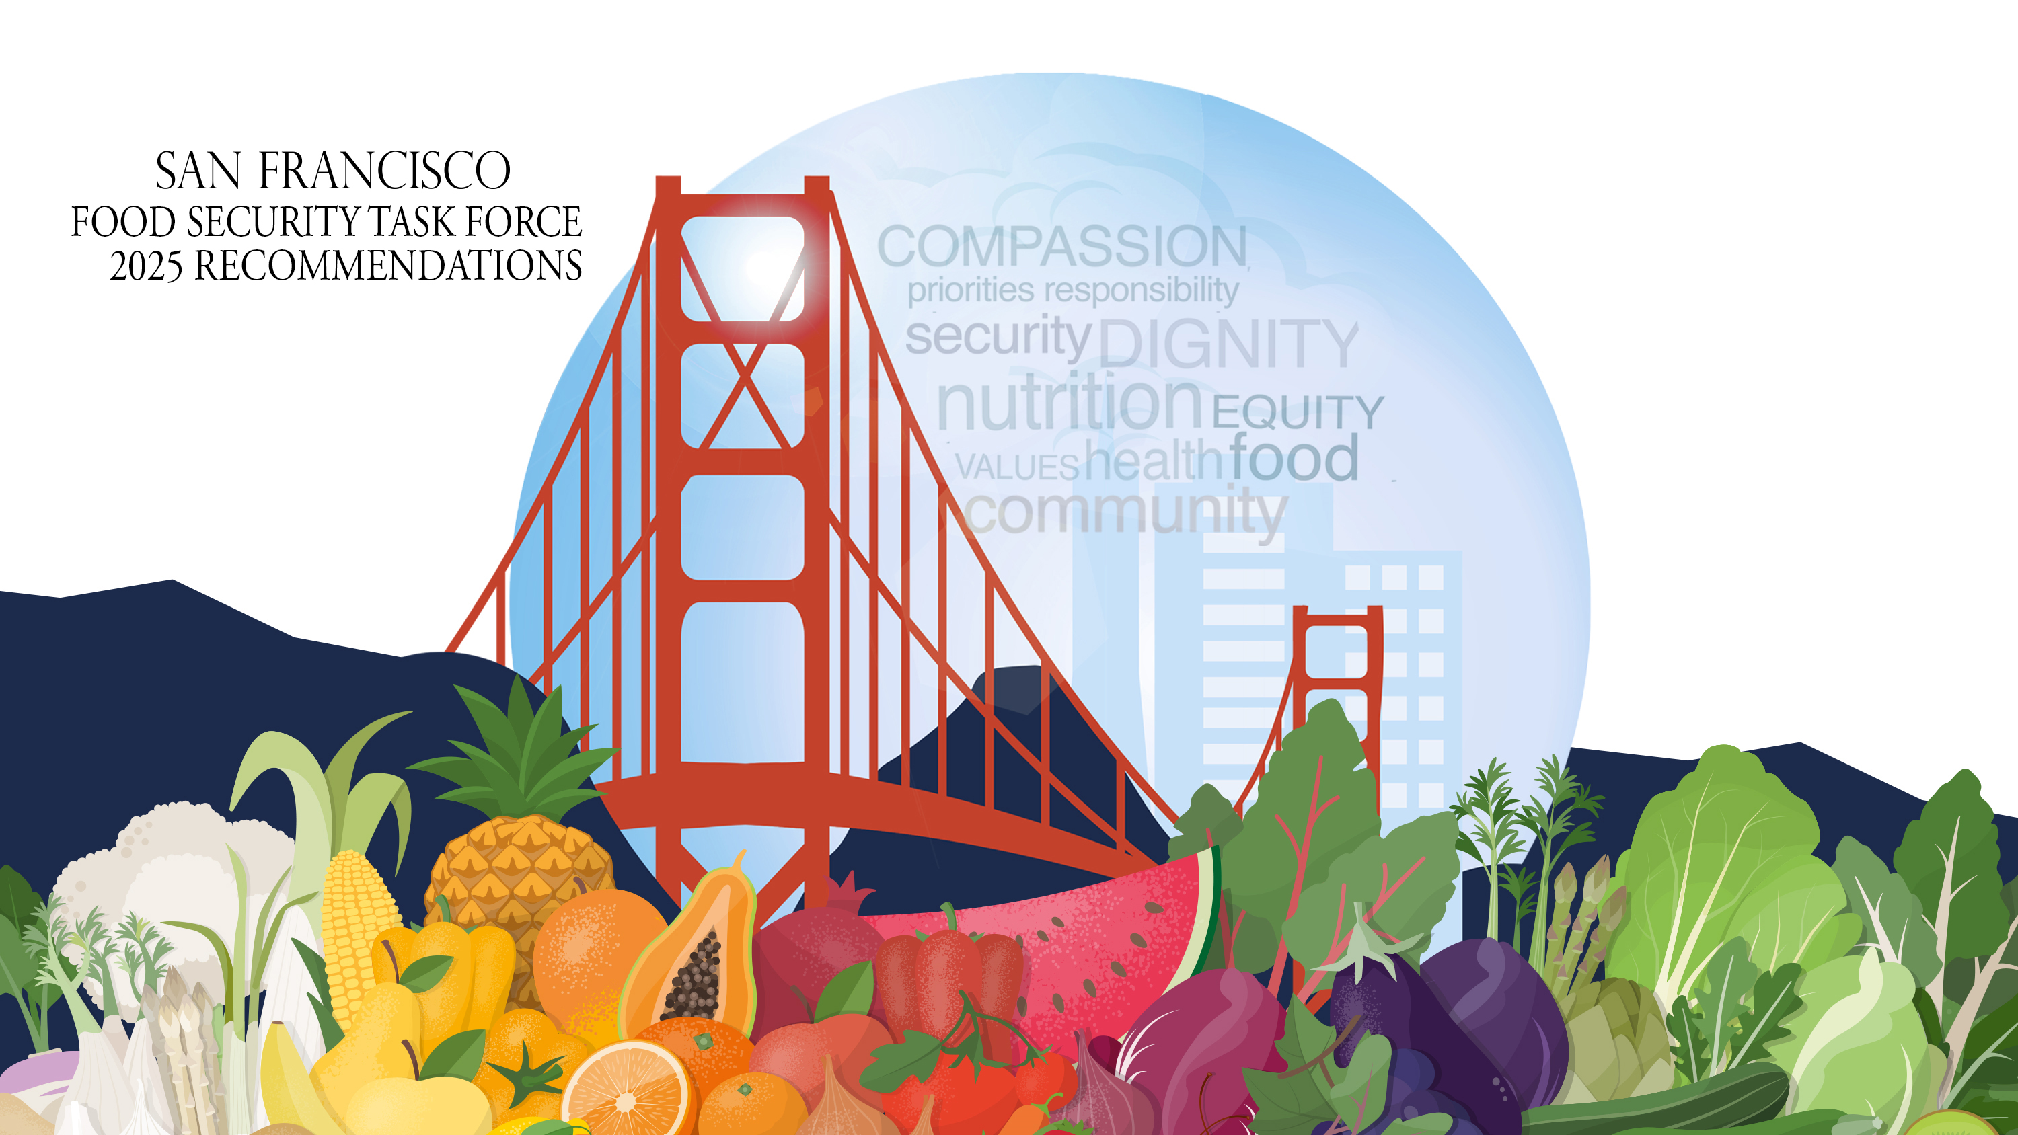

Slide 2

Background
The Food Security Task Force (FSTF) was created by the Board of Supervisors with the purpose of making recommendations on policies, programs, and funding to improve food security.
The Task Force’s membership consists of representatives from City departments, San Francisco Unified School District, and community-based organizations.
The Task Force meets monthly, and meetings are attended by public agencies, organizations and individuals working to address the diverse food needs of San Francisco residents.

Slide 3

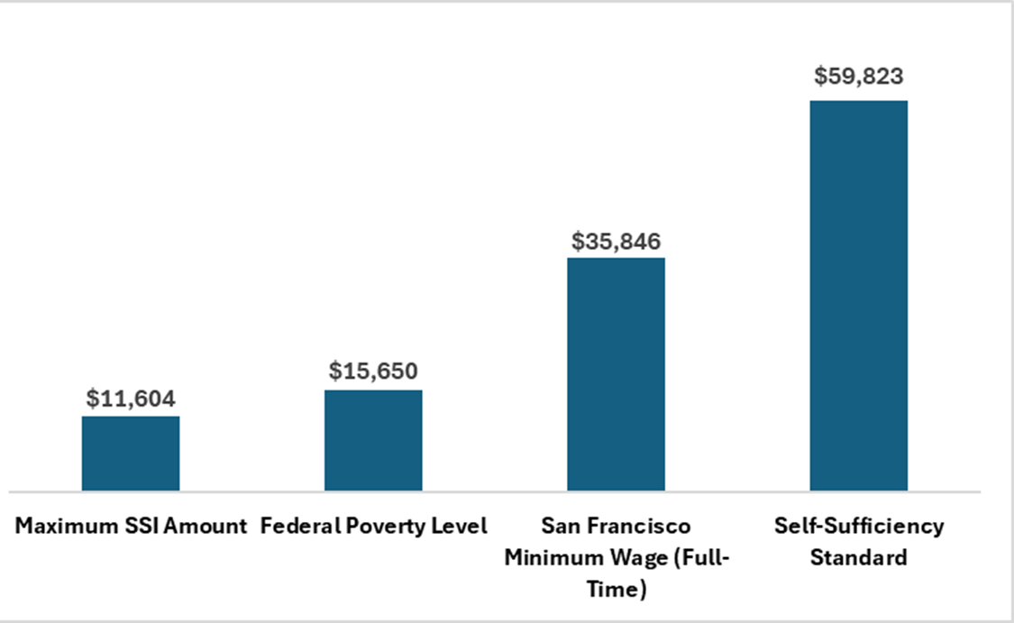
High Cost of Living in San Francisco
Annual Income Comparisons for a Single Adult, 2025
The city-wide median income is $141,446.
Data Source: ACS Survey 5-Year Estimates, U.S. Census Bureau. 2019-2023.

Slide 4
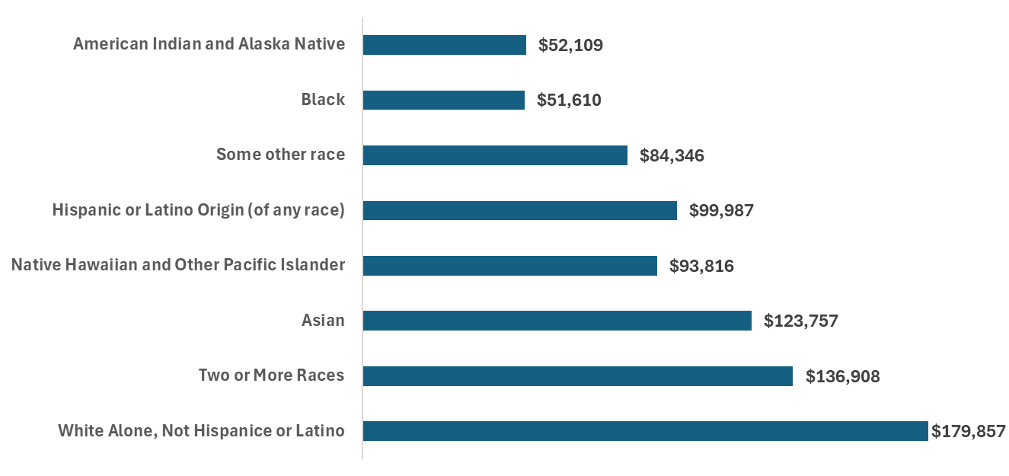
High Cost of Living in San Francisco
Median Annual Household Income By Race/Ethnicity, 2019 - 2023
The city-wide median income is $141,446. Most race/ethnicities make below the city-wide median income, with Black and African American and American Indian and Alaska Native households only making a bit more than one third of the city-wide median income.
Data Source: ACS Survey 5-Year Estimates, U.S. Census Bureau. 2019-2023.

Slide 5

Current Landscape
The Self-Sufficiency Standard (SSS) is a budget-based, annual wage measure that defines the real cost of living for working families.
Based on the 2024 SSS data set, an annual income of $59,823 is needed for a single adult to live adequately in San Francisco.
At least 22% of SF households and 29% of non-family households live below the SSS.
San Francisco Residents Below Self Sufficiency Standard
 | Annual Household = 1 | % of Residents | # of Residents | Self Sufficiency Standard | Additional Income Needed to Meet SSS
<100FPL | $15,650 | 10.6 | 87,000 | $59,823 | ~ 3.8x ($44,173)
<200FPL | $31,300 | 21 | 171,000 |  | ~ 1.9x ($28,523)
<300FPL | $46,950 | 29.7 | 245,000 |  | ~ 1.2x ($12,873)
Data Source:
California Self-Sufficiency Standard, The University of Washington, 2024. ACS Survey 5-Year Estimates, U.S. Census Bureau. 2019-2023.

Slide 6

Current Landscape
Food costs have increased by 23.6% from 2020 to 2024.
In 2023, 37% of San Francisco residents below 200% FPL were food insecure.
When maximum income to receive CalFresh is at or below 200% FPL, benefit amounts need to be tied to the cost of living in SF.
The 2024 SF Marin Food Bank Hunger Report found that even at nearly 300% FPL, more than half of respondents struggle to put food on the table.
Data Source:
Cost of living Index, 2025.
California Health Interview Survey (CHIS), 2023.
U.S. Census Bureau, 2019 – 2023 ACS Survey, 5-Year Estimates.
SF Marin Food Bank Hunger Report, 2024.

Slide 7

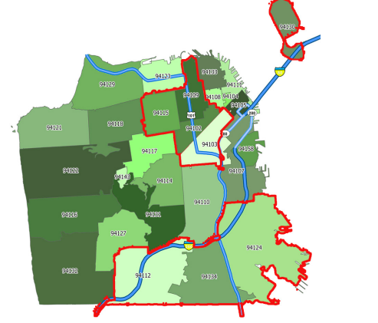
Health, Poverty, and Food Security
Zip Code | Neighborhoods
94102 | Hayes Valley, Tenderloin, North of Market, Civic Center
94103 | South of Market
94124 | Bayview-Hunters Point
94130 | Treasure Island
Zip codes 94102, 94103, 94124, and 94130 experience poverty rates higher than the city average, impacting access to food security and overall health and consistently have the highest age-adjusted rates of hospitalization due to diabetes, hypertension and heart disease.
Treasure Island, Bayview-Hunters Point, SOMA neighborhoods, and Tenderloin are ranked in the top 4 zip codes with age adjusted hospitalization rates for these conditions ranging between 1.6 to 3 times higher than the city’s average.
Data Source: California Department of Health Care Access and Information, 2017 -2021.

Slide 8

Investments in Food Security
A total of $200.7M from local, state, and federal funding was dedicated to food security programs in SF during FY 22-23.
Based on Biennial Food Security & Equity Report data, there were 9 departments that worked on food-related programming and/or provided food resources, operating a total of 36 programs.

Slide 9

Summary of Mayor’s Proposed Budget (June 5, 2024)
Based on the Mayor’s proposed budget that was presented to the FSTF in June 2024,funding for food security initiatives for each fiscal year is as follows:
CCSF Food Security Budget:
FY 23-24: $50.89 million
FY 24-25 proposed budget: $41 million (less $9.89M from prior FY)
FY 25-26 proposed budget: $36 million (less $4M from prior FY)
In addition to the 15-20% local budget cuts instructed by the Mayor, the proposed cuts to food security funding would significantly impact programs and services that address food insecurity (Food Pantries, Summer Food Service Program, etc.).

Slide 10
Nutrition Sensitive Health Disparities
Data from 2017-2021 indicated that hospitalizations due to diabetes, hypertension, or heart failure were 9x higher for Native Hawaiian/other Pacific Islander residents, and about 4x higher for Black/African American residents than the average rate for all SF residents.
Across all diet-sensitive causes of death, aside from Alzheimer Disease, Black/African American residents experience mortality rates that are often twice as high as the mortality rates experienced by other race/ethnicities.
Out of all the City food programs, only 8 focused on addressing nutrition sensitive medical conditions.
These programs had a combined budget of $7.54 million for FY 22-23 (only 3.7% of total food funding from all resources).
Out of this $7.54M, $3.15M were local funds, which is approximately 3.45% of all local funds.
Data Source:
California Department of Health Care Access and Information, 2017 -2021.

Slide 11

Healthcare Expenditures
Healthcare expenditures due to food insecurity totaled $52.9 billion nationally in 2016.
In San Francisco, the estimated healthcare cost of food insecurity in 2019 was $204.5 million.
105,530 (14%) adults are likely to be food insecure in San Francisco and are estimated to spend annually $1,925 more on healthcare costs than people who are food secure.
SNAP participants incur $1,400 less on healthcare spending than a low-income non-participant ($4,421 vs $$5,831).
Data Source:
The Healthcare Costs of Food Insecurity, Feeding America Research, 2022
Berkowitz, S.A., Basu, S., Gundersen, C., & Seligman, H.K. (2019). State-Level and County-Level Estimates of Health Care Costs Associated with Food Insecurity. Preventing Chronic Disease, 16. https://doi.org/10.5888/pcd16.180549.
Berkowitz, S.A., Seligman, H.K., & Basu, S.J., (2017). Impact of Food Insecurity and SNAP Participation on Healthcare Utilization and Expenditures. University of Kentucky Center for Poverty Research.

Slide 12

Local Threats to Food Access
Cuts to Pantry Programs
San Francisco Marin Food Bank (SFMFB) programs experienced funding cuts from federal and city/county government in 2023.
Planning to phase out all pop-up pantries by June 2025 impacting 7,500 unduplicated households.
40% reduction in their home-delivered groceries program, impacting another 4,500 households (12,000 households total).
Government food commodities decreased while inflation increased (FY 20-21: $55 million vs
FY 22-23: $15 million).
SFMFB Federal, State, and Local Budget Cuts
FY 22-23 funding - $19 million (federal: $4.2 million, state: $176k, city/county: $19.2 million)
FY 24-25 funding - $14 million (federal: $1.9 million, state: $1.6 million, city/county: $10.7 million)

Slide 13
Local Threats to Food Access
Cuts to Meal Support
HSA has seen budget cuts in its food programs, including Grocery Access and Meal Support.
Decrease in Citywide Food Access Team (CFAT) program funding from $20 million to $10 million from FY 23-24 to FY 24-25.
Most programs are taking a 25% - 35% budget cut, resulting in weekly to bi-weekly service.
Impacts CBOs working to combat food insecurity.
Retail Environment Constriction
The loss of Safeway in Fillmore in February 2025, impacting areas with many seniors and families.
The Land Use and Transportation committee held a public hearing on February 4, 2025.
Closure of The Market, 12 Walgreens, and others will constrict the food retail environment.

Slide 14
Local Threats to Food Access
Hiring Delays and Freezes
Staffing shortages due to hiring delays which impacts the efficiency of services and programs reaching the intended population.
Interdepartmental Collaboration
Need for improved coordination around food due to low-income, decreased funding, and rising costs for already high-priced foods.
Currently, 9 departments provide resources and programming through 36 programs.
Budget Priorities
Largest budget deficit in the city’s history ($876 million).
The new mayoral administration’s priorities around food security remain unclear.
The high cost of living in SF, coupled with rising food prices, is making it difficult for families to make ends meet.

Slide 15
Federal Threats to Food Access
Cuts to Federal Programs
Potential restrictions and/or cuts impacting the ability to access SNAP and WIC.
There may be tighter requirements that make it more difficult for existing recipients or new applicants to access these programs.
Uncertainty surrounding cuts to Medicaid funding and its impact on people's bottom-line budgets, which affects food security.
Potential funding cuts and tighter restrictions for free and reduced-priced school meals.
Elimination of the Administration for Community Living (ACL).
Decreased Budgets, Higher Prices
Budget contraction across the board (government agencies, CBO's) while the need far exceeds what is available with current funding.
Tariffs impacting food costs.

Slide 16
Opportunities and Successes
The FSTF Reimagining Food Coordination subcommittee developed detailed recommendations for a new food organization structure.
Opportunity to learn from the D10 Community Market.
Resulting from Ordinance 102-21, this HSA-funded store is centered around client choice and culturally relevant food.
Opportunity to expand SF’s food donation network.
Edible, donatable food represents about 4.8% of San Francisco's total landfill waste.
SF has successfully recovered more than 9.2 million pounds of edible food for human consumption since 2022, when State Law SB1383 went into effect.
With FSTF reports and other community reports, there is a level of data that will help us better understand the impact food insecurity has on SF residents.
Data Source:
2024 San Francisco Waste Characterization Study.

Slide 17
Food as Medicine
Prescribing healthy food in Medicare/Medicaid can improve health outcomes and save healthcare dollars.
Health insurance coverage for healthy food can potentially lead to:
$100 billion less in healthcare utilization over a model population’s lifetime.
120,000 cases of diabetes prevented or postponed.
3.28 million cases of cardiovascular disease prevented or postponed.
Medically Supportive Food & Nutrition (MSF&N) is currently 1 of the 14 approved Community Supports services offered through CalAIM and most utilized.
MSF&N integration into the City’s healthcare system can significantly improve food insecurity and address diet-sensitive medical conditions.
Data Source: Lee, Y., Mozaffarian, D., Sy, S., Huang, Y., Liu, J., Wilde, P. E., Abrahams-Gessel, S., Jardim, T. S. V., Gaziano, T. A., & Micha, R. (2019). Cost-effectiveness of financial incentives for improving diet and health through Medicare and Medicaid: A microsimulation study. PLoS medicine, 16(3), e1002761. https://doi.org/10.1371/journal.pmed.1002761

Slide 18

Recommendation 1: Community-driven food coordination office and concurrent public body
The FSTF Reimagining Food Coordination developed a proposal for a new food organization structure in SF.
A two-component recommendation:
An Office of Food
Community Advisory Board
An office like this will likely result in governmental resources to address food security directly.
High levels of authority to influence citywide (and even regional, state, or national) food policy.
High levels of influence over food sourcing, food acquisition, and other aspects of the local food economy.

Slide 19
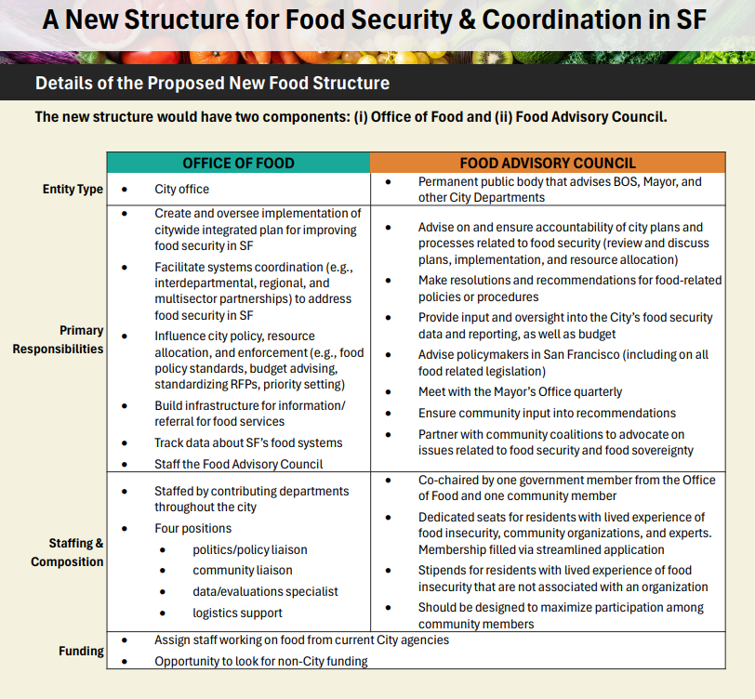
Current & Proposed Structure
FOOD SECURITY TASK FORCE (Current)
20-member body of city departments and CBOs.
City Dept appointed; CBO or Community apply, voted by FSTF and then approved by BOS
Public meetings required at least quarterly (currently held monthly).
Makes annual general policy and budget recommendations; restricted from specific legislative or budget recs.
Members vote on all actions by majority rule.
Administered and staffed by DPH.

Slide 20
Administrative Code 241119: Establishment of Office of Citywide Food Coordination, Dissolution of Food Security Task Force
Summary of Proposed Legislation
Establishes an Office of Citywide Food Coordination within the Human Services Agency (HSA).
HSA charged with preparing a Food Security Report every five years.
Dissolves the Food Security Task Force on July 1, 2025, instead of July 1, 2026.
Updates
Introduced to the Board of Supervisors Rules Committee on December 9, 2024.
Supervisor Shamann Walton tabled the proposal, citing the need for a more robust community engagement process.
Current status: Remains tabled
Access the Rules Committee here: recording

Slide 21

Recommendation 2: Adequate investment to address food security
Fully restore local budget cuts to sustain existing and new City food programs.
Ensure adequate funding levels in new and existing contracts to support quality and variety in food.
Decrease waitlists for programs including home-delivered meals and groceries, particularly for vulnerable populations such as older adults and people with disabilities, pregnant people, and residents with nutrition sensitive medical conditions, with special attention to culturally sensitive foods.
Fund food programs for residents of supportive and affordable housing.
Invest in food security to combat the drug crisis.
The fight against addiction is a complex and multifaceted approach where food security can address the nutritional needs of individuals in recovery and promote overall health.

Slide 22

Recommendation 3: Address food security through a health equity approach
Prioritize funding for programs that serve populations and neighborhoods that suffer the highest impact of nutrition sensitive medical conditions.
Determine the impact of current and future budget cuts on populations experiencing nutrition sensitive health disparities.
Support and expand medically supportive food and nutrition interventions (e.g., medically tailored and medically supportive meals and groceries, produce prescriptions, food pharmacies) allowed under CalAIM Community Supports.
Full integration of MSF&N in San Francisco:
Ensure MSF&N services are covered benefits by all SF insurers and that insurers cover the full spectrum of MSF&N interventions including step-down models.
Fully integrate MSF&N into SF healthcare system (especially DPH) through electronic medical record referrals and tracking, training, building awareness of MSF&N benefits, and infrastructure funding.

Slide 23

Recommendation 4: Restore grocery access in under-resourced communities
Support programs such as CalFresh and WIC to reduce barriers to service and improve wait-times.
Ensure nutritious, culturally responsive grocery options in neighborhoods that lack access to a full-service grocery store. Ensure short- and long-term planning to assist neighborhoods impacted by grocery store constriction.
Invest in grocery access options that create economic stimulus in under-resourced neighborhoods.
Improve public transportation to food programs and invest in additional delivery services.

Slide 24
Discussion Questions
How do these recommendations resonate with you?
Is your office currently working to address food insecurity?
What are your office’s goals around food security?
How can the Food Security Task Force assist you in reaching those goals?

Slide 25
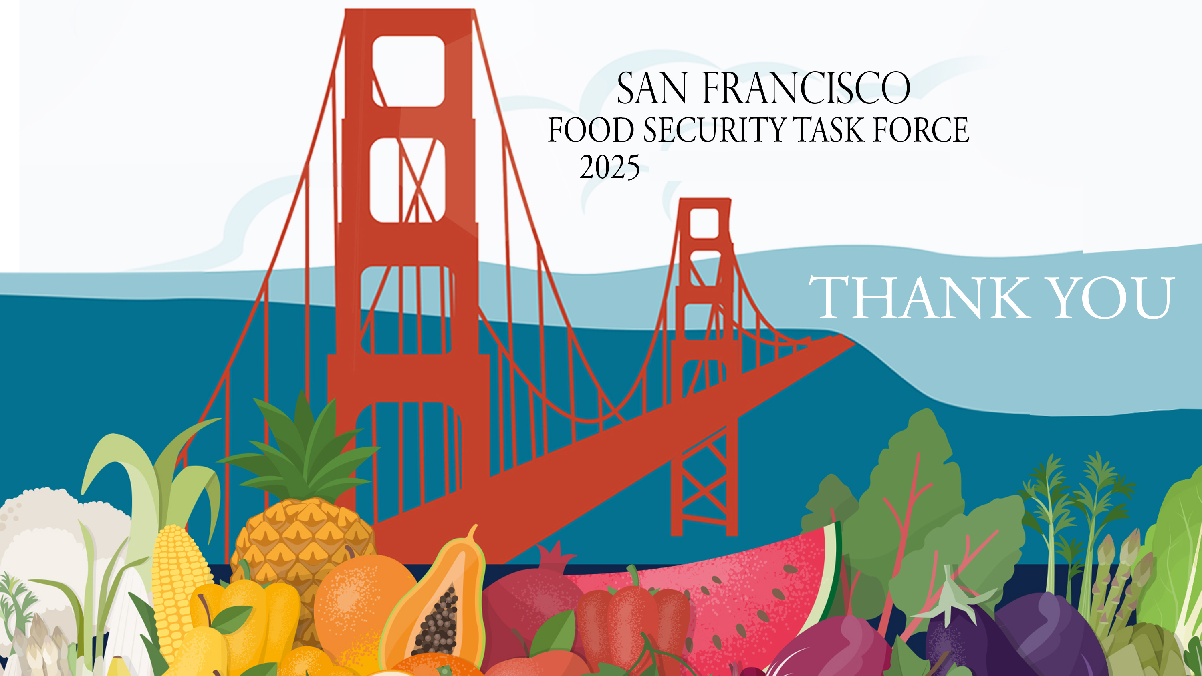
Cissie Bonini, FSTF Chair, cissie.bonini@ucsf.edu
Eric Chan, Staff, eric.g.chan@sfdph.org
Priscilla Rodriguez, Staff, priscilla.rodriguez@sfdph.org
sf.gov/departments/food-security-task-force

