Slide 1



Slide 2
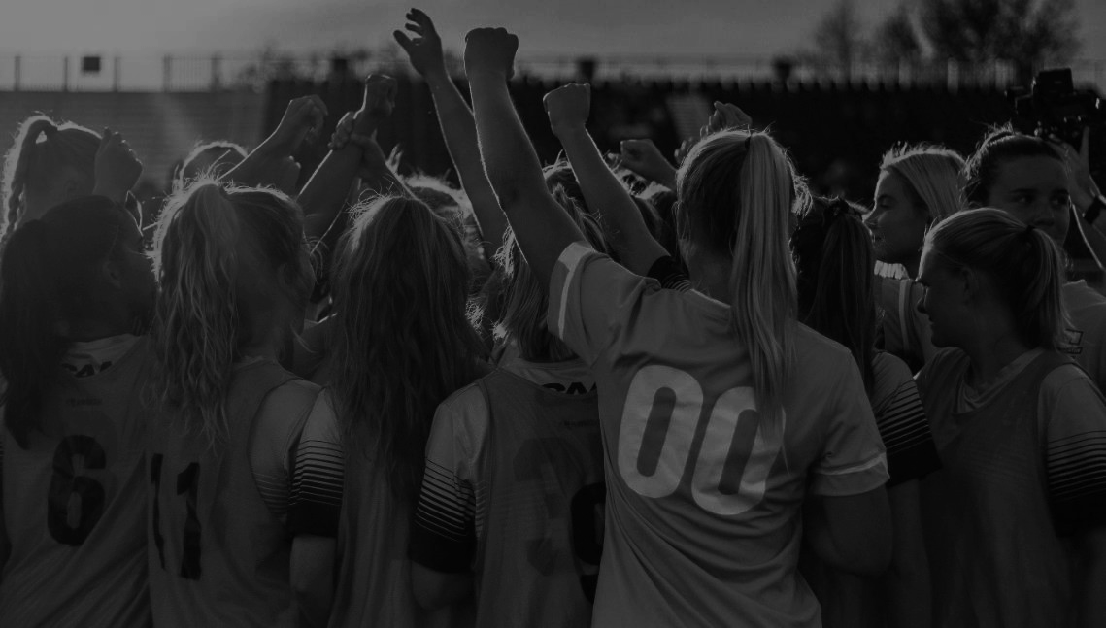
OUR VISION
To be a top global sports franchise and a catalyst for innovation and change.
BAY FOOTBALL CLUB
OUR MISSION
To create the most captivating soccer experience that unites the Bay, inspires greatness and leaves you wanting more.
A FORCE FOR GOOD
VISION & MISSION

Slide 3

WHO WE ARE
WHERE WE BEGAN AND WHERE WE’RE GOING
“Twenty years ago, youth soccer was only 25% girls' teams. Today it is at 50%. This is a consumer segment maturing into a fully formed market. We are at the inflection point where economic reality starts to catch up to the demand data.
-Alan Waxman, Co-chair of Bay FC and co-founder and CEO of Sixth Street
1988 - 2009
Founding Four collectively competed for the US Women’s National Team
APR 4, 2023
NWSL announced expansion into the Bay Area
JUN-DEC 2023
Roster Formation
MAR 2024
Inaugural Season Began
AUG 2024
Hosted FC Barcelona for International Friendly
OCT 2024
Defender Alyssa Malonson is first Bay FC player to be called up for U.S. Women’s National Team Duty
AUG 2020
Founding Four came together with the goal of expanding the NWSL to the Bay Area
JUN 1, 2023
Bay FC was born, name and logos released, followed by a launch party in the Bay on June 3rd
DEC 2023
NWSL Expansion Draft
JUL 2024
Three Players Represent Club in Summer Olympics
SEPT 2024
Treasure Island Training Facility Announced
NOV 2024
Club sets record for most wins in expansion team’s inaugural season (11) and makes playoffs

Slide 4
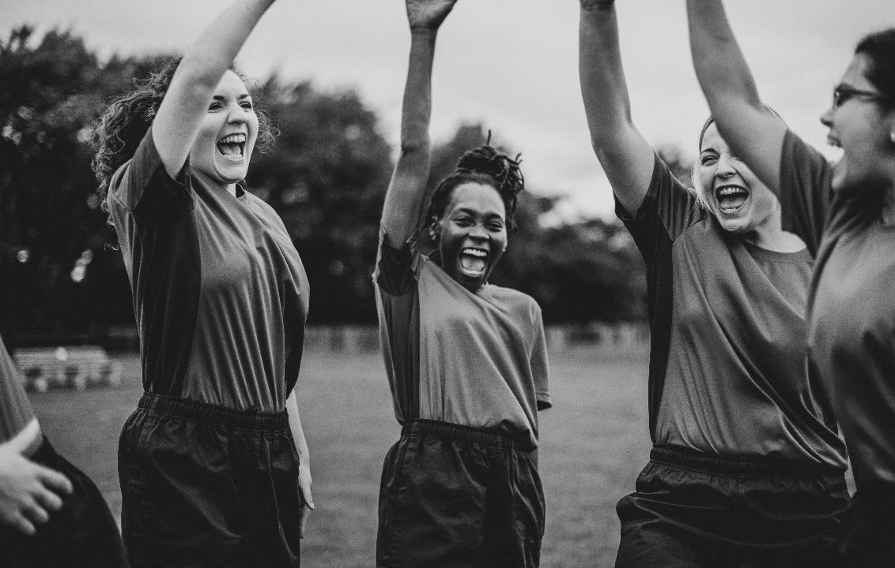
WORKING TOGETHER

Slide 5
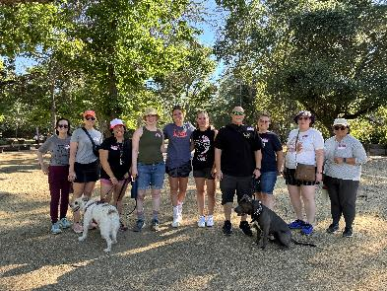
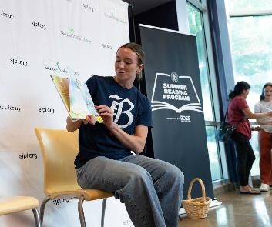
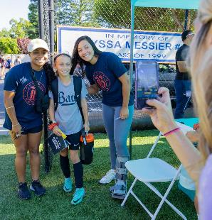

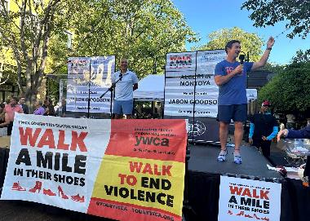
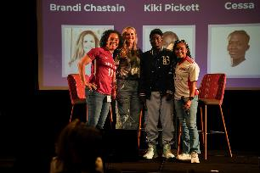
TOGETHER,
WE ARE PARTNERING WITH OUR COMMUNITY TO MAKE A DIFFERENCE IN THE BAY AREA.
BAY FOOTBALL CLUB
Hosted 75+ community groups at home matches and provided 5,000 tickets to community members
Hosted over a dozen community soccer clinics with 15 different youth organizations
Provided awareness for a variety of initiatives including breast cancer education, financial literacy, girls and health-focused leadership, summer reading loss, and more

Slide 6
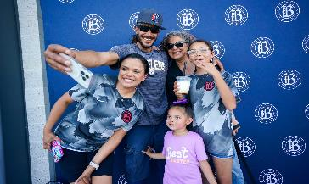
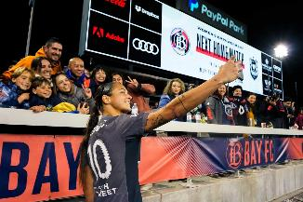
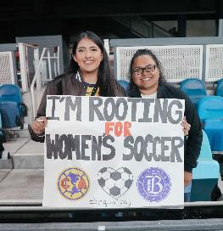
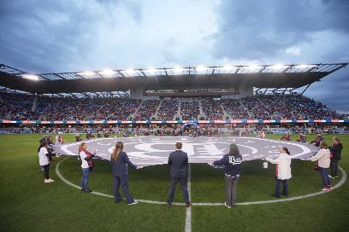
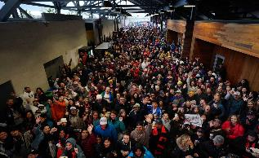
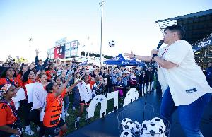
FOCUSING
ON A WORLD-CLASS EXPERIENCE FOR FANS IS ALWAYS TOP OF MIND.
BAY FOOTBALL CLUB
Bay FC fans are treated to a one-of-a-kind experience each and every home match including heritage/theme nights, including our most recent Fan Appreciation Night to conclude the Club’s inaugural season home matches
FanFest Activations for fans pre-match include face painting, lawn games, partner activations, and ample food choices at the food trucks on the lawn
Special pre-and post-match performances including player recognitions, Olympic send-offs, heritage night celebrations, and more

Slide 7
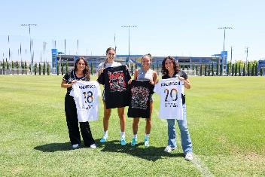
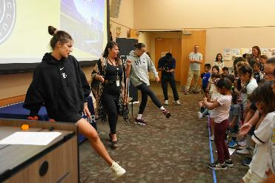
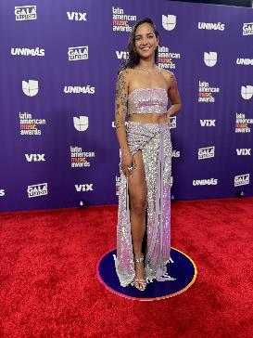
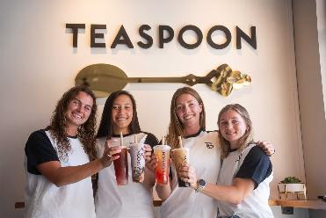
PLAYER-CENTRICITY
ALLOWS BAY FC TO TAKE CARE OF PLAYERS ON AND OFF THE PITCH.
BAY FOOTBALL CLUB
Providing players with access to financial literacy programs through partnerships with PNC Bank and others
Hiring a dedicated mental health coach
Surveying players about their interests off the pitch and providing opportunities for mentorships and/or internships in the off-season to help prepare them for life after soccer

Slide 8
INAUGURAL SEASON SUPERLATIVES
  Sold out home opener (18,000 in attendance)
  Great response from local sponsors including Sutter Health, PNC, Visa, Trader Joe’s and more
  First of its kind partnership with Visa to help support players off the pitch and maximize their additional compensation offerings
  #1 in merchandise sales across the league at the halfway point of the season (working to still receive end of season league numbers)
  Pacing to be top 3 in the league for ticketing revenue
  #4 in average ticketing attendance
  Secured 10,000 Season Ticket Members ahead of first match/season
  Have 360k total followers with a 6.2% engagement rate
  Bay FC announced plans and a location of Bay FC’s new permanent training facility on Treasure Island. The training facility represents the next step in Bay FC’s goal of becoming a global sports franchise. Built and created specifically for women athletes, Bay FC’s world-class training facility will be one of a few purpose-built training facilities for women’s sports in the United States (only Kansas City in the NWSL currently has their own facility).
  Hosted over 75 different community organizations at Bay FC matches this season, providing over 5,000 community members access to our games and hosted player appearances and community clinics in every county in the Bay Area.
  Bay FC defender Jen Beattie is on track to be a finalist for the annual NWSL Lauren Holiday Impact Award, recognizing a player who has made a significant impact on her community.
  Set record for most wins in expansion team’s inaugural season (11) and made playoffs.
  Built a roster in less than six months with top international signings including record-breaking transfer fee to acquire Zambian forward Racheal Kundananji from Madrid CFF and young up and coming future United States Women’s National Team (USWNT) players.
      Bay FC defender Savy King was named to the US Under-20 Women's Youth National Team roster for the 2024 FIFA Under-20 Women's World Cup, where they won bronze.
      Bay FC defender Alyssa Malonson was named to the U.S. Women’s National Team roster for friendly matches against Iceland and Argentina during the October FIFA window, spanning Oct. 21-30. This marks the first time Malonson has been named to a roster for the senior national team.

Slide 9

QUESTIONS?

