Slide 1
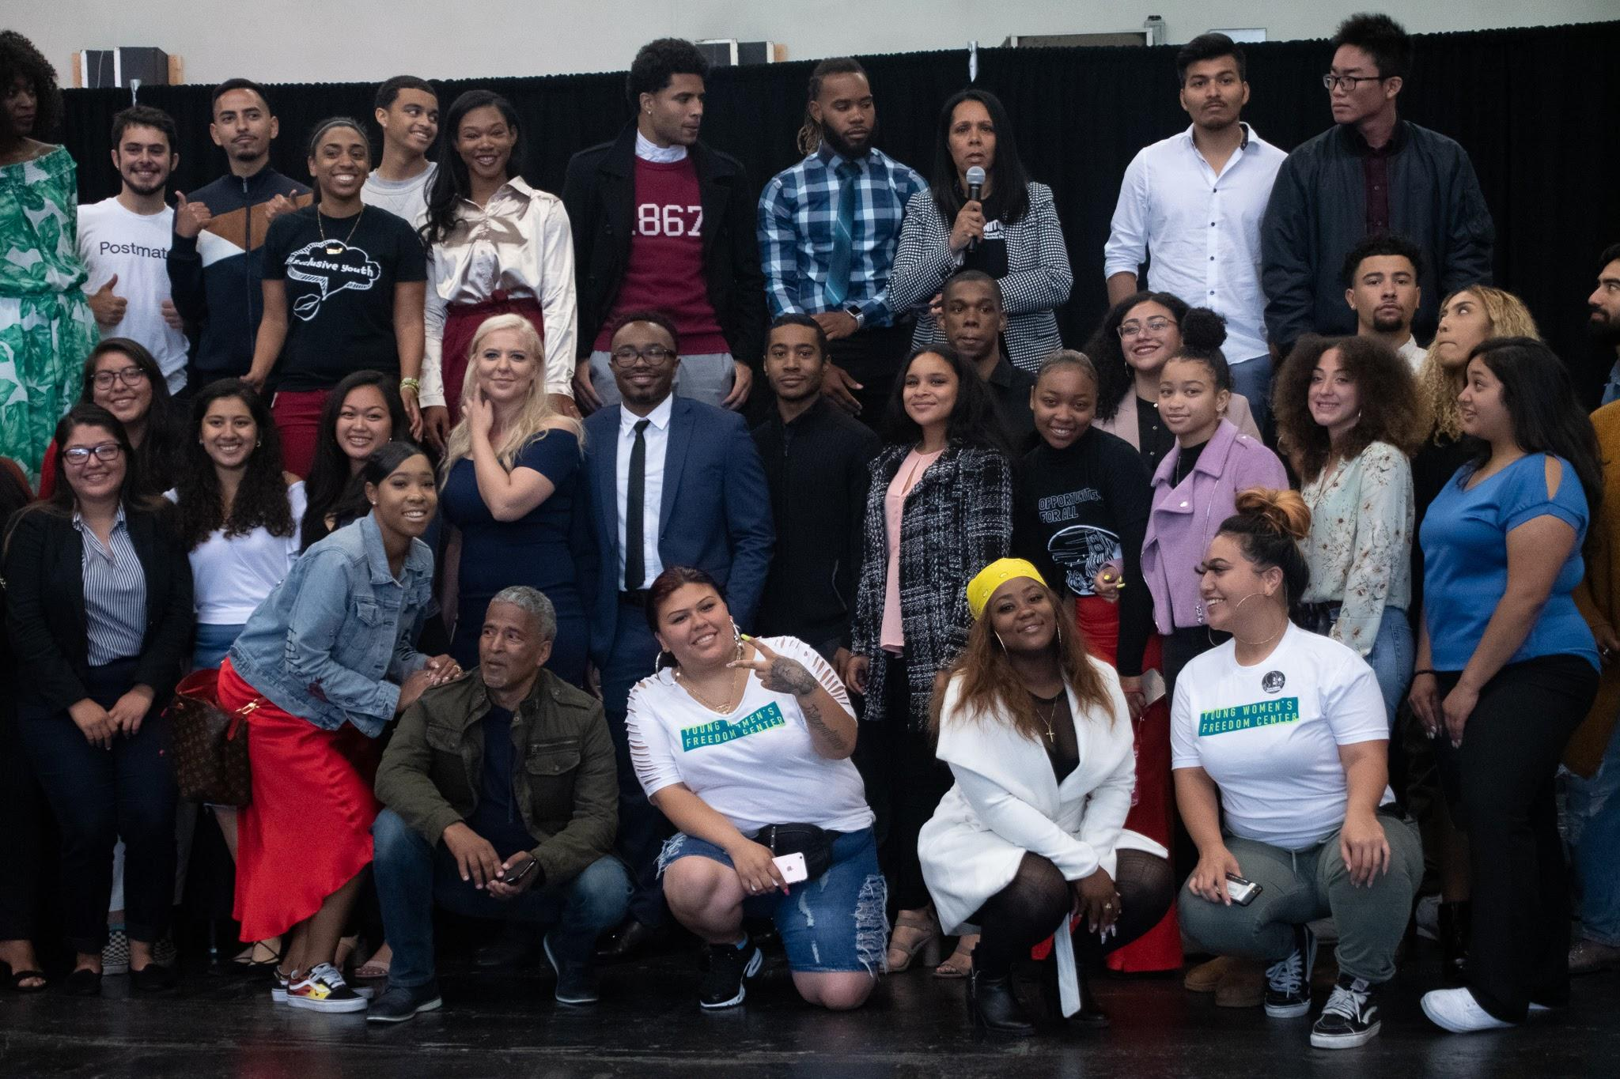
Education Equity
San Francisco Human Rights Commission

Slide 2
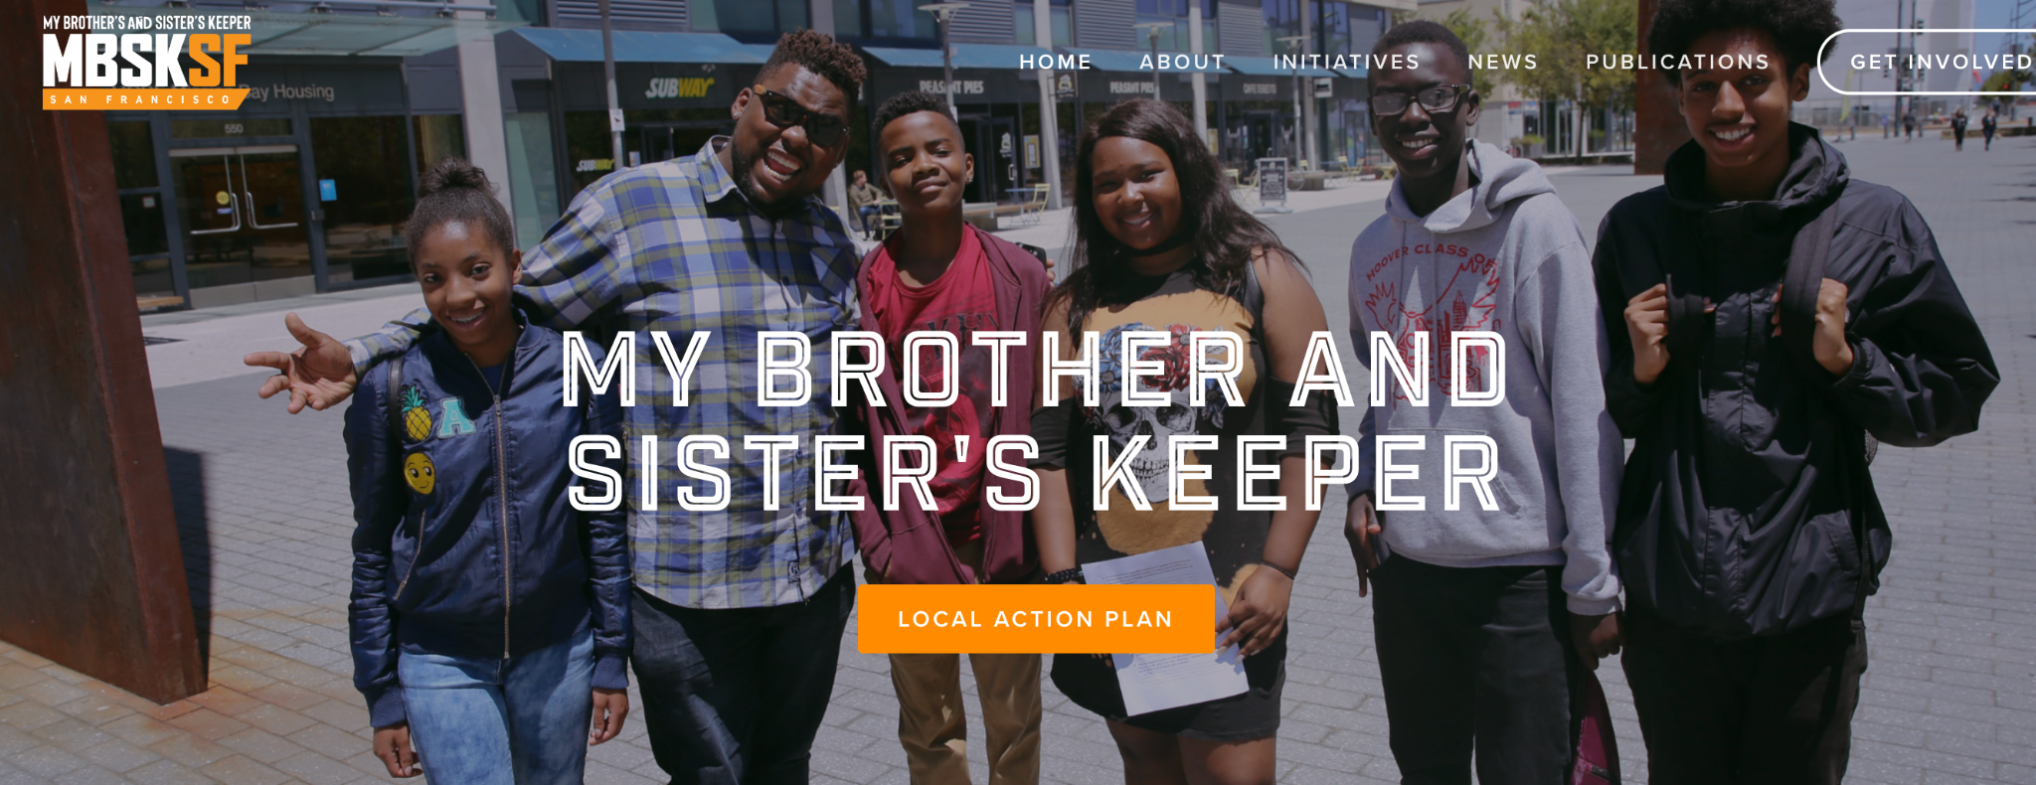
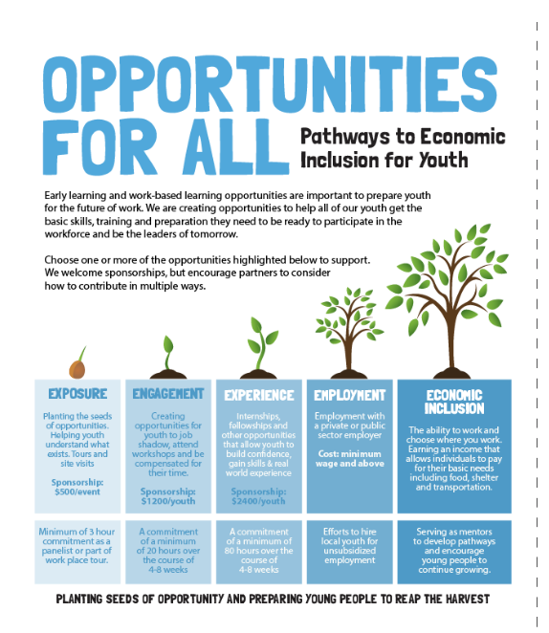


MBSK
School Groups
Opportunities for All
Educational Equity Strategies
Brighter Futures
Equity Studies Task Force
Everybody Reads
My Brother/Sister’s Keeper Initiative
Part of the Obama foundation My Brothers Keeper Initiative
Paid internships, focused on skills and youth development. Helping youth build their social and economic capital
Supporting schools with affinity groups, social justice and overall community building and youth development
Part of the Dream Keeper Initiative focused on supporting families with school aged children.
Created by a resolution from the Board of Education, focused on community infomed equity studies program
Collaborative literacy engagement program to increase access to books and amount of time youth spend reading.

Slide 3
Equity Studies Task Force “SFUSD Official member” list and record of who we emailed:
January 29, 2020 In person at Everett, Link to definitions exercise (parents/students/cbo/educators)b (58 participants at Everett)
March 4, 2020 Equity studies Shifts in curriculum doc (25 participants at the AAACC)
April 29, 2020 – focused on feedback: immediate basic needs of families and laptop/packet distribution, ELL learners, IEP (176 Participants)
May 27, 2020– focused on feedback: immediate basic needs of families and laptop/packet distribution, ELL learners, IEP Notes from the meeting: divided into topics from Parents/Caregivers, Equity, Recovery, Partnerships, Student support, Learning Support, (66 Participants)
Impacted by COVID-19
May 24, 2021 Agenda
June 28, 2021 Agenda/notes/script
July 26, 2021 Agenda –
August 30, 2021 Notes. Official attendance 6/28, 7/26, 8/30 (couldn’t make quorum but shows the PAC participation)
Meeting notes
September 27, 2021 (42 participants) Zach Manuel presented his Google forms. Meeting notes
October 25, 2021 (53 participants) Agenda – Jasmine Dawson SF Rise Presentation
Add SFHRC hands out
February 28, 2022 (28 participants)
Equity Studies Task Force

Slide 4
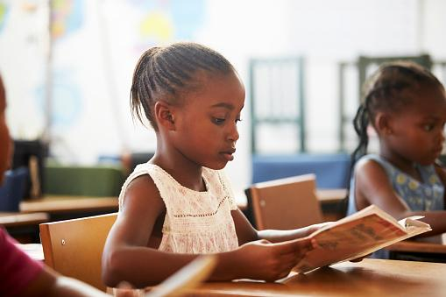
Everybody Reads
Strategies and Principles to Foster Literacy Engagement Partnerships

Slide 5
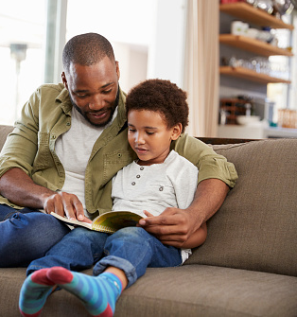
01
02
DISCUSSION AREAS
Engagement
Intentional
03
04
Participation
Activities
What is a collaborative literacy engagement partnership?
Who are you serving?
Who are the partners?
Why should I or do?
What do you do?

Slide 6
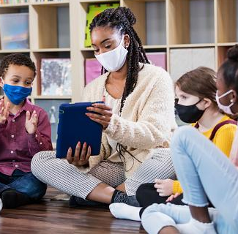
Literacy Engagement
What is a collaborative literacy engagement partnership?

Slide 7

Methodology
Events/Activities
Mixed Methods
Surveys, observations, document analysis
Data collected since 2015
Launched in 2015
Goal enroll 10 service providers
Over 100 participants in workshops
Goal to enroll 25 families.
Enrolled 60
40 completed

Slide 8
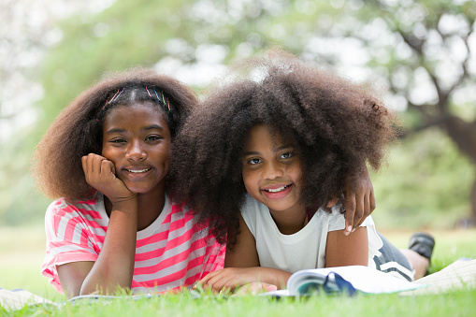
INTENTIONAL
Who are you serving? Why are you serving them? This will inform partnerships and strategies for engagement.

Slide 9

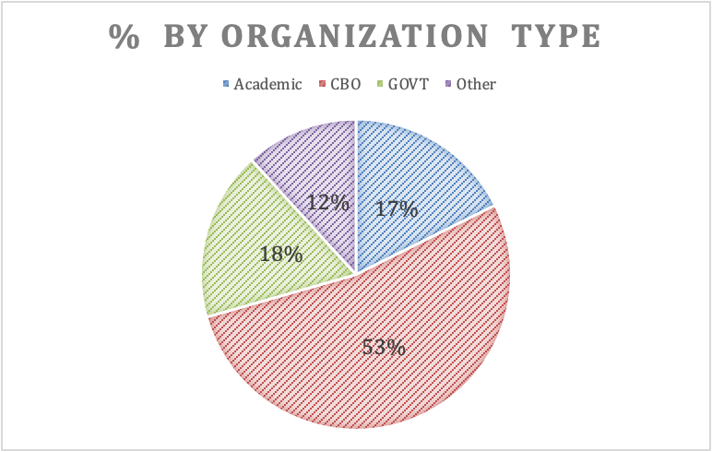
Defining the Who and the why

Slide 10
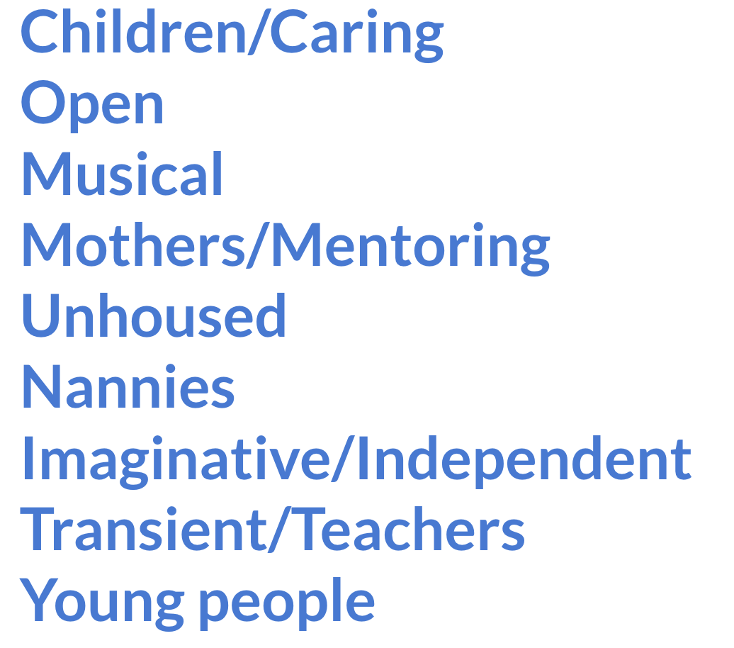
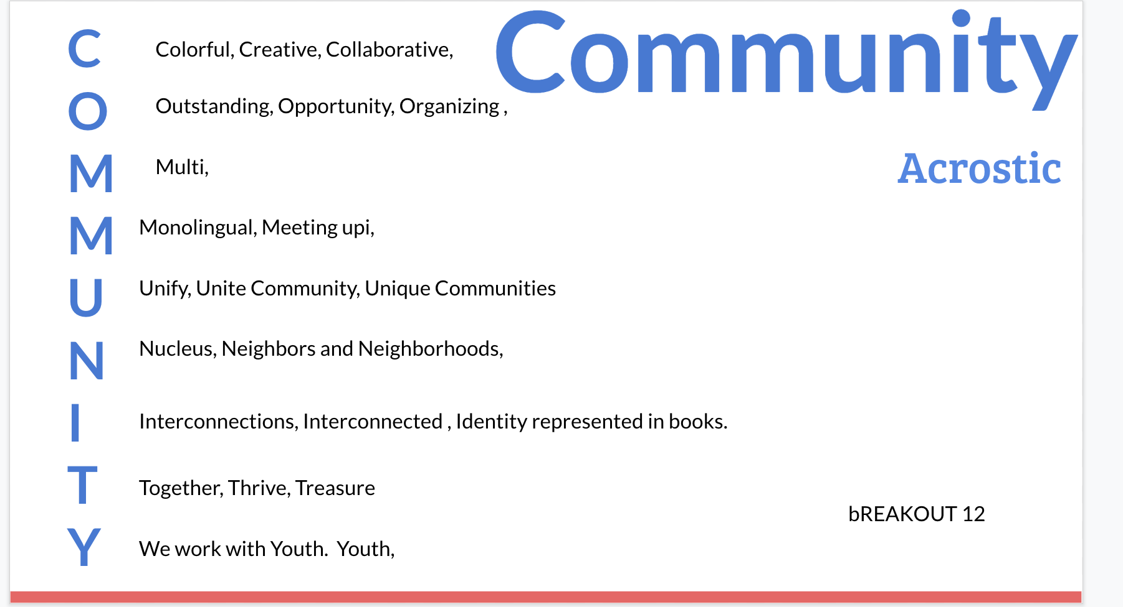
Defining the Who and the why

Slide 11

CONNECTING TO RESOURCES
OPPORTUNITIES FOR SUCCESS
ACTIVITIES
CULTURALLY RICH
Access to books, workshops, supplies
Familiar text that youth can read efficiently
Books & activities that spark interest with diverse representation

Slide 12

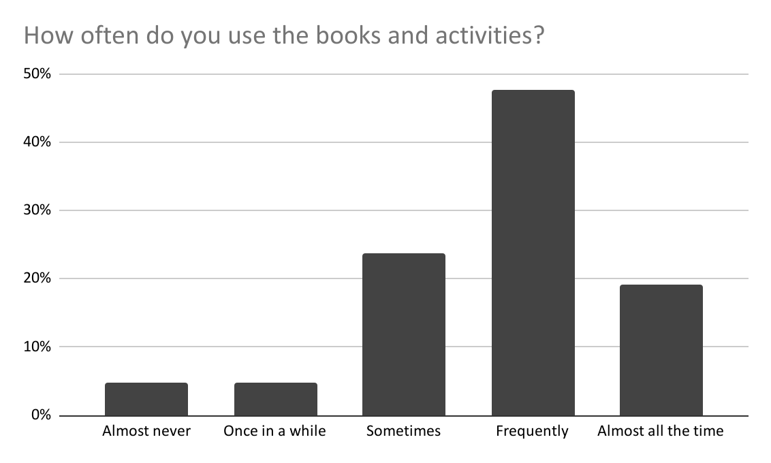
54%
RESOURCES
36%
COMMUNITY
31%
READING
PARTNERS VALUE
Access to resources and workshops
Help address inequity and opportunity gaps
Believe reading is important and want to help motivate reading

Slide 13
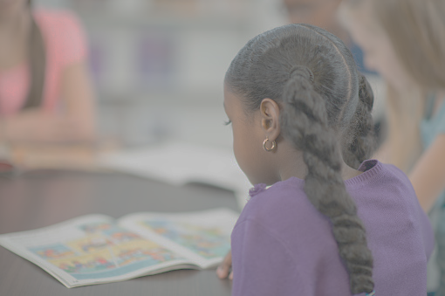
COLLABORATING FOR JUSTICE & EQUITY
COLLECTIVE IMPACT
LITERATURE REVIEW
COLLABORATIVE PARTNERSHIPS
LITERACY ENGAGEMENT
The collaboration of a group to solve a specific condition applying a structured process
Proposes to move beyond Collective Impact. Centers equity and justice. Works with diverse stakeholders in a shared leadership model
Is the partnership truly collaborative? Across planning, delivery and evaluation?
Behaviors, strategies, activities and processes that support literacy

Slide 14

BENEFITS OF PARTICIPATION
Learning best practices shared information gaining insight into the stories
Learning how to facilitate classes
Receiving suggestions on questions to ask to help students comprehension
Bring stories alive. Receiving books and other materials

Slide 15
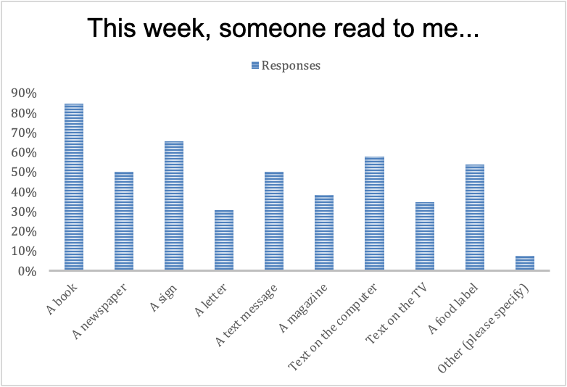
Readers

Slide 16
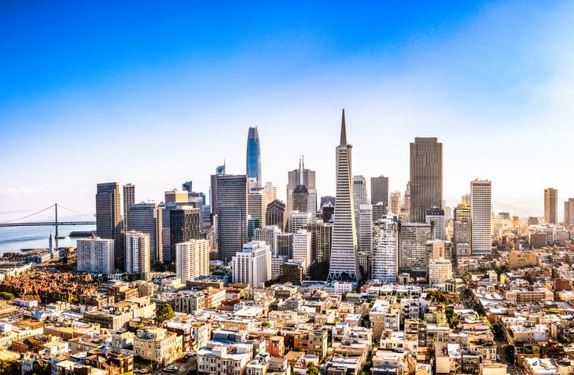
Once you learn to read, you will forever be free — Frederick Douglas
Serves as another tool for educating our young people and a chance to promote throughout the city

