Slide 1
LBEAC Director’s Report
June 5, 2025

Slide 2
Agenda
Introduction
New Legislation
Program Evaluation: Update
Announcements

Slide 3
NEW Legislation
File 250508 Introduced:
Minimum Competitive Amount and Threshold Amount for contracting to reflect recent consumer price index increases. "Delegated Purchasing Amount" as a defined term added (and replaces incorrect, hardcoded numbers).
File 250389 Approved on first reading:
City can buy fire apparatus without complying with solicitation requirements that would otherwise apply.

Slide 4








Program Evaluation
The LBE Program Evaluation consultant is still collecting feedback. Community engagement sessions are completed.
In-Person Meeting
Virtual Meeting
Focus Group
Invitation and Capacity Only
Email to
SFContractingEquity@bbcresearch.com
1
2
Phone Survey
Some individuals who complete survey will be selected
1 on 1 Interview
(20 selected)
Public Meeting
Same Agenda

Slide 5
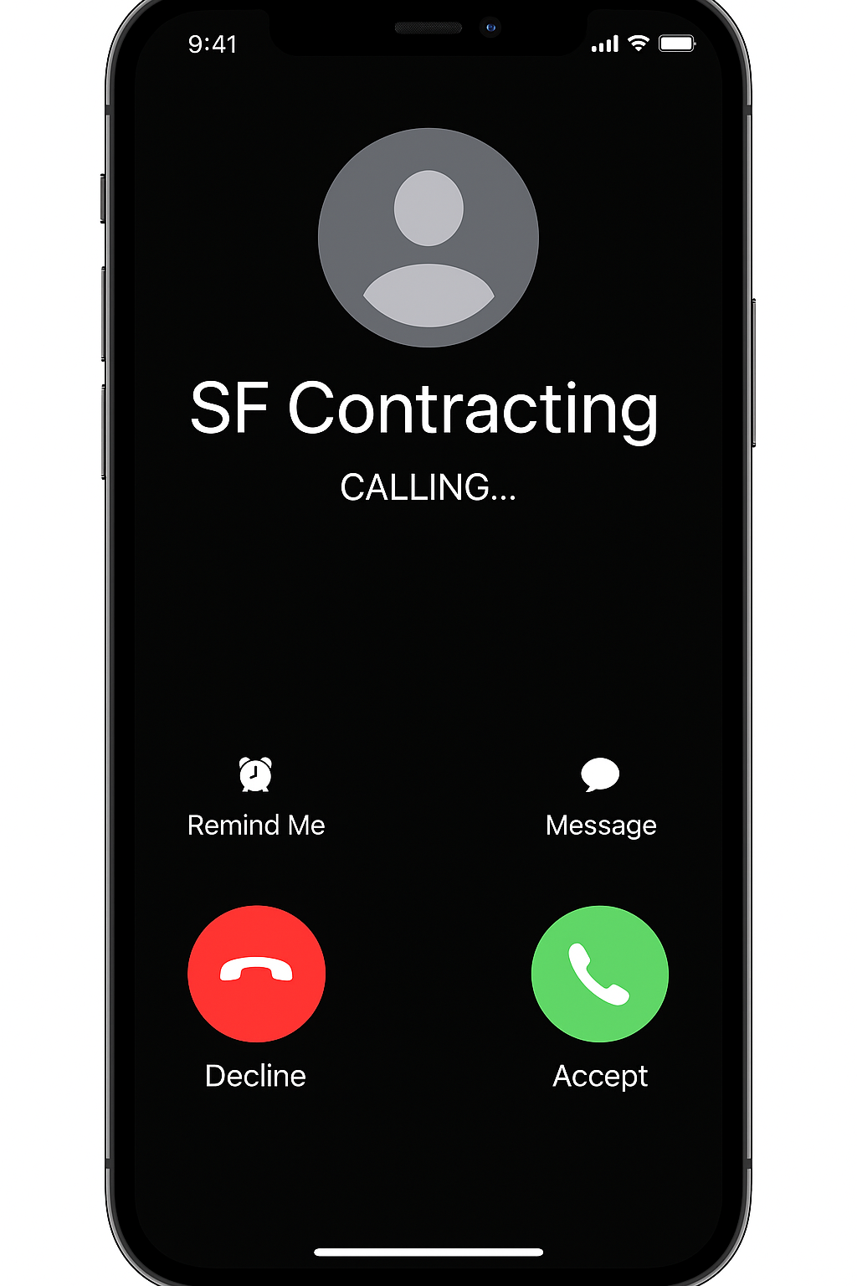
Program Evaluation: Availability Surveys
You may be contacted by phone numbers starting with:
  415-366
  415-231
  415-376
  415-463​

Slide 6
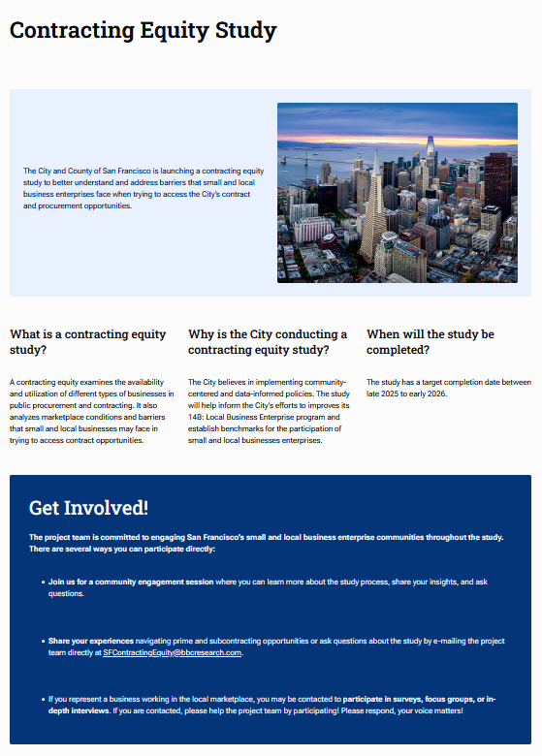
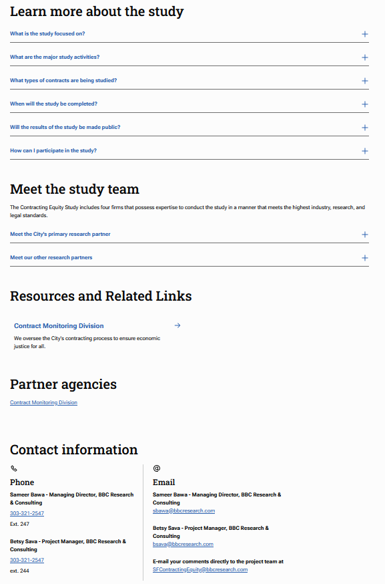
Program Evaluation:
Your Participation Matters
www.sf.gov/contracting-equity-study
Check for updates
  Program Evaluation Website
  CMD Website
  CMD Newsletter
  CMD Newsbits
  Email from me to LBEAC
Share your thoughts
  SFContractingEquity@bbcresearch.com

Slide 7
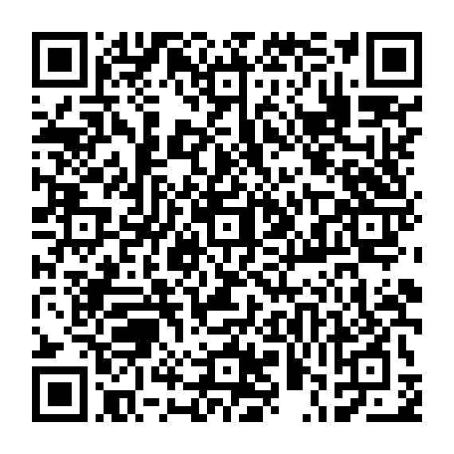
Announcement:
Interested in PW projects addressing homelessness?
Public Works is acting beyond legislative requirements to identify potential LBE partners.
Complete the short survey to express interest.

Slide 8
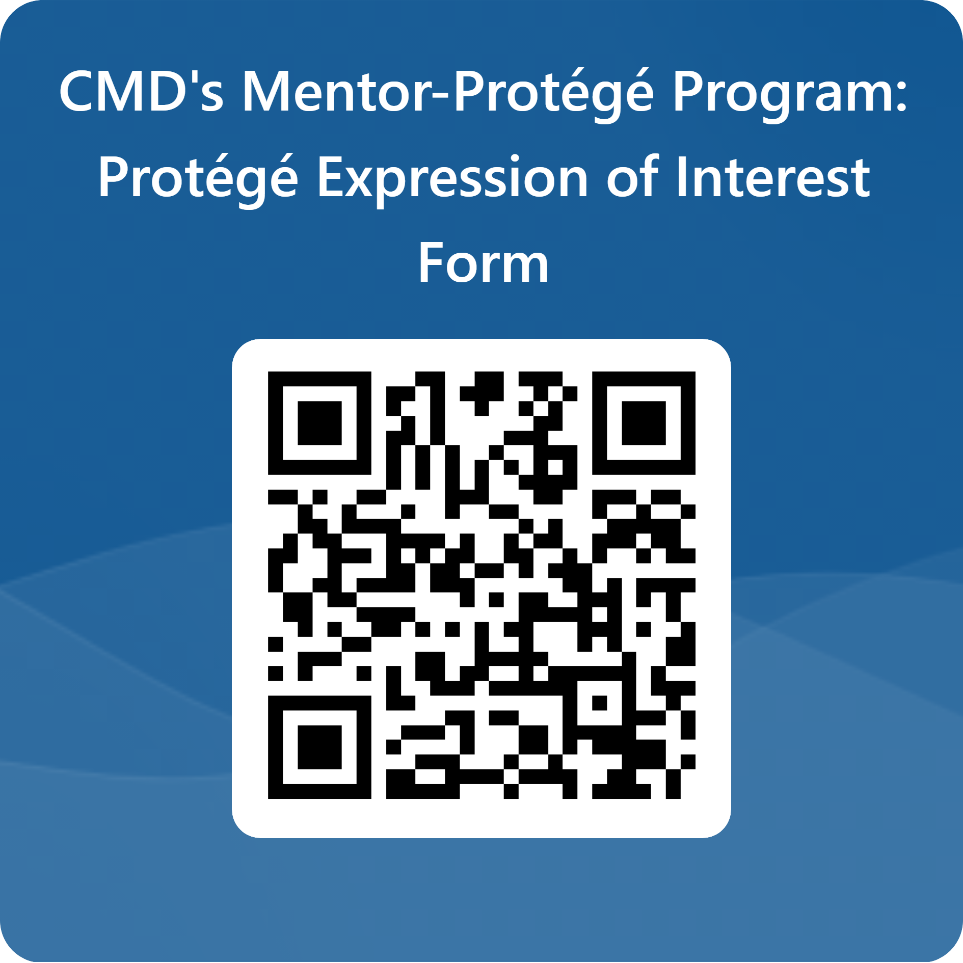
Announcement:
CMD Mentor Protégé Program
Recruitment for Cohort 4
Spread the word!
CMD is recruiting
for Cohort 4!
Questions?
Email MPP@sfgov.org

Slide 9
Next LBEAC
August LBEAC: The Naval Shipyard Parcel G contractor will present
August – December LBEAC is back at City Hall

