Slide 1
BFSER 2026 Preliminary Dataset Findings
Author: Phil Lowenthal and Kaela Plank
Date: May 13, 2026

Slide 2
Agenda
What is the preliminary dataset?
Review health data
Food Security
Income &Poverty
Health outcomes
Q&A
Notes:
Kaela: We will start with an overview of the preliminary dataset's purpose, then we will review the health data and end with a Q&A

Slide 3
Purpose of the preliminary dataset
“DPH shall provide a preliminary data set on health conditions and health disparities of City residents (“Preliminary Data Set”) to the Reporting Departments. The Preliminary Data Set shall include data on relevant social conditions and defined group conditions and, to the extent feasible, such data shall be disaggregated by race, ethnicity, and sexual orientation and gender identity. Relevant social conditions include, by way of example but not limitation, poverty and malnutrition. Defined group conditions include, by way of example but not limitation, hypertension and other cardiovascular diseases, low birth weight, diabetes, weight, mental health conditions, and dietary intake.”
- Ordinance No. 103-21
Notes:
Kaela: Ordinance No. 103-21, requires DPH to produce and share a dataset on food security and related health conditions as well as existing disparities with other city departments. The Preliminary Dataset was shared out to reporting departments back in February of this year along with the food program framework. The goal today is to share key findings from that report.

Slide 4
Food insecurity in San Francisco
43% (55,000) of SF residents with incomes below 200% FPL experienced food insecurity (pooled 2019-2023)
Disparities persist:
50% (10K) of Black or African American and 44% (14K) of Latinx respondents were food insecure
57% (5K) of 18–24-year-olds
55% (33K) of those with incomes below 100% FPL
Source: UCLA, California Health Interview Survey (CHIS), 2019-2023
Notes:
Kaela: Looking at pooled data from California Health Interview Survey, 43% of SF residents with incomes below 200% FPL ($29,160 for a family of one and $49,720 for a family of 3 in 2023) experienced food insecurity in 2019-2023.
The proportion of residents who were food insecure was even higher for those who identified as Black/African American or Latinx, those who were transitional aged youth (18-24 years old), and those with incomes below 100% of the FPL.
San Francisco Administrative Code Article X defines food security as “the state in which all persons obtain a nutritionally adequate, culturally acceptable diet at all times through local non-emergency sources.”

Slide 5
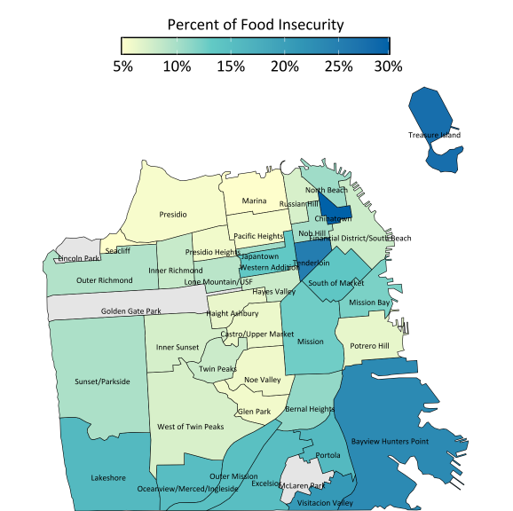
Map of food insecurity in SF
Percent of adults experiencing food insecurity differs across neighborhoods in San Francisco
Source: PLACES: Local Data for Better Health, 2024
Notes:
Kaela: In this map we are looking at 2024 PLACES data*. PLACES captures response data from a random sample of adults living in SF regardless of income level. The data from 2024 indicates that higher levels of reported food insecurity among adults were concentrated in the Northeastern, Southeastern, and Southern regions of San Francisco. Neighborhoods with the highest burden of food insecurity included Chinatown, the Tenderloin, Bayview–Hunters Point, and Visitacion Valley.
*Provides health and health-related data using small area estimation for counties, incorporated and census designated places, census tracts, and ZIP Code Tabulation Areas (ZCTAs) across the United States. Partnership between CDC and the Robert Wood Johnson Foundation.

Slide 6
Income and Poverty
Notes:
Kaela: Because Income is an important factor in protecting against food insecurity, we are interest in understanding disparities in economic metrics among San Francisco's residents

Slide 7
Median household income by race and Hispanic/Latino origin
Table 1. San Francisco Median Household Income* by Race and Hispanic/Latino Origin
Race and Hispanic or Latino Origin of Householder | Median Household Income
One race alone^ | NA
White | $177,030
Black or African American | $51,610
American Indian and Alaska Native | $52,109
Asian | $123,757
Native Hawaiian and Other Pacific Islander | $93,816
Some other race | $84,346
Two or more races | $136,908
Hispanic or Latino Origin (of any race) | $99,984
Median household income is lowest for those who identify as Black/African American or American Indian and Alaska Native
Source: United States Census Bureau, 2019–2023 American Community Survey 5-Year Estimates, tables B19013A-I.
*Median household income in the past 12 months in 2023 inflation-adjusted dollars.
^Persons of one race may also identify as Hispanic/Latino.
Notes:
Kaela: In 2024, the Citywide median household income for SF was $139,801. 5-year estimates from 2019-2023 show inequities in income by race/ethnicity. Black/African American and American Indian and Alaska Native residents had the lowest median household incomes, while those who identified as White had the highest median household income.

Slide 8
Poverty in San Francisco
In 2023:
10.6% (~87K) of SF residents live below the Federal Poverty Level (FPL).
21% (172K) lived below 200% of the FPL.
Source: U.S. Census Bureau. 2019-2023: American Community Survey 5- Year Estimates, Tables B17001 and S1701
Notes:
Kaela: overall, 10.6% of San Franciscans live below the Federal Poverty Level (which was an income around $14,580 for a one-person household and 30,000 for a family of 4 in 2023).
Residents with gross monthly incomes at or below 200% of the Federal Poverty Level ($29,160) are eligible for SNAP in California (CalFresh, Supplemental Nutrition Assistance Program). Nearly 172,000 (21%) San Francisco residents lived below 200% of the FPL in 2023. These residents were likely eligible to receive CalFresh.

Slide 9
San Francisco median household income by race and Hispanic/Latino origin
Table 1. San Francisco Median Household Income* by Race and Hispanic/Latino Origin
Race and Hispanic or Latino Origin of Householder | Estimated Percent Below 100% FPL
One race alone | 10.7%
White | 7.8%
Black or African American | 25.4%
American Indian and Alaska Native | 34.0%
Asian | 10.3%
Native Hawaiian and Other Pacific Islander | 10.8%
Some other race | 16.7%
Two or more races | 9.6%
Hispanic or Latino Origin (of any race) | 13.4%
White alone, not Hispanic or Latino | 7.7%
Poverty is highest among American Indian and Alaska Native and Black/African American residents
Source: United States Census Bureau, 2019–2023 American Community Survey 5-Year Estimates, tables B17001A-I.
Note: Percent values show the percent among SF residents who identify with each a specific race/ethnic group (ex. among all SF residents who identify as Asian, 10.3% are estimated to have household income below 100% of the FPL).
Notes:
Kaela: When stratifying by race/ethnicity, 5-year estimates from 2019-2023 indicate that the percent of SF residents living at or below the poverty level is highest among those who identify as Black/African American and American Indian and Alaska Native.

Slide 10
Poverty by age, San Francisco 2019-2023
Percent living at or below the Federal Poverty Level by Age, San Francisco 2019-2023
18–24 year old residents experience more poverty when compared to other age groups in San Francisco
Source: U.S. Census Bureau. 2019-2023: American Community Survey 5- Year Estimates, Table B17001​
Notes:
Kaela: when looking at the proportion in each age group living at or below the Federal poverty level, poverty is highest among those who are 18-24 years old, also referred to as Transitional Aged Youth (TAY).

Slide 11
Nutrition-sensitive mortality
Notes:
Kaela: Phil is now going to present mortality and morbidity data for nutrition-sensitive conditions. A nutrition-sensitive health condition is one where the prevention, management, or risk reduction depends not just on direct nutrient intake, but on broader social, economic, and environmental systems that shape food access and dietary quality.
Academic research shows associations between food insecurity status and several health conditions. If we were to address the social, economic and environmental factors that lead to food insecurity in San Francisco, we would likely see reductions in mortality and morbidity rates for these conditions.

Slide 12
Mortality due to malnutrition was highest among Black/African American residents of SF
Table 5. Number and Rate of Deaths Due to Malnutrition Among San Francisco Residents by Race/Ethnicity
Race and Ethnicity | Deaths | Crude Rate (per 100k)
American Indian and Alaska Native, not Hispanic/Latino | Suppressed | Suppressed
Asian, not Hispanic/Latino | 277 | 31.3
Black or African American, not Hispanic/Latino | 74 | 59.3
Hispanic or Latino, all races | 60 | 15.3
Native Hawaiian and Other Pacific Islander, not Hispanic/Latino | Suppressed | Suppressed
White, not Hispanic/Latino | 296 | 32.3
More than one race, not Hispanic/Latino | 10 | Unreliable
Total | 717 | 29.5
Source: Centers for Disease Control and Prevention (CDC). Multiple Cause of Death Files. CDC WONDER. Retrieved October 20, 2025, from https://wonder.cdc.gov/wonder/help/ucd.html.
Note: Data are from the 2021–2023 Multiple Cause of Death Files.
Selected ICD codes were chosen to align with malnutrition diagnoses.
Mortality due to malnutrition by race/ethnicity, San Francisco, 2021-2023
Notes:
Phil: Deaths due to malnutrition among all residents during 2021-2023 was 29.5 per 100,000 residents (crude rate). The mortality rate was highest among Black/African American residents (59.3 per 100,000) and lowest among Latino residents (all races) 15.3 per 100,000).
Data suppression and unreliable rates: statistics representing fewer than ten persons (0-9) are labeled suppressed. Rates are marked as "unreliable" when the death count is less than 20.
Background info:
CDC uses ICD10 codes (E40-E46) to designate deaths due to malnutrition.
E40: Kwashiorkor, a severe form of protein-calorie malnutrition
E41: Nutritional marasmus, a severe form of malnutrition characterized by extreme wasting and weight loss due to inadequate calorie and protein intake
E42: Marasmic kwashiorkor, a severe form of malnutrition characterized by both protein deficiency and energy deficiency
E43: represents unspecified severe protein-calorie malnutrition
E44: protein-calorie malnutrition of moderate and mild degree
E45: unspecified protein-calorie malnutrition
E46: retarded development following unspecified protein-calorie malnutrition
Notes: The Underlying Cause of Death data available on WONDER are county-level national mortality
Denominator: US Census Bureau, PEP

Slide 13
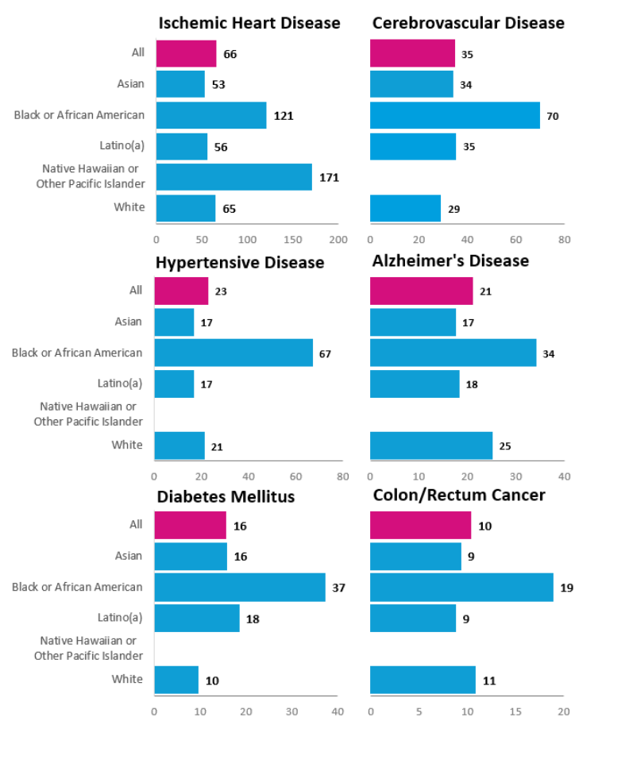
Mortality rates* were highest among Black/African American residents for each of these six nutrition-sensitive conditions *Per 100,000 residents
Source: Vital Records Business Intelligence System, Master Death File, 2020-2024
Mortality due to top six nutrition sensitive conditions (Ischemic heart disease, cerebrovascular disease, hypertensive disease, Alzheimer’s disease, diabetes mellitus, colon/rectum cancer) by race/ethnicity, San Francisco, 2020-2024
Notes:
Phil: The mortality rate (age-adjusted) due to each of the six nutrition-sensitive conditions displayed was highest among Black/African American residents of SF during 2020-2024. Approximately 2x Citywide for 4 of the 6 causes of death displayed here (IHD, CVD, DM, CRC). For HTN is was >2.5x Citywide, and for ALZ is was 1.5x Citywide.

Slide 14
Nutrition-sensitive health conditions
Notes:
Phil: Now let's look at hospitalization rates for nutrition-sensitive health conditions. Hospitalization rates are an imperfect way to measure the prevalence of these health conditions in San Francisco. Hospitalization rates capture the most severe health impacts of these conditions and can be indication of lack of access to preventative health care.
Limitations:
- We’re unable to de-duplicate hospitalizations. This means that the same person might be counted more than once in the data.
- Hospitalizations rates are for the entire SF population, not just those who experience food insecurity.

Slide 15
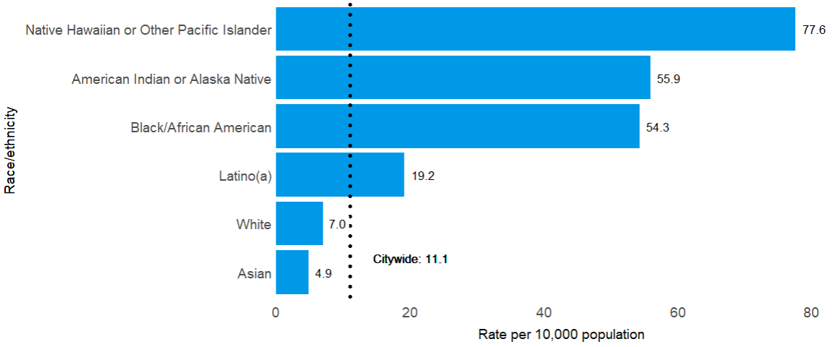
Hospitalization rates due to diabetes* were higher among several race/ethnic groups compared to all SF residents
*This indicator is not restricted to adults. Includes patients of all ages
Source: California Healthcare Access and Information, 2021-2023
Hospitalization rates (age adjusted per 10,000 population) due to diabetes by race/ethnicity, San Francisco 2021-2023
Notes:
Phil: Hospitalization rates due to diabetes during 2021-2023 were highest among:
NHOPI: 77.6 per 10,000 (7x Citywide) (<1% of SF pop)
AIAN: 55.9 per 10,000 (5x Citywide) (<1% of SF pop)
Black/African American: 54.3 per 10,000 (5x Citywide) (~5% of SF pop)
vs Citywide: 11.1 per 10,000

Slide 16
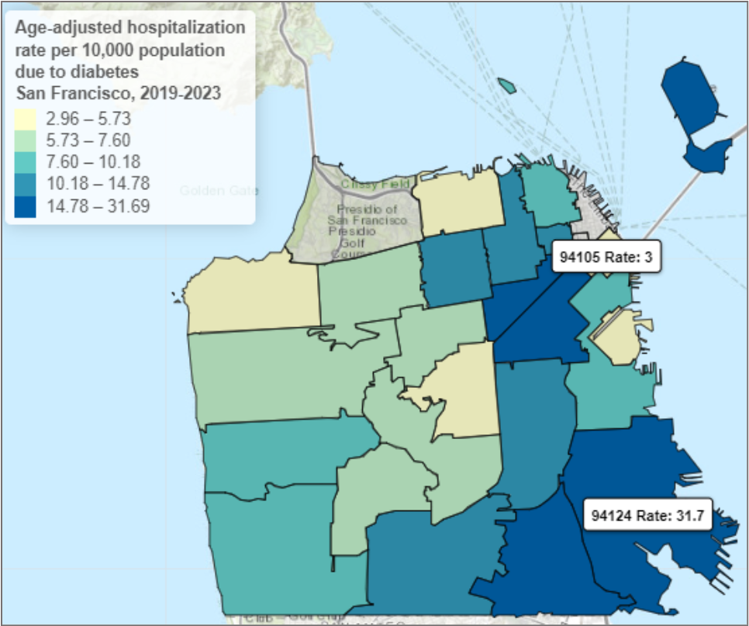
Age-adjusted hospitalization rate per 10,000 population due to diabetes* by zip code
31.7 hospitalizations per 10,000
94124
11.1 hospitalizations per 10,000
SF Citywide
*This indicator is not restricted to adults. Includes patients of all ages
Source: California Healthcare Access and Information, 2019-2023
Hospitalization rates (age adjusted per 10,000 population) due to diabetes by zip code, San Francisco 2019-2023
Notes:
Phil: The hospitalization rate due to diabetes (per 10,000 residents) in SF during 2019-2023 was highest in the Southeast region of SF, including:
Bayview Hunters Point neighborhood (94124): 31.7 per 10,000
Civic Center (94102): 22 per 10,000
Treasure Island (94130): 23 per 10,000
Lowest among residents of zip code 94105 (Downtown/Financial District): 3.0 per 10,000
*Map labels highlight the highest (94124) and lowest (94105) rates (per 10,000 population)

Slide 17
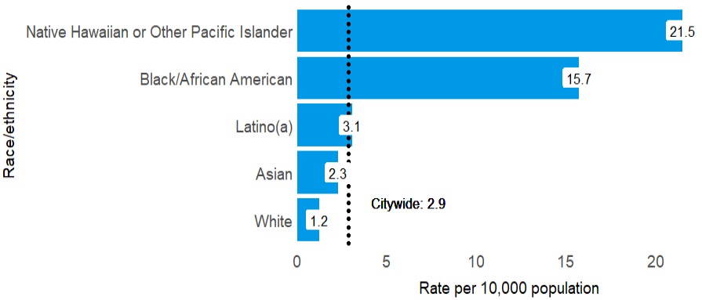
Hospitalization rates due to hypertension* were higher among NHOPI and Black/African American residents compared to all SF residents
*This indicator is not restricted to adults. Includes patients of all ages
Source: California Healthcare Access and Information, 2021-2023
Hospitalization rates (age adjusted per 10,000 population) due to hypertension by race/ethnicity, San Francisco 2021-2023
Notes:
Phil: The hospitalization rate due to hypertension was highest among NHOPI (21.5 per 10,000, 7x Citywide rate), and Black/African American residents (15.7 per 10,000, 5x Citywide rate) during 2021-2023.
*Note: after reviewing this indicator with a DPH clinician who has worked in primary care medicine, we were told that hospitalizations due to hypertension could have been associated with a range of health conditions including those that may not be nutrition-sensitive (ex. hypertension due to kidney disease, gestational hypertension).

Slide 18
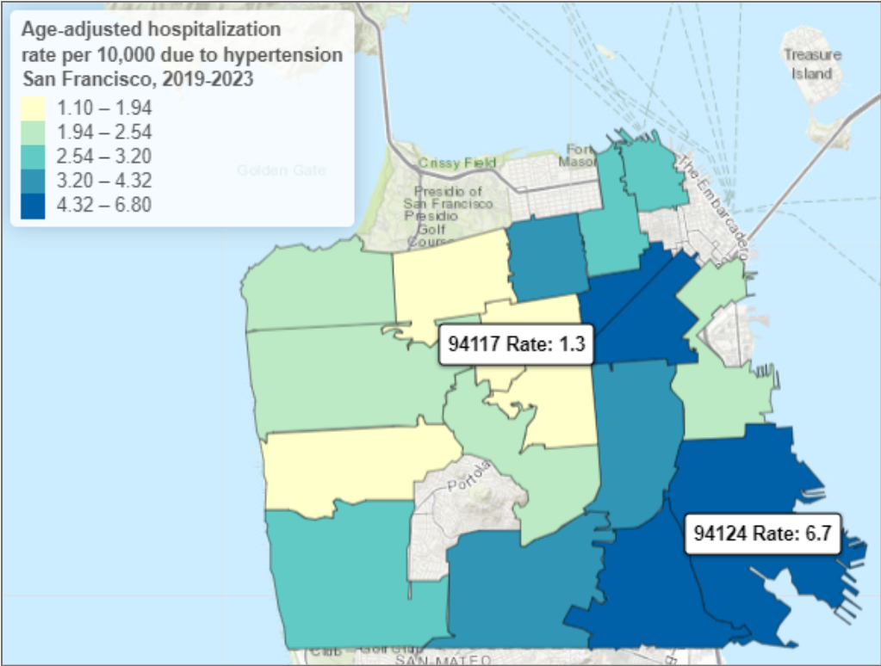
Hospitalization rates (age adjusted per 10,000 population) due to hypertension by zip code, San Francisco 2019-2023
The hospitalization rate due to hypertension was highest in zip code 94124
6.7 hospitalizations per 10,000
94124
2.9 hospitalizations per 10,000
SF Citywide
*This indicator is not restricted to adults. Includes patients of all ages
Source: California Healthcare Access and Information
Notes:
Phil: The hospitalization rate due to hypertension per 10,000 residents during 2019-2023 was highest among residents of zip code 94124 (Bayview Hunters Point neighborhood), 6.7 per 10,000 residents. The hospitalization rates were the lowest in 94117 (Western Addition), 1.3 per 10,000 residents.
*Note: hospitalization due to hypertension could have been associated with a range of health conditions including those that are not diet-sensitive.
*Map labels highlight the highest (94124) and lowest (94117) rates (per 10,000 population)

Slide 19
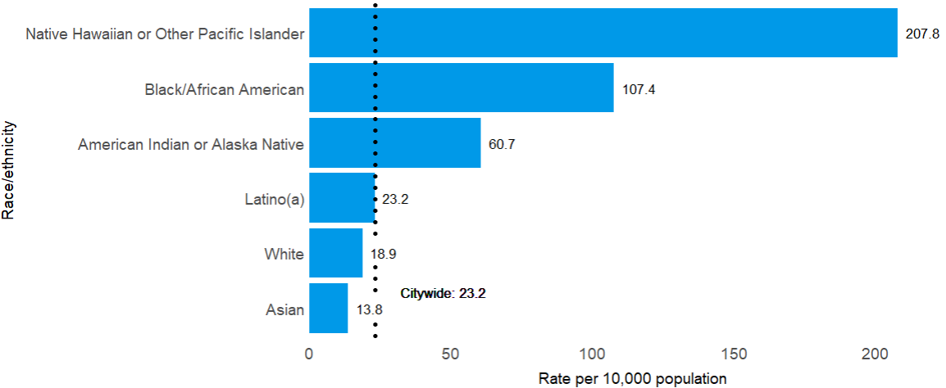
Hospitalization rates due to heart failure* were higher among NHOPI and Black/African Americans compared to all SF residents
*This indicator is not restricted to adults. Includes patients of all ages
Source: California Healthcare Access and Information, 2021-2023
Hospitalization rates (age adjusted per 10,000 population) due to heart failure by race/ethnicity, San Francisco 2021-2023
Notes:
Phil: The hospitalization rates due to heart failure per 10,000 residents during 2021-2023 were highest among:
NHOPI: 207.8 per 10,000 (~9x Citywide rate: 23.2)
Black/African American: 107.4 per 10,000 (~5x Citywide rate: 23.2)

Slide 20
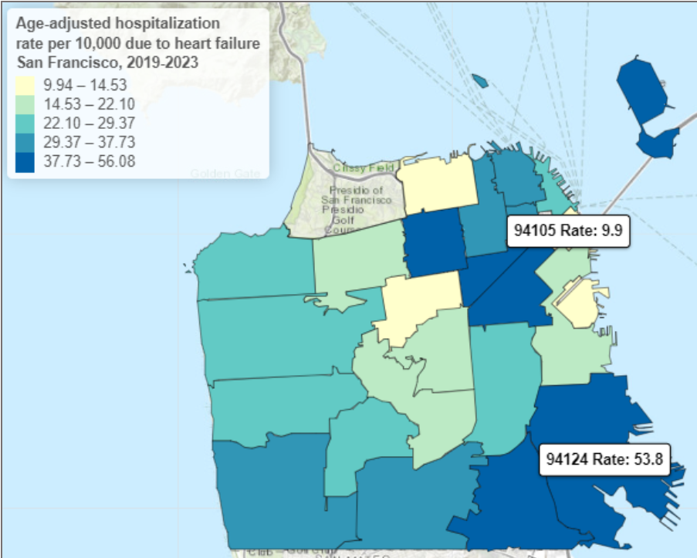
Hospitalization rates (age adjusted per 10,000 population) due to heart failure by zip code, San Francisco 2019-2023
The hospitalization rate due to heart failure was highest in zip code 94124
53.8 hospitalizations per 10,000
94124
23.2 hospitalizations per 10,000
SF Citywide
*This indicator is not restricted to adults. Includes patients of all ages
Source: California Healthcare Access and Information, 2019-2023
Notes:
Phil: The hospitalization rates due to heart failure per 10,000 during 2019-2023 were highest in zip code 94124 (Bayview Hunters Point neighborhood): 53.8 per 10,000 vs Citywide: 23.2 per 10,000 (2.5x higher). The lowest rate was in zip code 94105: 9.9 per 10,000.
*Map labels highlight the highest (94124) and lowest (94105) rates (per 10,000 population)

Slide 21
Pregnancy-related health outcomes
Notes:
Phil: We are now going to look specifically at pregnancy-related health outcomes. Research has shown that there are associations between food insecurity during pregnancy and pregnancy-related health conditions including:
1. pre-term birth
2. low birthweight
3. gestational diabetes, and
4. gestational hypertension
In San Francisco, the data indicates that there are disparities in the rates of these health conditions when stratified by race/ethnicity and by geography (SF zip code).

Slide 22
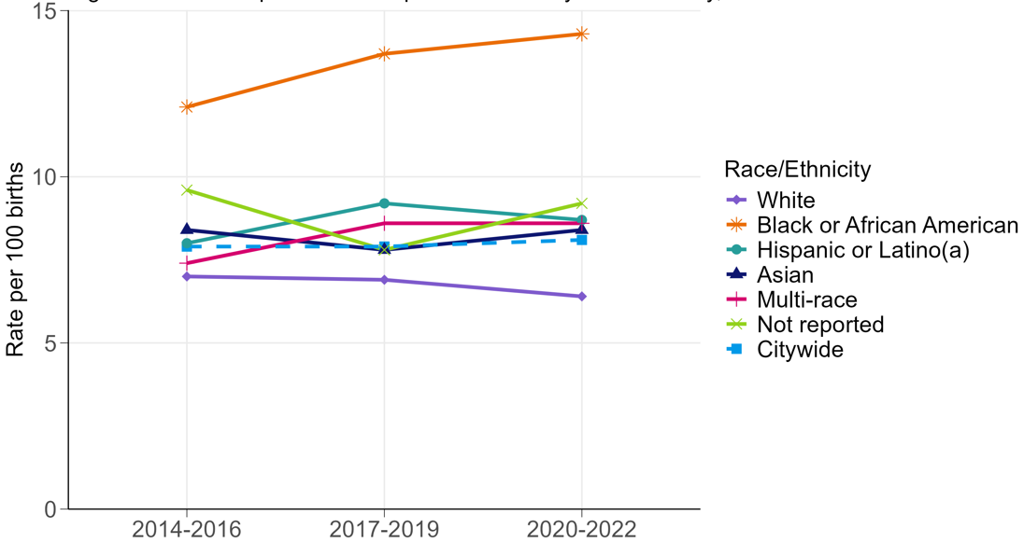
Pre-term birth
Rates of preterm birth are highest for Black/African American residents who are pregnant
Source: San Francisco Department of Public Health, Maternal Child and Adolescent Health Epidemiology. Health conditions of women, children, and adolescents in San Francisco, 2014-2022
Rate of preterm births (per 100 births) by Race/Ethnicity and Year, San Francisco 2014-2022
Notes:
Phil: Pre-term birth is defined as births occurring before 37 weeks (~8.5 months) of gestation. Pre-term birth is a leading cause of death among infants.
In 2022, 622 infants were born in San Francisco before 37 weeks of gestation. Pooled data from 2020-2022 shows the rate of pre-term births among Black/African American pregnant people, which was 77% higher than it was among Citywide pregnant people (14.3 vs 8.1 per 100 births).

Slide 23
Rate (per 100 births) of low birth weight by race/ethnicity, San Francisco, 2020-2022
Rate of low birthweight births was highest for Black/African American pregnant people in SF (14.1 per 100 births) vs Citywide (7.1)
Source: San Francisco Department of Public Health, Maternal Child and Adolescent Health Epidemiology. Health conditions of women, children, and adolescents in San Francisco, 2020-2022
Notes:
Phil: In San Francisco, differences are seen in the rate of low birth weight (LBW) outcomes among those from different racial/ethnic groups. The rate of LBW was highest among Black/African American residents (14.1 per 100 births) during 2020-2022 (Figure 14), which is nearly double the Citywide rate (7.1 per 100 births).

Slide 24
Rate (per 100 births) of gestational diabetes by race/ethnicity, San Francisco, 2020-2022
Rate of gestational diabetes was highest for Asian pregnant people in SF (15.7 per 100 births) vs Citywide (9.4)
Source: San Francisco Department of Public Health, Maternal Child and Adolescent Health Epidemiology. Health conditions of women, children, and adolescents in San Francisco, 2020-2022
Notes:
Phil:
Gestational diabetes is defined as high blood sugar that occurs during pregnancy in those who don’t already have diabetes prior to pregnancy. ⁸
Having gestational diabetes during pregnancy increases the risk for pre-eclampsia (high blood pressure and protein in the urine), cesarean delivery and diabetes later in life. ¹⁷
In San Francisco, differences are seen in the rate of gestational diabetes during pregnancy among those from different racial/ethnic groups. Residents who identify as Asian have the highest rate (15.7 per 100 births) compared to the citywide rate of 9.4 per 100 births.

Slide 25
Rate (per 100 births) of gestational hypertension by race/ethnicity, San Francisco, 2020-2022
Rate of gestational hypertension is highest for Black/African American pregnant people in SF (18.3 per 100 births) vs Citywide (12.1)
Source: San Francisco Department of Public Health, Maternal Child and Adolescent Health Epidemiology. Health conditions of women, children, and adolescents in San Francisco, 2020-2022
Notes:
Phil:
Gestational hypertension is high blood pressure that develops during pregnancy among those who did not have high blood pressure prior to pregnancy.⁸
It is a risk factor for heart disease and stroke and a major cause of maternal and fetal mortality. ^{8,18}
In San Francisco, racial differences are seen in the rate of gestational hypertension during pregnancy with those who identify as Black/African American having the highest rate (18.3 per 100 births) compared to the citywide rate of 12.1.

Slide 26
Mental health outcomes
Notes:
Phil: Past studies have shown food insecurity to be associated with an increased risk of mental health conditions such as depression, anxiety, sleep disorders and suicidal ideation.
While we do not have local data on the number of food insecure residents with mental health conditions, we do see the following general trends around mental health in San Francisco. Addressing food insecurity may reduce mental health vulnerabilities among San Francisco residents.

Slide 27
General trends in mental health
From 2019-2023, the highest rates of hospitalization for major depression were observed among:
15–24 year-olds, (31 hospitalizations per 10,000)
Black or African American (21 per 10K) and Native Hawaiian and Other Pacific Islander residents (19 per 10k)
From 2020-2024, having serious psychological distress within the past year was more prevalent among:
Females (17%),
Individuals who identify with two or more races (32%),
People with low incomes ranging from 0-199 percent of the FPL (21%),
and people identifying as bisexual or pansexual (26%; 2023-2024 pooled data).
California Department of Health Care Access and Information. Limited Data Set, inpatient (PDD) file. 2019-2023. Accessed August 10, 2025. https://hcai.ca.gov/data/request-data/limited-data-request-information/#limited-data-set
UCLA Center for Health Policy Research. AskCHIS 2020-2024 Likely has had serious psychological distress during past year (San Francisco). Accessed 12/22/2025. http://ask.chis.ucla.edu
Notes:
Phil:
2019-2023 pooled data showed that hospitalization due to major depression was highest among those who identify as Black/African American, Native Hawaiian and other Pacific Islander, and those ages 15 to 24 years of age.
Pooled data from 2020-2024 showed that 16% of SF adults reported experiencing Serious psychological distress in the past year. Experiencing serious psychological distress was more common in those who identify as female, those who identify as two or more races, those with incomes below 199% of the federal poverty level, and those who identified as bisexual or pansexual.

Slide 28
Nutrition
Notes:
Phil: Income plays a large role in a person’s ability to afford nutritious foods. Research has found an association between food insecurity and lower fruit and vegetable intake and higher sugary drink consumption.

Slide 29
Youth dietary intake
Fruit and vegetable intake remains low while sugary drink intake is high among SF youth
Less than half of high school students reported daily fruit (43%) and vegetable (49%) intake in the past week.
20% of high school students consumed sugary drinks daily in the past week
58% of middle school students drank a sugary drink the day prior.
Source: Centers for Disease Control and Prevention San Francisco Unified School District. Data from: Youth Risk Behavior Surveillance System (YRBS) data [Data set]. 2022-2023.
Notes:
Phil: Based on 2022-2023 YRBS data:
Only 43% of high school students in San Francisco reported daily fruit intake, and only 49% report daily vegetable consumption in the past week .
The percentage of high school students who consumed at least one sugary drink per day in the past week was 20%. the proportion of middle school students who consumed a sugary drink the day prior was 58%.

Slide 30
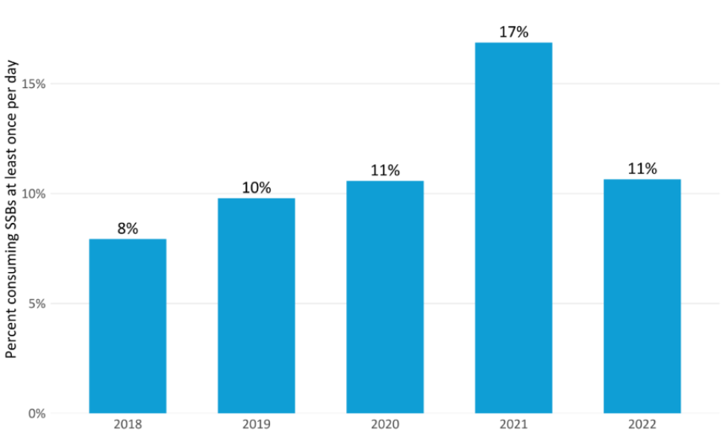
Adult dietary intake
Adult sugary drink consumption has increased since 2018
Percent of San Francisco Adults Consuming SSBs at Least Once per Day by Year, 2018-2022
Note: Data is the percentage of adults that self-reported consuming soda or sugar-sweetened fruit drinks, sweet tea, or sports or energy drinks at least one time per day during the past 30 days
Source: Centers for Disease Control and Prevention (CDC). California Department of Public Health. Behavioral Risk Factor Surveillance System Survey Data, 2018-2022.
Notes:
Phil: While we don’t have recent fruit and vegetable intake data for adults, from 2018 through 2022 there is a general increase in the percent of adults consuming sugary drinks at least once per day, from 8% in 2018 to 11% in 2022. In 2021 a large increase was observed, however the estimate for that year has more variance than other years and may not be as reliable .

Slide 31
Putting it all together
Notes:
Phil

Slide 32
Priorities based on the data presented
Priority populations | Priority indicators
Age Transitional Aged Youth (18-24 years old) Children (0-17 years old) Older Adults (65 years and older) | Poverty Mental Health Nutrition
Race/ethnicity American Indian Alaska Native (AIAN) Black/African American residents (B/AA) Native Hawaiian Other Pacific Islander residents (NHOPI) Asian pregnant people | Diabetes Heart failure Hypertension Mental health Pregnancy outcomes
Zip code/neighborhood 94124 - Bayview Hunters Point 94102 - Downtown, Civic Center 94103 - South of Market 94130 - Treasure Island* 94134 - Portola, Visitacion Valley | Diabetes Heart failure Hypertension Pregnancy outcomes
Notes:
Phil: We presented a lot of health indicator data related to food insecurity. This table shows a summary of the data presented including priority populations. The populations noted stand out based on the disparities observed in income, mortality, and morbidity outcomes when compared to citywide metrics.

Slide 33
Q&A
Notes:
Phil: We have some time for Q&A. Any questions about what was presented here?

Slide 34
thank you!
Phil Lowenthal & Kaela Plank
Further questions can be directed to:
Kaela Plank | kaela.plank@sfdph.org
Eric Chan | eric.g.chan@sfdph.org
Notes:
Thank you for attending this presentation. If you have further questions about the data you can reach out to me directly or Eric Chan.

