Slide 1

SFDPH WIC Program
The Supplemental Nutrition Program For Women, Infants and Children (WIC)
Food Security Task Force
June 4th, 2025
Priti Rane MS, RD, IBCLC
Director of Nutrition Services
San Francisco Department of Public Health
Maternal, Child and Adolescent Health

Slide 2
About the WIC Program
WIC (Women, Infants, and Children) is a federally funded nutrition program that supports:
  Pregnant, postpartum, and breastfeeding individuals
  Infants and children up to age 5
Key Services:
Healthy food benefits
Nutrition education and counseling
Breastfeeding support
Referrals to healthcare and social services
Goal:
To improve health outcomes and reduce nutrition-related risks during critical stages of growth and development.

Slide 3
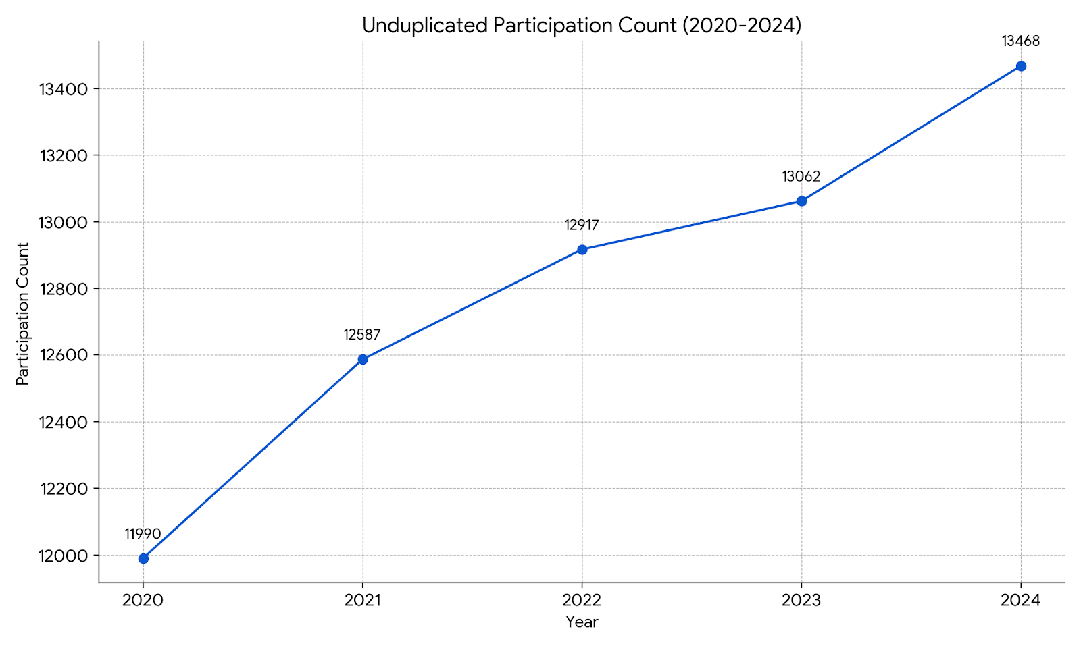
Participation 2020- 2024

Slide 4
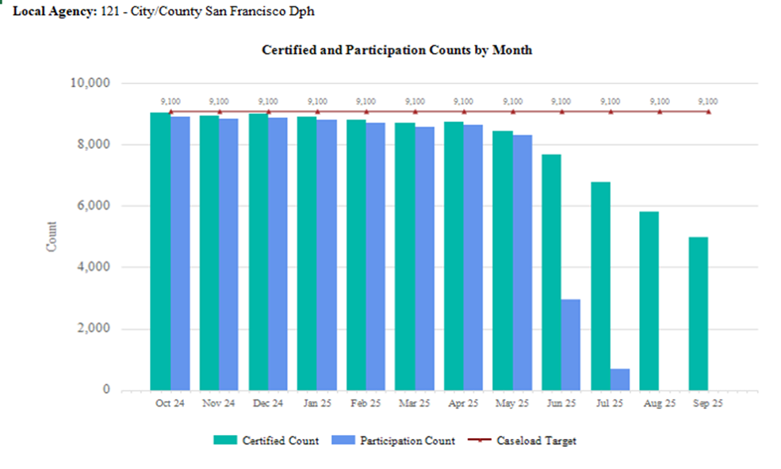
Participation trend FY 2024-2025

Slide 5
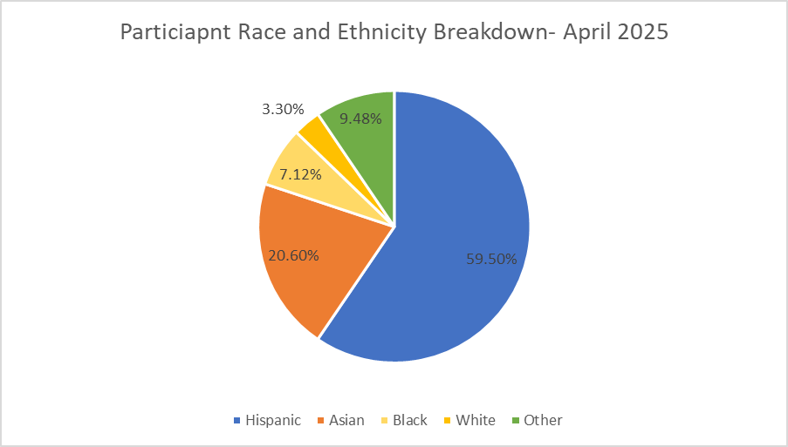
Participation Breakdown by Race and Ethnicity

Slide 6
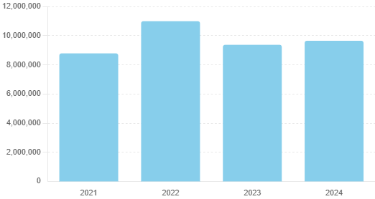
Total benefit redemption 2021-2024
$10,998,387
$9,374,905
$9,652,423
$8,787,947
Higher redemption in 2022 due to formula shortages

Slide 7
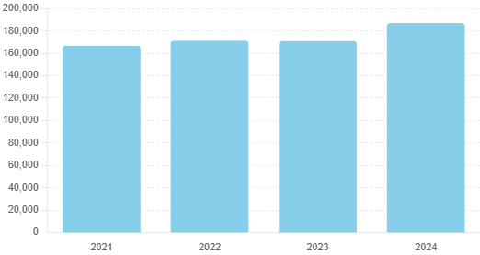
Total grocery store transactions 2021- 2024
187,102
171,159
170,816
166,661

Slide 8
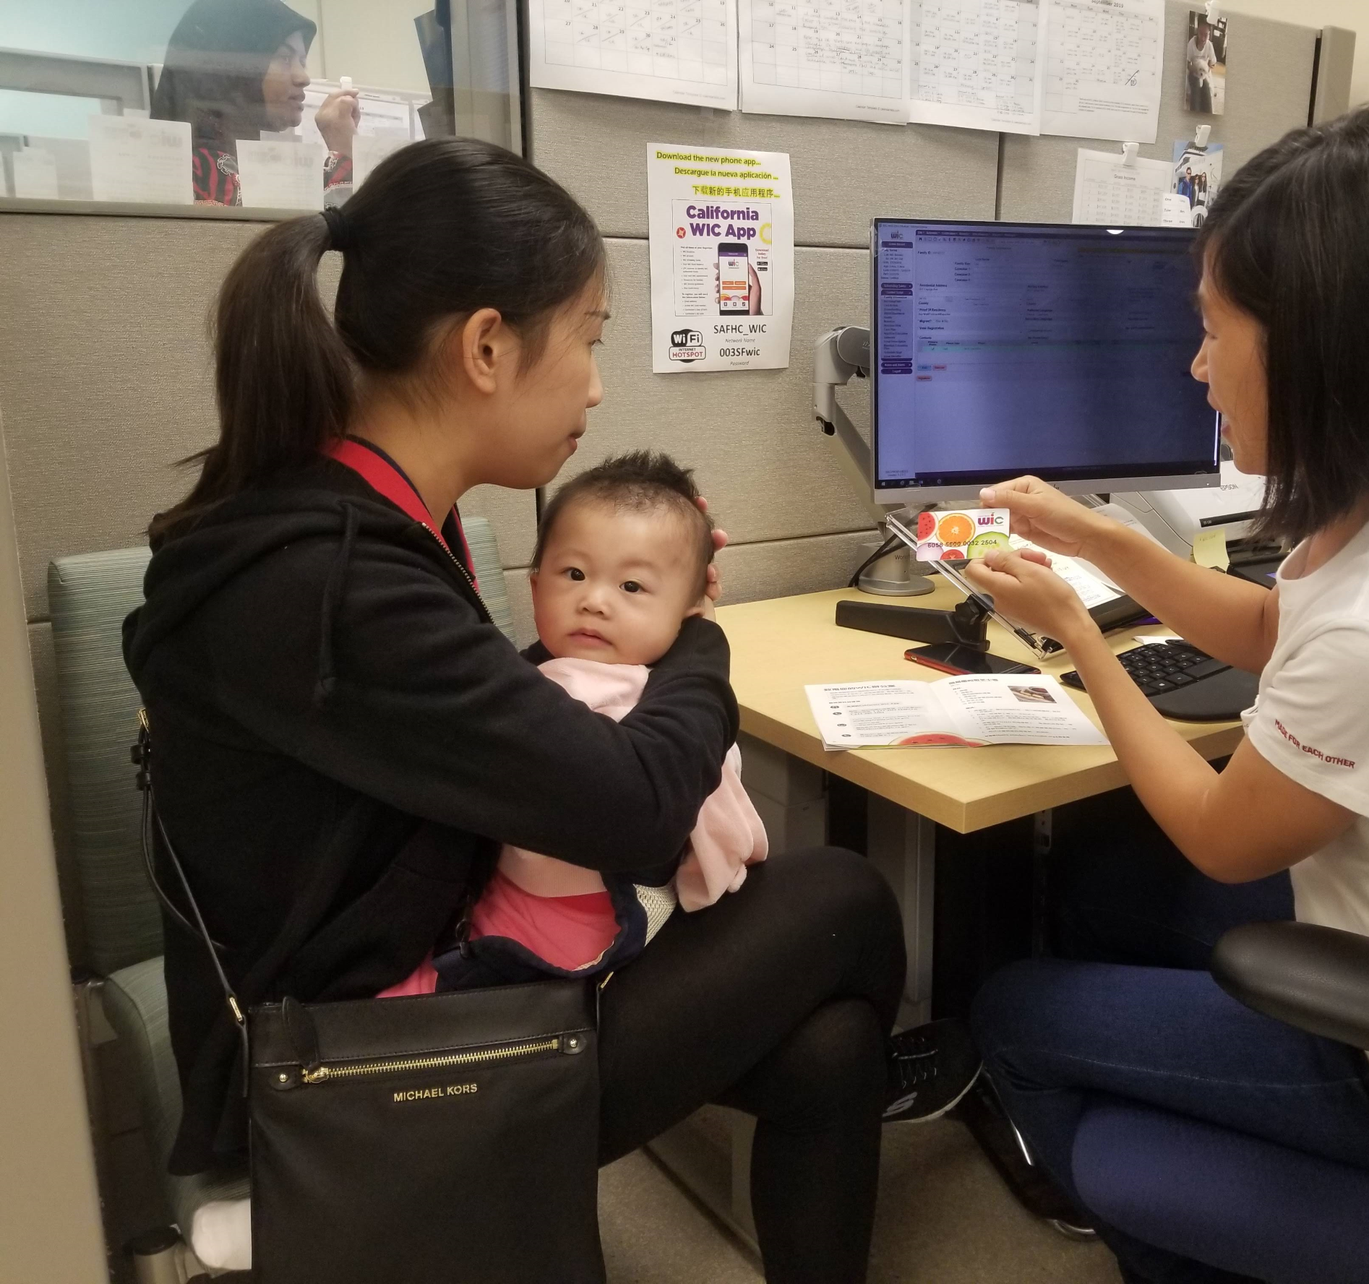
Addressing Food Insecurity
Per 2018-2020 MIHA data, prevalence of food insecurity during pregnancy in SF among prenatal WIC participants was 40.1%.
In March 2025, families redeemed over $800k benefits at local grocery store.
~ $14M benefits issued in 2024.
70% redeemed.
Average benefit amount per family- ~ $150-200/month.
EatSF vouchers- $700K annually to prenatal participants- adds $40/month.

Slide 9
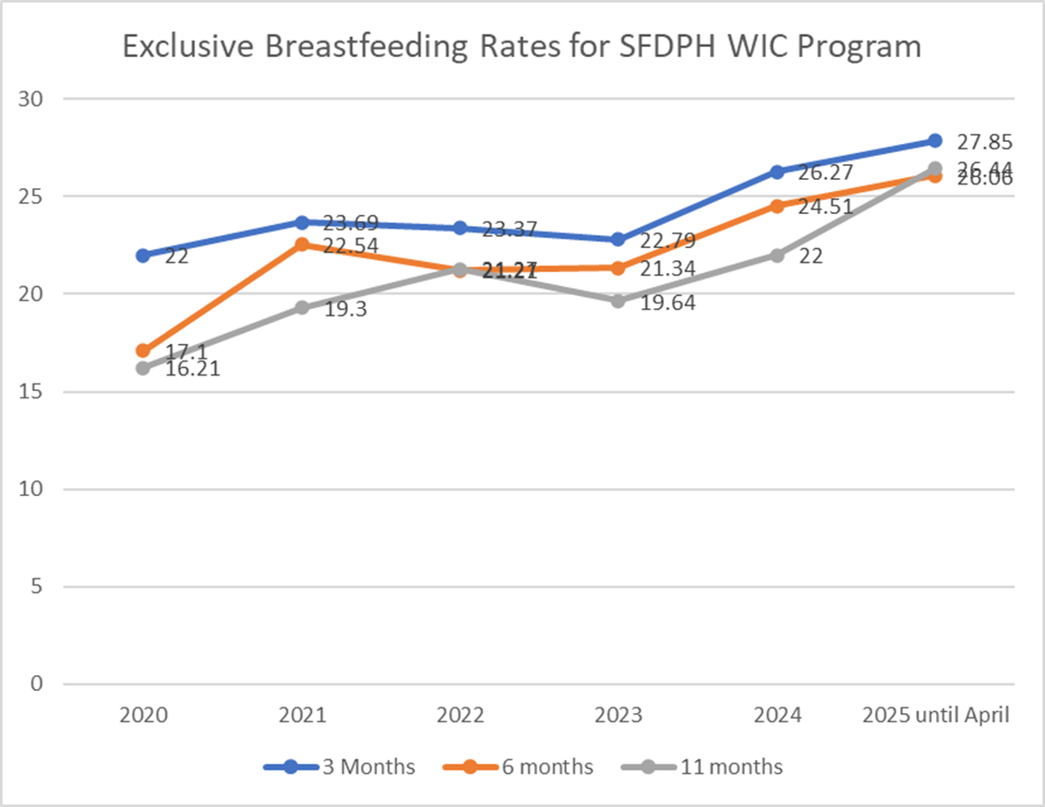
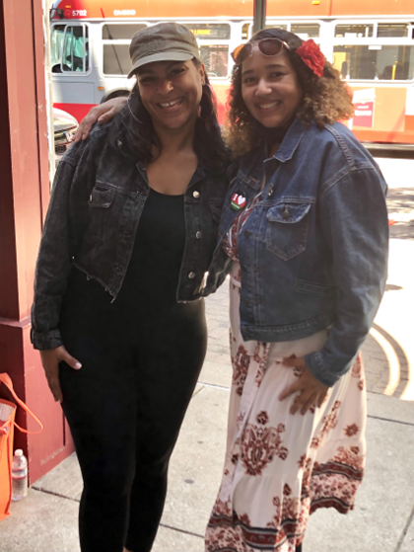
WIC Breastfeeding Program
Suzanne Malone WIC RD, IBCLC with Black Infant Health Program participant
Notes:
Just a quick reminder of how to request access to WRAD for your staff. There is an electronic account request form available on LASS on the WIC Director’s tile, in the left menu bar. WIC Directors must be the one to request access for their staff. Specific instructions on how to complete the request form are also available on LASS.

Slide 10
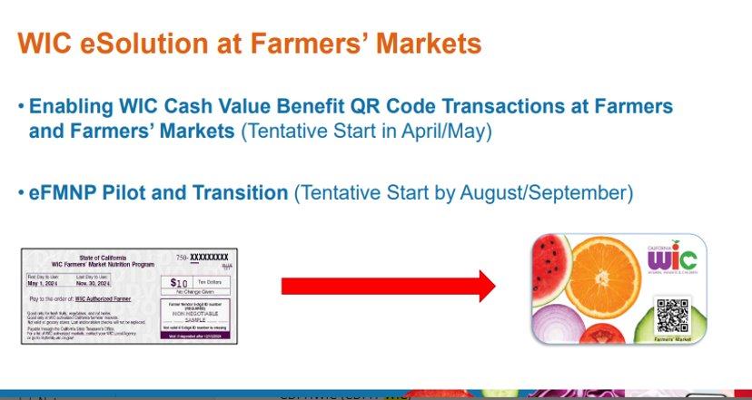
WIC Famers Market Program
Notes:
Just a quick reminder of how to request access to WRAD for your staff. There is an electronic account request form available on LASS on the WIC Director’s tile, in the left menu bar. WIC Directors must be the one to request access for their staff. Specific instructions on how to complete the request form are also available on LASS.

Slide 11
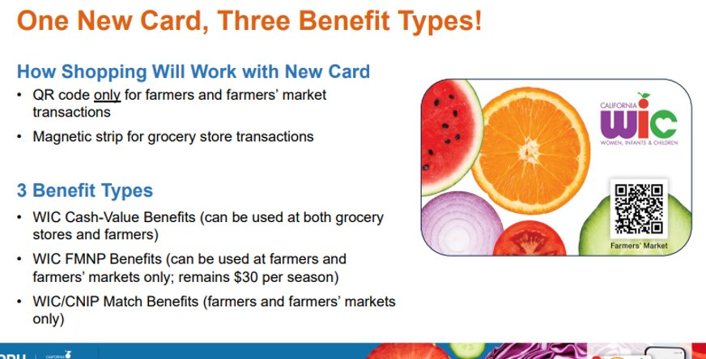
Notes:
Just a quick reminder of how to request access to WRAD for your staff. There is an electronic account request form available on LASS on the WIC Director’s tile, in the left menu bar. WIC Directors must be the one to request access for their staff. Specific instructions on how to complete the request form are also available on LASS.

Slide 12
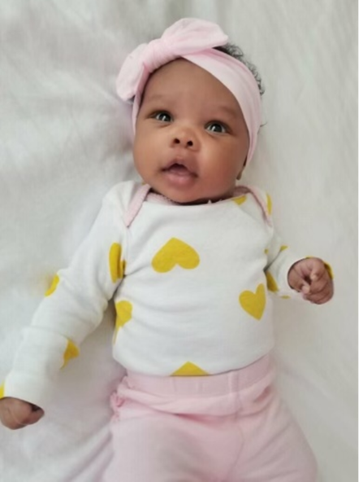
Current Program Challenges
Staffing continues to be our biggest challenge
Workload- 822 ppts/FTE (Recommended participants/FTE ratio- 500-600 ppts/FTE)
Current appointment wait time is 6-8 weeks
HR delays, lengthy training process
Demand for services continue to remain high
Remote services may end after September 30, 2026

Slide 13

Funding Status & Policy Implications
Current Funding Status-WIC is federally grant funded
  In March 2025, the Senate passed a Continuing Resolution (CR) funding the government through September 30
  The CR includes $7.6 billion for WIC – an increase of over $500 million from FY24.
  The White House emphasized this increase was critical to avoid waitlists, which have not occurred in over 25 years.
  Policy Landscape & Risks
  Congress is considering significant cuts to safety net programs like Medicaid and SNAP
  While WIC is not directly targeted, indirect impacts are expected
Notes:
Some of you may have attended the WRAD Viewer Training Webinars we had in November. We have posted the slides as well as the recording for one of these webinars on LASS in the Data and Research tile. Because the slides and recording are available for all staff to listen to, we have decided it would be a better use of everyone’s time to have live Q&A sessions instead of repeating the training webinar.
Also available on LASS are the WRAD User Guide, as well as Practice Scenarios for both the Viewer and Explorer roles.

Slide 14
Thank You!
Questions?
Contact: Priti Rane – priti.rane@sfdph.org

