Slide 1
Welcome to the
San Francisco Department of Police Accountability
Wednesday,
February 11, 2026
5:00 pm

Slide 2
MAYOR’s Budget Instructions
DPA’s FY 2026-2028 Budget Proposal
The Mayor’s budget priorities are: Making the City more affordable and livable for families, strengthening our social safety net Ensuring safe and clean streets Stabilizing reliable public transit Transforming our health and homelessness systems Delivering excellent core city services with modern systems and structures Strengthening the city’s economy
Department of Police Accountability

Slide 3
MAYOR’s Budget Instructions (CONT.)
DPA’s FY 2026-2028 Budget Proposal
The Mayor’s primary instructions to departments include: Eliminate discretionary programs. Restructure departments around current staffing levels. Review all contracted services and non-personnel expenditures to identify savings. Reduce all city-wide workorders. Identify redundancy and shared administrative needs. Identify investment opportunities to reduce long-term costs.
Department of Police Accountability

Slide 4

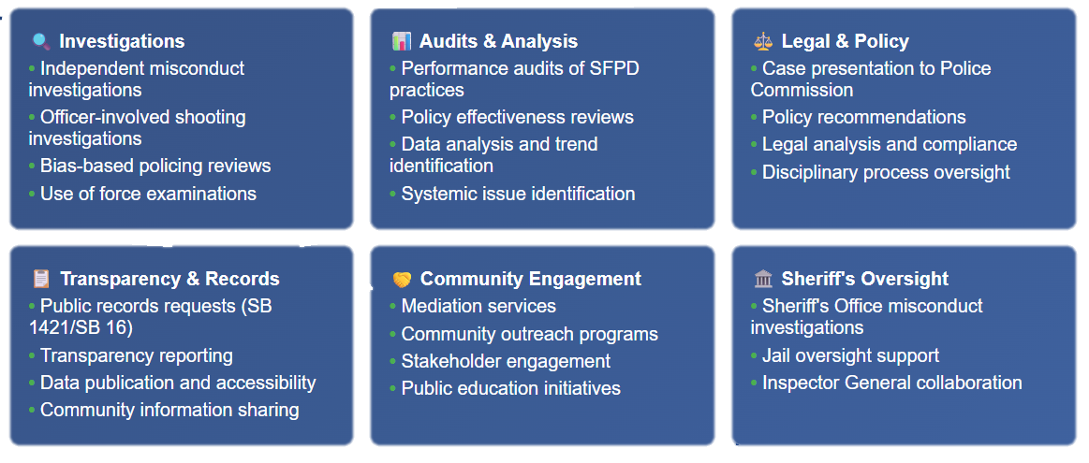
DPA’s FY 2026-2028 Budget Proposal
DPA’s FY 2026-2028 Budget Proposal
Overview of DPA’s Divisions and Core Services
Department of Police Accountability

Slide 5
Funding by category
DPA’s FY 2026-2028 Budget Proposal
Department of Police Accountability

Slide 6
Funding by Expense Category
DPA’s FY 2026-2028 Budget Proposal
 | FY 2025-26 Original | % of Total Budget
Salaries | $5,594,791 | 57%
Fringe | $1,958,271 | 20%
Programmatic Projects | $100,000 | 1%
Non-Personnel Services | $301,223 | 3%
Materials and Supplies | $33,422 | <1%
COIT Projects (1-time funding) | $695,000 | 7%
Interdepartmental Services | $1,111,554 | 11%
TOTAL | $9,794,261 | 100%
Department of Police Accountability

Slide 7
DPA’s Positions BY DIVISION
DPA’s FY 2026-2028 Budget Proposal
Department of Police Accountability

Slide 8
Funding by category
DPA’s FY 2026-2028 Budget Proposal
Department of Police Accountability

Slide 9
Thank you

