Slide 1
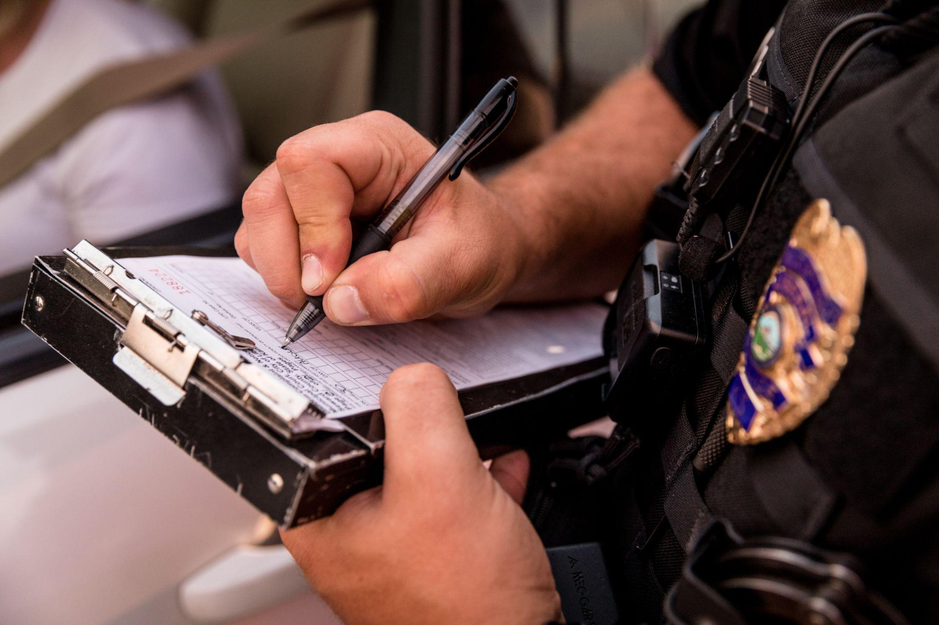

Redesigning Traffic Safety
Recommendations to Address Racial
Disparities in Traffic Crashes and
Enforcement
Scarlet Neath, Policy Research Manager
Charlotte Resing, Government Affairs Manager

Slide 2
Our time today
Introduction to CPE
Overview of our holistic traffic safety recommendations
Focus on pretextual stops recommendations
Questions

Slide 3
About the Center for Policing Equity
A research and action group that uses science to promote racial justice in public safety systems.
Work to create safer communities with a smaller law enforcement footprint, and have partnered with over 60 law enforcement agencies in 30 states.
Rely on science that says situations predict bias more than individual biases.

Slide 4
Recommendations to Redesign Traffic Safety
End Pretextual Stops
Invest in Public Health Approaches to Road Safety
Limit Use of Fines and Fees
Pilot Alternatives to Armed Enforcement
Improve Data Collection and Transparency

Slide 5
Limiting Fines and Fees: Local Examples
Repair vouchers for equipment violations
Reminder notifications or income-based fee waivers for expired registrations
Driver’s license suspension restoration programs

Slide 6
What are pretextual stops?
When police pull someone over for a minor traffic violation so that they can investigate an unrelated offense for which they lack reasonable suspicion

Slide 7
What are pretextual stops?
Stops such as equipment, license, and registration violations
Pretextual stops
Stops with high racial disparities that are an inefficient use of resources

Slide 8
Who is impacted by pretextual stops?
White drivers are more likely to be pulled over for safety-related violations like speeding, while Black drivers are more likely to be pulled over for equipment, license, and registration violations.
Black drivers are searched at higher rates at traffic stops, but those searches are less likely to produce contraband.
Analysis of 20 million records of traffic stops in North Carolina showed that 99.7% did not produce both contraband and an arrest.

Slide 9
Recommendations to limit pretextual stops
Prohibit officers from using traffic stops as a pretext for criminal investigation and from conducting consent searches
Ban stops for low-level violations
Collect data and enforce reforms through accountability measures

Slide 10
Prohibit stops that are a pretext for criminal investigation
This reform has been shown to significantly decrease racial disparities in traffic stops
Unless they have independent cause, officers should not be allowed to:
  ask investigative questions unrelated to the initial reason for the stop
  conduct a consent search

Slide 11
Ban stops for low-level violations
Virginia, Philadelphia, and Pittsburgh have enacted this legislative reform
Early evidence from Virginia shows large reduction in the number of traffic stops, but a continuation of racial disparities

Slide 12
Enforce any reforms through accountability measures
Officers should be required to record a narrative description of their justification for each stop and search they conduct to ensure compliance with policy

Slide 13
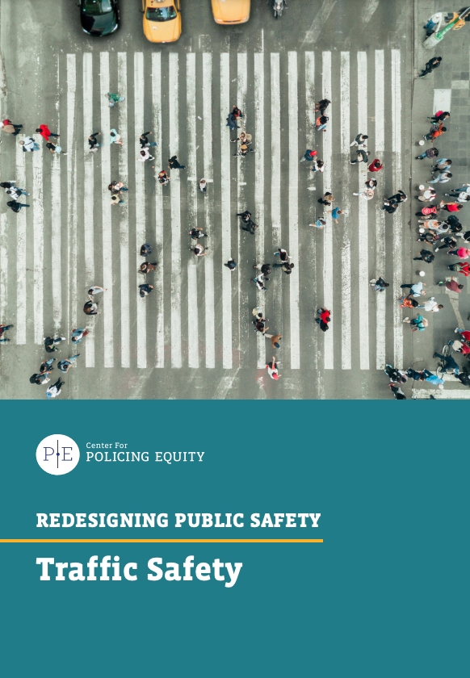
Thank you & questions
For our full traffic safety recommendations, visit www.policingequity.org/traffic-safety
Contact sneath@policingequity.org or cresing@policingequity.org for additional questions

