Slide 1

Overdose Crisis and Public Health Response
A presentation to the Behavioral Health Commission
February 15, 2024
Hillary Kunins, MD, MPH, MS​ Director of Behavioral Health Services and Mental Health SF​ San Francisco Department of Public Health​
Notes:
Good afternoon and thank you for the introduction.
I did my residency at UCSF but spent the much of the last 10 years in Philadelphia. It’s good to be back, and I’m especially appreciative of being able to be at ZSFG, where my interest in this topic was really nurtured.

Slide 2
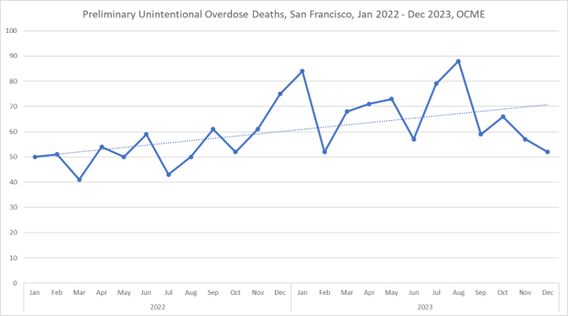
Overdose deaths are increasing in San Francisco in 2023 compared to 2022
806 preliminary overdose deaths in 2023, 159 (25%) above 2022
Office of the Chief Medical Examiner, 2023

Slide 3
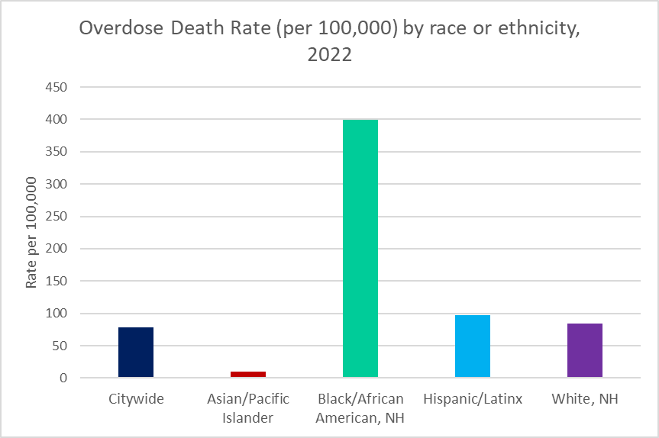
Profound racial disparities exist among overdose decedents in SF
Black/African Americans represent just 6% of the population in SF, but 31% of preliminary overdose deaths in 2023
The overdose death rate among Black/African Americans is 5X higher than the citywide rate
San Francisco Office of the Chief Medical Examiner, 2023; Center on Substance Use and Health, 2023

Slide 4
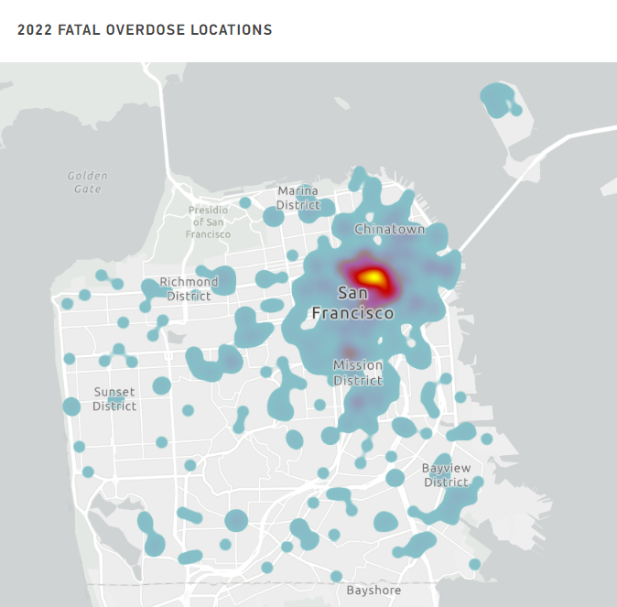
The majority of overdose deaths occur in a residence
25-35% of overdose deaths occur among people without a fixed address
Deaths occur citywide
and disproportionately impact people experiencing homelessness
Office of the Medical Examiner, 2023

Slide 5
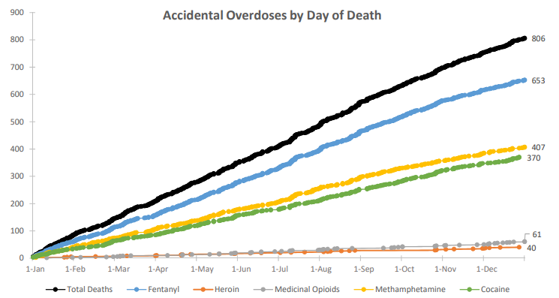
Fentanyl is the most common drug involved in overdose deaths
Cumulative accidental overdoses by day of death, 2023
Over 80% of preliminary overdose deaths in 2023 involved fentanyl, up from 12% in 2016.
In 2022, >80% of overdose deaths involving fentanyl also had at least one other drug present (heroin, cocaine or methamphetamine)
Office of the Chief Medical Examiner, 2023; Center on Substance Use and Health 2022

Slide 6
Our strategic approach to overdose prevention and response
Prevention: Education, Engagement, and Support Saturate high-risk settings with naloxone and overdose response training and connections to care. Strengthen community engagement and social support for people at high risk for overdose.
Strengthen Treatment and Other Substance Use Services
Expand access and availability of the most effective substance use disorder treatments such as medications for addiction treatment and contingency management as well as post-overdose response.
Collaborate with Partners Implement a “whole City" approach to overdose prevention.
Reduce Racial Disparities Work closely with Black-led and Black-serving organizations to address the profound racial disparities seen among our overdose decedents.
Data-informed Response Track overdose trends and related drug use metrics to measure success and inform program development and change

Slide 7
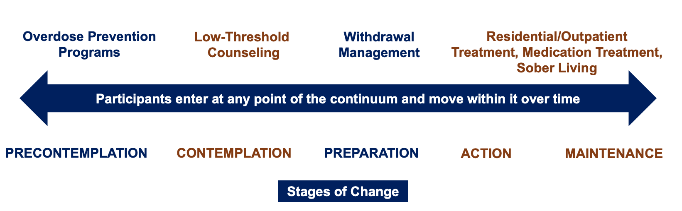
Strengthening the continuum of evidence-based services will save lives
Recovery Residences
Center for Substance Abuse Treatment. Brief Interventions and Brief Therapies for Substance Abuse. Rockville (MD): Substance Abuse and Mental Health Services Administration (US); 1999. (Treatment Improvement Protocol (TIP) Series, No. 34.)

Slide 8
Increased access to the continuum of substance use services in SF
~5,000 people treated for substance use disorders in DPH programs
2,500 people in SF receive buprenorphine for opioid use disorder annually 2,300 people receive methadone for opioid use disorder annually
~575 residential treatment admissions annually ~1,100 people use withdrawal management services annually

Slide 9
Educated and trained community members in overdose recognition and naloxone use
Other activities include:
Developing new relationships with Black-led and predominantly Black-serving organizations
Collaborated with the Entertainment Commission (https://sf.gov/information/overdose-prevention-resources-nightlife)
Launched a Request-by-mail naloxone program
Expanded naloxone access at DPH pharmacy, community events, lobby of county jail
Supported legislation to requiring retail pharmacies stock naloxone
120,000+ naloxone doses distributed by DPH and the DOPE Project in 2023 5,000 completions of the online DPH Overdose Recognition and Response training since October 2022
1,000+ members of the public
received DPH Overdose Recognition and Response training in-person since February 2023

Slide 10
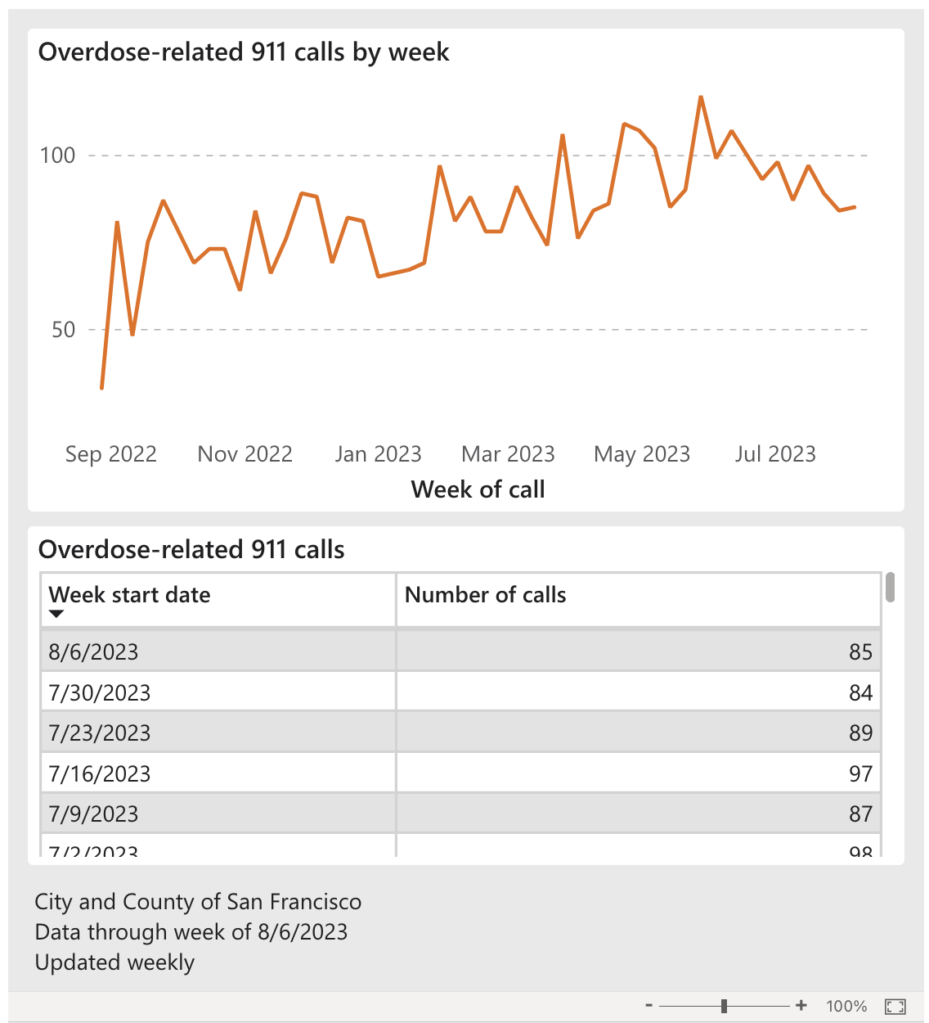
Track overdose trends and related treatment metrics
Goal: Measure success and inform program development and change
Centralize data collection on drug-related metrics, including fatal and non-fatal overdose
Launched a publicly-available dashboard on overdose and treatment trends (September 2023)
Bi-weekly meetings with community members and frontline staff of service organizations to review data and discuss findings
Overdose Dashboard
Notes:
Between 2015 and 2020, deaths involving fentanyl in San Francisco increased 4600%, illustrating the rapidity with which the drug supply and drug use can change. Data must be used to inform and evaluate service delivery, policies and resource allocation, as well as to advance racial equity. To achieve this, the City is:
centralizing data collection on drug-related metrics, including fatal and non-fatal overdose,
using data to improve programs,
developing materials for communicating data, including a publicly available dashboard for tracking important citywide metrics, and
regularly meeting with community members and frontline staff of service organizations to review data, discuss findings, and guide future planning.

Slide 11
Thank you
Notes:
Here is an overview of what I’ll be discussing today, starting with the magnitude of the crisis…

