Slide 1
San Francisco Department of Public Health Division of Behavioral Health Services Behavioral Health Commission – Director's Update January 18, 2024
Hillary Kunins, MD, MPH, MS Director of Behavioral Health Services and Mental Health SF San Francisco Department of Public Health

Slide 2
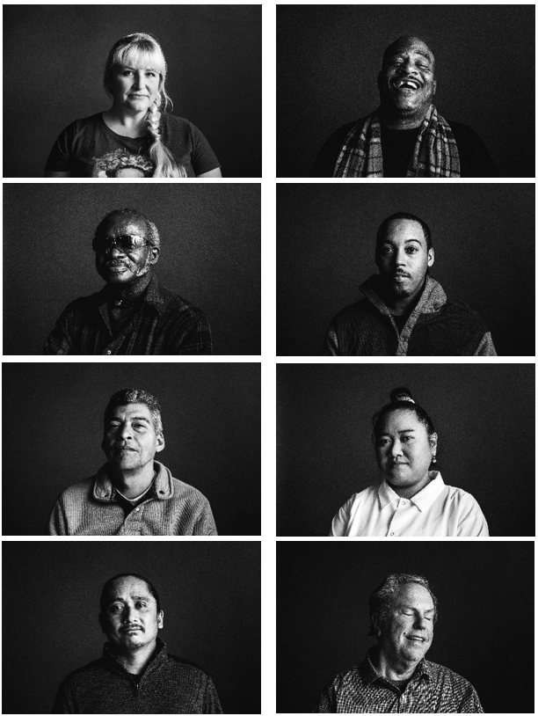
Agenda
Budget Update
CARE Court Update
SB43

Slide 3
Budget Update

Slide 4
Budget Financial Forecast and Fund Reduction
Total DPH Budget: $3.2B
Total BHS Budget: $719.6M
San Francisco’s economic reality remains challenging due to the following:
Reduced revenue expectations, particularly in transfer, hotel & sales taxes
Increased health care costs: 9% projected employee health rate growth in FY24-25
Multi-Year Inflationary growth on CBO contracts (new ordinance)
As a result, there's a 10% general fund reduction and 5% general fund contingency target. For DPH the targets are:
FY24-25: $110M
FY25-26: $128M
With a contingency target of $49.6M
Notes:
Costs are growing faster than revenues and we need to address our growing structural deficit
Includes personnel costs, inflationary operating costs including CBO Cost of Doing Business
Not in a recession

Slide 5
Our Approach to the Upcoming Budget Process
Review feedback from internal and external stakeholders for cost-efficiencies and savings.
Review vacant positions.
Retain core services to minimize impact to clients.
Find opportunities to maximize revenue and shift costs from General Fund to other sources.

Slide 6
Budget Timeline
December – February Department Review
March – May Mayor’s Office Review
June – July Board of Supervisors Review
December 2023 Five-Year Projection & Mayor’s Instructions

Slide 7
CARE Court Update

Slide 8
CARE Court Basics
Civil court process established through legislation SB 1338.
Received one-time state funding to support planning and implementation.
Connects people who are experiencing serious, untreated mental illness (schizophrenia spectrum and other disorders) to essential care through county behavioral health services.
Various groups can file a petition such as county behavioral health agencies, family members, first responders, conservators, etc.
Petitions must be valid and should not be filed without merit or with the intention to harass or annoy.
If deemed eligible and the person will not engage voluntarily, participant will receive a court-ordered CARE plan for up to 12 months, with the possibility to extend for an additional 12 months.
Intended to be a less restrictive alternative to state hospitalization or LPS conservatorship.
There is uncertainty around eligible and enrolled populations. We estimate 1,000-2,000 in San Francisco are eligible.
Notes:
CARE Court Criteria:
18 years or older
Experiencing serious mental illness and has a diagnosis in the schizophrenia spectrum and other psychotic disorder class
Not clinically stabilized in on-going voluntary treatment
Meets one of the following:
The person is unlikely to survive safely in the community without supervision and the person’s condition is substantially deteriorating.
The person needs services and supports in order to prevent a relapse or deterioration that would be likely to result in grave disability or serious harm to the person or others, as defined in Section 5150.
CARE would be the least restrictive alternative to ensure the person’s recovery and stability
It is likely that the person will benefit from participation in CARE

Slide 9
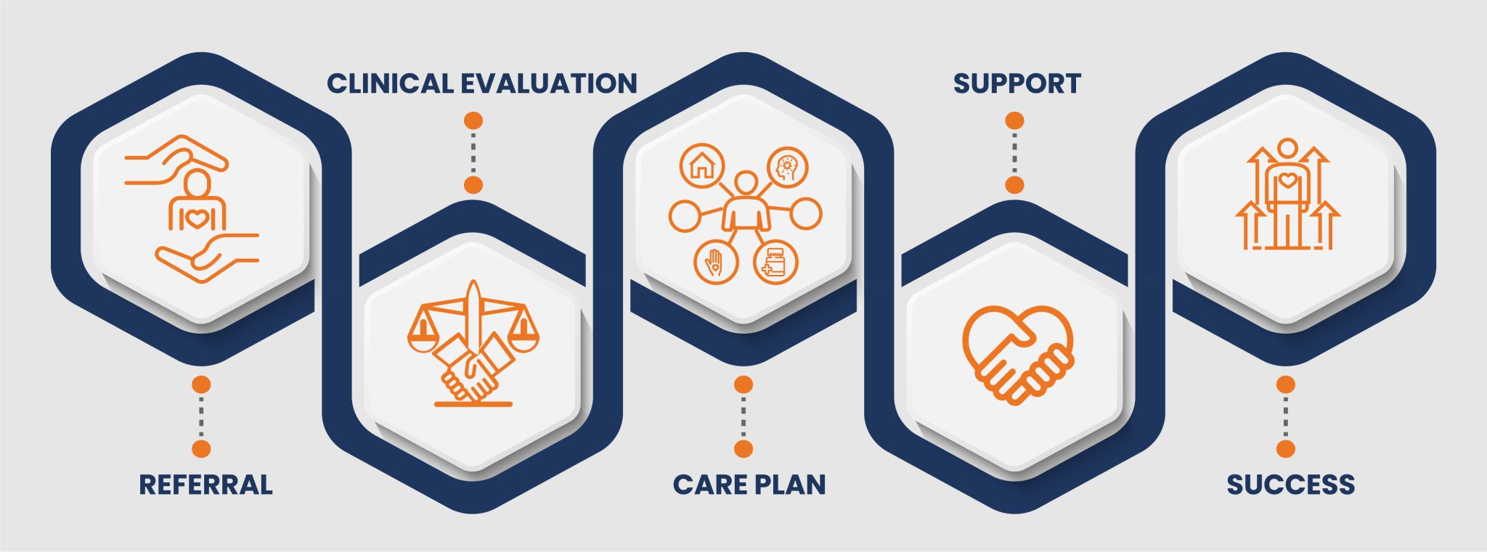
CARE Court Pathway
https://www.chhs.ca.gov/care-act/
Notes:
Participants are offered legal counsel and may choose a CARE Supporter in addition to their full clinical team
Each participant develops the CARE agreement or CARE plan in concert with the BHS Investigation & Engagement Team so that supports and services are coordinated and focused on the individual needs of the person it is designed to serve
Treatments aim to provide a clinically appropriate, community-based set of services and supports that might include short-term stabilization medications, wellness and recovery supports, and connection to social services and housing
A Psychiatric Advance Directive provides further direction on how to address potential future episodes of a mental health crisis that are as consistent as possible with the expressed interest of the respondent

Slide 10
CARE Court Updates
Hired and filled six positions. One position is still pending.
Launched CARE Court consultation line* to provide support and guidance around CARE Court processes:
Email: CARECourtConsultation@sfdph.org
Phone: 628-217-5171
Receiving investigation and engagement referrals from the Court and began filing petitions with the Court
Working in close coordination with the Court, City Attorney's Office, and other city departments.
Gathering data, which will be reported quarterly to the state.
Clients have been referred, but we can't report data because of the confidential nature of the cases.
Notes:
The following positions were filled with funding provided by the State:
Manager (Pending)
Health worker (x2)
Health Program Coordinator
Behavioral Health Clinician
Senior Behavioral Health Clinician
*The CARE Court Consultation line is meant to serve as a resource for potential referents to mitigate the filing of unsuitable petitions and provide guidance around the CARE Court process. Be prepared to give DPH information detailing why and how the person is deteriorating (information about 5150's, hospital visits, emergency contacts, etc., particularly if they are outside of General Hospital). Please allow 48-72 hours for response.

Slide 11
CARE Court, AOT, and Conservatorship
​ | CARE Court​ | AOT​ | Conservatorship​
Accepts referrals from hospital facilities​ | X​ | X​ | X​
Accepts referrals from first responders​ | X​ | ​ | ​
Accepts referrals from family​ | X​ | X​
Accepts referrals from behavioral health providers​ | X​ | X​
Involuntary treatment​ | ​ |  | X​
Requires grave disability criteria |  |  | X
Involuntary medication​ | ​ |  | X​
Court ordered treatment​ | X​ | X​
Requires prior negative outcomes​ | ​ | X​
Allows for Respondent-identified Supporter to assist in the process​ | X​ | ​
Notes:
We have found that AOT has longer term sustained outcomes of engagement in care and reductions in negative outcomes. Our three-year evaluation showed reductions in psychiatric hospitalizations as well as visits to psychiatric emergency services (PES) and justice-involved systems.

Slide 12
About SB43

Slide 13
SB43 Basics
Beginning January 1, 2024, SB43 expands the definition of Grave Disability to include to people who live with serious substance use disorder and people who are unable to provide for their own personal safety or necessary medical care.
The amended definition applies to 5150, 5250, 5270 holds and LPS conservatorships*
Serious substance use disorder is defined as: a presence of at least six symptoms, out of at least ten possible symptoms, pursuant to the DSM-5
Personal safety is defined as: the ability of one to survive safely in the community without involuntary detention or treatment
Necessary medical care is defined as: care needed to prevent serious deterioration of an existing physical medical condition, which if left untreated, is likely to result in serious bodily injury
*Subject to court approval at every stage of the proceedings

Slide 14
Grave Disability: Pre- and Post-SB43
Elements of Grave Disability Definition | Old Definition | New Definition
Mental Disorder diagnosis is a basis for Grave Disability (“GD”) | X | X
Stand-alone Substance Use Disorder (“SUD”) is a basis for GD |  | X
Co-occurring Mental Disorder and SUD is a basis for GD | X | X
Inability to provide for food, clothing, shelter is a basis for GD | X | X
Inability to provide for personal safety is a basis for GD |  | X
Inability to provide for medical care is a basis for GD |  | X
Causation required between Mental Disorder/SUD and inability to provide for basic needs | X | X
Referral from psychiatrist/psychologist required for conservatorship petition | X | X
Constitutional rights/protections for patients subject to involuntary holds and conservatorships | X | X

Slide 15
CARE Court Resources
Petitions can be filed at: https://sf.courts.ca.gov/divisions/civil-division/care-act-court ​
All forms needed to file are available at: https://www.courts.ca.gov/forms.htm ​
For help understanding how to file the forms, please see the Court's Access Center program: https://sf.courts.ca.gov/self-help
CARE Court matters will be heard on Mondays at 575 Polk Street
Additional information and resources can be found on our website: https://www.sf.gov/information/care-court​

Slide 16
Thank You

