Slide 1

San Francisco Department of Public Health
Behavioral Health Services Director’s Update to the Behavioral Health Commission
April 18, 2024
Hillary Kunins, MD, MPH, MS​ Director of Behavioral Health Services and Mental Health SF​ San Francisco Department of Public Health​

Slide 2
Agenda
Budget Reminder
About Proposition 1
Mental Health San Francisco Update

Slide 3
BHS Budget and Timeline
As you know, City departments including BHS, have been asked to make budget reductions due to projected financial forecast deficits for the City over the next five years. Our approach to the budget reduction process was to:
Review feedback from internal and external stakeholders for cost-efficiencies and savings;
Review vacant positions;
Retain core services to minimize impact to clients; and
Find opportunities to maximize revenue and shift costs from General Fund to other sources.
While we had to cut some vacant positions, our core services were not impacted.
The budget is currently with the Mayor’s Office for review.
December – February Department Review
March – May Mayor’s Office Review
June – July Board of Supervisors Review
December 2023 Five-Year Projection & Mayor’s Instructions

Slide 4
About Proposition 1

Slide 5
About Proposition 1
Prop 1, which was approved by voters in March 2024, will provide access to resources to support treatment beds and mental health and substance use disorder services. BHS is working closely with other City departments and community partners to implement the changes. Prop 1 consists of two major components:
Changes the Mental Health Services Act (MHSA) that was passed by voters in 2004, with a focus on how the money from the Act can be used. The Act is now known as the Behavioral Health Services Act (BHSA).
Approves a $6.4 billion bond. The City will determine how to apply Prop 1 bond funds once the notice of funding and guidance is provided by the State.

Slide 6
Mental Health San Francisco Update

Slide 7
Mental Health San Francisco
Established 2019 and funded through a local SF tax through Proposition C.
Expanding mental health and substance use services for people who are experiencing homelessness in San Francisco.
The four key initiatives of MHSF include:
Office of Coordinated Care
Mental Health Services Center
Improve and centralize care coordination for clients
Expand behavioral health treatment and care placements
Street Crisis Response
Provide help for behavioral health crises on the streets
New Beds & Facilities
Center for patients to access treatment, medications, and referrals
Residential Care & Treatment Dashboard
Notes:
Bolsters behavioral health services for:
Adults (18+);
Experiencing homelessness;
With a serious a mental illness and/or substance use disorder;
Who may be uninsured, enrolled in Medi-Cal or Healthy SF
People who are justice-involved and re-entering the community

Slide 8
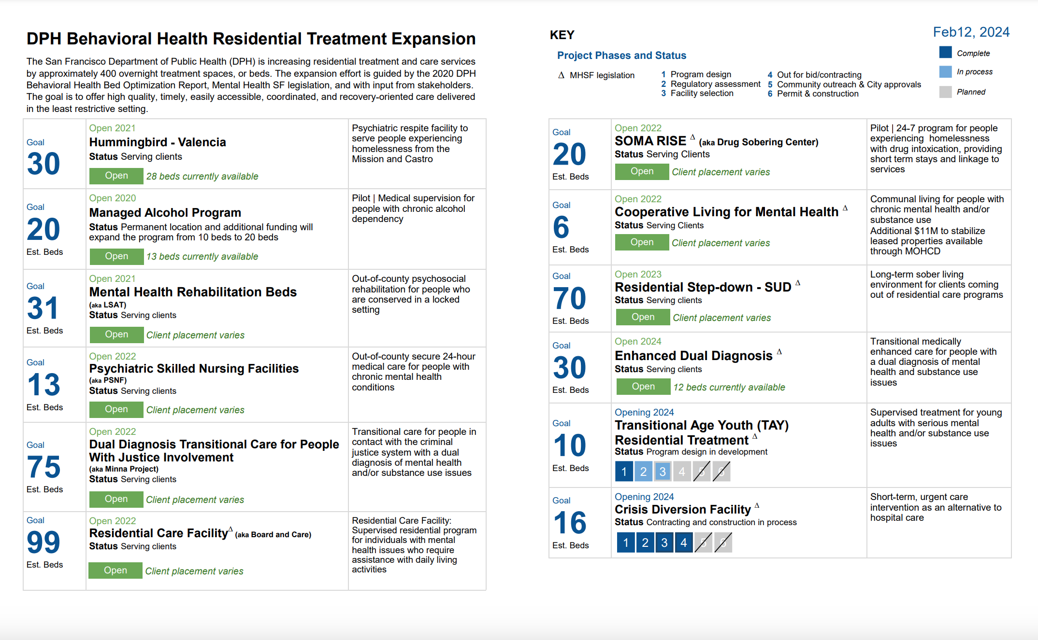
Beds Dashboard
350+ of 400 total beds opened
Notes:
In 2023, DPH added over 100 new residential care and treatment beds and made significant progress toward opening Enhanced Dual Diagnosis, Transitional Age Youth (TAY) behavioral health recovery, and Crisis Stabilization Unit programs. Since 2020, DPH has opened over 350 new behavioral health beds, nearly reaching the goal of 400 new beds for clients with mental health and/or substance use needs. 2023 Milestones include:
Residential Step-Down – Opened 70 beds
Minna Project – Expanded capacity from 48 to 75 beds
Managed Alcohol Program – Relocated and expanded capacity from 13 to 15 beds
Significant planning work to open the remaining Enhanced Dual Diagnosis, TAY behavioral health recovery, and Crisis Stabilization Unit beds.
~90% of 400-bed MHSF goal has been met
400 beds will be added to the ~2,200 existing bed inventory

Slide 9
Improving Access and Care Coordination for San Franciscans
The Office of Coordinated Care (OCC) manages behavioral health central access points, provides case management, care oversight, and care planning.
Access & Navigation – Information, screening, referral and direct connection to behavioral health care
CARE Coordination – Systematic and focused services for priority populations needing engagement and connections to care.
Behavioral Health Access Line (BHAL): 24/7 state-mandated/regulated call center
Behavioral Health Access Center (BHAC): Walk-in center, open 7 days/week, for access to behavioral health services
Triage: Central hub managing referrals; systematically tracking and ensuring connections to care after 5150 or SCRT contact; deploying OCC follow-up teams
BEST Care Management: Field-based follow up team focused on individuals leaving hospital of jail or post-crisis contact (provide follow-up for other pops as needed)
BEST Neighborhoods: Teams providing outreach, engagement, coordination for unhoused people with behavioral health needs using a neighborhood-based approach
OCC
Notes:
Shelter BH Care Coordination – outreach, engagement, care coordination, and connection to care for individuals in shelters and navigation centers; consultation regarding behavioral health resources and interventions for shelter/nav center staff; work in coordination with DPH Shelter Health team and with HSH
PHACS BH – part of larger PHACS team (collab btw BHS, WPIC, HSH) providing behavioral health and physical health care coordination and short-term services for individuals in permanent supportive housing programs

Slide 10
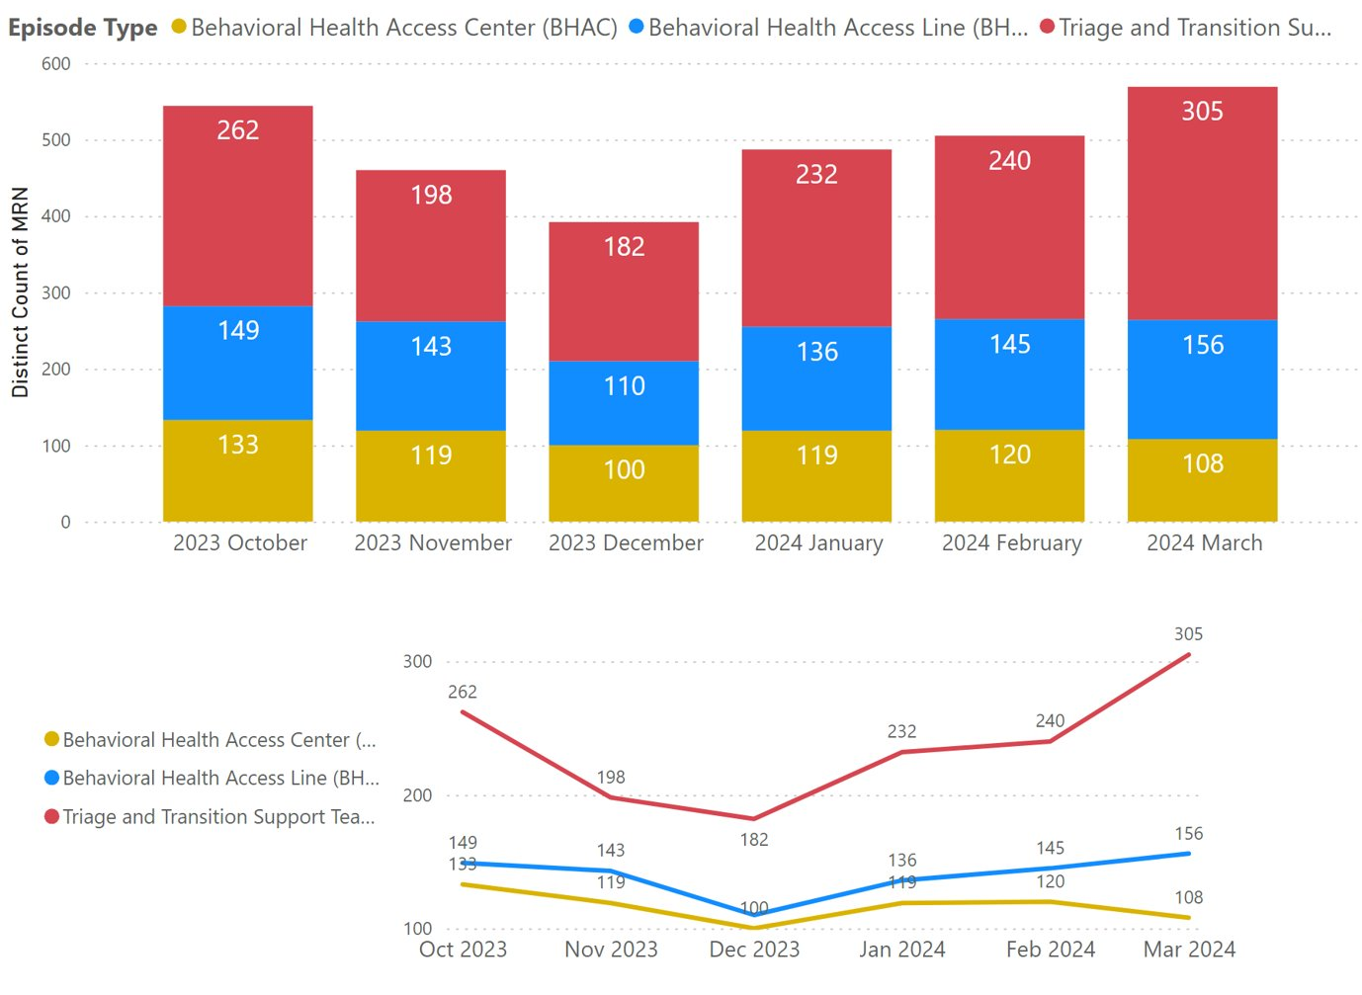
Office of Coordinated Care Monthly New Referrals

Slide 11
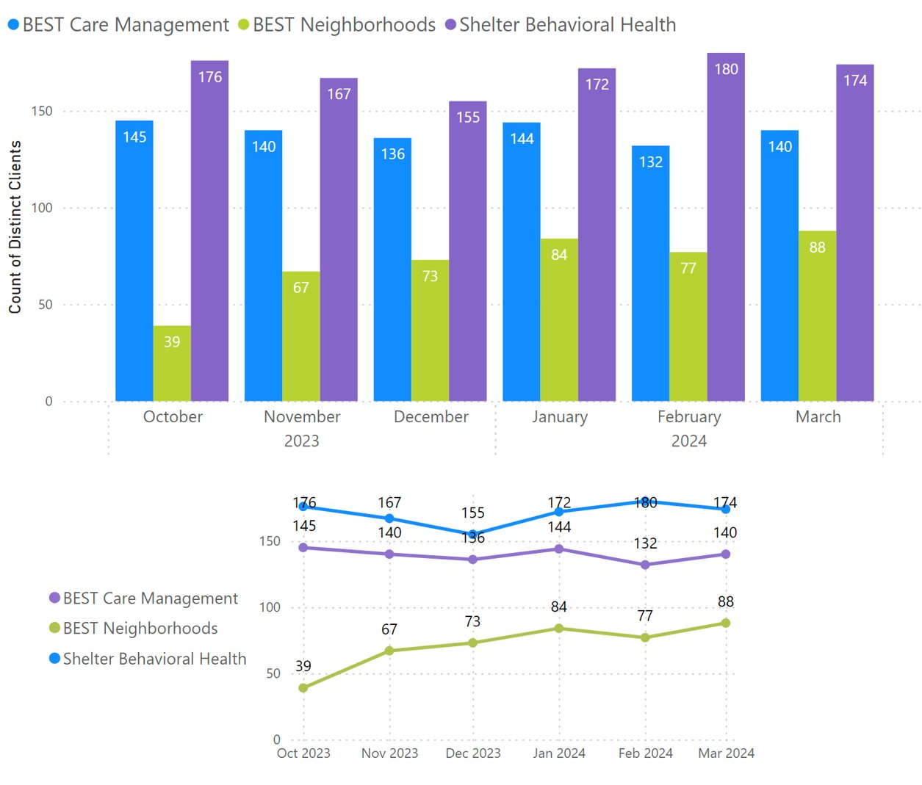
Office of Coordinated Care Clients Engaged Monthly by Follow-up Teams

Slide 12
Mental Health SF Successes & Challenges

Slide 13
Mental Health San Francisco Successes
Increased residential care and treatment by more than 350 beds.
Established Office of Coordinated Care (OCC) services to ensure successful transitions through care and treatment as well as keeping people with complex needs connected to care.
Launched BEST Neighborhoods behavioral health care team to regularly engage with high-priority unhoused people with serious behavioral health conditions.
In 2023, OCC implemented systematic follow-up for people with a recent Street Crisis Response Team (SCRT) encounter or an involuntary psychiatric hold (5150) at Zuckerberg San Francisco General Hospital (ZSFG).
Expanded assessment and treatment including hours of operation for the walk-in treatment center, pharmacy, OBIC, and Opioid Treatment Programs.
$1.8M added to existing intensive outpatient and stabilization providers to support filling critical vacancies, ensure competitive salaries, and increasing staffing.
More details on Mental Health SF implementation can be found in the 2024 report.
Notes:
Behavioral Health Access Center hours were extended to include weekends from 9 am to 4 pm. People can be assessed, referred, and linked to treatment options 8am-7pm on weekdays and 9am-4pm on weekends.
DPH made focused investments to strengthen case management within the behavioral health system of care. These investments are designed to ensure that clients continue to receive integrated case management services after being linked to mental health and/or substance use treatment.
DPH continued supplemental Prop C funding to increase capacity and support staff retention at four ICM and acute stabilization programs in 2023. Additionally, a new ICM program with 100 slots for older adults experiencing or at risk of experiencing homelessness began services in late 2023, with capacity to ramp up throughout 2024.

Slide 14
Key Challenges and Impacts to Service Delivery
Workforce recruitment and retention
Nationwide shortage of behavioral health clinicians
Acquiring new beds and facilities for care and treatment
In February 2024, SFDPH sought and received Board of Supervisors approval for an ordinance authorizing direct purchase of services from entities that would provide behavioral health and public health residential and treatment services, waiving any competitive solicitation or local business enterprise requirements for up to five years.
This waiver is intended to be used to reduce wait times, diversify its providers, increase flexibility to place clients, and relieve administrative burden, all while maintaining commitment to transparency, reporting, and monitoring requirements.
Notes:
Nationwide shortage of Behavioral Health Clinicians
Capacity for people to access both less and more intensive levels of care
Longer wait times

Slide 15
Thank you

