Slide 1

Our City, Our Home
Oversight Committee
FY 2024-25 & FY 2025-26
Annual Budget Recommendations Overview
CITY & COUNTY OF SAN FRANCISCO
City Performance
Office of the Controller
01.25.2024

Slide 2
2
Annual Budget Recommendations Overview
Review of OCOH Committee Priorities and Values
Context – Homelessness Gross Receipts (HGR) Tax Forecast
Timeline for FY25 and FY26 Budget Recommendations

Slide 3
1. Priorities and Values
3
Center Racial Equity
Setting aside resources for specific populations and/or neighborhoods. As examples, transgender, youth, Bayview neighborhood, justice involved.
Disaggregating reporting data by race, ethnicity, gender identity, sexual orientation and age.
Notes:
Combination of the OCOH Investment Plan (2021) and OCOH Committee Needs Assessment (2022) point to a purposeful focus of this Committee's work on addressing racial inequities, given that homelessness is rooted in racial and economic inequality.
From the outset, the Committee has ensured that the investment recommendations are embedded in equity and promote justice. Two prominent ways this priority shows up in the Our City Our Home Fund:
(1) Disaggregating data by race and ethnicity in order to inform all decision-making
(2) Using the insights from the disaggregate data to prioritize populations that are disproportionately impacted and/or face the greatest barriers to accessing housing and services through the existing homelessness response system. This is achieved by programs that focus investments in specific neighborhoods, as well as, those that tailors services according to population needs.

Slide 4
1. Priorities and Values
4
A wider array of programs to meet diverse needs
Permanent Housing
Flex pool subsidies including slots targeted to women, older adults, youth, and families
Family housing ladder
Long term subsidies for SRO families
Medium term subsidies with workforce dev.
Medium term subsidy extensions for families
Equity services in PSH
Mental Health
Outreach crisis and health services
Drop-in mental health services including targeted to TAY and Trans communities
Case Management & Care Coordination
A spectrum of treatment beds
Shelter and Hygiene
Crisis Interventions like Safe Sleep and Safe Parking/Vehicle Triage Center
A range of shelter program models: hotel vouchers, trailer program, non-congregate family shelter, navigation centers.
Prevention
Building a homelessness prevention system: eviction prevention, targeted homelessness prevention, problem solving
Notes:
OCOH Committee prioritizes a wider range of programs that meet people where they are, and not where they are expected to be. This means creating interventions aligned with various factors that contribute to homelessness that ultimately shapes up into a strong safety net.
This shows up in each service area of the fund – it can look like meeting the specific housing needs of Adults, Families, and TAY within the Housing service area, or ensuring system flow by pairing temporary interventions and services such as shelter, safe sleep sites, and behavioral health services with permanent housing solutions.

Slide 5
1. Priorities and Values
5
Prioritize permanent housing solutions to generate system flow
Permanent Housing
Acquiring & operating new site-based PSH
New development of family PSH
Flexible housing subsidy pool
Ongoing subsidies for SRO families
Family Housing Ladder
Medium-term housing subsidies and extensions
Mental Health
Expanded and new clinical support services for people in PSH
Prevention
Housing stabilization
Shallow subsidies and mental health services for legacy PSH tenants
Eviction prevention
Targeted homelessness prevention
Notes:
OCOH Committee prioritizes recommendations that align with the Housing First approach and program design that recognizes permanent housing as the solution to homelessness with low-barrier and individualized services. This is because when permanent housing is available, people leave homelessness creating outflow, and shelter beds and crisis intervention slots turn over and serve more households. And when permanent housing is not available, shelter and crisis intervention beds turn over slowly and serve fewer households, unsheltered homelessness increases, length of time people remain homeless increases, and demand for high-cost shelter beds increases.
Therefore, the work of the Committee has incorporated its previously mentioned priorities to limit the inflow of people into the homelessness system through programs that prevent homelessness or rapidly return people to housing, as well as, build out robust outflow through its permanent housing solutions and supports.

Slide 6
1. Priorities and Values
6
Increase investment by leveraging funding and coordinating efforts to bring resources to scale
Permanent Housing
Use of OCOH Funds as match in Homekey acquisitions
Use of OCOH Flex Pool funds to make Emergency Housing Vouchers accessible to people experiencing homelessness
Partnerships with Workforce Development
Mental Health
Whole Person Care and CalAIM for street health and overdose response
Shelter and Hygiene
Pandemic funding from federal & state sources complemented and extended OCOH funding for temporary shelter and crisis interventions.
Partnership with Adult Probation
Prevention
Pandemic funding from federal & state sources complemented and extended and OCOH funding for Homelessness Prevention
Notes:
The Committee has set out to prioritize OCOH funds for the most strategic uses with consideration of how to most effectively leverage and fill gaps of local, state, and federal funds, when needed.
This has ranged from using OCOH as matching funds in Homekey acquisitions from the State, to fortifying and extending federal funding for prevention resources. This work is ongoing and crucial to bring services to scale.

Slide 7
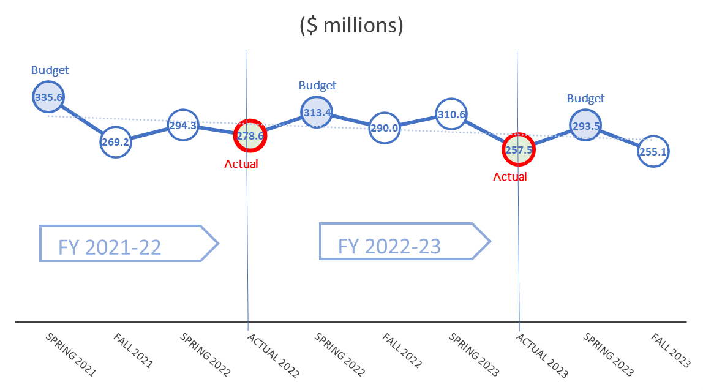
2. HGR Tax Forecast
7
OCOH revenue source is volatile
HGR Tax revenue came in significantly below budget in the last 2 years (by $57M in FY22 and $65M in FY23).
These variances are primarily due to (1) the taxpayer basis being highly concentrated so changes at a few large firms have an outsized effect on revenue (2) high levels of active business tax litigation that can affect prior year payments.
278.6
247.9

Slide 8
2. HGR Tax Forecast
8
FY24 through FY28 Preliminary Forecast
Based on the volume of recent tax refund claims, the forecast was lowered from CON’s previous assumptions.
Key assumptions:
  Slow or no growth of tax base in earlier years of forecast to reflect slowing of the economy, and back to inflation in future years.
  Current levels of remote work continue.
  Lower tax base to reflect ongoing litigation risk.

Slide 9
3. Timeline for FY25 & FY26 Budget Recommendations
9
Annual Budget Recommendations Process Timeline
February
Liaison Meeting #1: Programmatic Deep Dive
OCOH Committee Meeting: 6-month progress and implementation updates
March
Liaison Meeting #2: Fiscal Deep Dive
OCOH Committee Meeting:
  Updated revenue forecast
  Department presentations on OCOH Budget submission
  OCOH Committee budget priorities determination for DPH Health Commission and HSH Homelessness Oversight Commission
April
OCOH Committee Meeting: Budget recommendations for MYR, DPH Health Commission and HSH Homelessness Oversight Commission
Notes:
This calendar helps the committee understand the state of implementation of its previously recommended programs
This calendar aligns to the City's Budgeting process, including the role of the HOC
This process allows the committee to focus on priorities in this time of deficit

Slide 10
3. Timeline for FY25 & FY26 Budget Recommendations
10
Looking Ahead: February
Liaison Meeting #1: Programmatic Deep Dive
Committee meeting: CON will present 6-month update on Budget vs. Actuals
Committee meeting: HSH and DPH will present implementation progress updates
6-month spending + implementation progress updates will help inform potential underspend at year-end and implications to service areas

Slide 11
3. Timeline for FY25 & FY26 Budget Recommendations
11
Committee Discussion Prompts
Liaison meetings
  February Liaison Meeting Focus: Programmatic Deep Dive (including implementation progress)
  March Liaison Meeting Focus: Fiscal Deep Dive
  What would the Committee like to learn from those meetings?
Current Budget context
  OCOH: $95.9M two-year projected revenue shortfall over FY25 and FY26
  General Fund: $800M two-year projected deficit over FY25 and FY26
  What are the Committee's overarching priorities, given the City's current fiscal situation?

Slide 12
Reference Slides

Slide 13
1. Priorities and Values
13
1. Center Racial Equity
Center equity in recommendations and oversight responsibilities to be responsive to historic, structural, and systemic disparities (2 Year Investment Plan).
Structural racism and economic inequality are primary drivers of homelessness (Needs Assessment).
Seeking out, listening, and being guided by the experiences and voices of people with lived expertise of homelessness and housing instability (2 Year Investment Plan).
Notes:
The spending recommendations have used set-asides to prioritize equity. In addition to set asides, where are there additional opportunities to prioritize equity – or make the equity value even more visible – in the spending plan?

Slide 14
1. Priorities and Values
14
2. Prioritize a wider array of programs to meet diverse needs
Prioritize a wider range of housing and prevention options that meet people where they are, not where we expect them to be (2 Year Investment Plan).
Prioritize recommendations that align with the Housing First approach to system and program design that recognizes permanent housing as the solution to homelessness with low-barrier and individualized services (2 Year Investment Plan).
Need flexibility within program design and duration to accommodate individualized needs (2 Year Investment Plan).
People experiencing homelessness have diverse needs. An effective response to homelessness will be modeled on the population’s needs and may include approaches that aren’t currently part of the city-wide response (Needs Assessment).

Slide 15
1. Priorities and Values
15
3. Prioritize permanent housing solutions to generate system flow.
Develop recommendations that facilitate system flow by pairing temporary interventions and services with permanent housing solutions (2 Year Investment Plan).
Add investments with the twin goals of meeting diverse needs and increasing flow through the homeless response system will maximize capacity and effectiveness (Needs Assessment).
Prioritize permanent housing solutions (2 Year Investment Plan).

Slide 16
1. Priorities and Values
16
4. Increase investment, leverage funding, and coordinate effort to bring resources to scale.
Prioritize OCOH funds for the most strategic uses with consideration of how to most effectively leverage and fill gaps of other local, state, and federal funds (2 Year Investment Plan).
Resources are not available at the scale the homelessness crisis demands (Needs Assessment).
Effectively responding to all forms of homelessness will require significant new investment and coordinated effort (Needs Assessment).

