Slide 1
Biennial Food Security and Equity Report 2026 Community Meeting #1
Eric Chan, Priscilla Rodriguez, Jacklyn Wong, Kaela Plank
September 29, 2026

Slide 2
Land Acknowledgment
The San Francisco Health Commission/San Francisco Department of Public Health staff acknowledges that we are on the unceded ancestral homeland of the Ramaytush Ohlone who are the original inhabitants of the San Francisco Peninsula. As the Indigenous stewards of this land, and in accordance with their traditions, the Ramaytush Ohlone have never ceded, lost, nor forgotten their responsibilities as the caretakers of this place, as well as for all peoples who reside in their traditional territory. As guests, we recognize that we benefit from living and working on their traditional homeland. We wish to pay our respects by acknowledging the Ancestors, Elders, and Relatives of the Ramaytush Ohlone community and by affirming their sovereign rights as First Peoples.

Slide 3
Community Agreements
Take space, make space
Respect each other and assume good intent
Address ideas, not people

Slide 4
Biennial Food Security & Equity Report Project Team
Population Health/Community Health Equity & Promotion:
  Eric Chan, Health Program Planner
  Priscilla Rodriguez, Health Program Planner
Population Health/Center for Data Science:
  Jacklyn Wong, Epidemiologist II
  Kaela Plank, Health Program Planner
  Phil Lowenthal, Epidemiologist II

Slide 5
Why Are We Here Today
Present summary data on food security, nutrition-sensitive conditions, and poverty/self-sufficiency along with data from Reporting Departments.
Hear from you if:
  The data reflects your communities' experiences
  The programs are meeting your communities' needs
Collect and incorporate your insight and feedback into the report, examples being:
Direct quotes
Major themes and discussions to be highlighted in the community engagement section of the report
Meeting notes will be included in the appendices of the report
Other ways to look at the data; we as DPH will see if it's feasible to include additional analyses

Slide 6
Community Goals – Pair Share
What do you hope to learn today?
What do you want to make sure we leave with today?

Slide 7
Discussion Questions
    We want you to think about these questions throughout today:
    Does this data reflect your community and/or lived experiences?
    How well are these programs meeting your communities' needs?
    How well do these programs address health equity?
    What is missing from this data and story?

Slide 8
Health Equity & Food Insecurity
Health equity ensures that everyone has a fair and just opportunity to achieve their highest level of health, regardless of their background or circumstances.
When people do not have reliable access to affordable, nutritious, and culturally appropriate food, they are more likely to experience poor health, contributing to differences in rates of chronic disease, mental health challenges, and overall well-being.

Slide 9
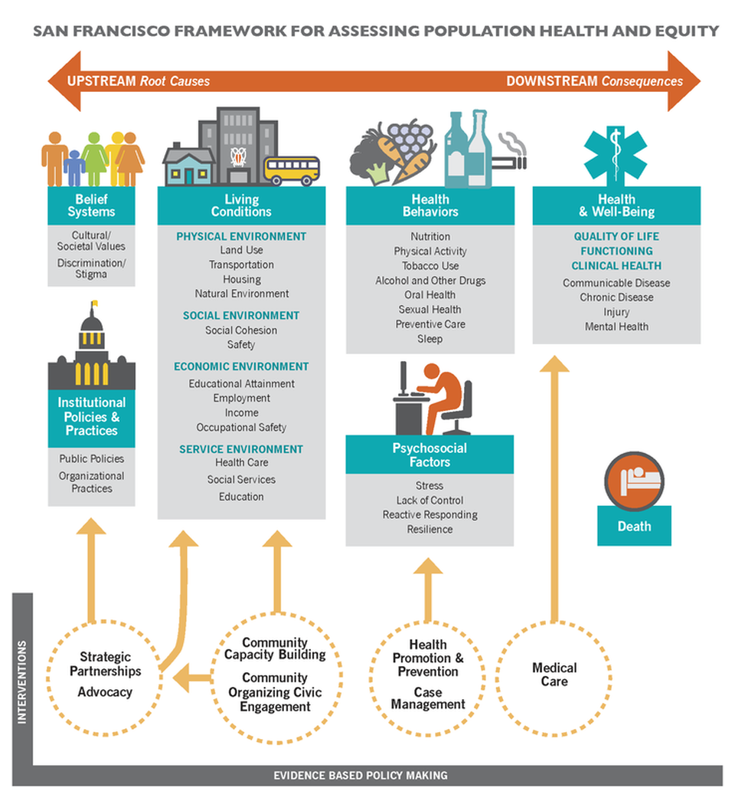
Health Equity Diagram

Slide 10
Overview and Updates

Slide 11
Purpose of the BFSER
Ordinance 103-21June 30, 2021 – PDF link to Ordinance.
The intent of this report is to identify:
  Populations in the City that are experiencing food insecurity;
  Populations receiving City food-related services;
  Whether those services address health, racial, geographic, age, or other inequities;
  What barriers to food security exist.

Slide 12
The Future of the BFSER
The Mayor's Office introduced legislation to create the Office of Food Security Coordination (OFSC), to be housed within the Human Services Agency (HSA).
  If the legislation passes, the OFSC will be responsible for producing the next version of the report, to be published every 5 years with an interim update report every third year.

Slide 13
Food Insecurity &
Nutrition-Sensitive Conditions
Notes:
Kaela
As Eric mentioned earlier, we know from the literature that Food insecurity is strongly associated with a variety of health outcomes. So for this report, we want to understand the landscape of health and food insecurity in San Francisco.

Slide 14
Priorities Based on the Preliminary Dataset
Priority populations | Priority indicators
Age Transitional Aged Youth (18-24 years old) Children (0-17 years old) Older Adults (65 years and older) | Poverty Mental Health Nutrition
Race/ethnicity American Indian Alaska Native (AIAN) Black/African American residents (B/AA) Latinx Native Hawaiian and Other Pacific Islander residents (NHOPI) Asian pregnant people | Diabetes Heart failure Hypertension Mental health Pregnancy outcomes Food insecurity
Zip code/neighborhood 94124 - Bayview Hunters Point 94102 - Downtown, Civic Center 94103 - South of Market 94130 - Treasure Island 94134 - Portola, Visitacion Valley | Diabetes Heart failure Hypertension Pregnancy outcomes Food insecurity

Slide 15
Food insecurity rates by zip code
Prevalence of food insecurity differs across zip codes
12%
SF Citywide
Zip code | Percent Food Insecure
94130 | 31%
94124 | 28%
94102 | 24%
94108 | 21%
94134 | 20%
Source: Centers for Disease Control and Prevention, PLACES: Local Data for Better Health, ZCTA Data, 2025 release.

Slide 16
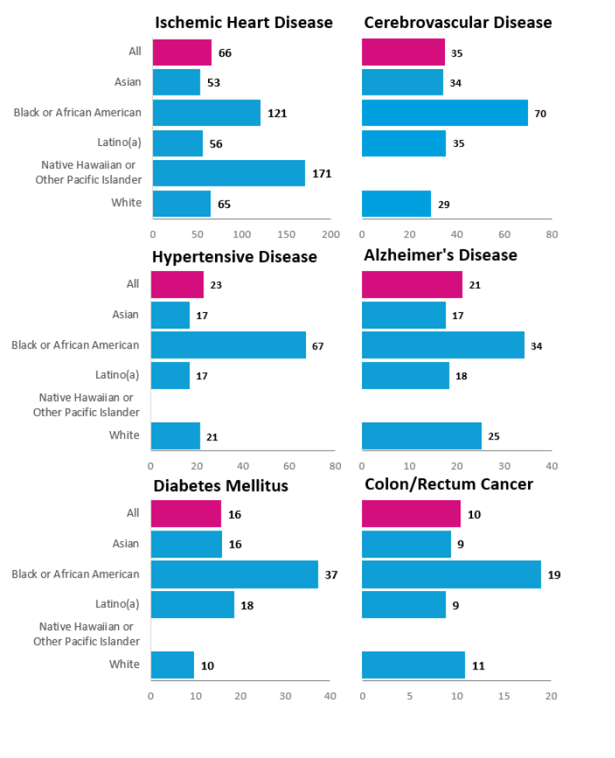
Mortality due to top six nutrition sensitive conditions (Ischemic heart disease, cerebrovascular disease, hypertensive disease, Alzheimer’s disease, diabetes mellitus, colon/rectum cancer) by race/ethnicity, San Francisco, 2020-2024
Mortality rates* were highest among Black/African American residents for each of these six nutrition-sensitive conditions
*Per 100,000 residents
Source: Vital Records Business Intelligence System, Master Death File, 2020-2024

Slide 17
Household Income, Poverty, and Self-sufficiency Data

Slide 18
Zip Codes With Lowest Annual Median Income in San Francisco
94104 (Financial District), 94102 (Civic Center/Tenderloin), and 94108 (Lower Nob Hill/Chinatown/Downtown) have the lowest annual median income in San Francisco by zip code.

Slide 19
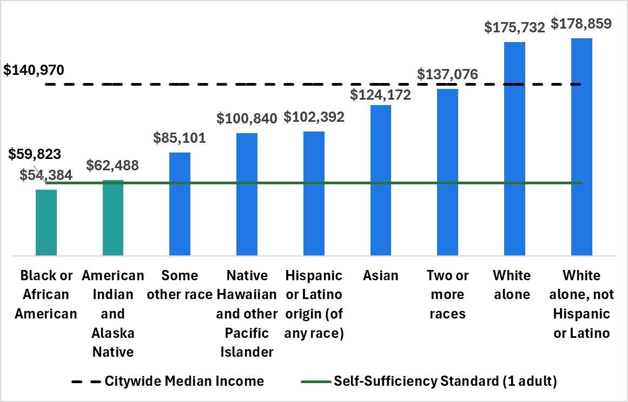
Annual Median Income & The Self-Sufficiency Standard in San Francisco
The self-sufficiency standard (SSS) is an alternative budget-based, annual measure to the federal poverty level that is geographic-specific.

Slide 20
What Story is This Data Telling?
    There are zip codes experiencing food insecurity rates 1.7x to 2.6x higher than the citywide average, all with large BIPOC populations.
    BIPOC are disproportionately impacted by nutrition-sensitive conditions.
    The cost of living and income disparity in San Francisco is high; people are struggling to obtain food.

Slide 21
Discussion – Break Out Groups
    What are your reactions and questions?
    Does this data reflect your community and/or lived experiences?
    What is missing from this data and story?

Slide 22
Break – 10 min.

Slide 23
Data Collection Process and Timeline

Slide 24
Report Process & Timeline
DPH compiles Reporting Department data and other analyses for the report – summer 2026
Data Collection Tool sent out on February 18th
Community/Public
engagement meeting #2 – October 27, 2026
Report is published late 2026/early 2027
Reporting Departments have 120 days to submit data to DPH - June 18th
Community/Public engagement meeting #1 –September 29, 2026
DPH develops written report on data, findings and recommendations from public meetings -
fall 2026

Slide 25
Data From Reporting Departments/Agencies
CITY AGENCY | Received
Office of Contract Administration | N/A
Office of the Controller | N/A
Treasurer & Tax Collector | N/A
Planning Department | N/A
Office of Racial Equity | N/A
Office of Economic Workforce & Development
San Francisco Municipal Transportation Agency
Department of Children, Youth, and Their Families
Department of the Environment
CITY AGENCY | Received
Human Rights Commission
Homelessness and Supportive Housing
San Francisco Unified School District
Human Services Agency
Department of Early Childhood
Recreation & Park
Real Estate Division
Department of Public Health
San Francisco Housing Authority

Slide 26
Data Collected from Departments
Total number of direct food programs operated
Types of infrastructure projects funded
Total funding for infrastructure projects
Results from evaluations conducted with SF residents experiencing food insecurity
Recommendations for improving food insecurity

Slide 27
Data Collected from Direct Food Programs
Population served by program
Total number of individuals/households eligible and served
Race/ethnicity of individuals served
Frequency of program services
Food insecurity screening data
  tool used to screen
  percent food insecure
Funding breakdown (Federal, State, Local)
Total units of service
Total number of city-funded grantees/subcontractors
Service deliver zip codes

Slide 28
City-funded Grantee Data Collection
Total number served
Race/ethnicity of participants served
Total amount of city funds received
Zip codes where services were delivered

Slide 29
Reporting Department Data

Slide 30
Response Type
Data provided | Total number of departments
Direct Food program only | 5
Infrastructure only | 2
Direct food and Infrastructure | 6
No food-related programming or funding | 5
Total | 18

Slide 31
Top Infrastructure Projects Funded
Project Type | Number of Reporting Departments (%)
Distribution infrastructure | 4 (50%)
Education, technical assistance, and workforce training | 4 (50%)
Transportation infrastructure | 4 (50%)
Food production infrastructure | 3 (38%)
Note: Denominator includes only those departments that funded infrastructure (n=8)

Slide 32
Infrastructure funding
~ $8 million
invested in infrastructure projects across San Francisco
Data Source: Department of Public Health. 2026 Biennial Food Security and Equity Report Food Program Framework

Slide 33
Department Evaluations
2 departments conducted evaluations with SF residents who have experienced food insecurity and/or participated in city-funded programs
  Homelessness and Supportive Housing (HSH)
  Human Services Agency (HSA)

Slide 34
Grantee Data

Slide 35
16 Programs provided Grantee Data
Department | Number of programs reporting grantee data | Number of grantees
Human Services Agency | 12 | 38
Department of Public Health | 2 | 9
Department of Early Childhood | 1 | 9
SF Housing Authority | 1 | 1

Slide 36
Funding Data for Direct Food Programs

Slide 37
Direct food program funding
$231 million
invested in 35 direct food service programs across San Francisco

Slide 38
Funding by department
Human Services Agency had the most funding and the largest number of direct food programs
(n = 13)

Slide 39
Top 5 Programs by Funding Amount
Department | Program | Funding
Human Services Agency | CalFresh | $107,504,434
San Francisco Unified School District, Student Nutrition Services | National School Lunch Program | $33,197,782
Human Services Agency | Home Delivered Meals - DAS | $15,682,833
Human Services Agency | Congregate Meals - DAS | $13,612,711
Human Services Agency | Shelter and Navigation Center Meals | $12,748,263

Slide 40
What story is this data telling us summary 2
What Story is This Data Telling Us?
    There are many Departments/Agencies funding and implementing food programs.
    The City funds and partners with many CBOs to implement food programming.
    Though many Departments conduct evaluations, very few ask about participants' experiences with city-funded programs.
    HSA has the largest budget dedicated to funding direct food programs. Rec & Parks the largest for infrastructure.

Slide 41
Discussion – Breakout Groups
What are your reactions and questions about the data presented?
What do you think is missing from this data?

Slide 42
Second break in presentation
Break – 10 min.

Slide 43
Program Data

Slide 44
Total number of individuals and households served
Direct food service programs served 428,036 individuals and 141,157 households

Slide 45
Types of food service programs overview
Types of Food Service Programs (n = 35)
Primary unit of service | No. programs | Depts | Total units delivered | Total individuals served | Total households served | FY24-25 budget | Delivery frequency
Grocery bags | 14 | DEC, DPH, HSH, SFHA, OEWD, HSA | 1,961,424 | 135,219 | 24,343 | $23.0 M | ~ 1 time per week
Meals | 11 | HSH, HRC, Rec & Parks, DCYF, HSA, SFUSD | 12,893,160 | 80,489 | 3,025 | $85.0 M | ~ daily
Produce (lbs) | 2 | Rec & Parks, HSA | 75,609 | 4,692 | 1,220 | $0.5 M | varies
Voucher or EBT | 8 | DPH, Real Estate, HSA | 695,285 | 207,636 | 112,569 | $122.1 M | ~ 1 time per month

Slide 46
Types of food service programs food delivery
Types of Food Service Programs (n = 35)
Primary unit of service | No. programs | Depts | Total units delivered | Total individuals served | Total households served | FY24-25 budget | Delivery frequency
Grocery bags | 14 | DEC, DPH, HSH, SFHA, OEWD, HSA | 1,961,424 | 135,219 | 24,343 | $23.0 M | ~ 1 time per week
Meals | 11 | HSH, HRC, Rec & Parks, DCYF, HSA, SFUSD | 12,893,160 | 80,489 | 3,025 | $85.0 M | ~ daily
Produce (lbs) | 2 | Rec & Parks, HSA | 75,609 | 4,692 | 1,220 | $0.5 M | varies
Voucher or EBT | 8 | DPH, Real Estate, HSA | 695,285 | 207,636 | 112,569 | $122.1 M | ~ 1 time per month

Slide 47
Types of food service programs financial resources
Types of Food Service Programs (n = 35)
Primary unit of service | No. programs | Depts | Total units delivered | Total individuals served | Total households served | FY24-25 budget | Delivery frequency
Grocery bags | 14 | DEC, DPH, HSH, SFHA, OEWD, HSA | 1,961,424 | 135,219 | 24,343 | $23.0 M | ~ 1 time per week
Meals | 11 | HSH, HRC, Rec & Parks, DCYF, HSA, SFUSD | 12,893,160 | 80,489 | 3,025 | $85.0 M | ~ daily
Produce (lbs) | 2 | Rec & Parks, HSA | 75,609 | 4,692 | 1,220 | $0.5 M | varies
Voucher or EBT | 8 | DPH, Real Estate, HSA | 695,285 | 207,636 | 112,569 | $122.1 M | ~ 1 time per month

Slide 48
Types of food service programs total units delivered
Types of Food Service Programs (n = 35)
Primary unit of service | No. programs | Depts | Total units delivered | Total individuals served | Total households served | FY24-25 budget | Delivery frequency
Grocery bags | 14 | DEC, DPH, HSH, SFHA, OEWD, HSA | 1,961,424 | 135,219 | 24,343 | $23.0 M | ~ 1 time per week
Meals | 11 | HSH, HRC, Rec & Parks, DCYF, HSA, SFUSD | 12,893,160 | 80,489 | 3,025 | $85.0 M | ~ daily
Produce (lbs) | 2 | Rec & Parks, HSA | 75,609 | 4,692 | 1,220 | $0.5 M | varies
Voucher or EBT | 8 | DPH, Real Estate, HSA | 695,285 | 207,636 | 112,569 | $122.1 M | ~ 1 time per month

Slide 49
Types of food service programs budget
Types of Food Service Programs (n = 35)
Primary unit of service | No. programs | Depts | Total units delivered | Total individuals served | Total households served | FY24-25 budget | Delivery frequency
Grocery bags | 14 | DEC, DPH, HSH, SFHA, OEWD, HSA | 1,961,424 | 135,219 | 24,343 | $23.0 M | ~ 1 time per week
Meals | 11 | HSH, HRC, Rec & Parks, DCYF, HSA, SFUSD | 12,893,160 | 80,489 | 3,025 | $85.0 M | ~ daily
Produce (lbs) | 2 | Rec & Parks, HSA | 75,609 | 4,692 | 1,220 | $0.5 M | varies
Voucher or EBT | 8 | DPH, Real Estate, HSA | 695,285 | 207,636 | 112,569 | $122.1 M | ~ 1 time per month

Slide 50
Types of food service programs delivery frequency
Types of Food Service Programs (n = 35)
Primary unit of service | No. programs | Depts | Total units delivered | Total individuals served | Total households served | FY24-25 budget | Delivery frequency
Grocery bags | 14 | DEC, DPH, HSH, SFHA, OEWD, HSA | 1,961,424 | 135,219 | 24,343 | $23.0 M | ~ 1 time per week
Meals | 11 | HSH, HRC, Rec & Parks, DCYF, HSA, SFUSD | 12,893,160 | 80,489 | 3,025 | $85.0 M | ~ daily
Produce (lbs) | 2 | Rec & Parks, HSA | 75,609 | 4,692 | 1,220 | $0.5 M | varies
Voucher or EBT | 8 | DPH, Real Estate, HSA | 695,285 | 207,636 | 112,569 | $122.1 M | ~ 1 time per month

Slide 51
Top 6 Populations Served by Food Programs

Slide 52
How well are direct food service programs serving those in need?

Slide 53
Number of programs serving priority race/ethnicity groups (N = 35)

Slide 54
Number of programs serving priority age groups
(N = 35)

Slide 55
Nutrition sensitive conditions
Nutrition-sensitive conditions:
$28.3 million
invested in 11 programs

Slide 56
Programs Addressing Nutrition-Sensitive Conditions
Dept | Program | Total funding | Condition(s)
DPH | Black Infant Health (BIH) Grocery vouchers | $506,250 | At risk pre-term birth
DPH | Bulk Food Distribution to Housing Sites for People with HIV | $129,083 | HIV
DPH | EatSF/SFHC | $411,840 | Diabetes
DPH | Food Pharmacies | $208,830 | Diabetes and hypertension
DPH | Groceries and Prepared meals for People Living with HIV | $2,469,282 | HIV
DPH | Healthy Food Purchasing Supplement | $683,545 | Pregnancy/postpartum
DPH | Sugary Drinks Distributor Tax Community Based Grants | $633,700 | Pregnancy/postpartum
DPH | WIC | $9,725,397 | Pregnancy/postpartum
HSH | Food Pantry in Permanent Supportive Housing | $263,699 | Diabetes and heart disease
HSH | Shelter and Navigation Center Meals | $12,748,263 | Diabetes and heart disease
HSA | Nutrition as Health - DAS | $474,746 | Heart disease, congestive heart failure, chronic obstructive pulmonary disease, diabetes
 | TOTAL | $28,254,635

Slide 57
Discussion – Large Group
What are your reactions and questions?
How well are these programs meeting your communities' needs?

Slide 58
Food programs – zip codes served
Where direct food programs operated in
FY 2024-2025

Slide 59
Food program locations and zip codes with highest rates of food insecurity
Priority zip codes based on health and
food insecurity
Top 5 zip codes for
Nutrition-sensitive conditions:
94102, 94103, 94124, 94130, 94134
Food insecurity:
94102, 94108, 94124, 94130, 94134

Slide 60
Food Insecurity Among Program Participants
14 programs (40%) screened for food insecurity
  All funded by DPH or HSA
  Used validated screening tools based on self-report

Slide 61
Percent food insecure by program
Among 7 programs reporting results, participant food insecurity ranged from 48-100%

Slide 62
What story is this data telling us summary 3
What Story is This Data Telling?
    Most programs focus on providing direct food access (grocery bags and meals).
    Only 12% of the city's food budget goes towards programs specifically addressing nutrition-sensitive conditions.
    There are some priority zip codes that are not well served based on health and food insecurity data.

Slide 63
Discussion – breakout groups 2
Discussion – Breakout Groups
What are your reactions and questions?
How well are these programs meeting your communities' needs?
What is missing from this data and story?

Slide 64
Summary & Next Steps
What were the major insights, feedback, and concerns from today?
Are you leaving today meeting the your goals that were discussed at the beginning of the meeting?
Your insight and feedback will be incorporated into the report via:
Direct quotes
Major themes and discussions to be highlighted in the community engagement section of the report
Meeting notes will be included in the appendices of the report
Other ways to look at the data; we as DPH will see if it's feasible to include additional analyses

Slide 65
Next Meeting:
Tuesday, October 27
1pm – 4 pm
Main Library – Hispanic/Latino Meeting Room
Please RSVP via Eventbrite
We will focus on hearing your recommendations on how to improve food security through programming, funding, and local policy.

Slide 66
thank you!
Please contact eric.g.chan@sfdph.org for any questions

