Slide 1
MENTAL HEALTH SF
Analytics & evaluation
IWG 8/23/2022

Slide 2
Presentation overview
Description of the Mental Health SF Population
Mental Health SF Core Metrics
Estimated timeline of publication of data for the Core Metrics
Sneak peak of draft data visualizations for wait time data:
  Intensive Case Management and Mental Health Residential Treatment
Next steps and challenges
Feedback, Q&A

Slide 3
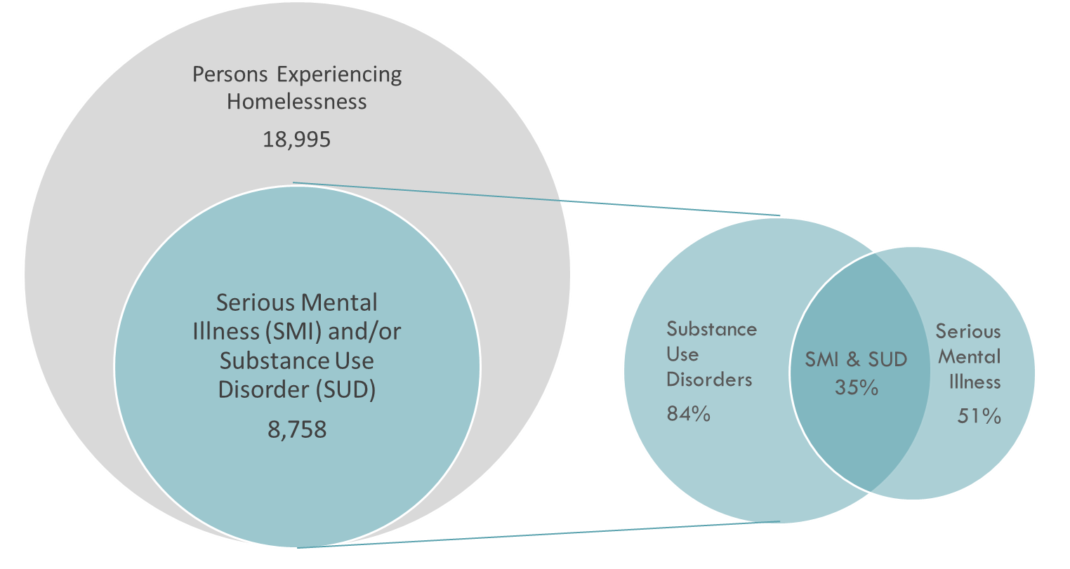
Mental Health SF POPULATION
Per the Mental Health SF Legislation:
The primary focus of Mental Health SF is to help people with serious mental illness and/or
substance use disorders who are experiencing homelessness get off of the street and into treatment.
Mental Health SF Population as of 8-3-2022
Data sources: DPH Electronic Health Record Systems (Epic, Avatar); Homelessness and Supportive Housing (ONE)
Notes:
46% of PEH had a SMI or SUD

Slide 4
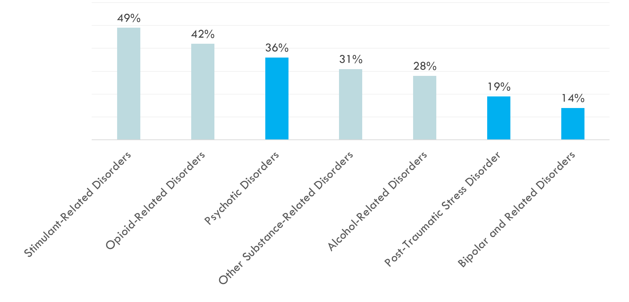
Mental health SF population:
Mental health and substance use diagnoses
Mental Health SF Population as of 8-3-2022
Data sources: DPH Electronic Health Record Systems (Epic, Avatar)
Notes:
Other SU-related disorders includes LSD, ecstasy, hallucinogens, inhalants, sedatives, and other substances
Only 1% had a Depressive Disorder with a psych inpatient episode in the prior year
<1% had a Cannabis Use Disorder with psychotic sxs

Slide 5
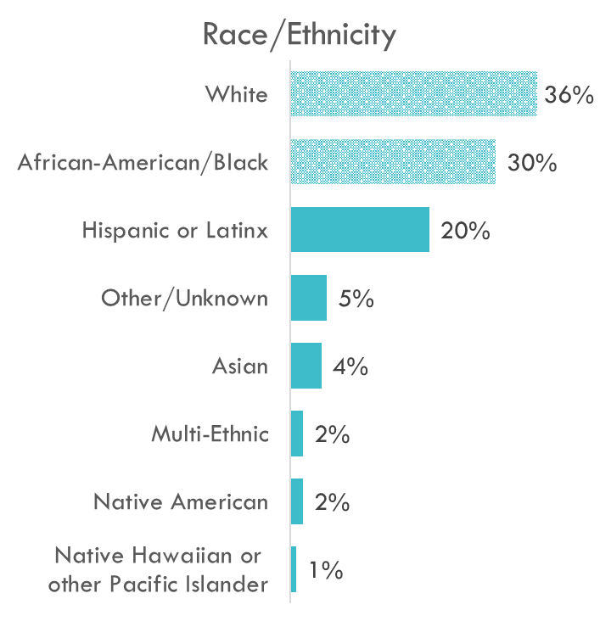
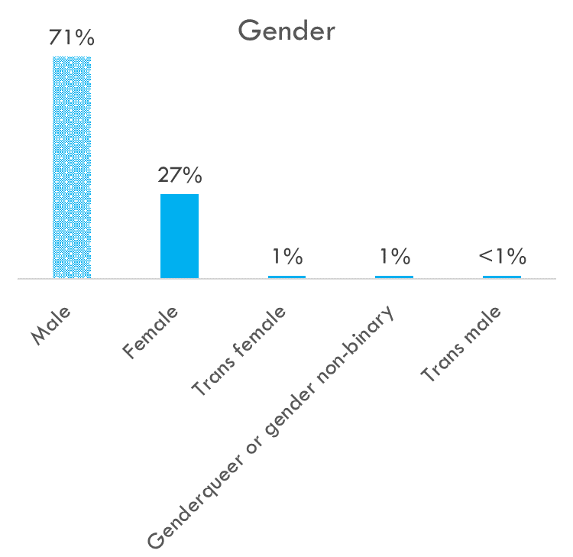
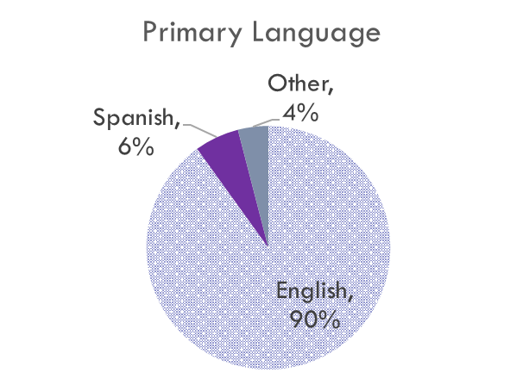
Demographic profile of the Mental Health SF POPULATION
(N= 8,758)
Mean Age = 44
Mental Health SF Population as of 8-3-2022
Data sources: DPH Electronic Health Record Systems (Epic, Avatar)
Notes:
Language: Cantonese, Vietnamese, Russian, Mandarin all <1%
Sexual orientation not shown due to the high % of missing data
Median age = 43

Slide 6
Mental Health sf core metrics

Slide 7
Mental Health SF CORE METRICS
All metrics will be stratified by race/ ethnicity, language, and sexual orientation/ gender identity to identify disparities among groups.
Category | Proposed Metric | Proposed additions
HOUSING | 1 | Increase the percentage of the Mental Health SF population assessed for housing.
 | 2 | Increase the percentage of the Mental Health SF population who are placed in supportive housing
ROUTINE CARE | 3 | Increase the percentage of the Mental Health SF population receiving routine health care.
 | 4 | Increase the percentage of the Mental Health SF population receiving routine health care post 5150 discharge.
WAIT TIMES | 5 | Decrease wait times for intensive case management services.
 | 6 | Decrease wait times for residential treatment beds.
OVERDOSE RESPONSE | 7 | Increase the amount of naloxone distributed in the community.
 | 8 | Increase the percentage of persons with opioid use disorders started on buprenorphine or methadone treatment.
 | 9 | Decrease the number of deaths due to overdose.
 | 10 | Decrease the disparity rates in deaths due to overdose.
QUALITY OF LIFE | 11 | Improve quality of life and functioning for persons in the Mental Health SF population
Notes:
These are the not an exhaustive list of all metrics that will be tracked for MHSF; rather, these are the core list that are prioritized for development now and that will be tracked over time for MHSF overall.
There are many other metrics, which are primarily operational and represent the programmatic work happening within MHSF domains and specific programs. These additional metrics are still being formed and refined; in the future, those operational metrics could be linked and nested under these core metrics.

Slide 8
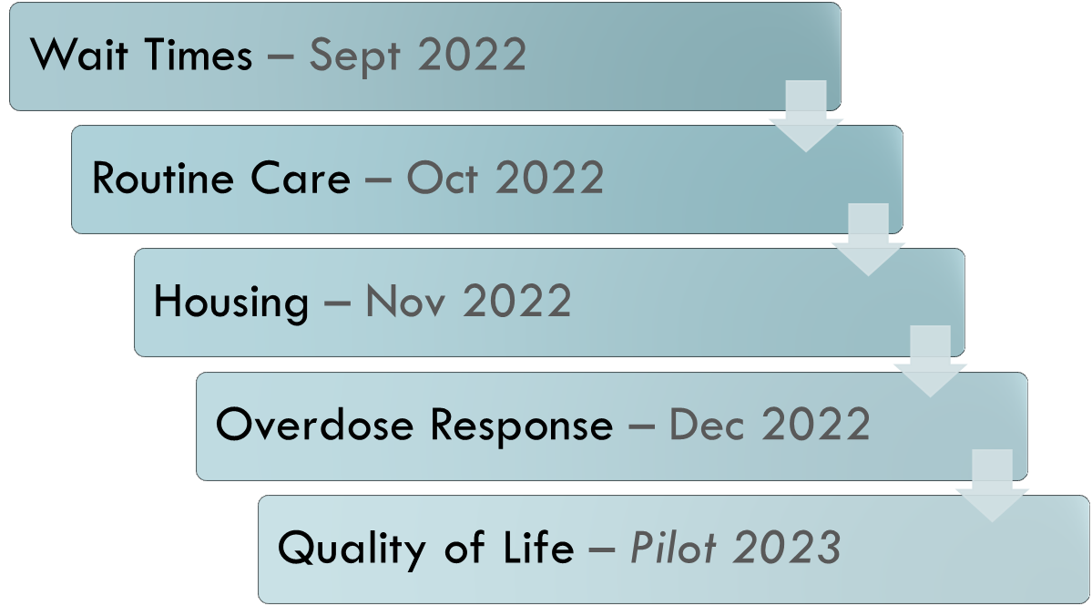
Estimated dates first METRICS will be published

Slide 9
Sneak peak of
Draft data visualizations: intensive case management wait times

Slide 10
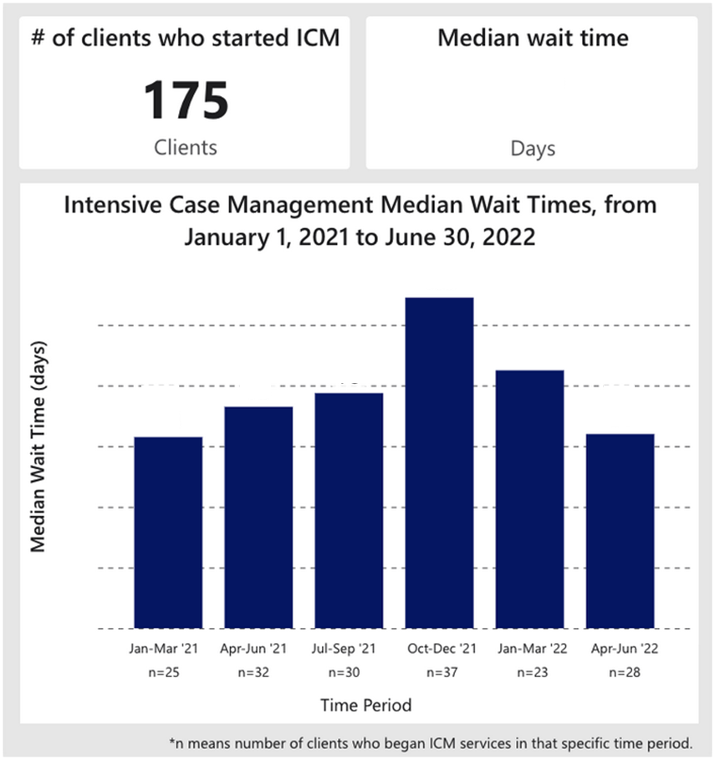
draft Data Visualizations: intensive case management
How do we calculate wait times?
ICM wait time begins the day a client’s referral is received by DPH Behavioral Health Services and ends the day a client’s ICM treatment episode starts.
Data sources: DPH Electronic Health Record System (Avatar)
Data has not been finalized and may change

Slide 11
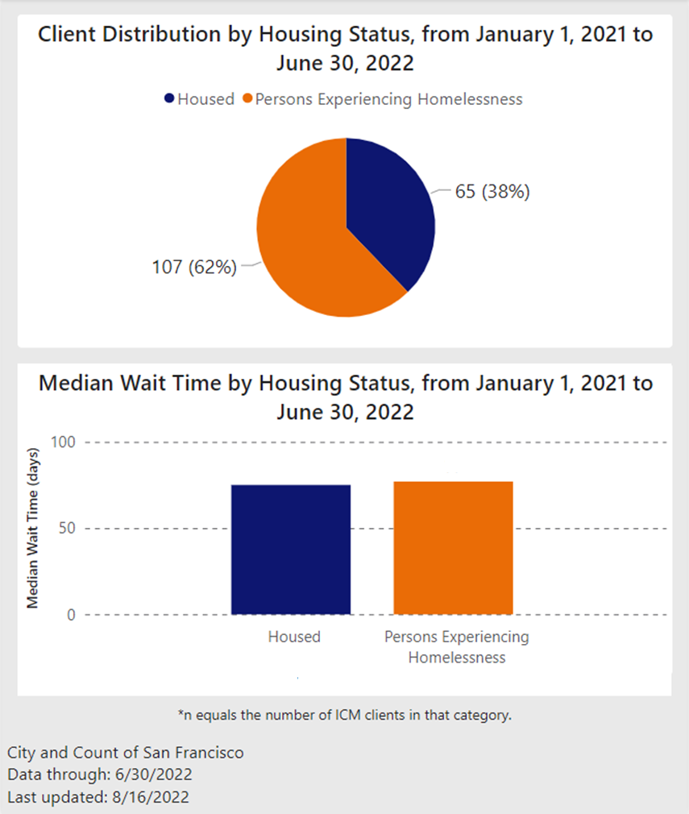
Draft Data Visualizations:
Intensive Case management cont.
Comparison by
Housing Status
Data sources: DPH Electronic Health Record Systems (Epic, Avatar); Homelessness and Supportive Housing (ONE)
Data has not been finalized and may change

Slide 12
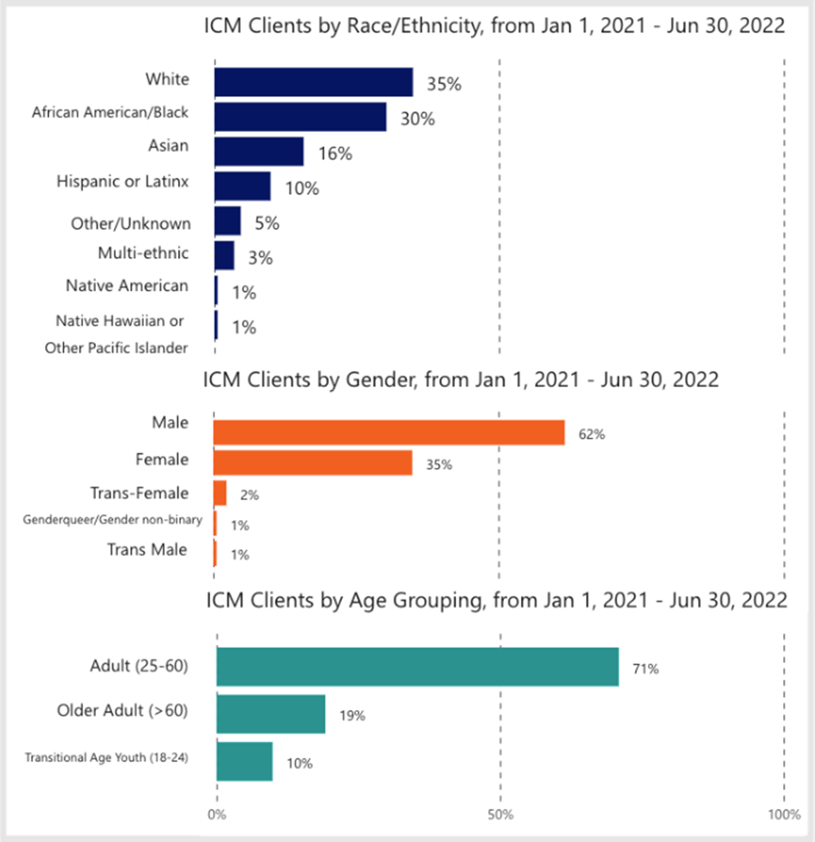
draft Data Visualizations:
Intensive case management cont.
Demographic
Information
Data source: DPH Electronic Health Record Systems (Avatar)
Data has not been finalized and may change

Slide 13
Sneak peak of Draft data visualizations:
Mental health residential treatment wait times

Slide 14
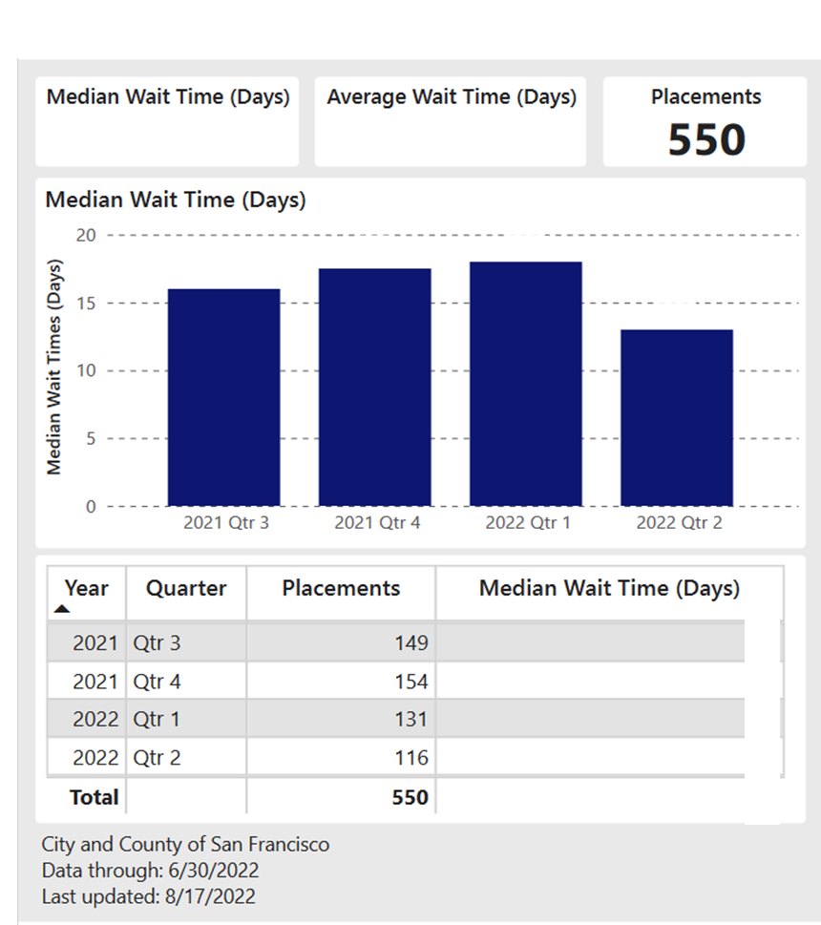
draft Data Visualizations: mental health residential treatment
How do we calculate wait times?
Wait time for mental health residential treatment beds begin the day a client’s referral is received by DPH Behavioral Health Services and ends the day a client’s mental health residential treatment episode starts.
Data sources: DPH Electronic Health Record Systems (Epic, Avatar)
Data has not been finalized and may change

Slide 15
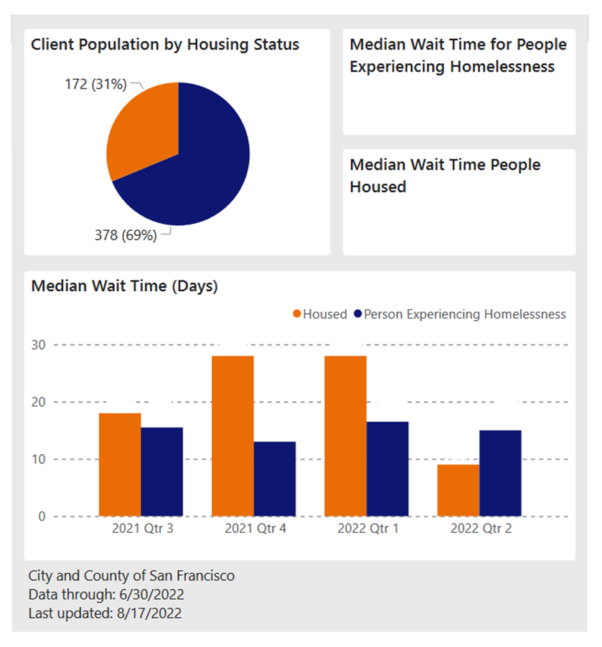
draft Data Visualizations: mental health residential treatment cont.
Comparison by
Housing Status
Data sources: DPH Electronic Health Record Systems (Epic, Avatar); Homelessness and Supportive Housing (ONE)
Data has not been finalized and may change

Slide 16
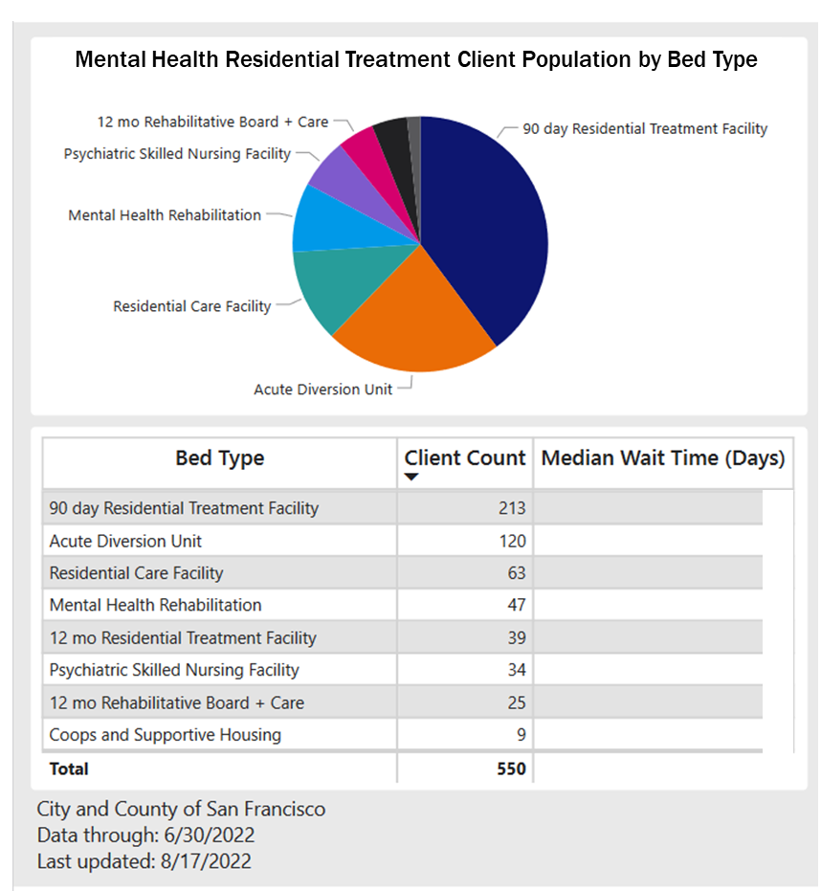
draft Data Visualizations: mental health residential treatment cont.
Wait times by
Bed Type
Data sources: DPH Electronic Health Record Systems (Epic, Avatar)
Data has not been finalized and may change

Slide 17
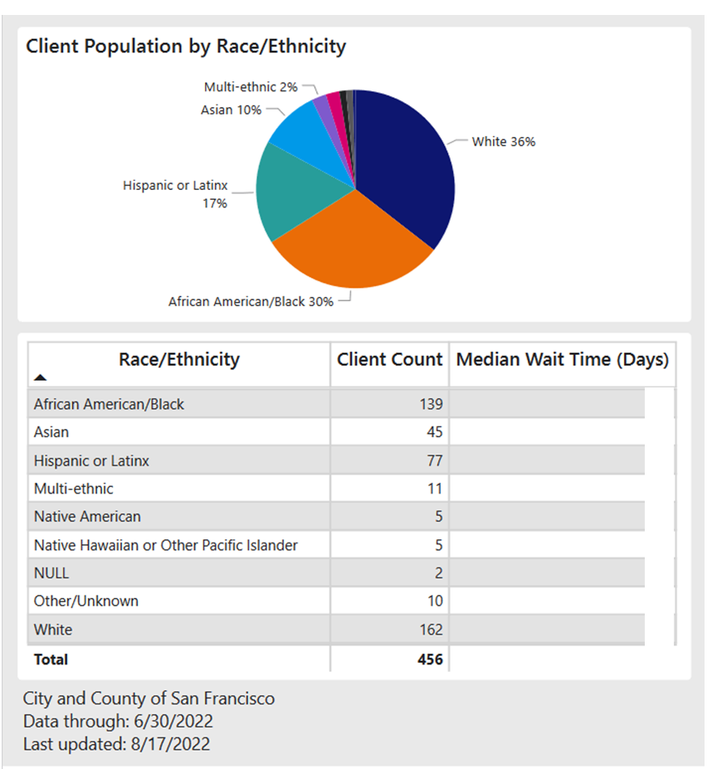
draft Data Visualizations: mental health residential treatment cont.
Wait time by Race/Ethnicity
Data sources: DPH Electronic Health Record Systems (Epic, Avatar)
Data has not been finalized and may change

Slide 18
Next steps
& Challenges
  NEXT STEPS
  Complete draft of webpages for intensive case management wait times and mental health residential wait times
  Publish webpages and update quarterly
  Analyze data by demographic factors to identify inequities
  Continue working on the rest of the core metrics
  Work on data to support operations
  Convene stakeholders to begin discussions of measuring “quality of life”
  CHALLENGES
  Implementing new protocols for reporting data across multiple electronic health records
  Incomplete, inconsistent data

Slide 19
Feedback? Questions?
    Any feedback on today’s content?
    What further information would you like to see in our next presentation(s)?
              Ideas from A&E:
                Share findings from equity analyses
                Discuss how to define and measure “quality of life”
? ? ? ? ? ? ? ?

Slide 20
appendix

Slide 21
Mental health SF POPULATION DEFINITIONS
Persons Experiencing Homelessness (PEH)
Individual or family who lacks a fixed, regular, and adequate nighttime residence
Serious Mental Illness (SMI)
Persons 18 years of age and older with a Psychotic Disorder, Bipolar Disorder, Post-Traumatic Stress Disorder, or at least one inpatient visit for a Depressive Disorder
Substance Use Disorder (SUD)
All Substance Use Disorders included except Cannabis*, Nicotine, Caffeine-related Disorders , and Substance Use Disorders in remission (no use in >12 months)
Time frames: PEH in the last year, SMI and/or SUD in the last 2 years
*Cannabis-related disorders with psychotic symptoms are included
Notes:
Any indication of PEH within the last year based on data from HSH, Epic, or Avatar
SMI or SUD diagnosis within the past 2 years in DPH (Epic or Avatar)

Slide 22
DEVELOPING & choosing “CORE” METRICS
A select group of metrics to begin working on 1st
Prioritized thus far based on areas identified by the Mental Health Reform Work, the Mental Health SF Legislation, and stakeholders and SMEs from the Mental Health SF domains, Behavioral Health Services (BHS), Ambulatory Care, and DPH leadership
Metrics that will enable broad tracking of the impact of Mental Health SF programs and services for the MHSF population
Metrics that are measurable, meaningful, and actionable
Feasible based on data that is available or can be collected
Manageable number of metrics

Slide 23

Using data to identify inequities
Data collection and maintenance
Standardized reporting
Consistent & routine reporting of metrics by key demographic factors
Determine appropriate comparison groups and benchmarks
Ensure data reports and visualizations clearly highlight disparities
Share findings with stakeholders

