Slide 1
Small Business Commission Strategic Planning + Retreat
June 13, 2022
Agenda Item 4: The Commission will review the goals and ground rules of the strategic planning retreat where commissioners will participate in teamwork exercises, learn about current OSB and OEWD programs, the budget, and action planning to assist the Commission to set goals for FY 22-23.

Slide 2
Goals
Get to know fellow Commissioners, OSB staff, OEWD staff
Better understanding of what OSB does, how OSB works with OEWD, and the Commission's role in this work
Understand Strengths/Weaknesses/Opportunities/Threats to SF Small Businesses
Find alignment on a vision for SBC for the coming year
Identify 2-3 policy areas to proactively pursue (legislative opportunities)
Identify 2-3 programmatic goals to focus on (administrative initiatives)

Slide 3
Introductions/ Ice Breaker
Staff Introductions
Ice breaker:
  What's something surprising you learned about your fellow commissioners?
  What common themes are there among us?

Slide 4
Review of Current Programs
Agenda Item 5:
The Commission will learn about the history and current programs within the Office of Small Business and Office of Economic and Workforce Development, including a review of City Charter language, the Office of Small Business mission, business support services, the Legacy Business Program, and current staffing.

Slide 5
Office of Small Business History
2003
San Francisco voters approved Proposition D, which created a chartered Small Business Commission that oversees the Office of Small Business.
2007
Voters passed Proposition I, which required OSB to operate a Small Business Assistance Center to focus on the needs of San Francisco businesses with fewer than 100 employees.
2015
Board of Supervisors created the Legacy Business Registry in March 2015.
Voters approved Proposition J, which created the Legacy Business Historic Preservation Fund in November, 2015.
2020
Voters approved Prop H/Save Our Small Businesses Initiative

Slide 6
Mission & Mandate
To equitably support, preserve and protect small businesses in San Francisco. We provide high quality direct services and programs, drive practical policy solutions, and serve as a champion for San Francisco’s diverse small business community.
The Office of Small Business is the City's central point of information for small businesses located in the City and County of San Francisco.

Slide 7
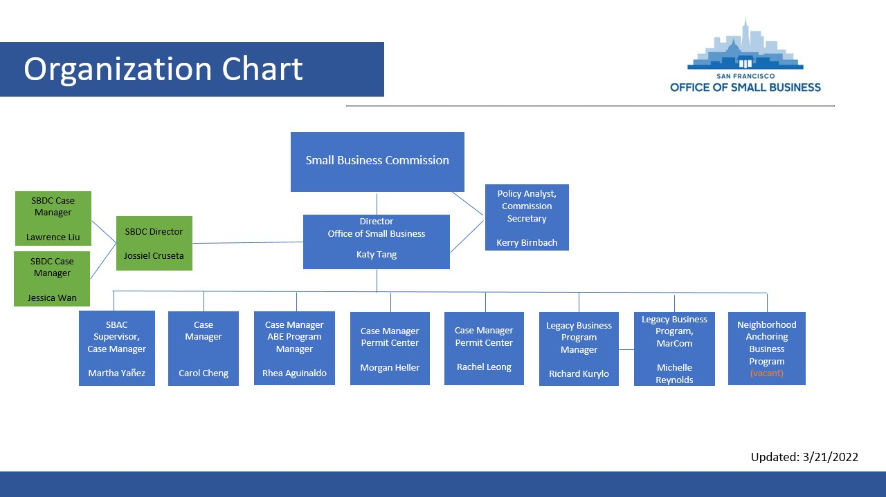

Slide 8
What we do
One on one business counseling in Chinese, Spanish, or English to help with:
  Business Entity classification
  Checklists for starting a business​
  Filing LLC/Corp paperwork and obtaining EIN​
  Business Registration, Registration Renewal, License Fee Payments
  Fictitious Business Name Statement Filing & Publication ​
  Other regulatory license and permit processes and application
Support Legacy businesses through rent stabilization grants
Policy advocacy
Research (2020 Survey of Small Businesses re: Impacts of COVID-19)
Administer venue fund grants to support entertainment venues through COVID-19
Assist small businesses to navigate the permitting process
Offer resources on grants and technical assistance

Slide 9
Legacy Business Program

Slide 10
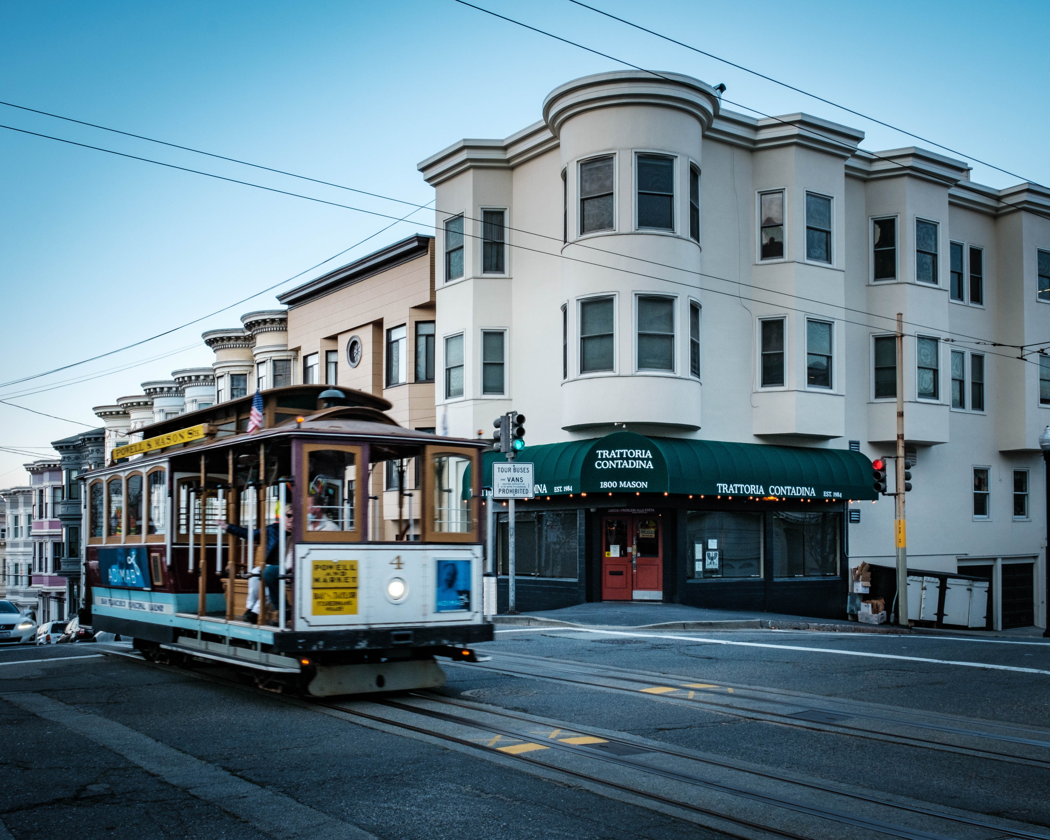
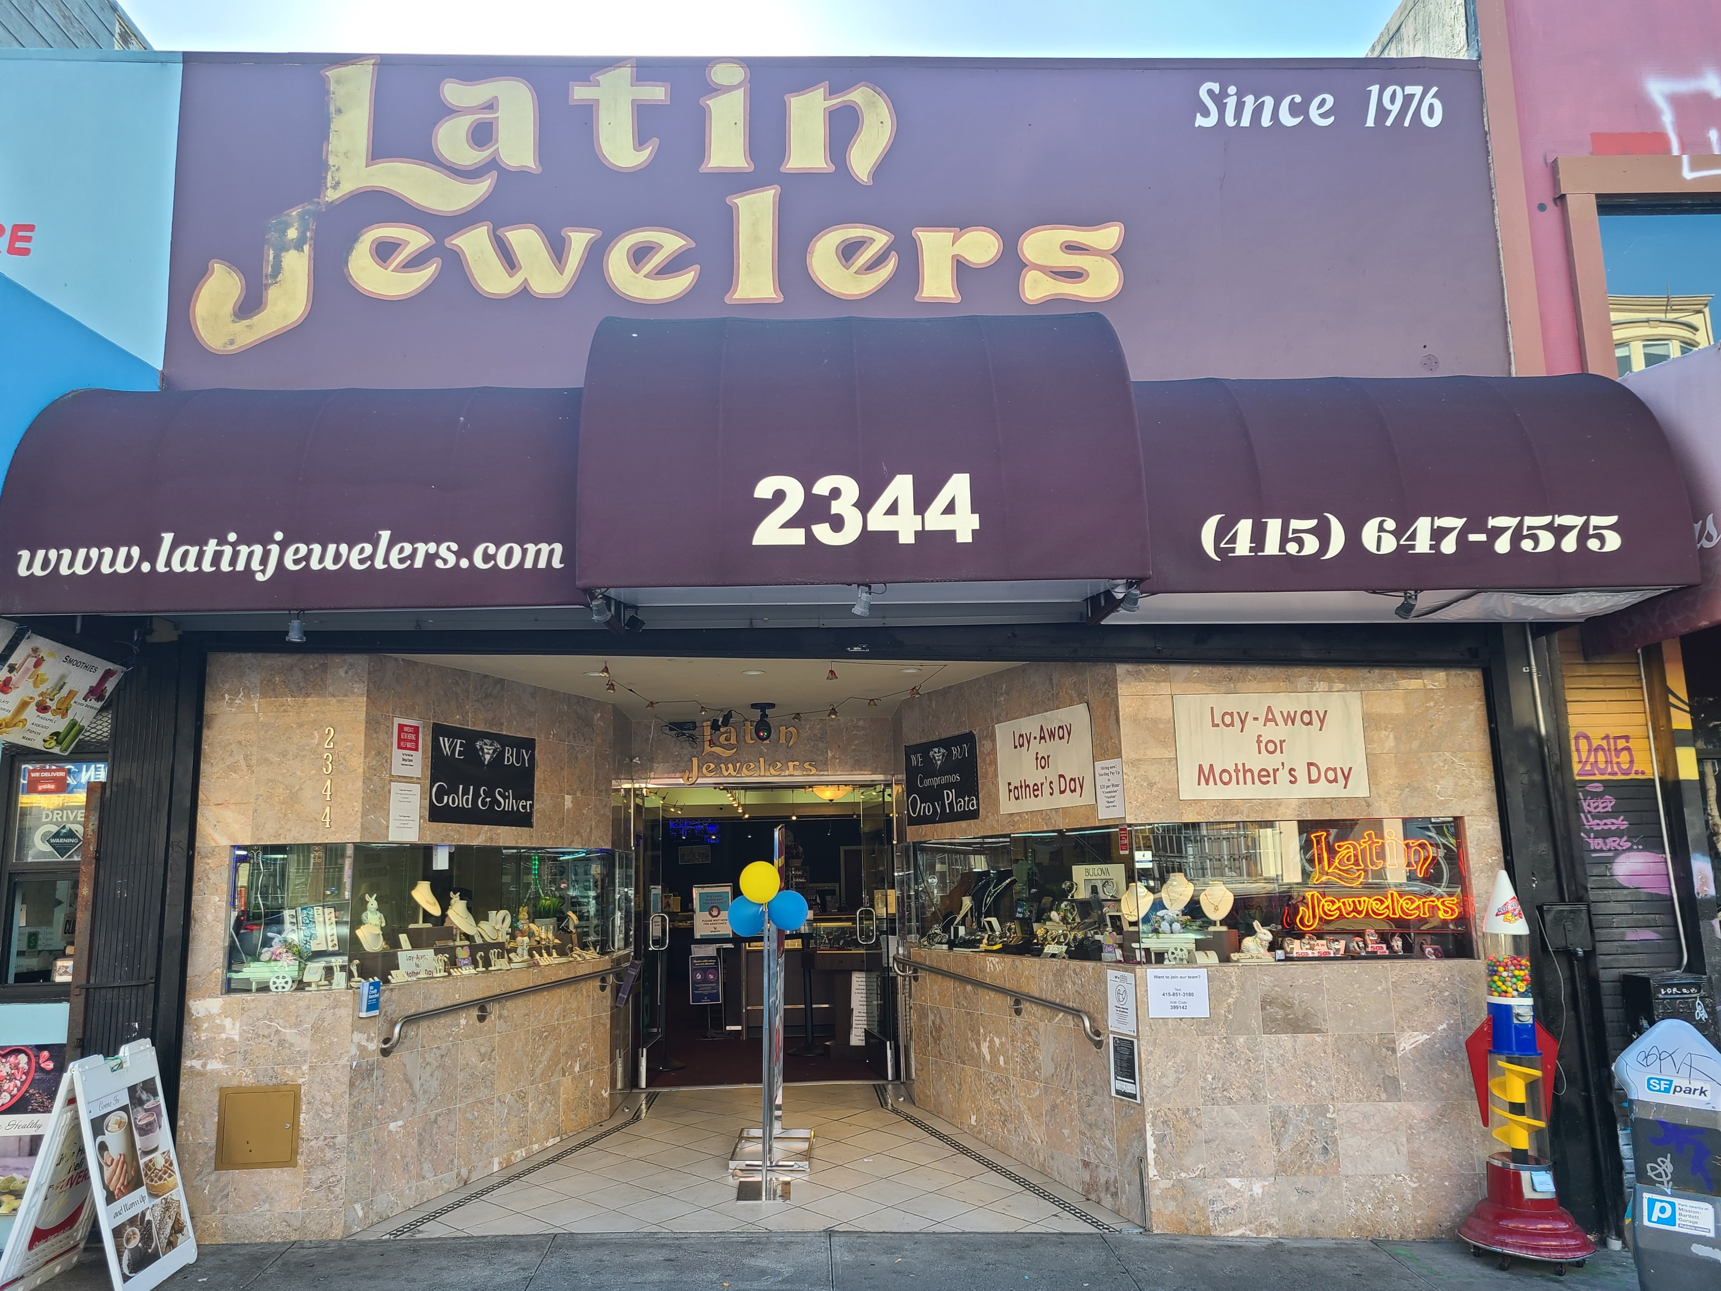
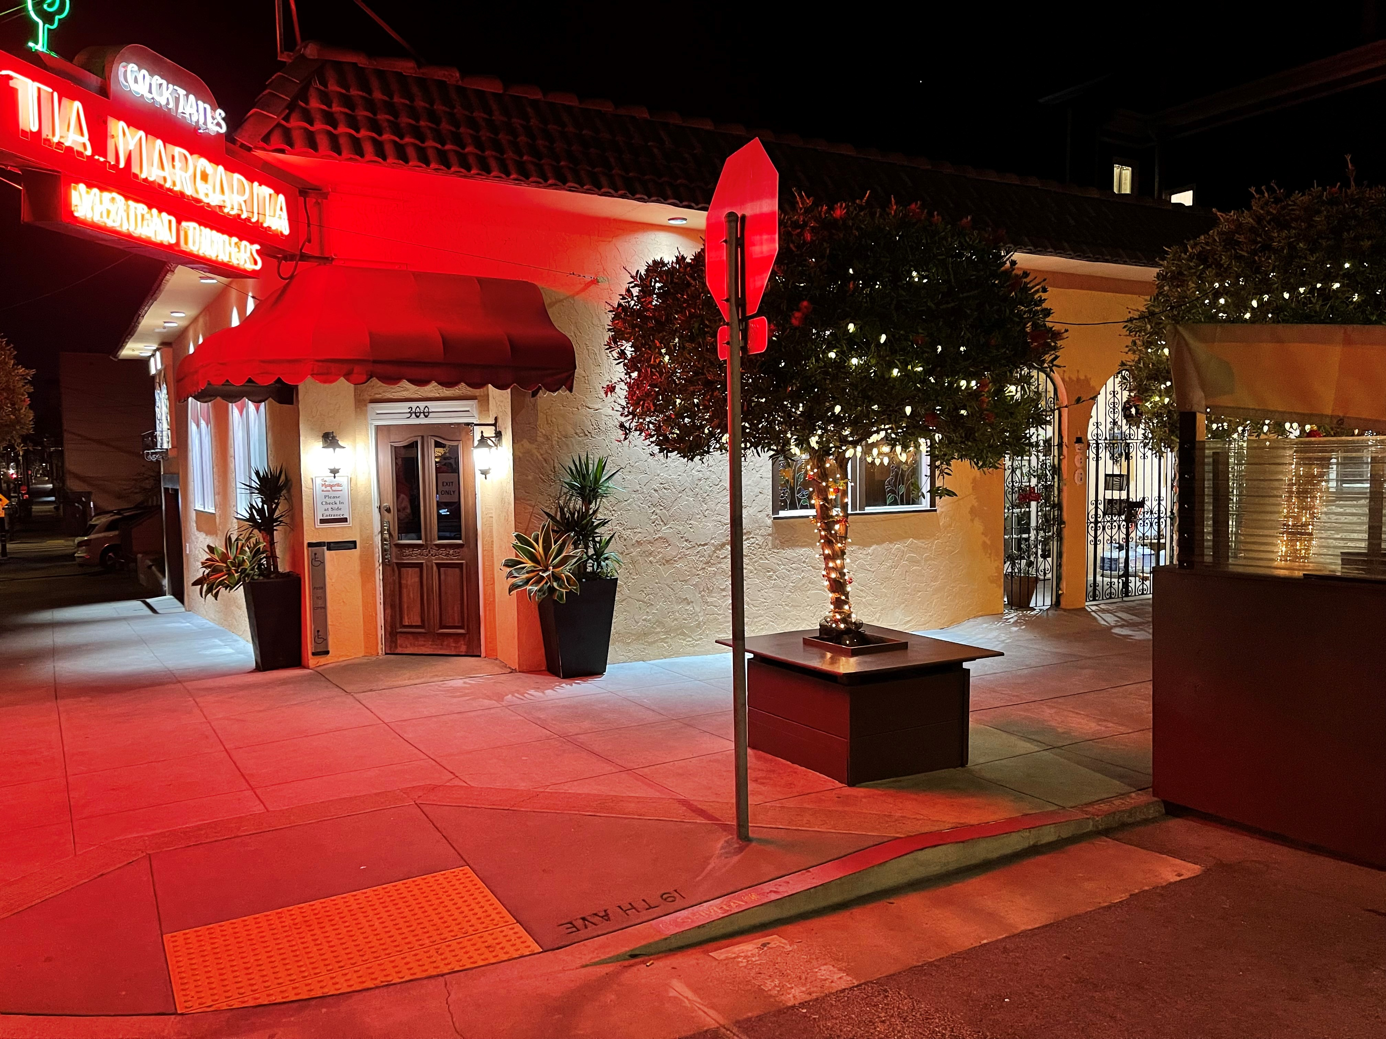
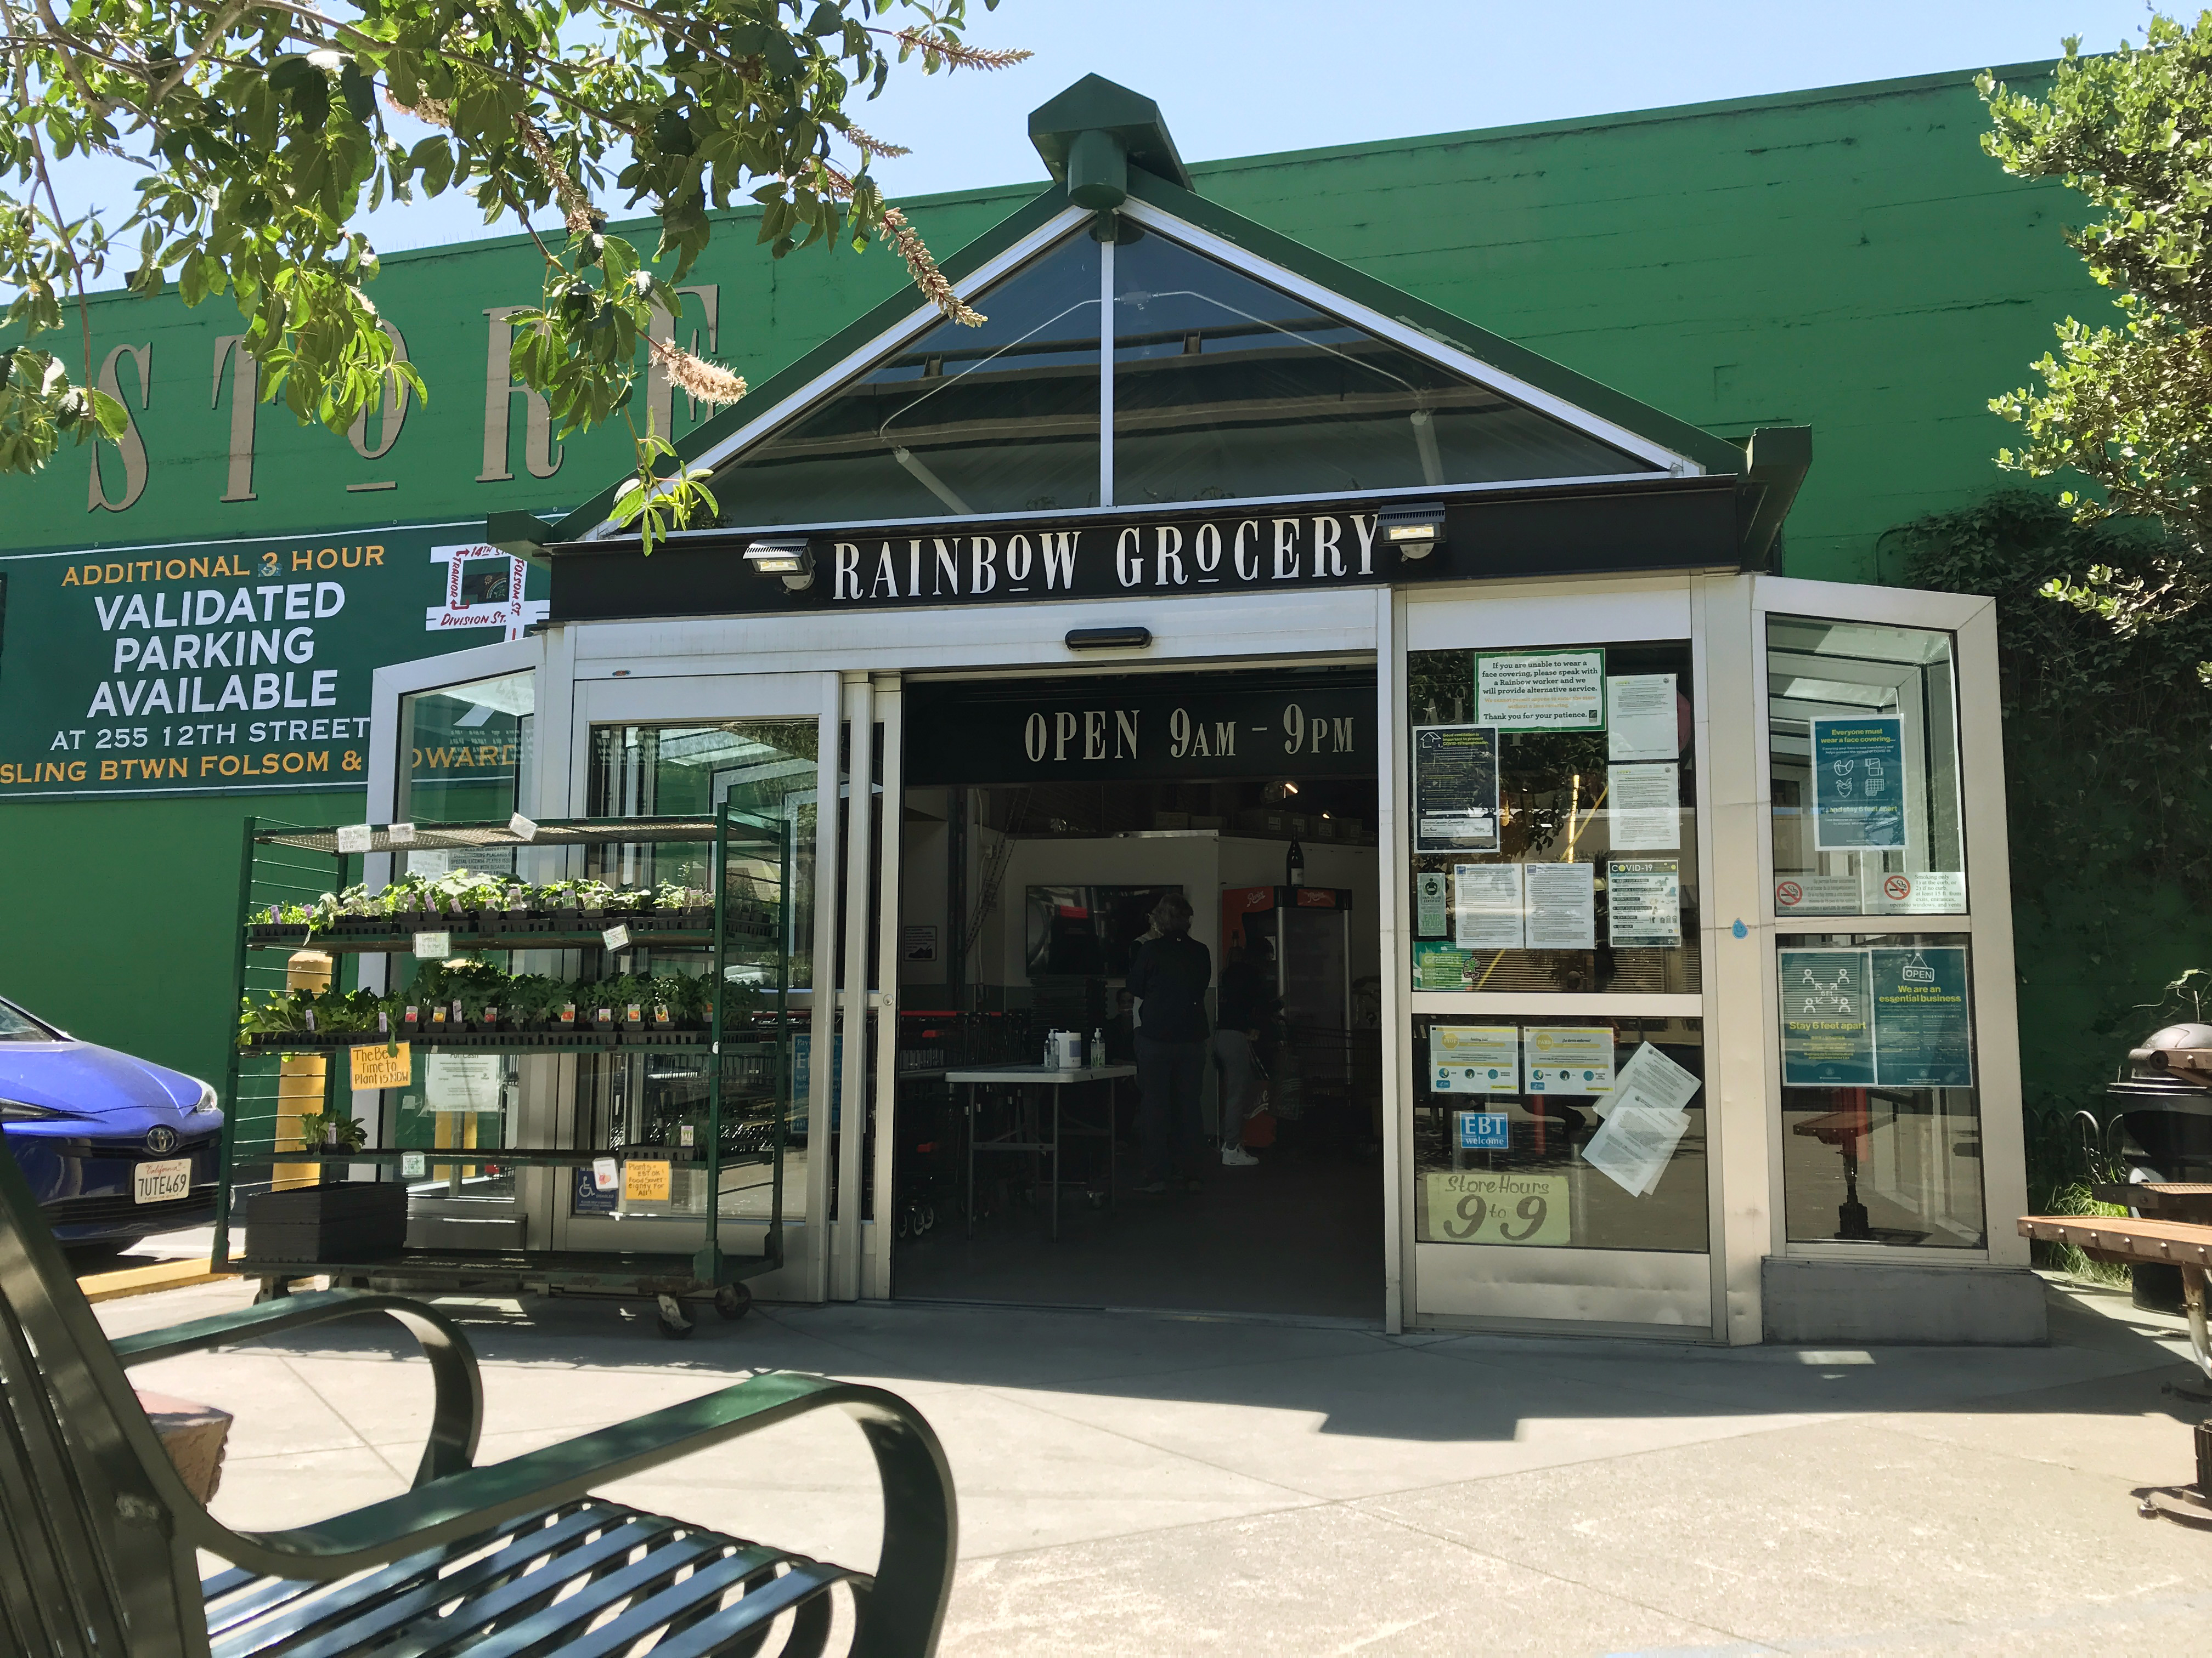
Annual
Highlights
316 Businesses have been added to the Legacy Business Registry since its inception in 2015
27 Legacy Businesses added in FY2021-22*
$2,678,342 in grants to Legacy Businesses since inception
$943,677 in FYTD grants to Legacy Businesses
*Previous annual average has been 45/year.
The lower number in FY22 reflects staff re-focus on administering the new Venue Fund for COVID-19 relief during a portion of the year.

Slide 11


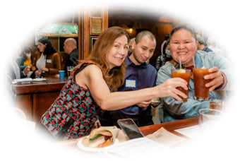

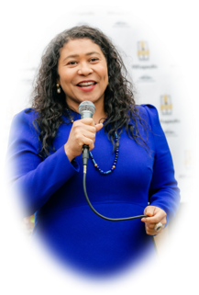
Promoting the Legacy Business Registry
2021-2022 Highlights
May 5, 2022: Our San Francisco Legacy event to celebrate and promote the Legacy Business Registry
Creation of new branded merchandise to give to Legacy Businesses
Final round of bronze plaques initiated, for 50 Legacy Businesses. Completion expected in 2022-2023.
Brochure promoting Legacy Businesses: 10,000 distributed to hotels and visitor landmarks
Legacybusiness.org website updates by Design Media

Slide 12
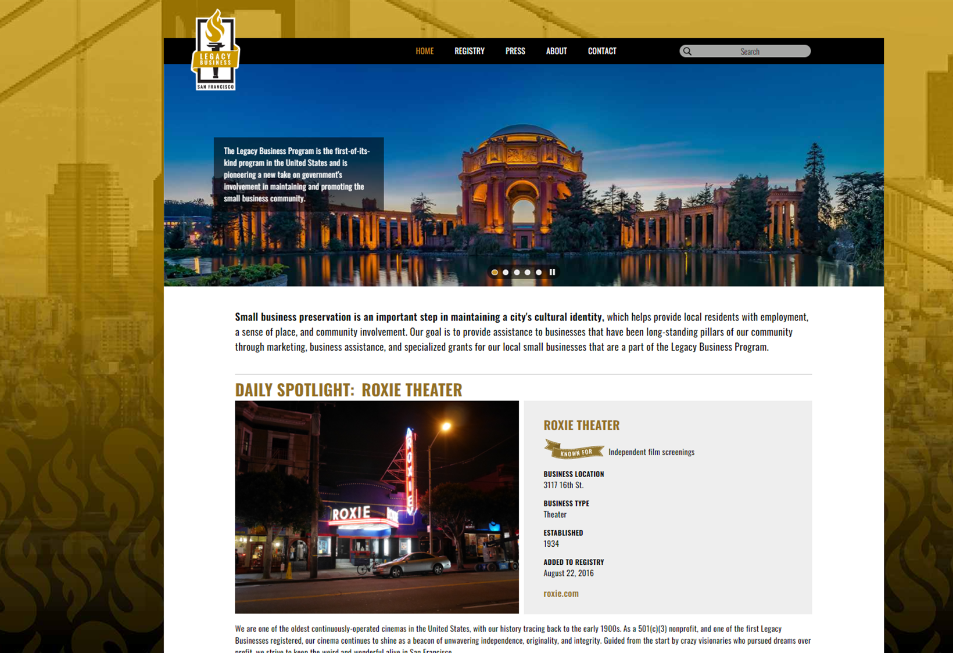
Legacybusiness.org
Dedicated custom website highlighting Legacy Businesses for a general audience.

Slide 13
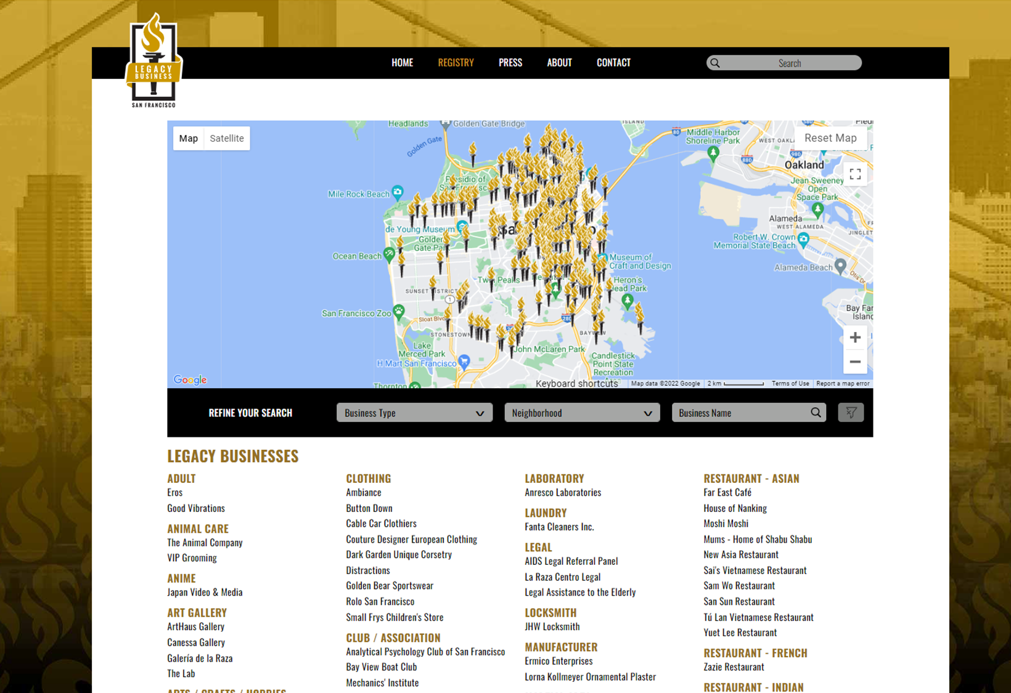
Find Legacy Businesses
Search by Business Type, Neighborhood, or Name

Slide 14
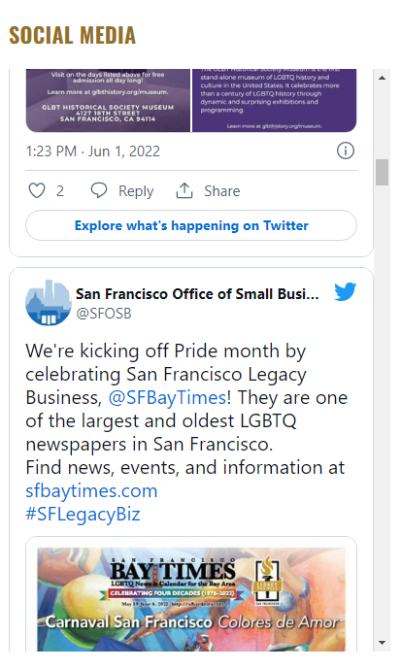
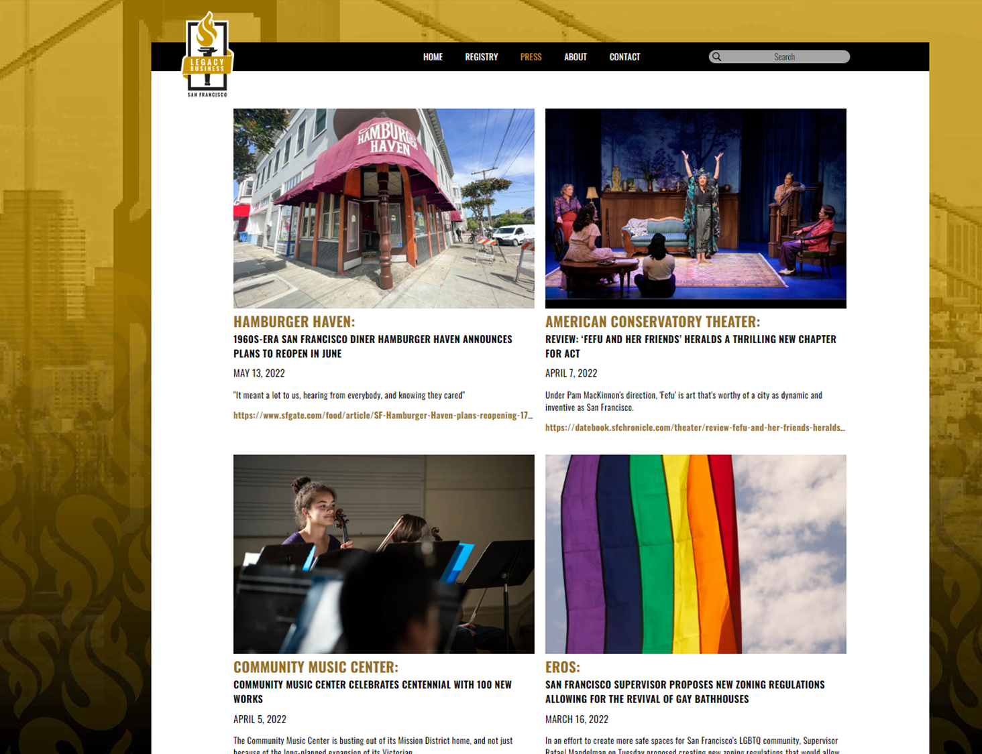
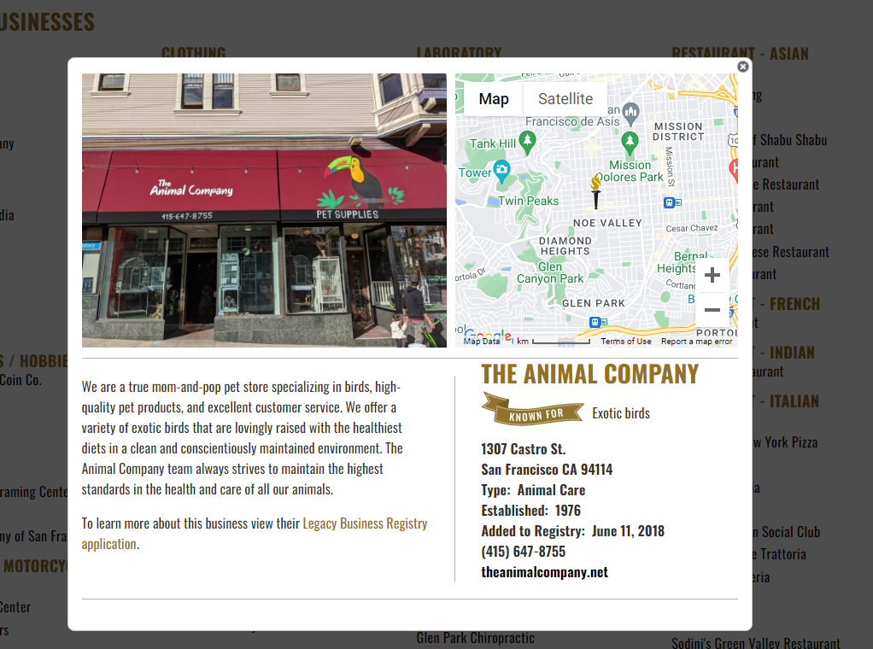
New features added in 2022
Daily Spotlight
"Known for" highlight
Twitter feed
Press page
Links to full application

Slide 15
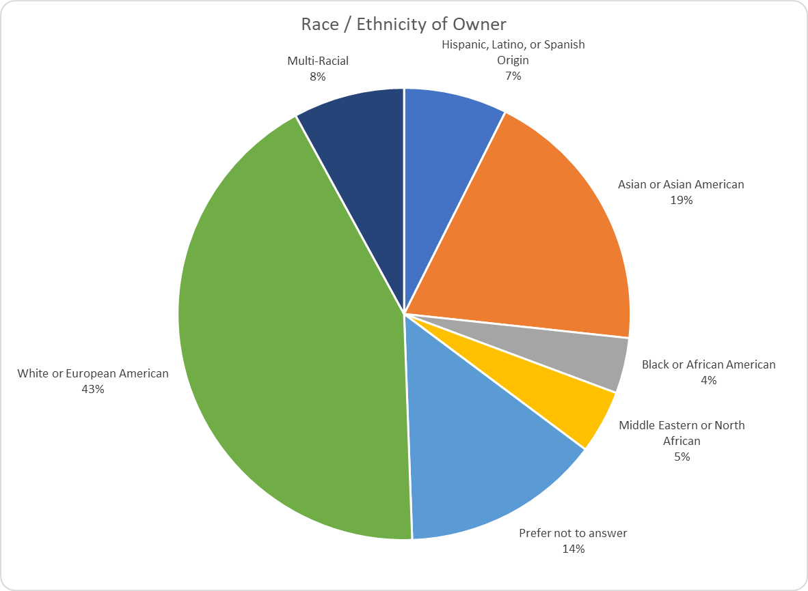
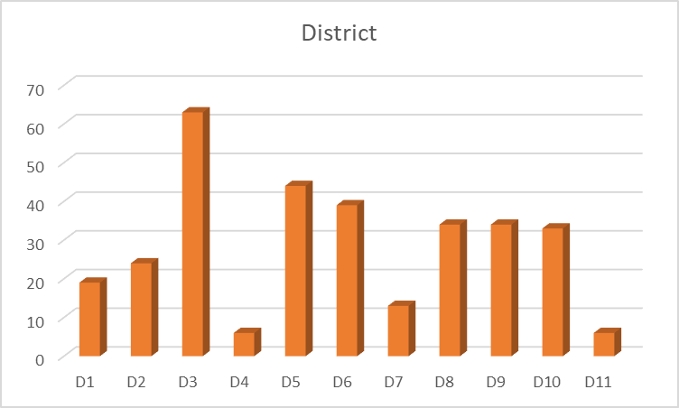
Outreach strategy
Focus on identified gaps in racial and geographic representation
Goals
Broaden racial and geographic representation in the Legacy Business Registry
Process a minimum of 5 apps/mo.
Improve internal workflow to help manage the queue of applicants
Action items
Create flyer about how to apply
Distribute flyer to key community organizations
In-person merchant walks to specific neighborhoods
Communicate with Board of Supervisors and their staff to provide flyer and encourage nominations
Small Business Commissioners share materials in their networks

Slide 16
Overview of City Budget Process

Slide 17
Overview of City Budget Process
Agenda Item 6:
The Commission will review the City budget process, the Office of Small Business and Office of Economic and Workforce Development proposed FY 22-23 budget, and future budget priorities.

Slide 18
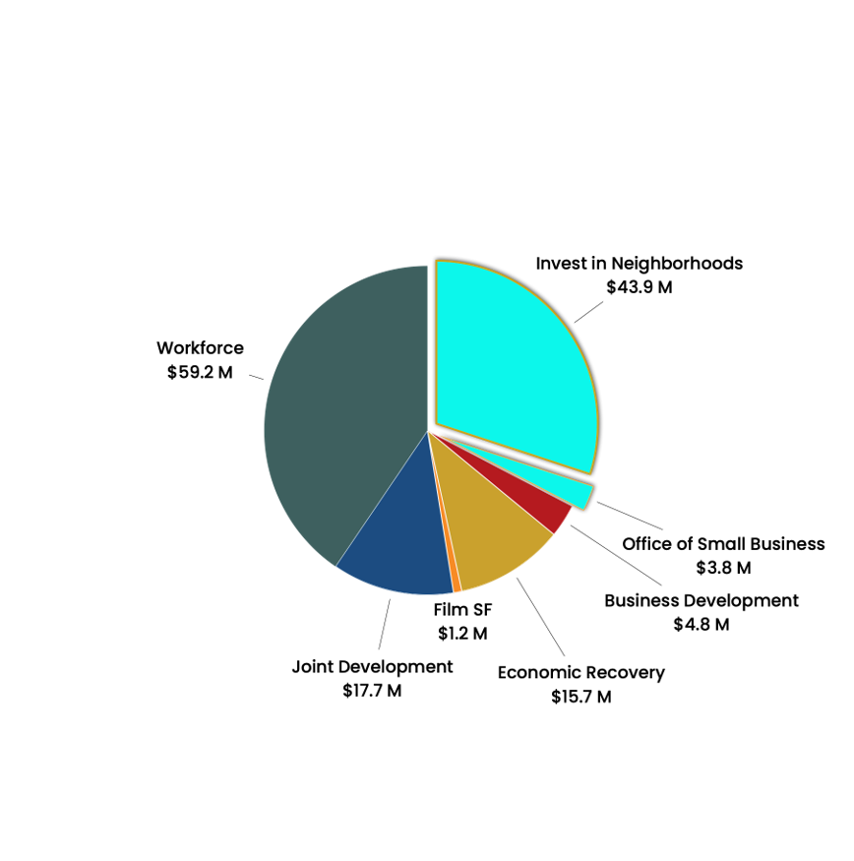
Budget
The Office of Small Business is a division within the Office of Economic & Workforce Development (OEWD)

Slide 19
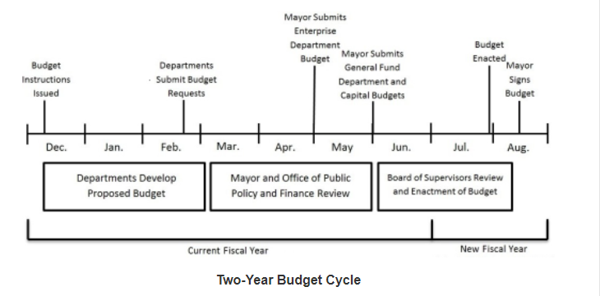
City Budget Process

Slide 20
Mayor's budget proposal
The Mayor’s Budget proposal includes:
$10 million for direct grants and loans aimed at helping small businesses launch, stabilize, scale up and adapt business models. New funding will expand programs to serve businesses throughout the City, including businesses within the Economic Core.
$10.5 million over the two years for the City Core Recovery Fund to support events, public space and ground floor activations, as well as a city-wide marketing campaign. This funding is envisioned to support community driven efforts to beautify, improve, and activate public spaces and ground floor vacancies throughout the Economic Core.
$25.4 million over the next two years to continue the Mid-Market/Tenderloin Community-Based Safety Program, which provides community ambassadors.
$2 million for SF Welcome Ambassadors and Retired Police Community Ambassadors stationed in key transit and tourist nodes such as Downtown BART stations, Union Square, Moscone Convention Center, and along the Embarcadero.

Slide 21
Next steps
The entire budget is heard and must be voted on and approved by the full Board of Supervisors by August 1st.
The Board may cut expenditures in the Mayor’s proposed budget and reallocate that money to “add back” increased funding for existing programs or funding for new programs.
The Board may increase line items in the budget or add new line items, even where the Mayor did not include the funding in the proposed budget.

Slide 22
OEWD/OSB Budget Priorities
Good Government
Remove barriers to permitting
Increasing revenue / markets
Provide resources for digital evolution to online sales
Increase trainings and technical assistance
Access to capital
Increase outreach regarding resources
Commercial space
Support to fill vacancies
Connect more businesses to lease negotiation resources
Workforce pipeline
Collaborate on training and job placement services for businesses in opportunity communities

Slide 23
Action Planning
Where do we want to be in the future and how can we get there?
Agenda Item 7: The Commission will review the results of the Commissioner Pre-Retreat Survey, their goals for the coming year, and brainstorm/ identify future policy priorities and programmatic priorities.

Slide 24
Commissioner Survey Results
Personal goals: be a voice for BIPOC businesses, businesses who are monolingual, have challenges with tech, policy reform, economic recovery
Areas of focus in the future: supporting equity merchant groups, downtown revitalization, crime reduction
SBC goals should include: making business simple, reaching businesses not traditionally included in merchant groups, make tools/toolkits for merchant groups to activate space/do events,
What could we improve: better orientation/onboarding for new commissioners, closer relationships with electeds, more context for items on our agenda, closer connections with OSB business councilors/permit staff.

Slide 25
Today's Goal
Leave with 2-3 policy areas and 2-3 programmatic goals to proactively pursue.
Guiding Questions:
What are the biggest hurdles small businesses face today?
What are the hot topics that we may need to address?
What role can SBC play?

Slide 26
Discussion
Commissioner goals / interests | Biggest hurdles | Hot topics that we need to address | SBC role | Next Steps

Slide 27
Draft Objectives & Key Results
Objective 1: Support the retention and growth of small businesses in San Francisco
Key Results through OSB:
  Provide technical assistance (linkage) to 75 small businesses in finding commercial leasing opportunities
  Provide technical assistance (outreach) to 50 small businesses in securing Neighborhood Anchor or Legacy Business designation
    Of those, 20 are with underrepresented ownership (BIPOC, women, LGBTQIA, disabled, immigrant, etc.)
  Provide technical assistance to 200 small businesses in improving ADA accessibility at storefront and online
  Provide 1,000 small businesses with 1:1 general technical assistance

Slide 28
Draft Objectives & Key Results
(continued)
Objective 2: Attract new small businesses by making it faster, cheaper and easier to open a new business in San Francisco
Key Results through OSB:
  Increase the number of businesses that get expedited permit review (under Proposition H) to 100 small businesses
  Identify 5 code change or process improvements that would be most effective in streamlining the permitting process for small businesses
  Provide 500 aspiring entrepreneurs with 1:1 technical assistance
    Of those, 100 are with underrepresented entrepreneurs (BIPOC, women, LGBTQIA, disabled, immigrant, etc.)

Slide 29
Draft Objectives & Key Results
(continued)
Objective 3: Restore economic vibrancy in neighborhood commercial corridors
Key Results through OSB:
  Fill 50 ground floor commercial vacancies
    Of those, 25 are with underrepresented ownership (BIPOC, women, LGBTQIA, disabled, immigrant, etc.)

