Slide 1
EOC Annual Report
Fiscal Year
2024 - 2025

Slide 2
Overview
Scope of Report
  Seven Joint Commission EOC Chapters
    Emergency Management
    Fire Life Safety
    Hazardous Materials and Waste
    Medical Equipment
    Safety Management
    Security Management
    Utilities Management
Annual Review by Environment of Care Committee. The overall program was deemed effective.

Slide 3
Who are the Program Managers?
Emergency Management (Vacant – Director of Emergency Management)
Fire & Life Safety Management (AJ Singh – Director of Facilities Services)
Hazardous Materials and Waste Management (Joey Williamson– Safety Officer)
Medical Equipment Management (Eunice Santiago – Director of Biomedical Engineering)
Safety Management (Joey Williamson– Safety Officer)
Security Management (Basil Price – SF DPH Director of Security)
Utility Systems Management (AJ Singh –Director of Facilities Services)

Slide 4
What does the EOC Committee do?
Identifies risks and implements systems that support safe environments.
Ensures that the hospital staff are trained to identify, report and act on environmental risks and hazards.
Sets and prioritizes the hospital’s EOC goals and performance standards.
Assesses whether EOC goals are being met.
Works to ensure the hospital is compliant with the EOC-related requirements of all applicable regulatory bodies.

Slide 5
Membership of the EOC Committee is comprised of:
Program managers for each of the seven EOC Management Programs (as previously listed).
Representatives from:
  Clinical Laboratories (Andy Yeh),
  Dept. of Education & Training (Justin Dauterman),
  Environmental Services (Francisco Saenz),
  Infection Prevention & Control (Elaine Dekker),
  Nursing (Andrea Chon),
  Quality Management (Emma Moore for Regulatory),
  Food Nutrition Services (Vacant),
  Materials Management (David Lawlor),
  Linen and Messenger Services (Olivia Johnson)
  Pharmaceutical Services (Janet Seung)

Slide 6
Also Supporting EOC Activities Are:
Biomedical Engineering, (Eunice Santiago)
Bloodborne Pathogen/Safe Device Committee, (Gemma Cohen)
Environmental Services, (Richard Fiel)
Environmental Services, (Reyland Manatan)
Facilities Services, (Pia Cheeseborough)
Materials Management, (Joseph Nauer)

Slide 7
Highlights and Findings by Chapter
Emergency Management
Program Objectives: Met & Not Met
Effectiveness: Program found to be effective.
Accomplishments:
Completed 2025 HVA (Hazard Vulnerability Analysis)
Performed multiple exercises/real events such as mystery patient drill, MRSE, labor action) Distributed the updated Emergency Operations Plan to all departments.
Hosted Emergency Management Event with several emergency management leaders from different nations.
Emergency Management Policy revised and updated
Goals and Opportunities for Improvement in FY 2025-26 include:
Continue to develop and implement progressive Drills and Exercises for Security Emergencies Response, including Lockdown, Shelter in Place, and Active Assailant response.
Continue providing training on the Hospital Incident Command System (HICS) for Incident Management Team members, supervisors and managers.
Update the Emergency Management IntraNet site to provide easily accessible information for all ZSFG staff.
Continue to ensure effective and efficient incident management and documentation.
Update Everbridge communication system for DPH/UCSF staff on campus.

Slide 8
Highlights and Findings by Chapter
Fire Life Safety Management
Program Objectives: Partially Met (exceeded goal for false fire alarms).
Effectiveness: Program found to be effective.
Goals and Opportunities for Improvement in FY 2025-26 include:
Manage false fire alarms for a quality and safe care experience in Building 25.
Continue engagement with projects on the ZSFG Campus. Ensure that the appropriate Risk Assessments for a quality, and safe care experience are followed.
Continue implementing fire alarm upgrade funded by the 2016 bond.
Engage staff and contractors to implement projects funded by the 2016 bond measure.
Create a project to replace all sprinkler heads in Building 5 (per NFPA 25, 5.3)
Award new fire alarm maintenance contract for the campus

Slide 9
Highlights and Findings by Chapter
Environmental Health and Safety
Program Objectives: Met
Effectiveness: Program found to be effective.
Hazardous Materials and Waste Program
Accomplishments:
Continued to work with Capital Projects, ZSFG Facilities, and Infection Control to allow construction within operating hospital buildings as well as in very close proximity to staff, patients, and visitors without significant incidents or exposure concerns.
Maintained ZSFG Environmental Permits and acted as liaison between regulatory agencies including the SF PUC, DPH Hazardous Materials Unified Program Agency, Cal/EPA, Cal/OSHA and ZSFG. Continued to work with ZSFG management and staff regarding Cal/OSHA regulations, policies, and practices and assisted in responding to inquiries from Cal/OSHA regarding concerns about working conditions.
There were zero worker illness/injuries related to hazardous materials at ZSFG for the fiscal year.
Completed the 2025 Hazardous Materials and Waste Inspection conducted by the City and County of San Francisco, Department of Environmental Health.

Slide 10
Highlights and Findings by Chapter
Continued for Environmental Health and Safety…………….
Achieved zero late payment penalties and zero violations related to hazardous materials storage and disposal.
Decommissioned the former hazardous waste holding area and transitioned operations to Building 1, in full compliance with the California Health and Safety Code (HSC) and Title 22 of the California Code of Regulations (22 CCR).
Delivered the 2025 Chemo Spill Management presentation at the Oncology Department update conference.
Completed the annual required training for the Hazardous Materials and Emergency Response and Contingency Plan in collaboration with the Facilities Department.
Completed the annual Safety Data Sheet (SDS) update in all units in compliance with Occupational Safety and Health Administration (OSHA) requirements.
Updated the chemical inventory in the California Environmental Reporting System (CERS) to maintain compliance with state reporting requirements..
Partnered with Stericycle and the ZSFG Department of Pathology to coordinate the safe disposal of approximately 8,400 pounds of B5 fixed paraffin blocks and slides dating from 1960–1985.

Slide 11
Highlights and Findings by Chapter
Continued for Environmental Health and Safety…………….
Goals and Opportunities for Improvement in FY 2025-26 include
Continue to work with PHL for their move to the ZSFG campus.
Work with the facility to finalize the move of the hazardous waste storage for PHL and Pathology Department.
Work with departmental managers for the annual chemical inventory update and SDS updates.
Work with facility for the annual Hazardous Materials and Waste training requirement.
Strive to maintain our record of zero hazardous materials related worker injuries, zero late penalties for disposal payments, zero overage charges, and zero regulatory violations.

Slide 12
Highlights and Findings by Chapter
Medical Equipment Management
Program Objectives: Met
Effectiveness: Program found to be effective.
Accomplishments:
Philips Healthcare telemetry system upgraded to revision 4 located in building 25 (main hospital)
Vital sign monitors and ophthalmoscope/otoscopes replaced throughout various clinics
Provide input to DPH on selecting a new CMMS database to manage all the medical equipment inventory and associated service reports
Goals and Opportunities for Improvement in FY 2025-26 include:
Continue working with clinical department leaders to plan the replacement of their medical devices that are considered by the manufacturer End of Life (EOL) and/or End of Support (EOS).
  One-on-one meetings with heads of clinical departments to discuss medical equipment capital submissions.
  Assist clinical department heads on obtaining price quotes from vendors.
Continue training Biomedical Technicians to increase the number of services (PMs and repairs) in-house.
  Reduce the total cost of ownership
  Reduce the service turnaround time

Slide 13
Highlights and Findings by Chapter
Environmental Health and Safety
Program Objectives: Met.
Effectiveness: Program found to be effective
Safety
Accomplishments:
Safety Management is designed to identify and address potential safety risks in the ZSFG environment. At ZSFG, Safety Management is shared by two complementary programs, Patient Safety and Environmental Health and Safety:
Patient Safety is a function of Quality Management and oversees the organization’s patient safety plan and national patient safety goals. Patient Safety reports via Process Improvement and Patient Safety Committee (PIPS).
Environmental Health & Safety (EH&S) focuses on staff health, safety, and well-being. The Environmental Health and Safety Department provides consultation, resources and training to create, maintain and improve the hospital’s working environment. The goals of EH&S are to reduce or eliminate staff injuries and illnesses and create a safe environment for all persons including staff, patients, clients, and visitors at the ZSFG site. EH&S reports their activities through the Environment of Care Committee in both this chapter and the Hazardous Materials and Hazardous Waste Chapter.
The Safety Management Program’s scope encompasses all departments and areas of the ZSFG campus, except for UCSF research activities, which fall under UCSF management

Slide 14
Highlights and Findings by Chapter
Environmental Health and Safety continued……
Goals and Opportunities for Improvement in FY 2025-26 include:
Continue to assist new and existing staff with ergonomic needs.
Continue to work with Capital Projects for construction noise surveys/monitoring.
Body mechanics injuries (BMI) have been trending upward over the last five years and increased in fiscal year 2024-2025. There are a total of 75 reported BMI incidents for 2024-2025, an increase of 10 from the previous fiscal year. Work with the safety Committee to reduce BMI to our revised goal of 65 or fewer incidents per year.
Blood & body fluid exposures (BBFE) are highly variable but trending upward over the last five years, and increased in fiscal year 2024-2025. There are a total of 109 reported BBFE for 2024-2025 an increase of 14 from the previous year. Work with the Safety Committee to reduce BBFE to our revised goal of 95 or fewer incidents per year.

Slide 15
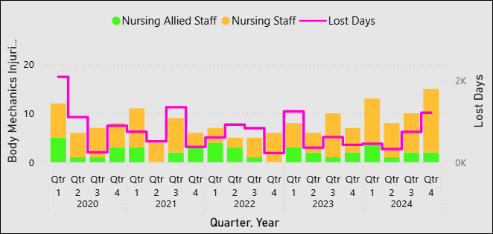
OSHA Recordable Injuries Fiscal Year 2024 – June 2025
Figure1. Body mechanics injuries (BMI) and lost days of production from associated injuries for ZSFG Nursing and Nursing Allied staff from 2020 to 2024. Results for Nursing and Nursing Allied staff are variable but with an upward trend, similar to results for all ZSFG staff, with the greatest peak in 2024 (44). The greatest peak for BMI for all ZSFG staff was also in 2024 (75). 2025 data is omitted due to lack of compiled information at this time.

Slide 16
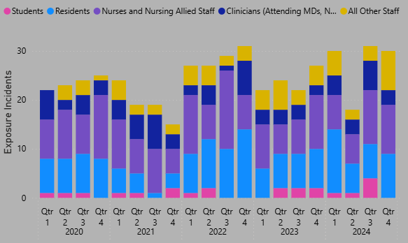
OSHA Recordable Exposures Fiscal Year 2024 – 2025
Figure 2. Blood and body fluid exposures (BBFE) for ZSFG staff for 2020-2024, for each year and various types of staff. Results are variable each year over this period, with the greatest peak in 2022 (114), a dip in 2023 (95), and then an increase in 2024 (109). 2025 data omitted due to lack of complete information at this time.

Slide 17
Highlights and Findings by Chapter
Security Management
Program Objectives: All program objectives were met.
Effectiveness: Program was found to be effective.
Accomplishments:
The 2024-2025 Security Program was successful in assuring the provision of a safe, accessible, and secure environment for staff, patients, and visitors, which included the following:
Use-of-force decreased 28% (39 to 28 incidents) from the previous fiscal year.
Reduction in use-of-force ratios per 1K Sheriff’s Office calls-for-service (9,000) and PES intakes by 60%.
Confiscated nearly 10,500 weapons and contraband through the Emergency Department Security Weapons Screening.
Investigated 27-moderate/high risk workplace violence threat incidents (forty-two percent increase from the previous year by eight incidents) and developed security plans to address the threat and protect the individuals involved.
Increased security technology through state-of-the-art network video recorders, video management software, and security safeguards to support campus buildings.

Slide 18
Performance Metrics
FY 2024-2025, Annual Performance Metrics
Target | Target | Overall Performance
Code Green Response (Patient Elopement) | 90% | 100%
Customer Satisfaction | 90% | 92%
Electronic Security Systems | 98% | 96%
San Francisco Sheriff Office MOU Compliance | 3.5 | 3.6
Employee Security Awareness | 90% | 100%

Slide 19
Threat and Workplace Violence Investigations
Over a 4-year period, moderate and high-risk investigations increased 13%.
Threat management investigations increased 42% (8 reports) from the previous year.
- Building 5 lobby accounted for 33% of investigations and 89% (24 of 27) involving reports of threats.

Slide 20
Threat and Workplace Violence Investigations
Security-plans to address threats and acts of violence, included:
Remedial Action Taken
Behavioral Plan | 6
HR Investigation | 11
Employee Disciplinary Action | 2
SFSO Admonishment | 1
SFSO Detention | 1
UCSFPD Response | 4
Patient-on-Employee and Employee-on-Employee equally accounted for ninety-percent of reported workplace violence investigations.

Slide 21
Crimes Against Persons and Property
Yearly Comparison | 2023-2024 | 2024-2025
Facility Property Thefts Reports (>$900) | 4 | 1
Burglary Reports | 6 | 7
Battery Reports | 58 | 47
Sexual Offense Reports | 11 | 10
Assault Reports | 10 | 9
Robbery Reports | 2 | 2
Homicide Reports | 0 | 0
Total | 91 | 76
Reported crimes against persons and property decreased 16% (15 reports) from the previous year.
Reported crimes against person reports increased 16% (81 to 68) from FY 23-2024.
Since FY 21-22, there has been a 72% decrease in reported crimes.
* Numbers are based on supporting documentation provided by SFSO.

Slide 22
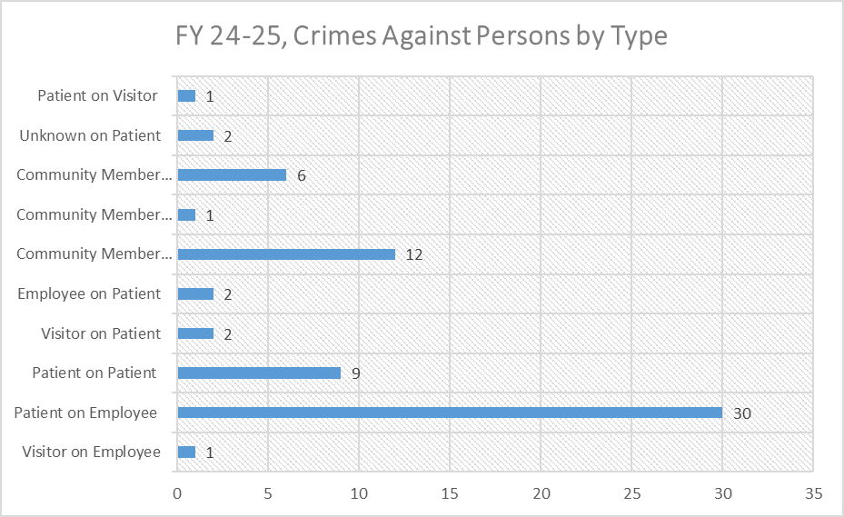
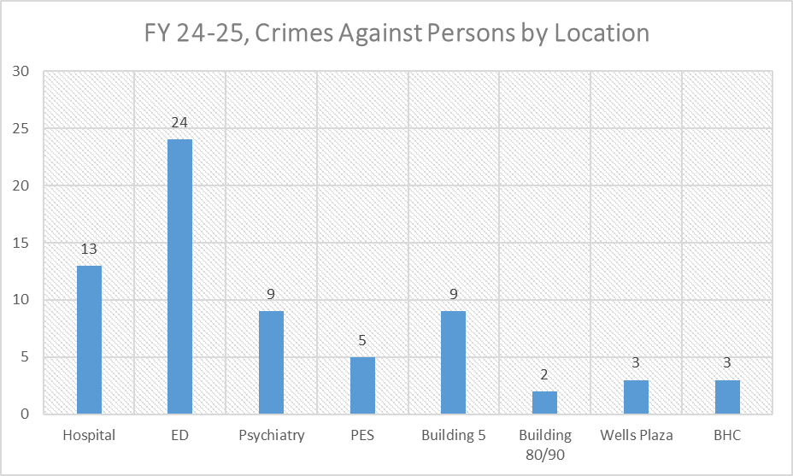
Crimes Against Persons and Property
Patient-on-Employee reports accounted for 44% of crimes against person incidents (30 of 68 reports).
Reports from the ED accounted for 35% of person-crimes (35 of 81 reports).
Crimes Against Persons Action Taken
Deputy Arrest | 17
Private Person Arrest | 28
Citation Issued | 12
Psych Evaluation | 2
Criminal Investigation Unit | 5
Emergency Protective Order | 1
Deputy Detention | 3
Forty-one percent of victims of physical attack, pressed charges against their assailant (28 of 68.)

Slide 23
Crimes Against Property
2024-2025 Crimes Against Property by Location
Theft |  | Burglary
Building 5 |  | 3
Hospital Building 25 | 1 | 4
Building 90 |  | 1
Building 100 |  | 1
Building 5 |  | 3

Slide 24
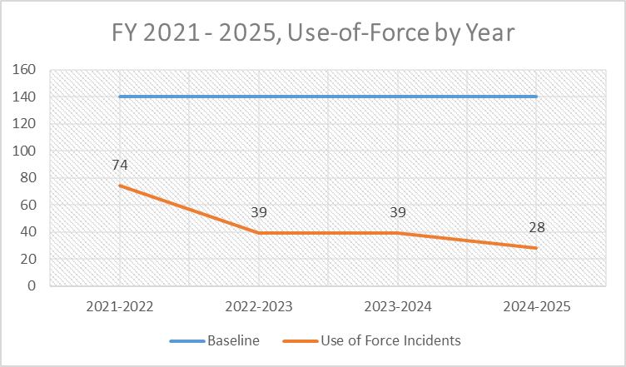
Use of Force by Year
Use-of-force data is tracked of all SFSO incidents occurring on ZSFG campus. In 2024-2025, there were 39 incidents of use-of-force. The data was stratified by the types of force, type of incidents, location, demographics, reported acts by demographics, and demographics by high-risk department.
Use-of-Force by Patient Related Service calls and Clinical Data
Per 1K Patient Related Service Calls | 3
Per 1K ED Registrations | 0
Per 1K PES Intakes | 1
Per 100 Psychiatry Admissions | 0
Since FY 21-22, law enforcement use-of-force has decreased 37%.
From FY 22-23, use-of-force decreased 28% (17-incidents.)
* Less than 1%

Slide 25
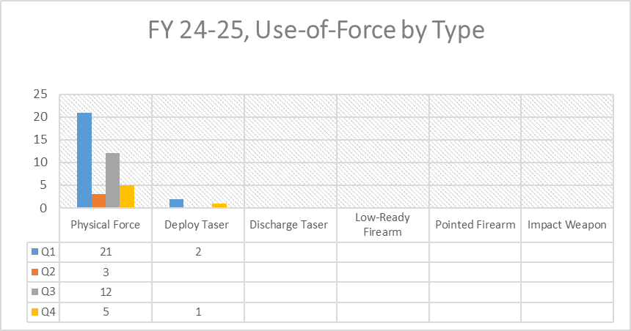
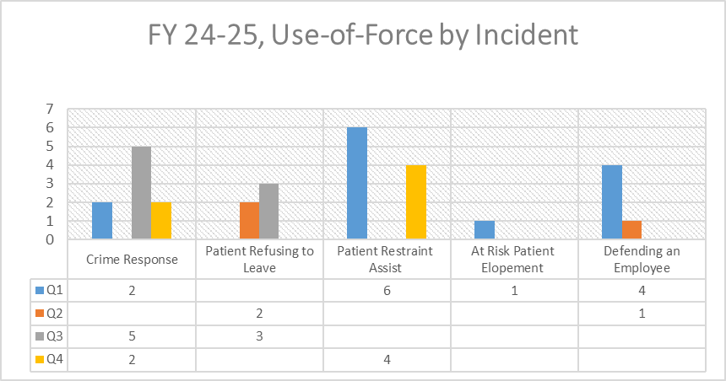
Use of Force by Type and Incident
Of the 28 use-of-force incidents, there were 44 types of force used. Physical force accounted for 93% of the force used (41 of 44 types.)
Deputies assisting with patient restraints accounted for 33% of use-of-force incidents (10 of 30 incidents.)

Slide 26
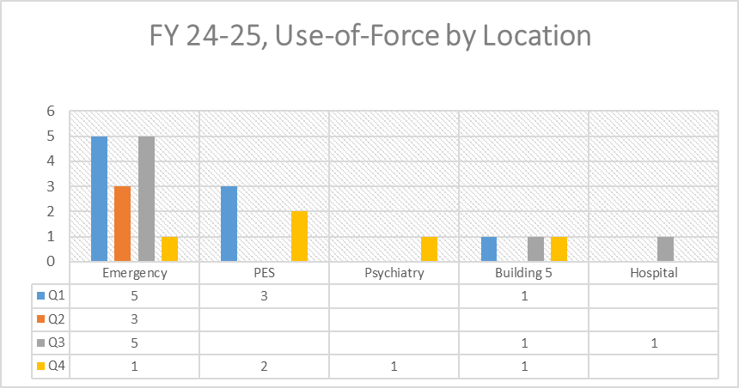
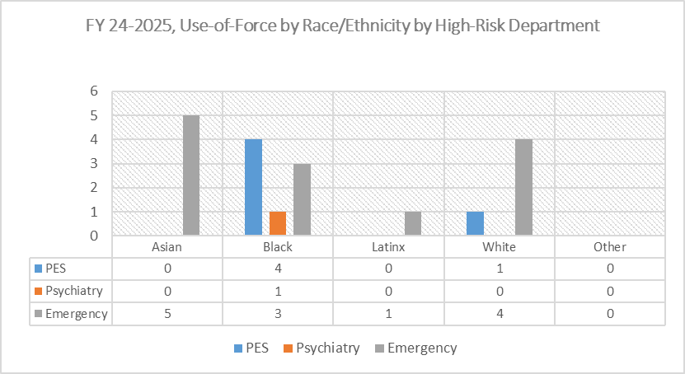
Use of Force by Location and Demographics by High-Risk Dept
Sixty-eight percent of force in high-risk departments occurred in the Emergency Department where force against Black/ African Americans accounted for 42% of the incidents.
Fifty percent of use-of-force incidents occurred in the Emergency Services (14 of 28)

Slide 27
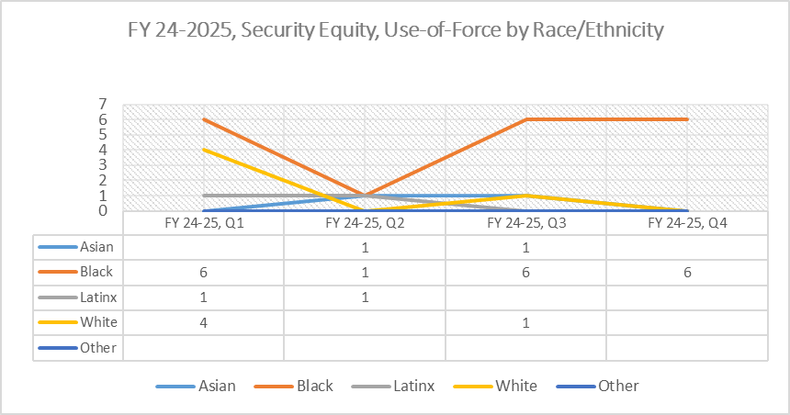
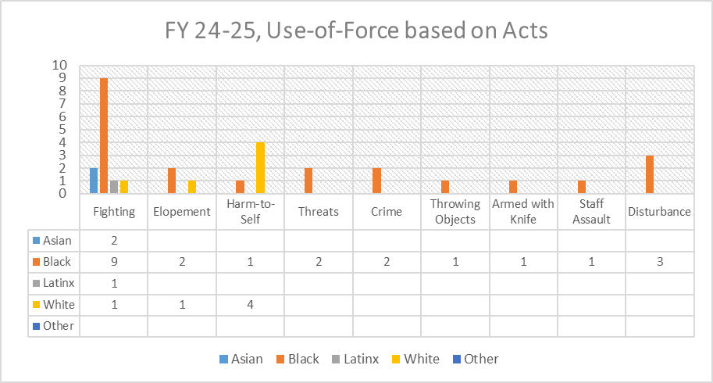
Use of Force by Demographics
In FY 24-25, use-of-force decreased in all race/ethnicities, except Asians and Black/African Americans and force against Black/African Americans increased 58% from the previous year.
Sixty-eight percent of force incidents were against Black/African Americans.
Forty-two percent of use-of-force was in response to reports of fighting.
Seventy-one percent of the acts reported to the Sheriff’s Office were committed by Black/African Americans.

Slide 28
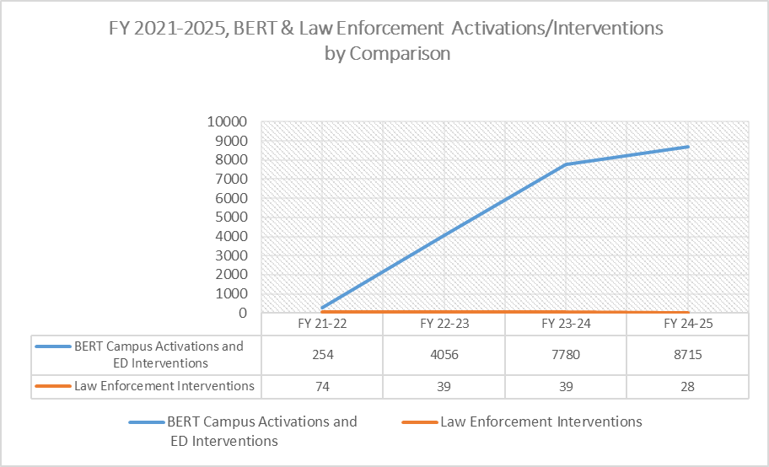
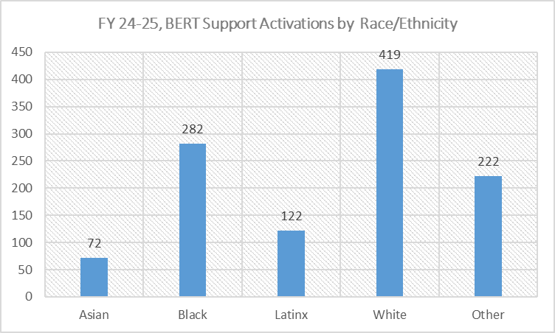
Security Equity Countermeasures
Behavioral Emergency Response Team (BERT) FY 24-2025
Since its implementation, BERT has performed nearly 21,000, support interventions to prevent escalating behavior.
Since FY 21-22, BERT interventions have increased 116% (based the 3-year average of 4030 interventions from FY21-24)
In FY 24-25, BERT patient interventions exceeded law enforcement interventions for patient by more that 8,500.
To prevent escalations, BERT Support Activations and Emergency Department Interventions were near equally provided between Black/African American and Caucasian patients (31%, 2,737 for Caucasian patients and 30%, 2,604 for Black/African American patients).

Slide 29
Highlights and Findings by Chapter
Utility Systems Management
Program Objectives: Met
Effectiveness: Program found to be effective
Goals and Opportunities for Improvement in FY 2025-2026 include:
Provide ongoing support for the chiller and cooling tower replacement projects in Building 2.
Support Security projects improvement projects for the campus.
Support the main switchgear, and electrical distribution replacement project in Building 5.
Schedule, coordination, and completion of switchgear maintenance and electrical panel IR scanning in Building 25. NFPA Requirement every 5 years.
Complete implementation of the new CMMS program.
Develop a building maintenance plan for assets that have been deferred and long overdue for replacement.
Support facilities refresh improvements in Building 5, unit 4A SNF.

Slide 30
Questions?

