Slide 1
ZSFG FY 24-25 ANNUAL REPORT
Susan Ehrlich, MD, MPP
October 27, 2025

Slide 2
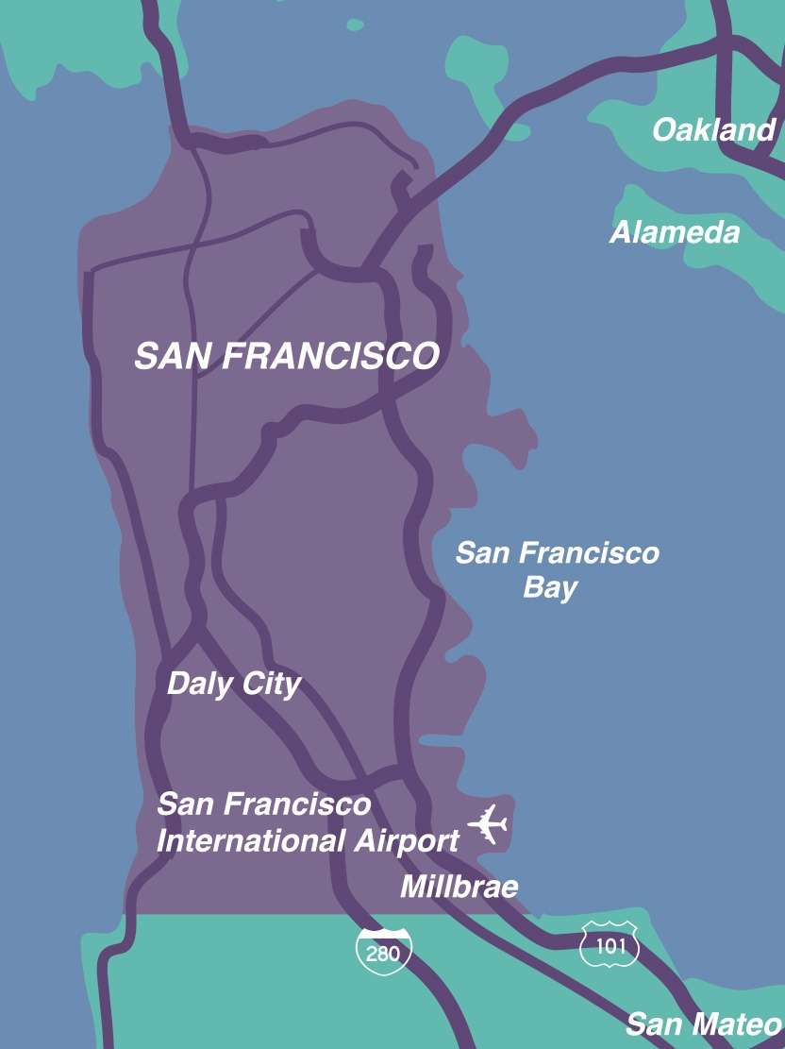
About ZSFG
Who We Are
Part of DPH’s SF Health Network
Only Trauma Center for SF & Northern San Mateo County
City’s only 24/7 psychiatric emergency service
Top academic medical center partnering with UCSF
Who We Serve
~104,000 patients per year
20% of ambulance calls in the city
A diverse patient population providing services in >20 languages

Slide 3
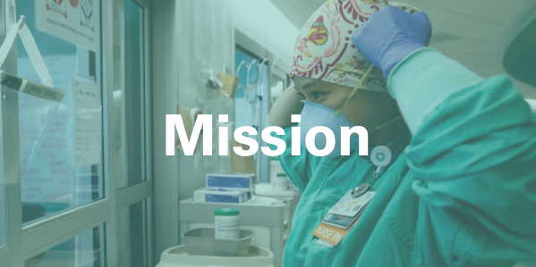
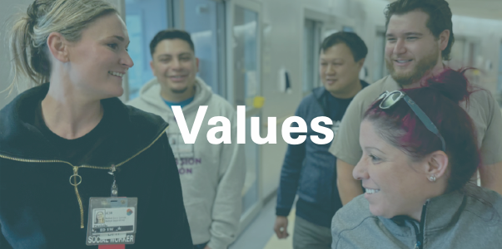
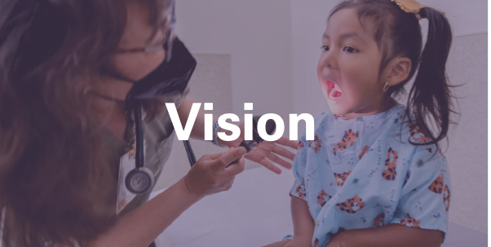
About ZSFG
To provide quality health care and trauma services with compassion and respect
Joy in our Work, Compassionate Care, and Thirst in Learning
To be the best hospital by exceeding patient expectations and advancing community wellness in a patient-centered, healing environment

Slide 4
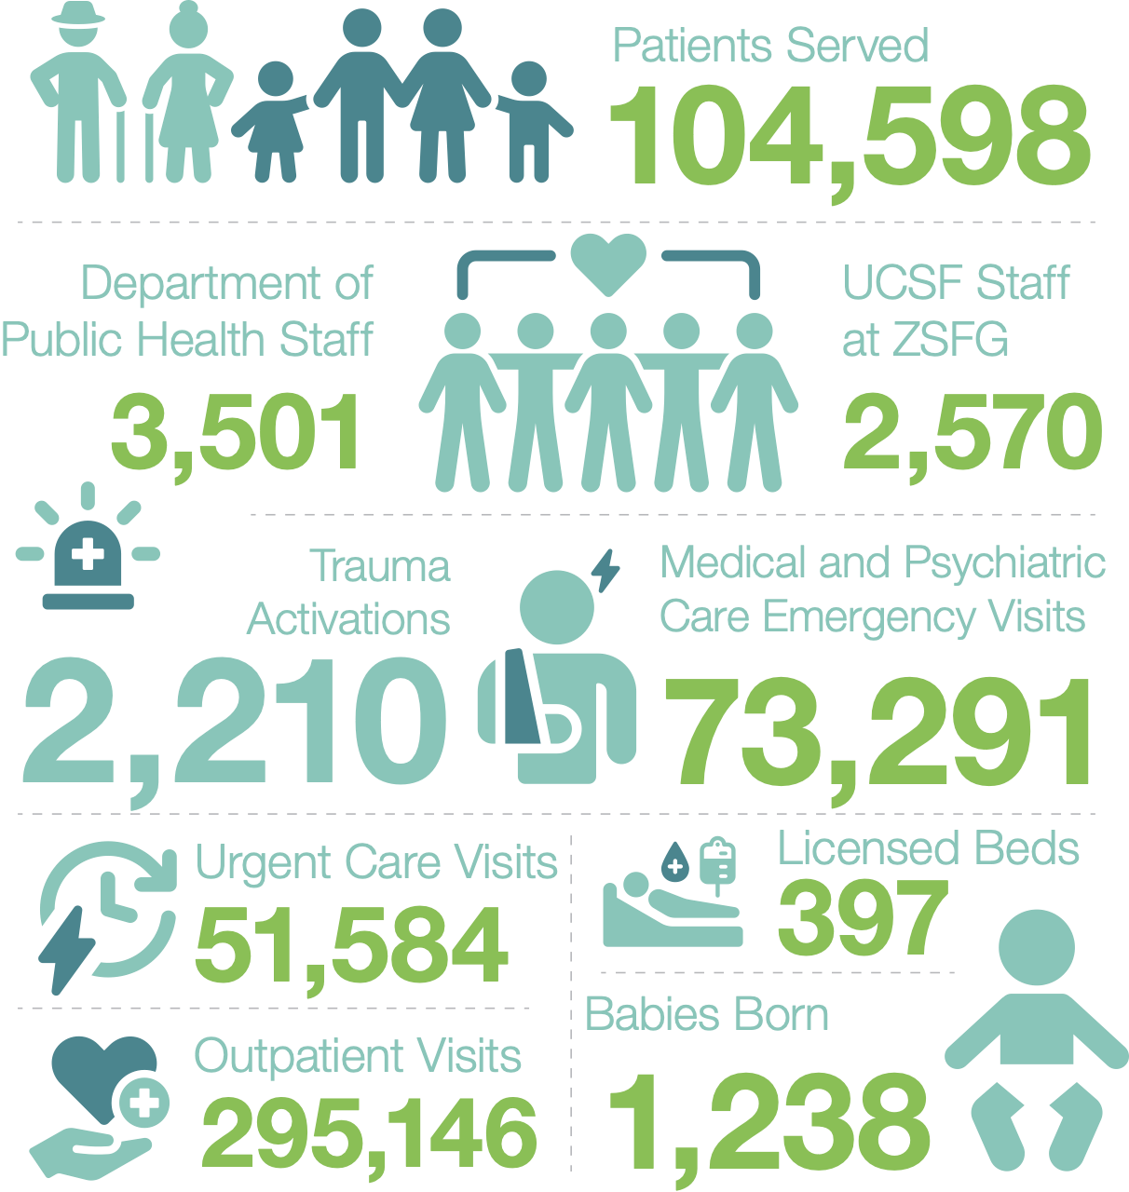
ZSFG By the Numbers

Slide 5
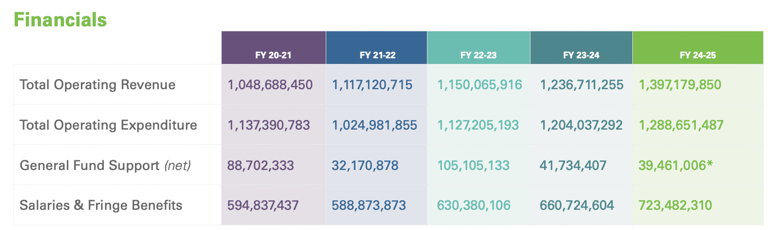
ZSFG Financials
* Net General Fund Support varies each year due to prior year cost report settlements, unanticipated revenues, and year-end intra-departmental transfers. Does not include local funds to the State to draw down matching federal dollars.

Slide 6
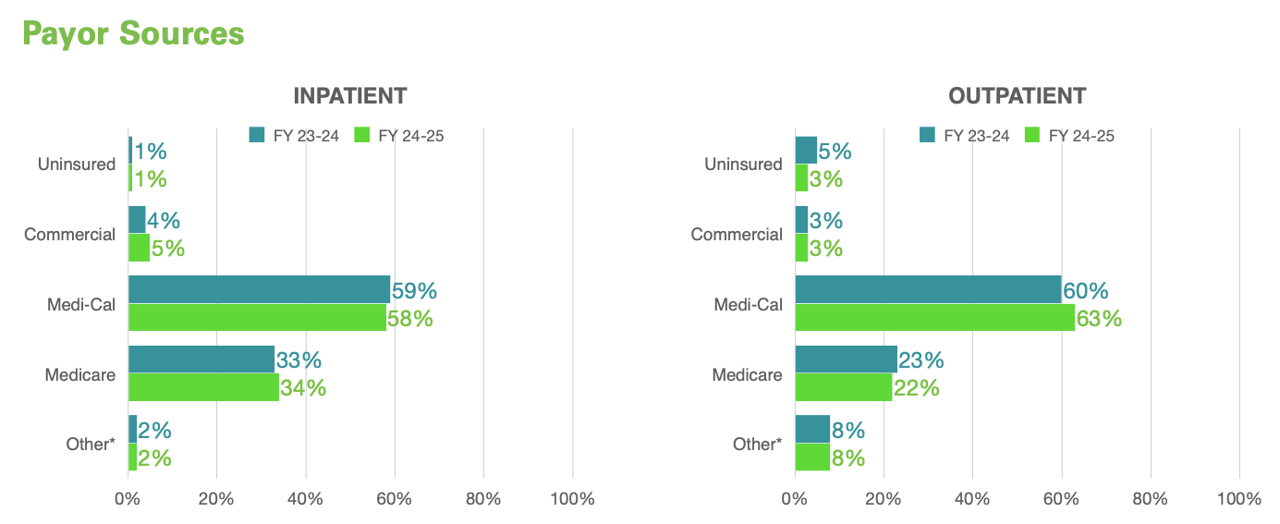
ZSFG Payor Sources
* Healthy Families, Research, Jail, Workers’ Comp, Non-Medi-Cal, CHN Capitated plans
***Medi-Medi patients are included in Medicare

Slide 7
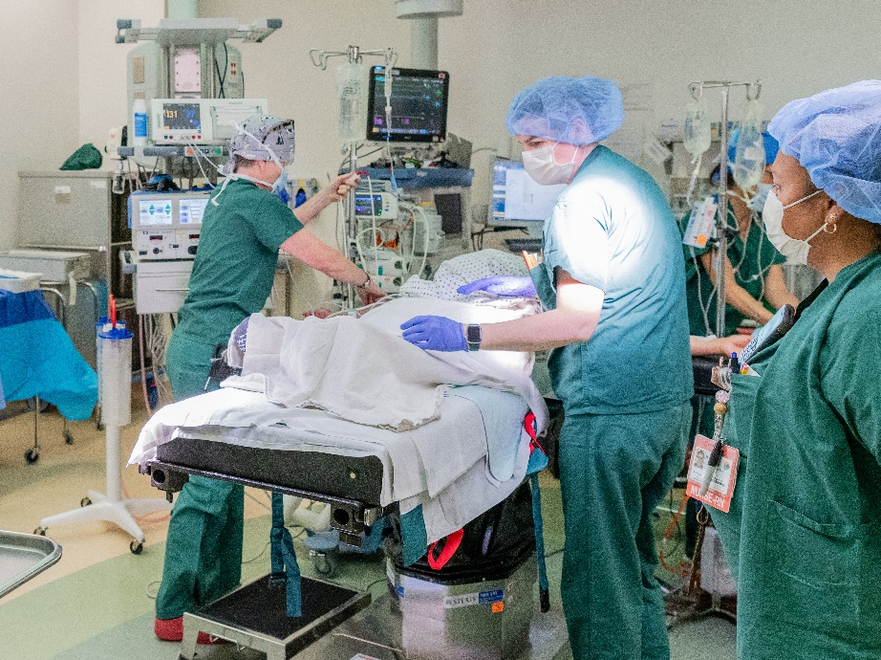
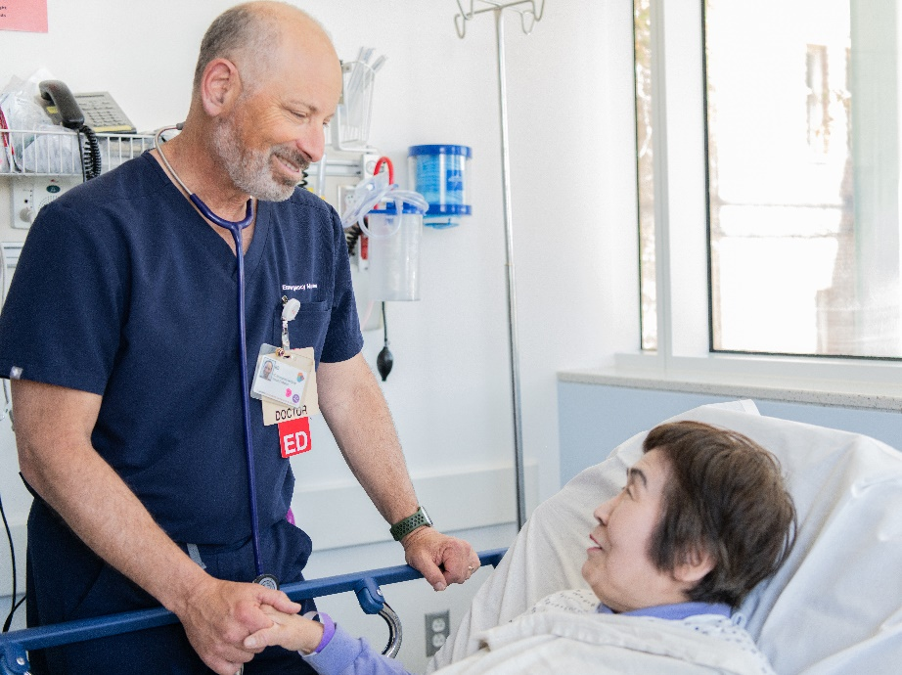
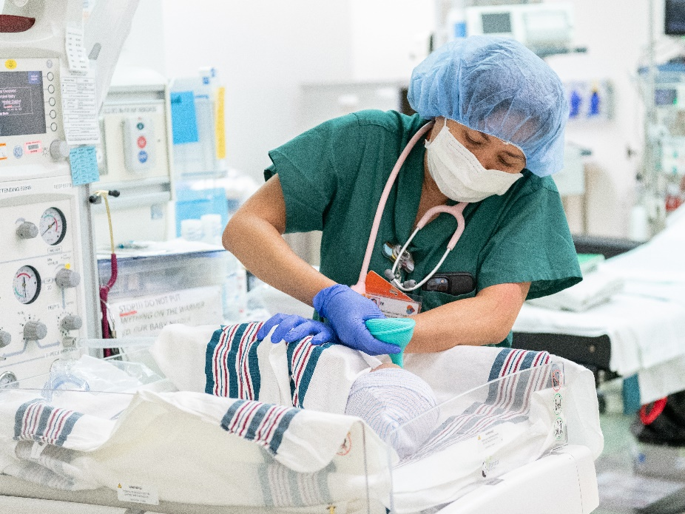
Honors and Awards
Heart Failure Equity Team Receives National Awards
The DPH, SFHN, and ZSFG collaborative team received the 2024 Bernard J. Tyson National Award from the Joint Commission & Kaiser Permanente and the 2024 Quality Leader Award from the California Association of Public Hospitals / HealthCare Safety Net Institute.
Geriatric Emergency Department Accreditation
ZSFGs Emergency Department received Level 3 accreditation in recognition of its commitment to high-quality care for older adults.
2025 NICU of the Year
The NICU received statewide recognition from the California Breastfeeding Coalition for excellence in equity-focused lactation care, with exclusive breastfeeding rates well above the state average.

Slide 8
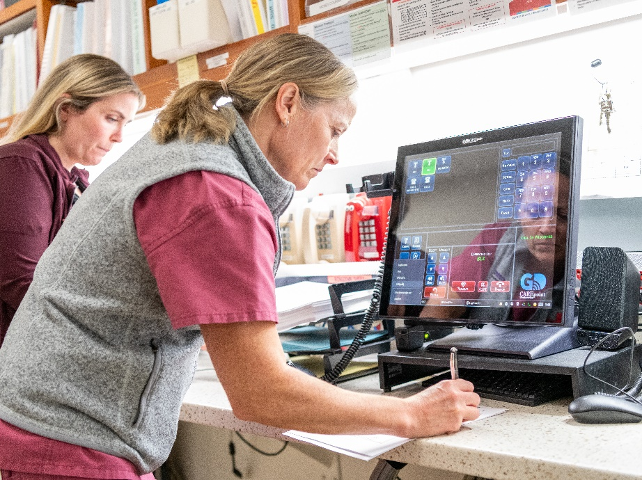
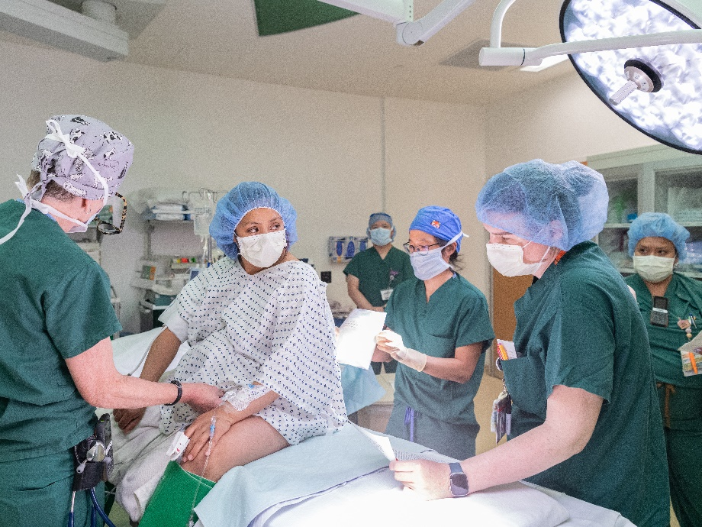
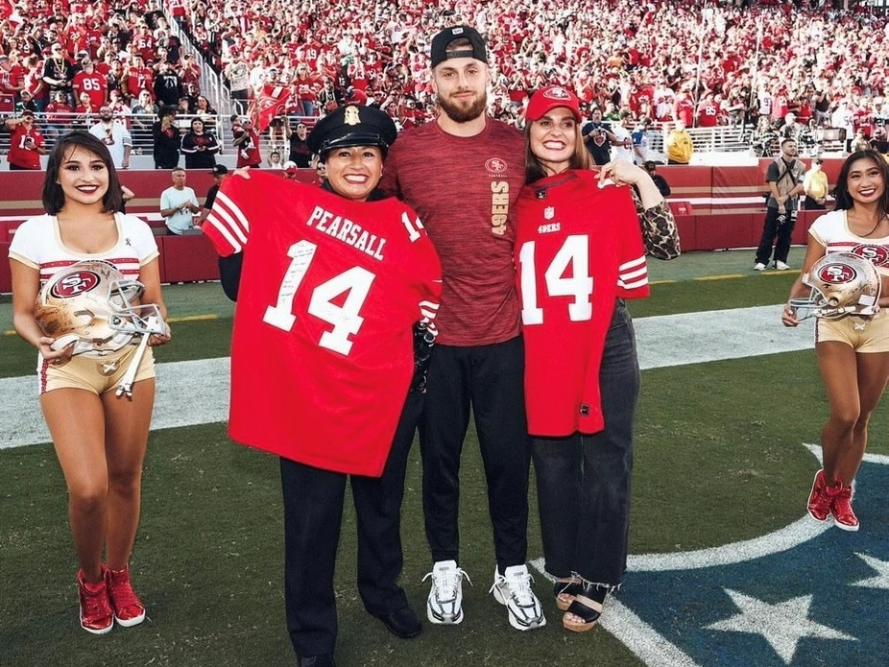
Highlights
Triage Taskforce Puts Patient Needs First
This interdisciplinary team strategized new ways to reduce the number of patients who leave without being seen, including creating a family waiting room and adding two nurse practitioners.
ZSFG Expands Perioperative Services
To meet growing demand, the team increased anesthesia staffing, adding capacity for one more operating room each day.
49ers Honor Trauma and Emergency Teams
The 49ers honored ZSFG Trauma and Emergency Department teams and Dr. Lucy Kornblith during Monday Night Football for the care provided to wide receiver Ricky Pearsall.

Slide 9

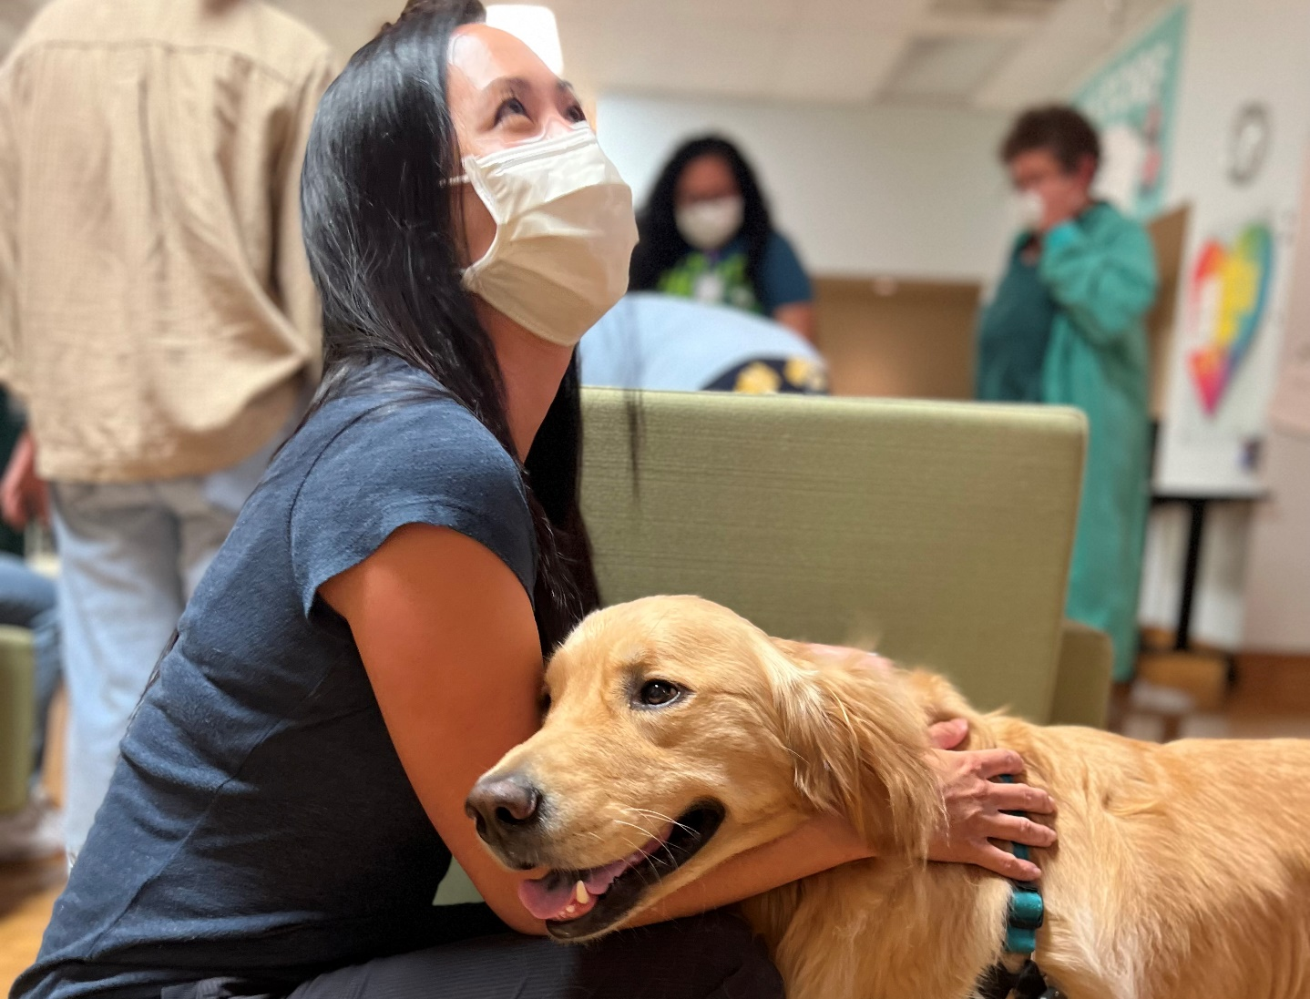
Staff Experience and Wellness
Quarterly Town Halls
Hundreds of staff attended ZSFG's All-Staff Town Hall at two virtual sessions held in June, with DPH Director Dan Tsai and Dr. Susan Ehrlich sharing important updates and joining all staff with leadership.
Wellness Center
The ZSFG Wellness Center provided a valued space for staff to relax, recharge, and connect through popular programs like visits from the SF SPCA canine crew, massage therapy, and exercise classes.

Slide 10
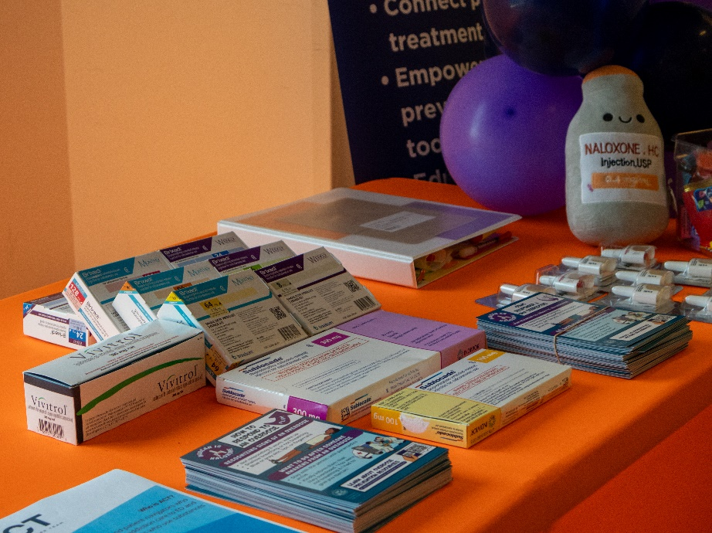
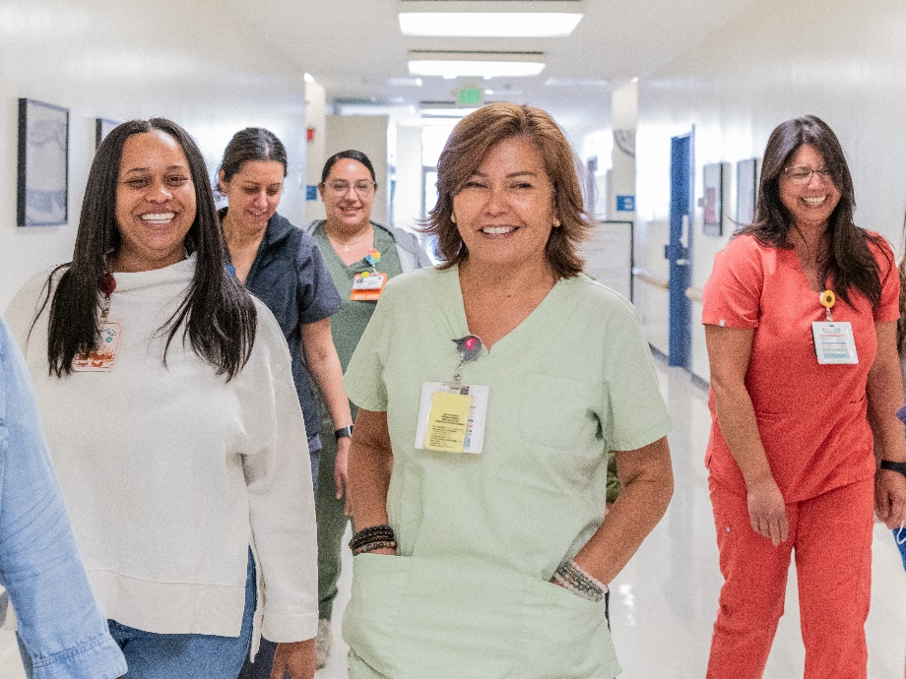
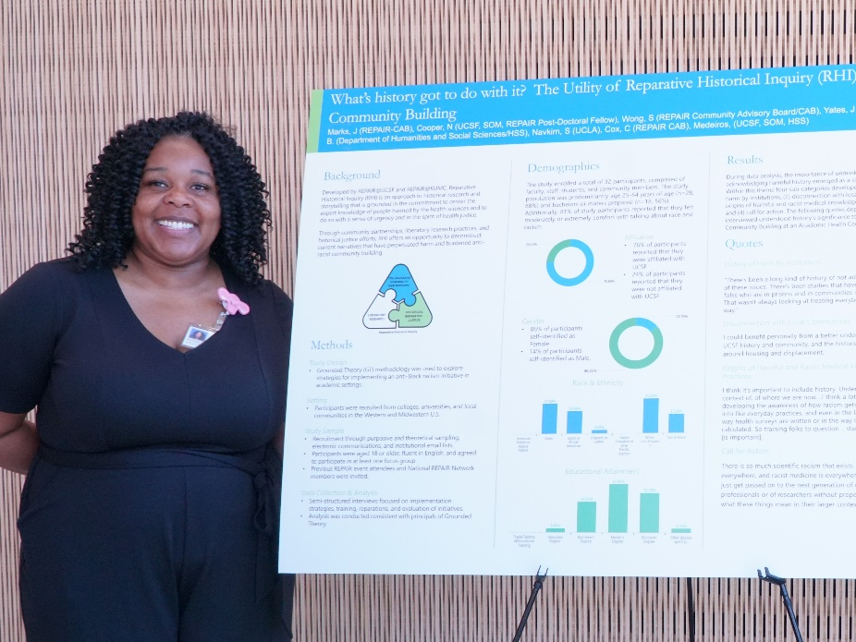
Nursing
ZSFG Hosts Addiction Care Symposium
More than 200 ZSFG and DPH staff gathered in December for the second annual Addiction Care Symposium, cohosted by the San Francisco General Hospital Foundation, the Addiction Care Team, and DPH.
Nurse Hiring and Promotions
ZSFG and DPH HR partnered to host a successful nurse hiring event and promoted several staff to registered nurse positions.
Nurses Week Research Symposium
ZSFG’s Inaugural Nurses Week Research Symposium showcased innovative, evidence-based work led by our nurses.

Slide 11
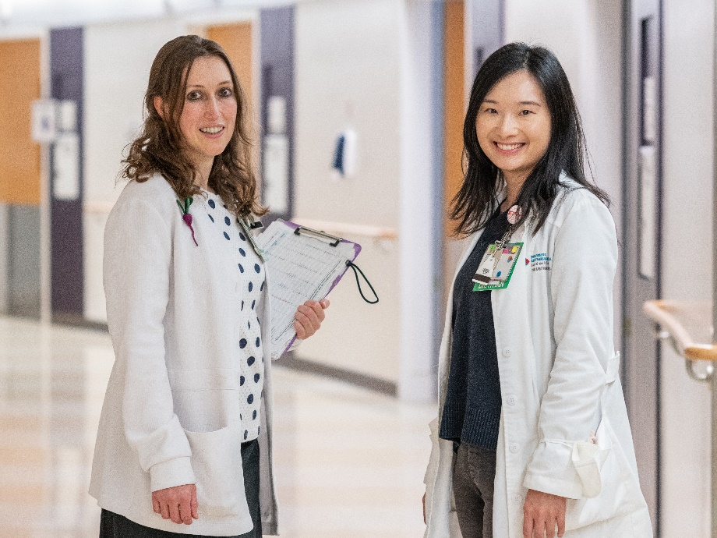
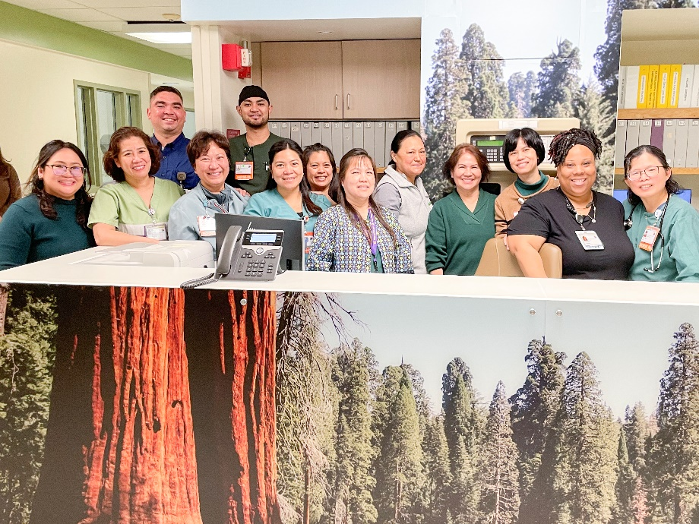
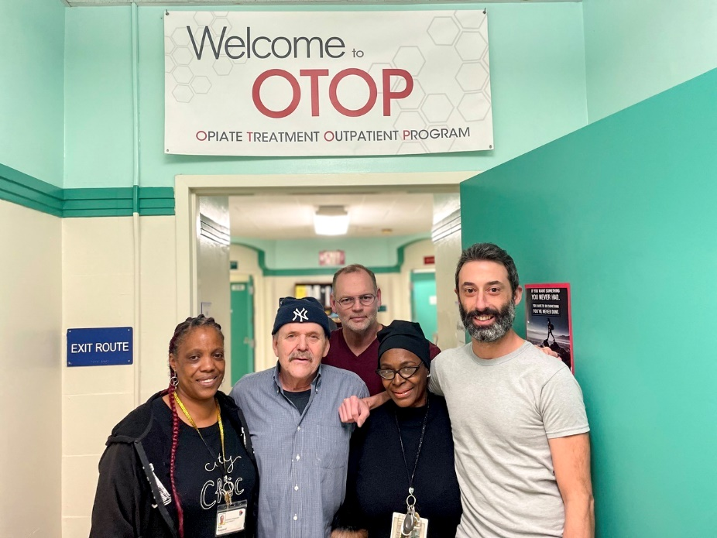
Surveys
ZSFG’s multidisciplinary teams excelled during a steady pace of survey visits in fiscal year 24-25, showcasing their strong commitment to delivering excellent patient-centered care.
The Joint Commission Biennial Recertification
Following a two-day evaluation, the Joint Commission recertified the Advanced Primary Stroke program.
4A Skilled Nursing Facility
The Centers for Medicare and Medicaid Services and California Department of Public Health recertified the facility for the year.
Outpatient and Office-Based Opiate Treatment
The Department of Health Care Services relicensed these programs.

Slide 12
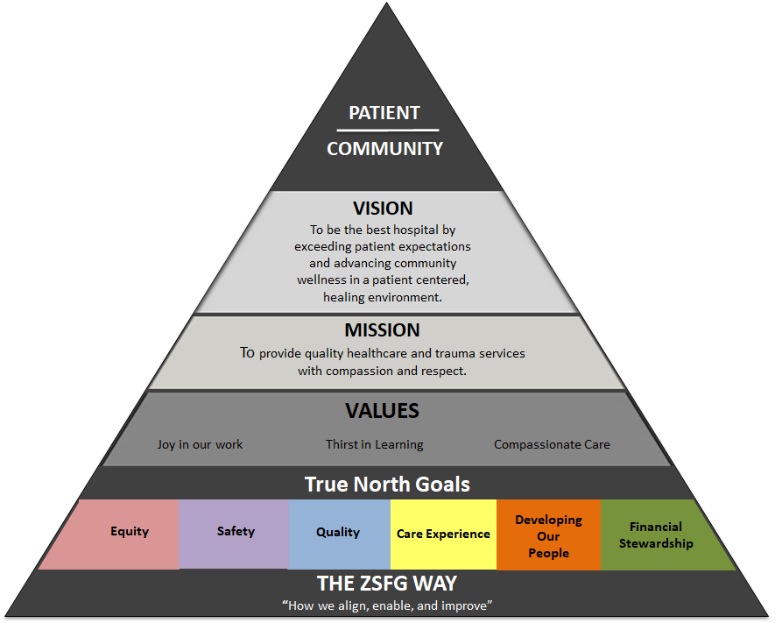
True North Strategies
True North Overview

Slide 13
True North Strategies
True North Overview
SELECTED METRICS | TARGET (FY 24-25) | ACTUAL (FY 24-25)
% of departments with active improvement initiatives around equity and reducing disparities | 65% | 74%
Adult Hospitalized – Inpatient Length of Stay | 5.0 | 6
Boarding – Medical Patients (ED, PACU, ICU) | 15 | 35
Boarding – PES Patients | 57.8 | 57.1
Psychiatry – % Acute Patients | 19.8% | 21.8%
Sepsis Bundle Compliance | 59% | 38%
Falls with Moderate and Major Injury | 0.07 | 0.08
Reduce the # of physical assaults that lead to injury across 5 high risk areas | Avg of less than 4 assaults per month with injury | Avg of 6 assaults with injury, per month
Account Receivable Days | 59 | 58
% Realized Revenue | 14.25% | 14%
Hospital Billing Denial Rate | 15.6% | 15.8%
Equity
Quality
Safety,
Care
Experience
Safety,
Developing Our People
Financial
Stewardship

Slide 14
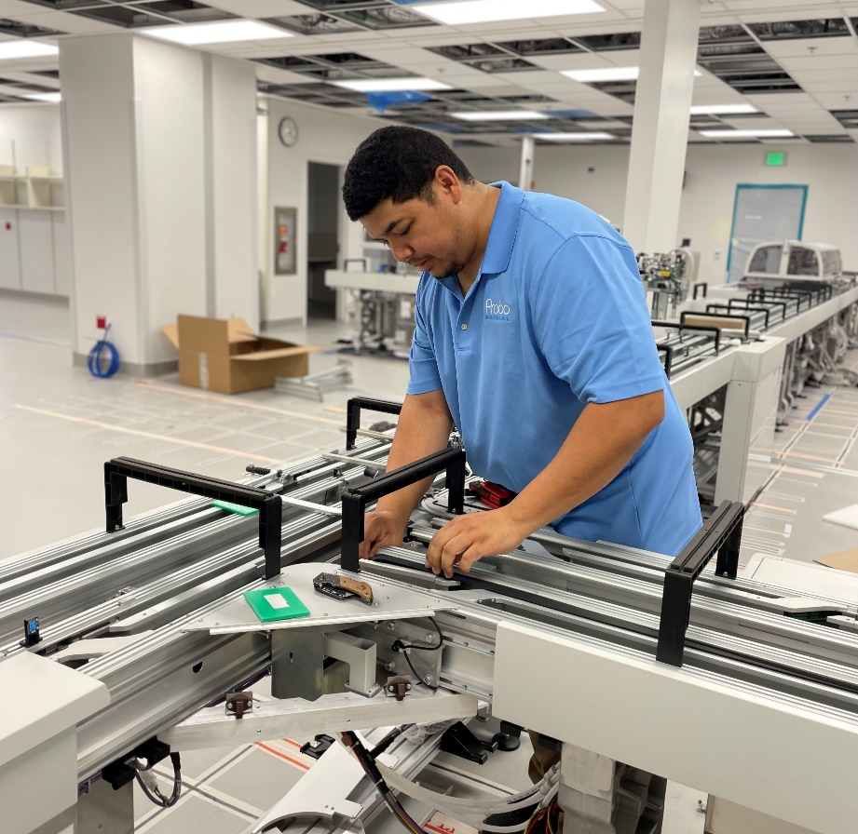
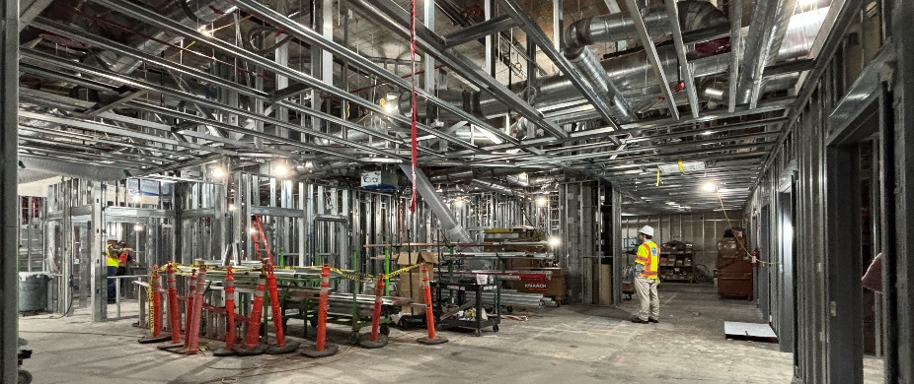
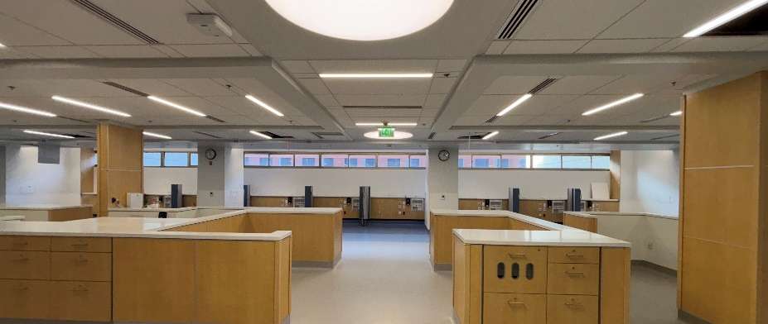
Capital Projects
Building our future
ZSFG Receives Funding for Critical Capital Upgrades
With the passage of Prop B in November, ZSFG will make healthcare infrastructure improvements including seismic retrofit of Building 3, mechanical and IT systems upgrades, and climate-resilient infrastructure improvements.
Clinical Lab Completion
Completed project in May, this tremendous undertaking included the installation of a modern robotic clinical lab track that now processes more diagnostic tests, helping meet increasing patient demand.
Psychiatric Emergency Services
More than 40% complete, construction of the new 8,000-square-foot PES will bring in much-needed daylight for patients and expand the size of the unit for better patient care.
Dialysis Relocation
This new and modern facility for dialysis patients is on track to be substantially complete by the end of 2025.

Slide 15
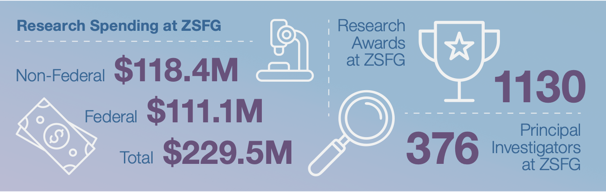
UCSF at ZSFG
Research highlights
Neurology
An investigation on substance use-related in cardiac arrest patients found more severe outcomes for cases involving fentanyl use, which informs resuscitation education with overdose prevention groups.
Surgery
The division advanced its mission of improving outcomes for trauma and critically ill patients through impactful research, collaboration, and innovation, producing more than 90 peer-reviewed publications.
Emergency Medicine
Medical staff continue to make significant contributions to scientific advancement and patient care, with more than 150 peer-reviewed publications representing a broad spectrum of research topics.

Slide 16
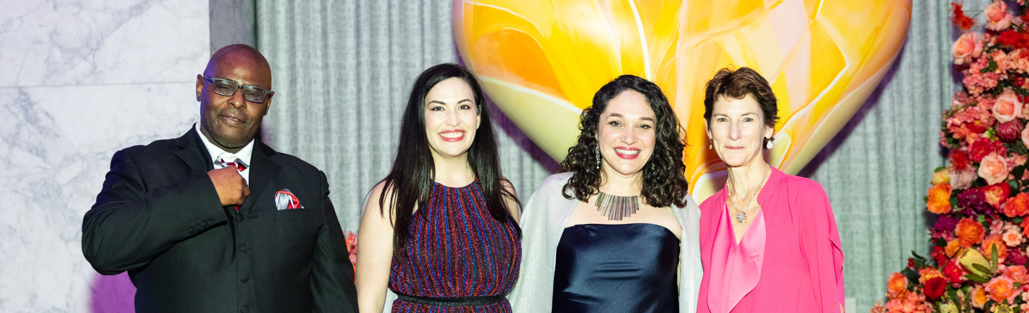
San Francisco General Hospital Foundation
Hero & Heart Awards
Congratulations to Michael Texada, the Wraparound Project; Dr. Marlene Martin, Addiction Care Team; and Kathryn Margolis, PhD, HealthySteps.
Equity and Innovation Grants
Two grantees received a $100,000 capacity-building grant, for new initiatives that will have a widespread impact on patient care.
Project Reach
Transforming surgical care for people experiencing housing instability or homelessness by developing care plans that meet patients where they are.

Slide 17
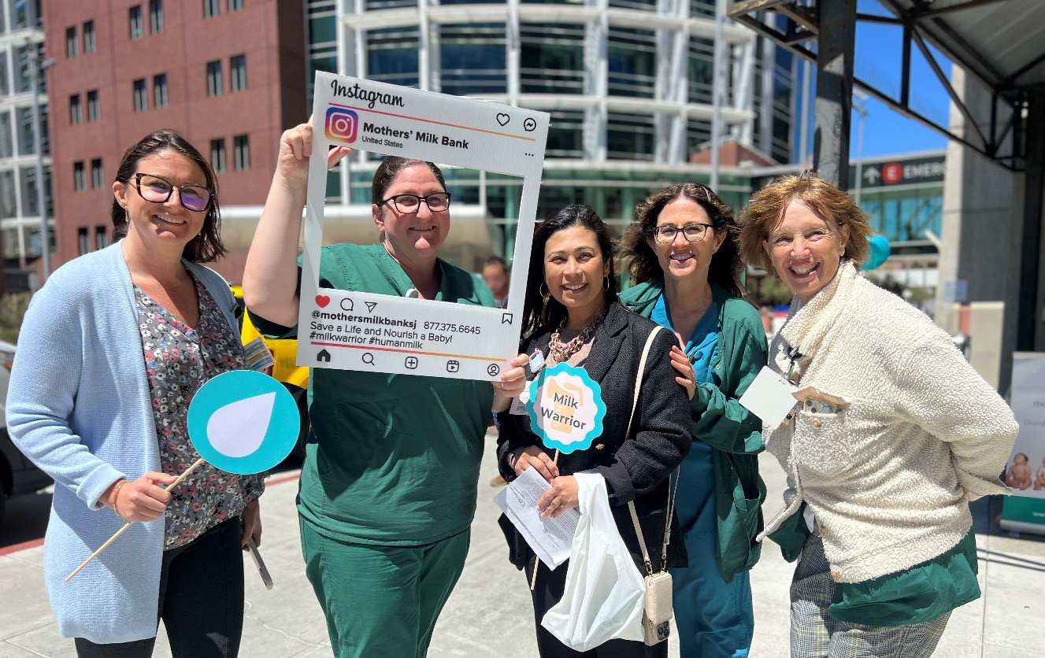
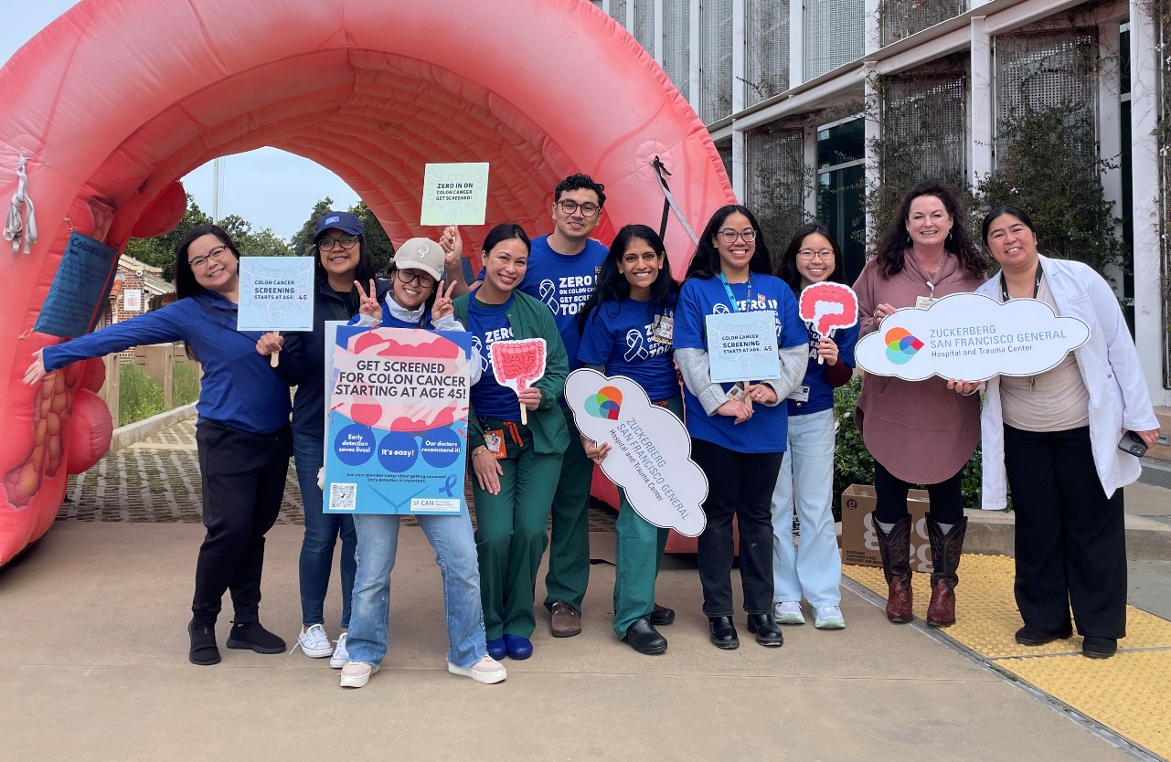
Community Outreach
ZSFG Hosts First Milk Drive in San Francisco
In August, ZSFG hosted San Francisco’s first Milk Drive in partnership with the Mother’s Milk Bank of California. ZSFG’s Family Birth Center collected more than 3,000 ounces to support NICUs and families in need across the country.
ZSFG Raises Awareness for Colorectal Cancer
In March, ZSFG’s Gastroenterology (GI) and Nutrition teams hosted community events to promote colorectal cancer prevention, offering education and healthy eating tips to encourage screenings and reduce stigma.

Slide 18
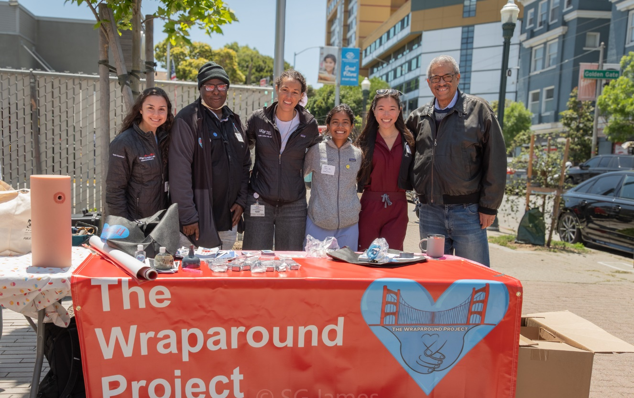
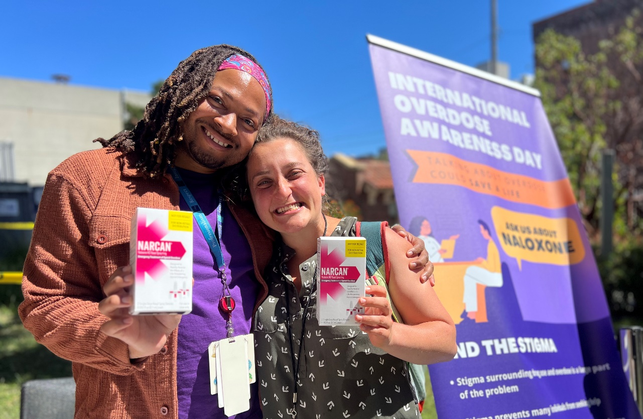
Community Outreach
Community Health Fair in the Western Addition
The ZSFG Stroke Team and Wraparound Project hosted their first Community Health Fair in the heart of the Western Addition. The free, family-friendly event brought together doctors, nurses, pharmacists, and staff from across DPH.
International Overdose Awareness Day
Staff encouraged open conversations and connected community members to addiction services at several tabling events on the ZSFG campus.

Slide 19
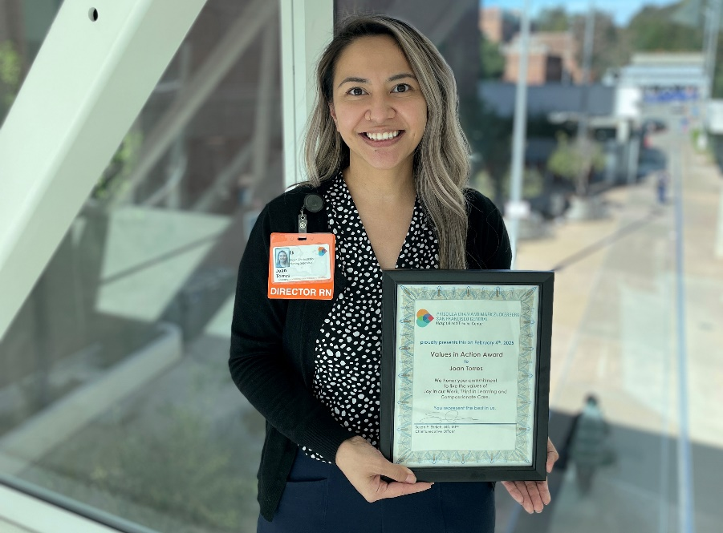
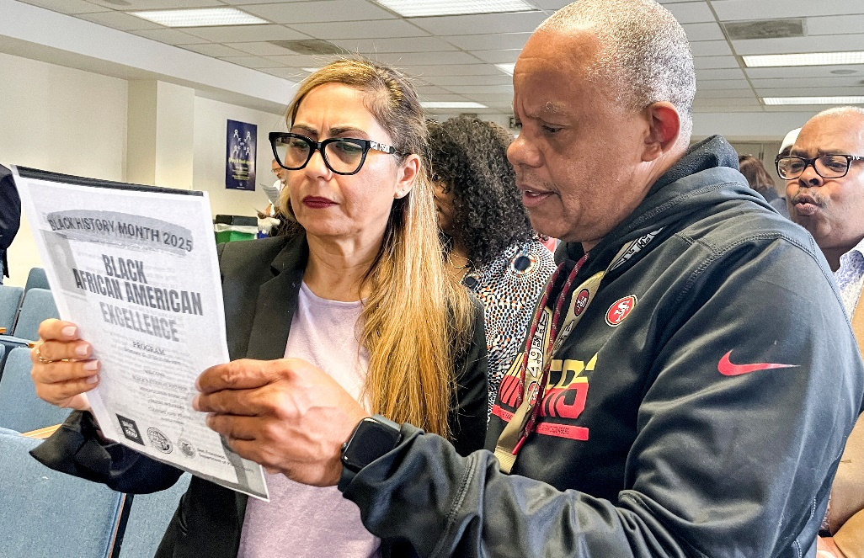
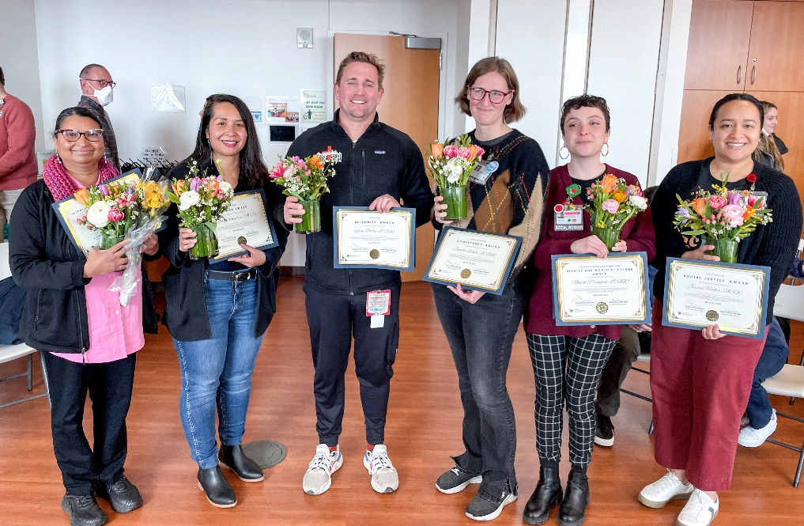
Staff Celebrations
Values in Action
Each month ZSFG honors a staff member who exemplifies ZSFG's core values of Joy in Work, Thirst in Learning, and Compassionate Care.
Black History Month
ZSFG hosted a powerful Black History Month celebration led by labor partners, featuring music, reflections, and remarks from DPH and community leaders.
Honoring ZSFG Social Workers
ZSFG held its first Social Workers Awards Ceremony in March to recognize the essential role they play in patient care and advocacy.

Slide 20
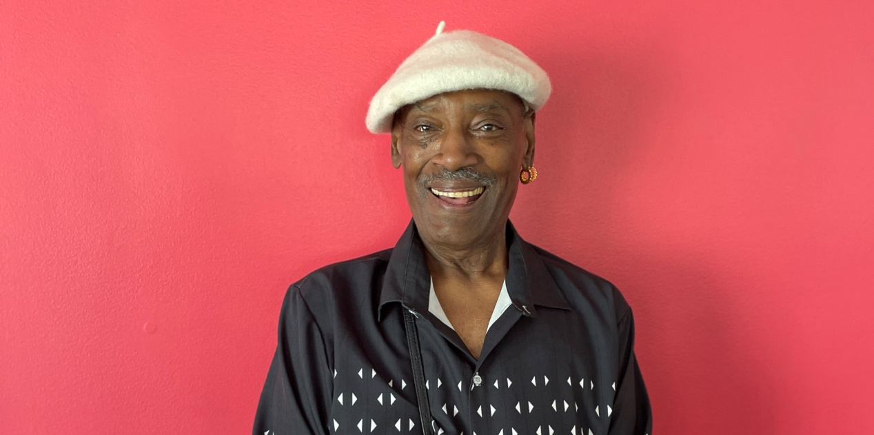
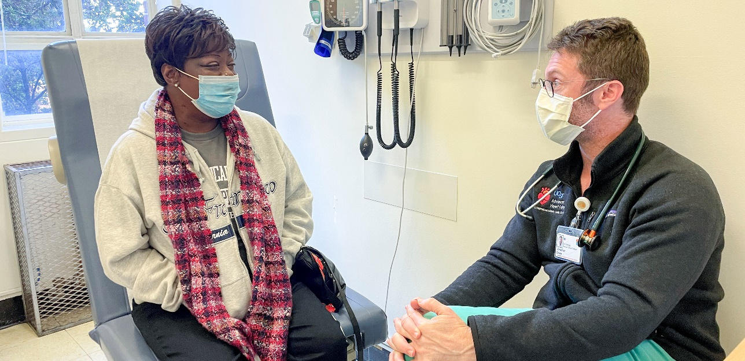
Our Patients
Roscoe Makes a Strong Recovery
After a visit to the Emergency Room, ZSFG’s Age-Friendly Emergency Department team connected Roscoe with a community partner, Stepping Stone, whose staff pick up his medications and bring him food.
Pamela Turns Struggle into Survival
Post-heart transplant, Pamela Dorsey is building her strength, exercising regularly, and singing her heart out in the church choir.
“The staff was wonderful. Every time I came in, I felt comfortable with the nurses and the doctors. We really got on well.”
“Dr. Davis saved my life. He really did.”

Slide 21
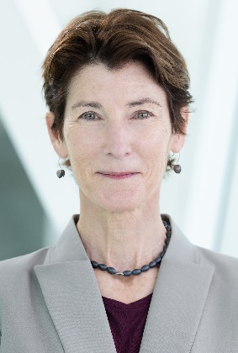
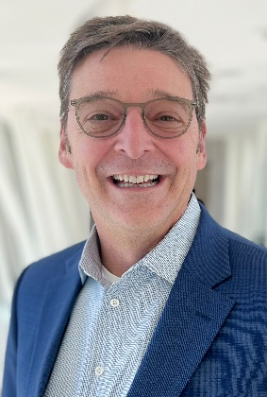
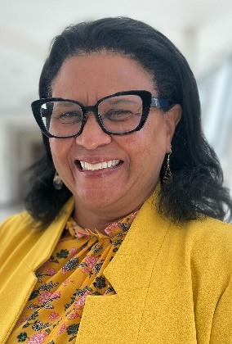
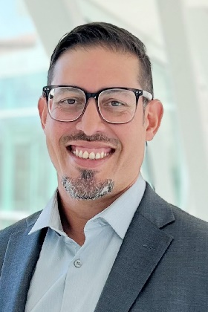
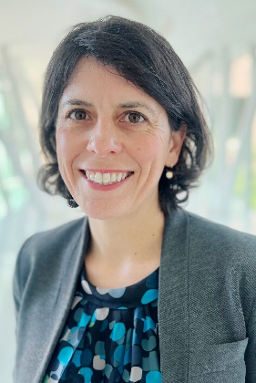
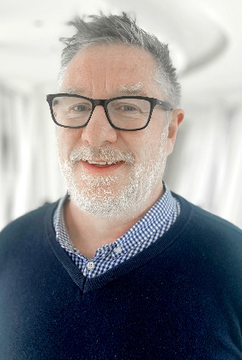
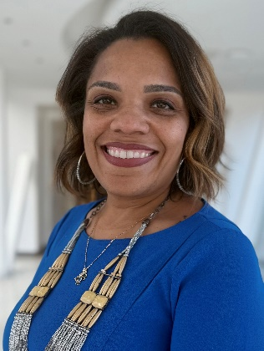
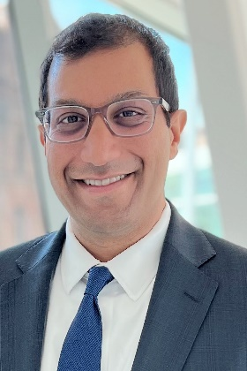
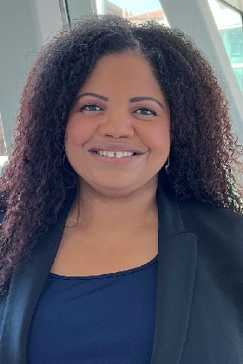
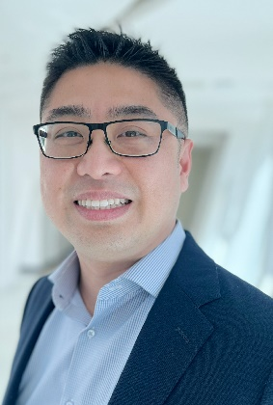
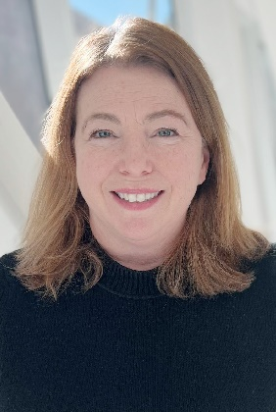
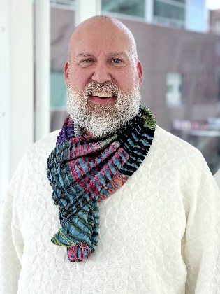
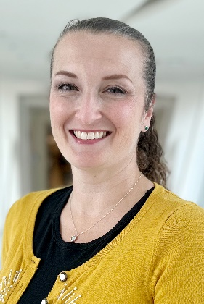
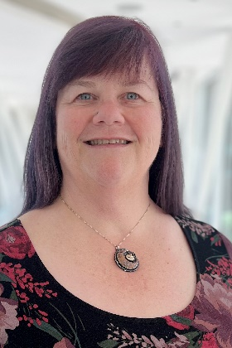
Profiles
ZSFG Executive Team
Susan P. Ehrlich, MD, MPP
Chief Executive Officer
Jeff Critchfield, MD
UCSF Vice Dean
Gillian Otway, MSN, RN
Chief Nursing Officer
Gabriel Ortiz, MD
Chief Medical Officer
Mary Mercer, MD, MPH
Chief of Staff
Adrian Smith, MSN, RN
Chief Quality Officer
Sabrina Robinson, MBA, CMPE, FACHE
Chief Operating Officer
Hemal Kanzaria, MD
Chief Performance
Excellence Officer
Angelica Jourdain, JD, MHA
Chief Administrative Officer
Eric Wu, MPA
Chief Financial Officer
Christine Falvey, MPA
Chief Communications Officer
Justin Dauterman, MSN, RN Chief Experience Officer
Angelica Almeida, PhD
Chief Integrative Officer
Laurae Pearson
Associate Dean
Administration and Finance

Slide 22
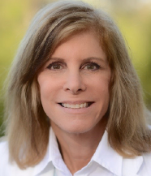







Profiles
San Francisco Health Commission
Laurie Green, M.D. Health Commission President
Tessie M. Guillermo
Vice President
Edward A. Chow, M.D.
Susan Belinda Christian, J.D.
Suzanne Giraudo, Ph.D.
Judy Guggenhime
Karim Salgado
Mark Morewitz, MSW

Slide 23



In Summary
Joy in our Work
Compassionate Care
Thirst in Learning

Slide 24


ZSFG would like to express our deepest gratitude to our patients and the community of San Francisco.
Notes:
Thank you.

