Slide 1
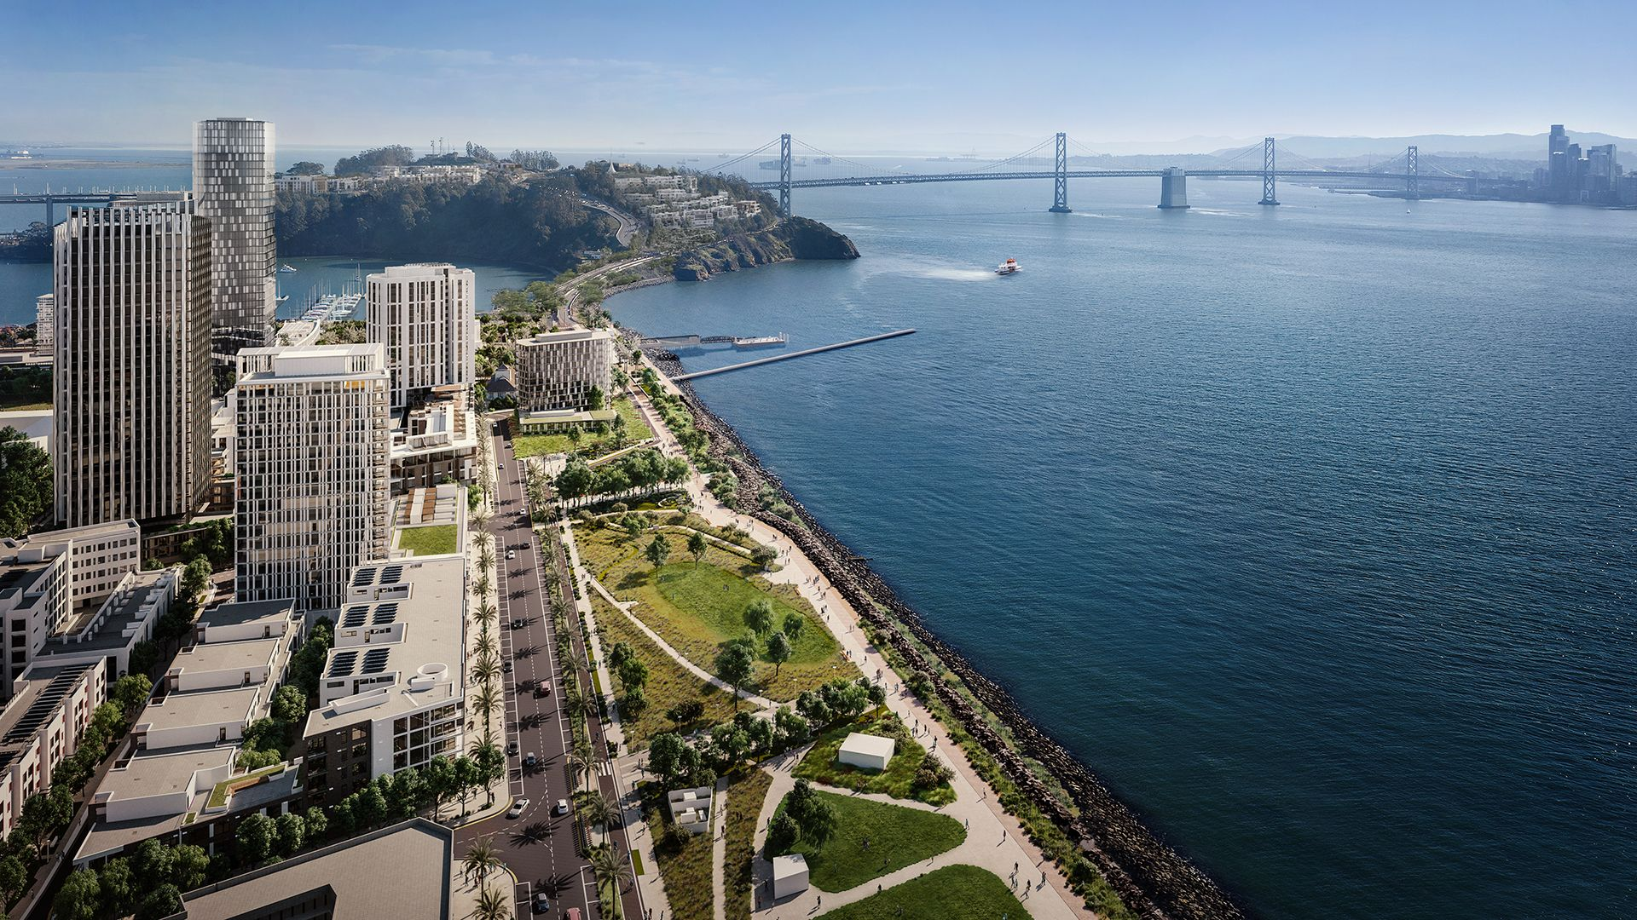
TI Advisor Board Report
Presented By
Karen Eddleman
May 8, 2024
Notes:
I will be covering familiar ground today, but hopefully the information is organized and presented in a way that better communicates the opportunities available to residents and the challenges of implementation.

Slide 2
Additional Engagement with Residents of The Villages
Community Events
Star View Court Informational Poster Session –
Informational Meeting with SF Housing Authority for Section 8 Voucher Holders – April 20th
Star View Court Unit Tours – March - April
Informational Event for Inclusionary Affordable Units - March 14th
Ongoing Assistance
DAHLIA Registration Help
Continued One-on-One TI Advisor Meetings (50+ in April)
TI Advisor Drop In Sessions

Slide 3

Transition Housing Timeline
January
September
Engagement with all Residents of The Villages |  |  | TIDA issues First Notice to Move to Matching Legacy Households in Legacy Household Rank Order |  | Star View Court Affordable Unit Lottery |  | TIDA issues Second Notice to Move Households Select Transition Benefit Option |  | Star View Court Legacy Household and DAHLIA Lottery Winner Moves
Ongoing |  |  | Beginning April 2024 |  | May 16, 2024 |  | Beginning June 2024 |  | July to September 2024
Additional Island Housing Options in 2024/2025
Isle House Market Rate or Inclusionary Apartments
Hawkins Market Rate or Inclusionary Apartments
490 Avenue of the Palms Market Rate or Inclusionary Condominiums

Slide 4
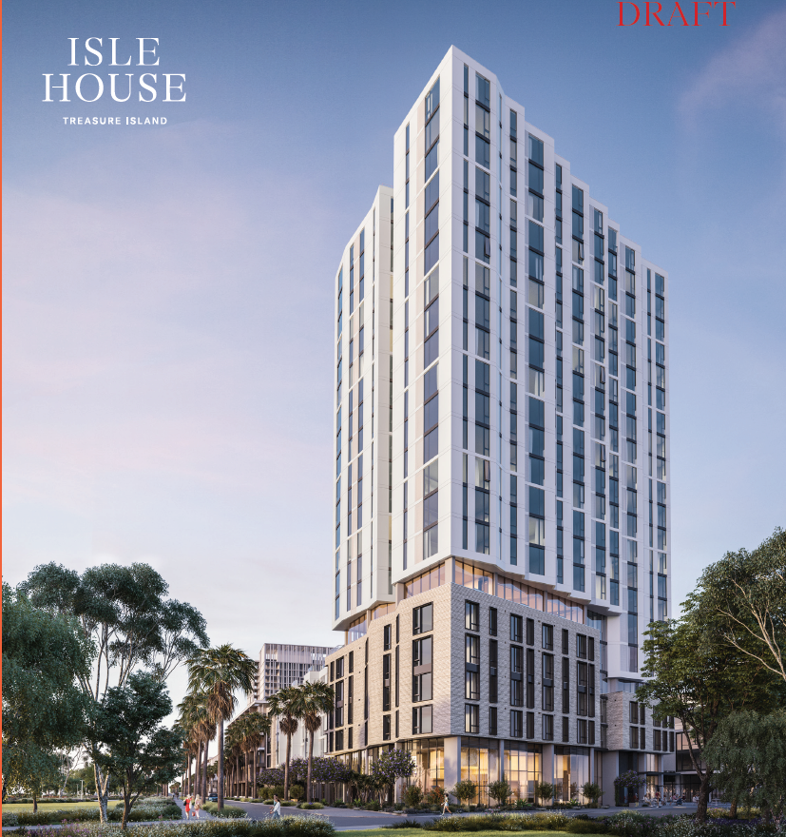
Housing Opportunities for All
Rent a Market Rate or Below Market Rate Apartment in 2024!
Premarketing May 2024
DAHLIA Application Period Late May/Early June 2024
MOHCD holds DAHLIA Lottery for Inclusionary Affordable Apartments June/July 2024
Lease Up in Fall 2024
Inclusionary Affordable Apartments are priced for Households earning
60% of Area Median Income (AMI)
Legacy and Vested Residents have the Highest Priority using their Treasure Island Resident (TIR) Preference Number
Isle House
Apartments for Rent
226 Market Rate Apartments
24 Inclusionary Affordable Apartments

Slide 5
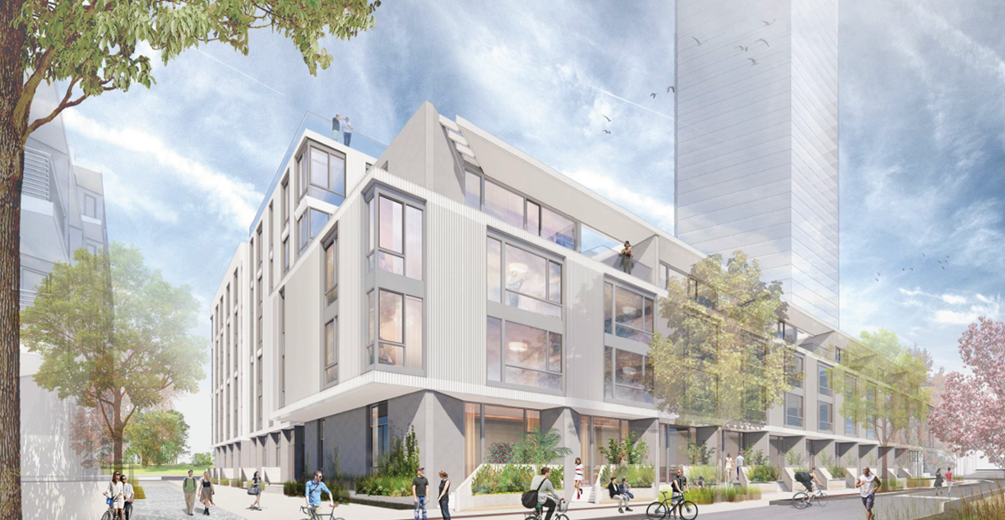
Housing Opportunities for All
Rent a Market Rate or Below Market Rate Apartment in 2024!
Premarketing Early Fall 2024
DAHLIA Application Period Early Fall 2024
MOHCD holds DAHLIA Lottery for Inclusionary Affordable Apartments Fall 2024
Lease Up in Winter 2024
Hawkins
Apartments for Rent
169 Market Rate Apartments
9 Inclusionary Affordable Apartments
Inclusionary Affordable Apartments are priced for Households earning
60% of Area Median Income (AMI)
Legacy and Vested Residents have the Highest Priority using their Treasure Island Resident (TIR) Preference Number

Slide 6
Housing Opportunities for All
How to apply for a Below Market Rate Apartment
Use the DAHLIA website to understand your household income. https://housing.sfgov.org/income-calculator/rental/intro
Register for DAHLIA now for affordable housing at https://housing.sfgov.org/
Apply on DAHLIA when the property is advertised for rent. https://housing.sfgov.org/
If you win the DAHLIA lottery, work with MOHCD and the property manager to complete your application.

Slide 7
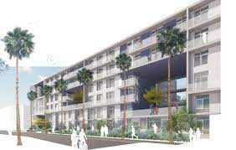
Housing Opportunities for All
Purchase a Market Rate or Below Market Rate Condominium!
Priced for households earning 80-120% of Area Median Income (AMI)
Treasure Island Resident (TIR) Preference Certificate Number for Legacy and Vested Residents
Down Payment Assistance for Legacy Residents
First Time Homebuyer Education Available
Studio, 1-, 2-, and 3-Bedroom Condominiums for Sale
490 Avenue of the Palms
(formerly “Portico”)
Condominiums for Sale
141 Condominiums for sale at Market Rate
7 Condominiums for sale at Below Market Rate
Lottery Anticipated in Early 2025
Contact your TI Advisor Today
for the latest information and additional details about Premarketing Notices and DAHLIA Lottery Schedules for Inclusionary Affordable Units.
TIAdvisor@arws.com or 415-650-6078
Notes:
Portico
DAHLIA Open Application Period Starts approx. 1 month before lottery, lasts 21 days
DAHLIA Lottery Date January/February 2025
Potential Move In Date March 2025
CTCAC 80% to 120% AMI for CTCAC Inclusionary Units 2023: Below is the link to the AMI chart for CTCAC 2023. This shows the 80% AMI Level. To get the 120% AMI level, you just need to multiply the 100% income level by 1.2.
https://www.treasurer.ca.gov/ctcac/rentincome/23/income/income-limits-051523.pdf
One Person: $104,080 to $156,120
Two Person: $118,860 to $178,440
Three Person: $133,840 to $200,760
Four Person: $148,460 to $222,960
Five Person: $160,560 to $240,840
Six Person: $172,480 to $258,720
Seven Person: $184,320 to $276,480
Eight Person: $196,240 to $294,360

Slide 8
Housing Opportunities for All
How to apply for an Inclusionary Condominium at Below Market Rate
Determine if you can buy a Below Market Rate condominium. https://sf.gov/determine-if-you-can-buy-affordable-housing-program
Complete all First Time Homebuyer Education and Obtain a Certificate. https://www.homeownershipsf.org/homebuyer-education/
Register on DAHLIA. https://housing.sfgov.org/
Apply on DAHLIA when the property is advertised for sale. https://housing.sfgov.org/
If you win the DAHLIA lottery, work with MOHCD and your lender to complete the purchase of your condominium.

Slide 9
Encouraging Villages Residents to Act Now!
Legacy and Vested Residents can use their
Treasure Island Resident (TIR) Preference Certificate Number
to secure a chance to rent or own an Affordable Unit!
Contact your TI Advisor to learn more about qualifying for these affordable units!
We can assist you in signing up for TI Advisor Portal and Premarketing Notices!
We can help you register for DAHLIA!
DAHLIA lottery for Affordable Units in 2024!

Slide 10

Thank you for your time.

