Slide 1
Star View Court Transition Units and DAHLIA Application Support
Community Engagement
Star View Court Informational Poster Session –February 21
Informational Meeting with SF Housing Authority for Section 8 Voucher Holders – April 20th
Star View Court Unit Tours – March – April
Posters, Door Hangers, Emails, Calls, Portal Upload
Ongoing Assistance
DAHLIA Registration Help
Continued One-on-One TI Advisor Meetings (50+ in April)
TI Advisor Drop In Sessions

Slide 2
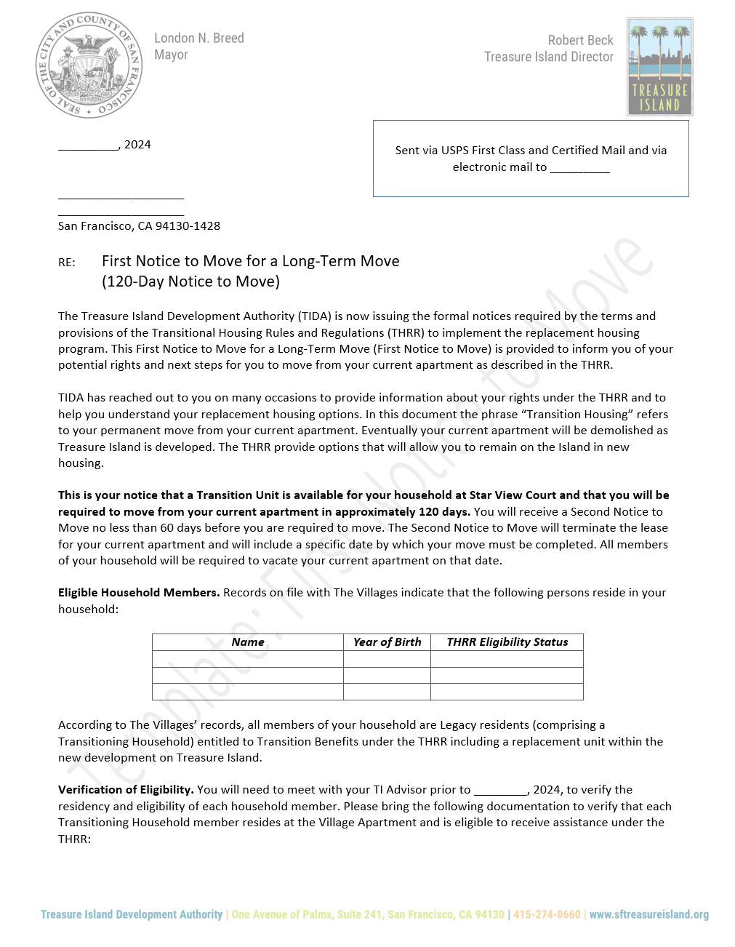
Transitioning Legacy and Mixed Households
TIDA issued 31 First Notices to Move: April 2024
Focus on Legacy and Mixed Households with Legacy Household Rank Numbers 1 to 69.
Focus on matching households to Transition Units at Star View Court.
TI Advisors engaging households to confirm eligibility and unit size.
Working with households to select apartments at Star View Court
Working with Property Managers at Star View Court to support lease up process.

Slide 3

36 Residents living at The Villages applied for Star View Court Affordable Units
10 Legacy Residents
25 Vested Residents
1 Post Vested Resident
Next Steps:
MOHCD Holds Lottery May 16
MOHCD Notifies Lottery Winners
Winners Required to Respond within 4 days
Successful Applicants work with Property Management at Star View Court to finalize lease and move July to September 2024

