Slide 1

Star View Court 78 Johnson Street, Treasure Island
May 8, 2024

Slide 2


About Mercy Housing & Catholic Charities
We are a national nonprofit organization that is working to build a more humane world where poverty is alleviated, communities are healthy, and all people can develop their full potential. We participate in the development, preservation, management and/or financing of affordable, program-enriched housing across the country.
Mercy handles almost every aspect of the affordable housing process
Project financing
Housing development
Community outreach
Property management and resident services
Founding member of One Treasure Island (formerly the Treasure Island Homeless Development Initiative)
Star View Court will be the 4th affordable housing project that MHC and CC have developed together
Catholic Charities provides resident services and supports families, aging adults, adults with disabilities, and youth through human services and opportunities for healthy growth and development
Provides wide range of services including:
Transportation services
Immigration services
Homelessness and housing services
Children and youth services
Founding member of One Treasure Island (formerly the Treasure Island Homeless Development Initiative)
Has operated supportive housing for families on Treasure Island since 1999

Slide 3
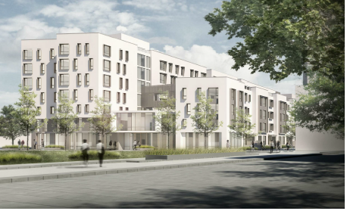

About Star View Court
Second Authority development on Treasure Island
138 units, mix of 1-BR, 2-BR, 3-BR, 4-BR apartments
Construction completion anticipated for June 2024
138 units
1 Bedroom – 23
2 Bedroom – 61
3 Bedroom – 40
4 Bedroom – 14
Notes:
Second development overall

Slide 4
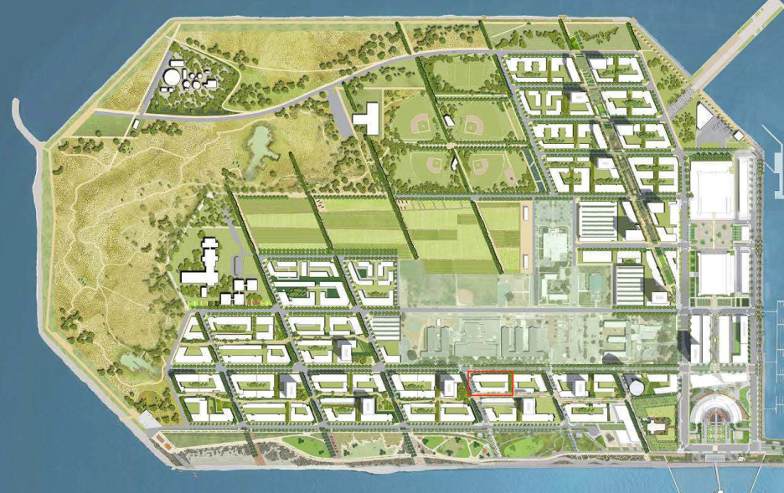
Project Location
Star View Court

Slide 5
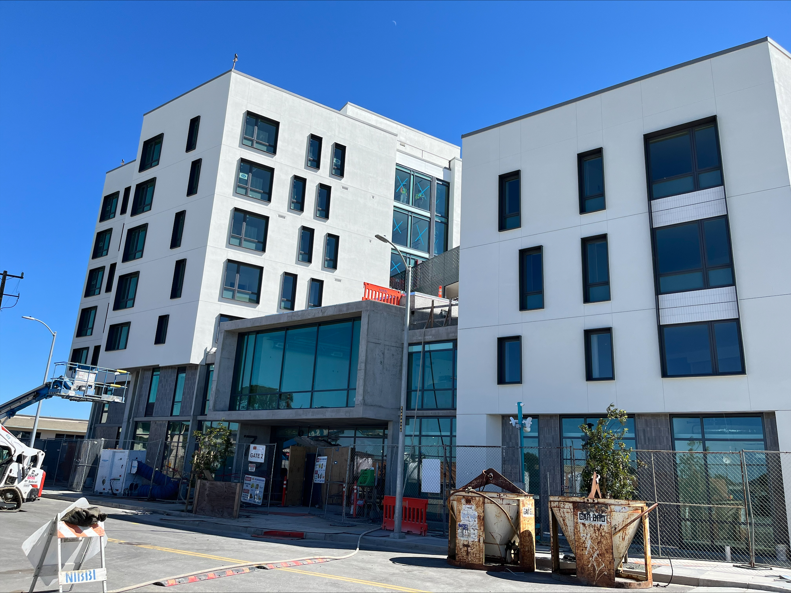
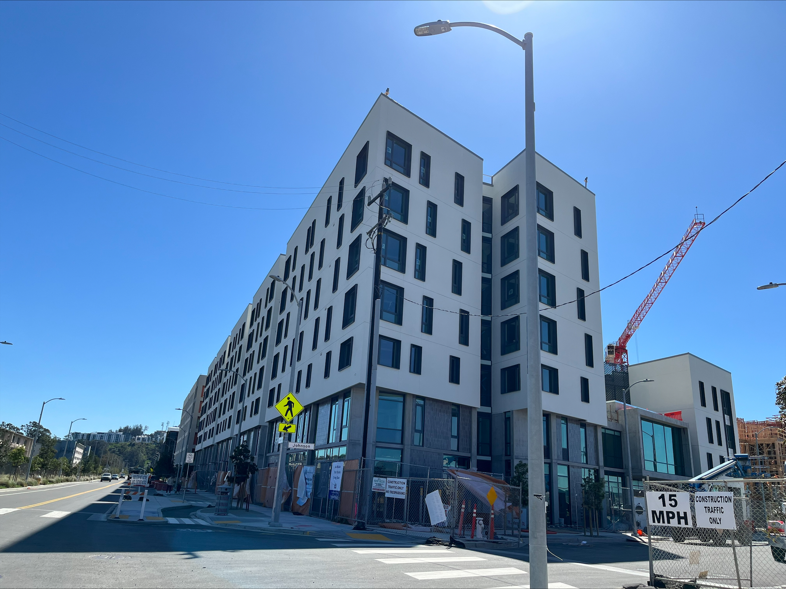
Construction Progress
Entrance on Johnson Street
View from Seven Seas Avenue

Slide 6
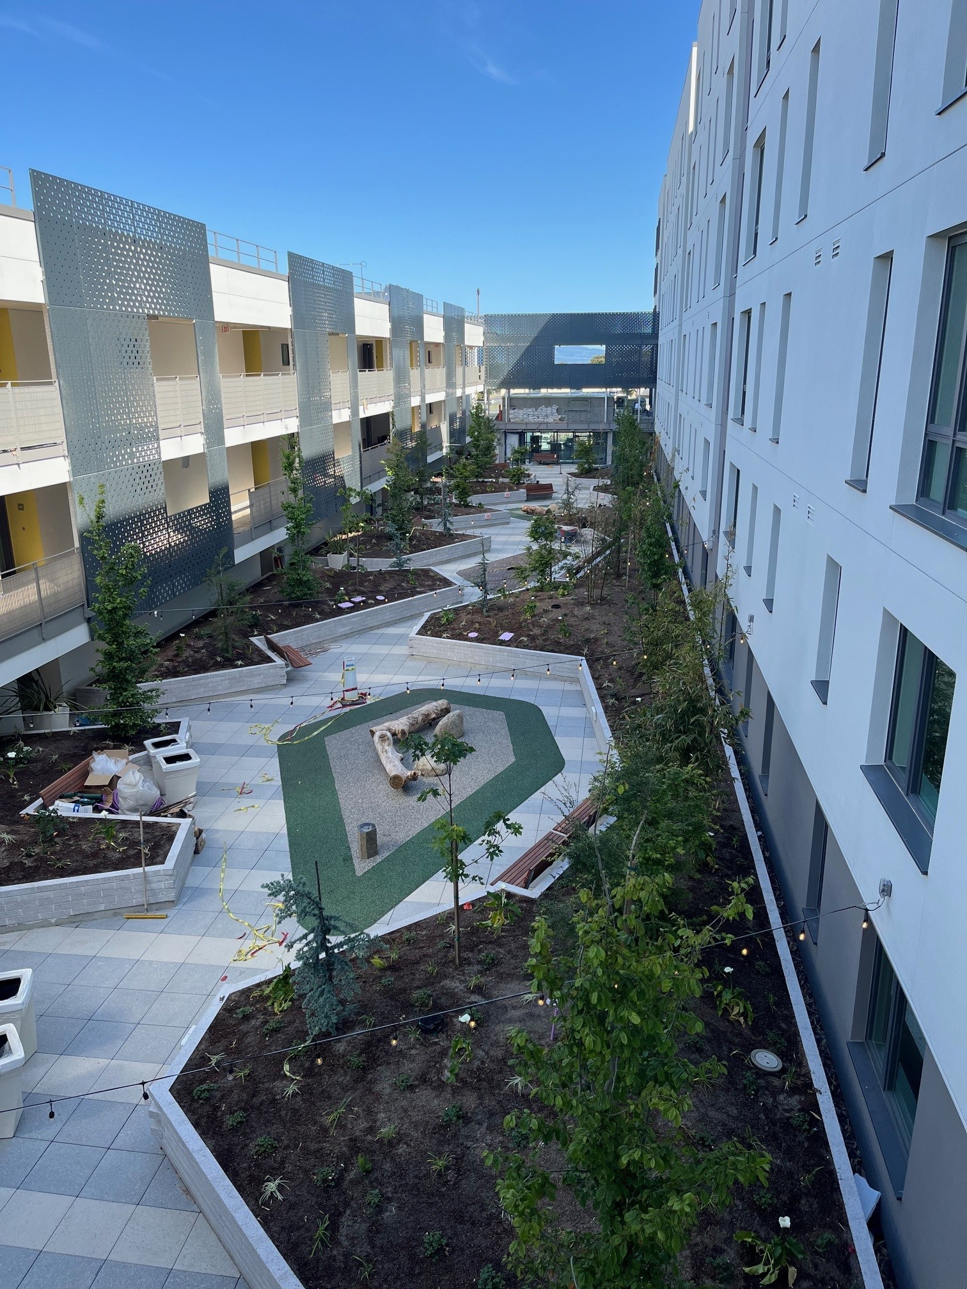
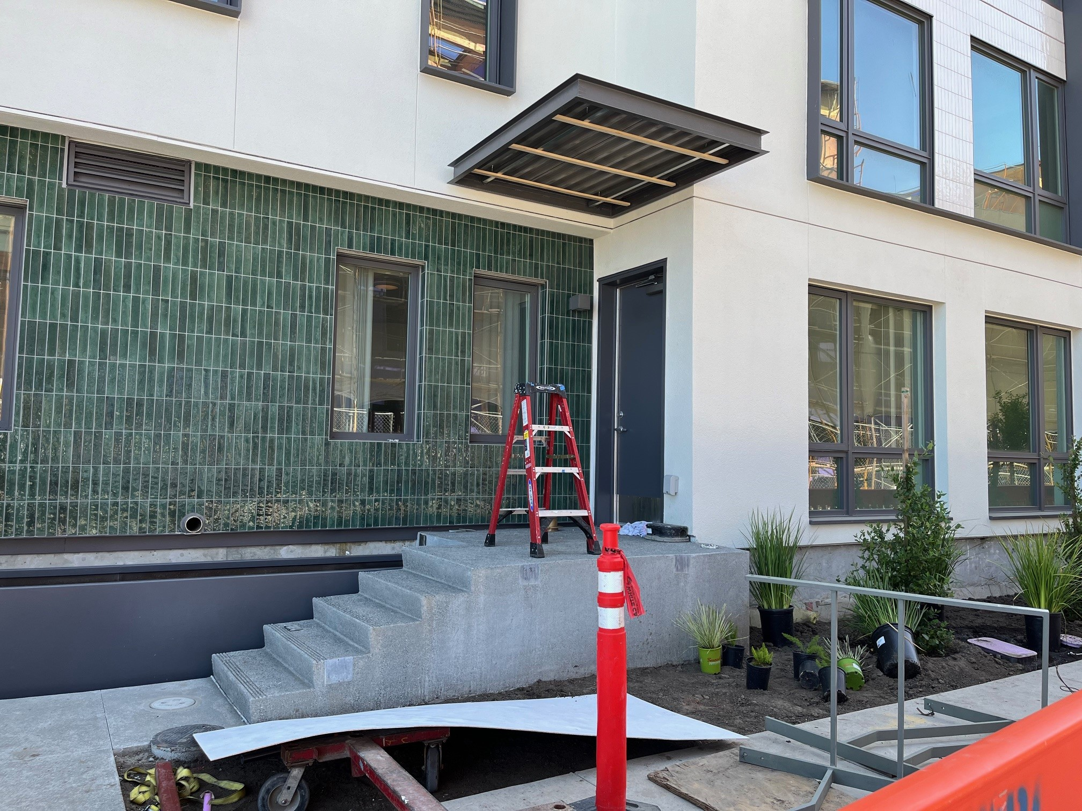
Construction Progress
Courtyard
Unit entry at shared public way

Slide 7
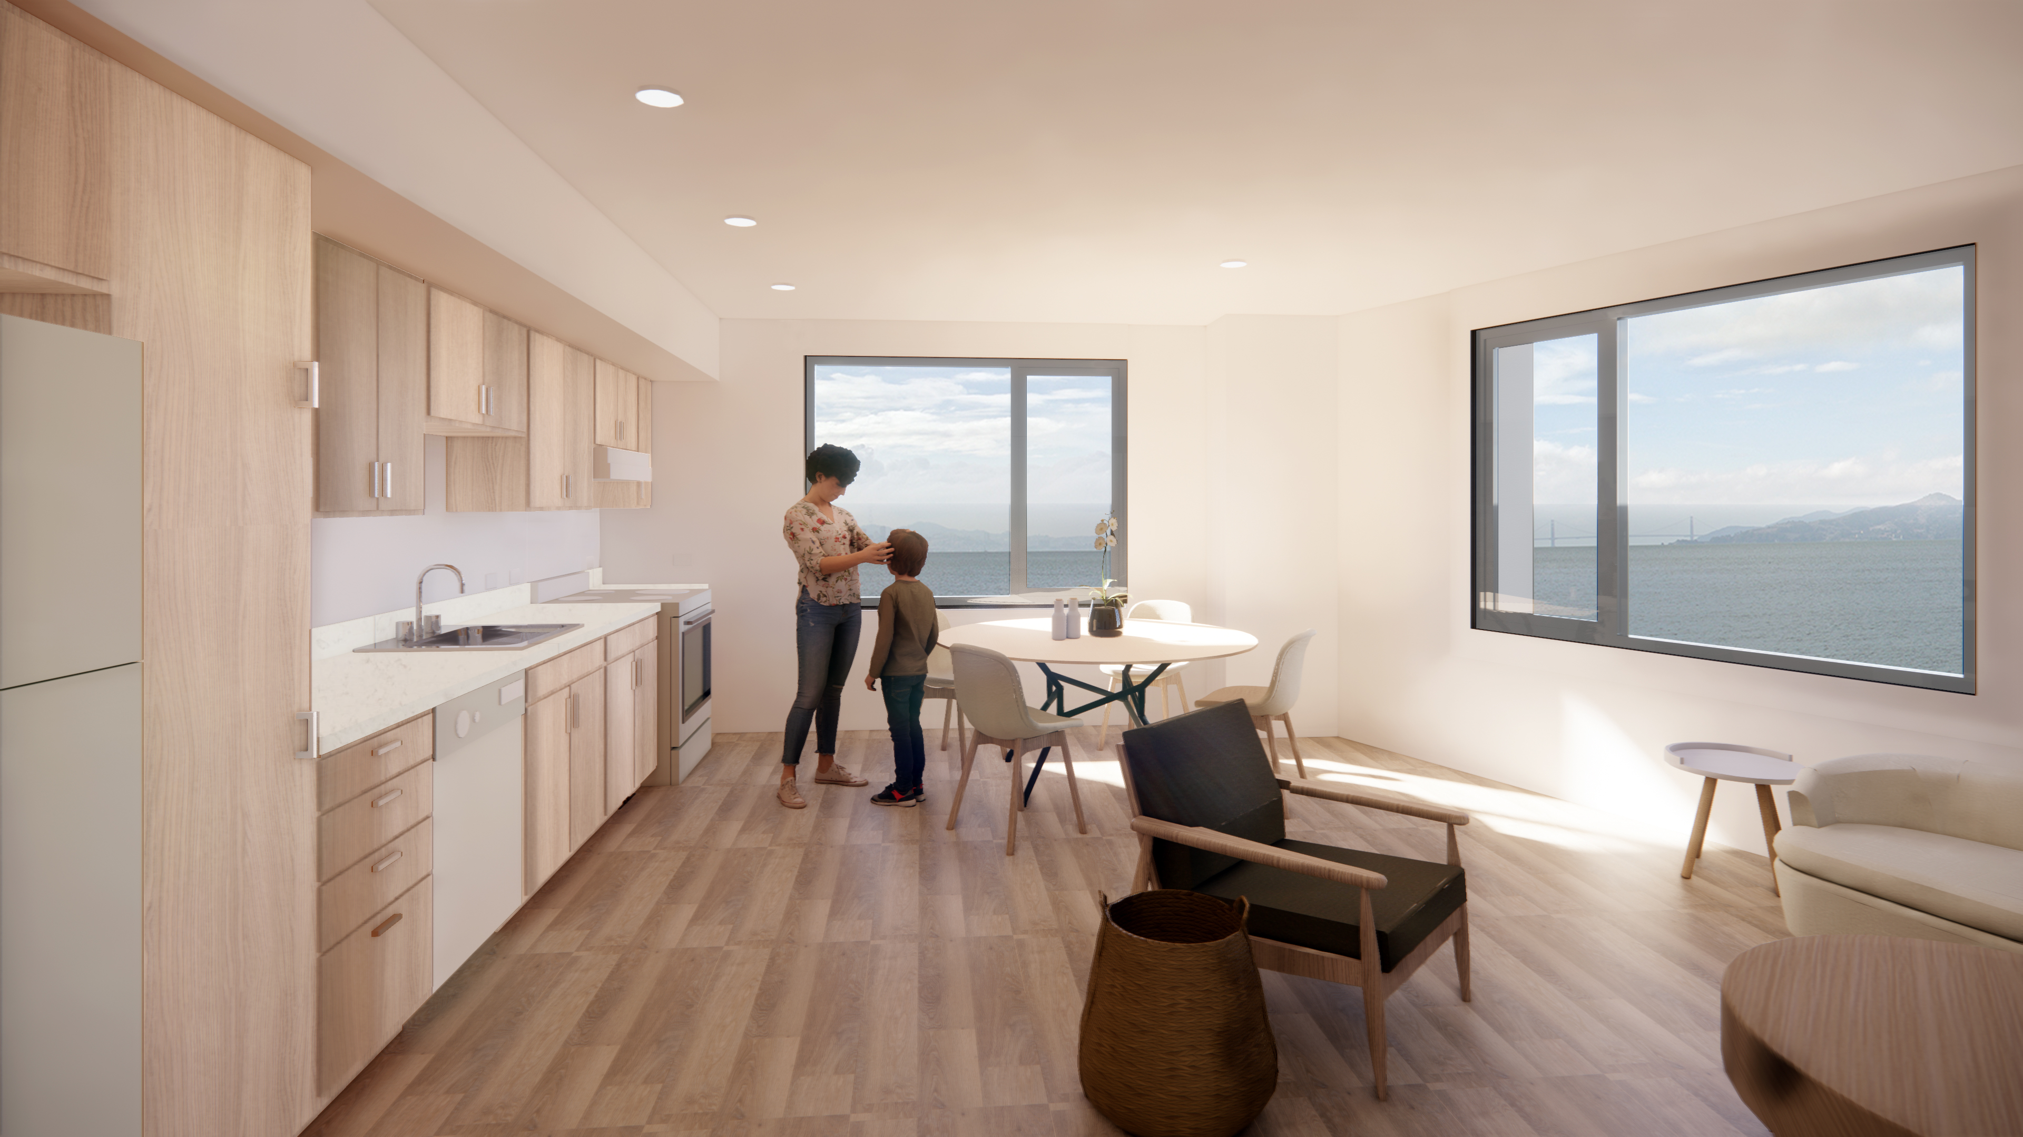
Who the Building Will Serve
71 apartments for families currently living on the island and receiving services from Catholic Charities (rent remains calculated the same way it is now)
Catholic Charities will remain the main service provider for these units
23 apartments for Legacy Households currently living in a unit at The Villages (rent remains calculated the same way it is now per unit size)
No income restrictions
Up to 31 apartments for households earning between 50%-60% AMI
Legacy & Vested Residents have preference for these units via DAHLIA
Rendering of unit kitchen and dining area

Slide 8
Staffing
Property Management
On-site management provided by Mercy Housing Management Group
Resident Services
On-site supportive services and case management provided by Catholic Charities
Mercy Housing Service Coordinator – 1 full-time Resident Service Coordinator (for all residents)
Referrals to Community Services
Housing Stability Support
After School Homework Help
Job Search Support/Coaching*
Technology Literacy
Health Education & Risk Reduction
Benefits Acquisition
Food Pantry*
Financial Literacy Programs & Support*
Community Events
*Services will be provided in conjunction with Island partners
Notes:
Senior Property Manager
Assistant Property Manager
Housing Support Specialist?
Desk Clerk
Maintenance Manager and Maintenance technician
Janitor

Slide 9
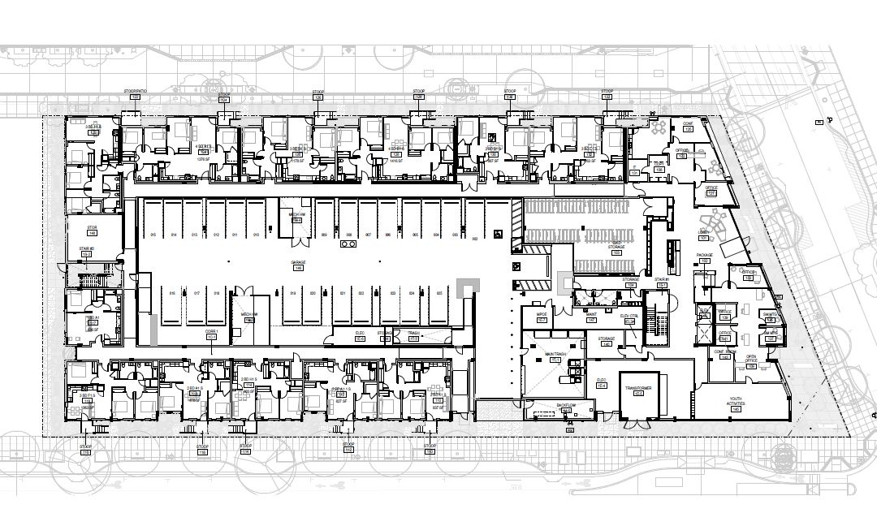
Design Features - Exterior
Main lobby and entry are located at the middle of Johnson Street across from a future park.
Building consists of 2 wings that are connected by bridges.
Units on the Ground floor of the Shared Public Way and Seven Seas have stoops that provide an additional entrance to those units.
Shared Public Way
Johnson Street
Seven Seas

Slide 10
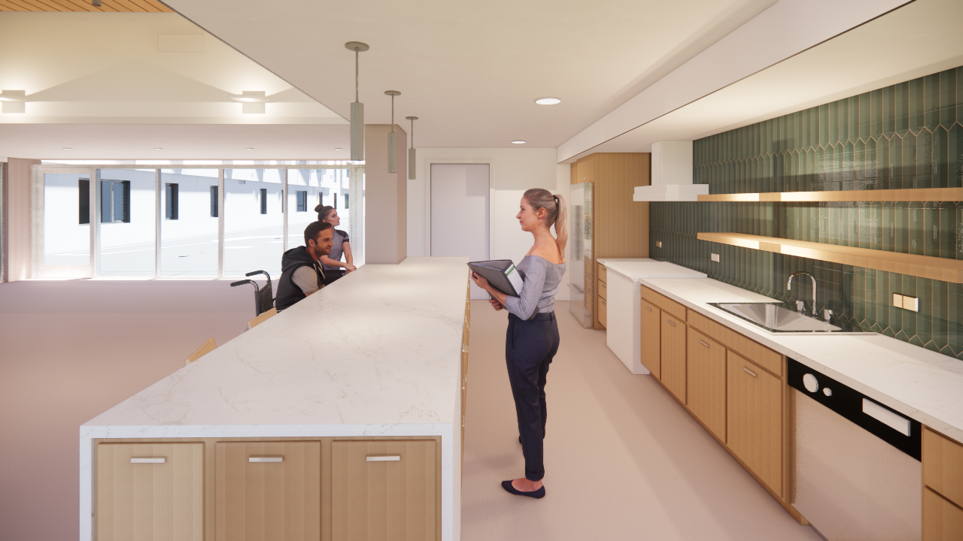
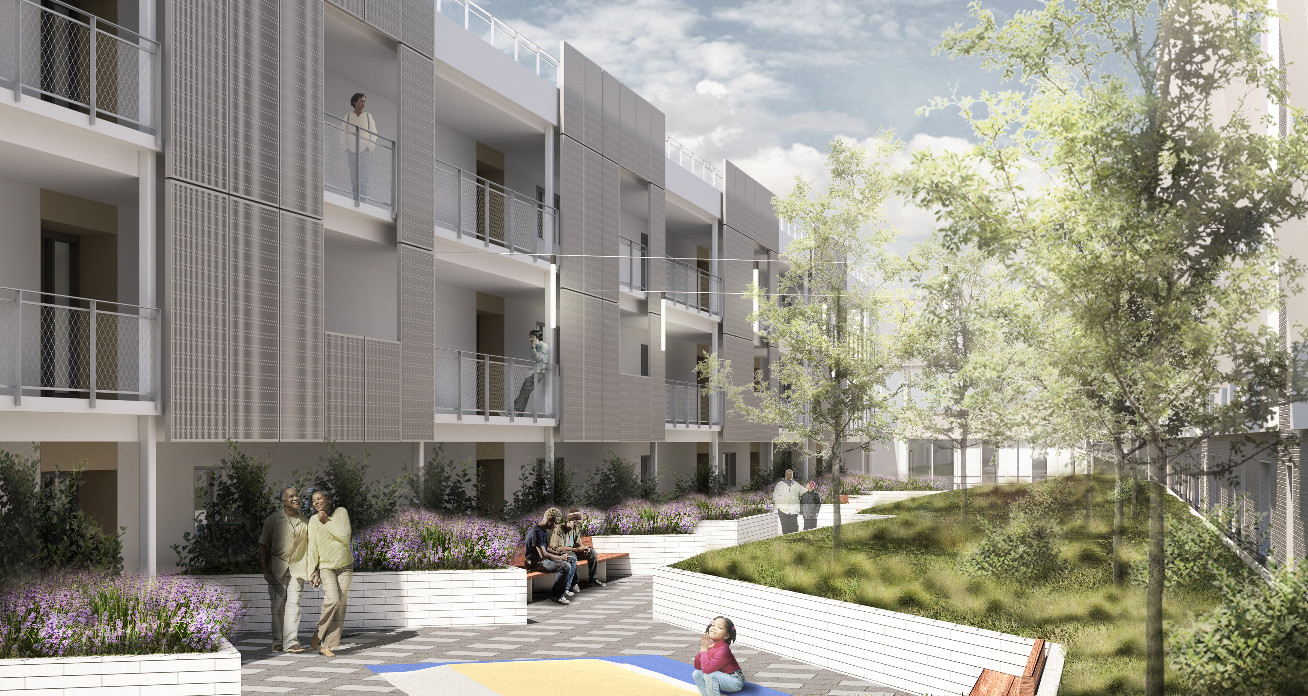
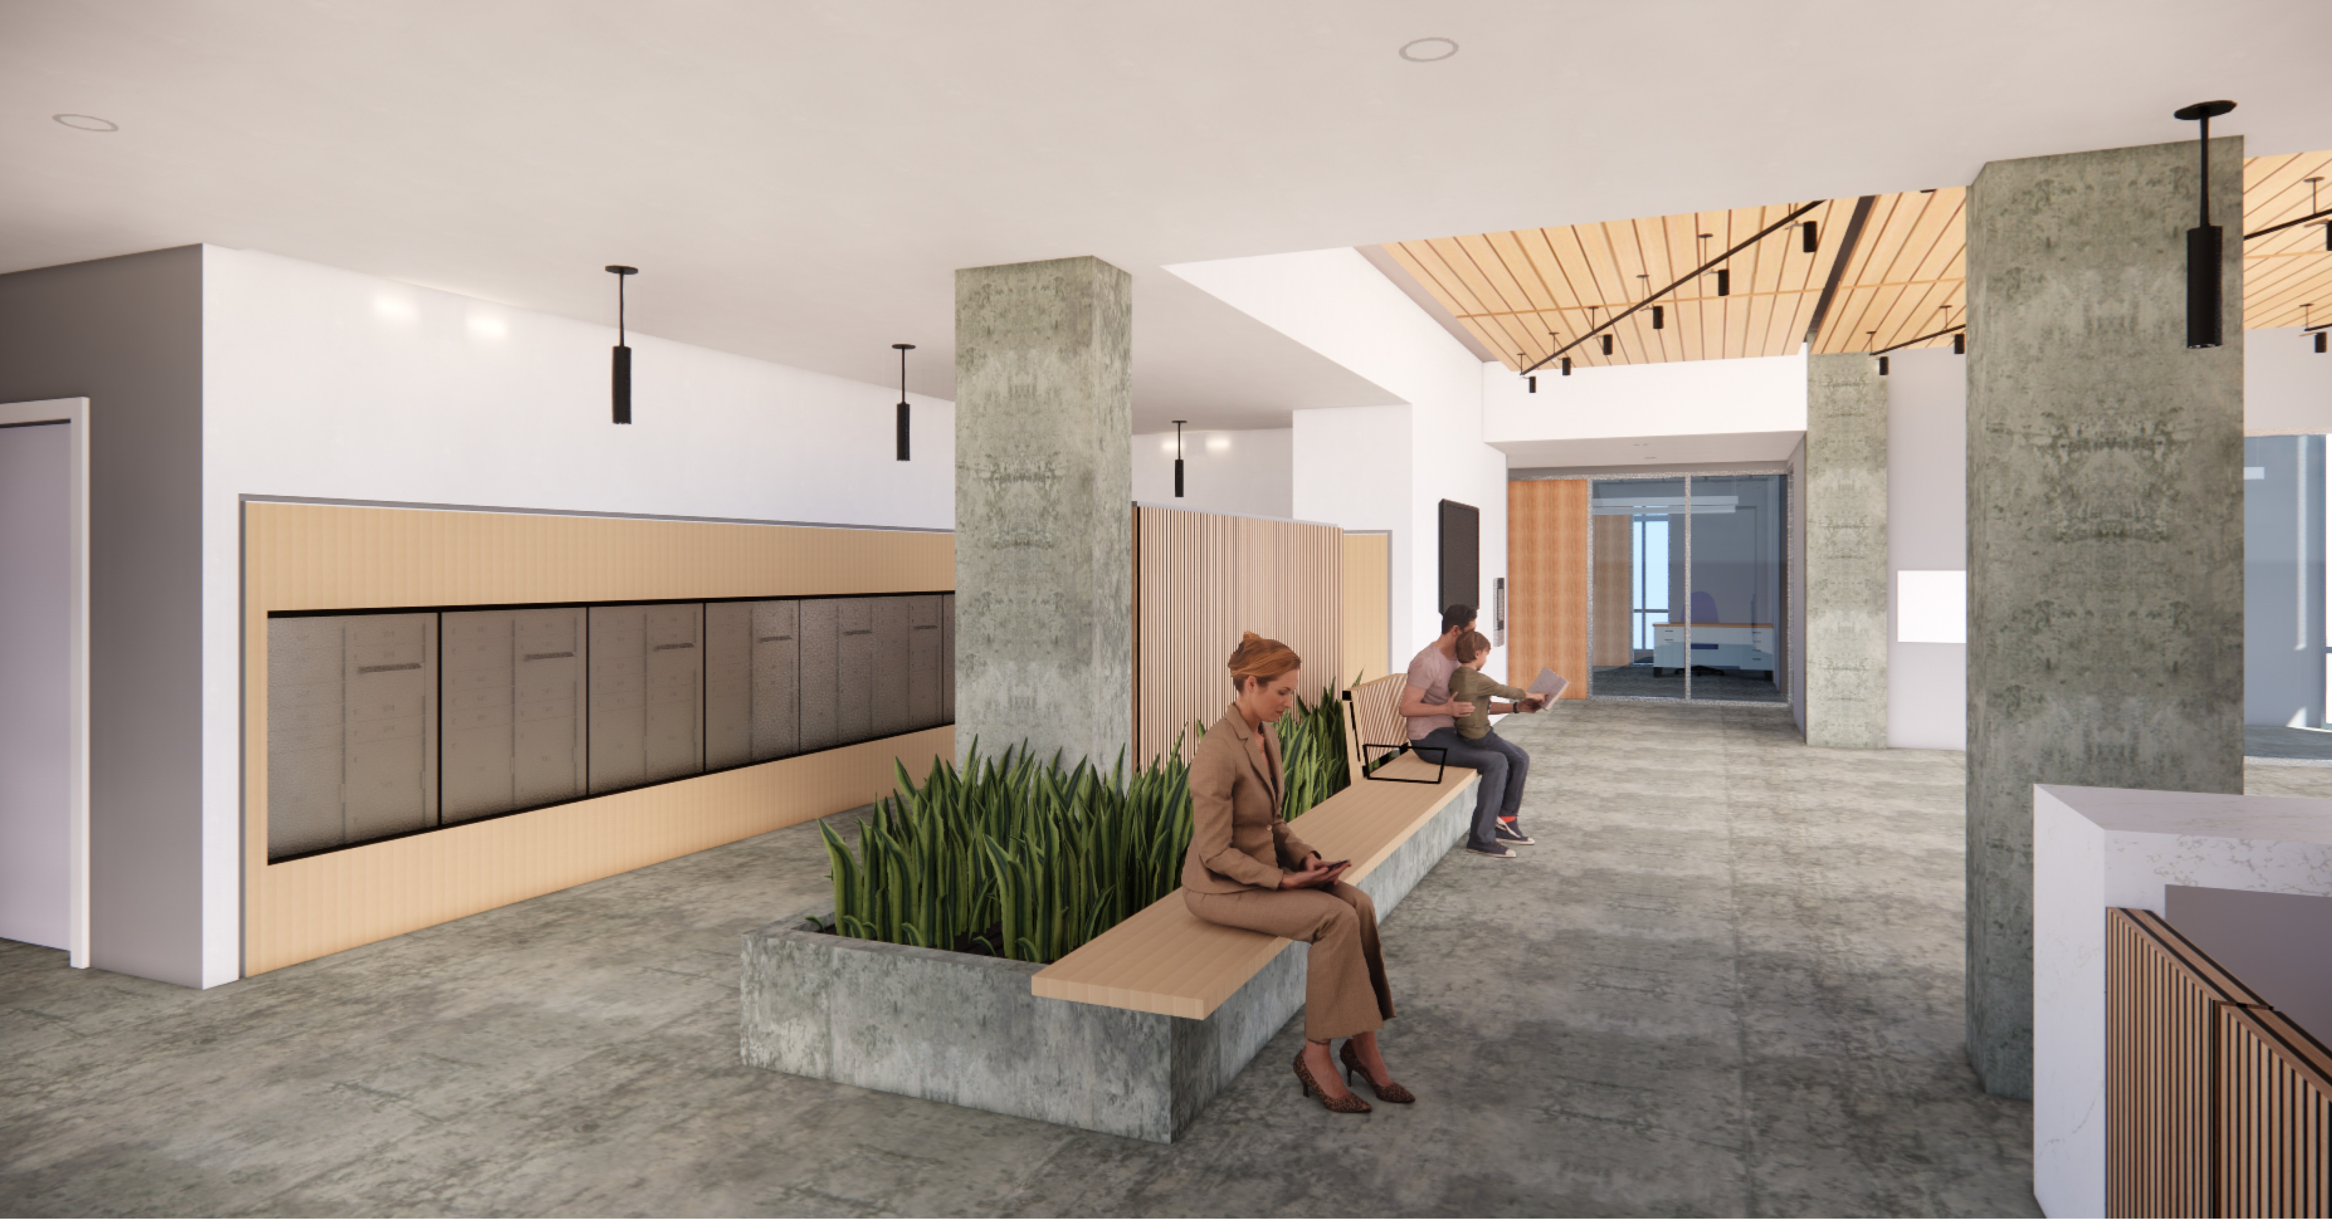
Design Features Interior
On-site bike parking for 138 spaces
At grade garage with limited parking spaces
Community serving uses including community room & kitchen & on-site laundry on 2nd floor adjacent to the outdoor courtyard
Laundry room has a lounge area that overlooks the future public park
Community room kitchen
Courtyard facing North
Entry lobby and mail area
Notes:
Community Room at Level 2 has large area storefront with glazing that has views that overlook the future public park.
Laundry Room at Level 2 has a lounge area that overlooks the future public park across Johnson Street.

Slide 11
Schedule
Marketing/Application
Period
April 10 – May 1
DAHLIA
Lottery
May 16
Construction Completion
May 2024
Earliest Move in Date
June 2024
92% Complete
March 2024
Notes:
Move notices for CC HH #1 February; Move Notice # 2 in April

Slide 12
Catholic Charities Households
Move notices
First move notice (120 Day): sent out February 17
Second move notice (60 Day): sent out April 30
Household/unit alignment
The move coordinator met with households in March to discuss their move needs.
Mercy Housing Property Management working with residents that have reasonable accommodations
Move window
June to August
Notes:
Move notices for CC HH #1 February; Move Notice # 2 in April

Slide 13
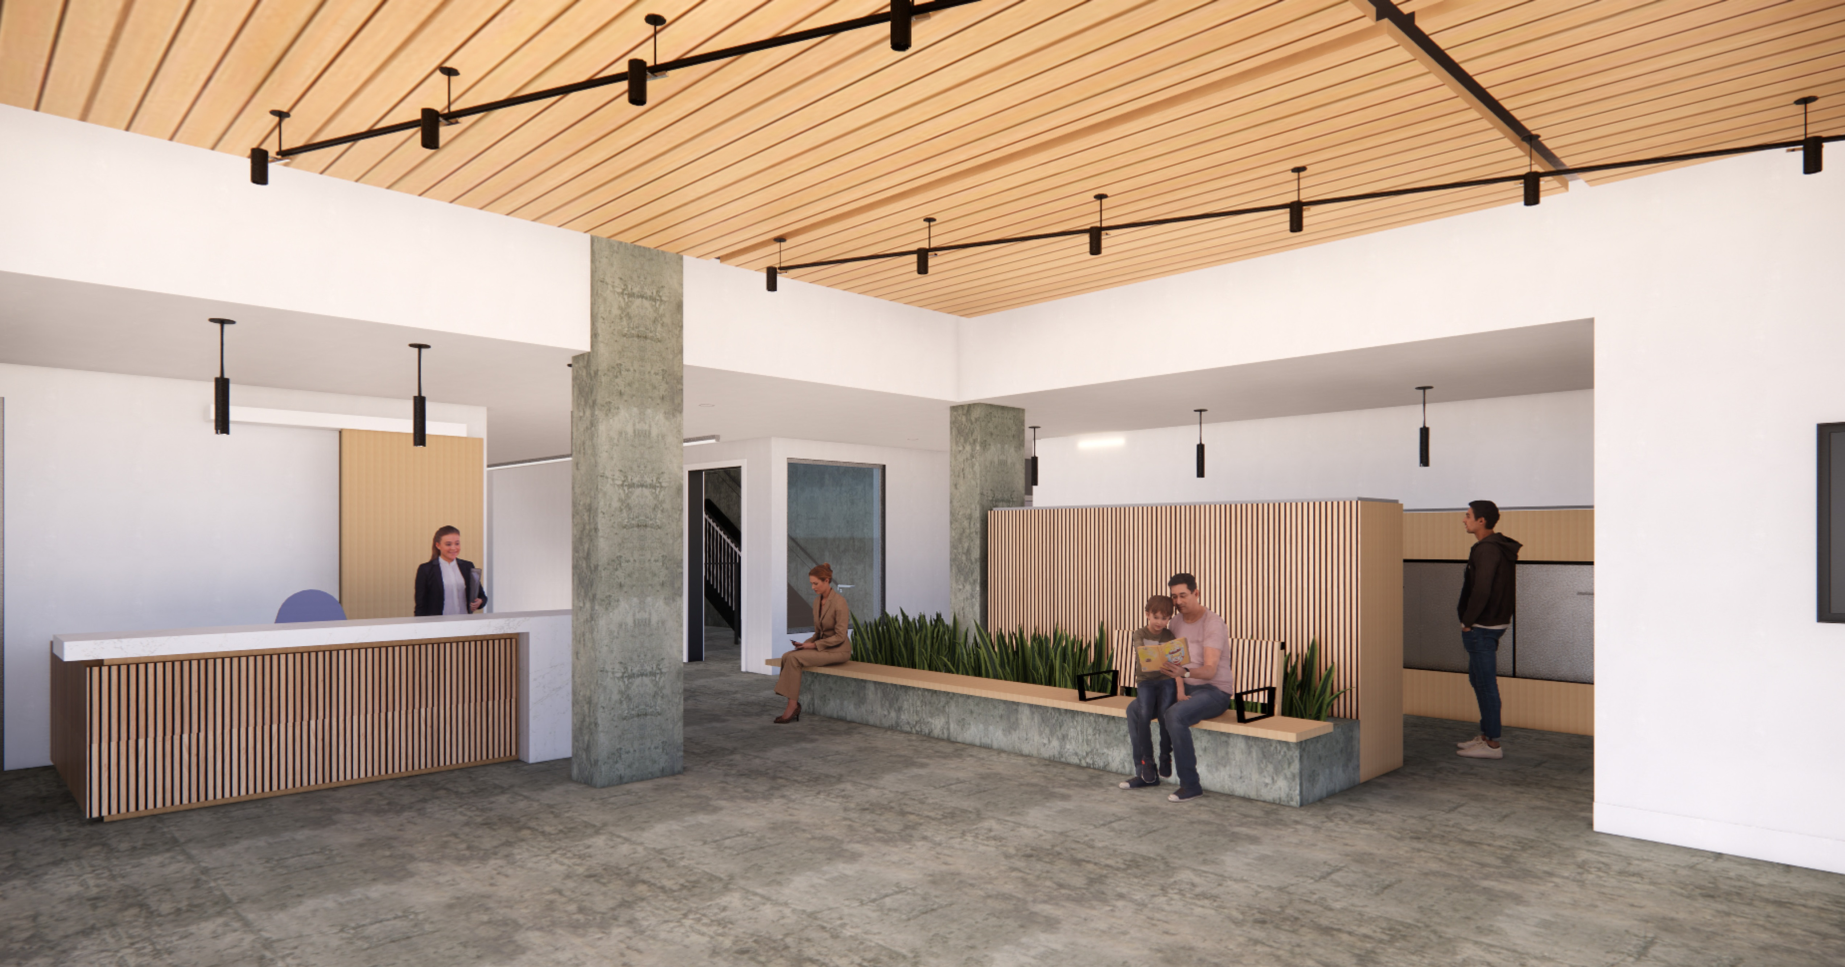
Contact
Evelyn Perdomo
Senior Project Manager
Mercy Housing California
Evelyn.Perdomo@mercyhousing.org
Email questions to: starview@mercyhousing.org
Visit our website: www.starviewcourt.org

